Slide 2
Docker
Kubernetes

Slide 3
What is Docker
Runs virtual containerized workloads
Minimal size.
Utilizes the Docker VM’s OS

Slide 4
Why Docker
Isolates different parts of a system
Works on your machine and other machines the same way.
Minimal config hassle (almost)
Does away with ordinary installation issues (more or less)
Can be run In Kubernetes or other orchestration solutions.

Slide 5
Why Docker cont.
Mix technologies in the same system
Java
.Net Core
Phyton
Etc.
Use open source
MySql
Mosquitto
Kafka
Promotheus
Elastic Search

Slide 6
Example – Home Automation
MQTT (eclipse-mosquitto)
Homeassistant
TimeSeries DB (InfluxDB)
HW Admin
(Tasmoadmin)
External web proxy
(Traefik)
Hardware
Light1
Light2
Switch1
Temp
Humidity

Slide 7
How
Docker CLI
Docker repositories (Docker hub++)
Both private or public repos
Dockerfile
Docker-compose

Slide 8
Docker repositories
Where you get container images
Local
Public
Private
Adress naming (Uri?)
[url/reponame/]application:tag

Slide 9
At the outset – Stateless & not reachable
Any changes in a running docker container is lost upon restart
Need to map hostsystem’s folders to keep state via volume mappings.
Need to map port(s) to host network interface via port mappings.

Slide 10
Exercise – running a container
Docker run –d [–rm] [imagename]
Docker run –p [hostport]:[containerport] [imagename]
Docker run –v [hostfolder]:[containerfolder] [imagename]

Slide 11
How to create our own container
Dockerfile – simple example
docker build -t helloapp:v1 .
Exclude files with .dockerignore
Every RUN/COPY/CMD makes a new layer.
# of layers make the container lager/slower.
Containers should be as small as possible
FROM ubuntu:18.04
COPY . /app
RUN make /app
CMD python /app/app.py

Slide 12
Multistage containers
Makes a larger temporary container
Compiles the code in this container
Outputs the compiled artifacts to a local output folder
Makes a new container from scratch
Copies the final artifacts from the compile conteiner to the new scratch container
FROM golang:1.11-alpine AS build
# Install tools required for project # Run `docker build --no-cache .` to update dependencies RUN apk add --no-cache git RUN go get github.com/golang/dep/cmd/dep
# List project dependencies with Gopkg.toml and Gopkg.lock # These layers are only re-built when Gopkg files are updated COPY Gopkg.lock Gopkg.toml /go/src/project/ WORKDIR /go/src/project/ # Install library dependencies RUN dep ensure -vendor-only
# Copy the entire project and build it # This layer is rebuilt when a file changes in the project directory COPY . /go/src/project/ RUN go build -o /bin/project
# This results in a single layer image FROM scratch COPY --from=build /bin/project /bin/project ENTRYPOINT ["/bin/project"] CMD ["--help"]

Slide 13
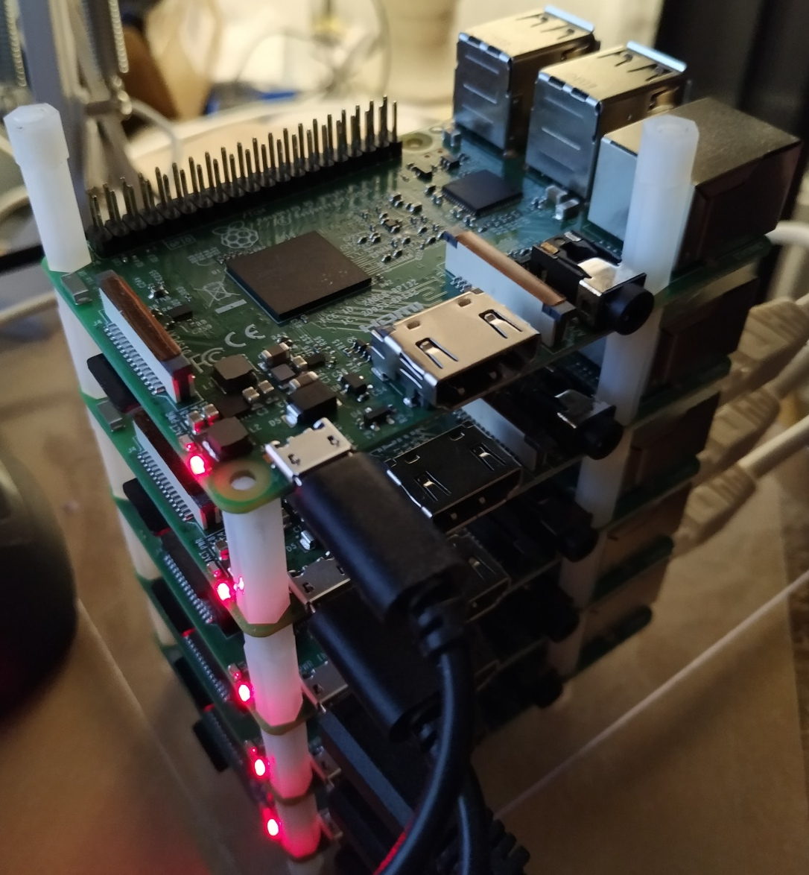
Caveats
Build host, determines processor architecture for end container.
X86/X64 build can only be run on X86/X64 hosts.
ARM build can only be run on ARM hosts.
RPI Clusters is cool, but more difficult….

Slide 14
Exercise – Making you own container

Slide 15
Kubernetes (k8s)
Portable
Scalable
Extensible
Open source
Can be used both
Imperatively (cmd line)
Declaratively (config)
“Kubernetes is a portable, extensible, open-source platform for managing containerized workloads and services, that facilitates both declarative configuration and automation”

Slide 16
What does it do
Can dynamically increase/decrease instances of a given container.
Run cron jobs.
Keep track of your config
Keep track of your secrets
Can do dynamic manipulation of running instances
Log aggregations
Monitoring
Etc.

Slide 17
What does it do, cont.
Can run annywhere
Different cloud providers
Bare metal/locally
Hybrid(local/any cloud)
Edge
McDonalds/BurgerKing POS solutions
Fleet services (Ruter)

Slide 18
The important stuff
The excact technology is NOT important
Mindset/methodology IS important
COTS – Comercial off the Shelf.
Not reinventing the wheel
Custom code, for custom/spesific problems

Slide 19
K8s – Artifacts
Cluster
Node
Namespace
Deployment
Deamonset
Replicaset
Pod
Service
Ingress

Slide 20
K8s- Artifacts cont.
Volumes
VolumeClaims
StorageClasses
Job
Cronjob

Slide 21
Kubernetes «physical» model
Host system (Node)
Client host
Docker VM
Kubelet
Minicube CLI
API srv
Kubectl
Etcd
DNS
k9s
Scheduler

Slide 22
Minikube – «physical» model
Host machine
VM - Minicube
Docker
Minicube CLI
Kubernetes – master node
Proxy
Etcd
Pod
Pod
Kubectl
API srv
Scheduler
Pod
k9s
Pod
Pod
Pod

Slide 23
Kubernetes network model
Cluster
Node1 - master
Node2
Node3
Overlay
Overlay
Overlay
Proxy
Etcd
Proxy
Pod
Proxy
Pod
Scheduler
DNS
Pod
Pod
API srv

Slide 24
Minikube - network model
Hostmachine
Node - master & the rest
Proxy
Etcd
Pod
Pod
Pod
Scheduler
DNS
API srv

Slide 26


