Slide 1

Exploring Electric Vehicles: An In-Depth Analysis.
By Giorgi Kurtanidze​

Slide 2

Data Source
You can access the dataset by following this Kaggle link.

Slide 3
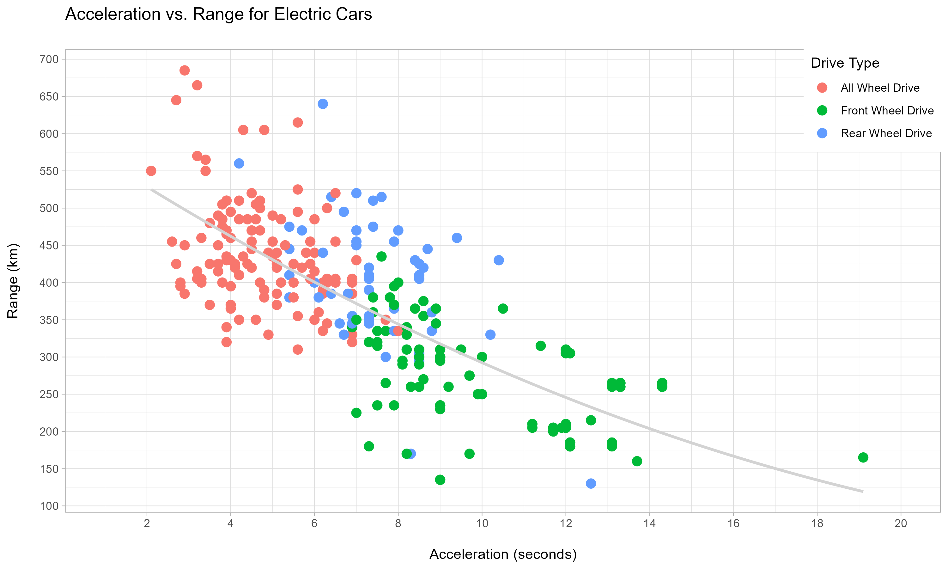

Slide 4
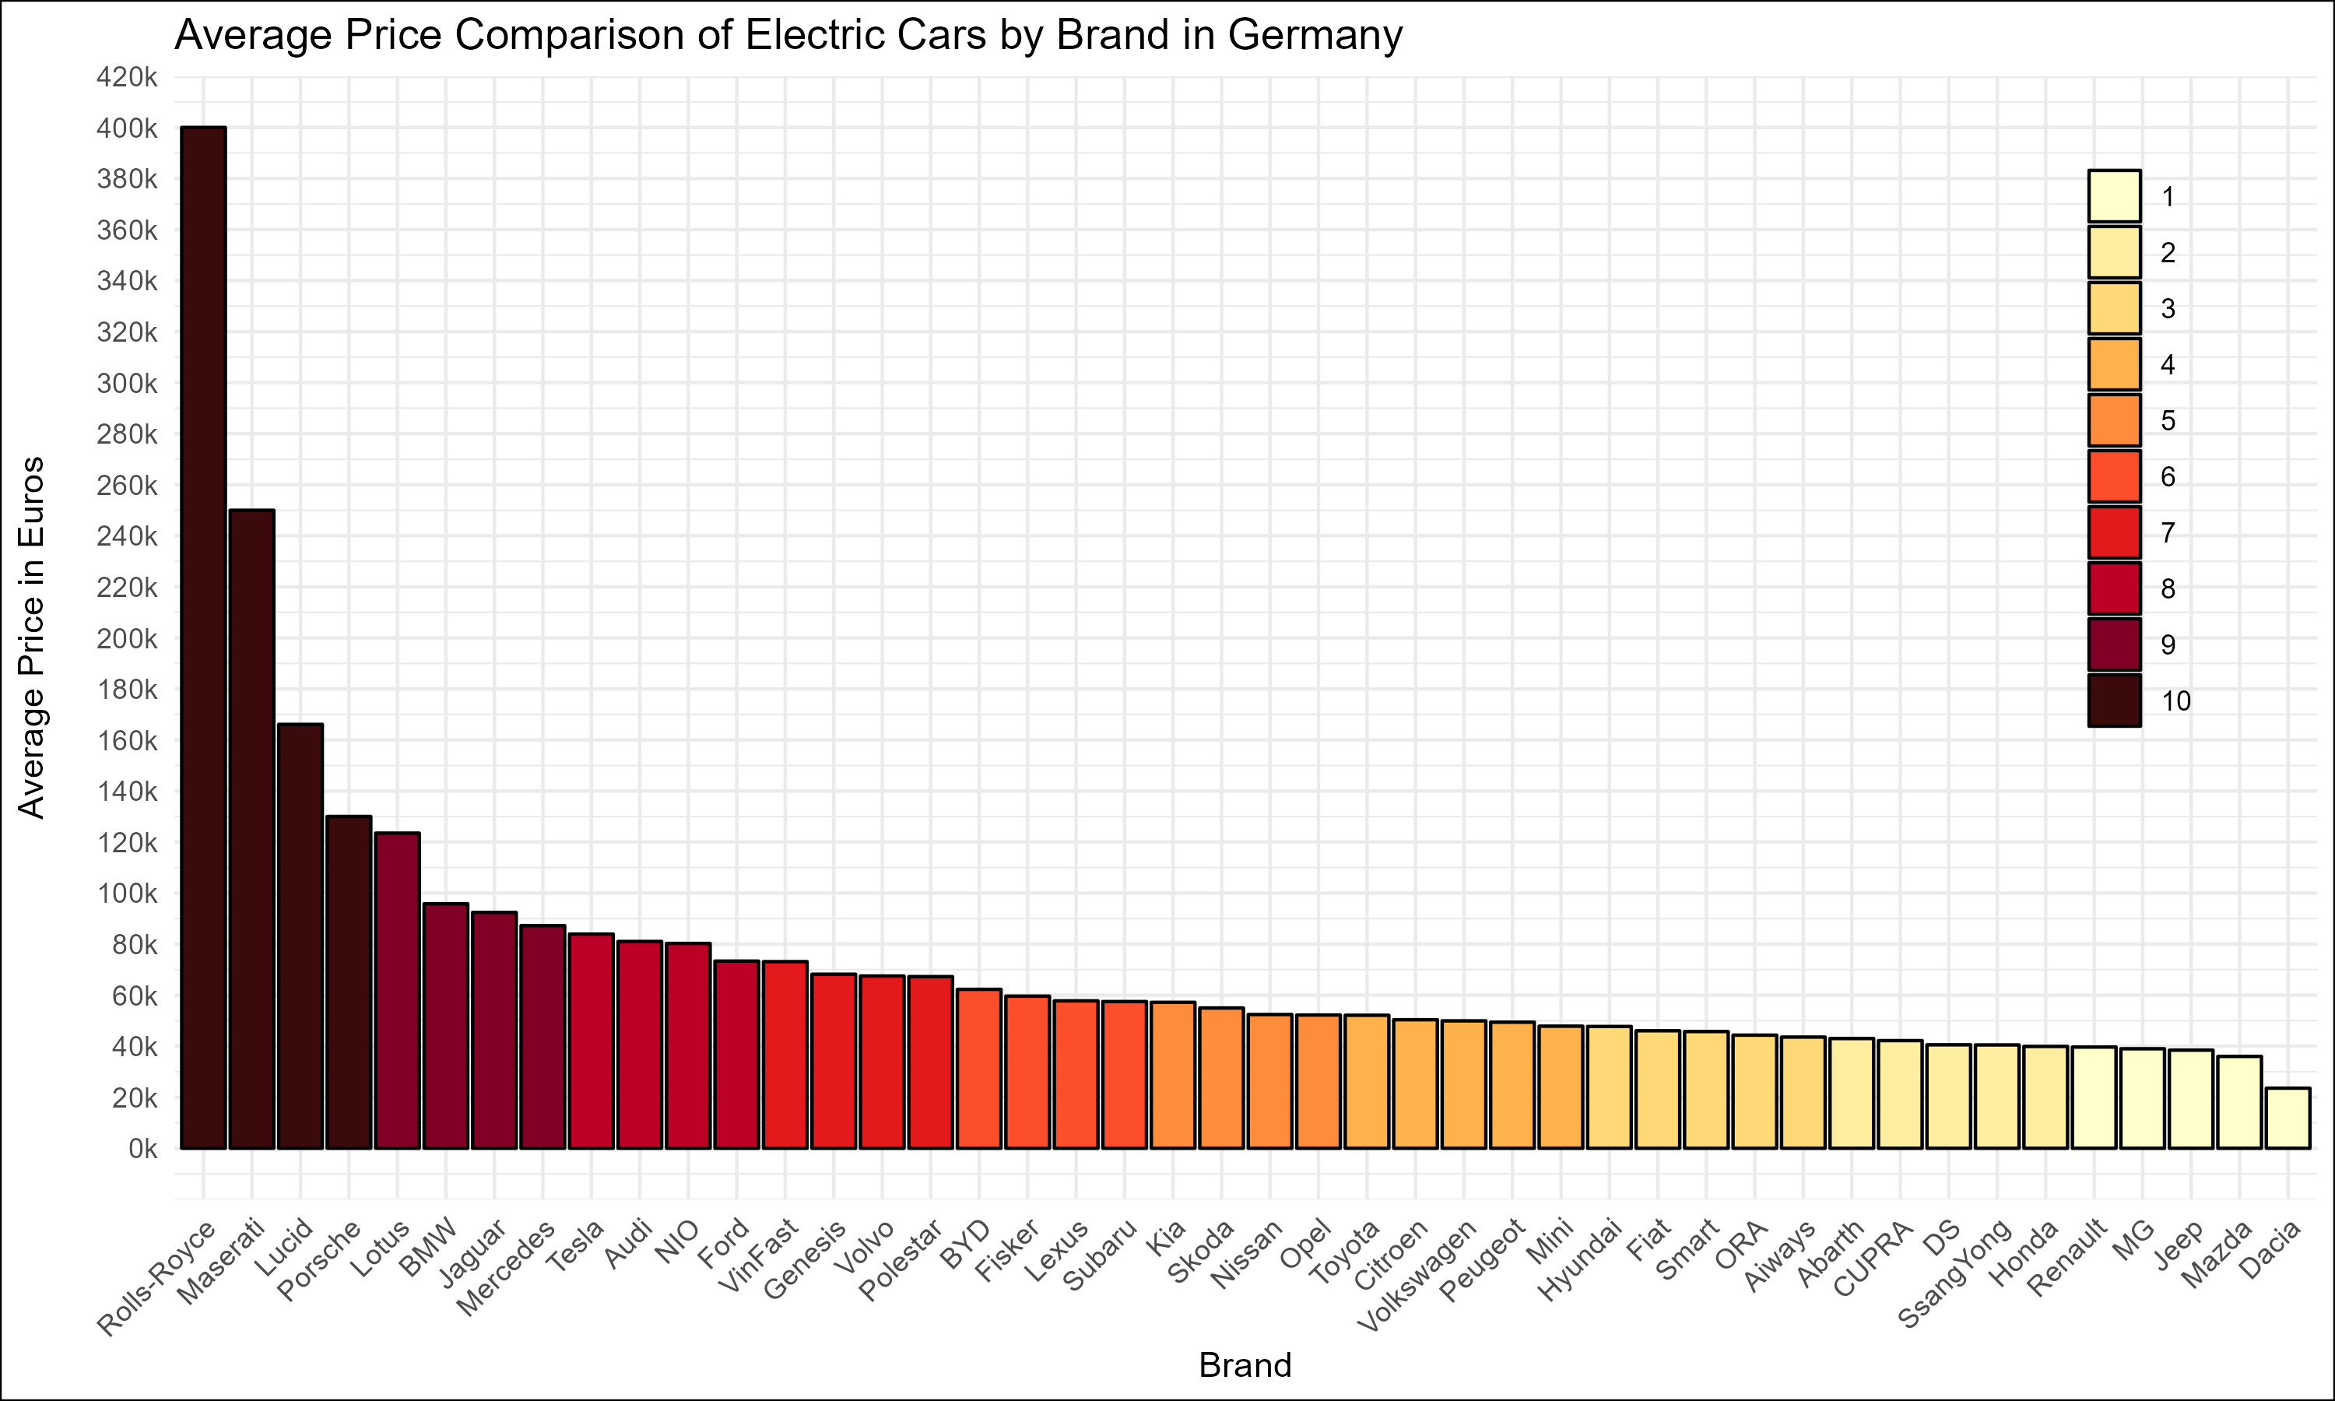

Slide 5
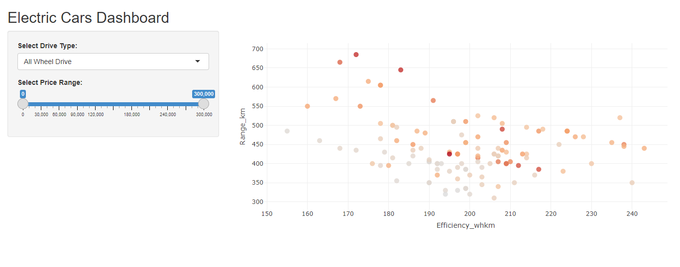

Slide 6

Thank you for your attantion

