Slide 1
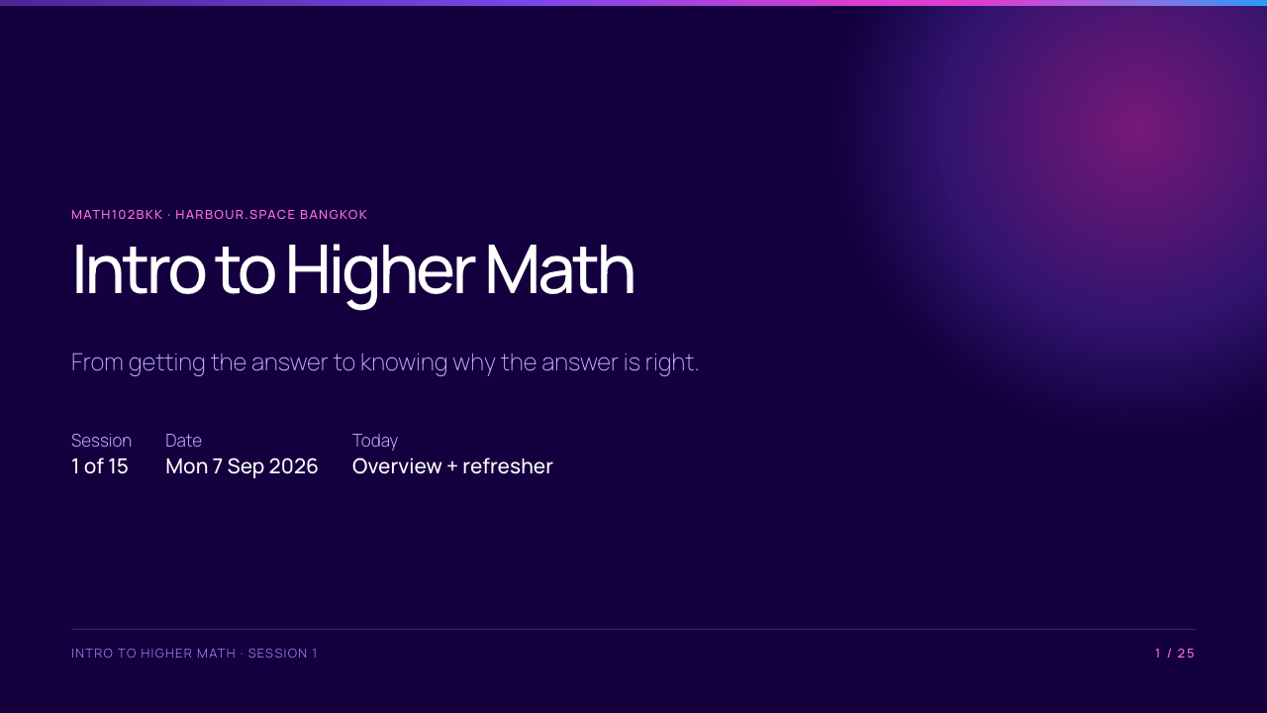

Slide 2
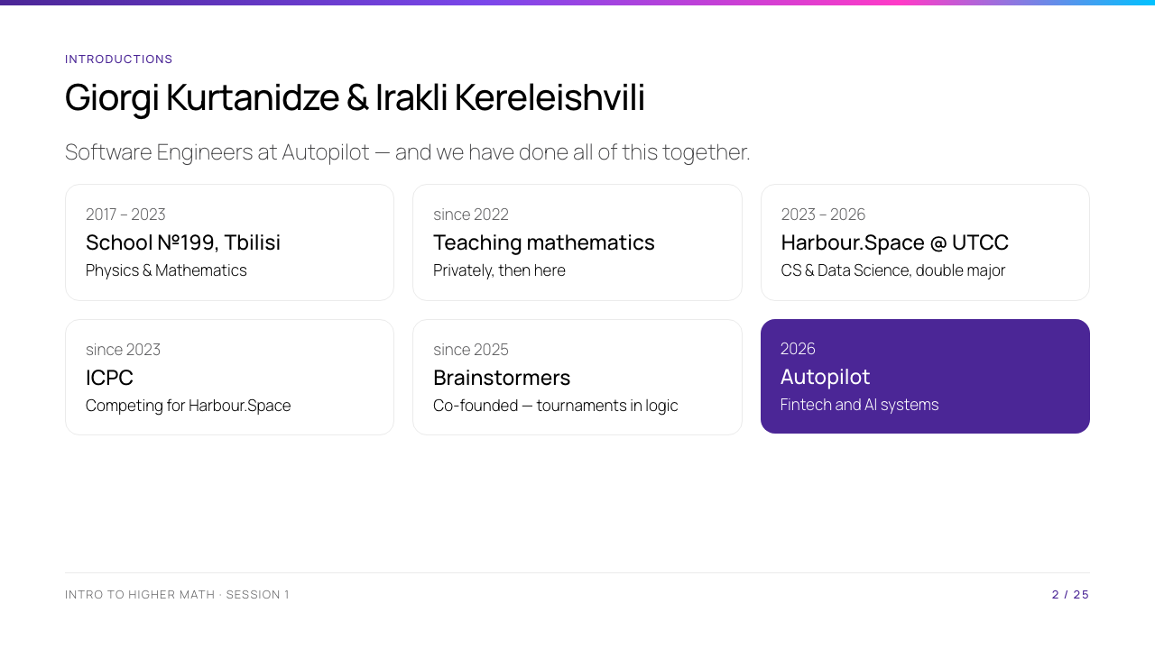
Notes:
Keep this to three minutes between you — the slide is the outline, you are the story. The through-line worth saying out loud: same school, same degree, same ICPC team, same company, and we have been teaching this material since 2022. Then ONE concrete example of maths inside real engineering work — a proof that caught a bug, modular arithmetic in a payment system, vectors in a model — and stop. Detail you can pull on if asked: Giorgi on payment infrastructure and AI products, earlier AI/Data at Siam Digital Lending and research at Betimes; Irakli on financial orchestration and AI automation agents, earlier Letsmod and MaxSolutions. Placements: Thailand 2024, 17th; Asia Bangkok 2025, top 10 among Thai teams; Asia Jakarta 2024. Medals from School №199 and a National Intellectual Competition title. None of that belongs on the screen.

Slide 3
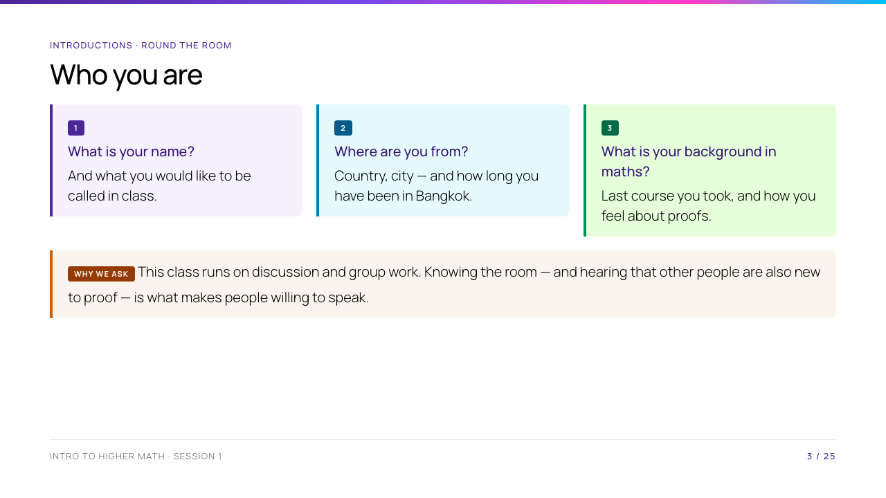
Notes:
Go round the room, roughly 30 seconds each; with 20 students that is ten minutes, and it is ten minutes well spent. Write the names down. Listen for the third answer especially: it tells you how much of the refresher to slow down for, and who to pair with whom in group work. Answer the three questions about yourselves first, so the format is clear.

Slide 4
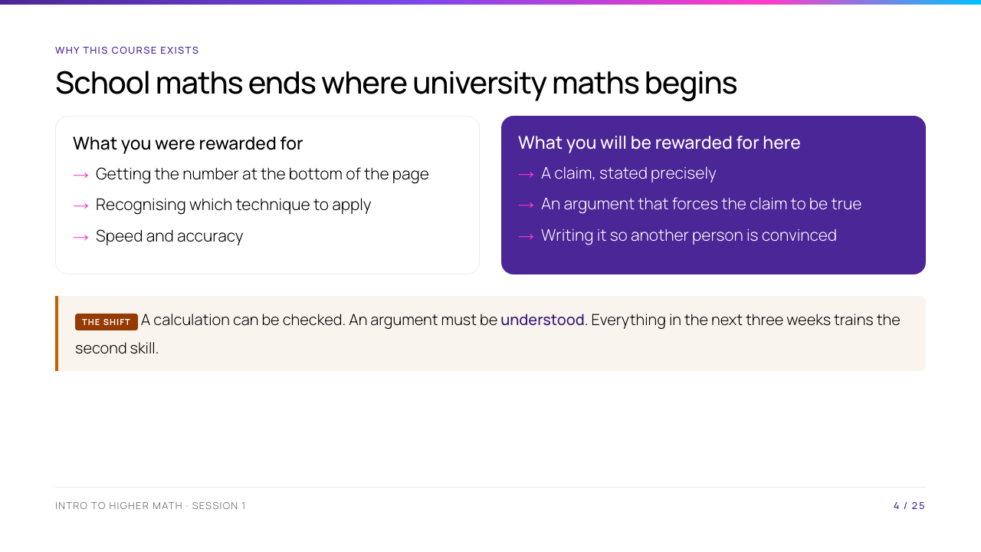
Notes:
Ask the room: "who has ever been asked WHY the quadratic formula is true?" Usually nobody. That is the whole gap this course closes. Do not rush this slide - it sets the contract.

Slide 5
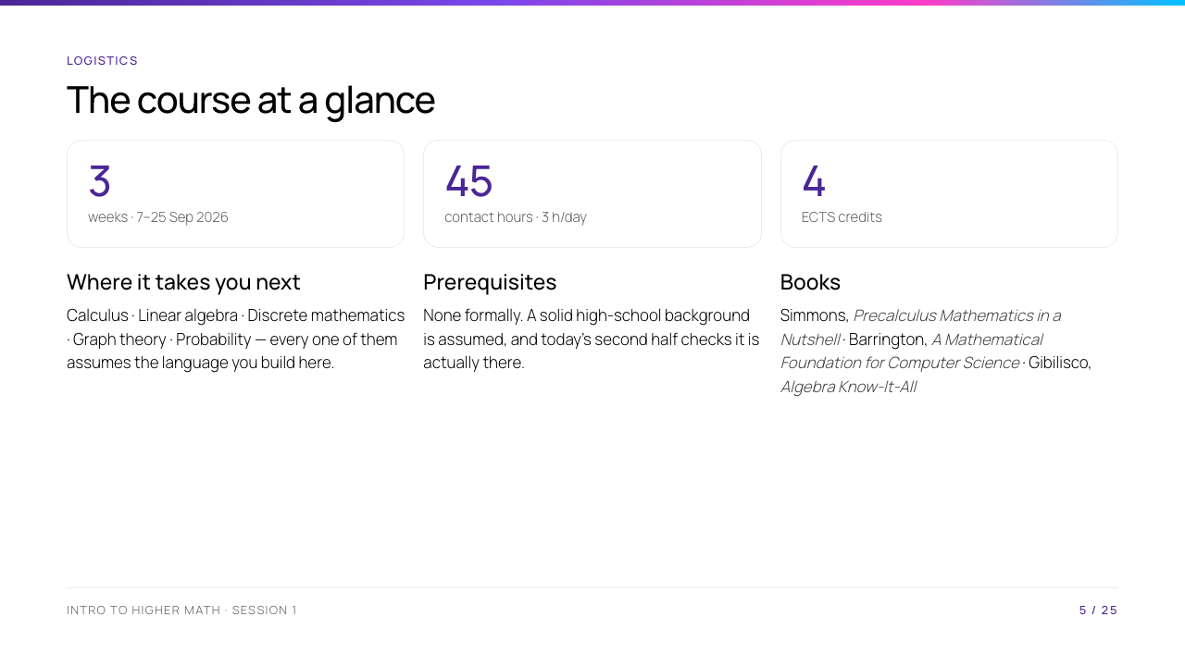
Notes:
Logistics only. Keep it under three minutes; they can read dates. The one line that matters is which later courses depend on this one.

Slide 6
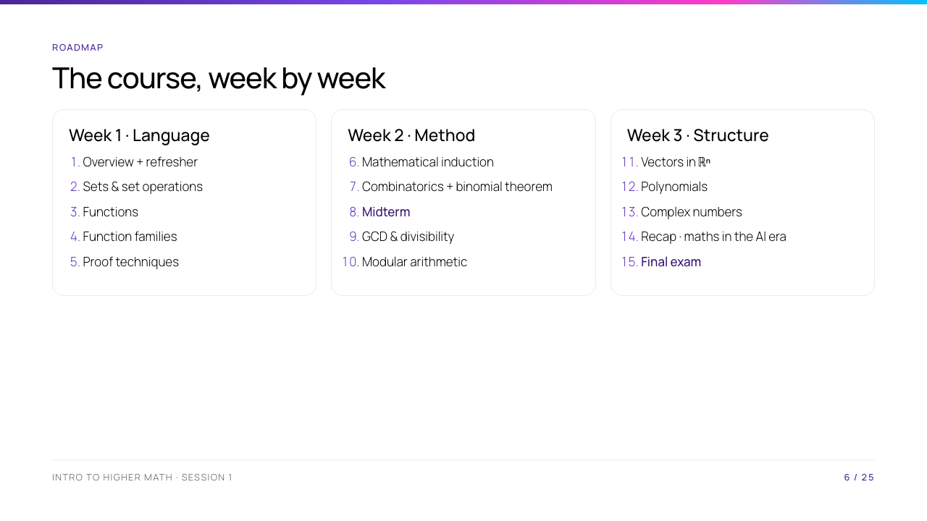
Notes:
Point at the three-week arc: week 1 builds the language, week 2 the methods, week 3 the structures. Session 5 (proof techniques) is the hinge - flag it now so they see it coming.

Slide 7
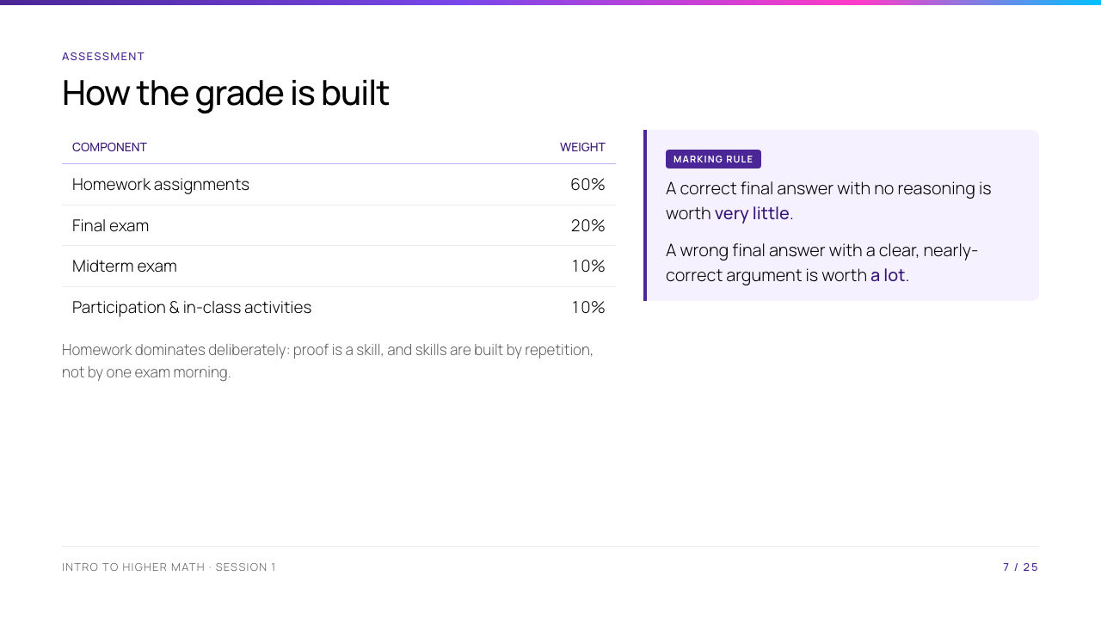
Notes:
Say out loud that homework is 60% - more than both exams combined - and that this is deliberate: proof is a skill, and skills come from repetition. The marking rule box is the single most important slide of the day; students will test it on the first problem set.

Slide 8
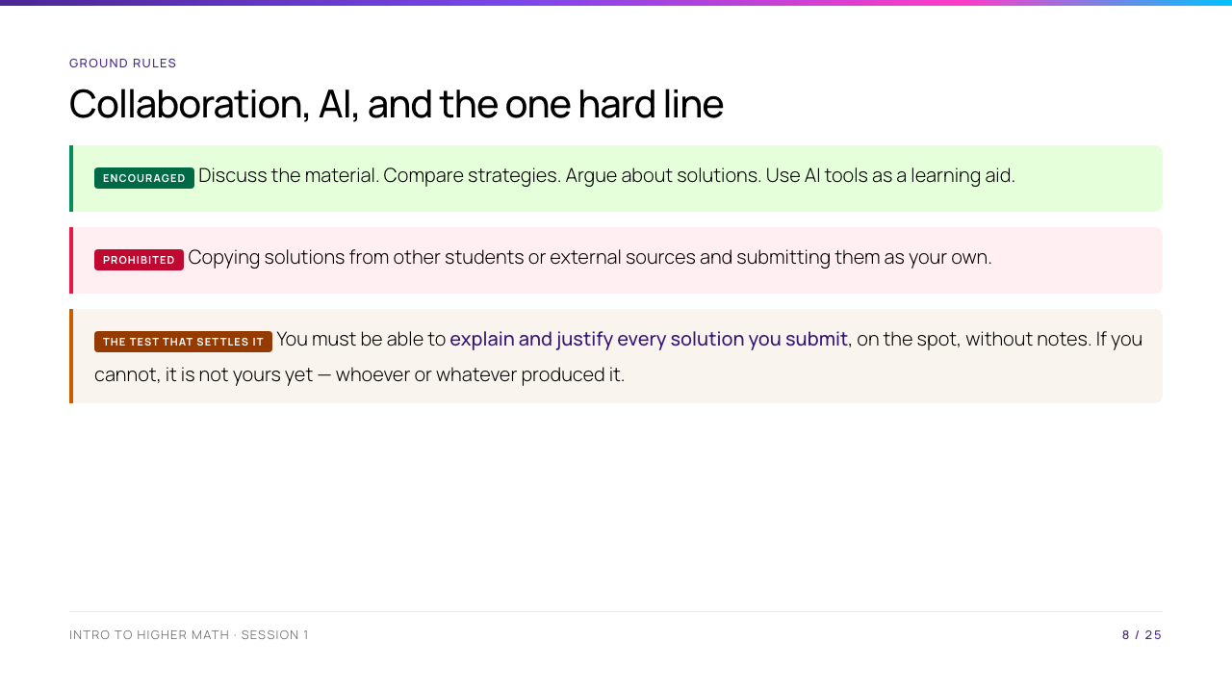
Notes:
The AI paragraph is course policy, not opinion - read it verbatim. The operative test is the third box: if you cannot explain it on the spot, it is not yours. Say you will actually ask.

Slide 9
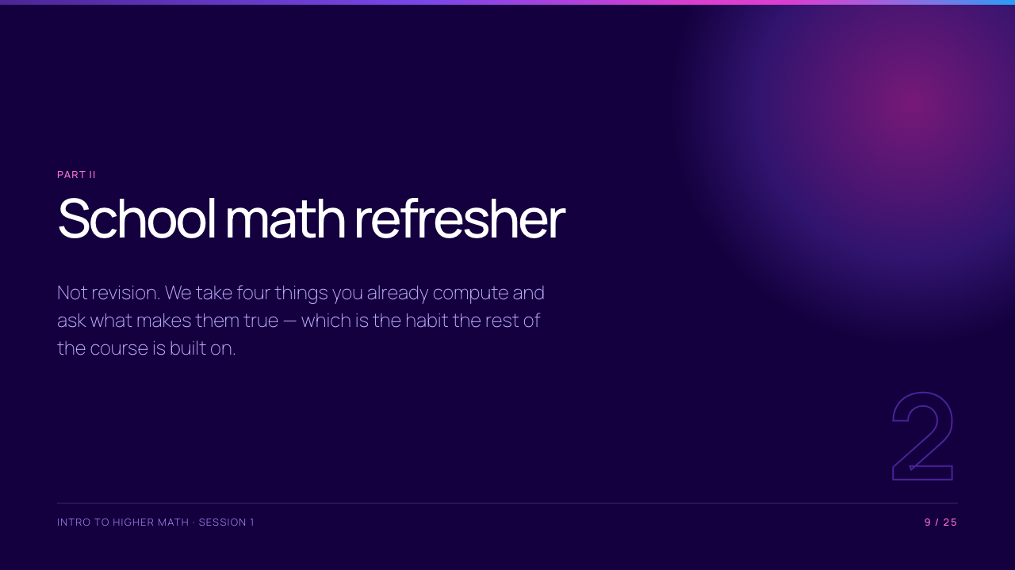

Slide 10
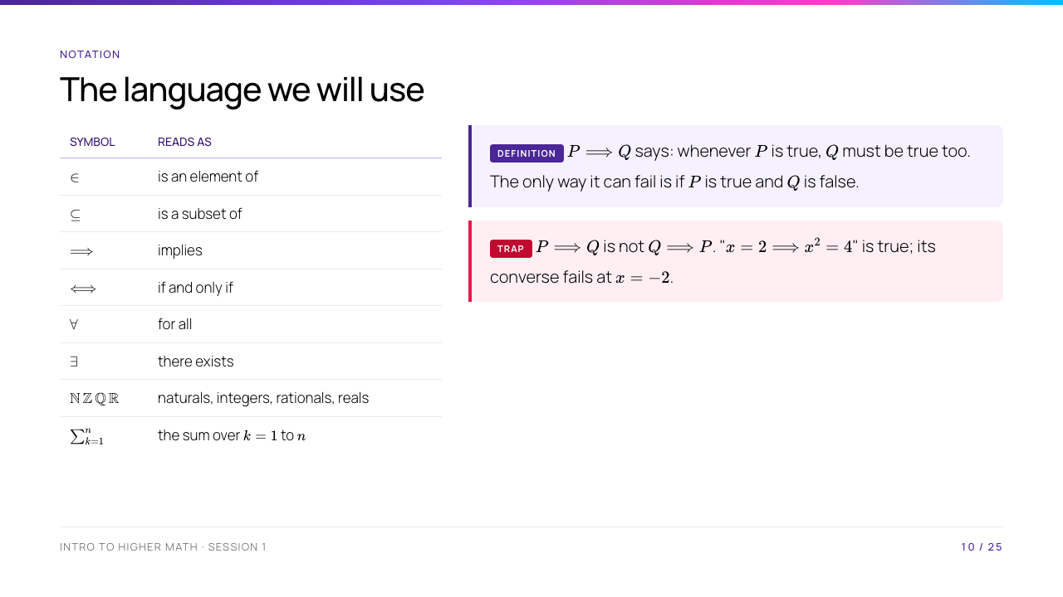
Notes:
Three minutes. They will meet all of this properly in Session 5; today they only need to read it. Do not introduce technical names for the truth table here. Students only need the practical test: an implication is broken by an example where the first part is true and the second is false. The last two rows are here because nothing else in the course stops to teach them: set-builder notation over N, Z, Q, R is used from tomorrow morning, and sigma appears in Session 6's induction proofs. Read both aloud, in words, once.

Slide 11
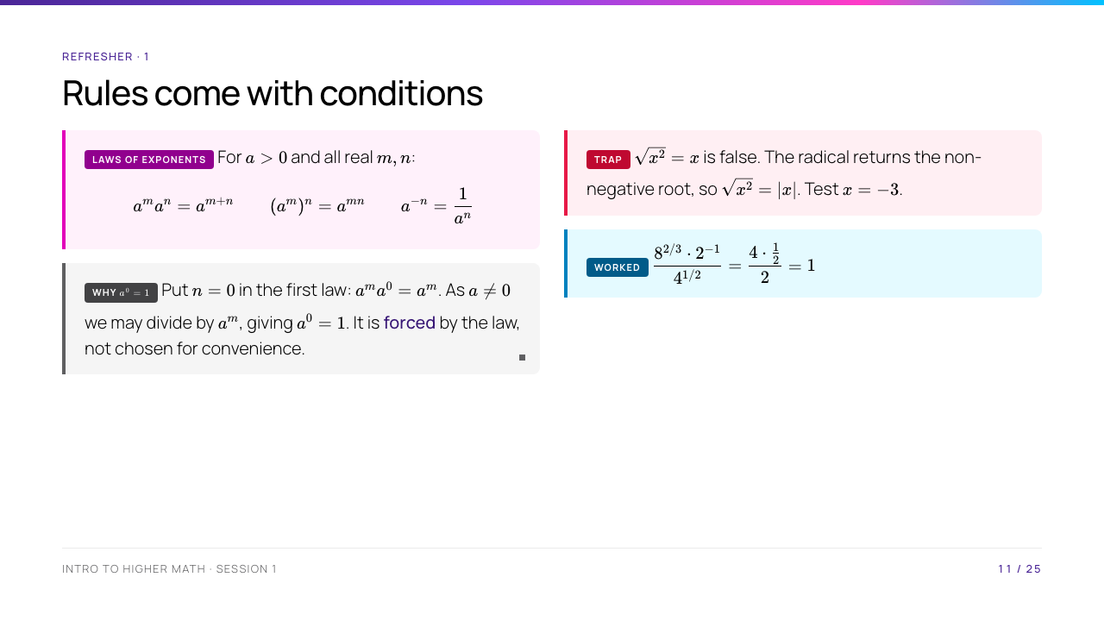
Notes:
The $a^0$ box is the slide. Derive it live: most of them were told $a^0=1$ as a rule to memorise, and seeing it fall out of a law in one line is the first small shock of the course. Then stress $a > 0$.

Slide 12
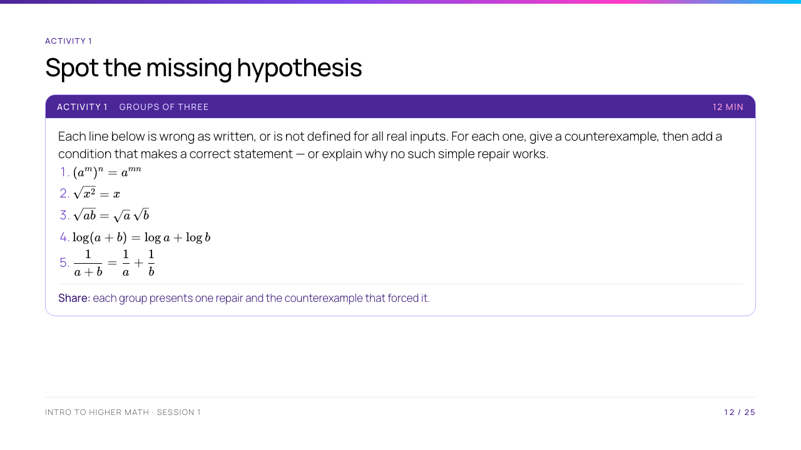
Notes:
Three are repairable (1, 2, 3 — all need a non-negativity condition); 4 and 5 are not, and noticing that difference is the point. Do not give the answers: let a group defend a wrong repair and let the room break it with a number. That is a proof in miniature.

Slide 13
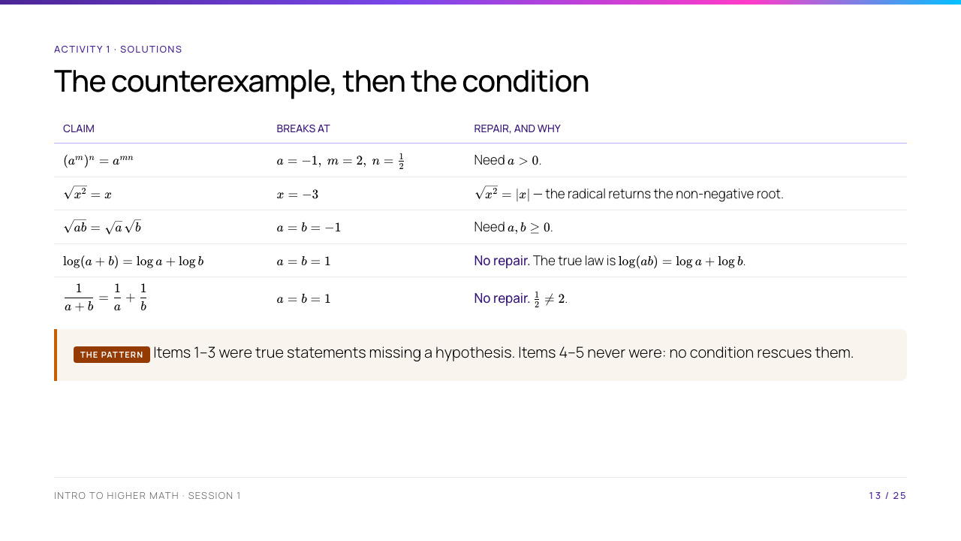
Notes:
Only show this after every group has presented. The distinction to draw out loud: three of these were theorems that had lost their hypothesis, and two were never theorems at all. Students who wrote "$a \neq 0$" for item 4 have found a condition that does not help — ask them to test it at $a = b = 1$.

Slide 14
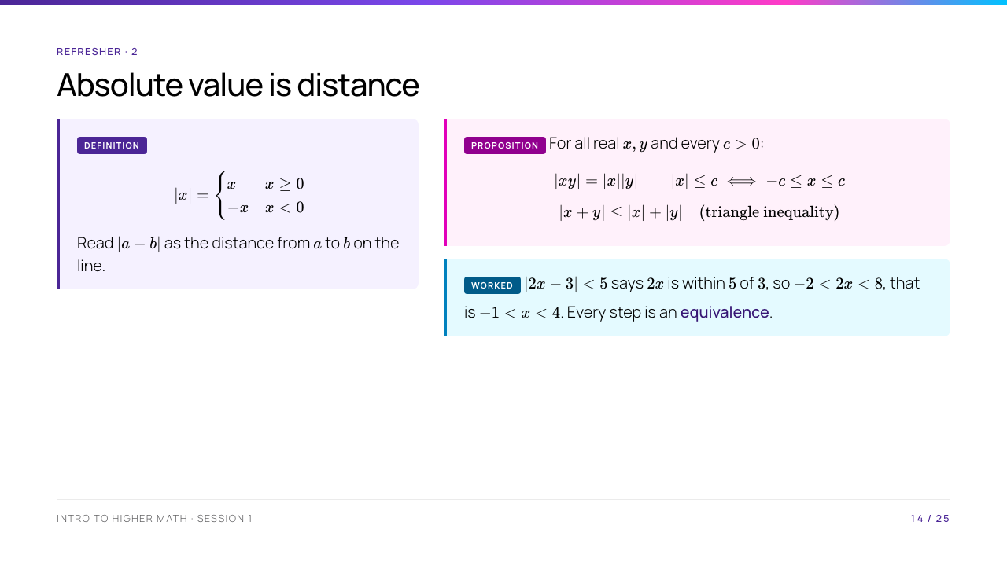
Notes:
Prove the triangle inequality on the board — it is two lines by squaring, and it is the first real proof they watch in this course. Say that it reappears in Session 11 for vectors, in exactly the same form.

Slide 15
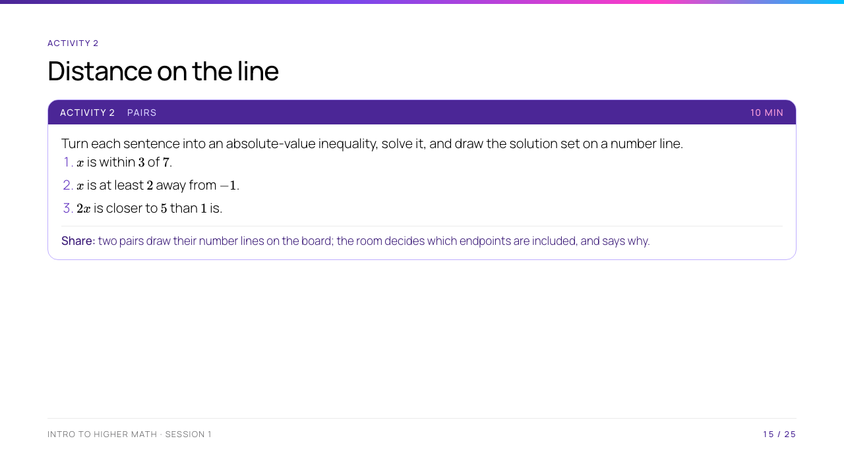
Notes:
The endpoints are the lesson: (1) and (2) are closed, (3) is open. Make them justify inclusion from the definition rather than from the shape of the symbol. Answers: $[4,10]$; $x \leq -3$ or $x \geq 1$; $2 < x < 3$.

Slide 16
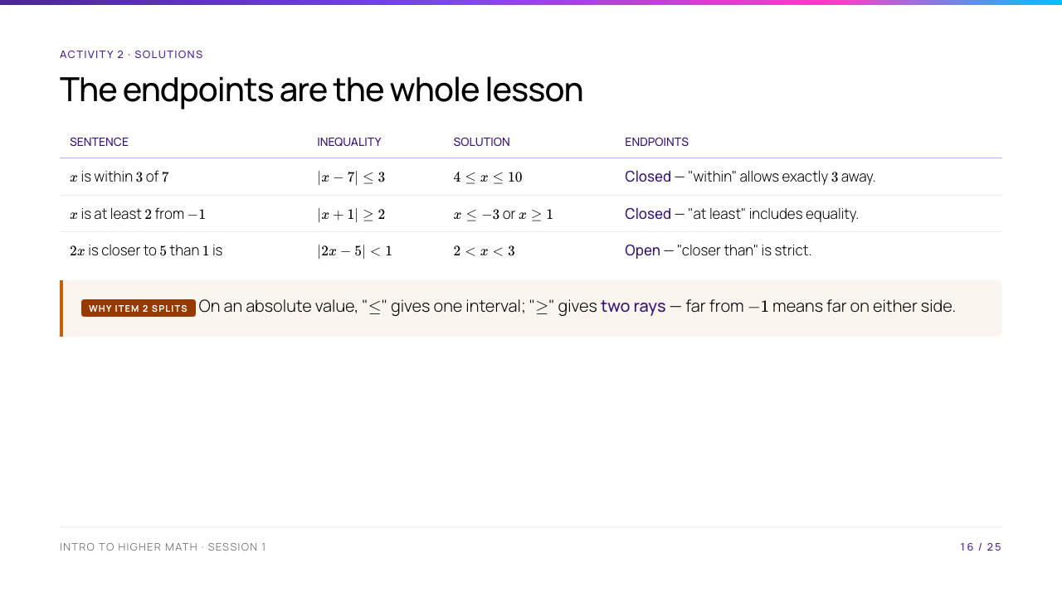
Notes:
The three answers matter less than the last column. Ask each pair to justify one endpoint from the definition of $|a-b|$ as a distance — "within 3" permits a distance of exactly 3, "closer than" does not. The note box is the generalisation; write the two shapes on the board side by side.

Slide 17
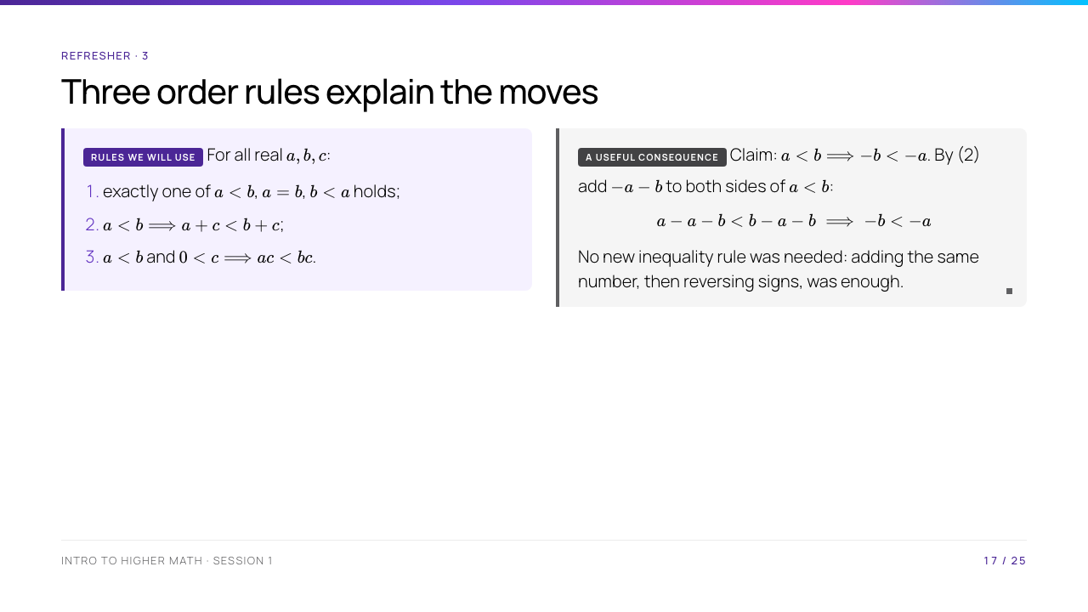
Notes:
This is the most abstract slide of the day and it is worth ten minutes. The message is modest but useful: familiar inequality moves have reasons. We will return to the formal foundations of the real numbers later; today, students should be able to name the rule that justifies a move.

Slide 18
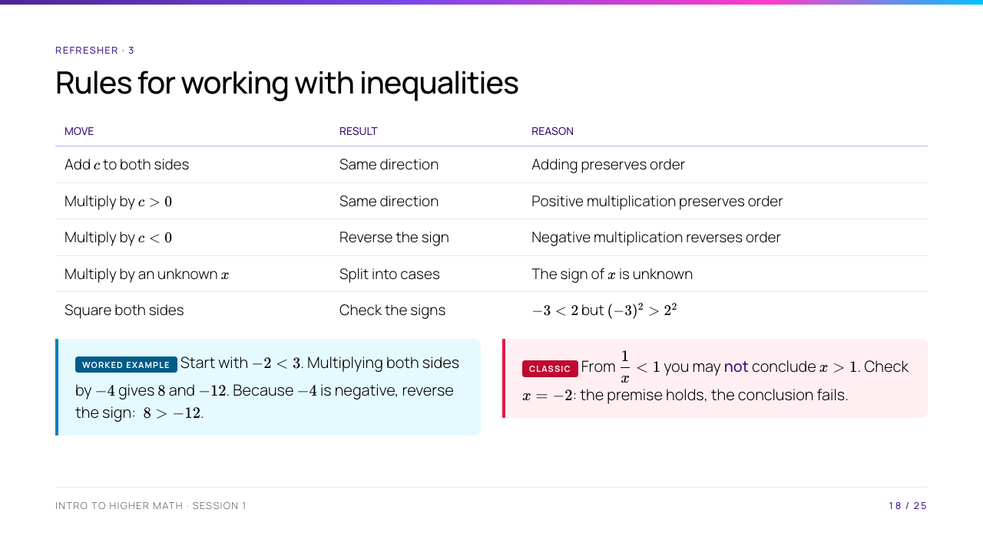
Notes:
Go row by row and make students state what happens before you reveal the answer. Do not refer to numbered axioms: the short explanation in the last column is enough at this point. The last two rows are where most algebra mistakes happen.

Slide 19
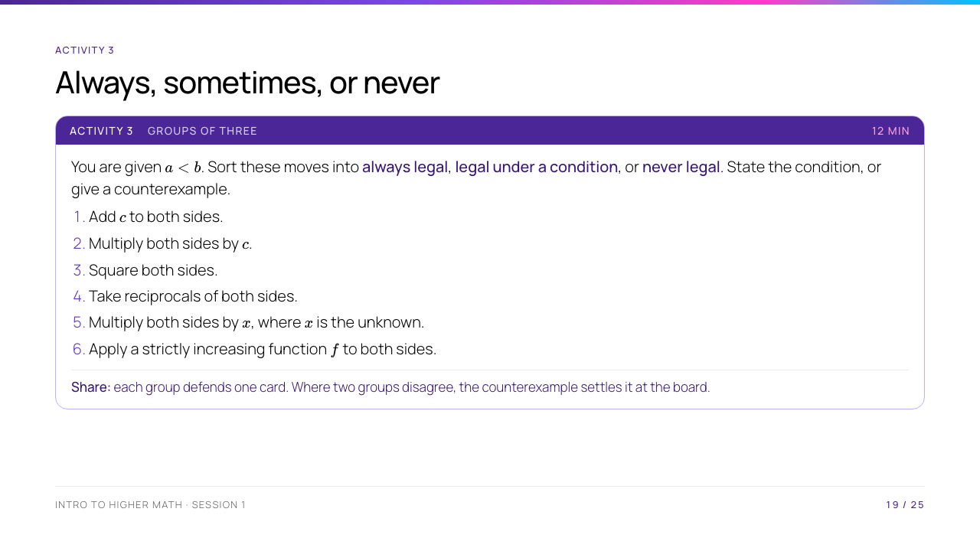
Notes:
Cards 3, 4 and 6 are the interesting ones. Taking reciprocals needs non-zero numbers of the same sign: $2 < 3$ gives $\tfrac12 > \tfrac13$, while $-1 < 2$ gives no reliable comparison after reciprocals. Card 6 is always legal and is the general principle behind cards 1 and 2 — if a group finds that, put it on the board.

Slide 20
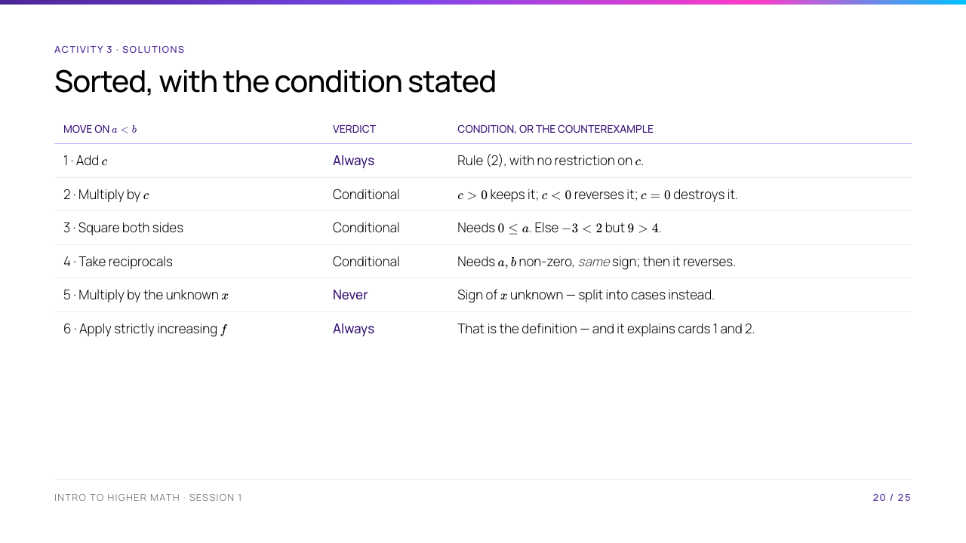
Notes:
Card 6 is the punchline: adding $c$ and multiplying by $c > 0$ are both instances of applying a strictly increasing function, so cards 1 and 2 are corollaries of card 6 rather than separate rules. If a group got there on their own, give them the board. Card 2's $c = 0$ case is the one nearly every group forgets — a strict inequality becomes an equality, so the move loses information.

Slide 21
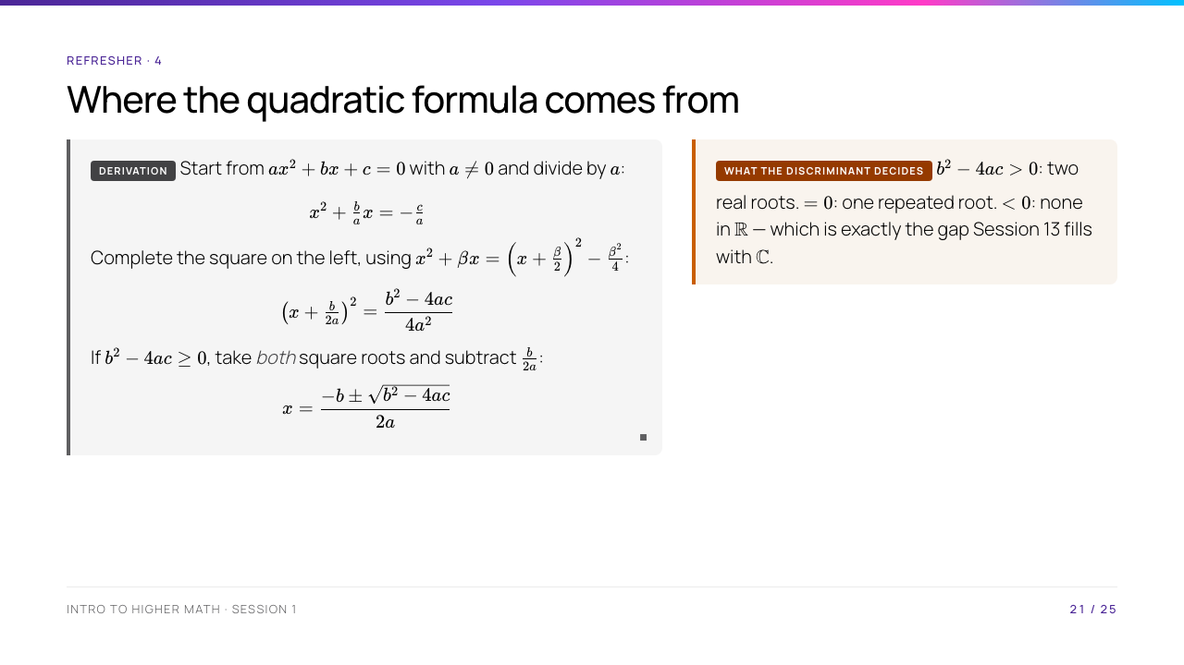
Notes:
Do every line on the board, slowly. Ask at the $\pm$ step why both roots survive — that is where the equivalence is, and where students silently drop a solution for the rest of their lives.

Slide 22
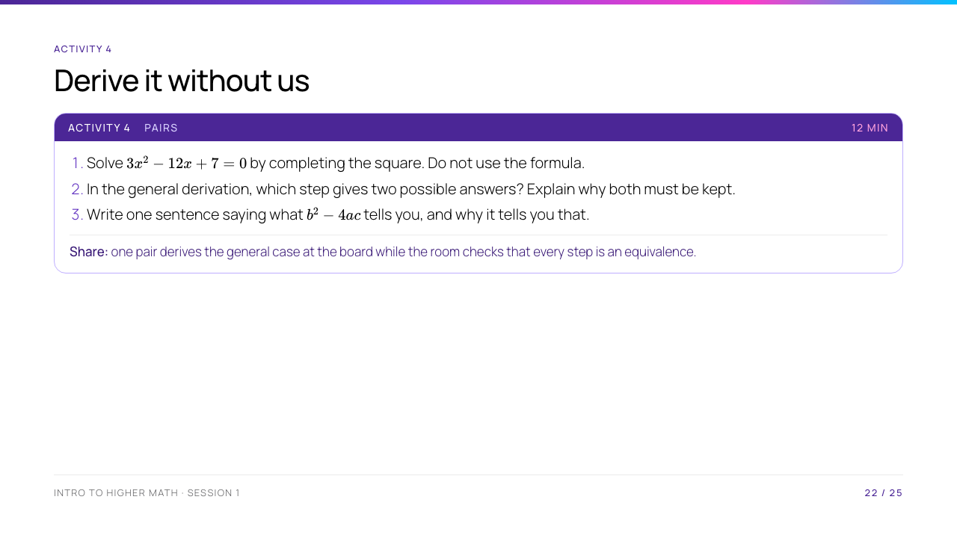
Notes:
Answer to (1): $x = 2 \pm \tfrac{\sqrt{15}}{3}$. For (2), the square-root step gives $\pm$; keeping both values is necessary because either may solve the original equation. For (3), the discriminant sits under the square root, so its sign decides whether real roots exist. Collect step 3 in writing; it is a rehearsal for how a full solution should read.

Slide 23
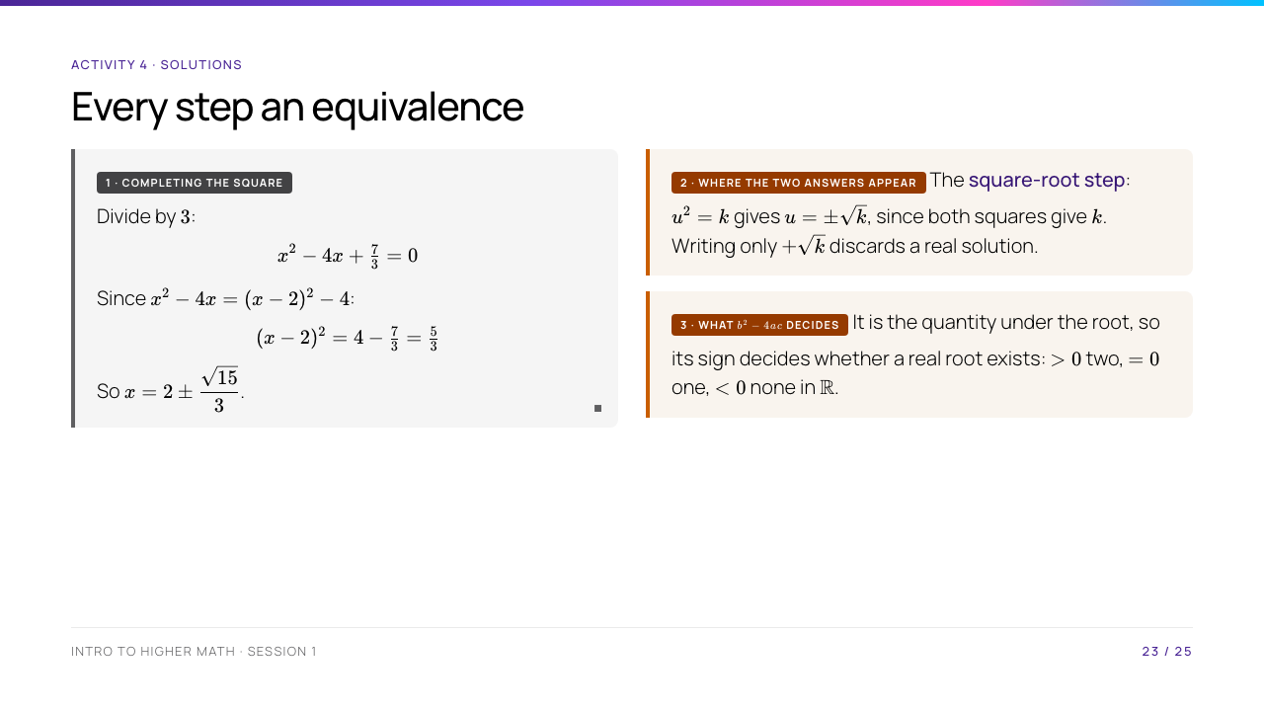
Notes:
Check the arithmetic in (1) publicly: $\sqrt{5/3} = \sqrt{15}/3$ trips up half the room, and it is worth doing the rationalisation on the board. For (3), accept any sentence that connects the sign to the existence of the square root; reject "it tells you the number of roots" with no reason, since that is the fact restated rather than explained — and say so, because the problem sets expect the same.

Slide 24
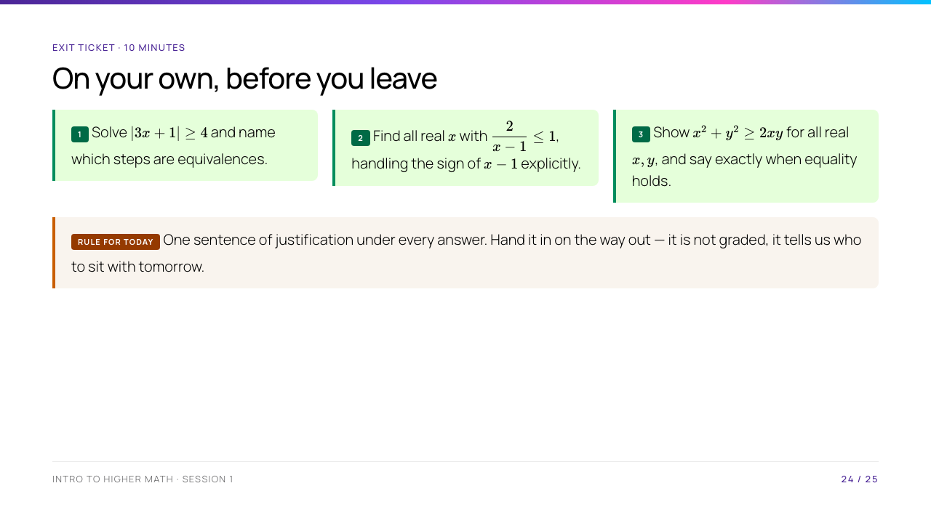
Notes:
Individual, silent, ten minutes. Collect them: this is your diagnostic for the whole cohort and it costs nothing. Expected: (1) $x \leq -\tfrac53$ or $x \geq 1$; (2) $x < 1$ or $x \geq 3$; (3) $(x-y)^2 \geq 0$, equality iff $x = y$.

Slide 25
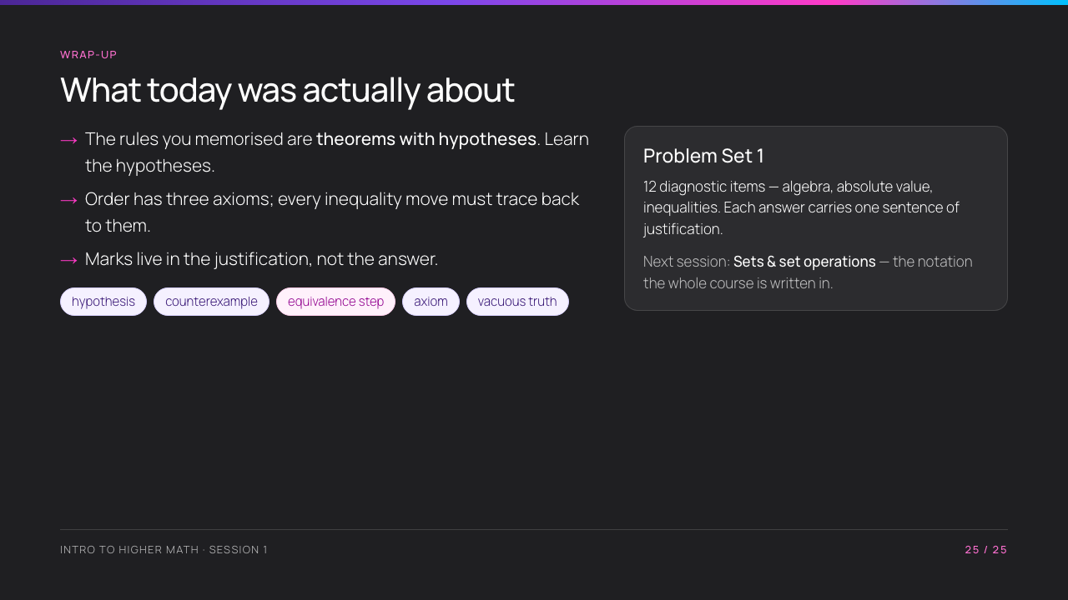
Notes:
Close on the three bullets, then brief Problem Set 1 concretely. Tell them tomorrow is sets, and that sets are the notation every remaining session is written in.

