Slide 1
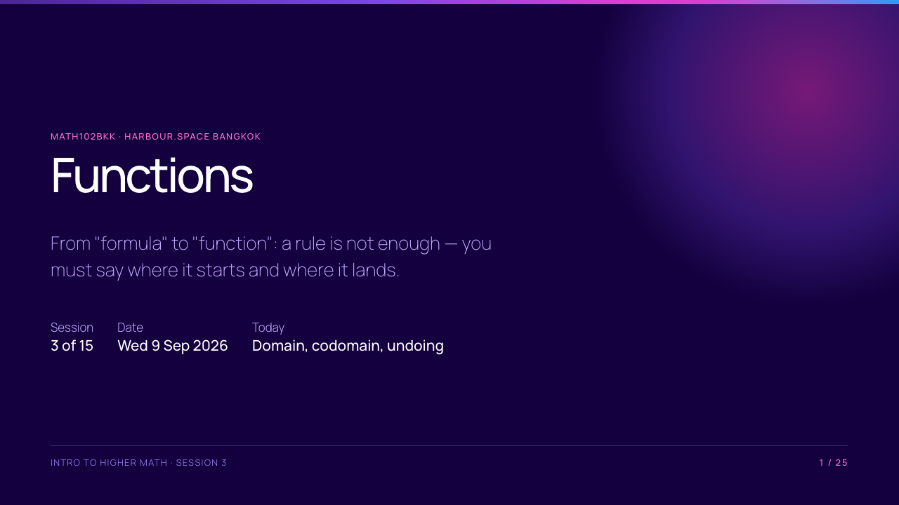

Slide 2
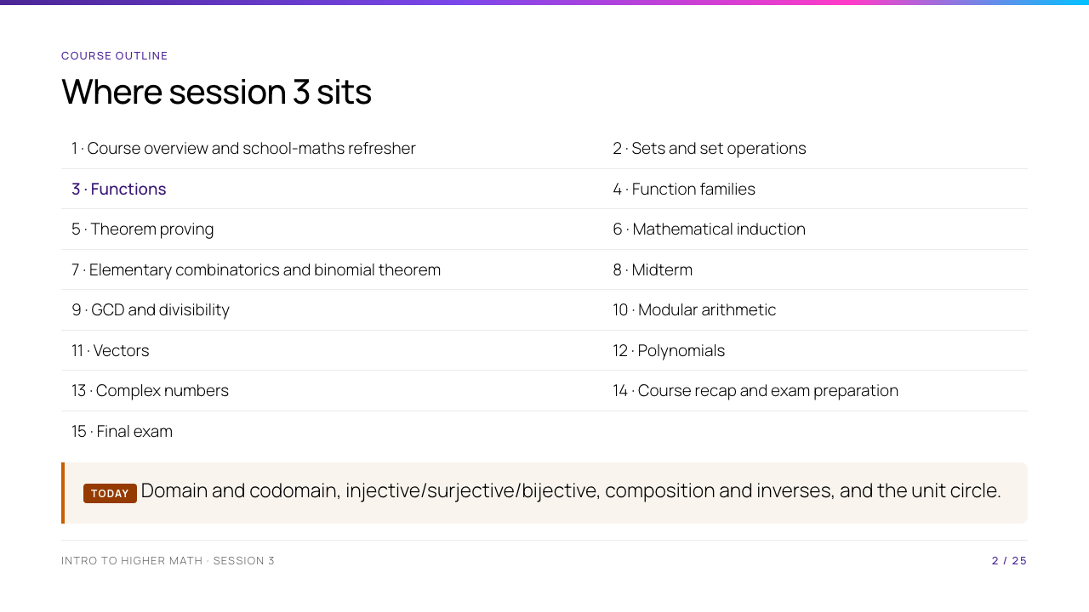
Notes:
Sets gave us the containers; today's functions are the maps between them, so session 2 is a prerequisite rather than a detour. Session 4 takes the same objects and asks which standard families they fall into and how fast each one grows.

Slide 3
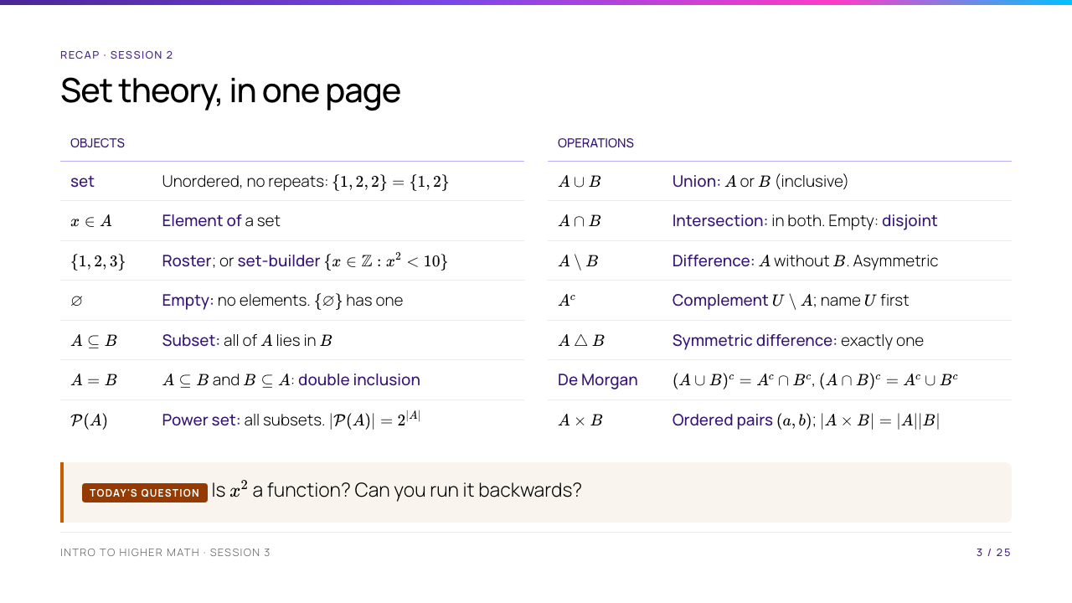
Notes:
This slide replaces the recap and the objectives, so it has to do both jobs in ten minutes. Do not read the tables out. Put them up, give the room ninety seconds to find the one line they cannot explain, and take three of those. The two lines worth defending out loud are $\in$ against $\subseteq$ — object to set versus set to set — and double inclusion, because that is the proof method today's injectivity and surjectivity arguments are built on. Then ask the question in the box and let them commit out loud. Most of the room says yes. A more precise answer is "not completely specified — you have given me a rule but not its domain and codomain", and by the end of the first hour they will see that the same rule $x^2$ is four different functions depending on the sets you attach. Today's assessed skill is proving injectivity, surjectivity and bijectivity: a verdict without a proof scores nothing.

Slide 4
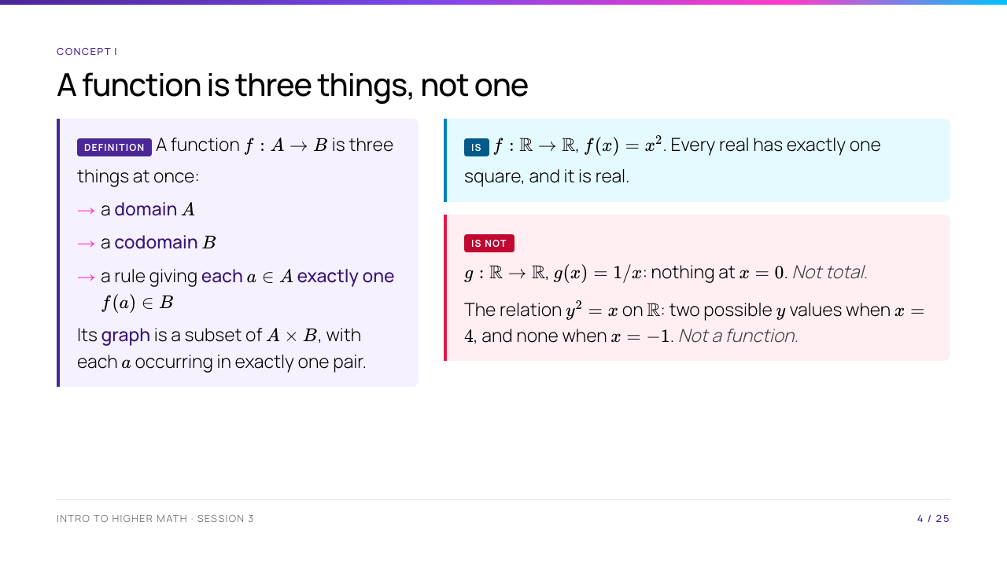
Notes:
Say the two failure modes by name and write them on the board: not total (some input has no output) and not single-valued (some input has more than one). Every non-example for the rest of the course is one of these two. The $A \times B$ line is the payoff from yesterday — a function is literally a set of ordered pairs, and "exactly one" is a condition on that set.

Slide 5
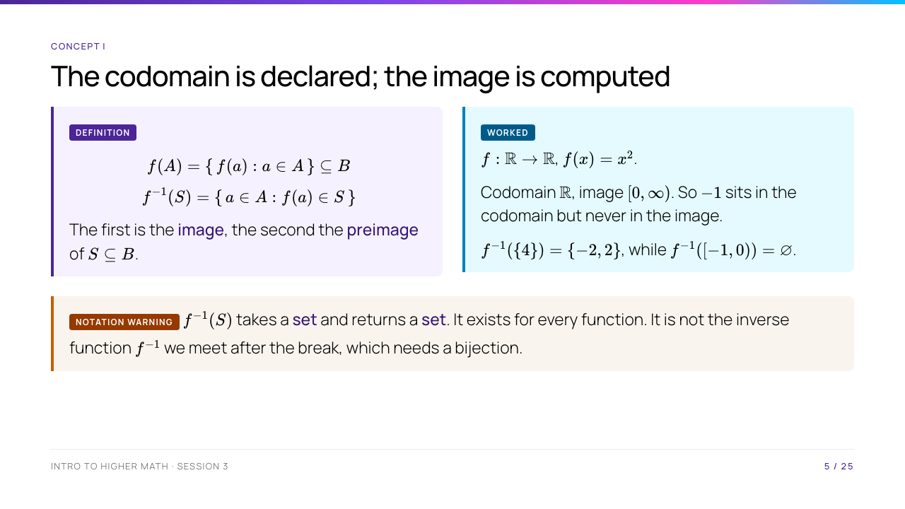
Notes:
The one sentence to repeat: the codomain is a promise you make, the image is a fact you must prove. Note that $f^{-1}(S)$ is written with the same symbol as an inverse function but is a completely different object — it takes a set, returns a set, and needs no bijection to exist. Say that now; they will meet the real $f^{-1}$ in an hour and confuse the two otherwise.

Slide 6
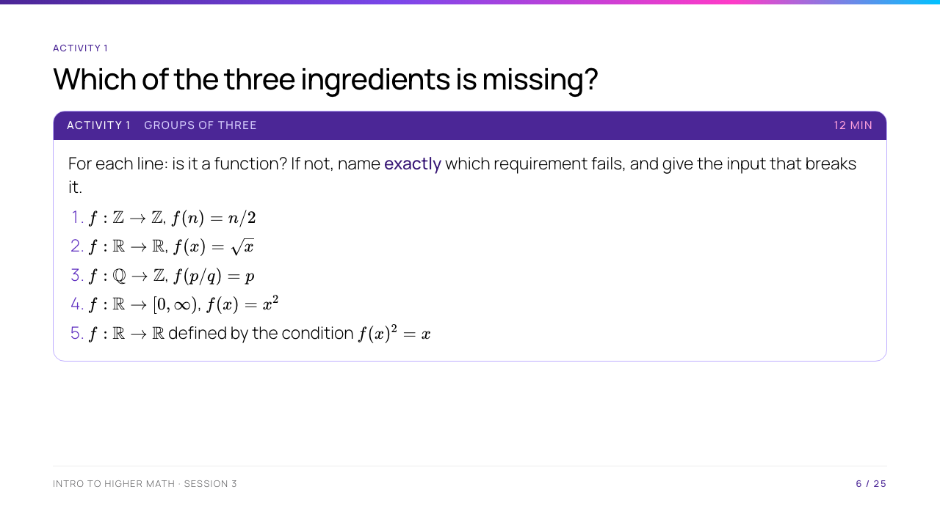
Notes:
Answers: (1) lands outside the codomain — $f(3) = 1.5 \notin \mathbb{Z}$. (2) not total — nothing at $x = -1$. (3) not well defined, which is the interesting one: $\tfrac12 = \tfrac24$ but the rule returns $1$ and $2$; the input is a rational, not a pair of integers. (4) fine. (5) no such function — at $x = -1$ we would need $f(-1)^2 = -1$, impossible over $\mathbb{R}$. Line 3 is worth most of the twelve minutes; well-definedness is a new idea and it returns in Session 10 when we define arithmetic on remainder classes.

Slide 7
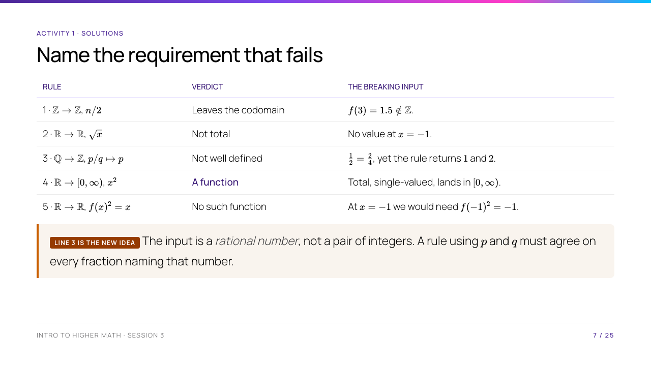
Notes:
Spend the discussion on line 3. Well-definedness is the one genuinely new concept here, and it returns in Session 10 when arithmetic on remainder classes has to be checked the same way. Lines 1 and 2 are often both called "not a function" without distinction — insist on the precise failure, since that vocabulary is what the codomain/image slide depends on.

Slide 8
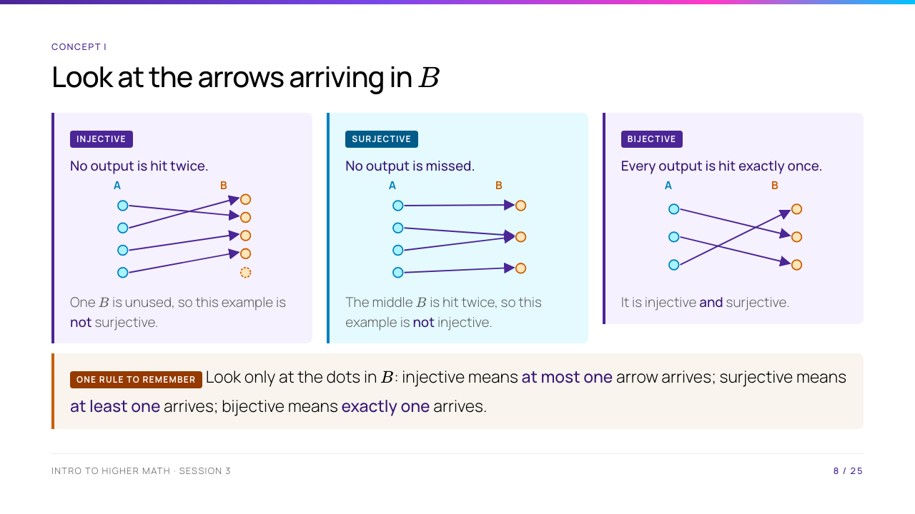
Notes:
Start with the right-hand set, B. Ask students to count the arrows arriving at each yellow dot. For injective, every dot has zero or one arrow; for surjective, every dot has one or more; for bijective, every dot has exactly one. Then point out the separate rule that makes these diagrams functions in the first place: every dot in A has exactly one arrow leaving it. Do not begin with the symbolic definitions; use the final rule box to turn the pictures into the words.

Slide 9
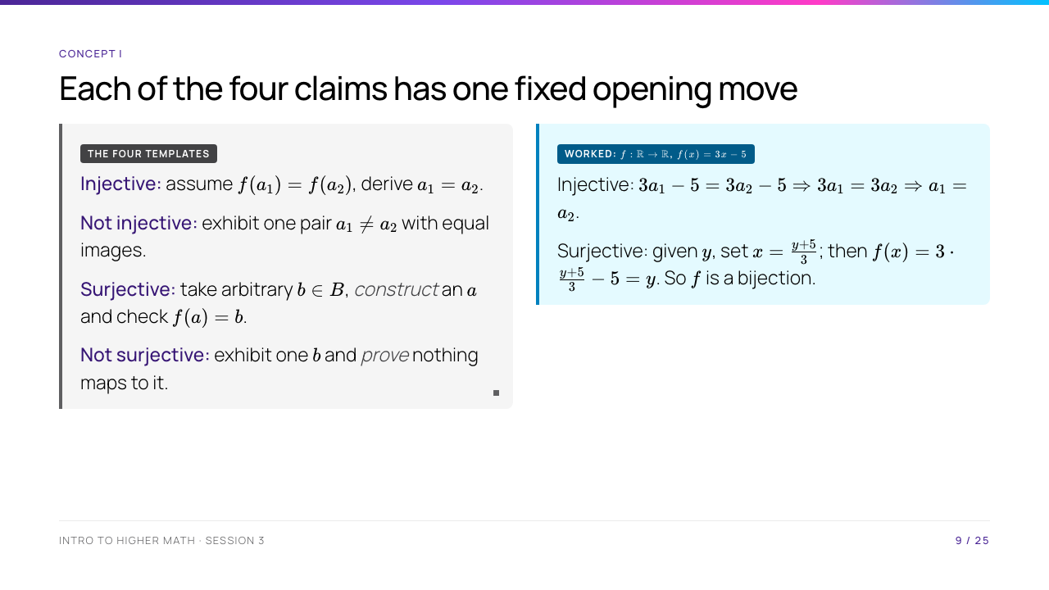
Notes:
The asymmetry is the lesson: the positive claims are universal and need an argument, the negative claims are existential and need one number. Students routinely try to disprove surjectivity by saying "it looks like nothing hits $-1$" — that is not the fourth template, and it costs marks all term. Note where the surjectivity witness $\tfrac{y+5}{3}$ came from: solve $f(x) = y$ on scrap paper, then present the answer as a construction. Say that out loud — the discovery and the write-up are different documents.

Slide 10
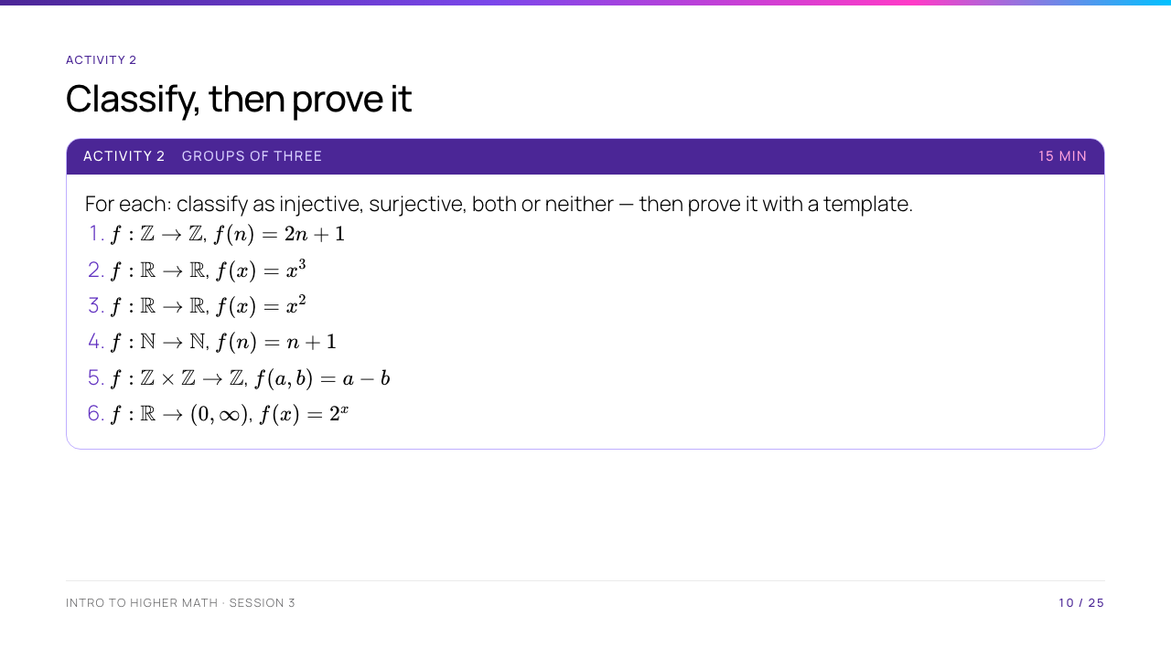
Notes:
Answers: (1) injective, not surjective — $2n+1$ is always odd so $2$ is missed. (2) bijective, inverse $\sqrt[3]{y}$. (3) neither — $f(-1) = f(1)$, while $-1$ is missed. (4) injective, not surjective — with $\mathbb{N}$ starting at $1$, nothing maps to $1$. (5) surjective via $(k,0)$, not injective since $f(1,1) = f(2,2)$. (6) bijective, inverse $\log_2 y$. Item 3 is the one to take to the board: it shows that one counterexample can settle injectivity, and one missed codomain value can settle surjectivity. Item 4 will start an argument about whether $0 \in \mathbb{N}$ — settle it by convention and point out the verdict changes.

Slide 11
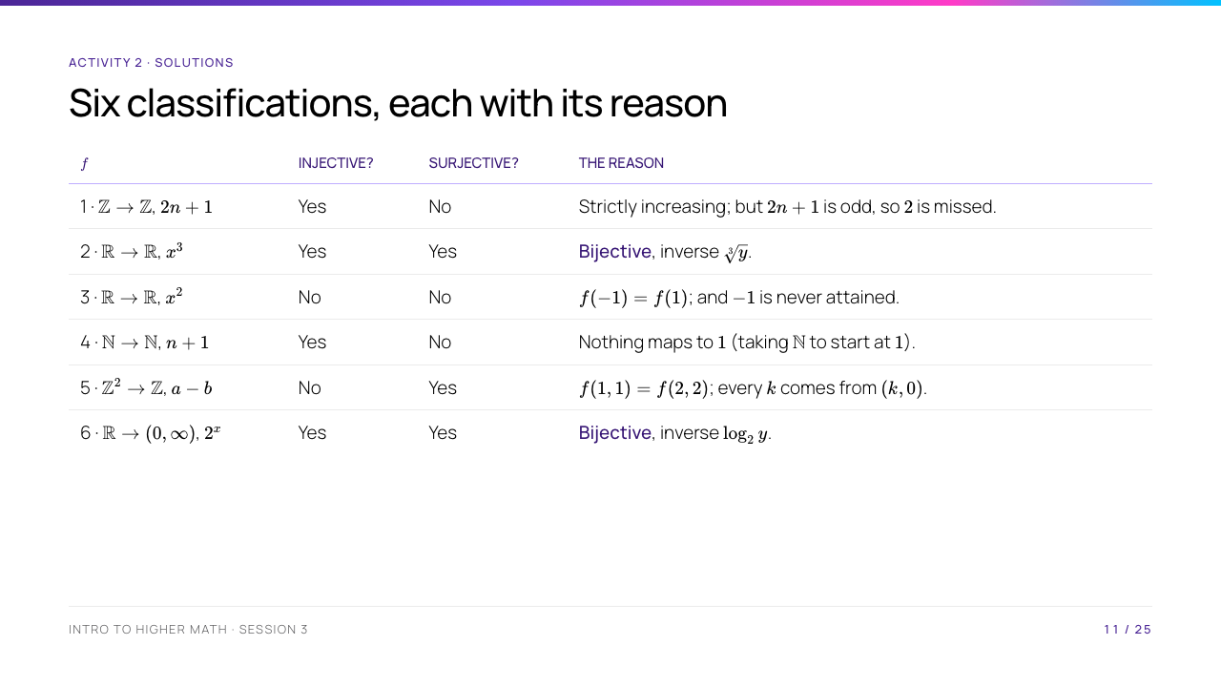
Notes:
Item 3 is the one for the board: a single counterexample settles injectivity, and a single missed codomain value settles surjectivity — neither needs a general argument. Item 4 will start the $0 \in \mathbb{N}$ debate; settle it by convention and point out that the verdict flips if $0$ is included, which is exactly why the domain has to be declared. Note that items 2 and 6 are the only invertible ones, which sets up the inverse-function slide.

Slide 12
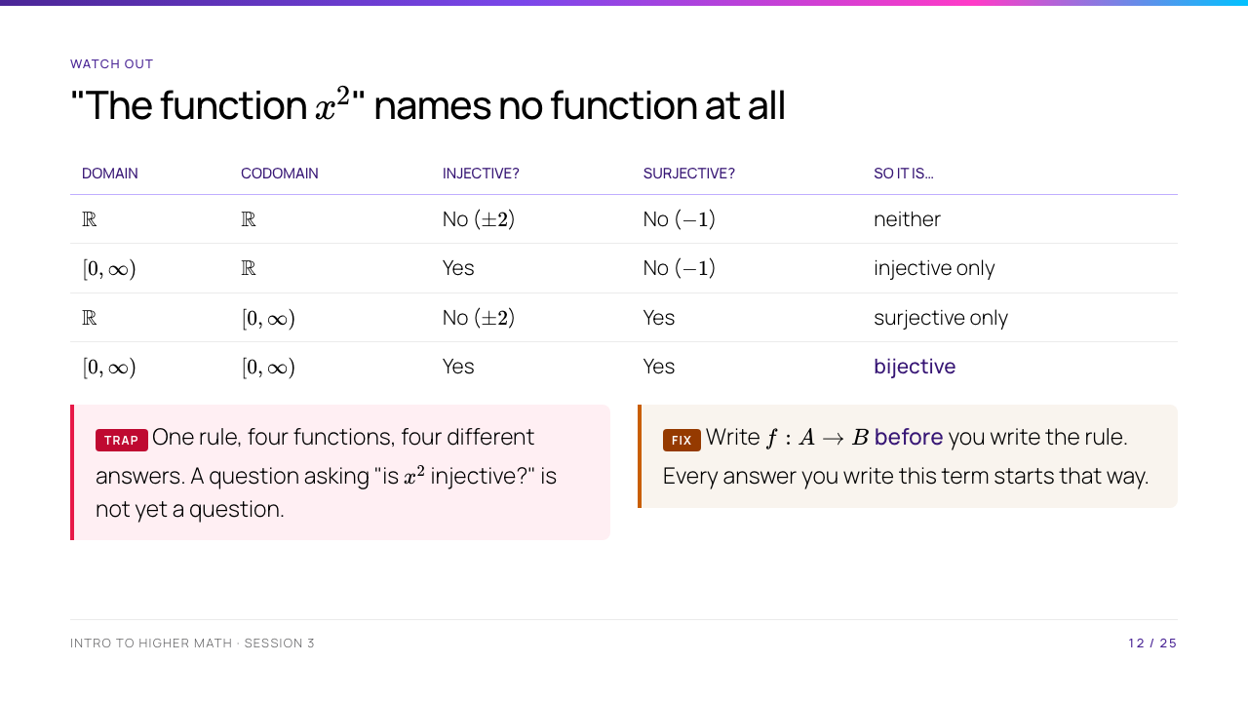
Notes:
Build the table live, one row at a time, asking the room for each cell — it lands far harder than revealing it. This is the slide students should photograph. Then connect it forward: the last row is what makes $\sqrt{\ }$ a legitimate function, and the same restriction trick is what will make $\arcsin$ exist at the end of today.

Slide 13
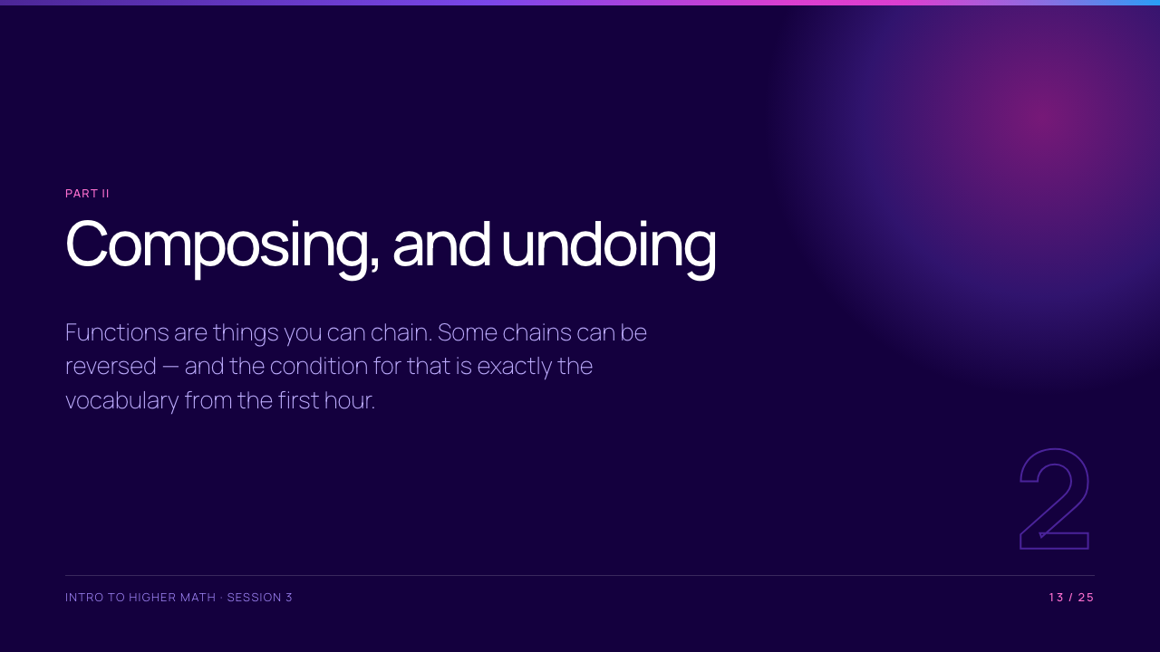

Slide 14
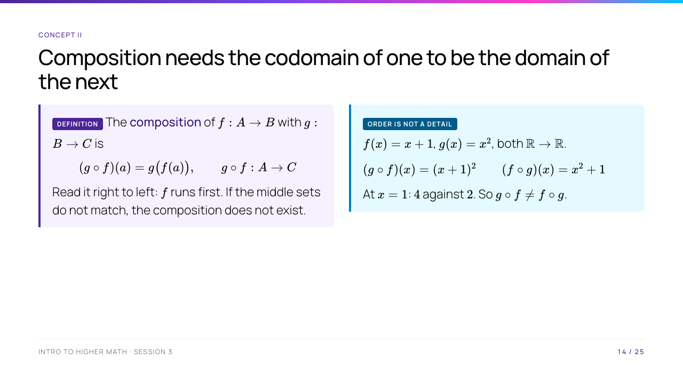
Notes:
The right-to-left reading trips everyone once; make them evaluate $(g \circ f)(3)$ out loud before you move on. The non-commutativity example is worth a beat — up to now every operation they have met (addition, multiplication, union, intersection) commuted, and this is the first that does not. Composition is associative, though: $(h \circ g) \circ f = h \circ (g \circ f)$, because both sides send $a$ to $h(g(f(a)))$. Say it; it is one line and they will use it silently forever.

Slide 15
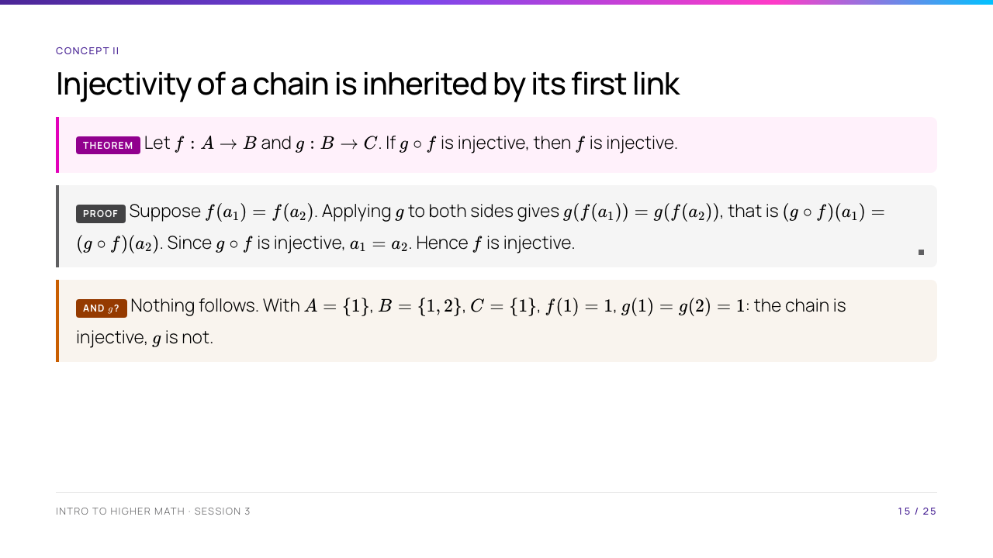
Notes:
This is boardExample 2 and it is the first proof of the day where the opening move is not obvious. Point out that the whole proof is the injectivity template with one extra step: apply $g$. Ask the room what happens if you try to prove the same thing about $g$ — someone will attempt it, and that failed attempt is exactly Activity 3, so let them start it and then cut them off.

Slide 16
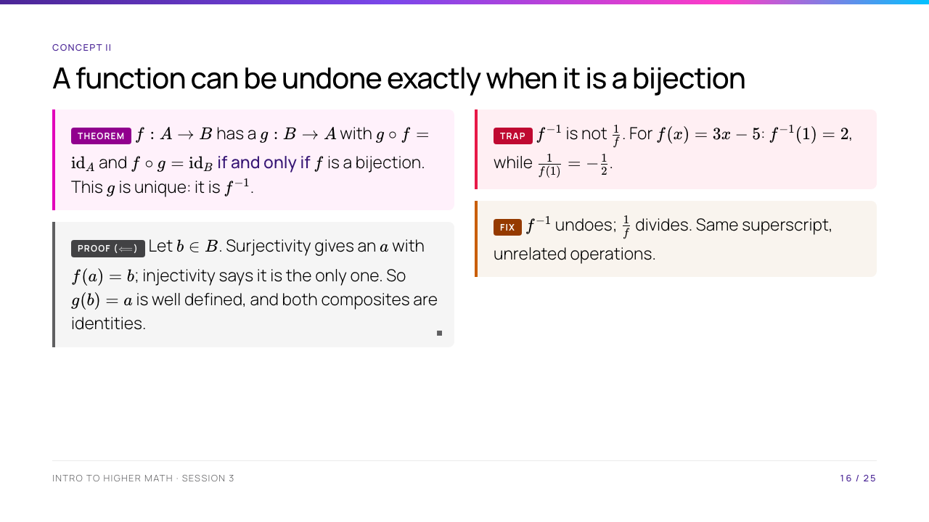
Notes:
The $\Longleftarrow$ proof is the day's most important sentence: surjectivity gives existence, injectivity gives uniqueness, and together they give a well-defined rule . Write those two words on the board under the two hypotheses. Do the $\Longrightarrow$ direction live: if $g \circ f = \mathrm{id}$ then $f(a_1) = f(a_2)$ gives $a_1 = g(f(a_1)) = g(f(a_2)) = a_2$; if $f \circ g = \mathrm{id}$ then any $b$ equals $f(g(b))$, so $b$ is hit.

Slide 17
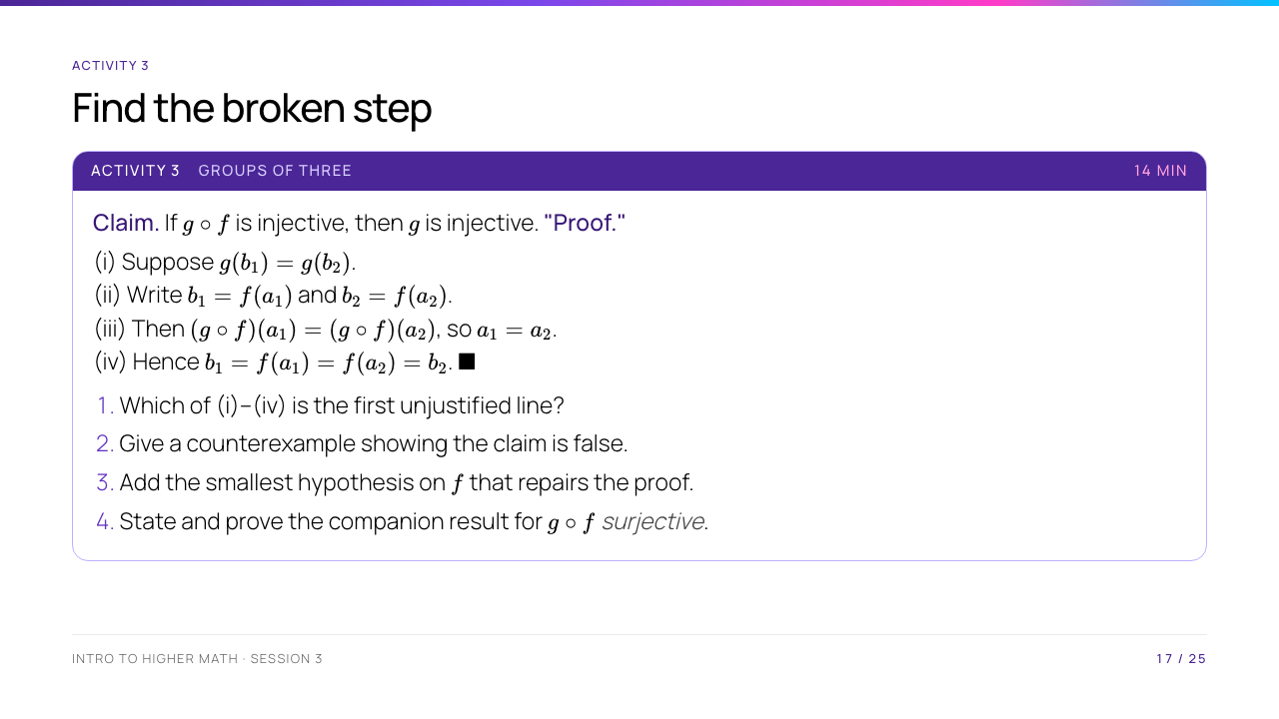
Notes:
The broken line is (ii): "write $b_1 = f(a_1)$" silently assumes every element of $B$ is in the image — that is surjectivity of $f$, and it was never given. Counterexample: the one from two slides ago, $f : \{1\} \to \{1,2\}$ with $g(1) = g(2) = 1$. Repair: assume $f$ surjective, and then the proof is correct as written. Step 4: if $g \circ f$ is surjective then $g$ is surjective — given $c \in C$ there is $a$ with $g(f(a)) = c$, so $f(a) \in B$ is a preimage. Note the pleasing symmetry: the chain hands injectivity down to the first link and surjectivity to the last .

Slide 18
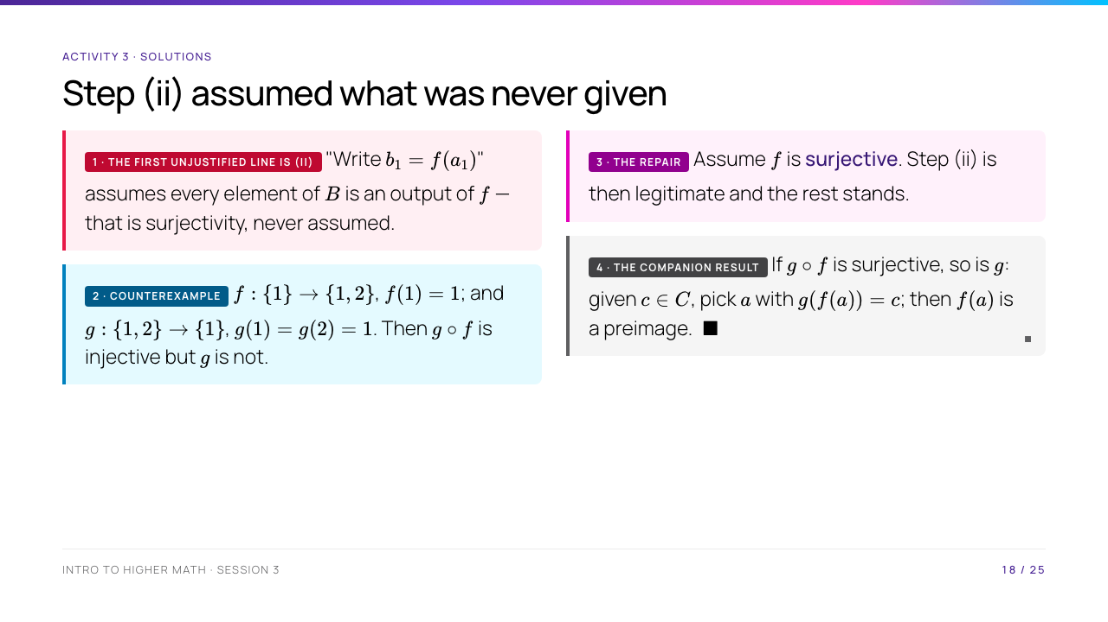
Notes:
The symmetry is the thing to leave them with: a composition hands injectivity down to its first link and surjectivity up to its last . Both halves fail in the other direction, and the counterexample above is the smallest witness for one of them. If a group proposed "assume $g$ injective" as the repair in part 3, point out that this assumes the conclusion.

Slide 19
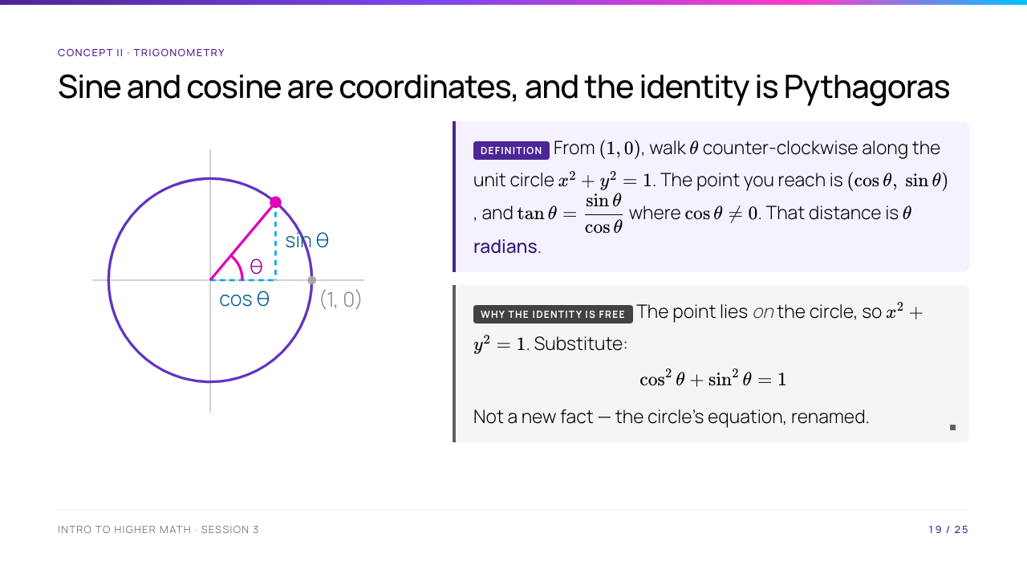
Notes:
Draw the circle before you say a word, and walk a finger round it. The single idea: $\theta$ is a length , so $\sin$ and $\cos$ are functions $\mathbb{R} \to \mathbb{R}$ like any other — not triangle ratios that stop at $90^\circ$. Derive $\sin^2 + \cos^2 = 1$ by pointing at the circle; most of them memorised it and have never been shown that it is one substitution.

Slide 20
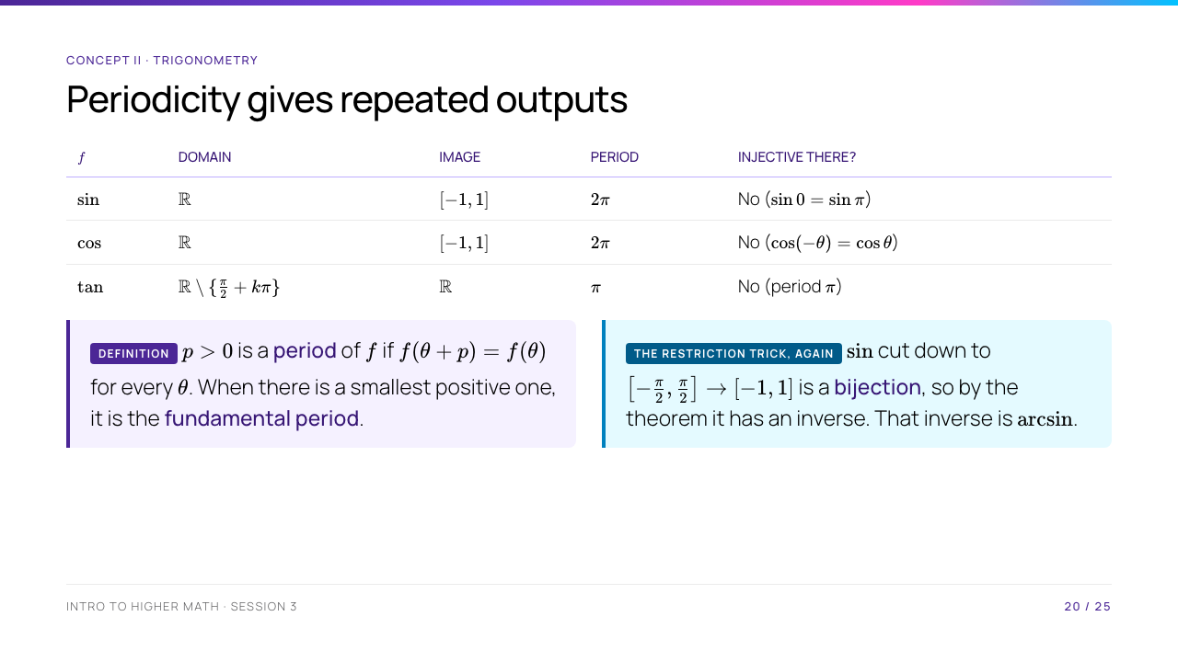
Notes:
This is the slide that ties the two halves of the day together, so do not rush it. A periodic function repeats, so it is never injective on all of $\mathbb{R}$, so it has no inverse there — full stop. Every calculator's $\sin^{-1}$ button is silently working on a restricted domain, which is why it returns $-\tfrac{\pi}{2}$ to $\tfrac{\pi}{2}$ and nothing else. Ask why we chose that interval and not, say, $[\tfrac{\pi}{2}, \tfrac{3\pi}{2}]$: we could have, it is a convention, and the theorem does not care.

Slide 21
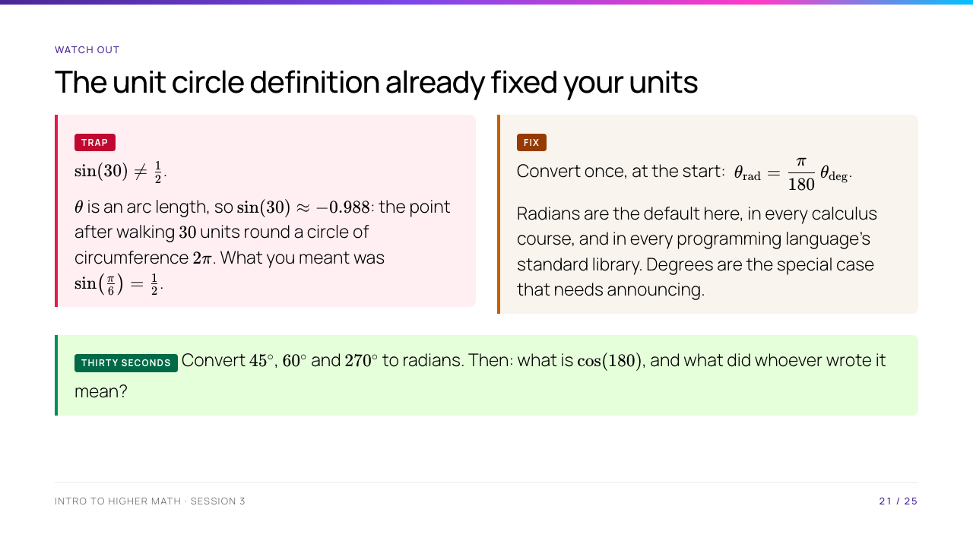
Notes:
Worth thirty seconds of live demonstration: type Math.sin(30) somewhere and show the room $-0.988$. Every student loses marks to this at least once, and it is silent — the answer is a plausible number, just the wrong one. The deeper reason radians win is that they make $\sin$ a function of a length rather than of an arbitrary $1/360$ convention; that is what makes the derivative of $\sin$ come out as $\cos$ with no stray constant, which they will meet in calculus. Drill answers: $\tfrac{\pi}{4}$, $\tfrac{\pi}{3}$, $\tfrac{3\pi}{2}$; and $\cos(180) \approx -0.598$, where almost certainly $\cos(\pi) = -1$ was meant.

Slide 22
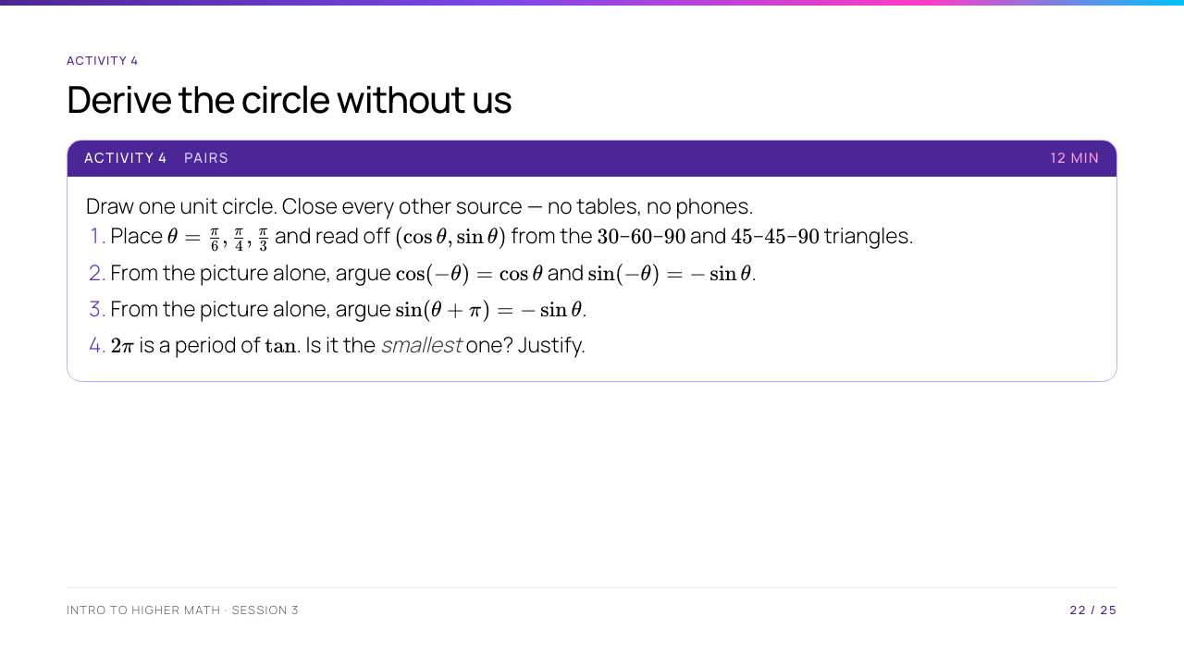
Notes:
Answers: (1) $\left(\tfrac{\sqrt3}{2}, \tfrac12\right)$, $\left(\tfrac{\sqrt2}{2}, \tfrac{\sqrt2}{2}\right)$, $\left(\tfrac12, \tfrac{\sqrt3}{2}\right)$. (2) reflecting in the $x$-axis fixes the first coordinate and negates the second. (3) adding $\pi$ sends the point to its antipode, negating both coordinates. (4) no — $\tan(\theta + \pi) = \tan\theta$, so $\pi$ is smaller, and it is in fact the smallest. Step 4 is the one they get wrong: "a period" and "the period" are different claims, and asking for the smallest is asking them to rule out everything below it, not just verify one value.

Slide 23
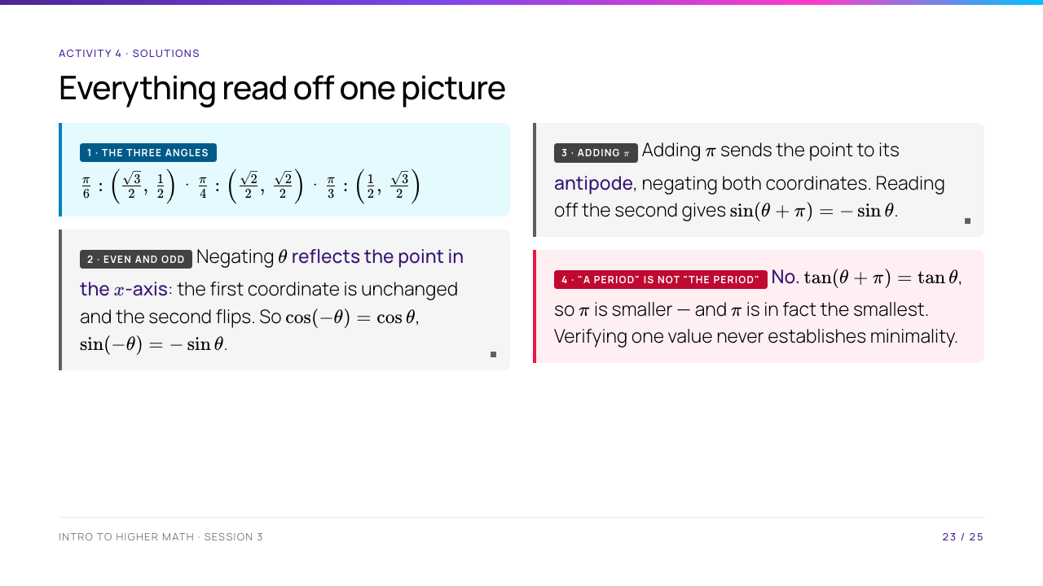
Notes:
Part 4 is where the marks are. Confirming that $2\pi$ works says nothing about whether something smaller also works; the question asks them to rule out every $p$ below, which is a different and harder claim. Half the antipode argument in part 3 is already the proof that $\pi$ is a period of $\tan$ — if a pair spots that, they have connected the two halves of the activity themselves.

Slide 24
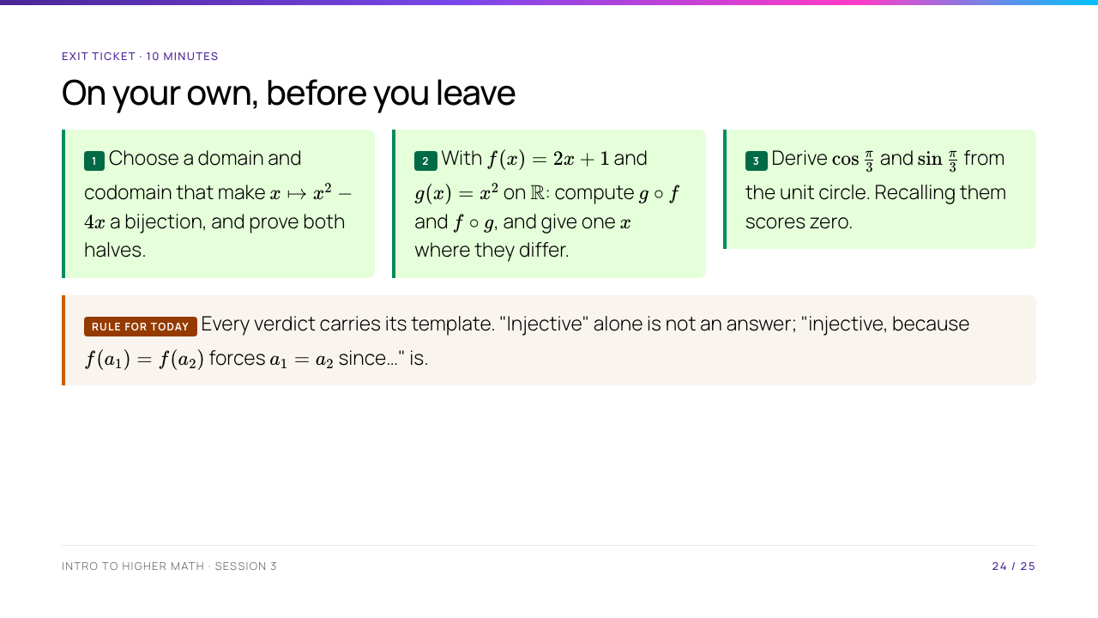
Notes:
Individual, silent, ten minutes, collected. Expected: (1) complete the square — $x^2 - 4x = (x-2)^2 - 4$, so $[2,\infty) \to [-4,\infty)$ works, injective by the same argument as $x^2$ on $[0,\infty)$ and surjective via $x = 2 + \sqrt{y+4}$. (2) $(g \circ f)(x) = 4x^2 + 4x + 1$, $(f \circ g)(x) = 2x^2 + 1$; they differ at $x = 1$, giving $9$ and $3$. (3) $\tfrac12$ and $\tfrac{\sqrt3}{2}$, from the $30$–$60$–$90$ triangle inscribed in the circle.

Slide 25
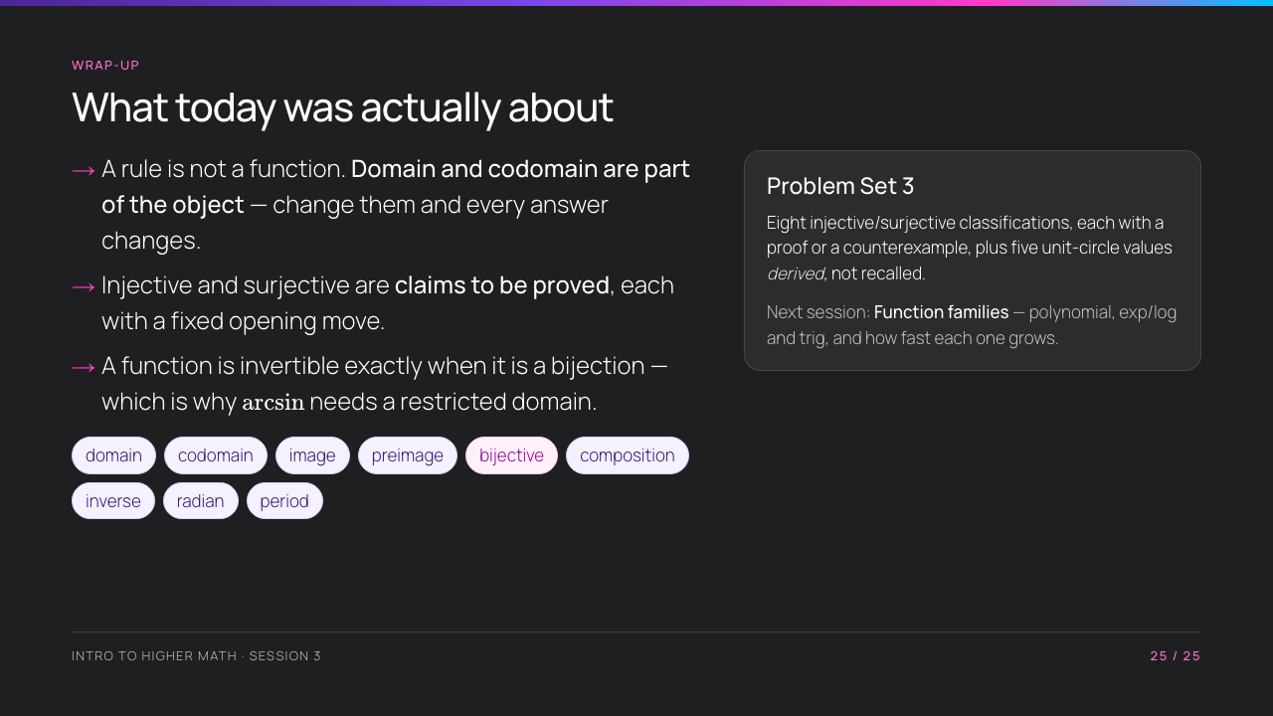
Notes:
Close on the three bullets, then brief the problem set concretely: a one-word verdict earns nothing, and "derived, not recalled" means we want the triangle, not the table. Flag tomorrow — today gave the grammar of functions, tomorrow gives the vocabulary: the standard families and their growth.

