Slide 1

Notes:
Connect to Session 3: students now know what a function is. Today gives them useful families of functions to recognise and compare. State that every graph shown today has a declared domain; when none is written, use the natural real domain of the formula.

Slide 2
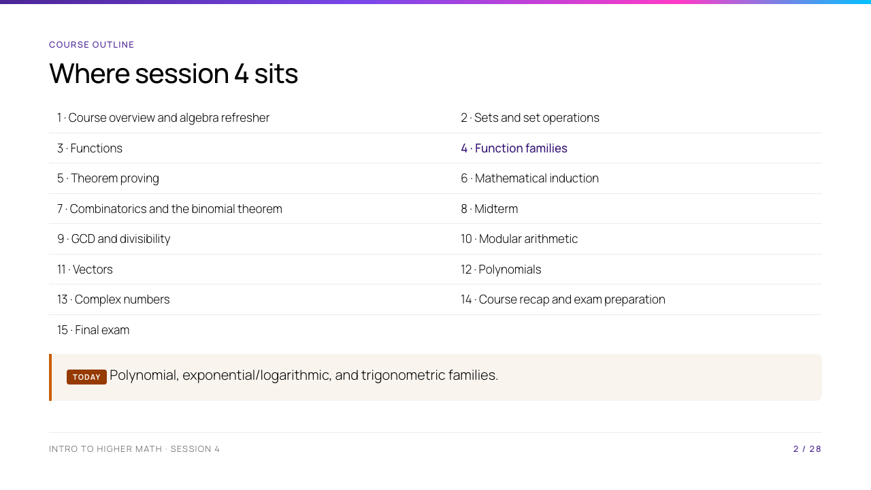
Notes:
Point out the deliberate repeat: polynomials appear today as a function family and return in Session 12 for deeper algebra. The course moves from the language of functions to proof techniques next session.

Slide 3
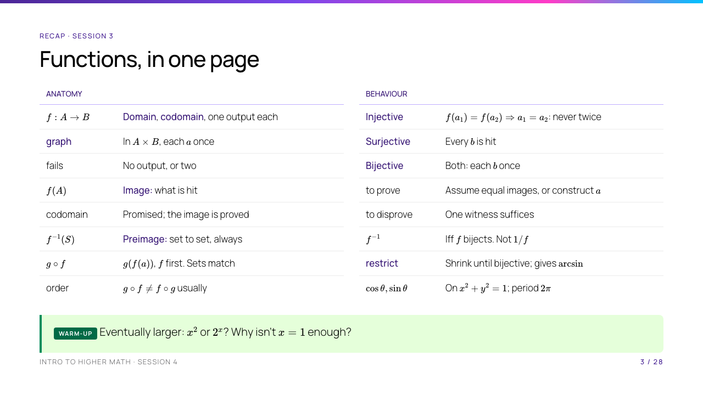
Notes:
This slide replaces the warm-up and the objectives, so it has to do both jobs in ten minutes. Do not read the tables out. Put them up, give the room ninety seconds to find the one line they cannot explain, and take three of those. Two lines carry today: codomain is declared, image is computed — every family today gets asked for its domain and range — and restrict until bijective , because that is the only reason $\log$ and $\arcsin$ exist at all. Then run the warm-up. Ask for predictions, not answers from memory. At $x=1$, $x^2=1$ and $2^x=2$; at $x=3$, $9>8$; at $x=10$, $1024>100$. That makes the need for the word "eventually" visible. Do not yet claim a formal growth theorem; it appears later. Today's assessed skill is explaining why a rule may be used, not only using it: degree and end behaviour, exponent and log laws with their conditions, base change, growth comparison, and reading amplitude, period and shift off a transformed graph.

Slide 4
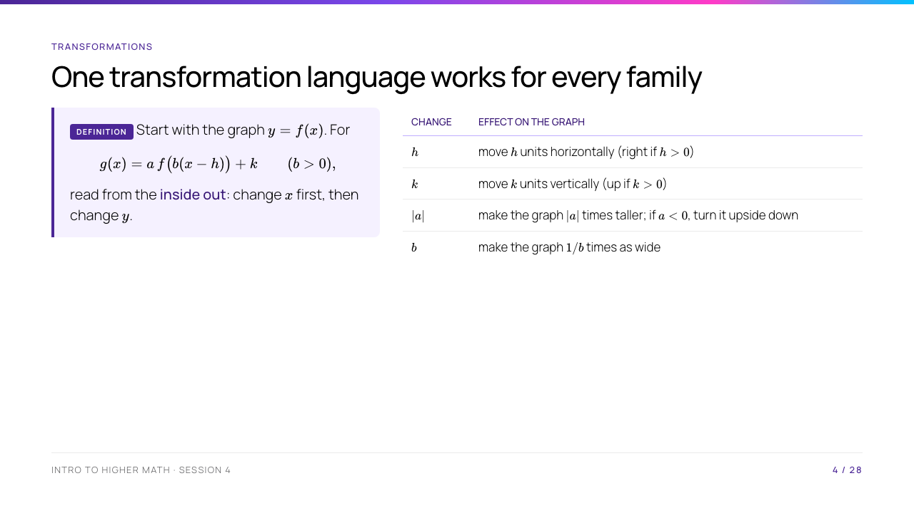
Notes:
Keep $b>0$ on this first-pass transformation rule so that the horizontal reflection case does not distract. Demonstrate with $g(x)=-2f(3(x-1))+4$: right $1$, horizontal compression by factor $1/3$, vertical stretch by $2$, vertical reflection, then up $4$. Emphasise that $f(x-3)$ shifts right, not left: to get the same old output $f(0)$, the new input must be $x=3$.

Slide 5
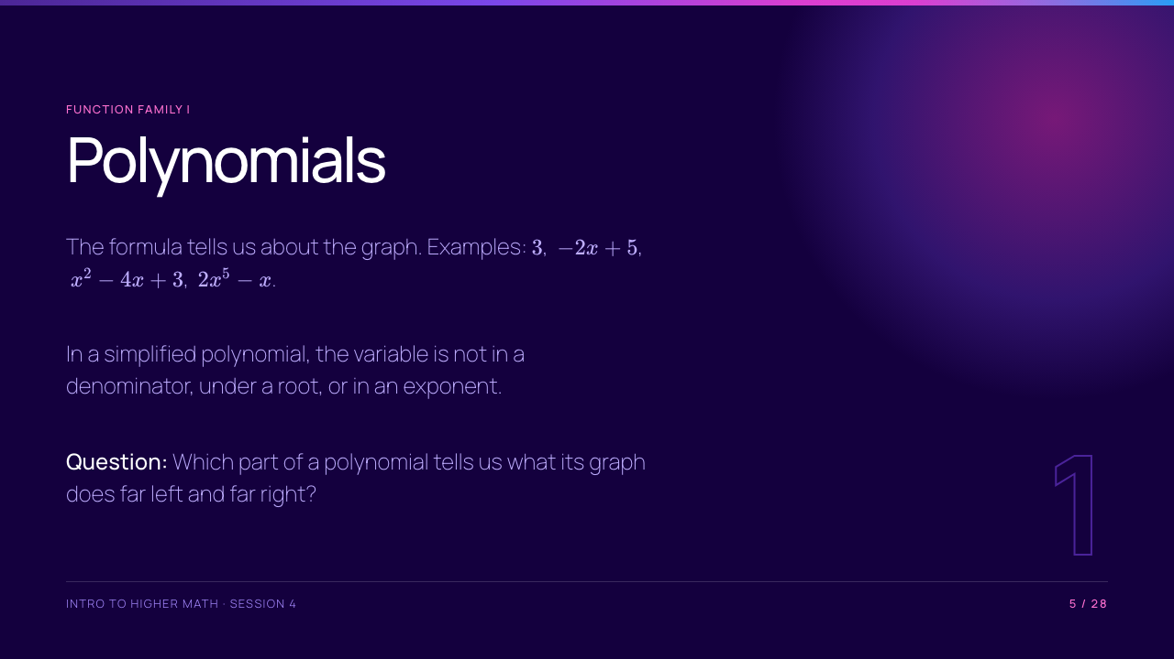
Notes:
Let students name familiar examples. A constant nonzero polynomial has degree $0$; the zero polynomial is special and does not have a degree under the usual convention, so leave it out of the classification discussion.

Slide 6
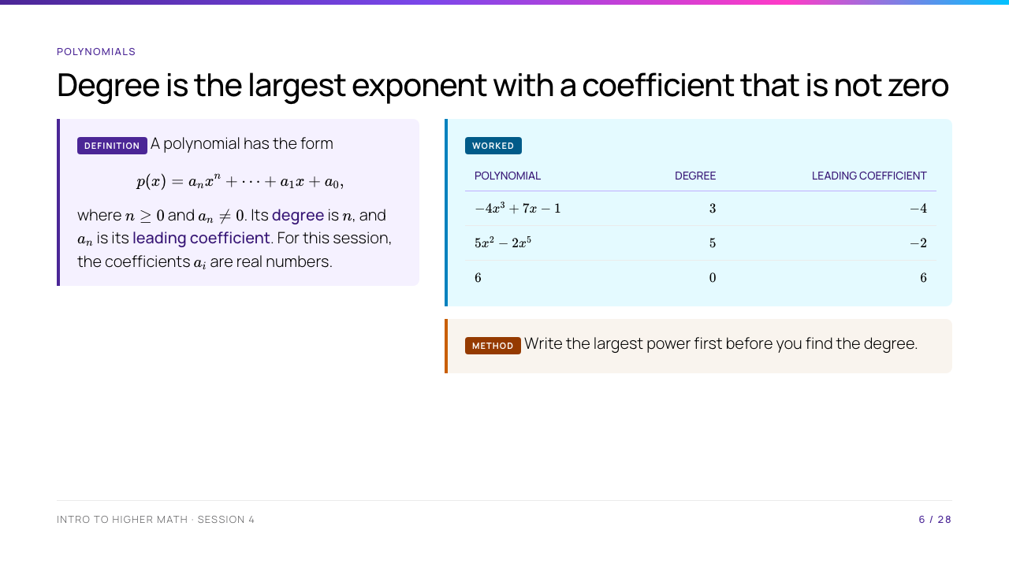
Notes:
Ask why $5x^2-2x^5$ has degree $5$, not $2$: position in the written expression is irrelevant. Mention that terms with coefficient zero are absent. The zero polynomial is excluded because there is no "largest exponent with nonzero coefficient."

Slide 7
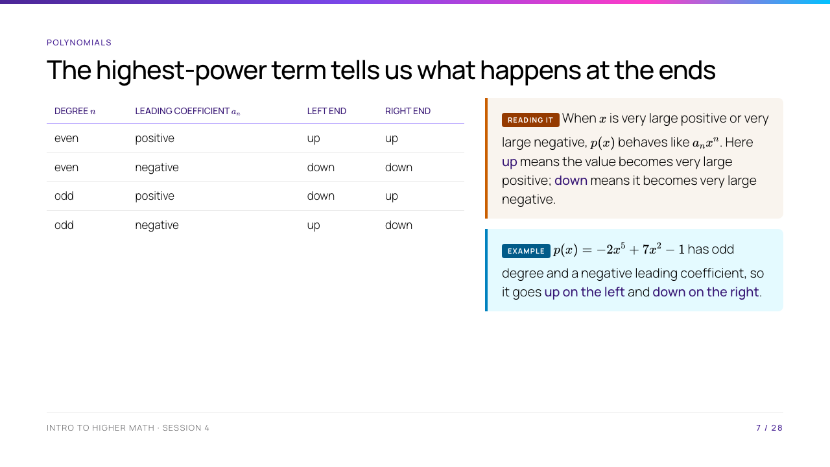
Notes:
"Up" means $p(x)\to+\infty$ and "down" means $p(x)\to-\infty$. Explain "leading term wins" informally: dividing by $x^n$ gives $p(x)/x^n=a_n+a_{n-1}/x+\cdots+a_0/x^n$, and all terms after $a_n$ approach $0$ as $|x|\to\infty$. This is a justification, not a slogan.

Slide 8
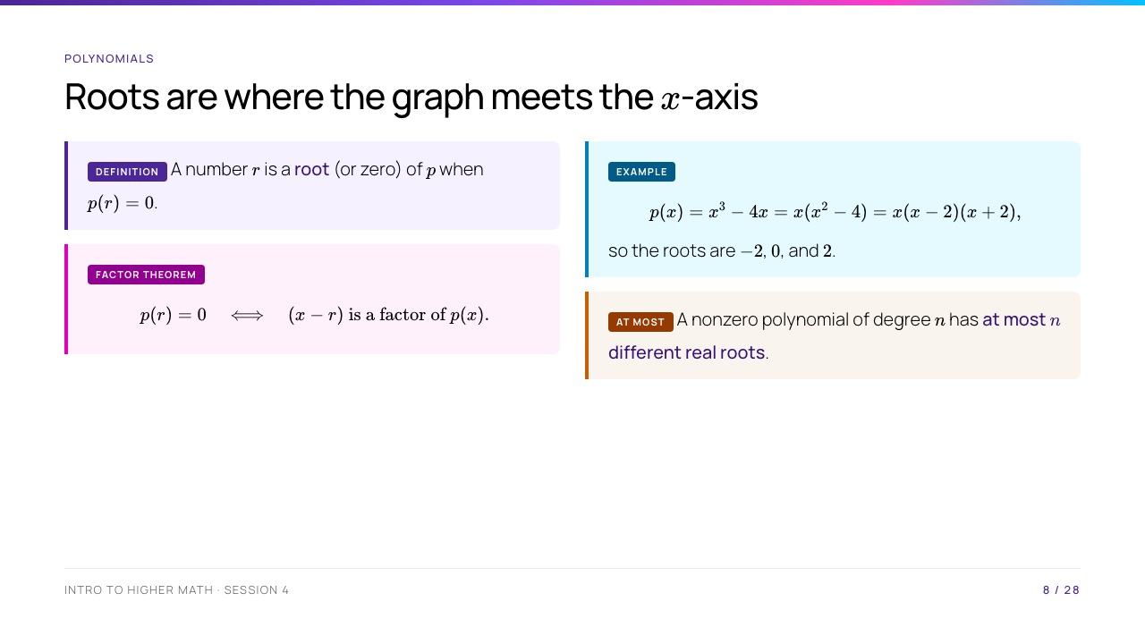
Notes:
Substitute each root: $p(-2)=0$, $p(0)=0$, and $p(2)=0$. The "at most" statement is important: $x^2+1$ has no real roots, while $(x-1)^2$ has one distinct real root but degree $2$. Briefly justify the theorem: each distinct root supplies a distinct linear factor, and a degree-$n$ polynomial cannot contain more than $n$ such factors. A full complex-root statement comes in Session 13.

Slide 9
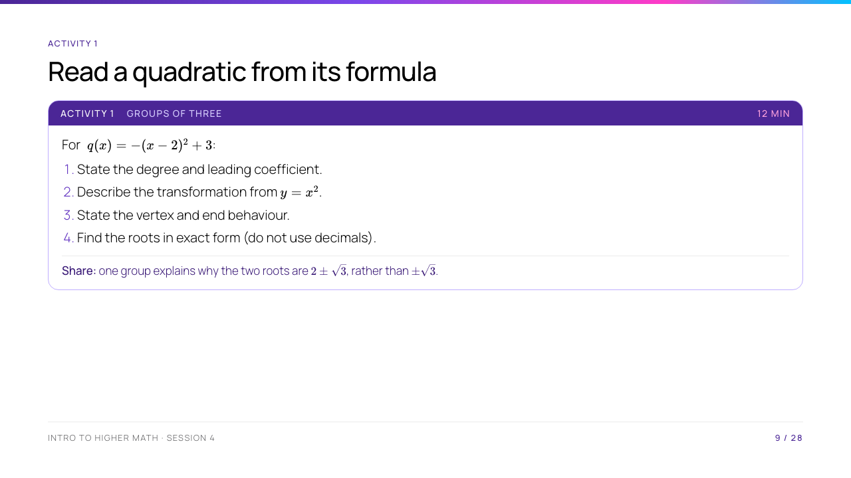
Notes:
Expected answer: degree $2$, leading coefficient $-1$; shift right $2$, up $3$, then reflect vertically; vertex $(2,3)$; both ends down. For roots, $-(x-2)^2+3=0$ is equivalent to $(x-2)^2=3$, then $x-2=\pm\sqrt3$, hence $x=2\pm\sqrt3$. The common mistake in the share prompt drops the horizontal shift.

Slide 10
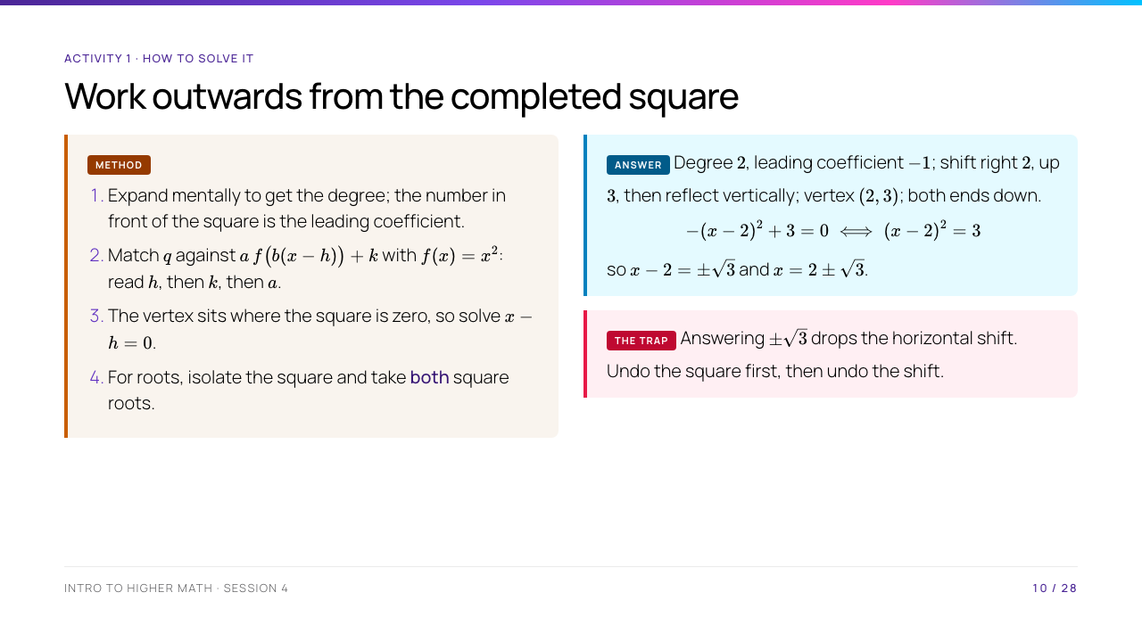
Notes:
Do not put this up until every group has committed to an answer. Walk the four method steps in order and ask which step each group actually skipped — it is almost always step 4. Write $x-2=\pm\sqrt3$ on the board as a single line with two solutions, and say aloud that the $\pm$ is where a solution gets silently lost for the rest of their lives.

Slide 11
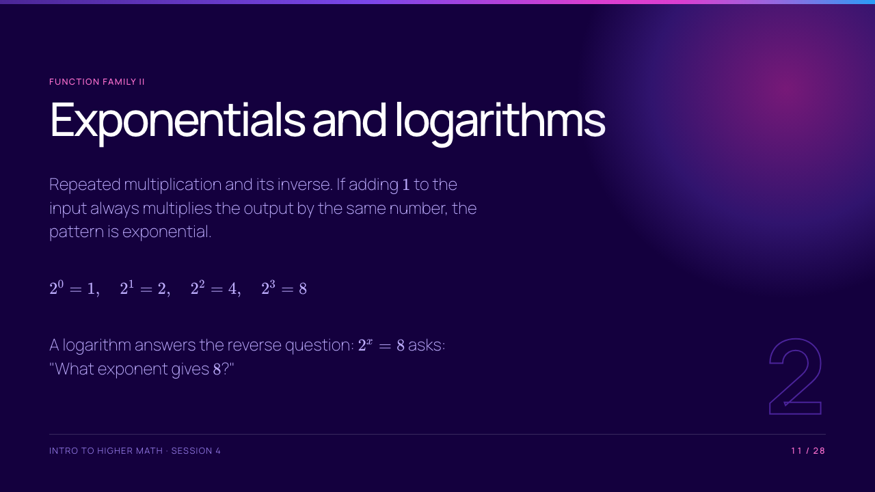
Notes:
This is the break divider. Read the exponent question in words before giving $x=3$. A logarithm is not an arbitrary new operation; it records the exponent in an exponential equation.

Slide 12
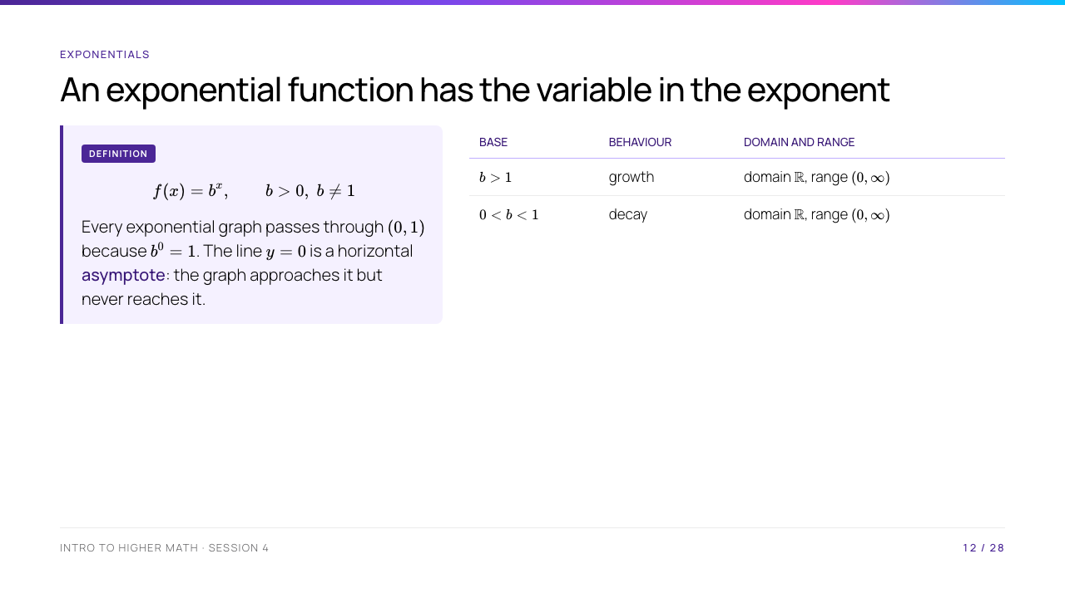
Notes:
Contrast $2^x$ with $x^2$: in an exponential, $x$ is in the exponent. Explain the restrictions: a negative real base does not define a real value for every real exponent, and base $1$ gives a constant function, not growth or decay. "Never reaches $0$" follows from $b^x>0$ for all real $x$ when $b>0$.

Slide 13
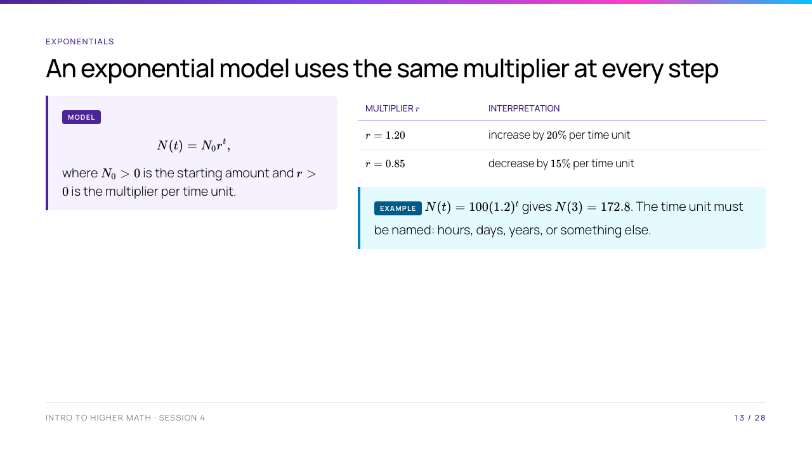
Notes:
Show the multiplication: $100\cdot1.2^3=100\cdot1.728=172.8$. A $20\%$ increase is multiplication by $1+0.20$, while a $15\%$ decrease is multiplication by $1-0.15$. Do not call any steep-looking curve "exponential"; the constant ratio test is the definition in a model.

Slide 14
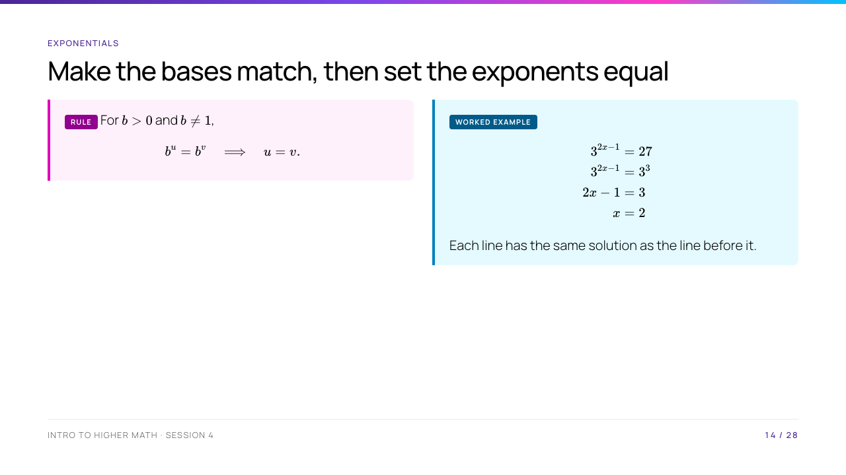
Notes:
State the missing hypothesis before the rule: the base must be positive and different from $1$. Here $27=3^3$, so the exponents may be equated. Confirm by substitution: $3^{2(2)-1}=3^3=27$. For bases that do not conveniently match, logarithms are the next tool.

Slide 15
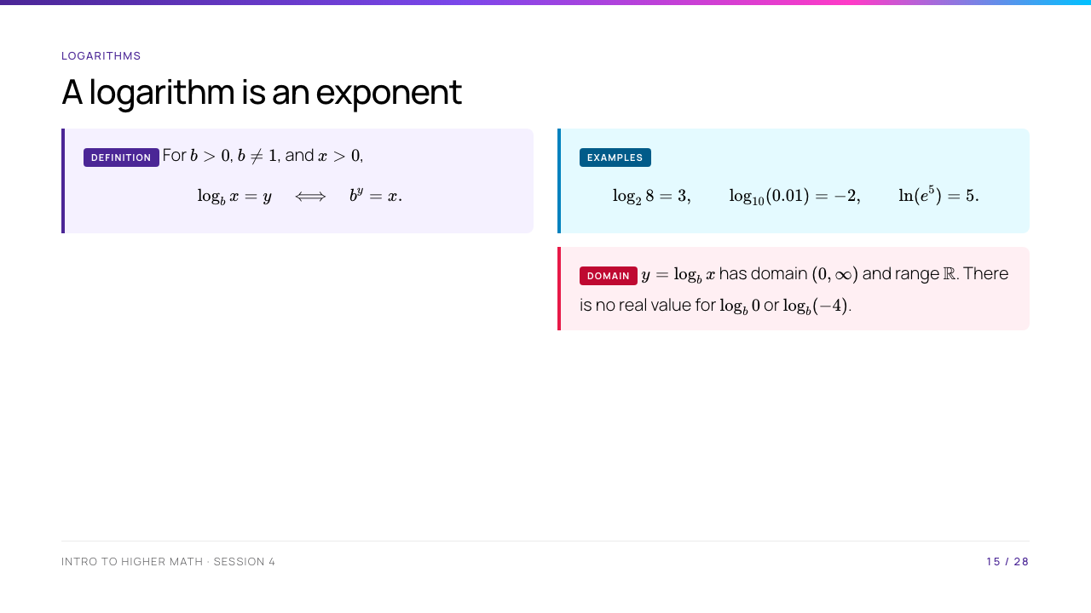
Notes:
Read each example as an exponential equation: $2^3=8$, $10^{-2}=0.01$, and $e^5=e^5$. The domain condition $x>0$ must be said every time a logarithm is introduced. "ln" means logarithm base $e$, where $e\approx2.71828$.

Slide 16
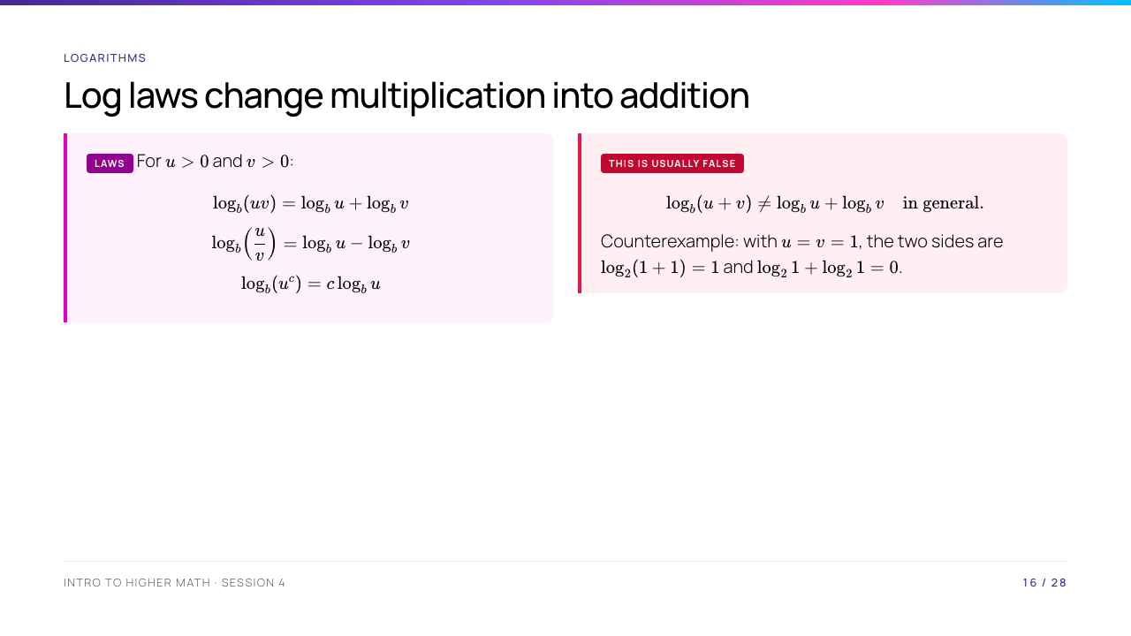
Notes:
The condition $u,v>0$ makes every displayed logarithm real. The product law follows directly from exponents: if $u=b^r$ and $v=b^s$, then $uv=b^{r+s}$.

Slide 17
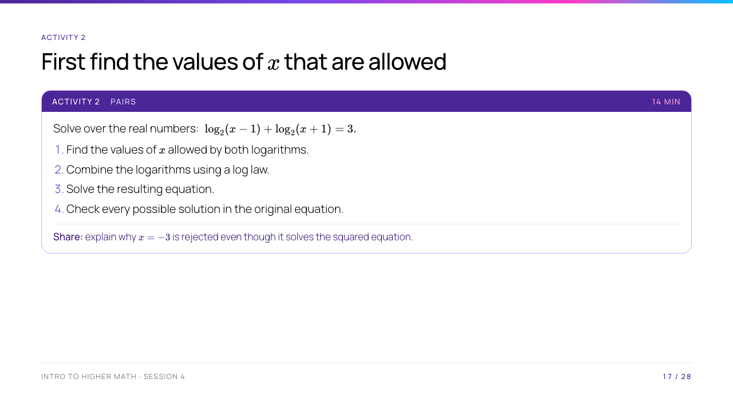
Notes:
Domain: $x-1>0$ and $x+1>0$, so $x>1$. Then $\log_2((x-1)(x+1))=3$, so $x^2-1=8$, then $x^2=9$ and $x=\pm3$. The original domain retains only $x=3$. Check: $\log_2 2+\log_2 4=1+2=3$. This activity makes the log-domain condition operational rather than decorative.

Slide 18
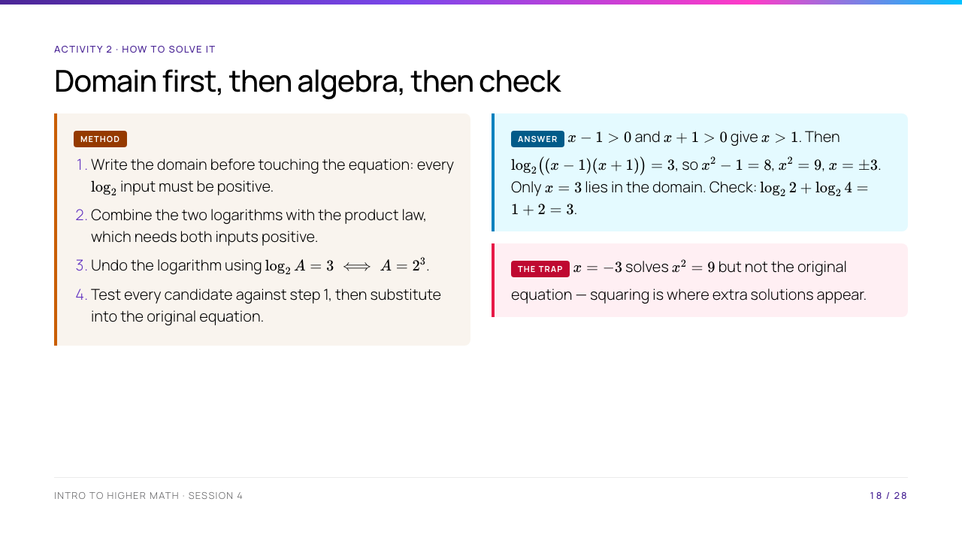
Notes:
The whole activity exists to make step 1 a habit rather than a decoration. Ask who wrote the domain down before solving; usually very few. Point out that step 3 is legal only because step 1 guaranteed the inputs are positive, and that step 4 is not optional politeness — the algebra in step 3 genuinely produces a value that is not a solution.

Slide 19
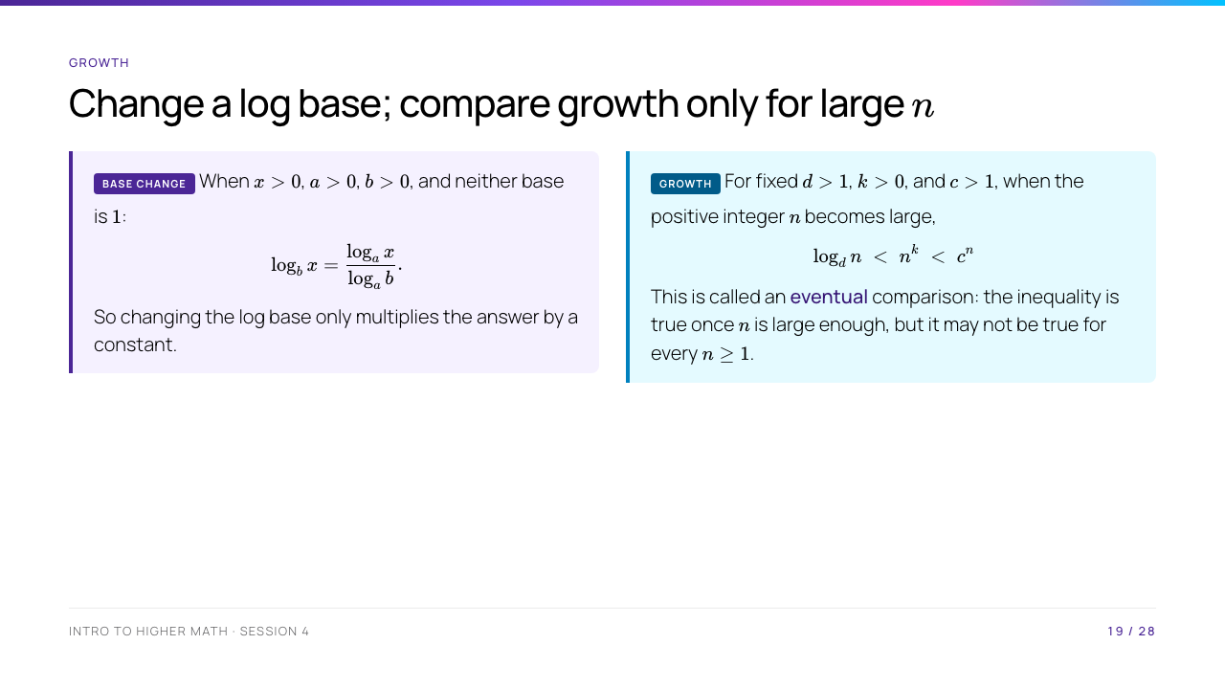
Notes:
For base change, choose $a=e$ in practice: $\log_bx=\ln x/\ln b$. The growth statement assumes any fixed logarithm base greater than $1$; bases between $0$ and $1$ give negative logarithms for $n>1$ and are not the intended growth convention. Give a finite comparison: $2^3=8<3^2=9$, but $2^{10}=1024>10^2=100$. We use the formal notation $\log n=o(n^k)$ and $n^k=o(c^n)$ only as optional vocabulary, not as required knowledge.

Slide 20
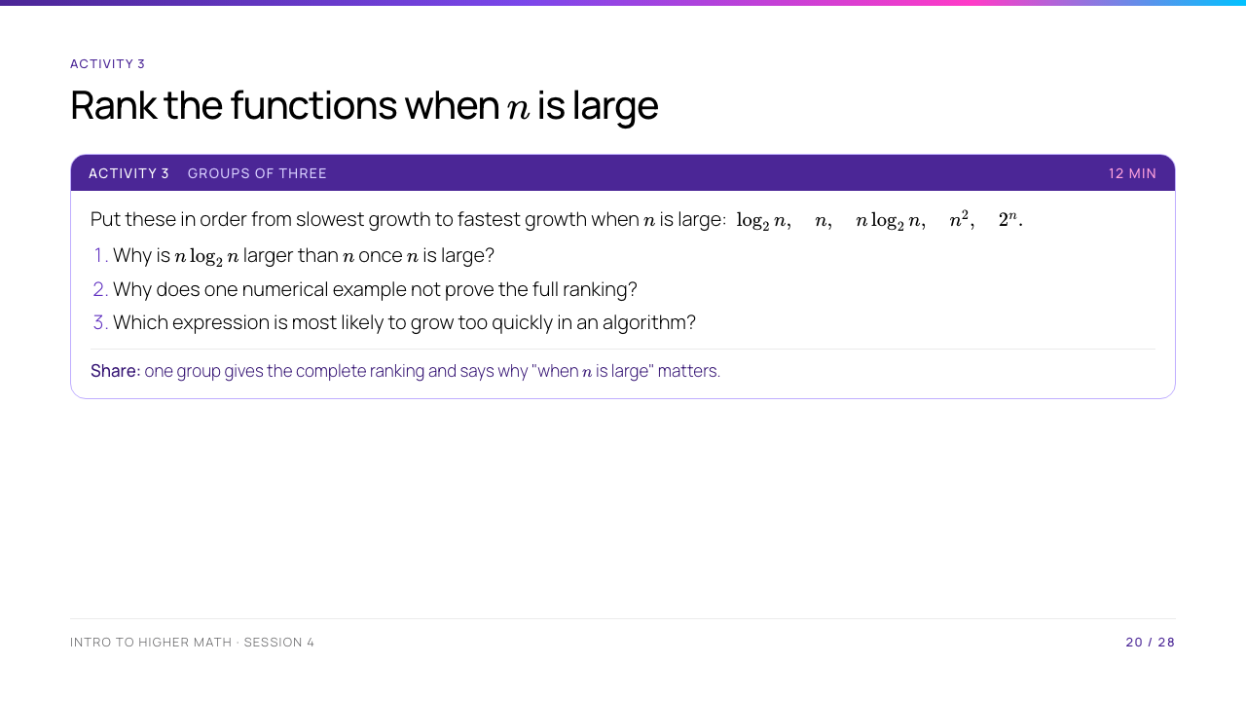
Notes:
Ranking: $\log_2n<n<n\log_2n<n^2<2^n$ eventually. For $n>2$, $\log_2n>1$, so $n\log_2n>n$. The step $n\log n<n^2$ eventually follows from $\log n<n$ eventually. The exponential term is the dangerous one for large inputs, but remind students that implementation constants and input size still matter in real computing.

Slide 21
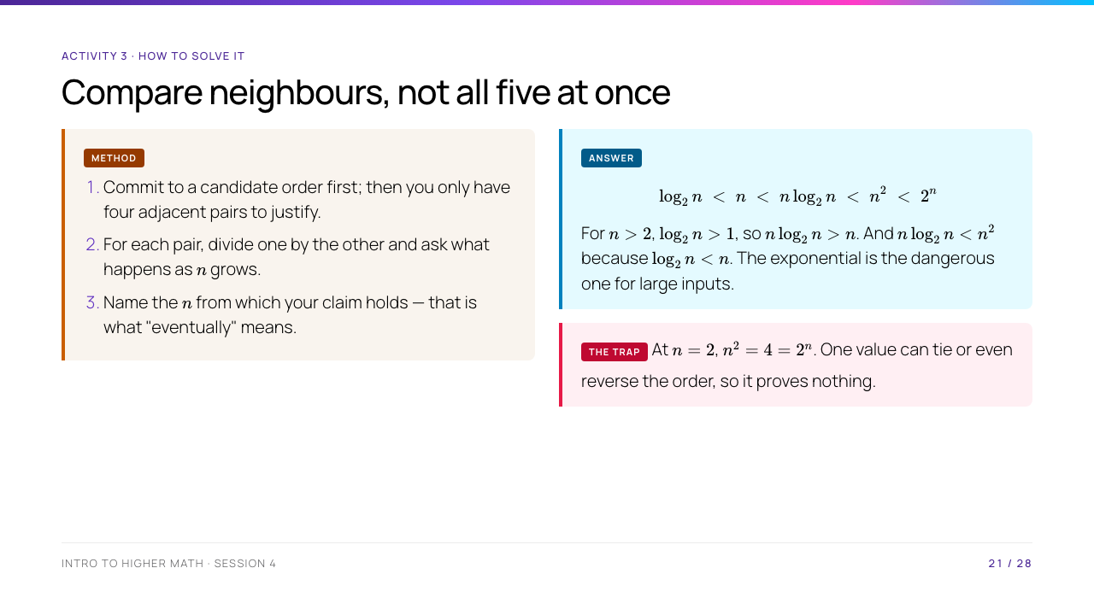
Notes:
Step 2 is the transferable skill: dividing $n\log_2 n$ by $n$ leaves $\log_2 n$, and asking whether that exceeds $1$ settles the pair immediately. Take question 3 seriously in discussion — $2^n$ is the dangerous term, but remind them that implementation constants and input size still matter in real computing, so "asymptotically worse" is not the same as "slower on your laptop today".

Slide 22
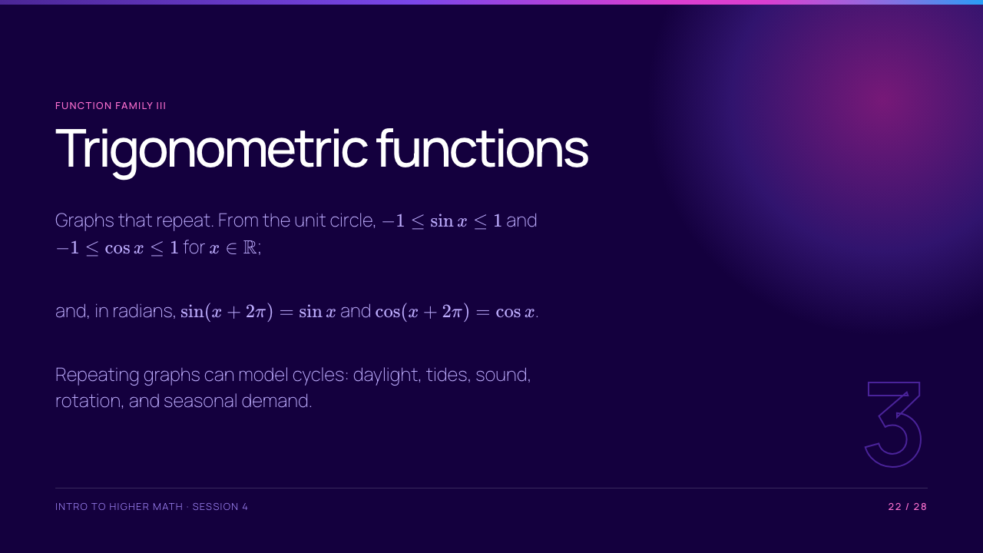
Notes:
Session 3 introduced sine and cosine on the unit circle. Here the focus is graph structure and modelling. "Period $2\pi$" means $2\pi$ is the smallest positive period for sine and cosine; the displayed equations only establish that it is a period, so state the smallest-period claim verbally or prove it from one complete unit-circle turn.

Slide 23
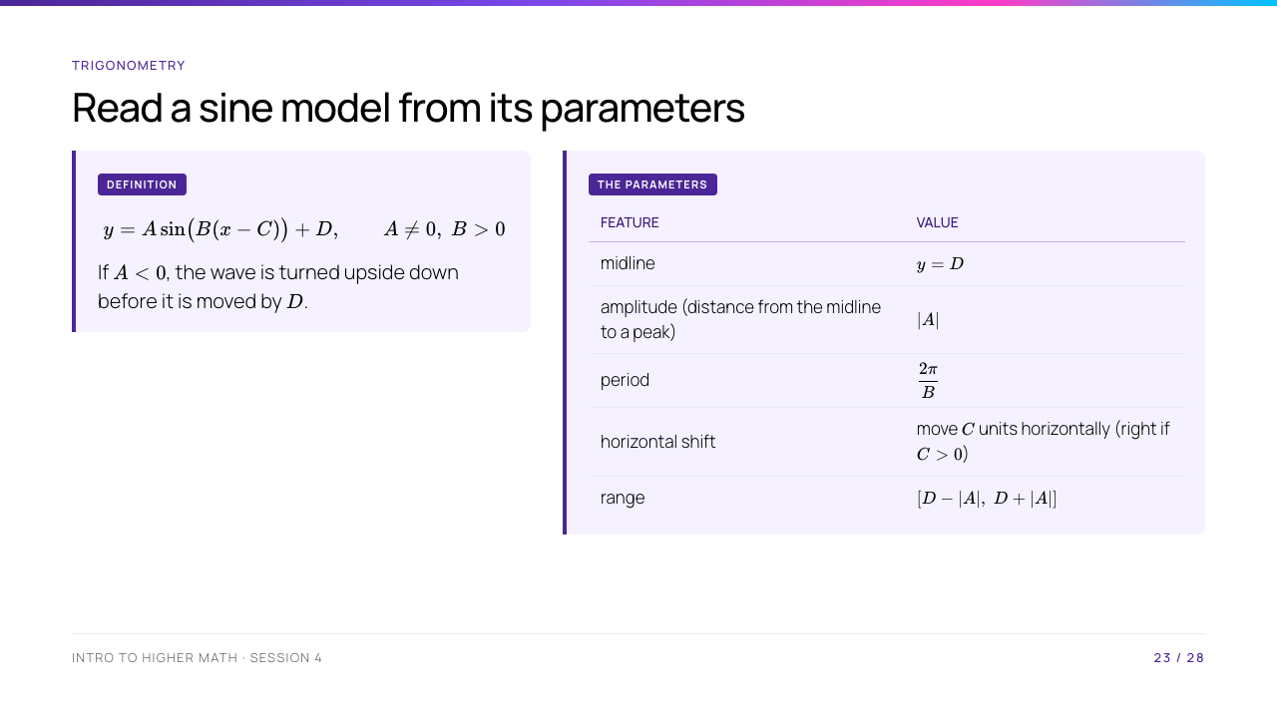
Notes:
Explain that amplitude is a nonnegative distance from the midline to a peak, so it is $|A|$, not $A$. The period calculation comes from demanding that the input to sine increase by $2\pi$: $B\Delta x=2\pi$, hence $\Delta x=2\pi/B$. The formula is also valid for cosine, with the same parameter meanings but a different starting shape.

Slide 24
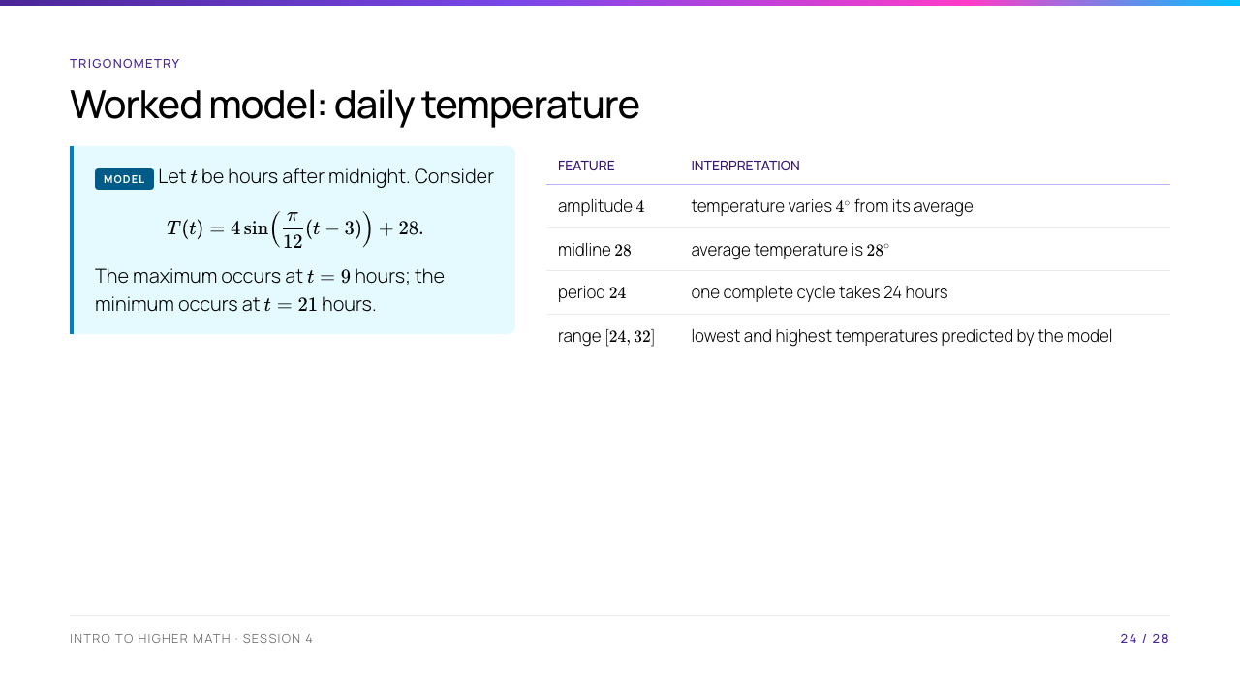
Notes:
Period: $2\pi/(\pi/12)=24$. For a maximum, sine must be $1$: $(\pi/12)(t-3)=\pi/2+2\pi k$, so $t=9+24k$; in one day $t=9$. For a minimum, use $3\pi/2+2\pi k$, giving $t=21+24k$. Make clear that the model's numerical values are illustrative, not a claim about every city or every day.

Slide 25
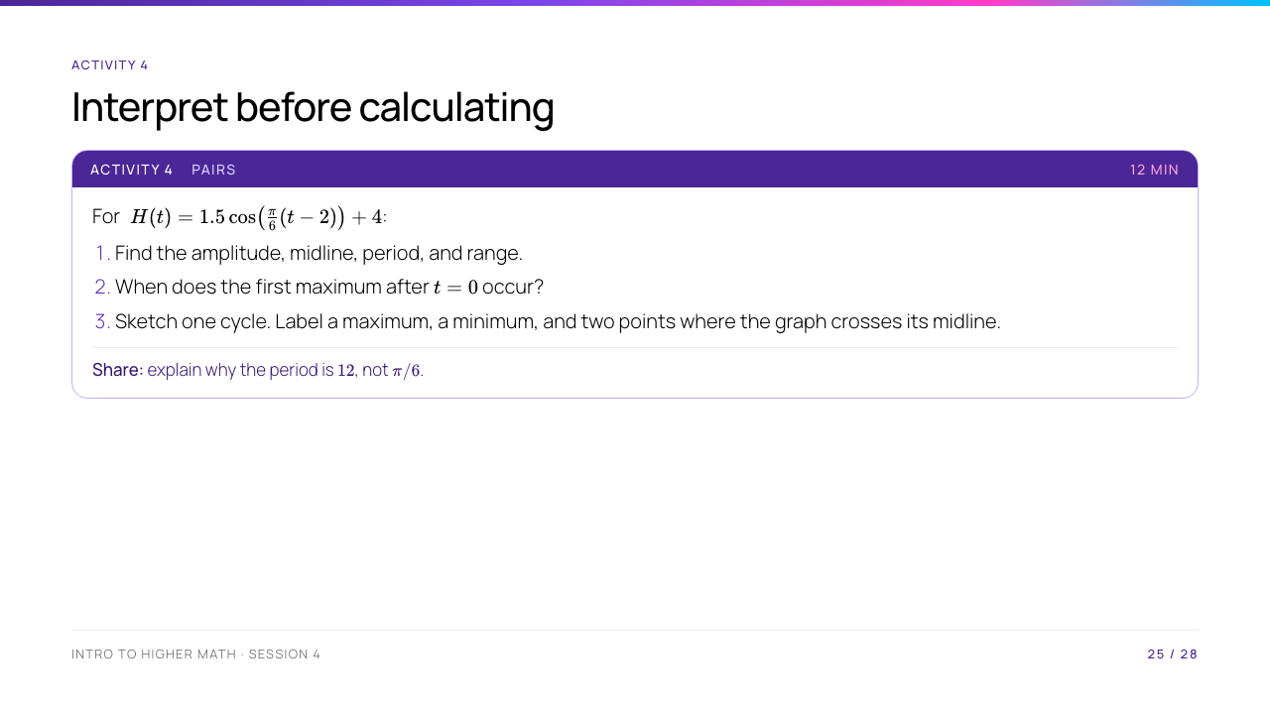
Notes:
Amplitude $1.5$, midline $y=4$, period $2\pi/(\pi/6)=12$, range $[2.5,5.5]$. Cosine reaches a maximum when its input is $0+2\pi k$, so $t=2+12k$; the first one after $t=0$ is $t=2$. One cycle can run from $t=2$ to $t=14$: maximum $(2,5.5)$, midline crossings $(5,4)$ and $(11,4)$, minimum $(8,2.5)$, and next maximum $(14,5.5)$.

Slide 26
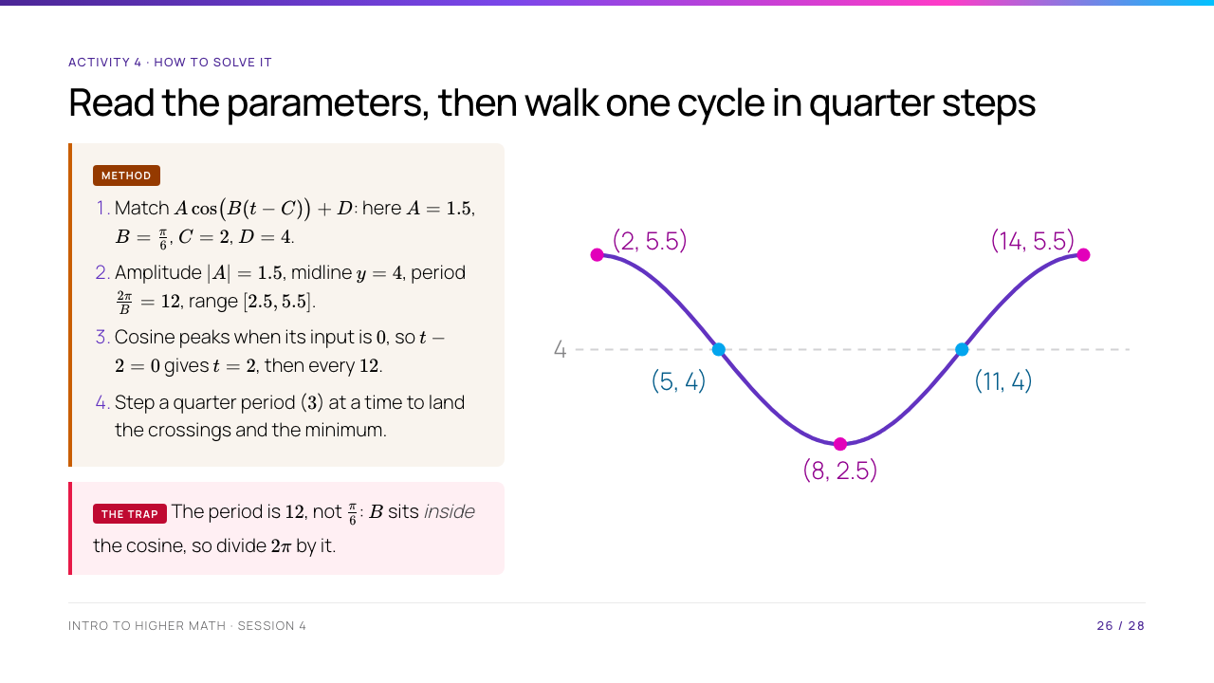
Notes:
Amplitude $1.5$, midline $y=4$, period $2\pi/(\pi/6)=12$, range $[2.5,5.5]$. Cosine reaches a maximum when its input is $0+2\pi k$, so $t=2+12k$; the first one after $t=0$ is $t=2$. One cycle can run from $t=2$ to $t=14$: maximum $(2,5.5)$, midline crossings $(5,4)$ and $(11,4)$, minimum $(8,2.5)$, and next maximum $(14,5.5)$. Show the sketch only after pairs have drawn their own, and make them check the five labelled points against what they drew.

Slide 27
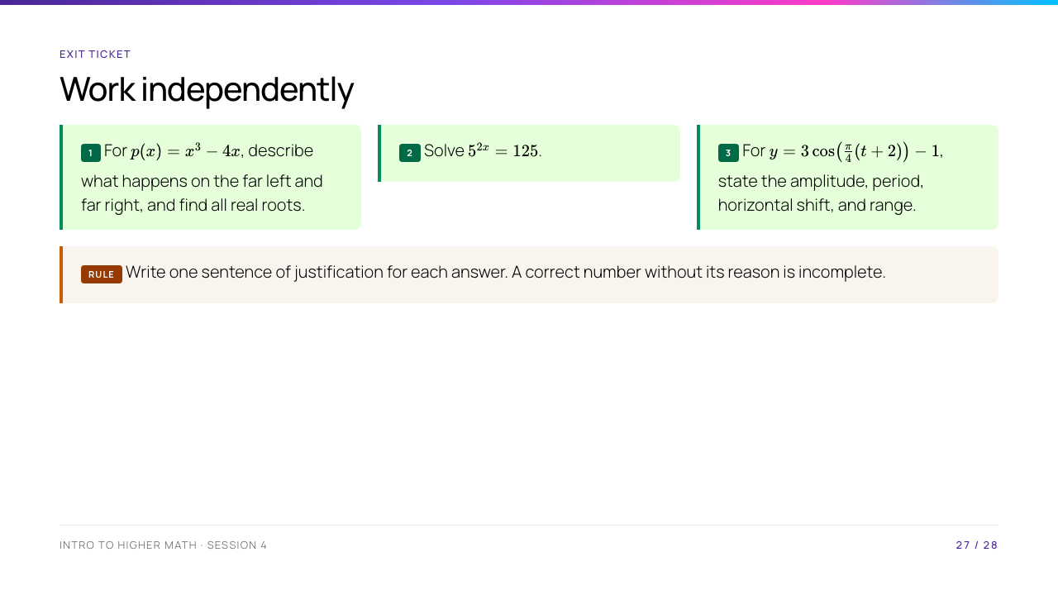
Notes:
1. $x^3-4x=x(x-2)(x+2)$, so roots $-2,0,2$; odd degree with positive leading coefficient means down on the left and up on the right. 2. $125=5^3$, so $2x=3$ and $x=3/2$. 3. Amplitude $3$; period $2\pi/(\pi/4)=8$; $t+2=t-(-2)$ means shift left $2$; range $[-4,2]$. Collect or photograph this as a quick check of where to begin next class.

Slide 28
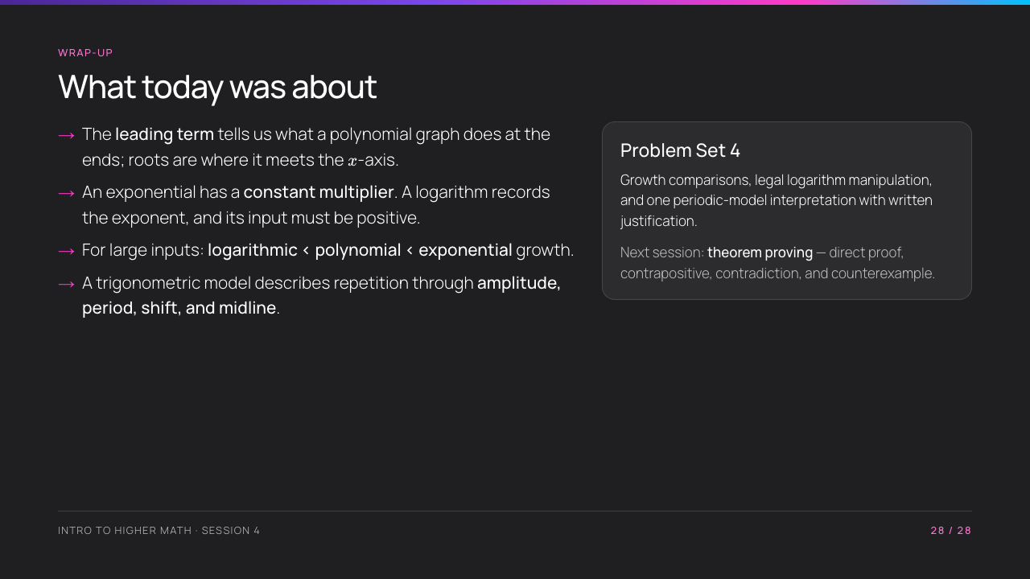
Notes:
Finish by asking students to name one condition they must not omit: $b>0$, $b\ne1$, positive log input, or "eventually" in a growth statement. Preview that the next session asks them to justify claims like the ones made today, rather than merely use them.

