Slide 1
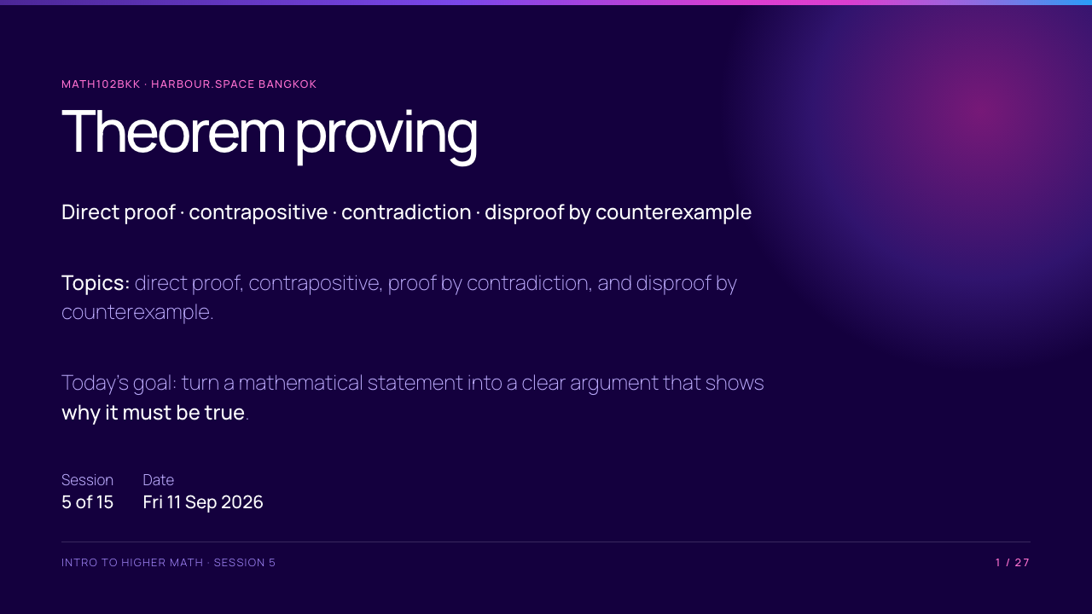
Notes:
Set the tone: an answer is not yet a proof. In this session, students learn a small number of dependable proof structures and practise choosing between them.

Slide 2
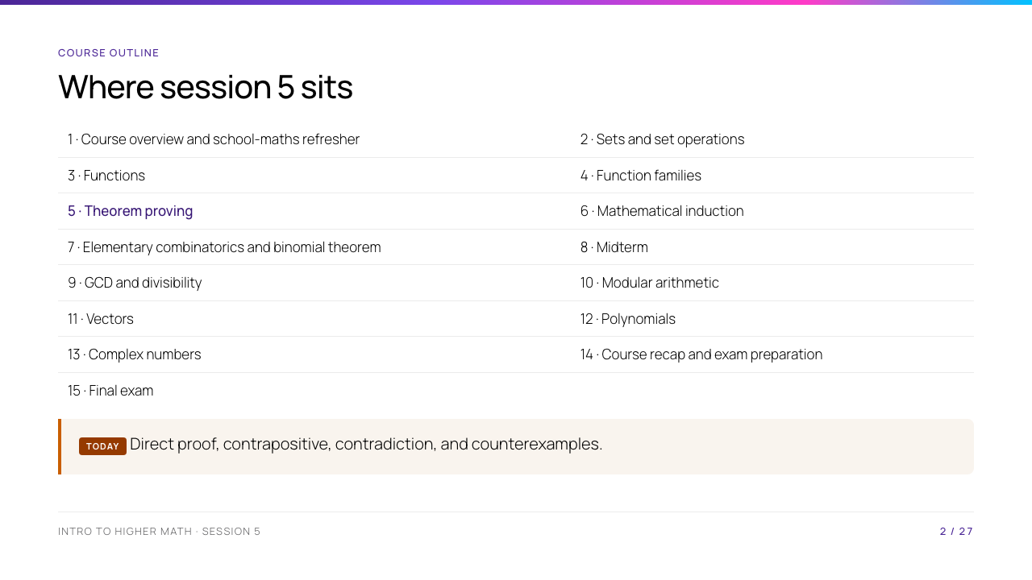
Notes:
Session 5 is the course pivot. Sets and functions supplied precise language; today students use that language to justify claims. Session 6 turns one of these proof ideas into a method for infinitely many cases.

Slide 3
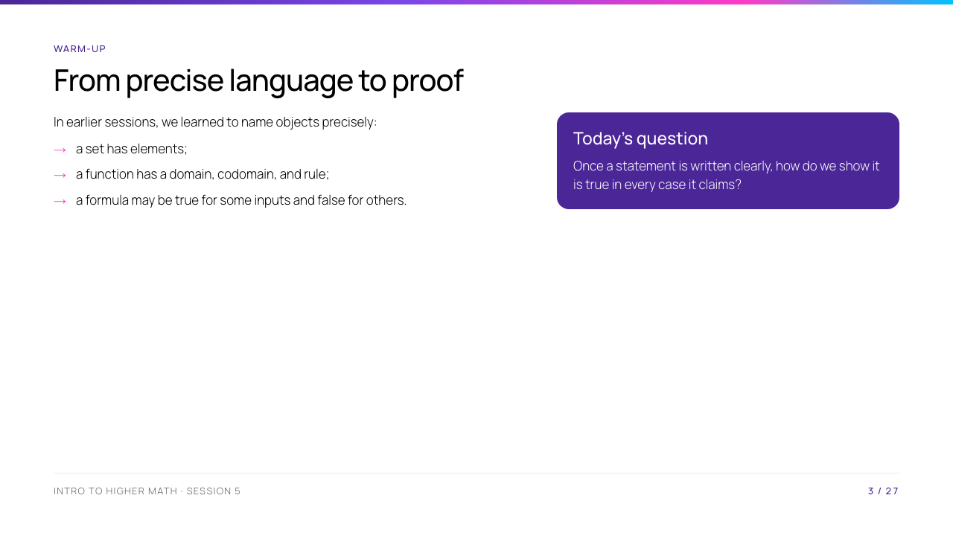
Notes:
Ask students for the difference between checking three examples and proving a statement. Accept the idea that examples can suggest a pattern, but the proof must cover every allowed case.

Slide 4
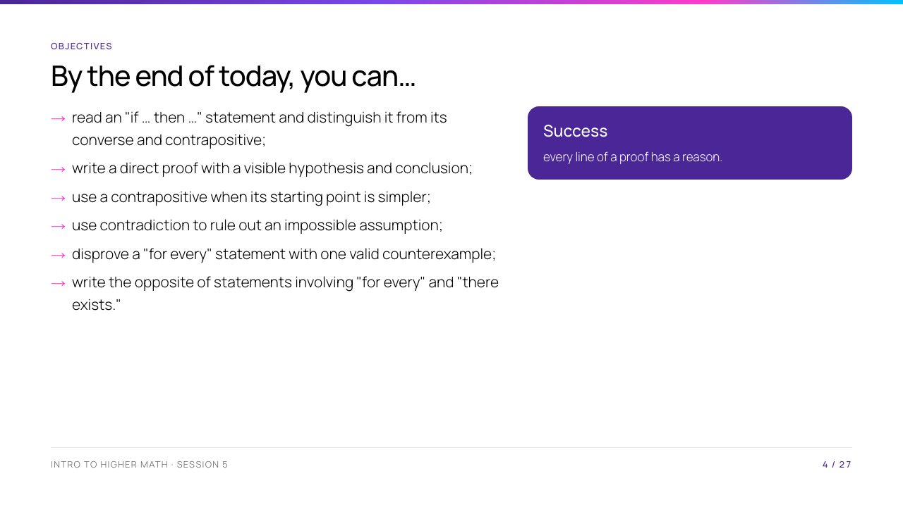
Notes:
Explain that students do not need to memorise a proof word for word. They need to recognise the shape of the argument and explain why each line follows.

Slide 5
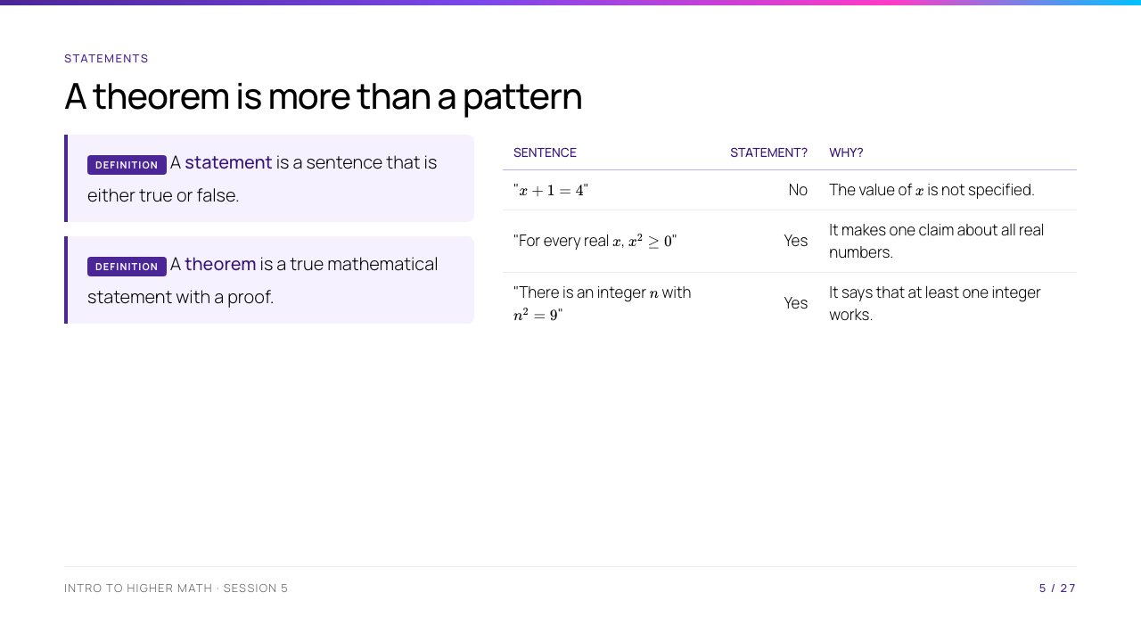
Notes:
Read the quantifiers in ordinary English. For the last row, ask for a witness such as $n=3$ or $n=-3$. Do not present a proof of $x^2\geq0$ here; it is used as a familiar fact about real numbers.

Slide 6
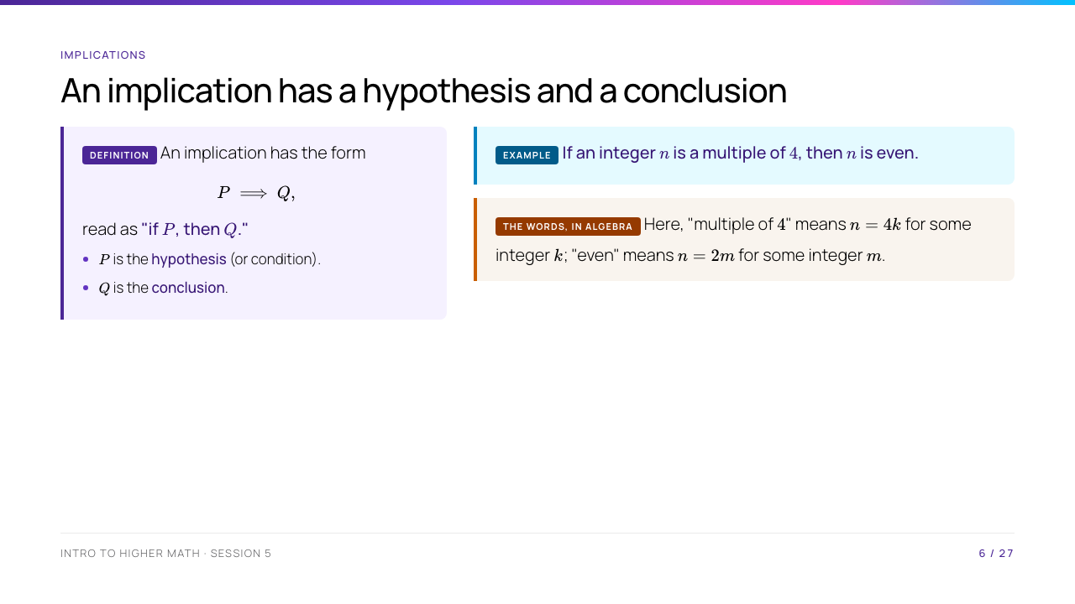
Notes:
Ask students to identify $P$ and $Q$ in the example. The definitions at the bottom prepare a direct proof without using unfamiliar divisibility notation.

Slide 7
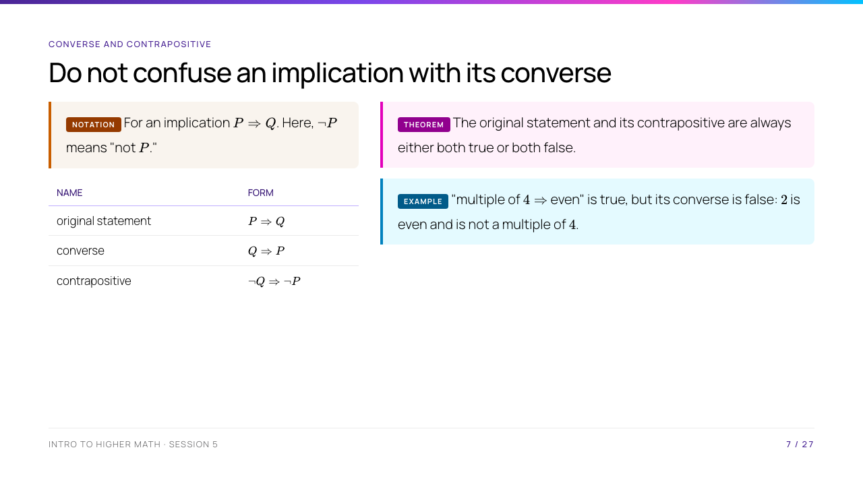
Notes:
The counterexample $2$ is enough because the converse makes a claim about every even integer. Leave the inverse form for a later logic course; it is not needed for today's proof methods.

Slide 8
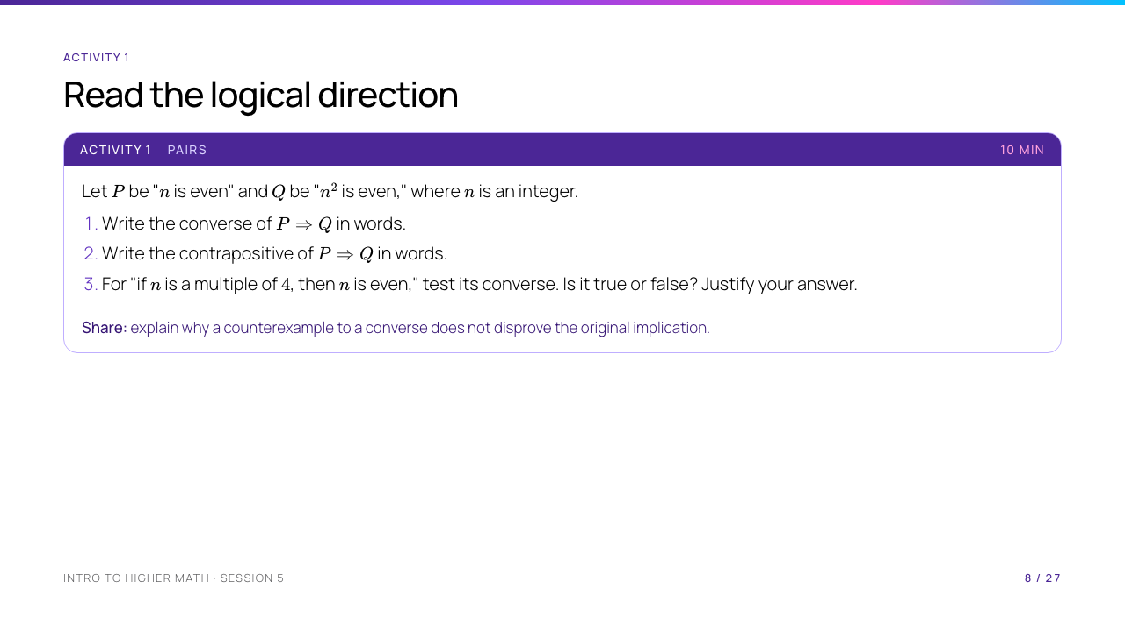
Notes:
Pairs should write complete sentences, not only symbols. Encourage them to keep $P$ and $Q$ visible while reversing and negating them.

Slide 9
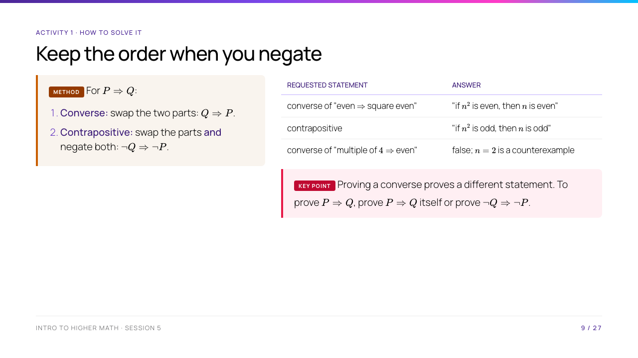
Notes:
Reveal the answers only after pairs have committed. "Not even" and "odd" are equivalent for integers; say that this equivalence is special to integers, not to all number systems.

Slide 10
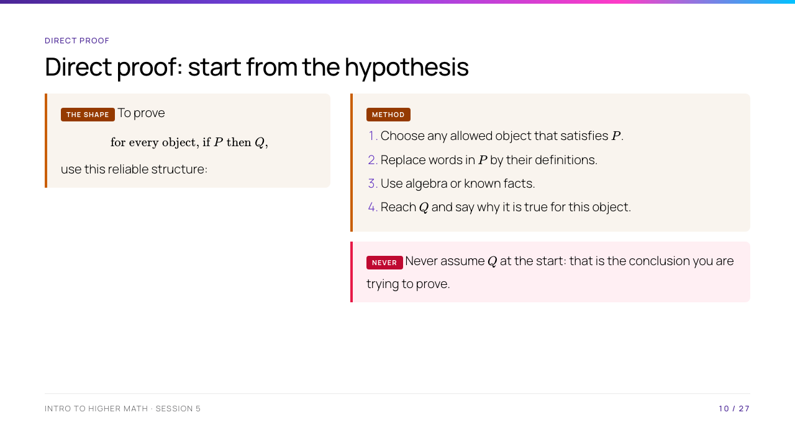
Notes:
The word "arbitrary" is essential: a proof about every integer cannot secretly choose a convenient integer. Point out that definitions turn informal labels such as "even" into algebra that can be used.

Slide 11
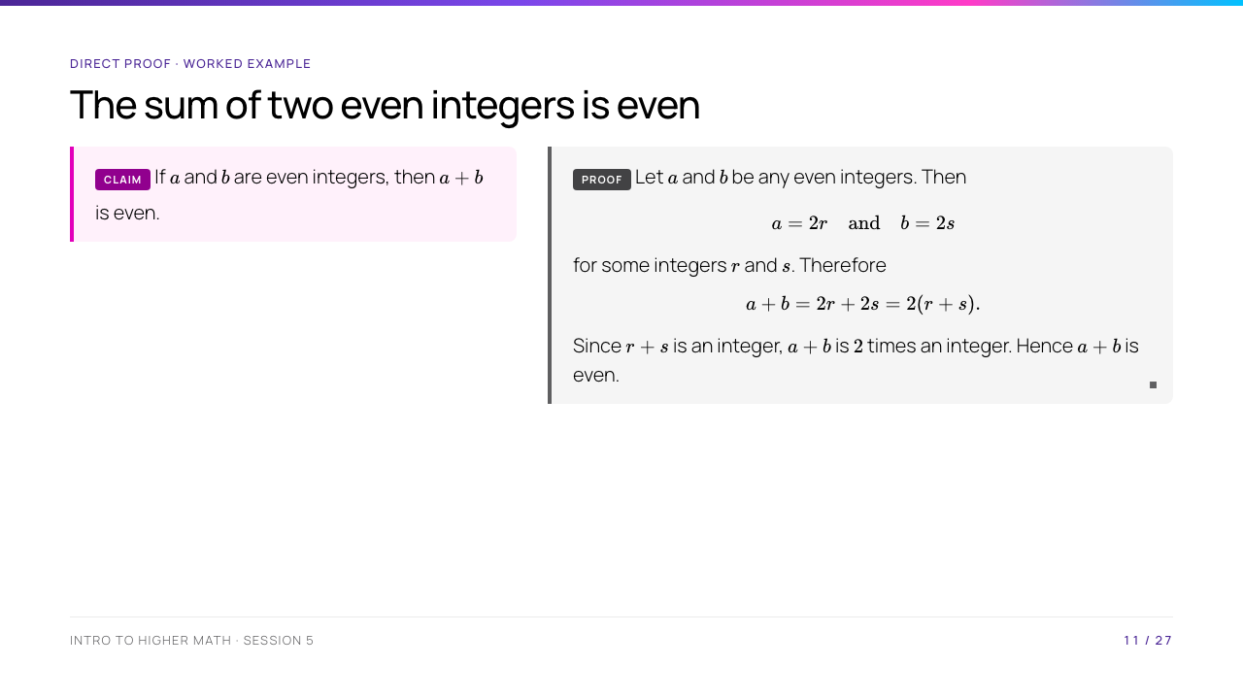
Notes:
Trace the proof's shape: the hypothesis supplies $a=2r$ and $b=2s$; the calculation produces the definition of "even" for $a+b$. The sentence "$r+s$ is an integer" closes a common hidden gap.

Slide 12
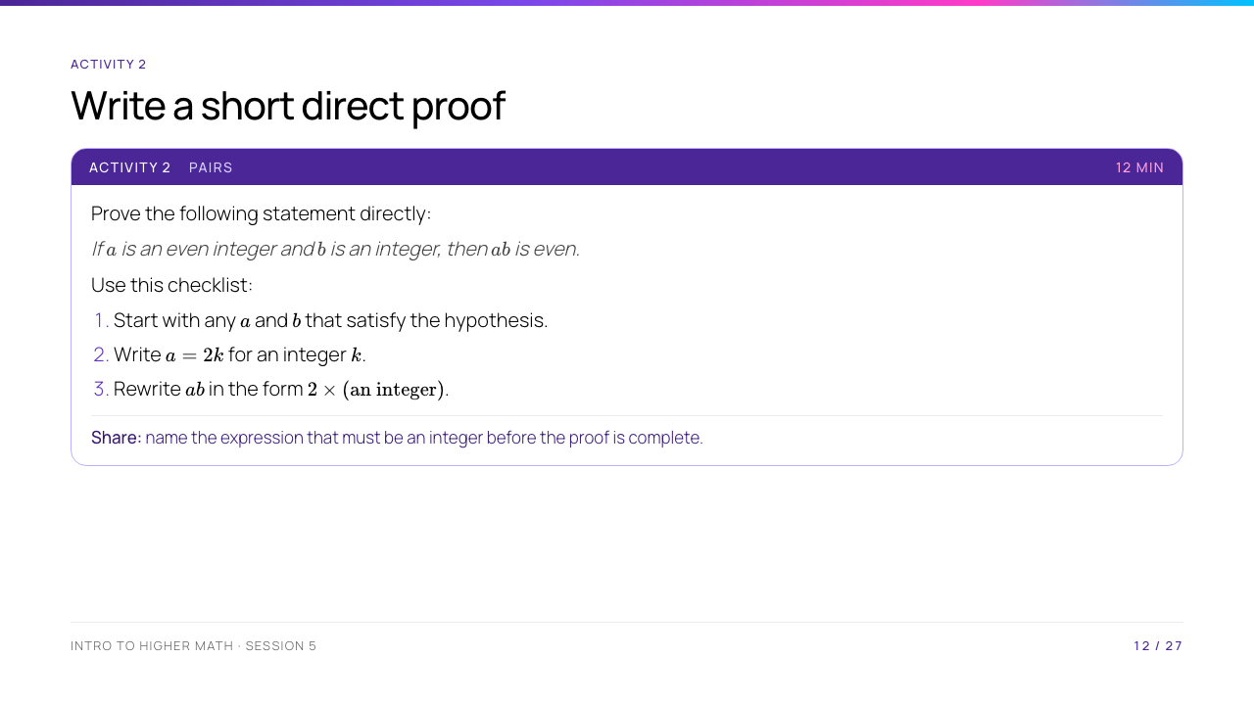
Notes:
Do not give the answer immediately. If a pair writes $a=2k$ but does not say $k\in\mathbb Z$, prompt them to make the definition explicit.

Slide 13
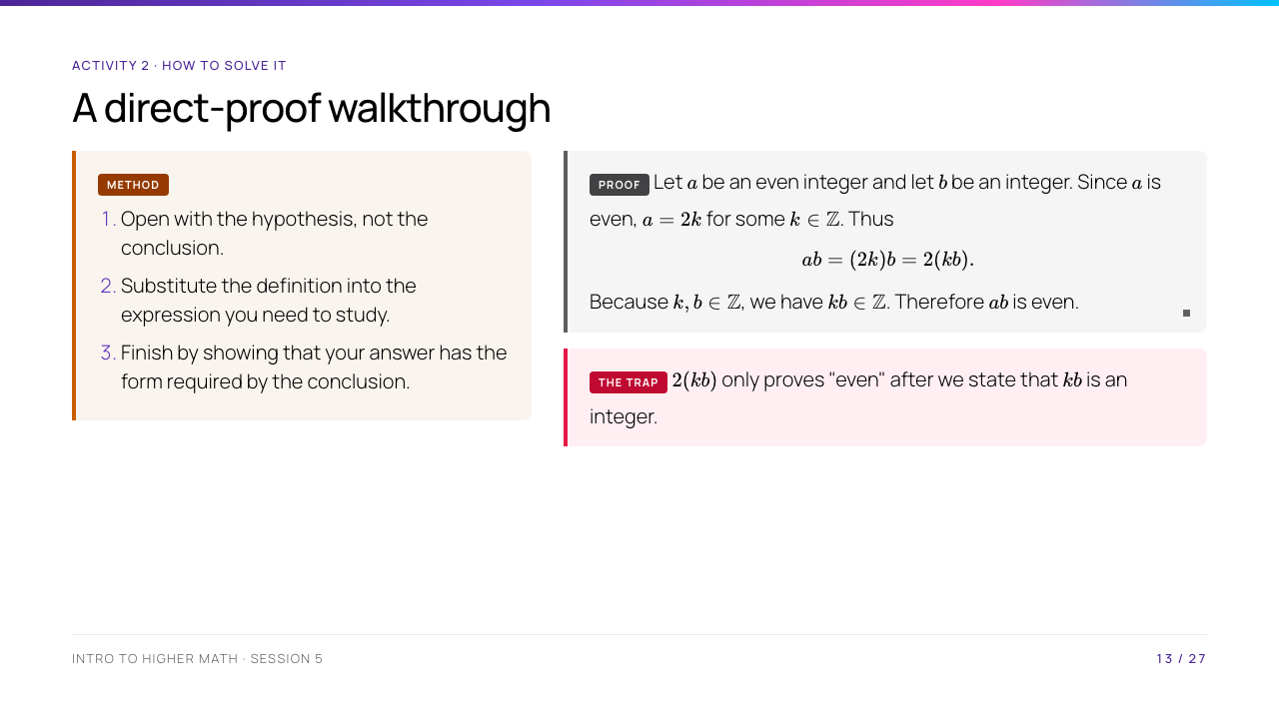
Notes:
Ask one pair to identify the exact line that uses the hypothesis. Emphasise that the proof works for every integer $b$, including negative values and zero.

Slide 14
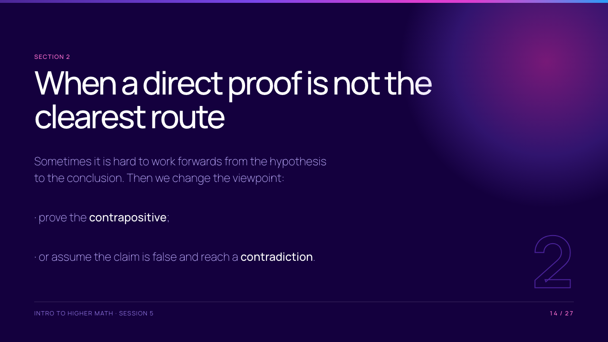
Notes:
Take the scheduled break before this section. On return, connect the new methods to the same goal: make an implication unavoidable.

Slide 15
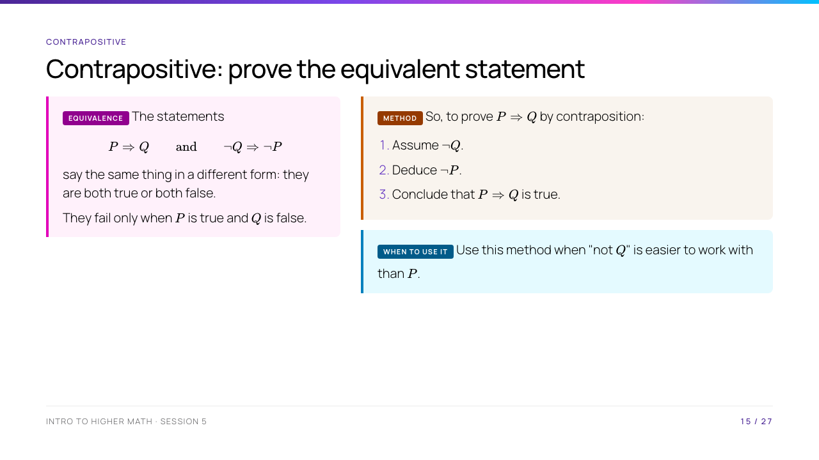
Notes:
The "same failure situation" is a compact proof of the equivalence: the contrapositive fails when $\neg Q$ is true and $\neg P$ is false, which means $Q$ is false and $P$ is true. Do not call contraposition a trick; it is an equivalence.

Slide 16
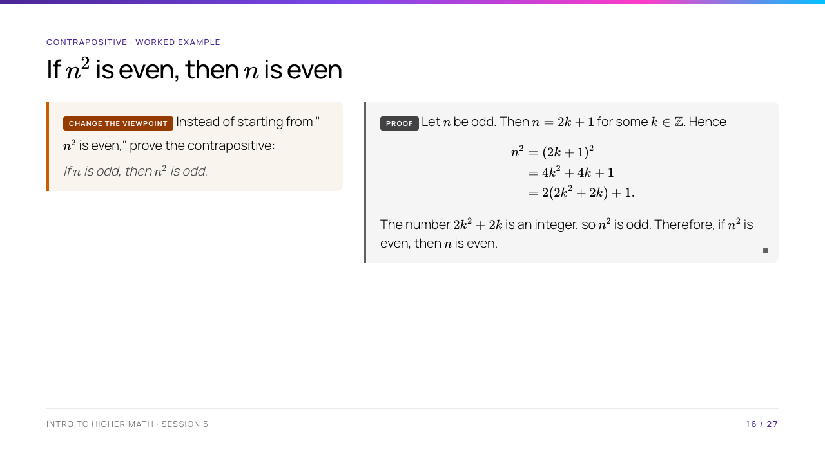
Notes:
Define odd as "$2k+1$ for an integer $k$." The last sentence is not a new, unsupported jump: it uses the logical equivalence on the previous slide.

Slide 17
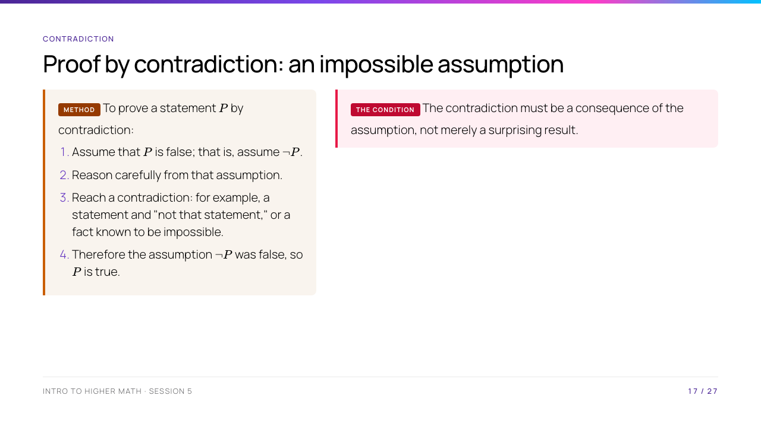
Notes:
Point out the difference between a contradiction proof and an invalid proof that quietly assumes two incompatible things. The goal is to show that the chosen negation cannot occur.

Slide 18
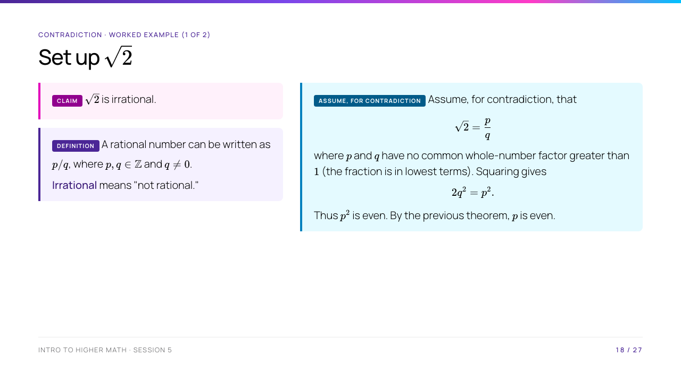
Notes:
Explain why squaring is legal: both sides of $\sqrt2=p/q$ are equal, so their squares are equal. The "lowest terms" condition is the fact we will contradict; students should see it before the algebra begins.

Slide 19
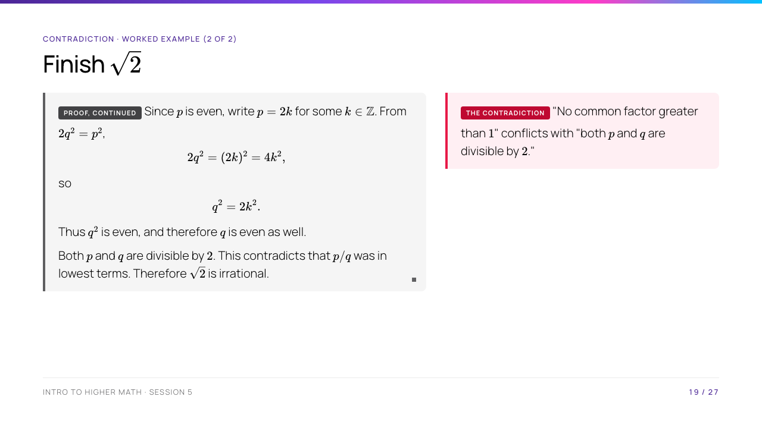
Notes:
Make the contradiction explicit: "no common factor greater than $1$" conflicts with "both are divisible by $2$." The proof uses the contrapositive theorem twice; this shows that proof methods can support each other.

Slide 20
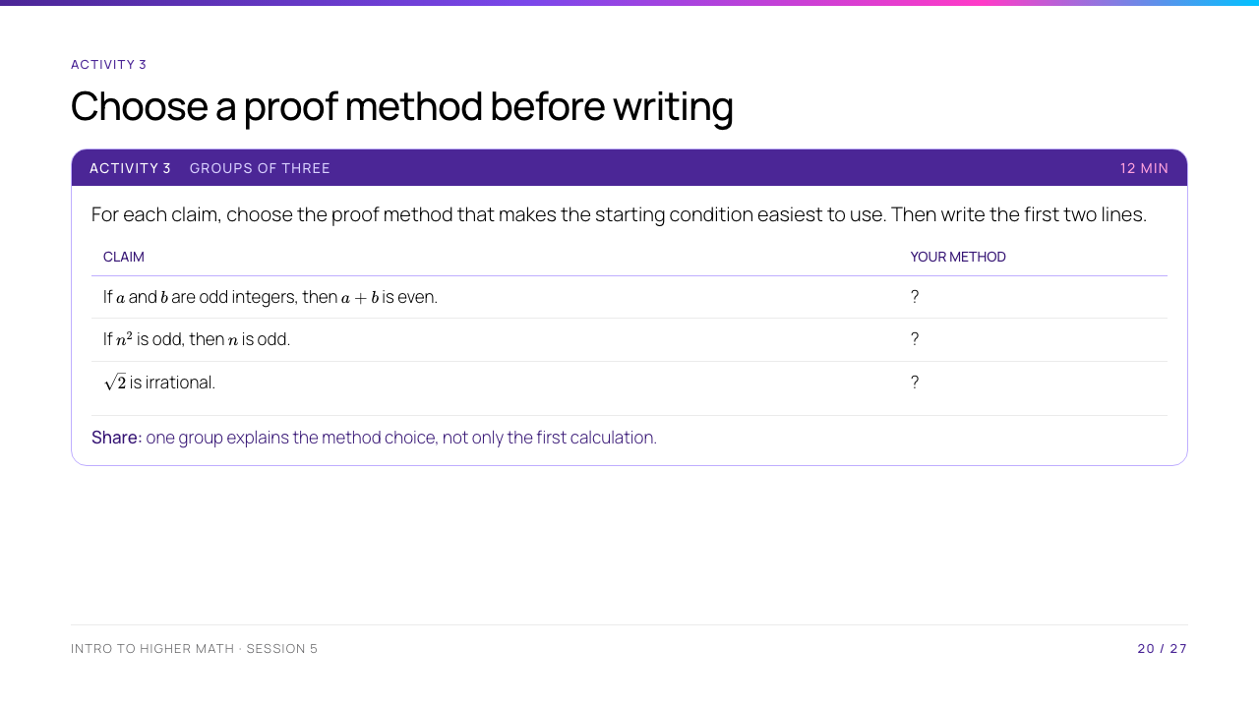
Notes:
Explain that more than one method can sometimes work; students should select the method that makes the hypothesis usable. The expected choices are direct proof, contrapositive, and contradiction respectively.

Slide 21
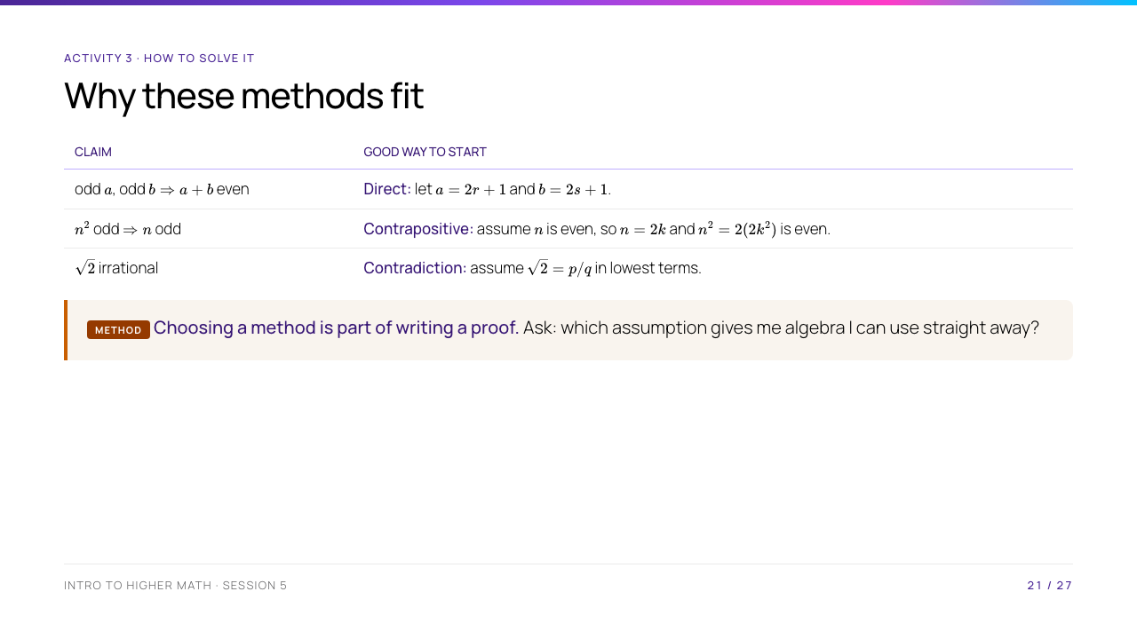
Notes:
For the first row, invite the room to finish: $a+b=2(r+s+1)$. For the second, point out that the contrapositive does not require expanding an odd square. For the third, state that the rest of the proof was just completed.

Slide 22
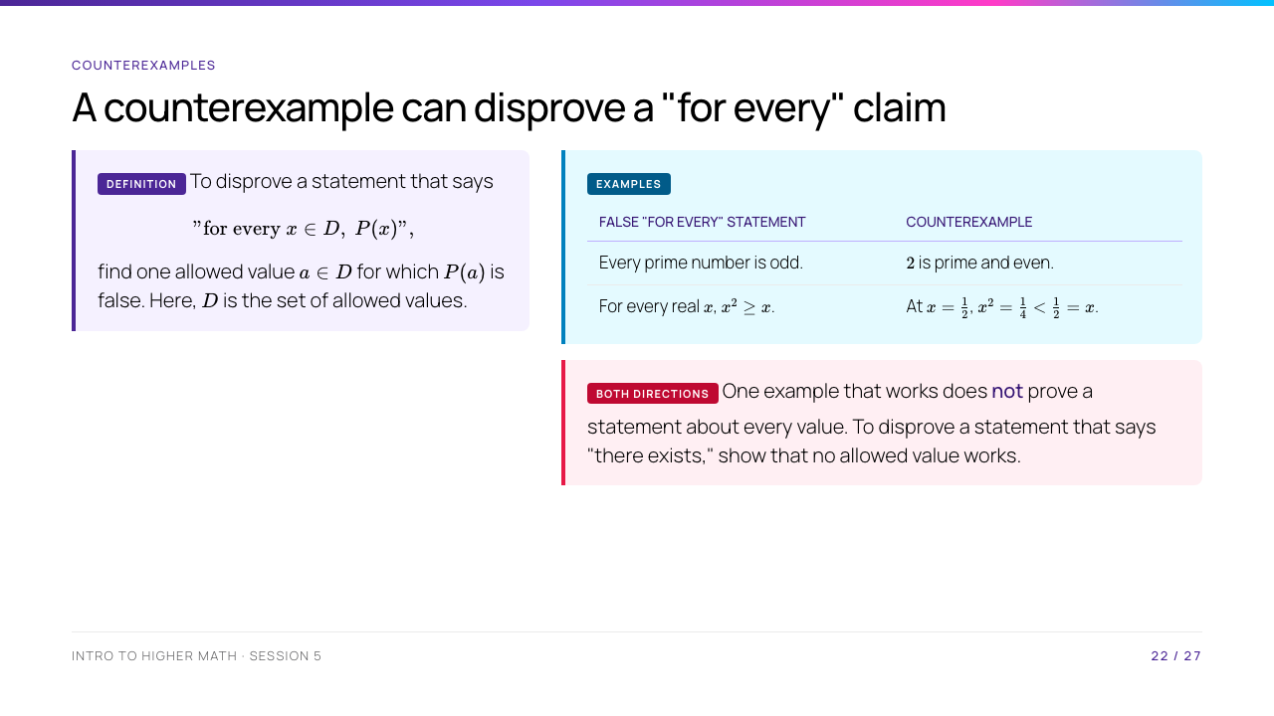
Notes:
Read the domain carefully before accepting a counterexample. For example, $x=-1$ would not disprove a claim only about positive real numbers. Contrast the two directions of quantifiers: one witness disproves "for every," but does not disprove "there exists."

Slide 23
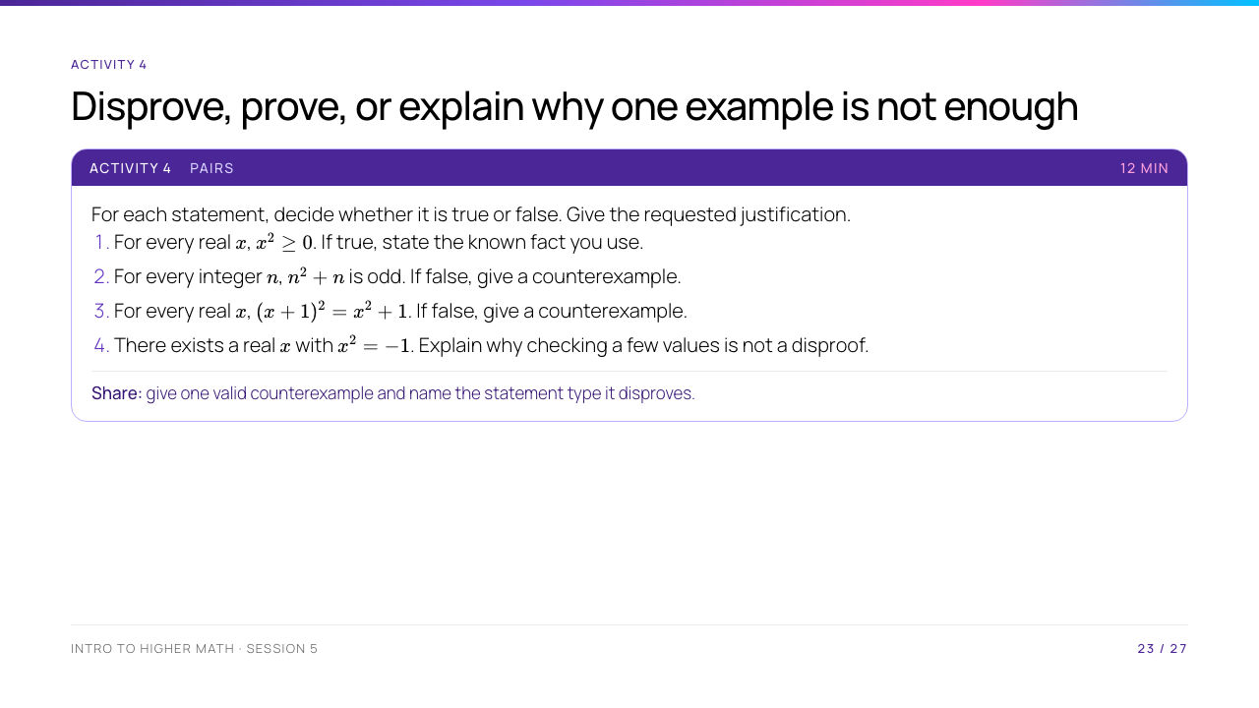
Notes:
Students may use $n=1$ or $n=0$ in item 2. For item 4, encourage the class to use the universal fact from item 1, rather than a list of unsuccessful trials.

Slide 24
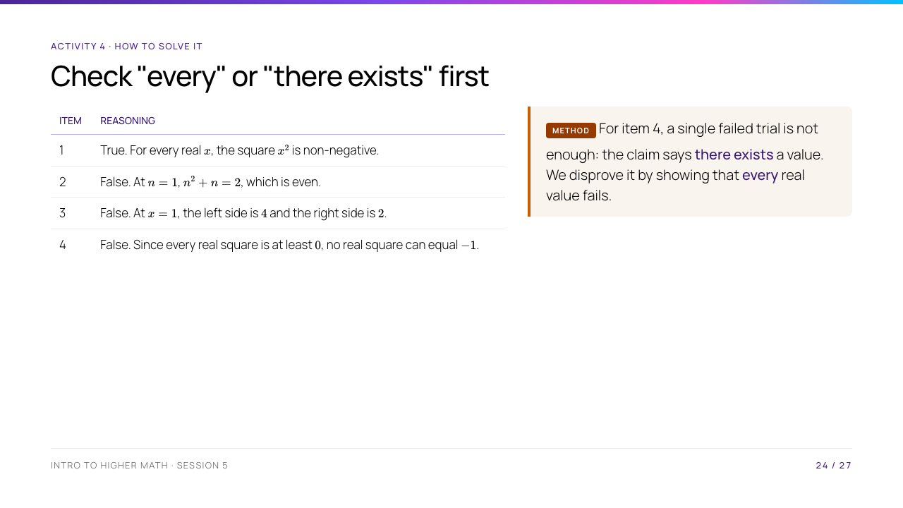
Notes:
Make students say the domain in item 4: real numbers. The final sentence is a preview of the quantifier-negation rule on the next slide.

Slide 25
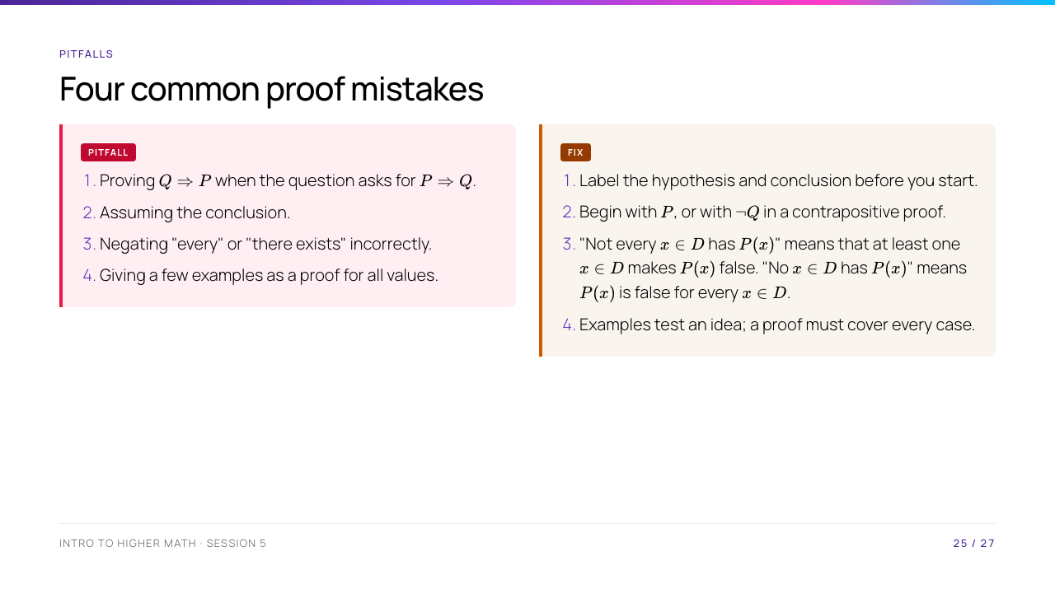
Notes:
For the last row, add the boundary: checking every member can prove a statement when the stated domain is finite. In this course, "a few examples" is never a proof of an infinite universal statement.

Slide 26
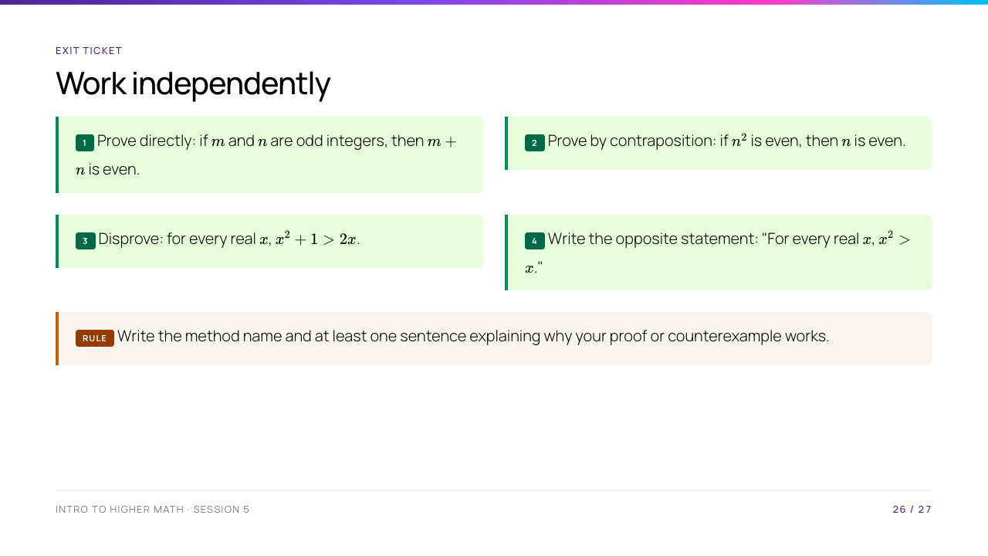
Notes:
Expected results: 1. $m+n=2(r+s+1)$ after writing $m=2r+1$, $n=2s+1$. 2. Use the proof from Slide 16. 3. $x=1$ gives $2>2$, which is false. 4. "There exists a real $x$ such that $x^2\leq x$." Collect a small sample before students leave.

Slide 27
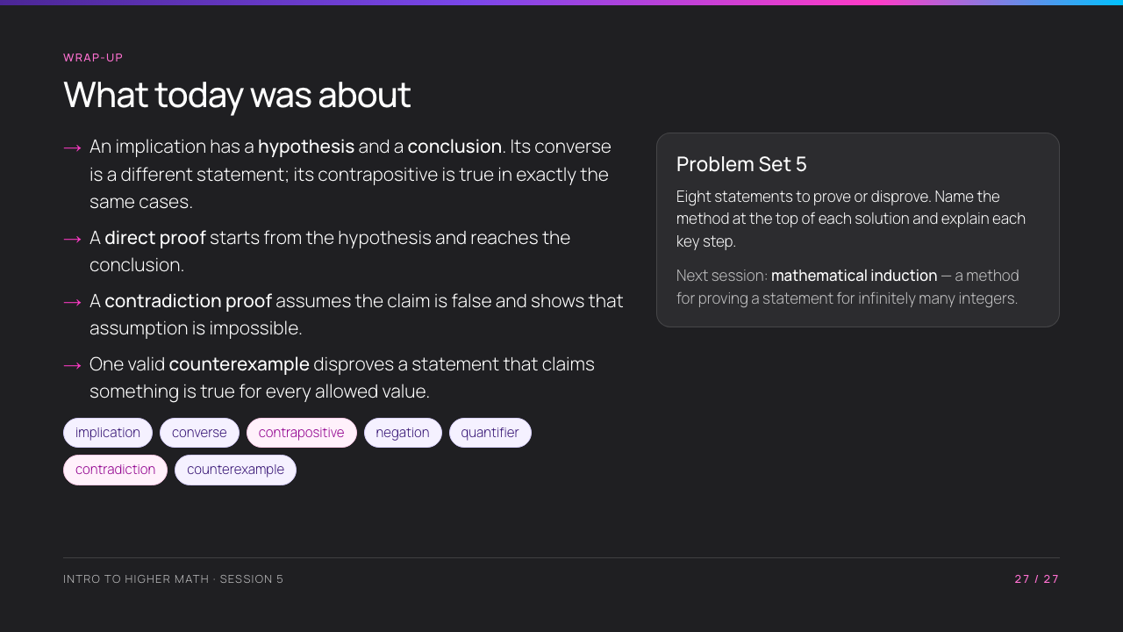
Notes:
Close by asking students to name one situation in which they would choose a counterexample rather than a proof. Remind them the problem set is practice, not assessment — but the reasoning is the whole point of doing it.

