Slide 1
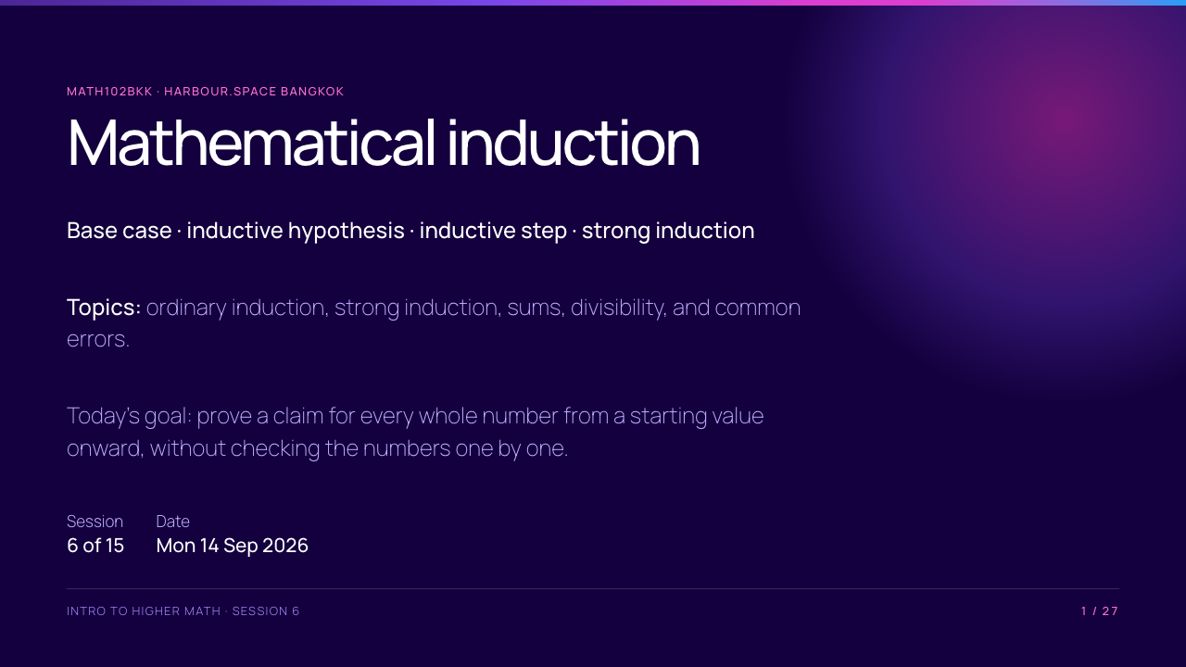
Notes:
Say that induction is a proof method, not a shortcut for guessing formulas. Students will use the proof language from Session 5, especially the idea of starting from an explicit assumption.

Slide 2
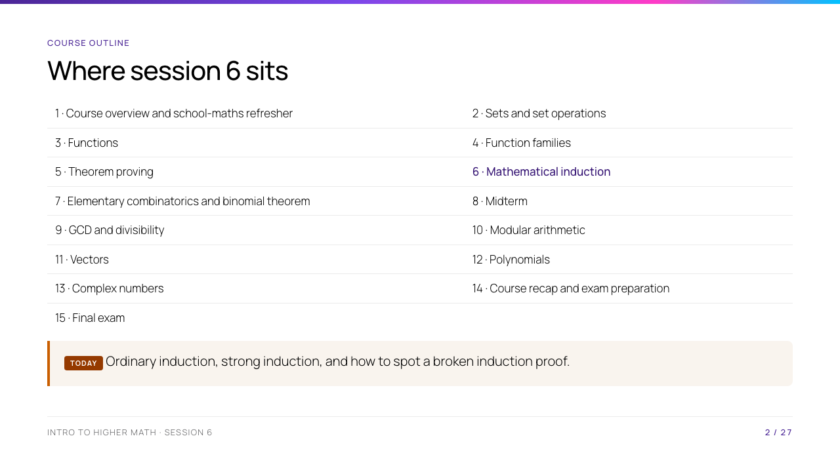
Notes:
Connect backward: Session 5 gave several ways to prove one claim. Induction is the method for a sequence of claims indexed by integers. Connect forward: counting formulas in Session 7 are often proved by induction.

Slide 3
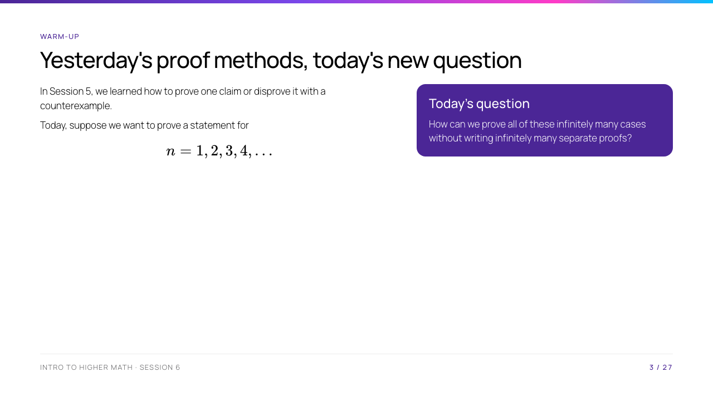
Notes:
Ask for examples of statements that depend on a whole number $n$: a sum of the first $n$ numbers, or a divisibility claim for every $n$. Do not introduce the formal induction principle until students feel the problem it solves.

Slide 4
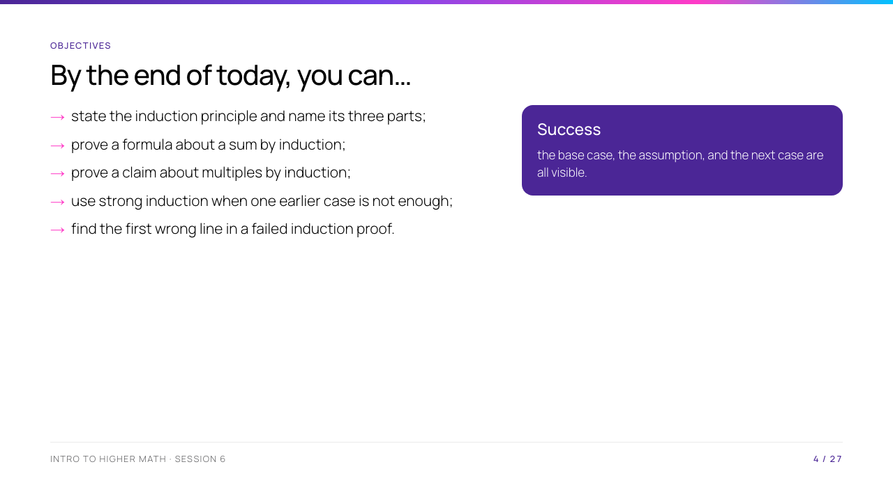
Notes:
The phrase "all visible" is deliberate. Students often write correct algebra but hide the logical structure that makes it an induction proof.

Slide 5
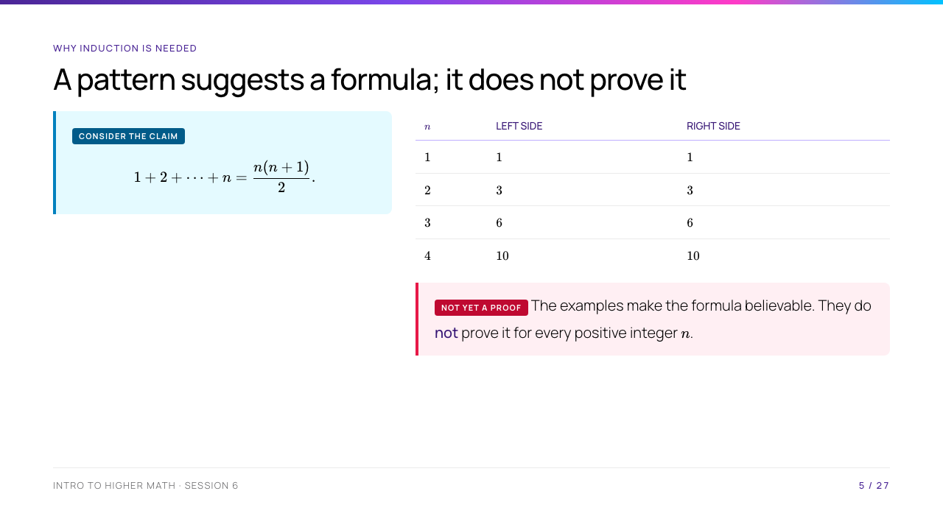
Notes:
Ask what might happen at $n=100$. The point is not that the formula is doubtful; it is that four checks cannot cover an infinite set of inputs.

Slide 6
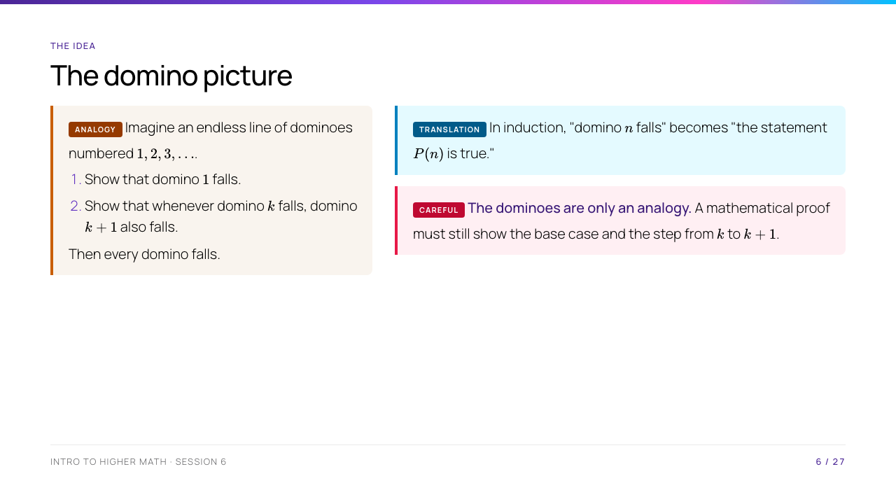
Notes:
Use the analogy only to make the chain visible. Emphasise that the second condition must work for every allowed integer $k$, not for one chosen example.

Slide 7
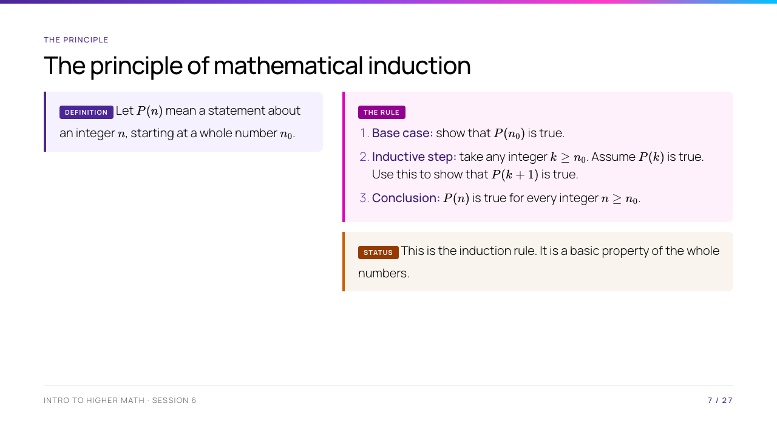
Notes:
Read the symbols slowly. The base number $n_0$ is not always $1$; later slides use $2$ and $12$. This is a proof principle, not a formula to substitute into.

Slide 8
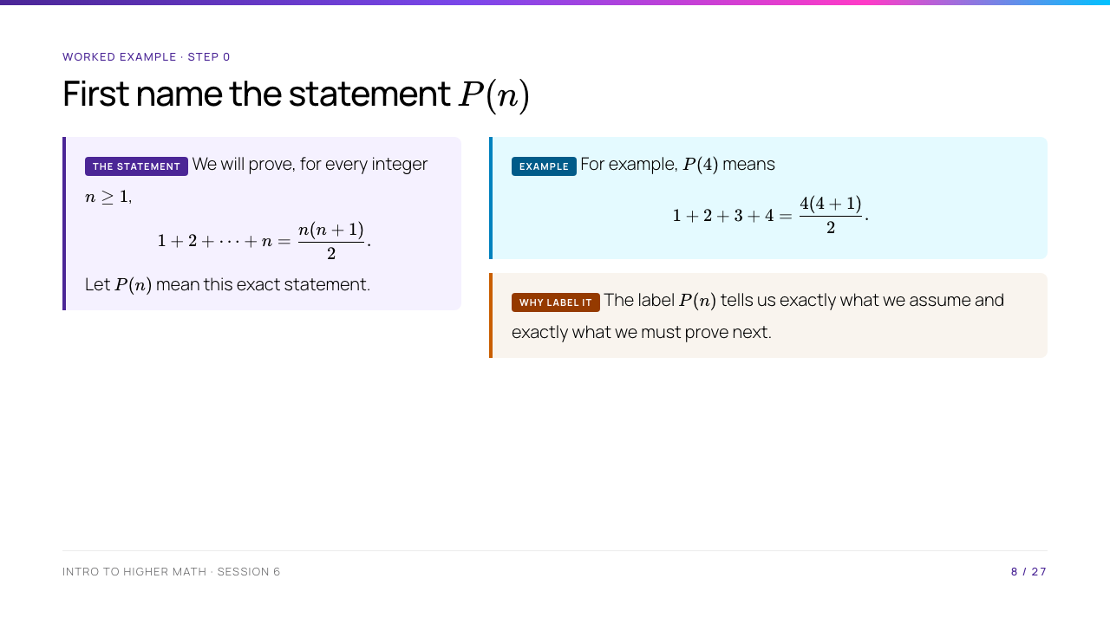
Notes:
Ask students to calculate both sides of $P(4)$. Stress that $P(n)$ is a label for a complete sentence, not a number or an algebraic expression.

Slide 9
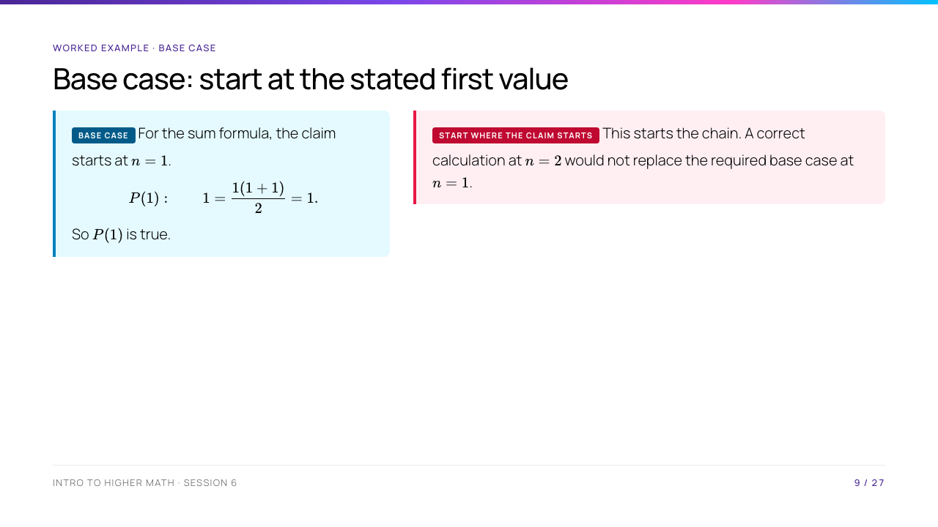
Notes:
Point to $n_0=1$ on Slide 7. This slide addresses a frequent error: checking a convenient value instead of the first value named in the claim.

Slide 10
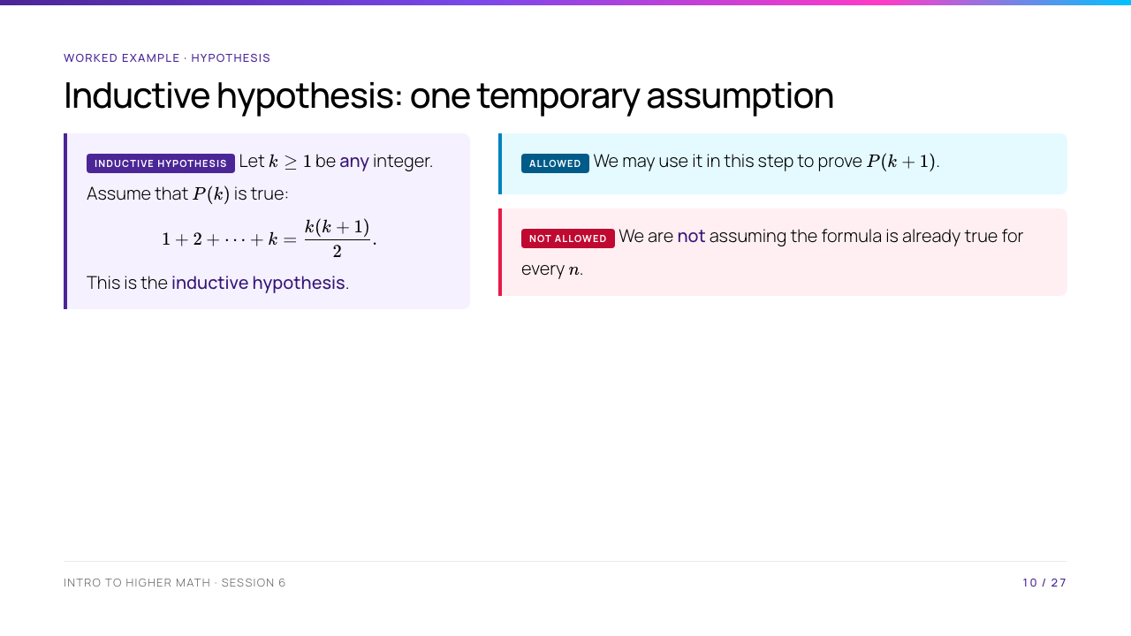
Notes:
Make the distinction explicit: "Assume $P(k)$ for an arbitrary $k$" is allowed inside the inductive step. "Assume the formula for all $n$" would assume the conclusion before proving it.

Slide 11
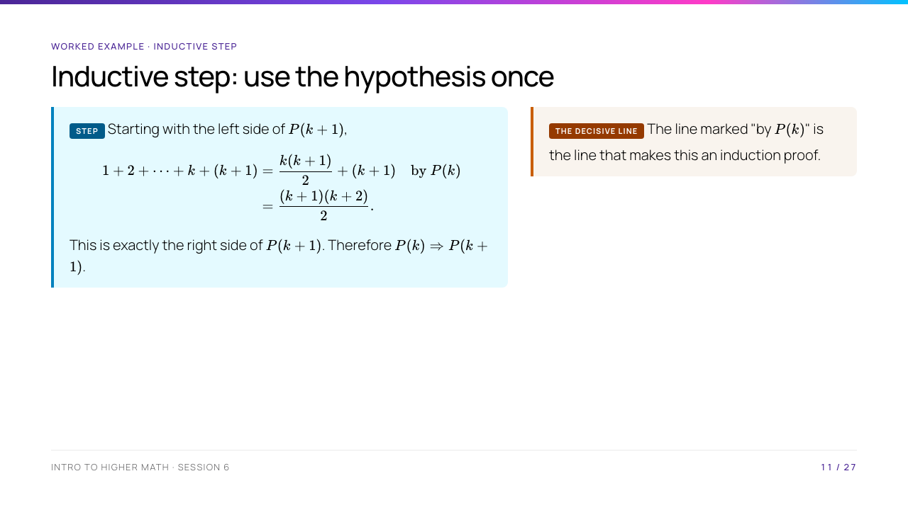
Notes:
Circle the line marked "by $P(k)$." It is the line that makes this an induction proof. Without it, students have not used their temporary assumption.

Slide 12
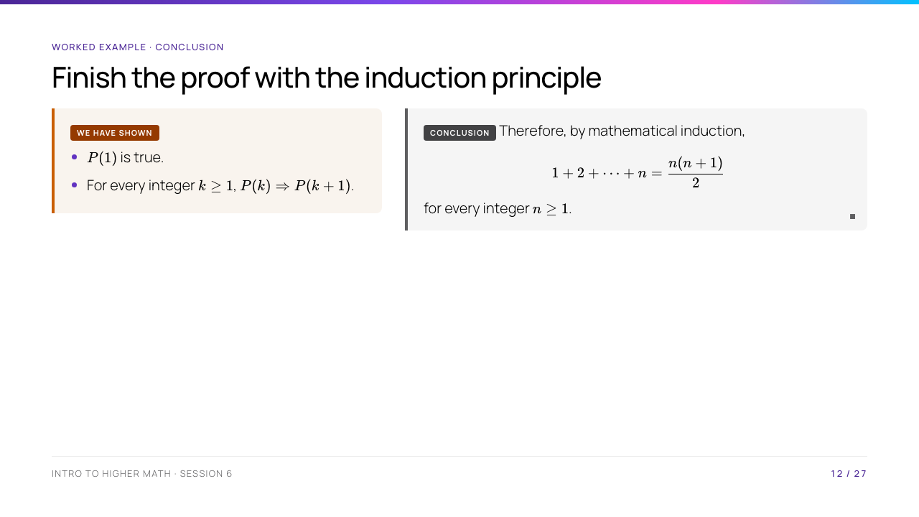
Notes:
This conclusion is where the infinite claim enters. The algebra in the step proves only a link; the induction principle turns the base and all links into a statement about every $n\geq1$.

Slide 13
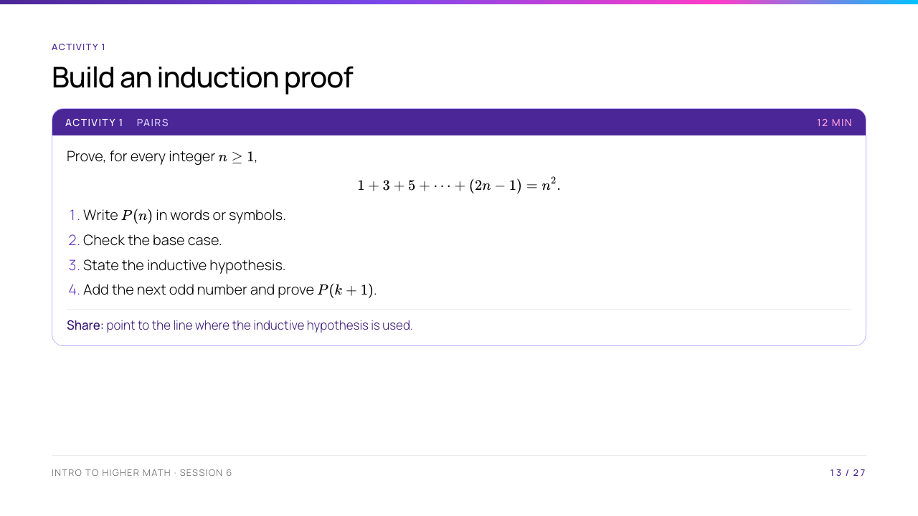
Notes:
Pairs should leave space between the hypothesis and the calculation. The next odd number after $2k-1$ is $2k+1$; this is the key detail to watch for.

Slide 14
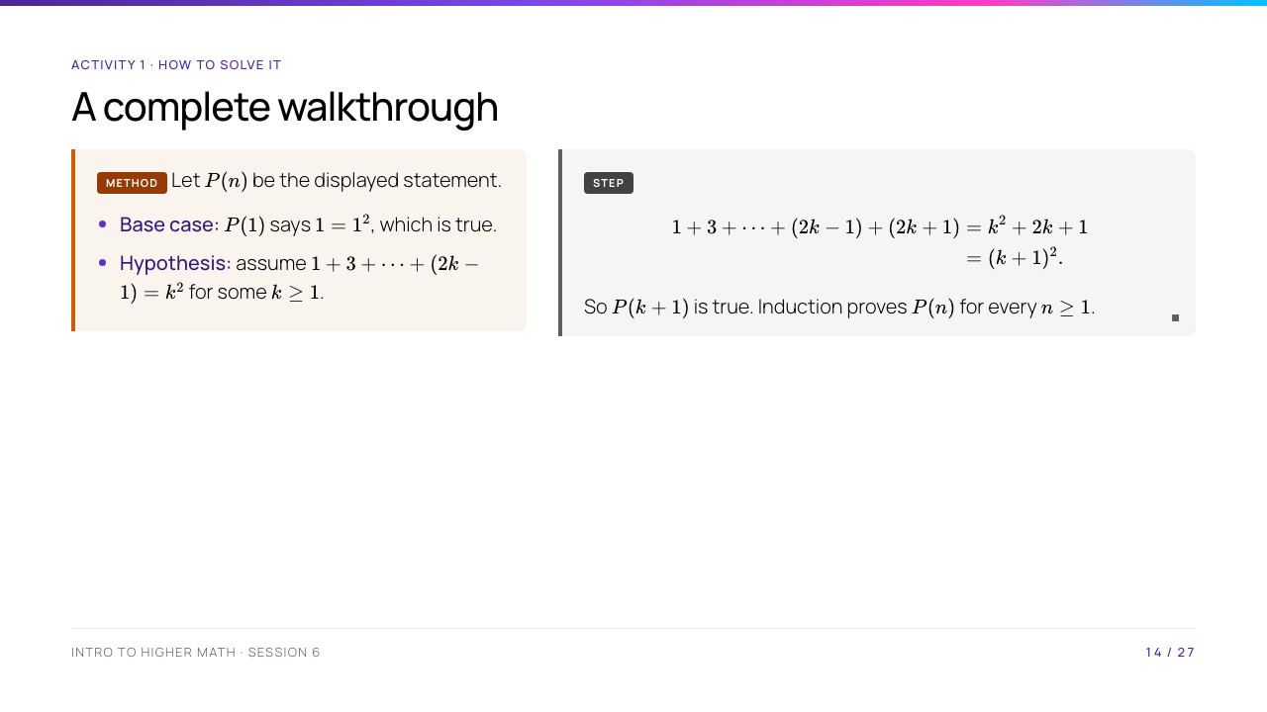
Notes:
Reveal this after the share. Ask why $2k+1$ appears: replacing $n$ by $k+1$ in $2n-1$ gives $2(k+1)-1=2k+1$.

Slide 15
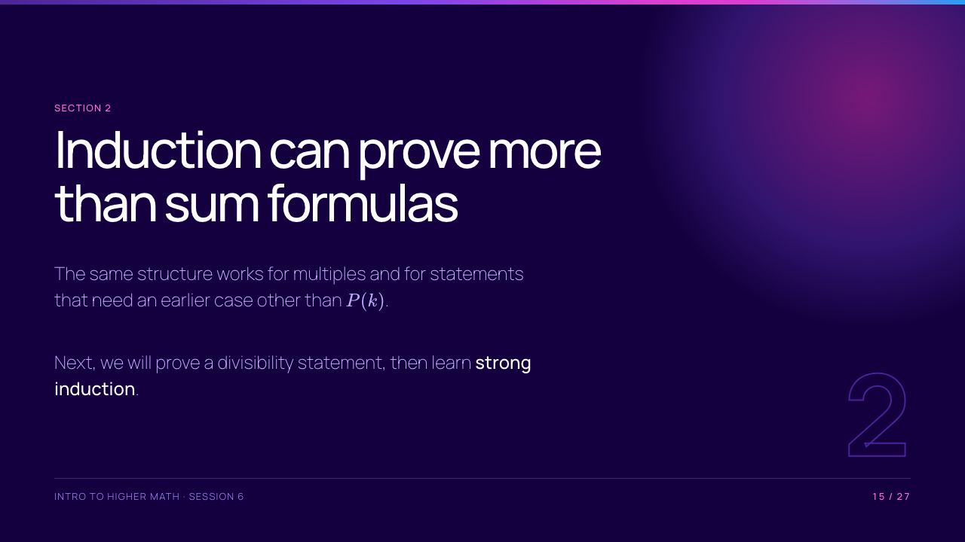
Notes:
Take the scheduled break before this section. On return, remind students that the base, hypothesis, and next case remain the same; only the algebra changes.

Slide 16
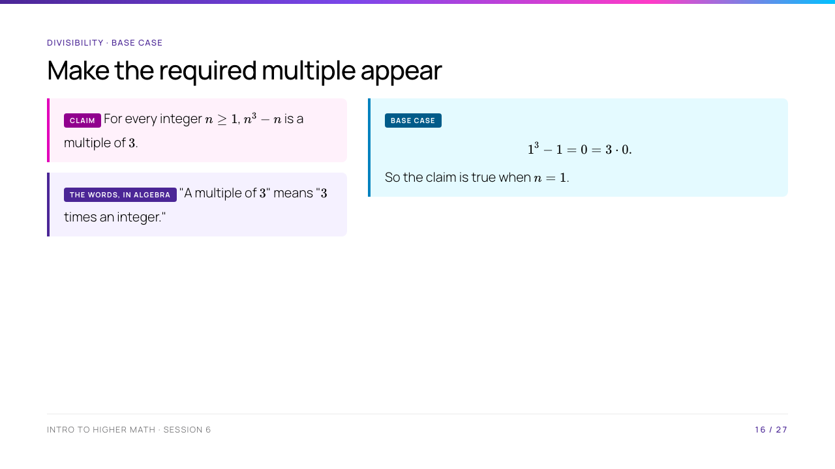
Notes:
Say that $0$ is a multiple of every integer: $0=3\cdot0$. The target form in the inductive step will be $3\times(\text{an integer})$.

Slide 17
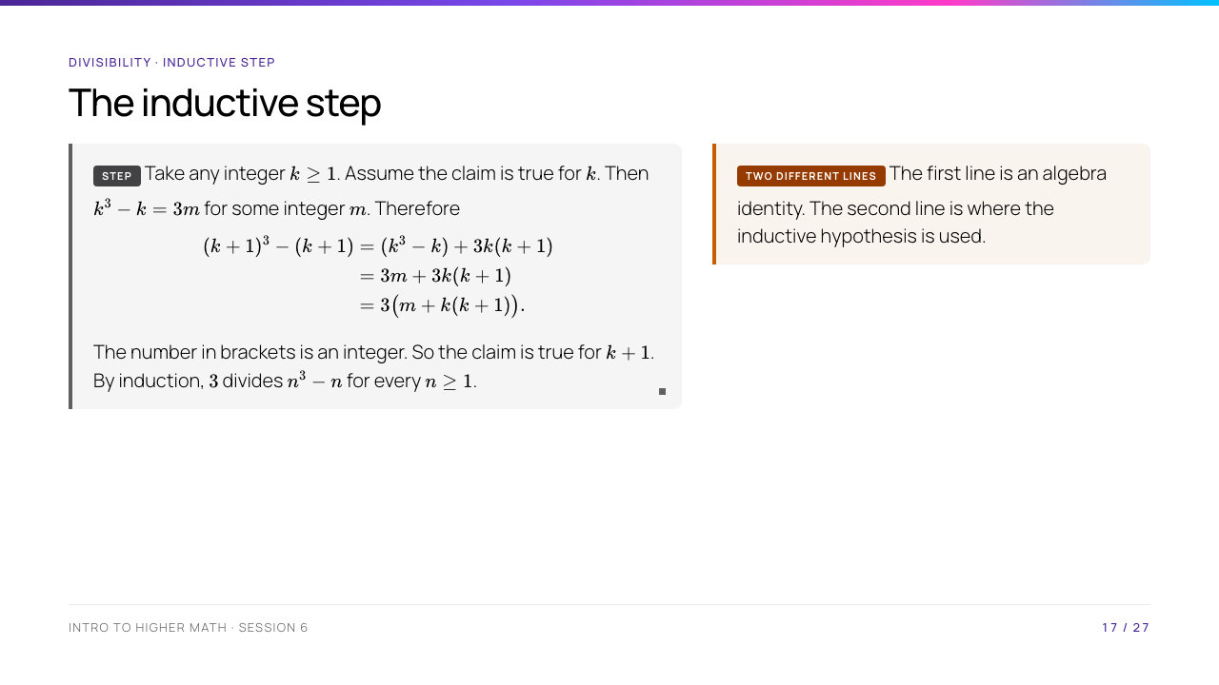
Notes:
Students may need to expand $(k+1)^3-(k+1)$ on the board first. State that the first line is an algebra identity; the second line uses the inductive hypothesis.

Slide 18
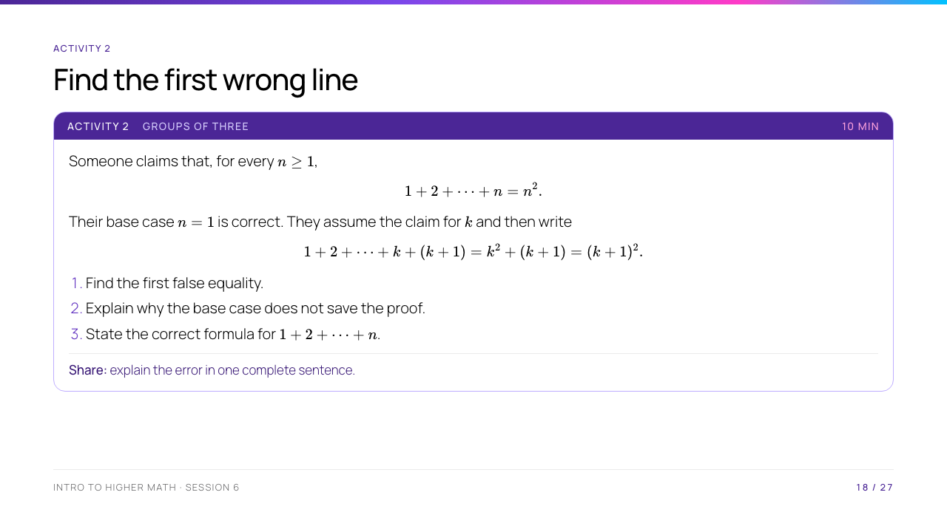
Notes:
Ask groups to test the false equality with $k=1$. The activity teaches that an induction proof can look structurally correct but still fail through one algebra mistake.

Slide 19
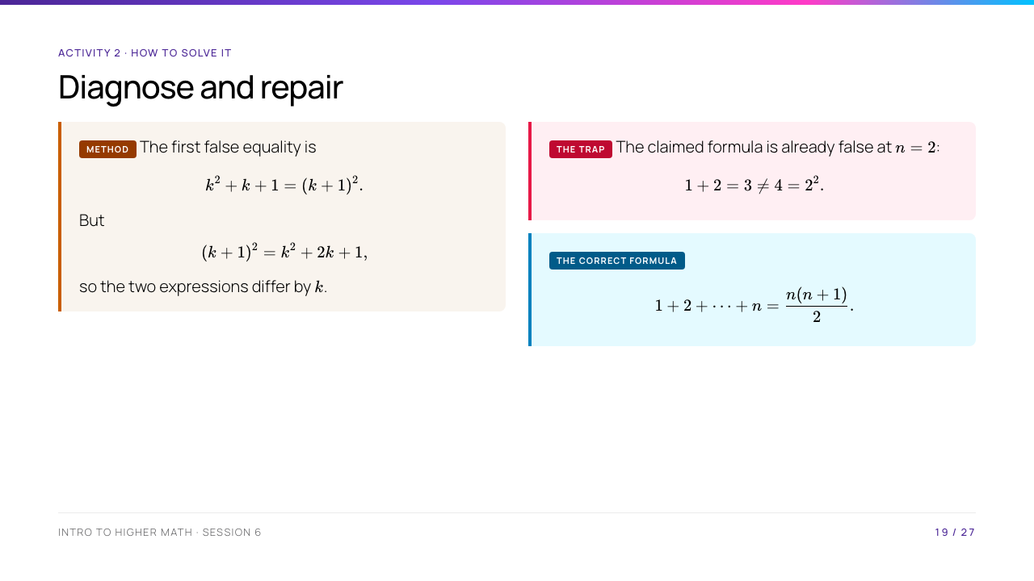
Notes:
Make a sharp distinction: a base case shows only one case. Both the statement and every algebraic line in the step must be correct.

Slide 20
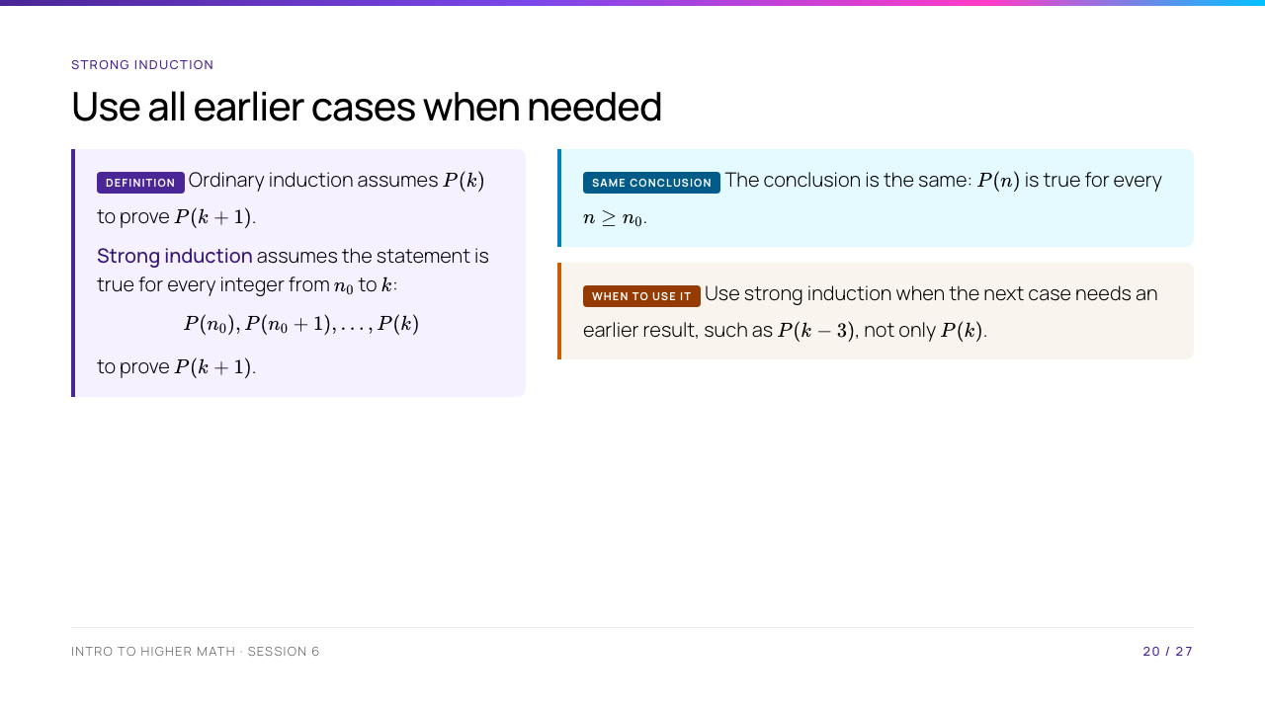
Notes:
"Strong" does not mean the conclusion is stronger. It gives more information in the inductive hypothesis. The next two slides show why a factorisation proof needs it.

Slide 21
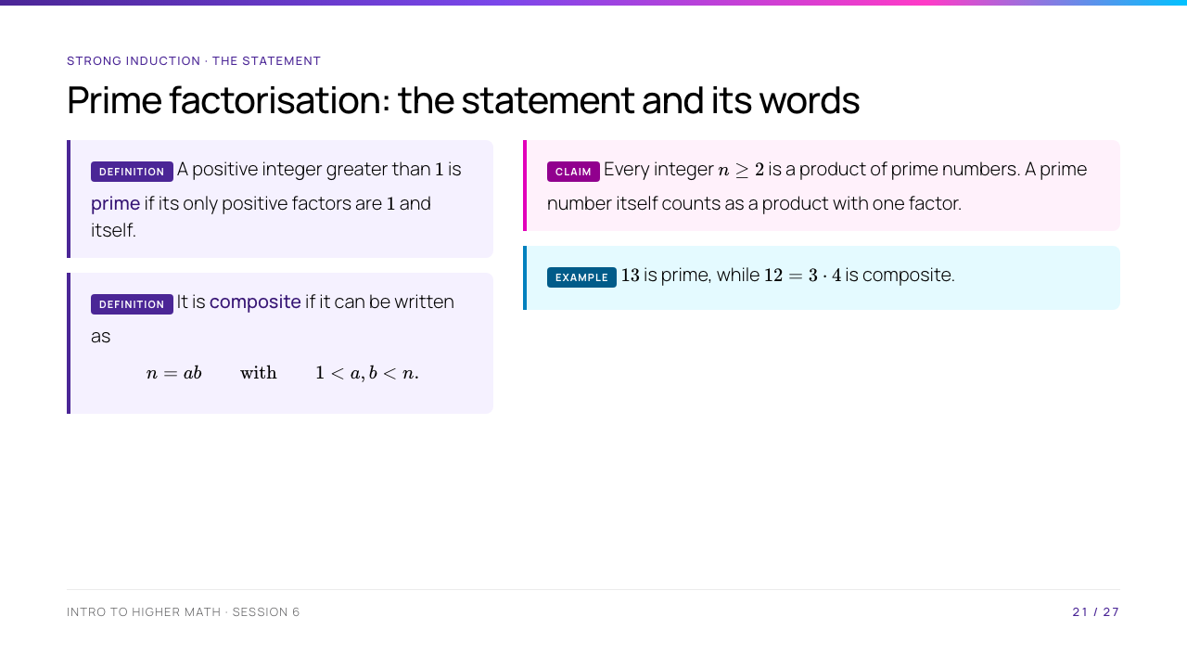
Notes:
Give examples: $13$ is prime, while $12=3\cdot4$ is composite. "A product of prime numbers" may have one factor, so the prime number $2$ is itself a product consisting of one prime.

Slide 22
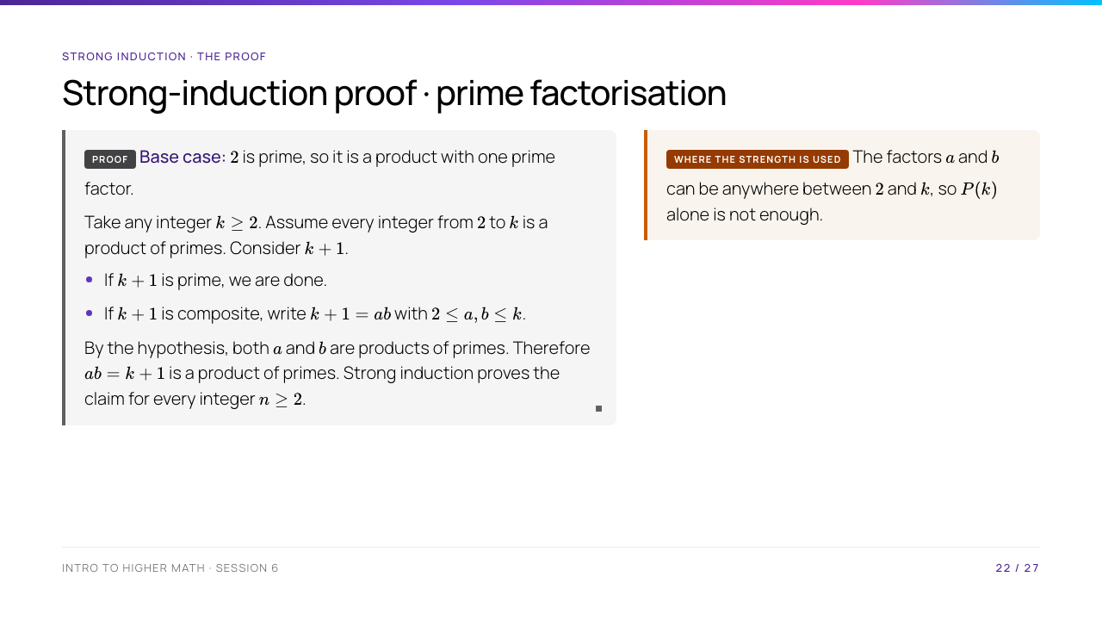
Notes:
Ask why $a,b\leq k$: since both are greater than $1$ and their product is $k+1$, neither can equal $k+1$. This is exactly where the full hypothesis, not merely $P(k)$, is used.

Slide 23
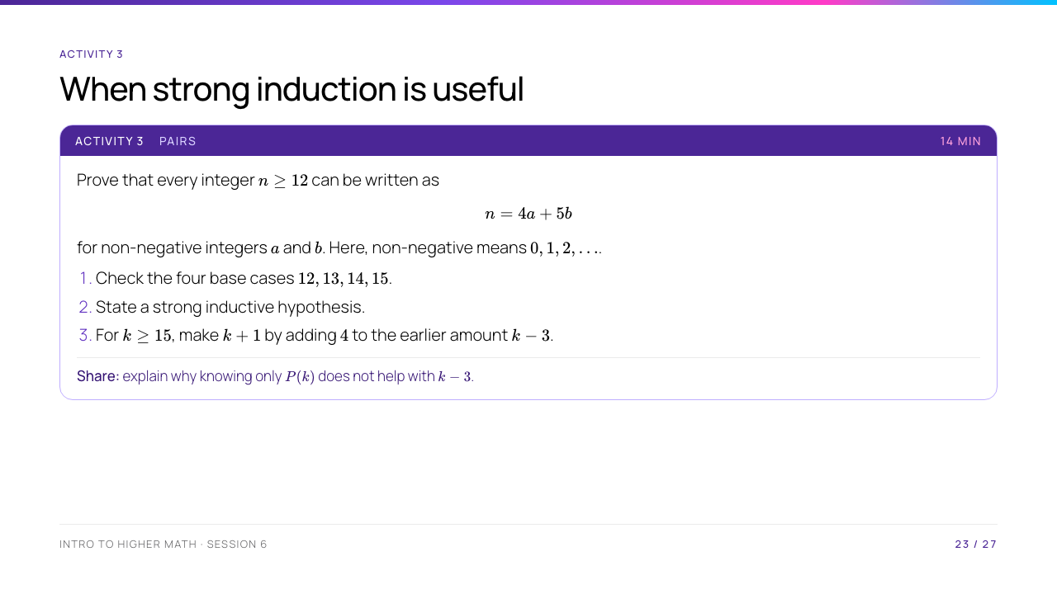
Notes:
Clarify that non-negative means $0,1,2,\ldots$. Students should write each base case as a sum of fours and fives before moving to the general step.

Slide 24
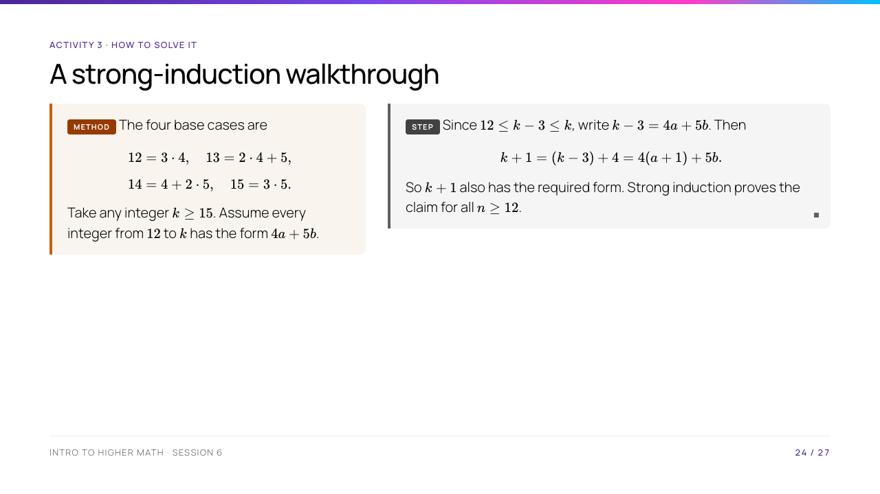
Notes:
The step looks back four places, so four base cases are needed. This is a good place to ask students to identify the exact earlier statement used: $P(k-3)$.

Slide 25
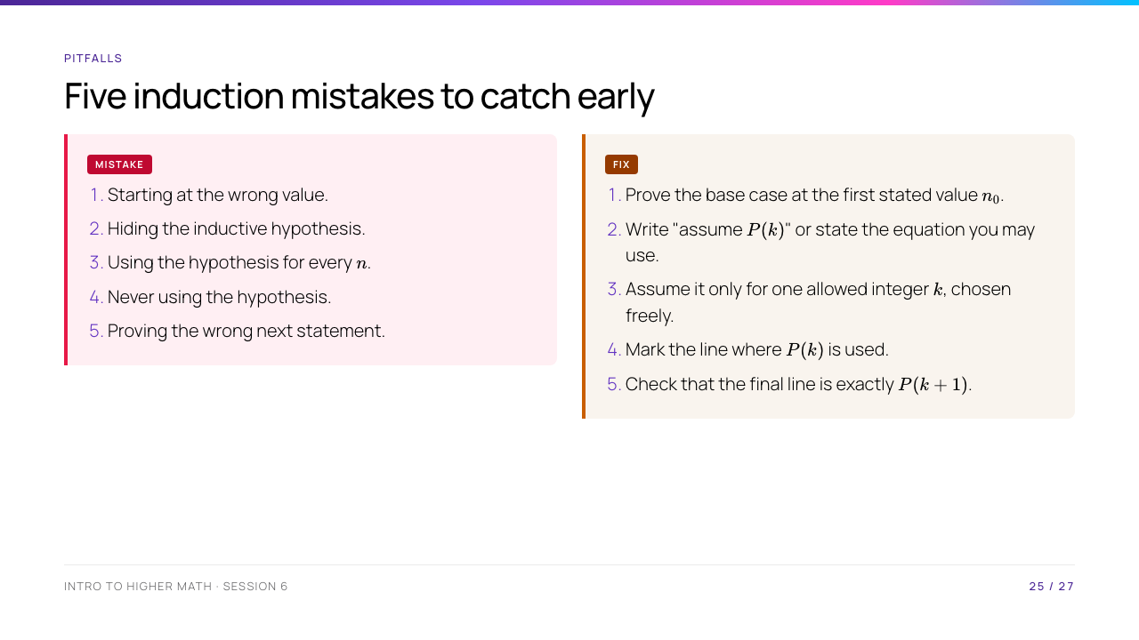
Notes:
The third and fourth errors are different: the first assumes too much, while the second assumes the right thing but does not use it. Invite students to find these errors in old work.

Slide 26
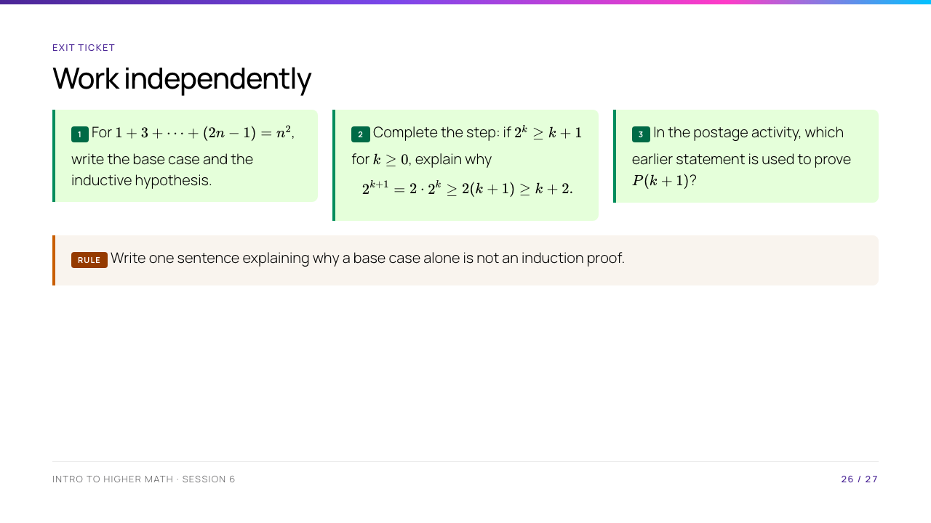
Notes:
Expected answers: 1. $P(1):1=1^2$; assume the identity for $k\geq1$. 2. The first inequality uses the hypothesis; the second follows because $k\geq0$. 3. $P(k-3)$. A base case proves one case, not the link to the next case.

Slide 27
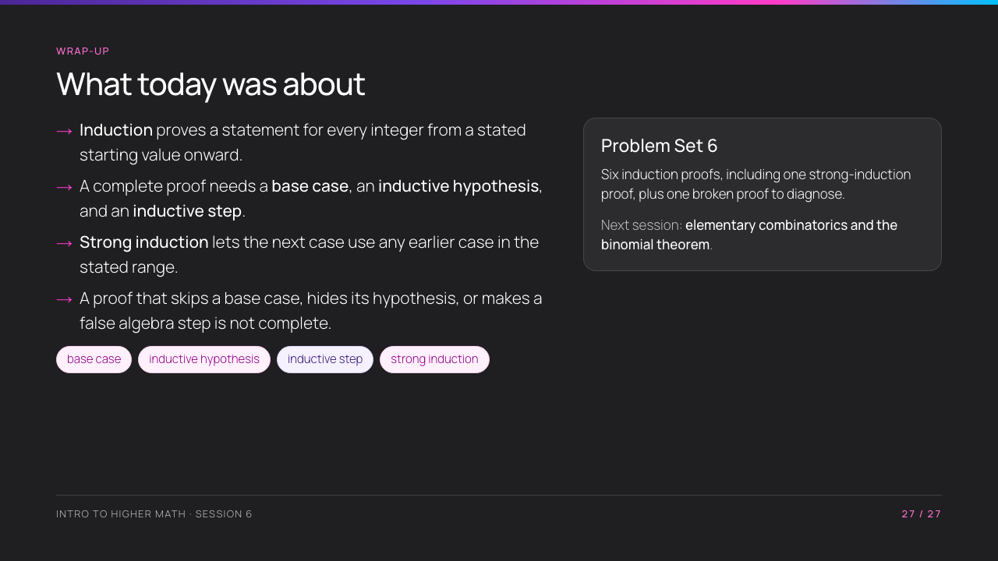
Notes:
End by asking students to say the difference between ordinary and strong induction in one sentence. Reinforce that the conclusion in both methods is the same; only the information available in the step changes.

