Slide 1
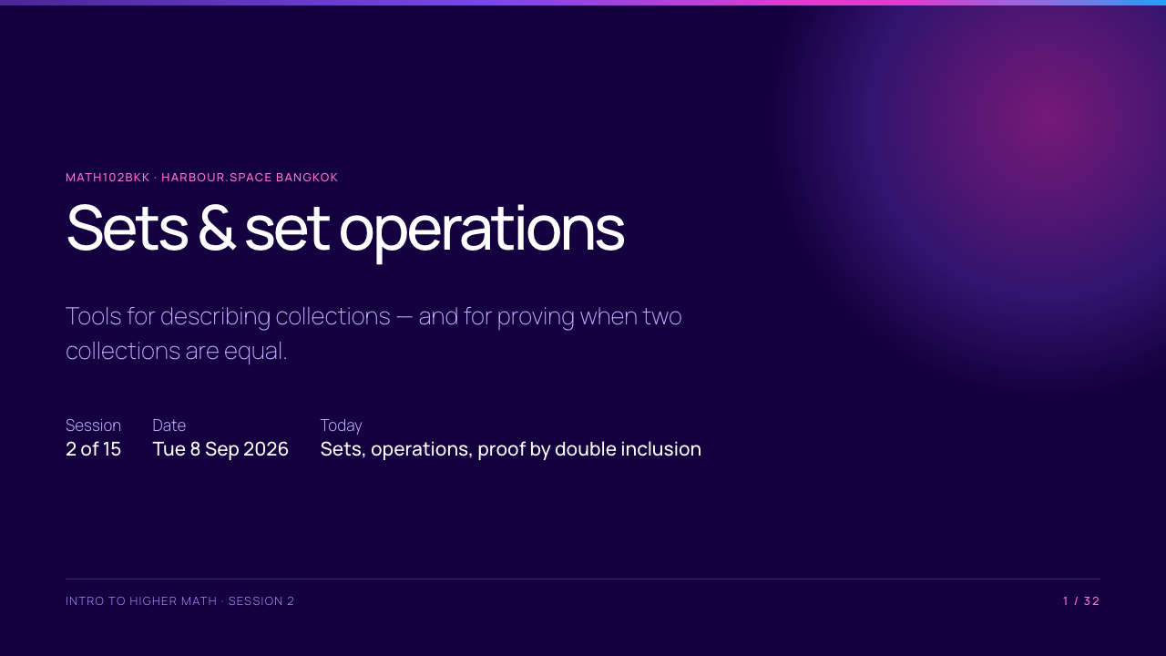

Slide 2
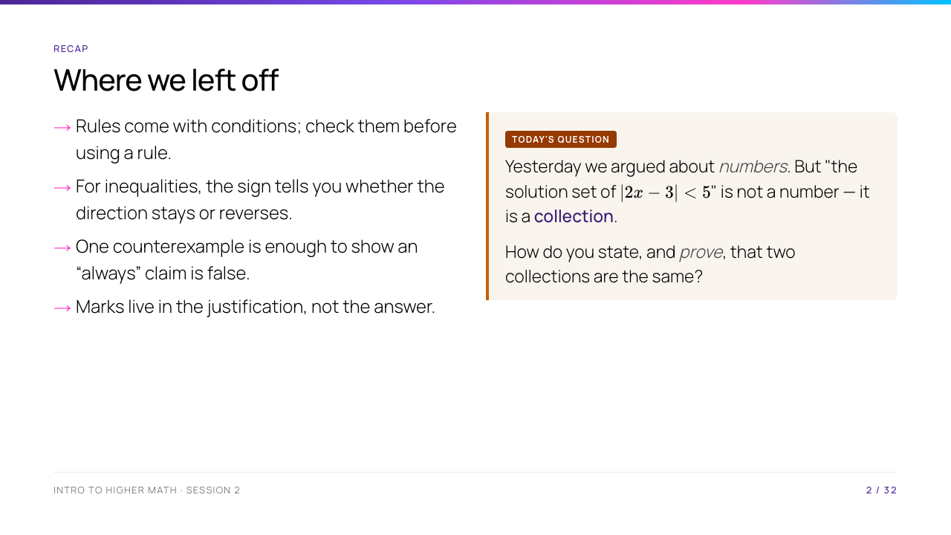
Notes:
Open with the question in the box, and do not answer it. Point back to yesterday's exit ticket: they all wrote $x \leq -\tfrac53$ or $x \geq 1$ — that is a set, and they have been manipulating sets all along without a language for it. Today supplies the language and the proof method. Two minutes, then move.

Slide 3
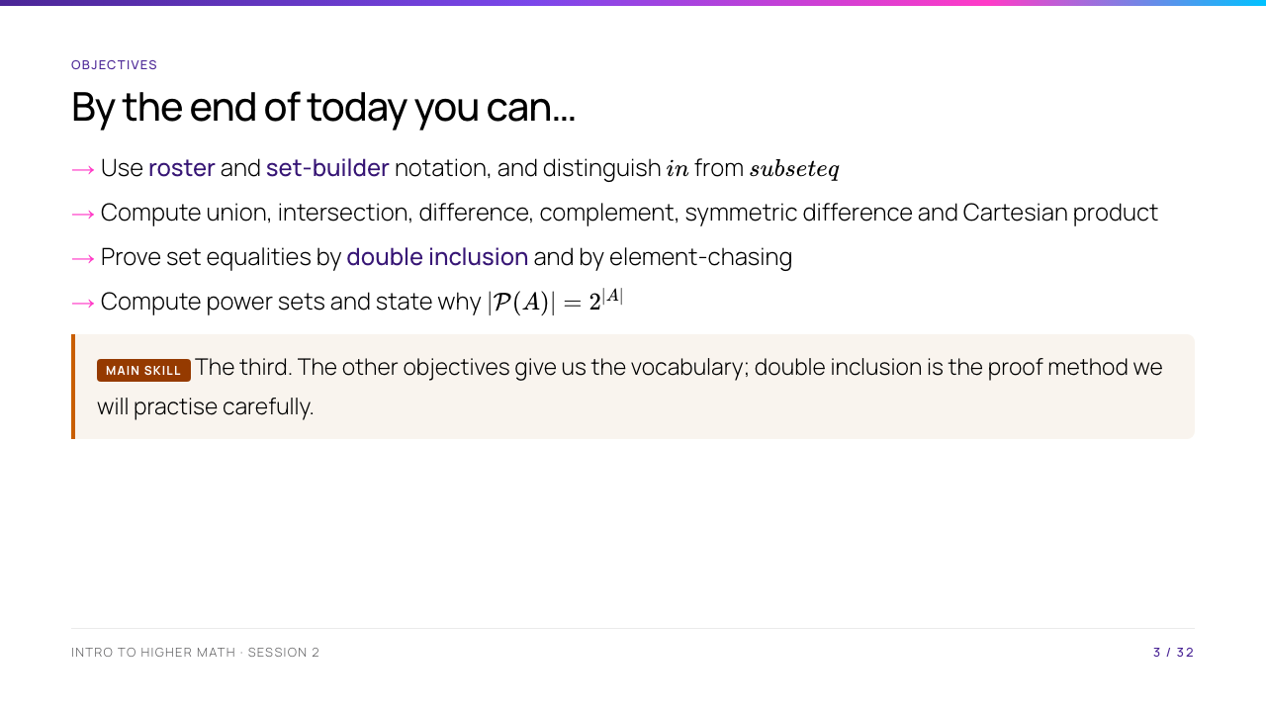
Notes:
Read them out. Tell them explicitly that objective 3 is the assessed skill and the other three are the vocabulary it needs. They should be able to self-assess against this list at 5pm.

Slide 4
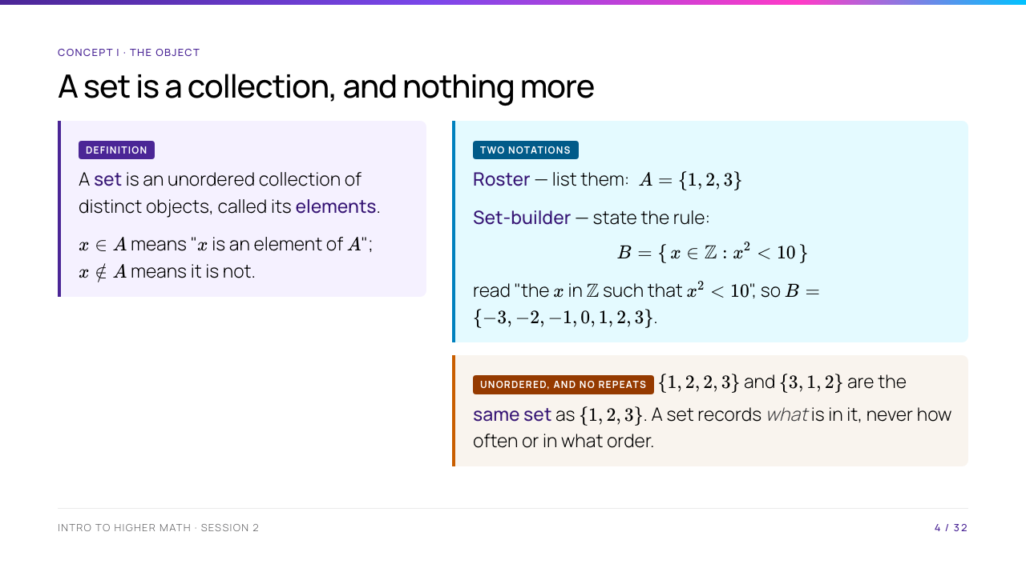
Notes:
Write $\{x \in \mathbb{Z} : x^2 < 10\}$ on the board and make the room read it aloud in words — "the set of integers x such that x squared is less than ten". They must be able to say it, not just recognise it. Then ask why $-3$ is in it and $\sqrt{5}$ is not: the $\mathbb{Z}$ before the colon is doing work. The no-repeats point looks pedantic and is not — it is exactly why $|\{1,2,2\}| = 2$.

Slide 5
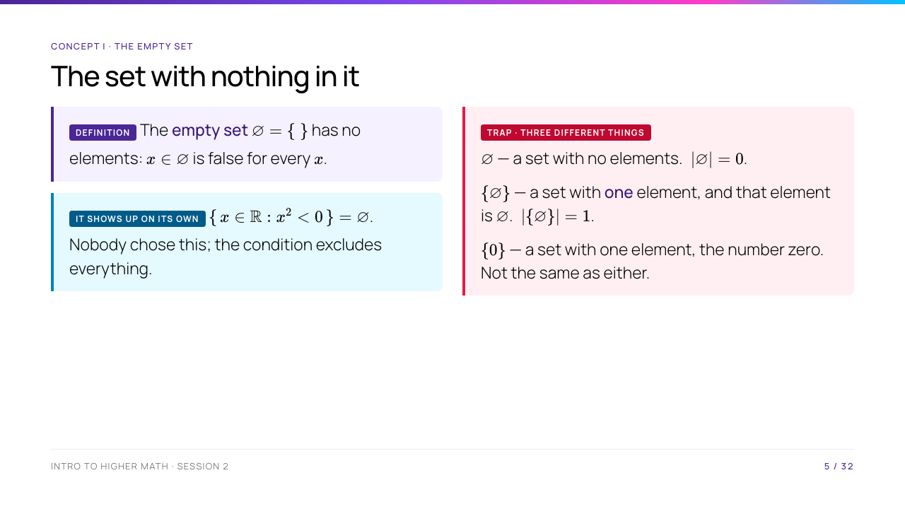
Notes:
The box-in-a-box picture is the one that lands: $\varnothing$ is an empty box; $\{\varnothing\}$ is a box containing an empty box, so it is not empty. Draw it. This distinction returns in Session 6 when they build $\mathbb{N}$ from nothing, and it is worth a mark on the midterm every year.

Slide 6
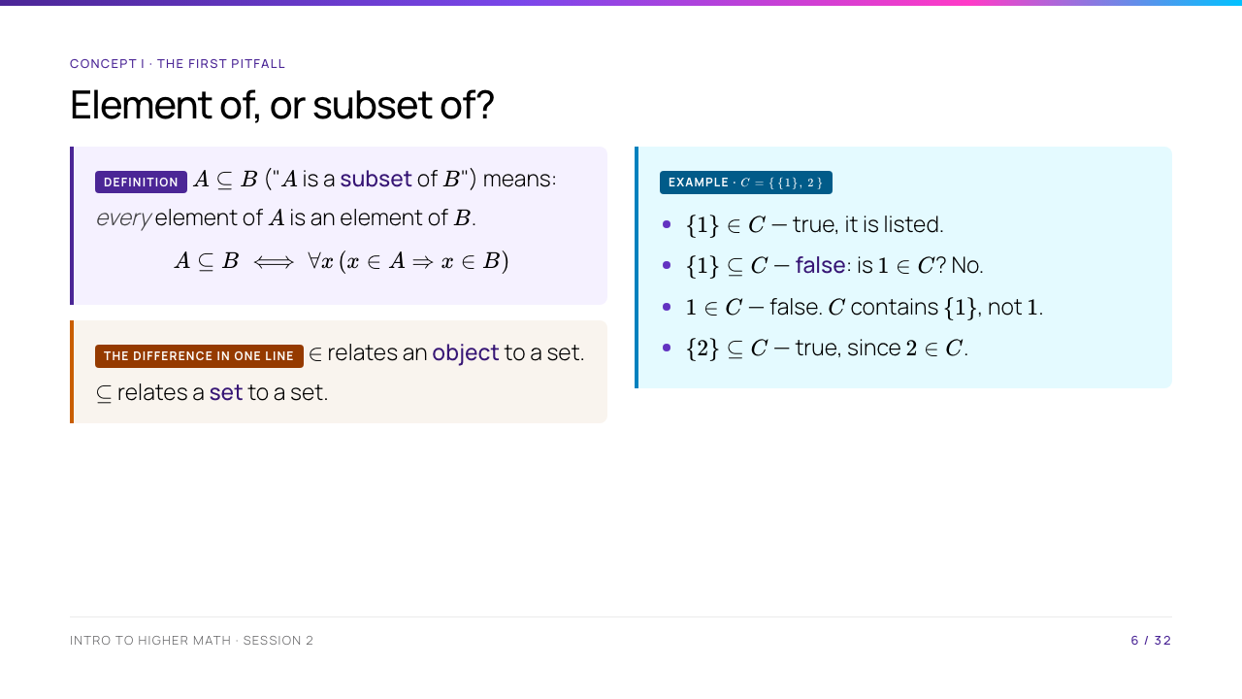
Notes:
Go through the four lines one at a time and make the room vote before you reveal each. They will get the first two wrong, which is the point — this is pitfall one from the course spec, and it costs marks all term. The fix is mechanical: to test $\subseteq$, take an arbitrary element of the left-hand set and ask whether it is in the right-hand set. To test $\in$, look at the list.

Slide 7
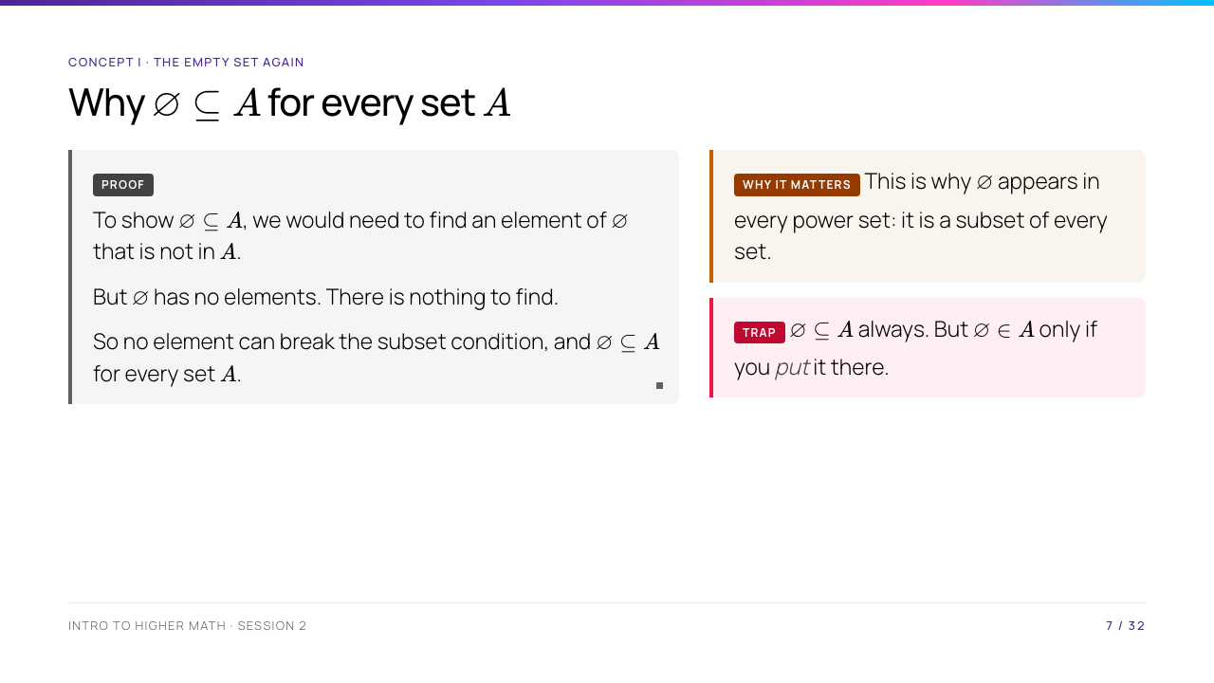
Notes:
Students often find this surprising. Ask them to produce an element of $\varnothing$ that is not in $A$. They cannot, because there are no elements to test. That is the whole proof. Then contrast $\varnothing \subseteq A$ with $\varnothing \in A$: the second statement is only true when the empty set was explicitly included as an element.

Slide 8
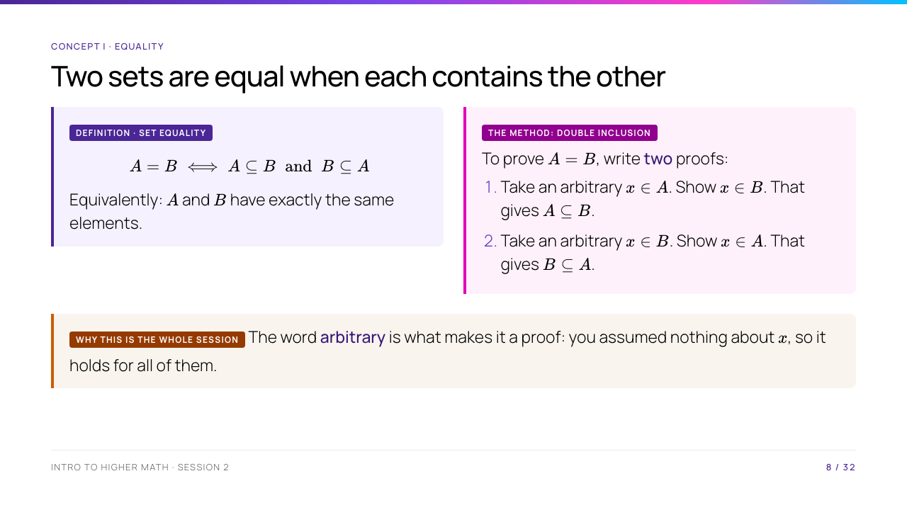
Notes:
Stress "arbitrary" hard. The commonest wrong proof is checking $x = 3$ and stopping — that is an example, not a proof, and it is the same error as offering examples for a universal claim yesterday. Say the template out loud in the form they should write it: "Let x be an arbitrary element of A. Then... so x is in B. Hence A is a subset of B. Conversely..."

Slide 9
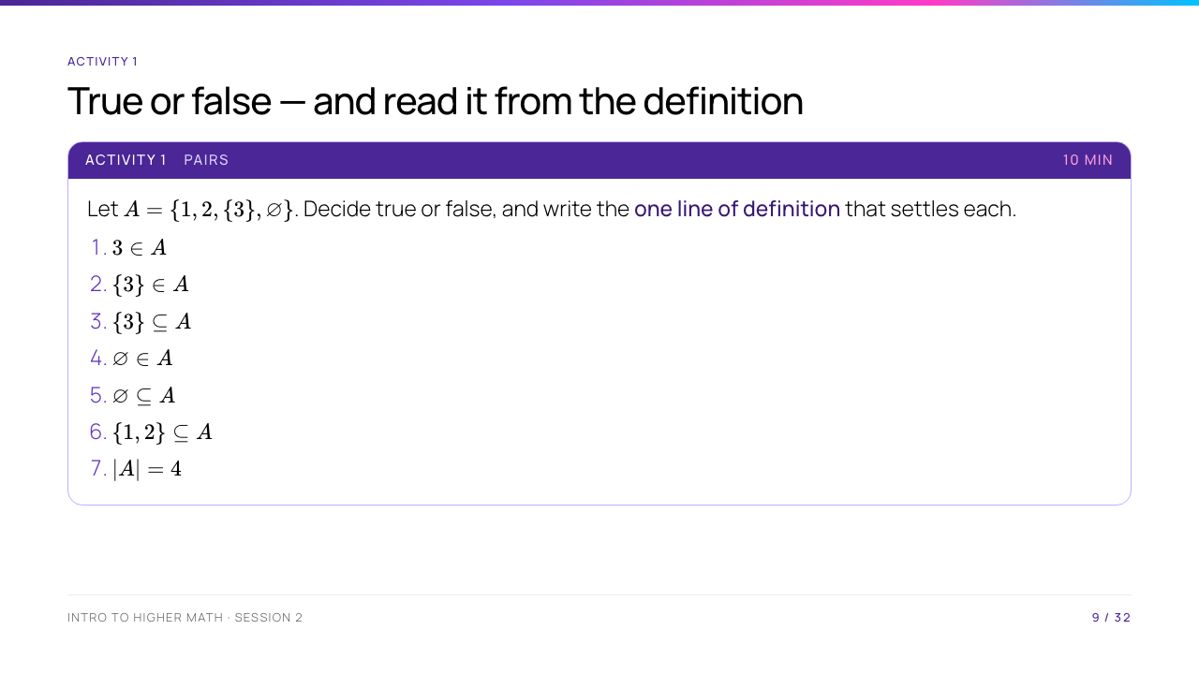
Notes:
Answers: F, T, F, T, T, T, T. Item 4 is true only because $\varnothing$ was explicitly listed, and item 5 is true for every set — make sure somebody says that difference out loud. Item 3 is the money question: $\{3\} \subseteq A$ would need $3 \in A$, and $3$ is not in $A$; only $\{3\}$ is. Circulate and listen for "because it looks like" — send those pairs back to the definition.

Slide 10
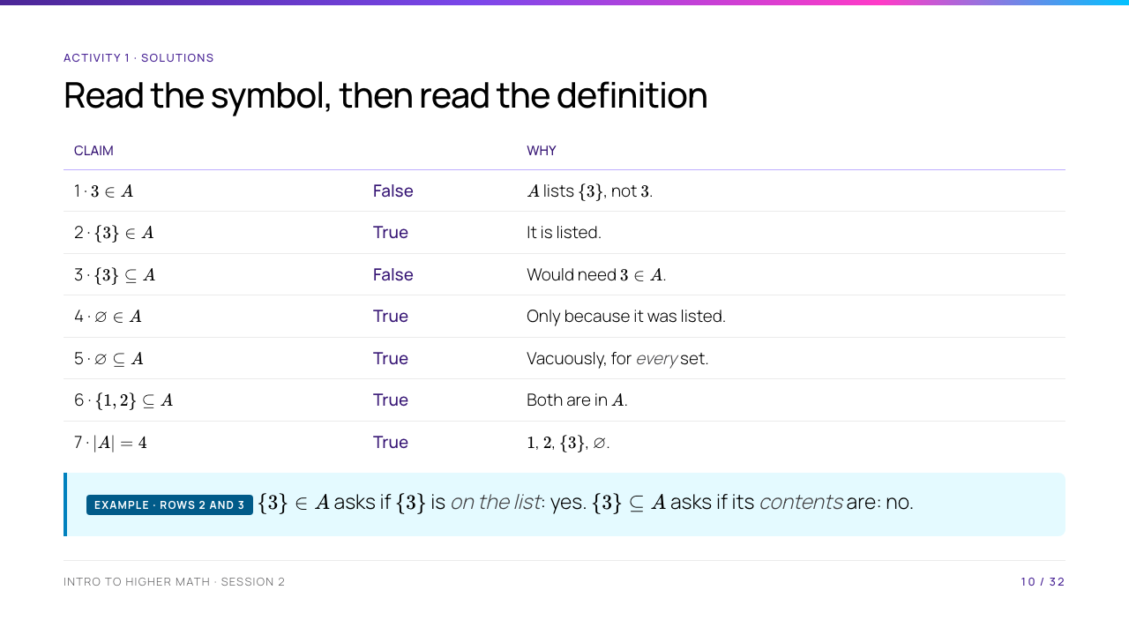
Notes:
Rows 4 and 5 are the pair to contrast out loud: 4 is true by accident of how $A$ was written, 5 is true for every set in mathematics. Row 3 is where the marks go all term — $\{3\} \subseteq A$ asks about the contents of $\{3\}$, not about $\{3\}$ itself. If a pair says "but 2 and 3 look the same", that is exactly the confusion to name and kill here.

Slide 11
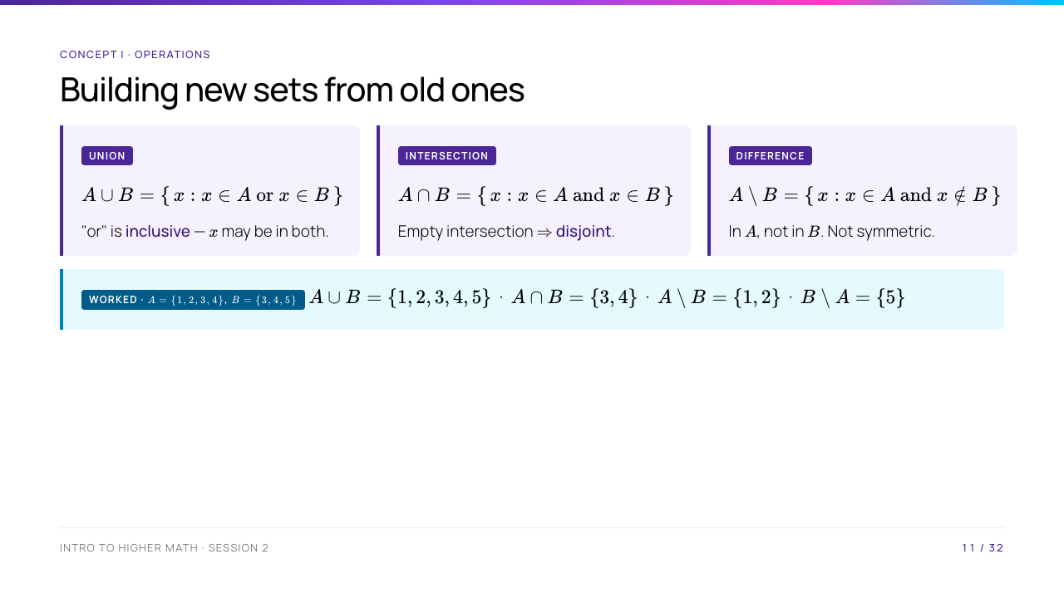
Notes:
Do the worked line on the board with the room calling out elements. The one thing to labour: "or" in mathematics is inclusive, unlike "tea or coffee". Then point at $A \setminus B$ versus $B \setminus A$ and ask whether difference is commutative — they should see immediately that it is not, which sets up the Cartesian product question after the break.

Slide 12
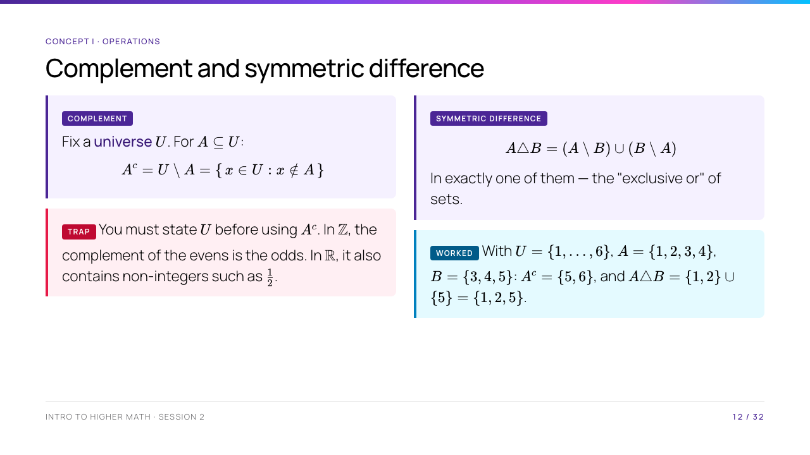
Notes:
Always write the universe on the board before writing a complement — model the habit you want. The symmetric difference is the one they have not met; the "exactly one" reading is what makes it click, and it is worth noting it equals $(A \cup B) \setminus (A \cap B)$, which they will prove in the problem set.

Slide 13
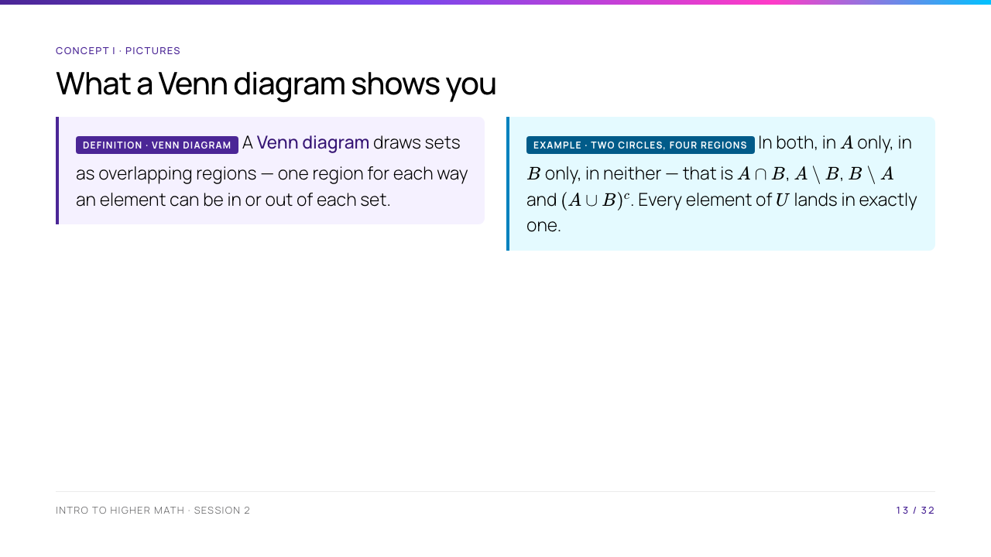
Notes:
Draw the two circles and label all four regions with the operations from the last two slides — this is the slide where the vocabulary becomes a picture, and it is worth the two minutes. Ask which region $A \triangle B$ is (the two crescents) before you move on. Then hold the thought: the next slide takes the picture away again.

Slide 14
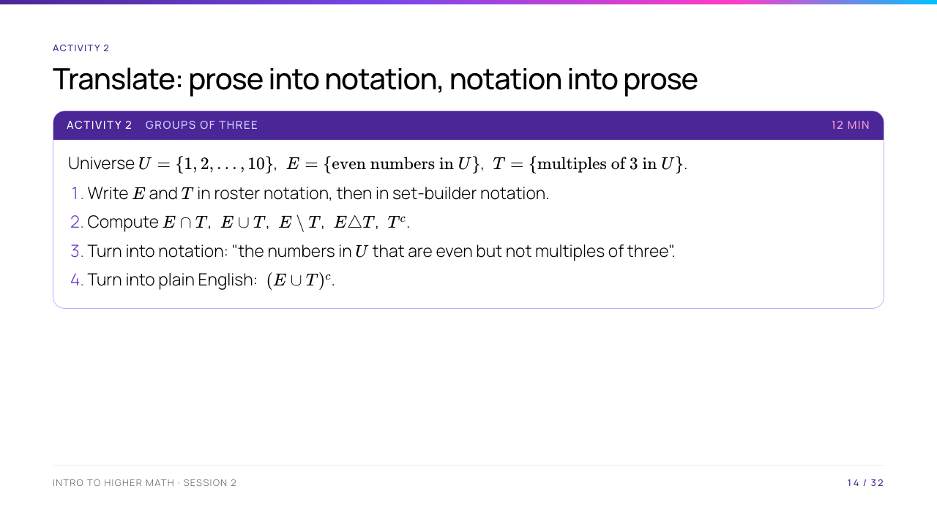
Notes:
Answers: $E = \{2,4,6,8,10\}$, $T = \{3,6,9\}$; $E \cap T = \{6\}$, $E \cup T = \{2,3,4,6,8,9,10\}$, $E \setminus T = \{2,4,8,10\}$, $E \triangle T = \{2,3,4,8,9,10\}$, $T^c = \{1,2,4,5,7,8,10\}$. (3) is $E \setminus T$. (4) is "the numbers from 1 to 10 that are neither even nor multiples of three", namely $\{1,5,7\}$ — and that phrasing is De Morgan in English, which is exactly where we go next. Do not tell them that yet; let the next slide land it.

Slide 15
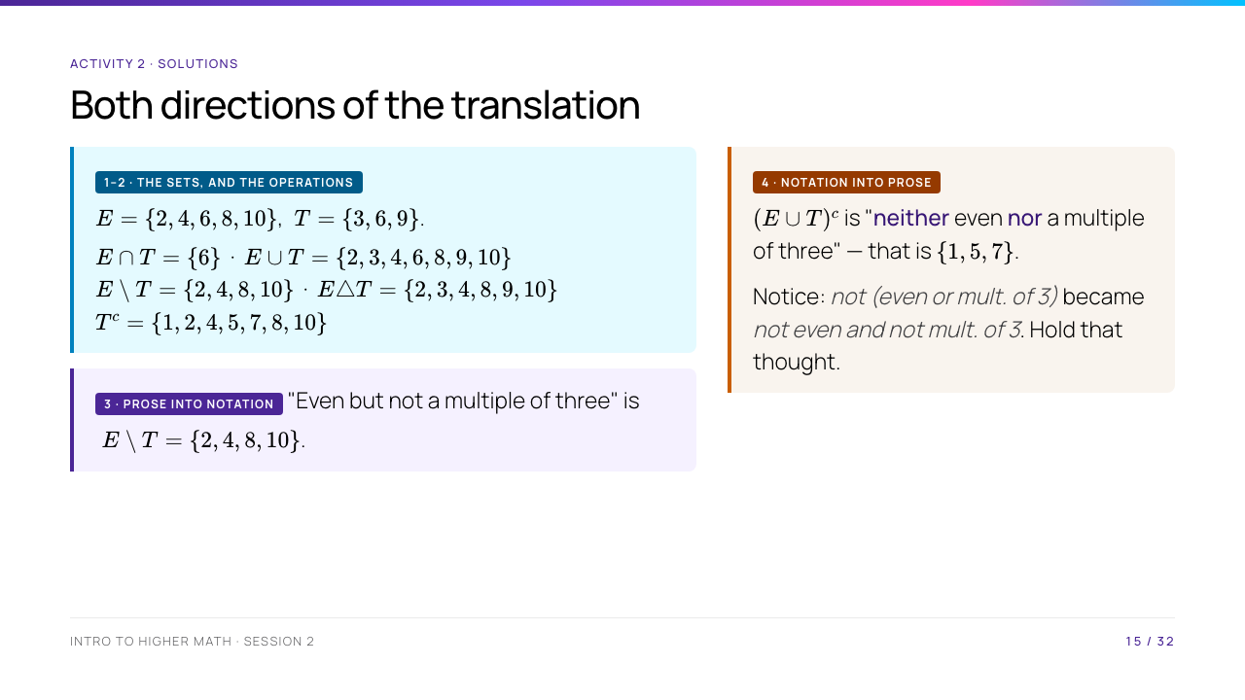
Notes:
Do not name De Morgan yet — the next slides earn it. But do make somebody say sentence (4) out loud in both forms, because they have just produced an instance of the theorem in English before meeting it in symbols, and that is the best possible motivation for it. Common slip: giving $T^c$ without reference to $U$, or forgetting that $2 \in T^c$.

Slide 16
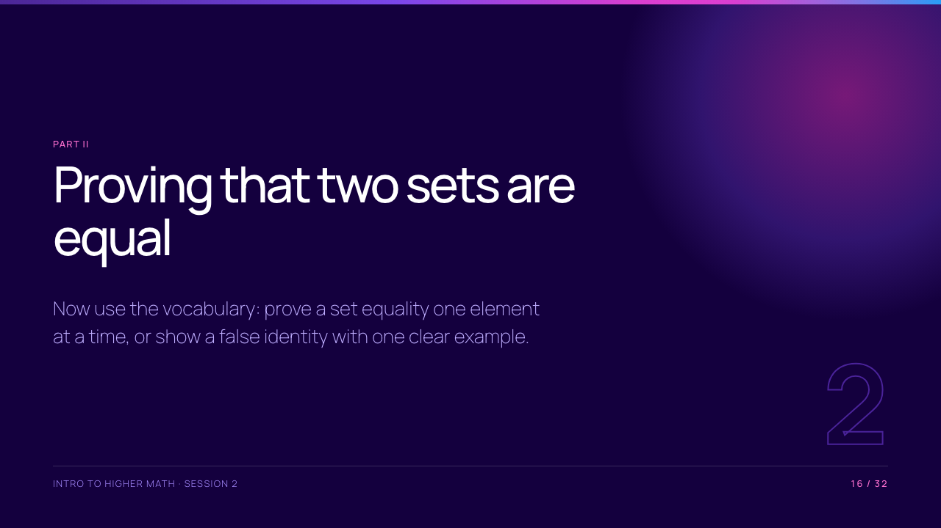

Slide 17
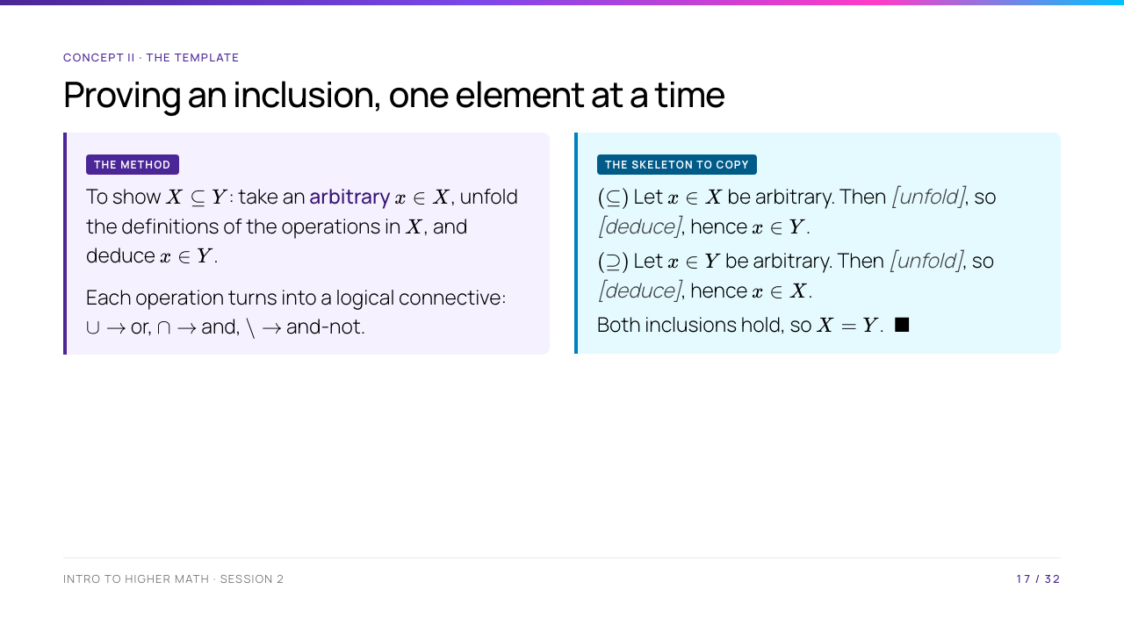
Notes:
Put this skeleton on the board and leave it there for the rest of the session — every proof today and every proof they write this week is this shape with different filling. The translation table (union-or, intersection-and, difference-and-not) is the entire technique: once the sentence is in logic, the deduction is usually one step.

Slide 18
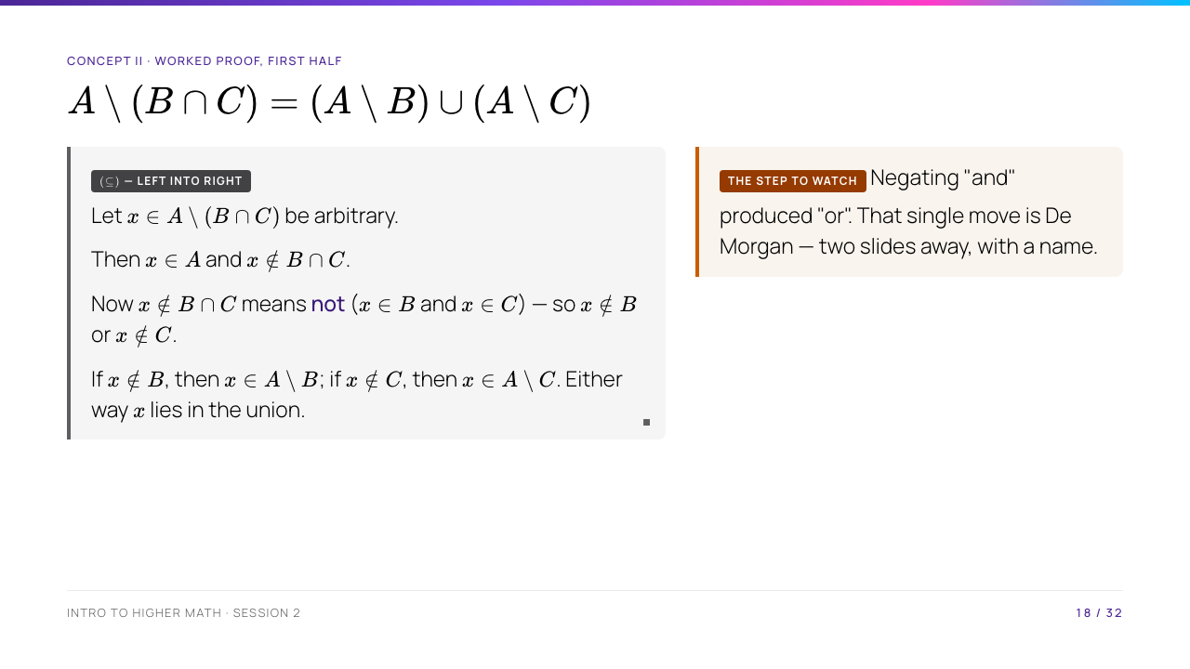
Notes:
Board example one from the course spec. Do this half live and slowly, in full sentences, and leave it on the board when you turn the slide — the second half is easier to follow with this still visible. The step students skip is the negation: "not (P and Q)" becomes "not P or not Q".

Slide 19
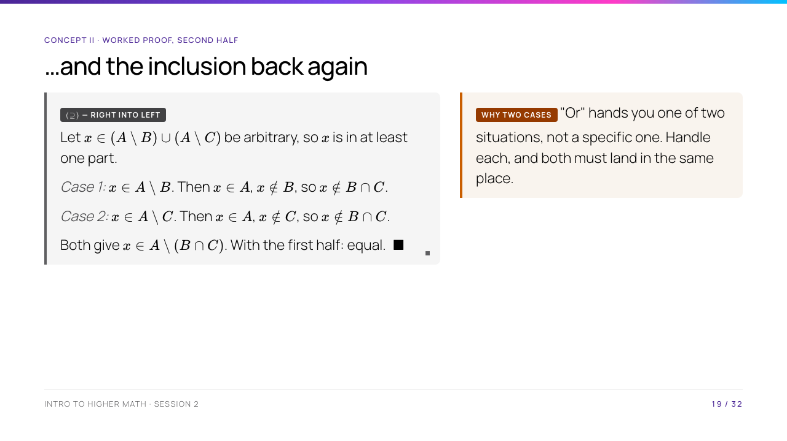
Notes:
Ask the room why the case split is forced before you write it: a union hypothesis tells you $x$ is in at least one part, but not which, so a proof that assumes it is in $A \setminus B$ has covered only half the possibilities. Then close the argument explicitly — both inclusions shown, therefore equal — because students routinely prove both halves and forget to say the conclusion.

Slide 20
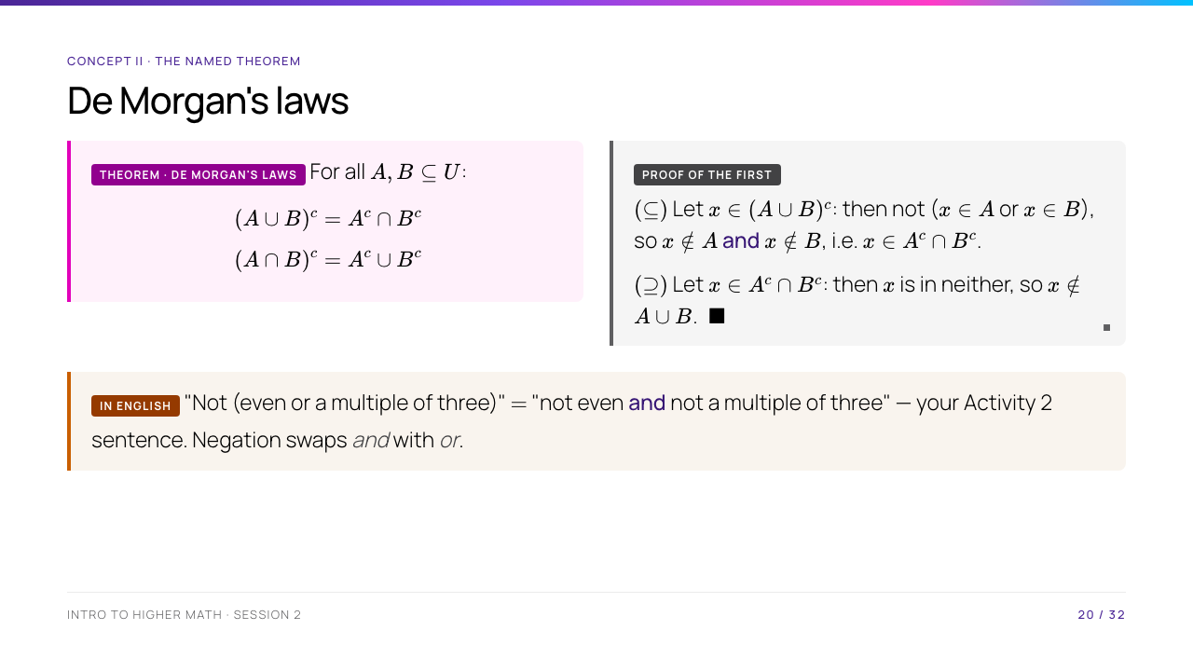
Notes:
Call back to Activity 2 explicitly: they already proved an instance of this in English without knowing its name. Prove the first law on the board and set the second as a thirty-second exercise — it is the same argument with the connectives swapped, and noticing that is worth more than watching you do it. De Morgan returns in Session 5 for quantifiers and in Session 10 for logic; flag that.

Slide 21
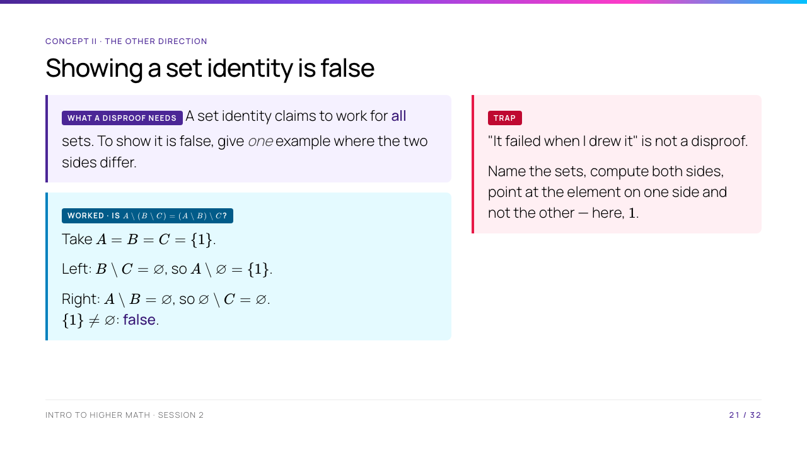
Notes:
Set difference is not associative and this is the smallest witness. Make them see the asymmetry: the search for a counterexample is not random, you look where the operations disagree — sets that overlap heavily, or the extremes $\varnothing$ and $A$ itself. Tell them the problem set has three disprove items and this is the format expected: named sets, both sides computed, offending element named.

Slide 22
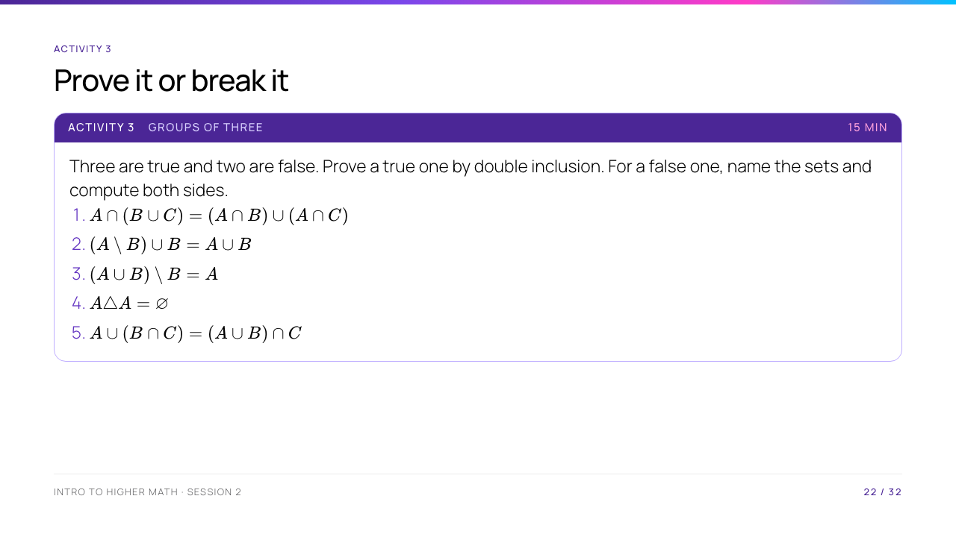
Notes:
True: 1 (distributivity), 2, 4. False: 3 and 5. For 3, take $A = \{1\}$, $B = \{1\}$: left is $\varnothing$, right is $\{1\}$ — it only holds when $A$ and $B$ are disjoint, and asking a group to find that repair is the good follow-up. For 5, take $A = \{1\}$, $B = C = \varnothing$: left $\{1\}$, right $\varnothing$. Do not let a group claim 1 by Venn diagram; that is the pitfall from before the break and this is where it gets tested.

Slide 23
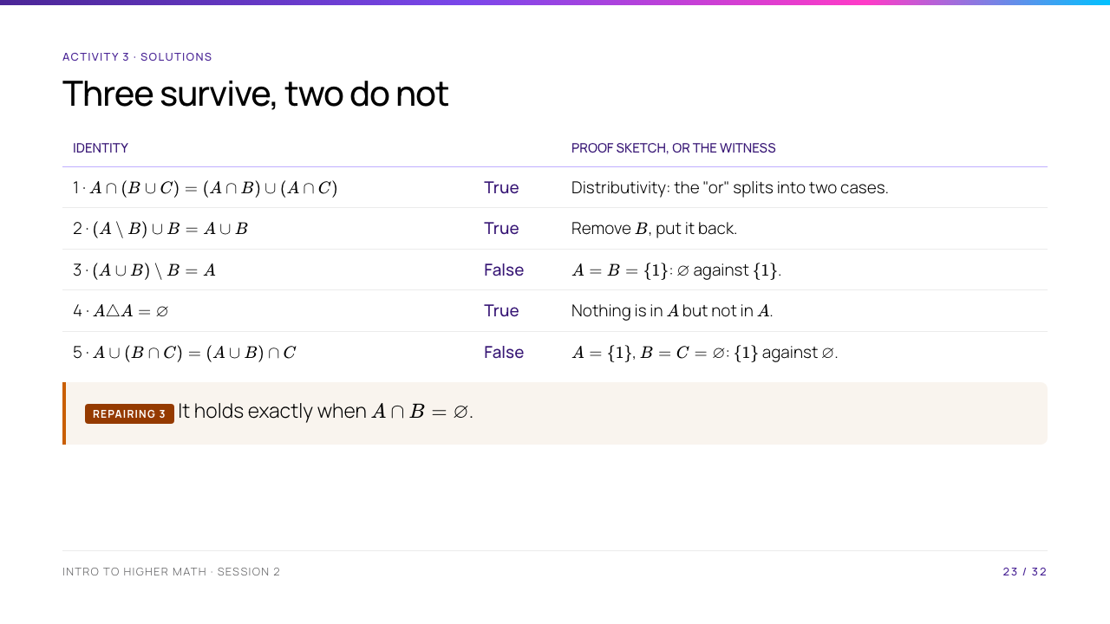
Notes:
Item 5 is worth a moment: it looks like distributivity but the outer operation on the right is wrong, which is why $\varnothing$ breaks it instantly. The general lesson for hunting counterexamples — try $\varnothing$ and try $A = B$ first, since those are where set operations degenerate. If any group proved item 1 with a Venn diagram, this is the moment to ask them for the element-chasing version.

Slide 24
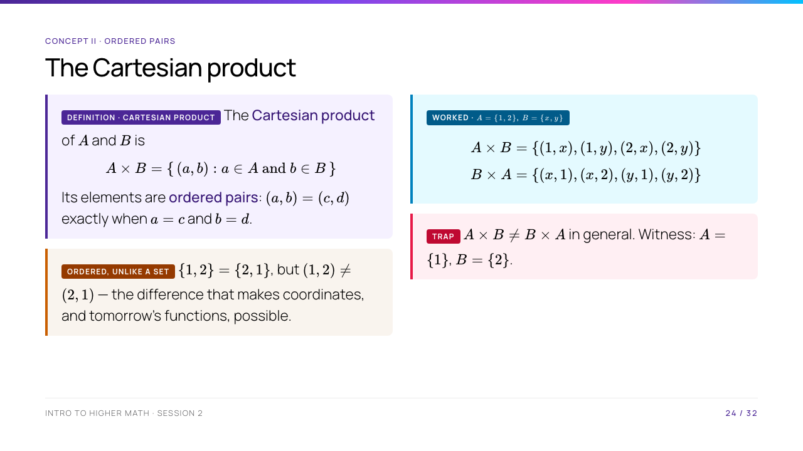
Notes:
Board example three from the spec. The point to make: $\mathbb{R} \times \mathbb{R} = \mathbb{R}^2$ is the plane they have used since school, and they have been taking ordered pairs for granted for years. Ask when $A \times B = B \times A$ actually does hold — the answer ($A = B$, or one of them empty) is a nice small proof and a good problem-set item.

Slide 25
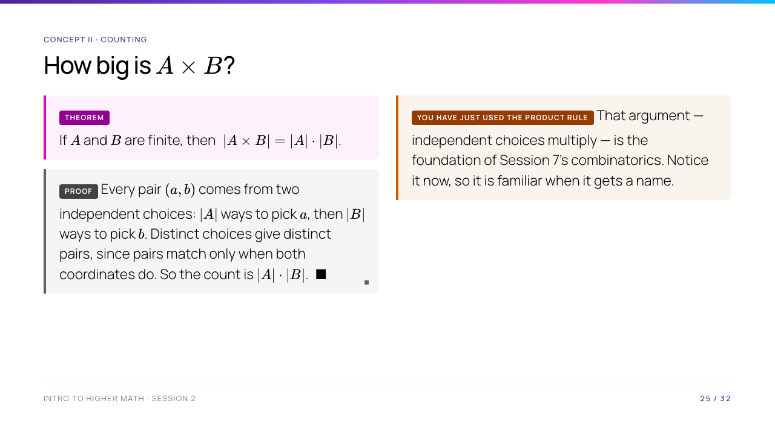
Notes:
Verify it on the $2 \times 2$ example from the previous slide before proving it in general — concrete first, then the abstraction, which is the order this cohort needs. Flag honestly that "distinct choices give distinct pairs" is the step doing the real work, and that in Session 7 this becomes the product rule with a proper name.

Slide 26
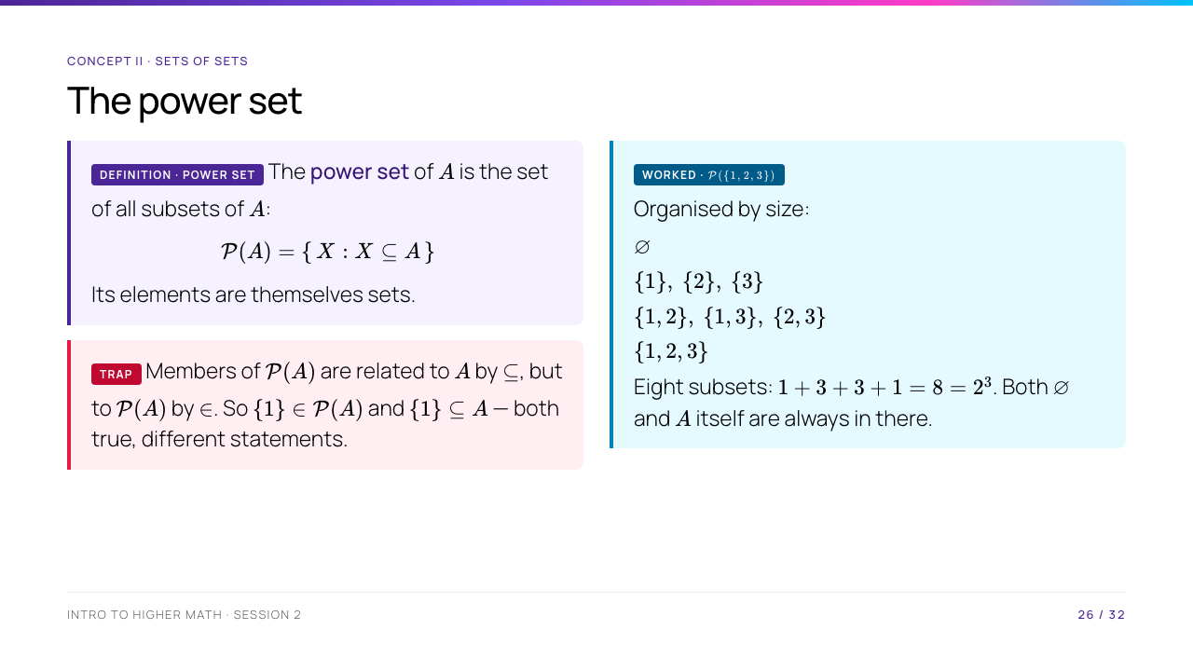
Notes:
Board example two from the spec — list all eight live, in that order, and make them tell you what is missing when you deliberately leave out $\varnothing$. The rows $1,3,3,1$ are a row of Pascal's triangle; do not explain it, just point at it and say Session 7. The $\in$ versus $\subseteq$ box is pitfall one returning in a harder costume, which is exactly why power sets are where students lose it.

Slide 27
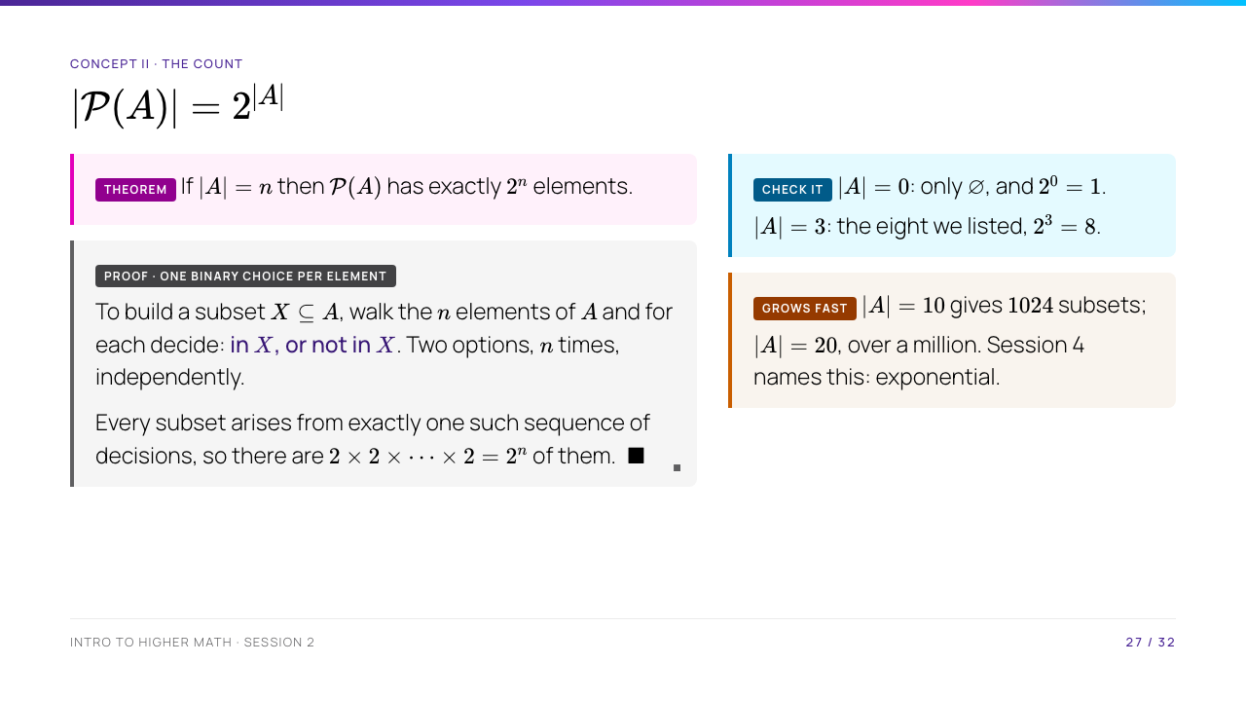
Notes:
The bijection with binary strings is worth drawing: $\{1,3\} \subseteq \{1,2,3\}$ is $101$. That picture makes $2^n$ obvious rather than memorised, and it comes back in Session 7. Note the $n = 0$ case out loud — the empty set has exactly one subset, itself — because students expect zero and it is a classic exam slip.

Slide 28
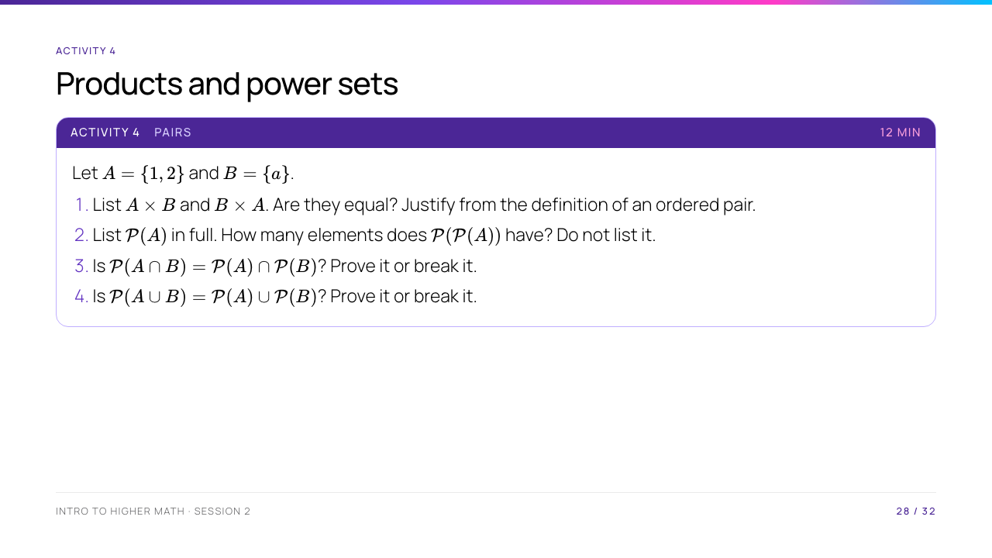
Notes:
(1) Not equal: $(1,a) \neq (a,1)$. (2) $\mathcal{P}(A)$ has 4 elements, so $\mathcal{P}(\mathcal{P}(A))$ has $2^4 = 16$ — several pairs will try to list it and lose five minutes; let one of them, it teaches the point about growth. (3) is TRUE for all sets. (4) is FALSE: with $A=\{1\}$, $B=\{2\}$, the set $\{1,2\}$ is in the left but in neither part of the right. Only $\supseteq$ holds. That asymmetry between (3) and (4) is the best thing in this activity — make sure it gets said out loud.

Slide 29
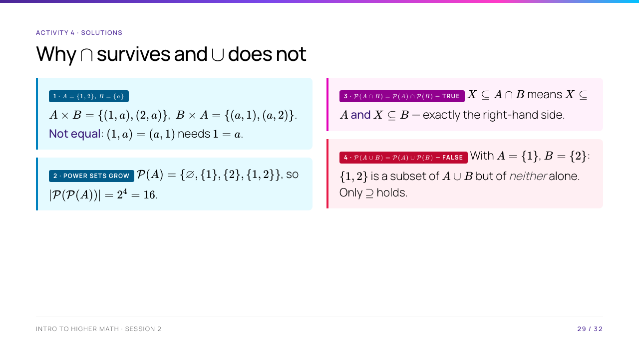
Notes:
The asymmetry is the whole point, so make somebody articulate it: "$X \subseteq A \cap B$" splits into an and , which matches intersection exactly; "$X \subseteq A \cup B$" does not split into an or, because a subset of the union may straddle both sets without sitting inside either. Item 2 is worth mentioning again — several pairs will have tried to list all 16.

Slide 30
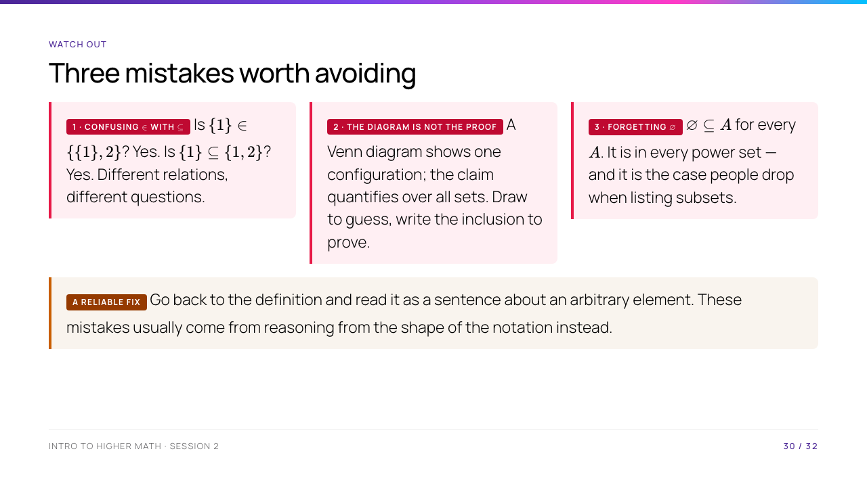
Notes:
All three are the spec's pitfalls, and each has already appeared today — call back to where. The unifying fix in the note box is the sentence to leave them with: when stuck, unfold the definition and talk about an arbitrary element. Two minutes; they are tired by now and this is a checklist, not new material.

Slide 31
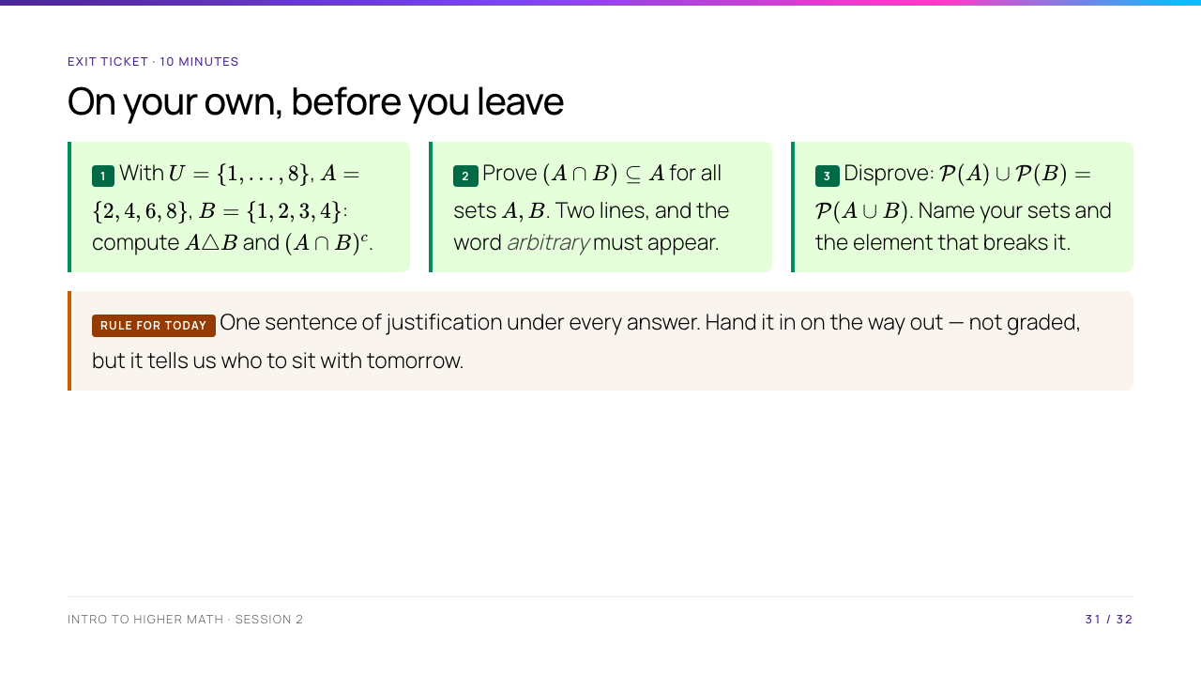
Notes:
Individual and silent. Expected: (1) $A \triangle B = \{1,3,6,8\}$ and $(A \cap B)^c = \{1,3,5,6,7,8\}$; (2) let $x \in A \cap B$ be arbitrary, then $x \in A$ and $x \in B$, in particular $x \in A$; (3) $A = \{1\}$, $B = \{2\}$, and $\{1,2\}$ is in the right side but neither part of the left — the same fact as Activity 4 question 4, so watch whether they transfer it. Collect these; they are your read on who understood double inclusion before the problem set lands.

Slide 32
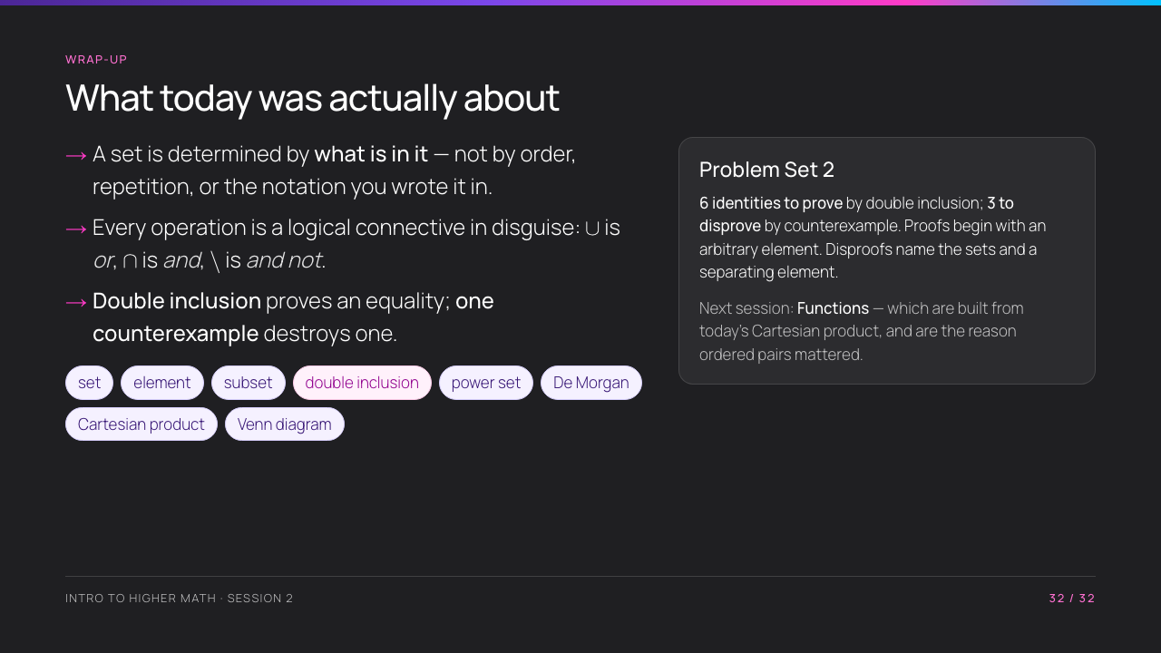
Notes:
Close on the three bullets, especially the middle one — if they remember only that operations are connectives, they can reconstruct every proof from today. Brief Problem Set 2 concretely and repeat the two format rules, because that is where marks go. Then the hook for tomorrow: a function is a special subset of $A \times B$, so today's last hour was the groundwork.

