Slide 1
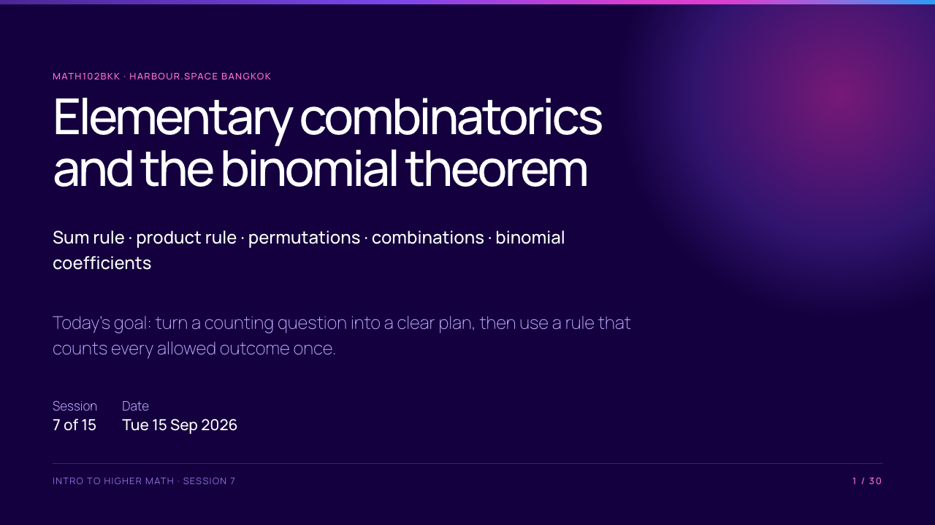
Notes:
Counting is not about choosing a formula first. Students should first say what one outcome is, whether order matters, and whether repetition is allowed.

Slide 2
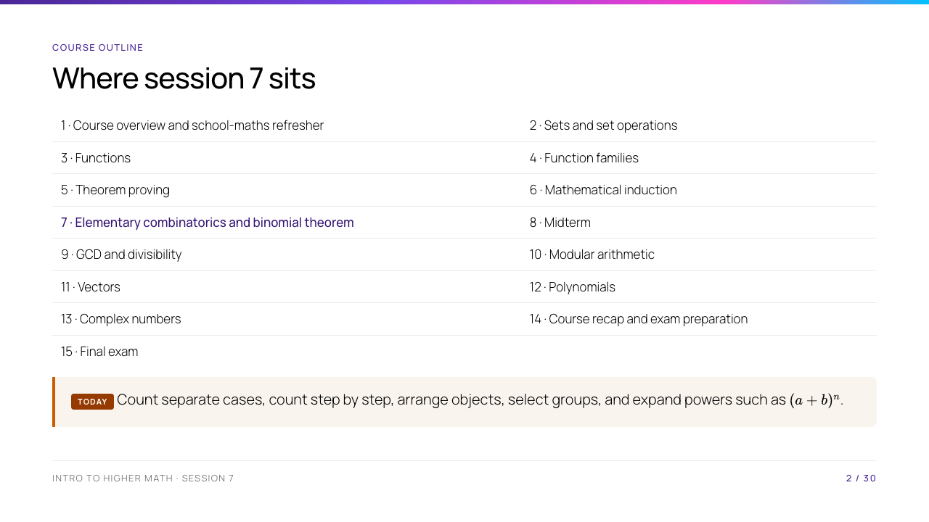
Notes:
Connect backwards to induction: many counting formulas can later be proved by induction. Connect forwards to the midterm: students need to justify why their chosen counting rule matches the question.

Slide 3
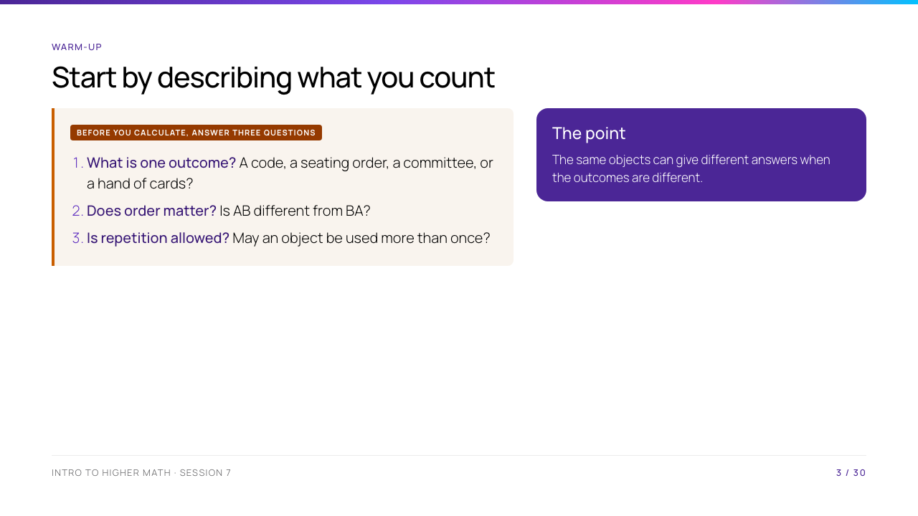
Notes:
Use two names, A and B. Choosing a two-person committee gives one outcome, but choosing a president and a secretary gives two possible ordered outcomes. This distinction drives the rest of the lesson.

Slide 4
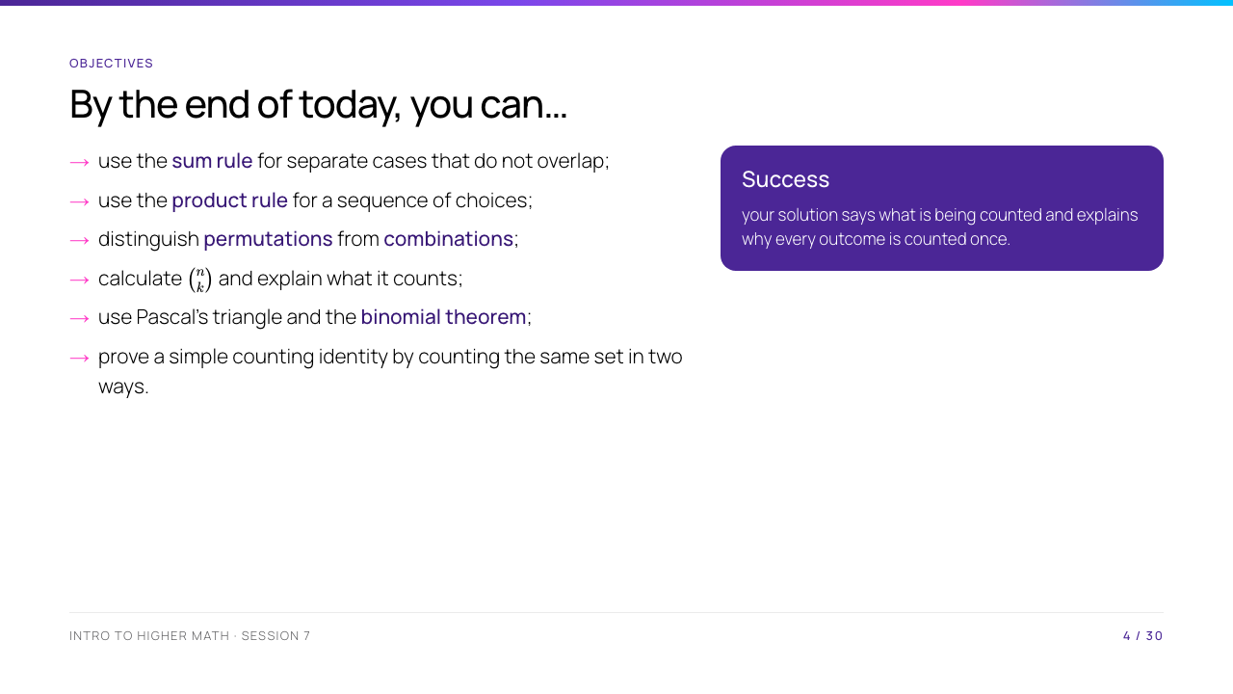
Notes:
Read "disjoint" in everyday language: one outcome cannot belong to two cases at the same time. This is the condition students often omit when using addition.

Slide 5
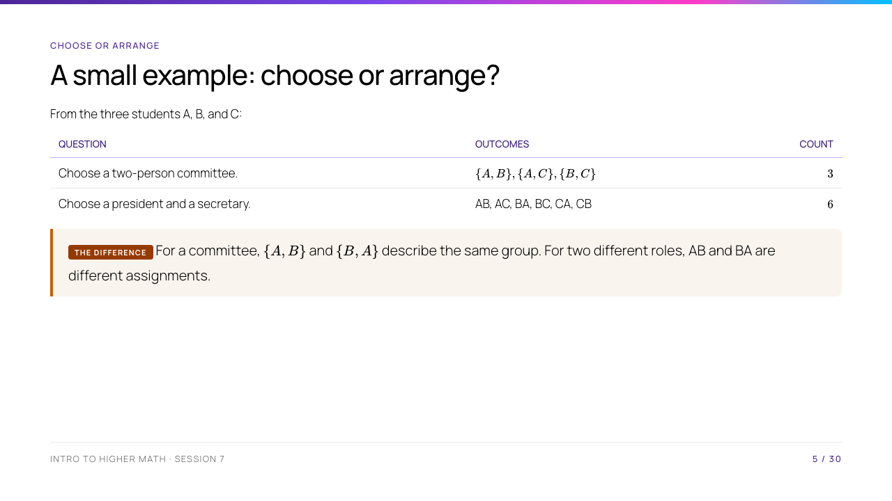
Notes:
This slide is deliberately concrete. Ask the class to explain why the first list uses braces and the second does not. Braces represent an unordered set.

Slide 6
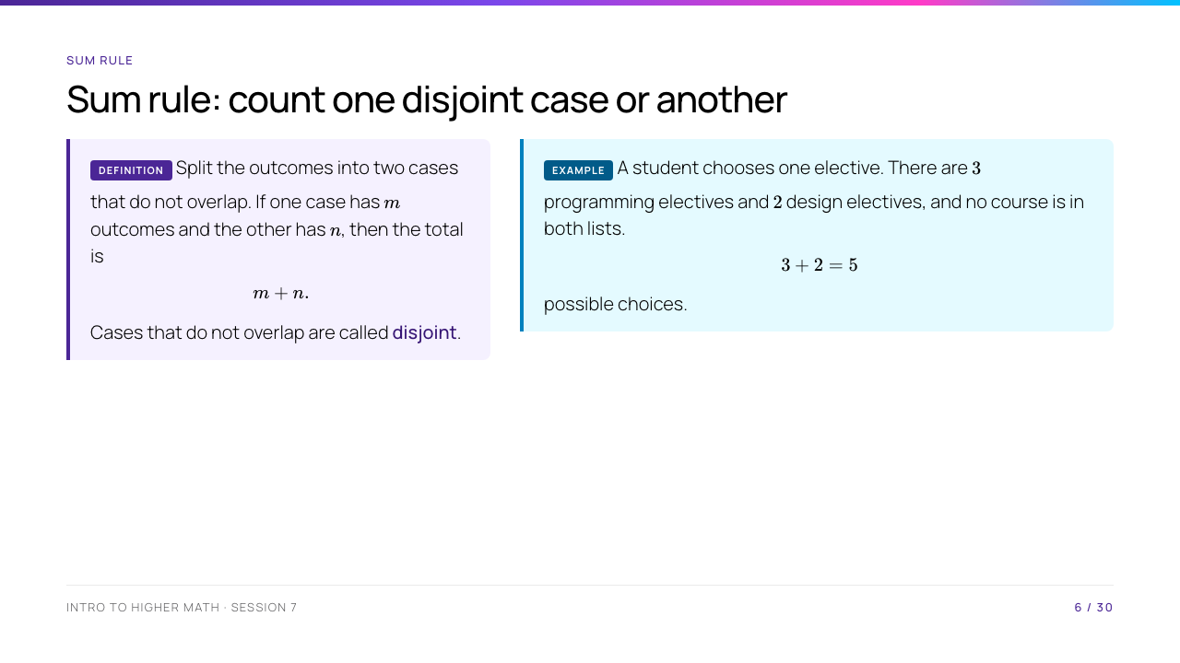
Notes:
Stress the condition. If a course were listed in both groups, adding would count it twice. Inclusion–exclusion is the repair for overlapping cases, but it is beyond today's core material.

Slide 7
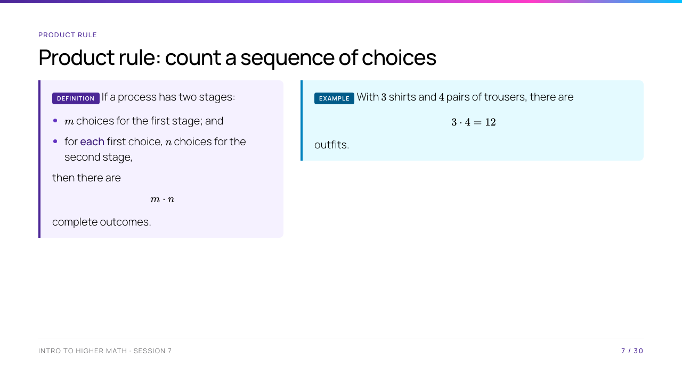
Notes:
The phrase "for each first choice" matters. The rule still works if the number of second-stage choices changes, but then multiply the relevant branch sizes and add the disjoint branches.

Slide 8
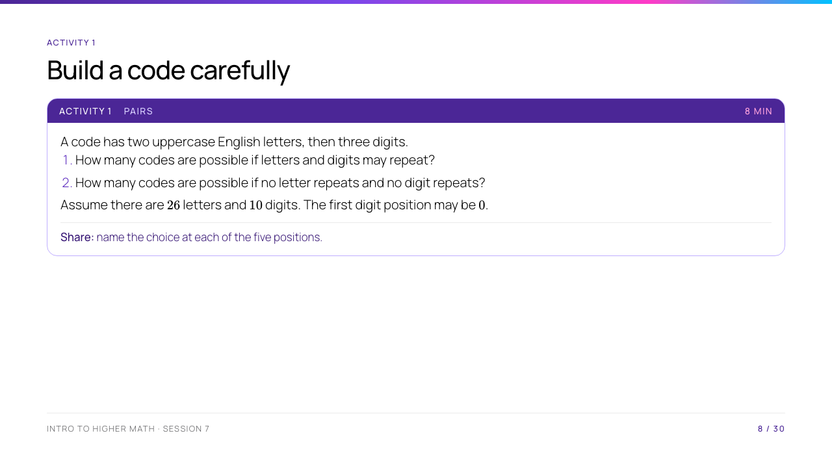
Notes:
Ask pairs not to calculate immediately. They should first write five multiplication slots. The statement about zero prevents students from treating the code as a five-digit number.

Slide 9
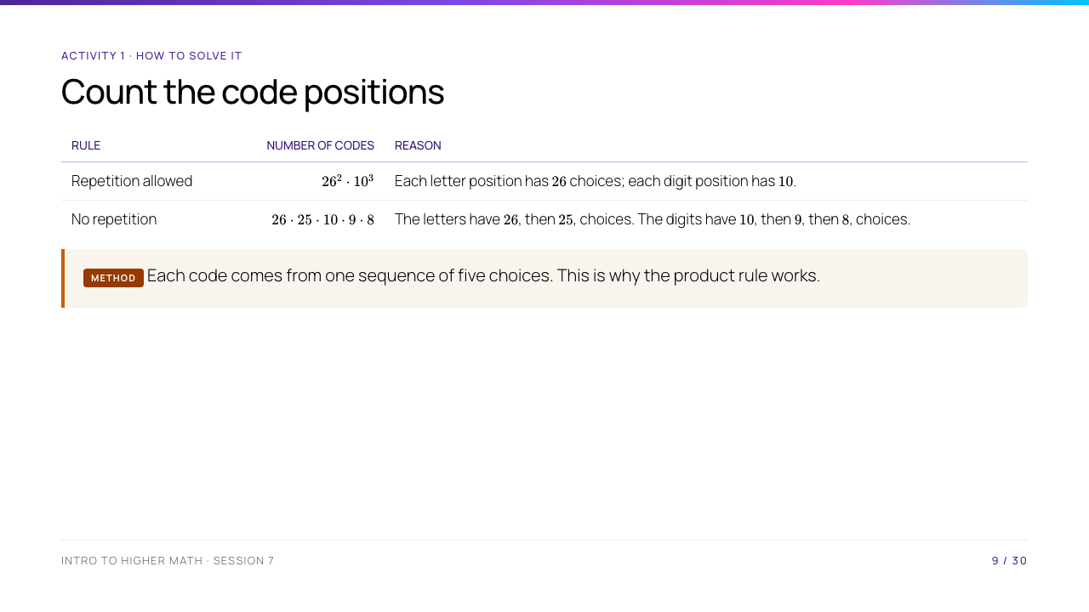
Notes:
Point out that choosing the first letter does not reduce the digit choices: letters and digits are different kinds of symbols. Only a previous letter restricts a later letter here.

Slide 10
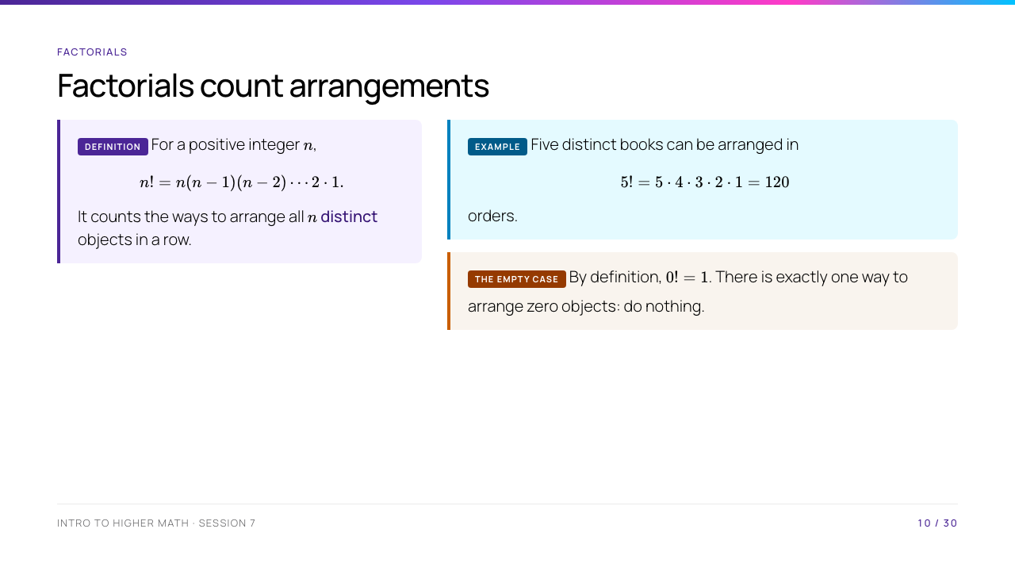
Notes:
The word "distinct" is essential. Do not apply $n!$ unchanged when some objects are identical. The definition of $0!$ is useful for binomial coefficients later.

Slide 11
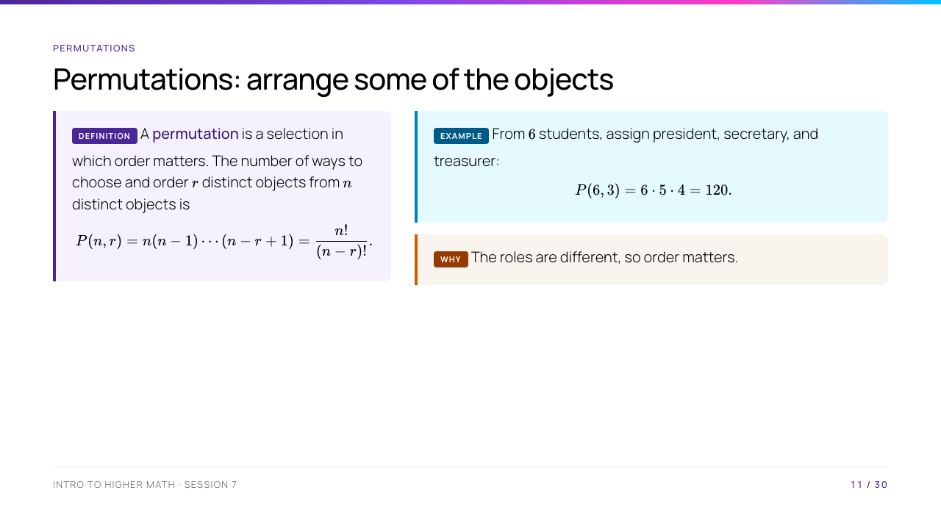
Notes:
Read $P(6,3)$ as "permutations of 6 things taken 3 at a time." The formula assumes $0\le r\le n$ and distinct candidates.

Slide 12
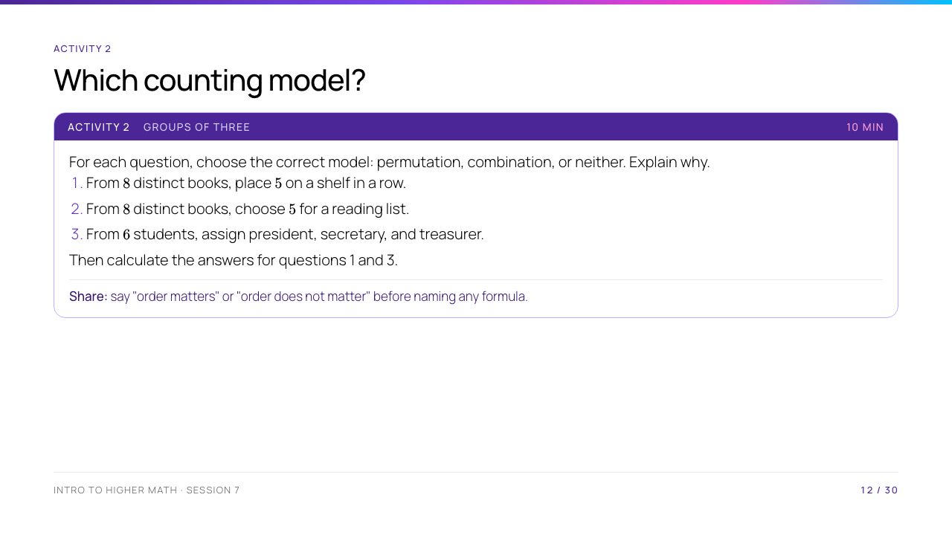
Notes:
Students should write "order matters" or "order does not matter" before any formula. Question 2 deliberately introduces combinations before the formula appears; it should be identified, not yet calculated.

Slide 13
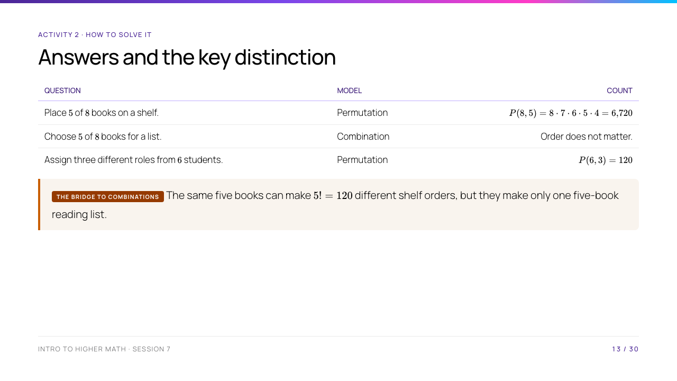
Notes:
This is the bridge to combinations. The final sentence explains exactly why a permutation count is too large for an unordered selection.

Slide 14
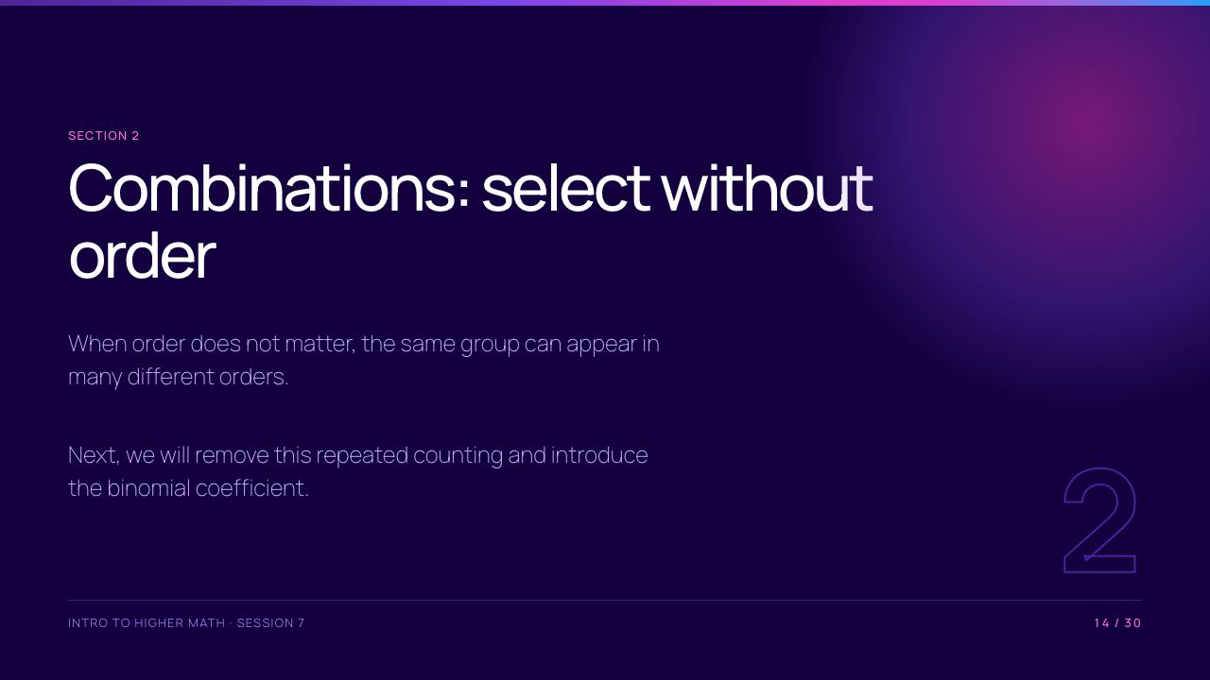
Notes:
Take the scheduled break before this section. On return, ask for the number of shelf orders of the particular five books A, B, C, D, E: it is $5!$. This motivates the division in the next slide.

Slide 15
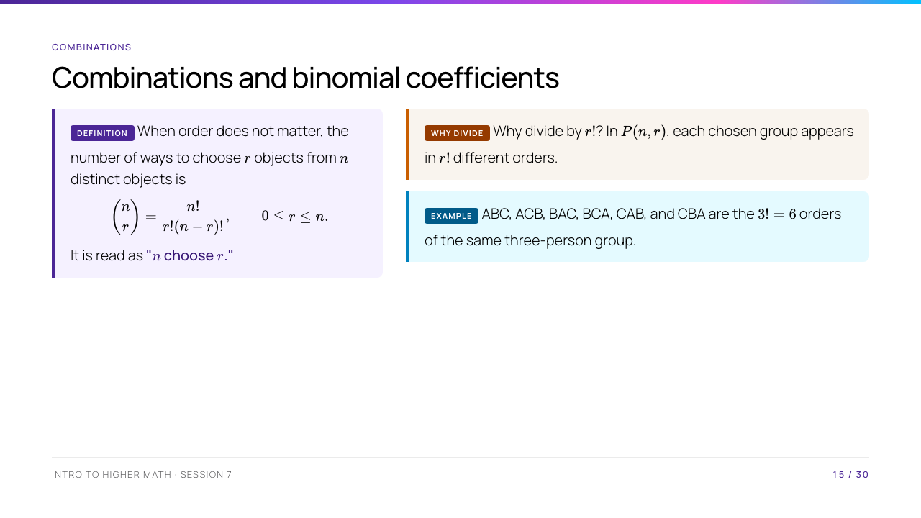
Notes:
Link directly to the previous slide: $P(n,r)=n!/(n-r)!$, then divide by $r!$. Give the small example that ABC, ACB, BAC, BCA, CAB, and CBA are the six orders of the same three-person group.

Slide 16
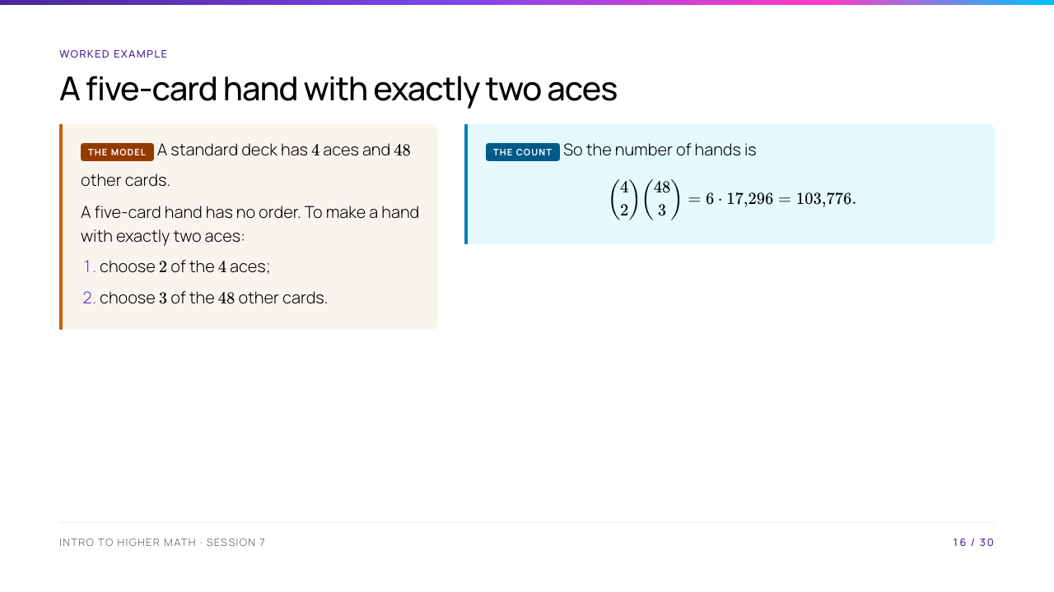
Notes:
Students often multiply by an unnecessary $5!$. A hand has no first card, second card, and so on, so both choices are combinations. The two stages produce disjoint card types, so the product rule connects them.

Slide 17
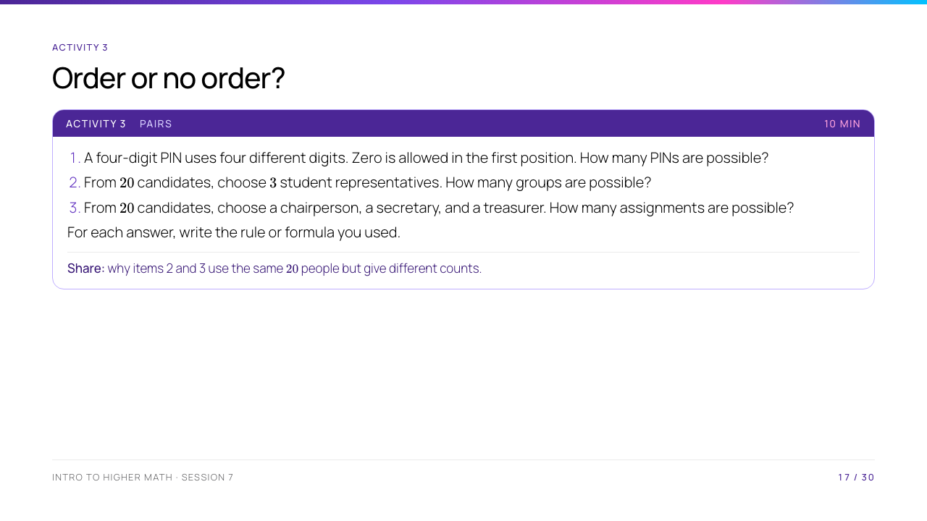
Notes:
All digits and candidates are distinct. The contrast between items 2 and 3 should be made explicit: the same three people can form one representatives group but six different three-role assignments.

Slide 18
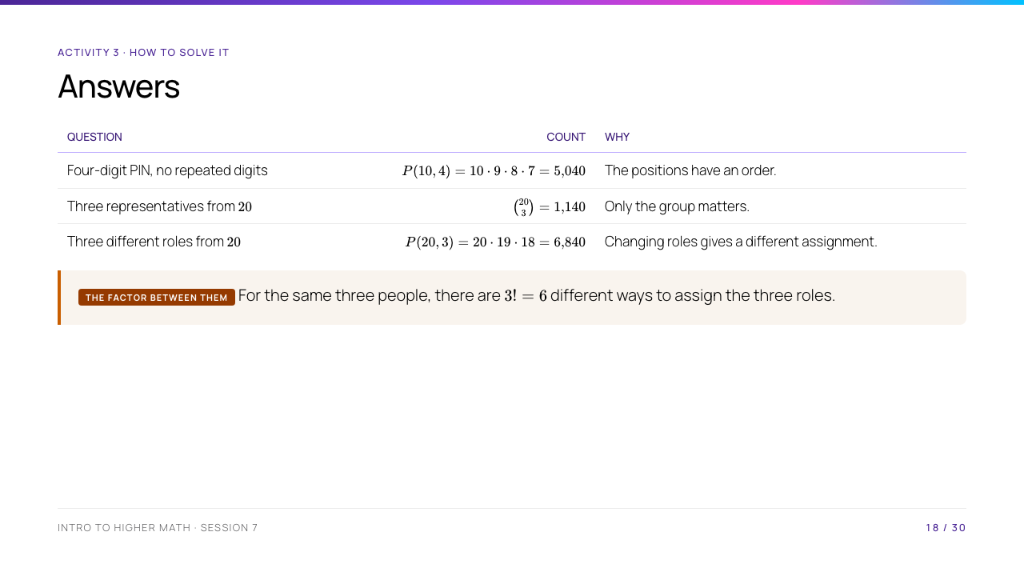
Notes:
Check the arithmetic on the board: $\binom{20}{3}=20\cdot19\cdot18/(3\cdot2\cdot1)=1{,}140$. This makes the "divide by $3!$" idea concrete.

Slide 19
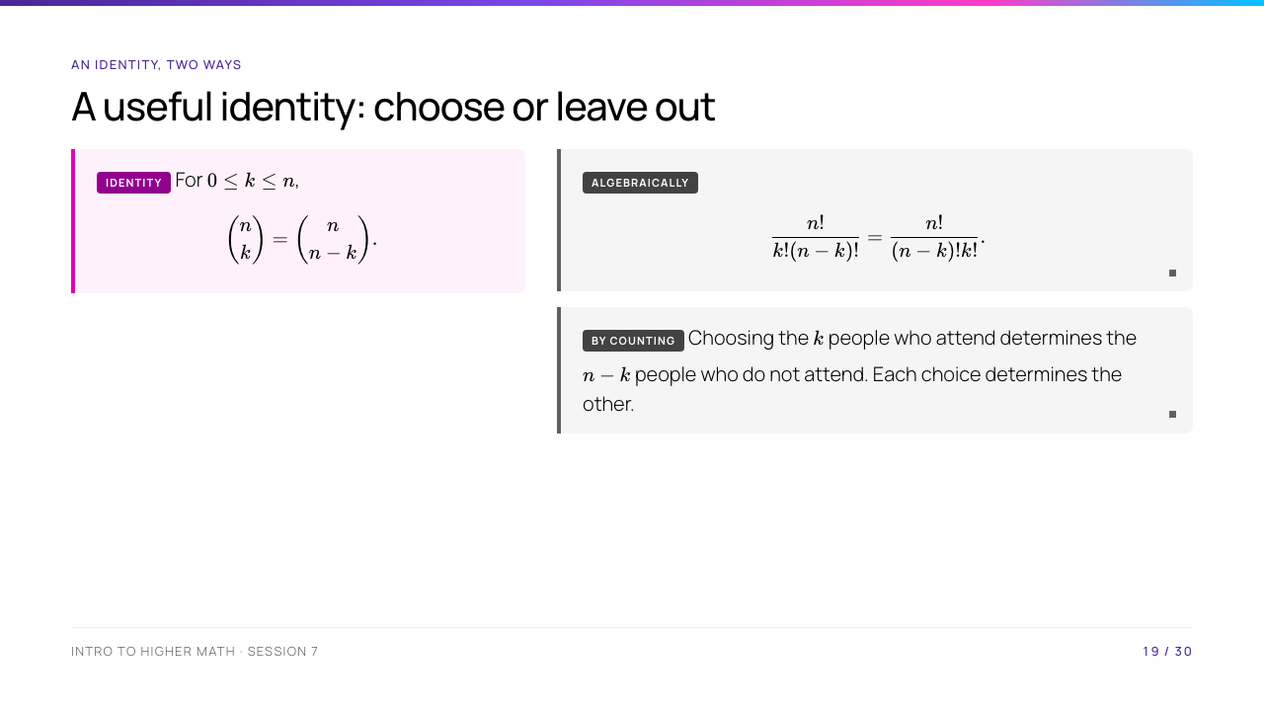
Notes:
Name the reversible matching: take a selected subset and send it to its complement. This is a bijection, so the two sets of choices have equal size. Both proofs are deliberately short and visible.

Slide 20
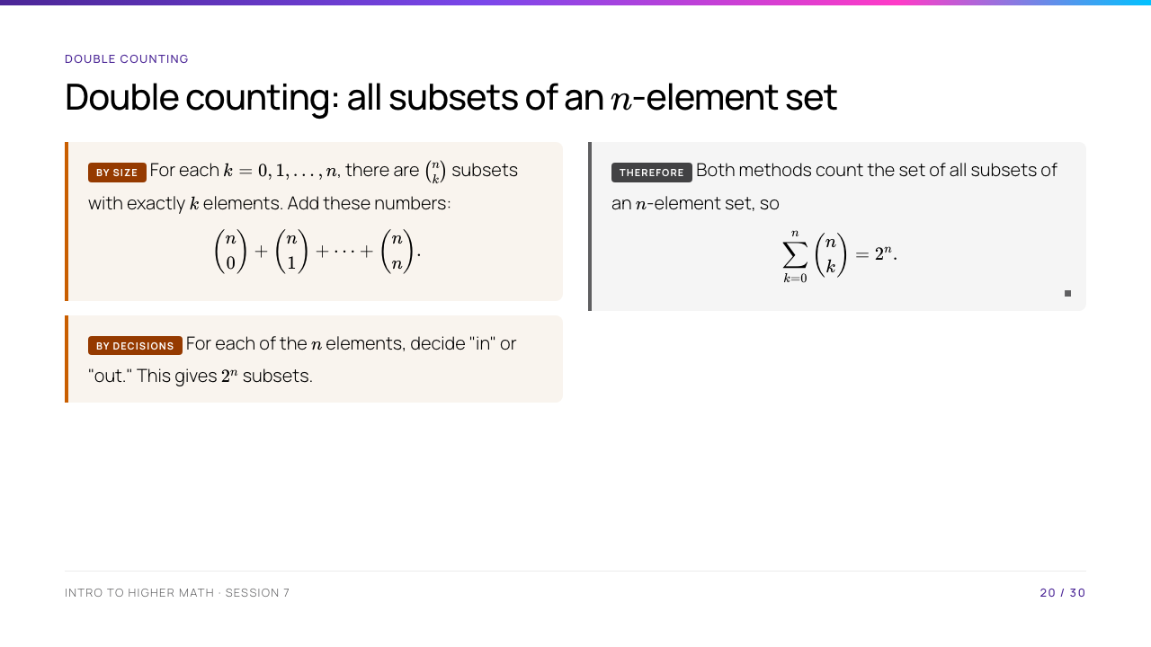
Notes:
This is double counting: both methods count the same collection, not two different collections that happen to have the same answer. For $n=3$, students can list the eight subsets as a check.

Slide 21
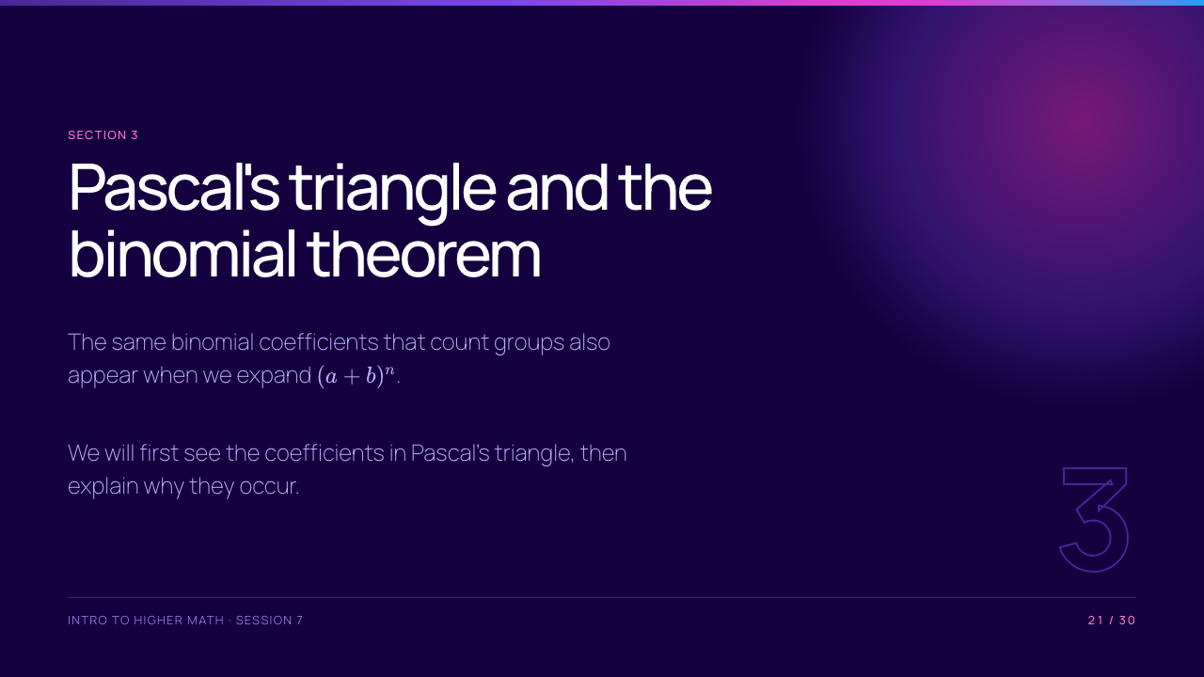
Notes:
The word "binomial" means an expression with two terms, such as $a+b$. Do not assume students know this vocabulary.

Slide 22
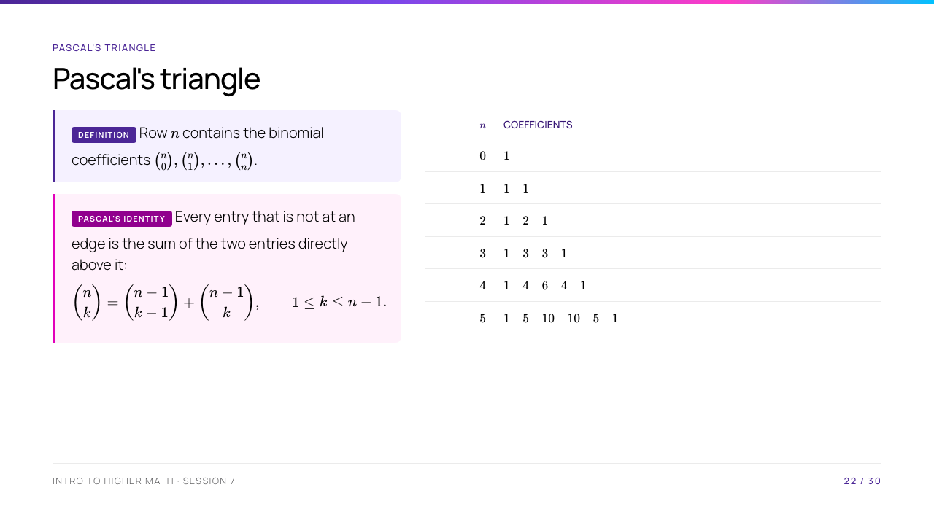
Notes:
Use the row $n=4$ to read $\binom42=6$. The last formula is Pascal's identity; its usual combinatorial proof separates a $k$-person choice according to whether one particular person is selected.

Slide 23
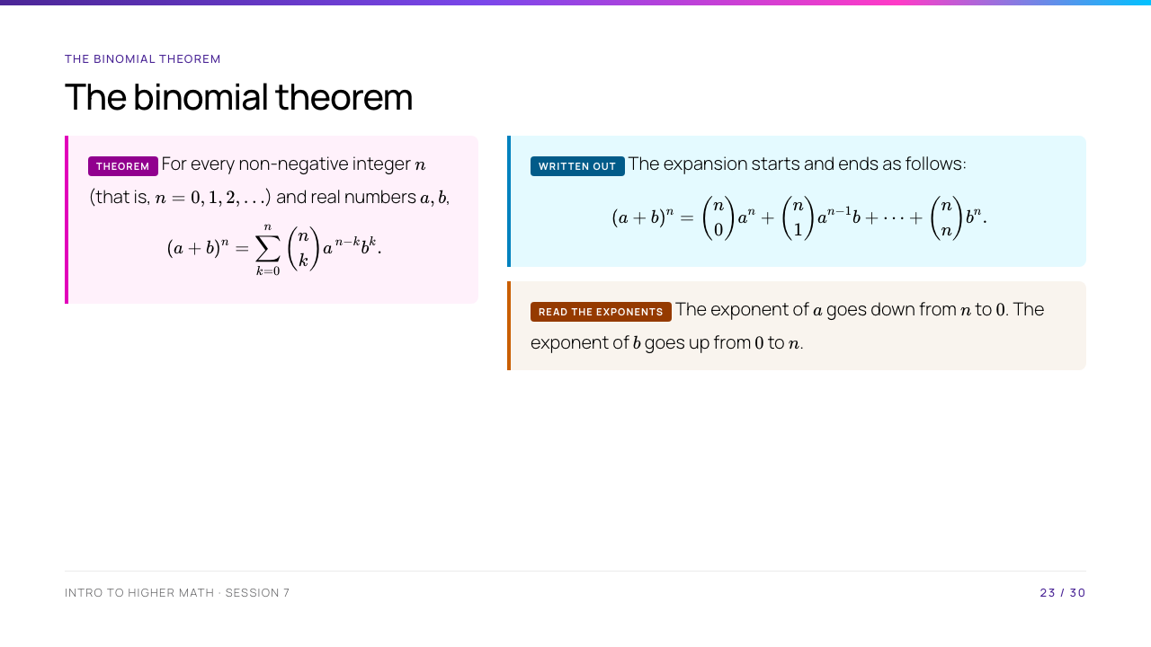
Notes:
First check $n=2$: $(a+b)^2=a^2+2ab+b^2$. The formula includes the endpoints because $\binom n0=\binom nn=1$ and $a^0=b^0=1$.

Slide 24
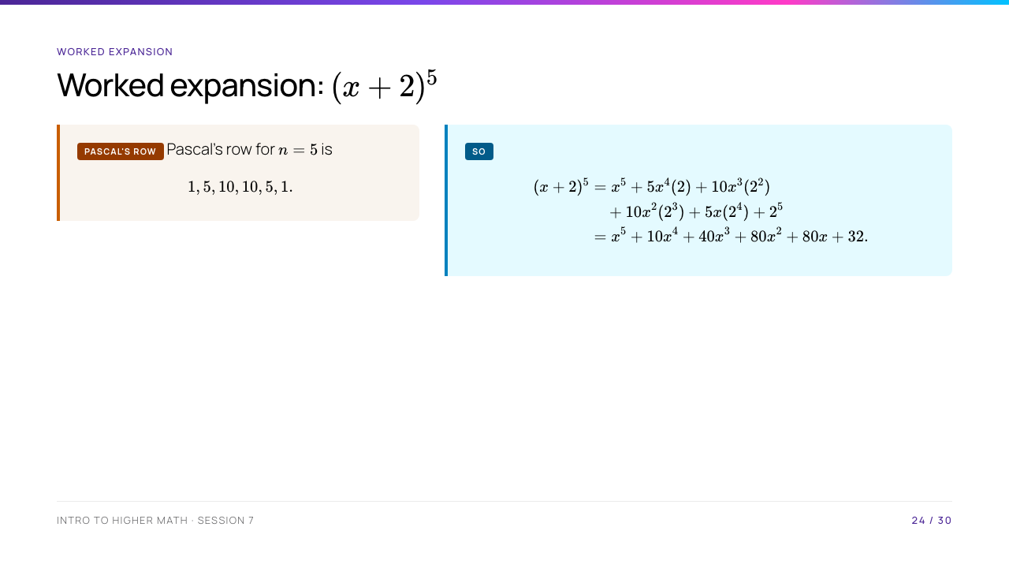
Notes:
Keep the unsimplified line visible long enough for students to trace the source of every term. In particular, the exponent on $x$ plus the exponent on $2$ is always $5$.

Slide 25
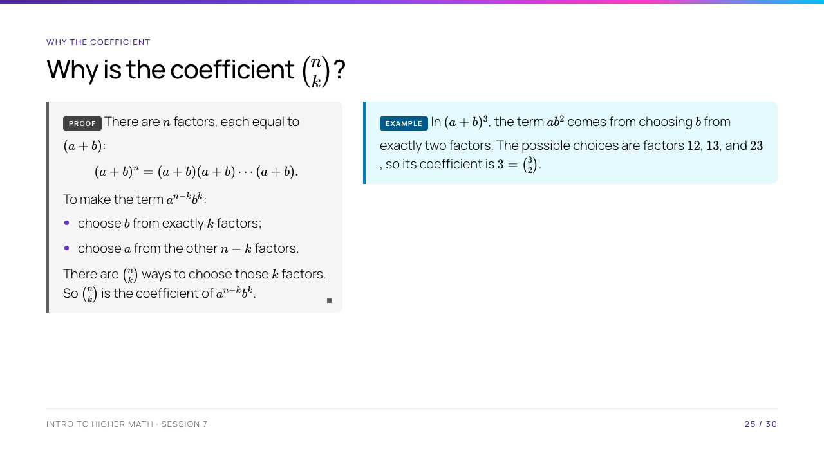
Notes:
Give the example $(a+b)^3$. The term $ab^2$ comes from choosing $b$ from exactly two factors; the possible choices are factors $12$, $13$, and $23$, so its coefficient is $3=\binom32$.

Slide 26
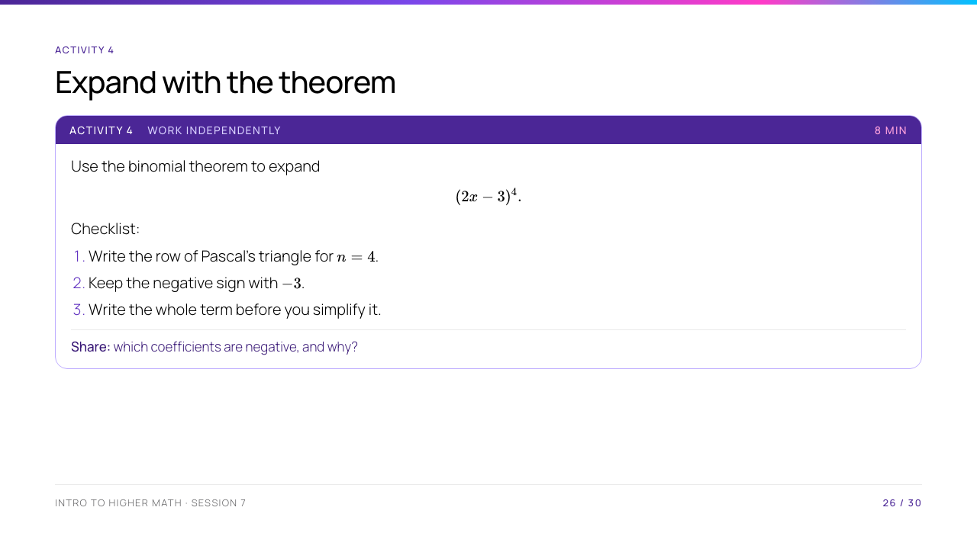
Notes:
Do not let students distribute only once and stop. The sign alternates because the power of $-3$ alternates between positive and negative values.

Slide 27
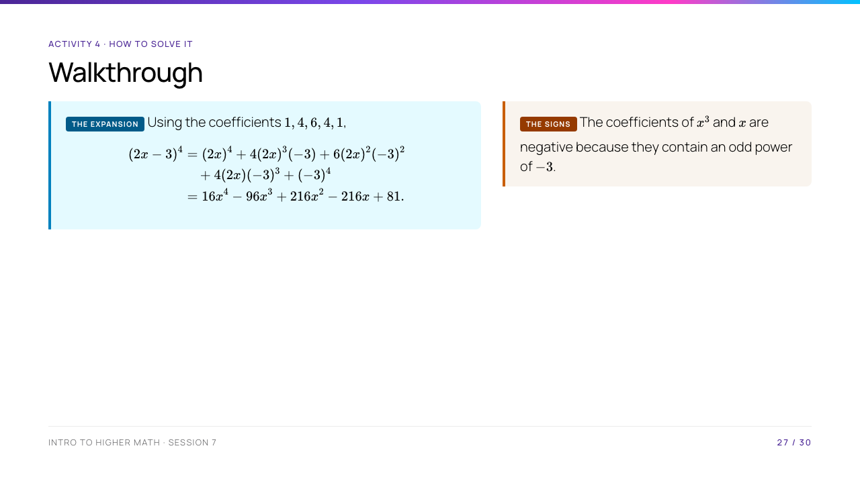
Notes:
Invite students to check one middle coefficient independently: $6(2x)^2(-3)^2=6\cdot4x^2\cdot9=216x^2$. This isolates a common arithmetic error.

Slide 28
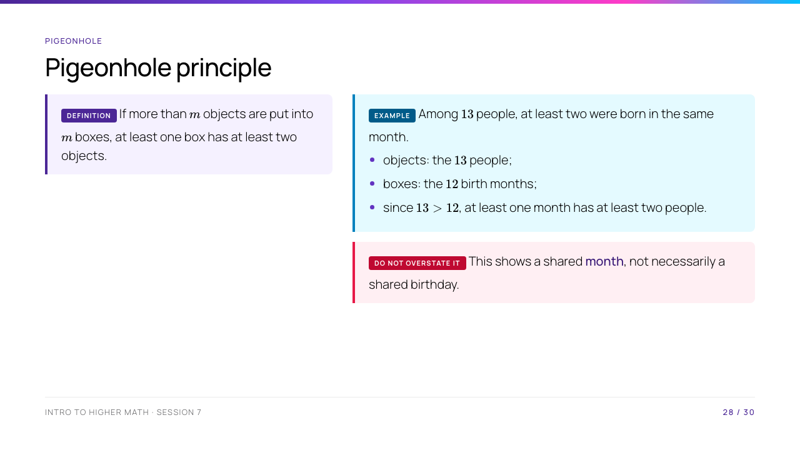
Notes:
This principle guarantees that a repeated category exists; it does not identify which category. The last sentence prevents a common overstatement of the conclusion.

Slide 29
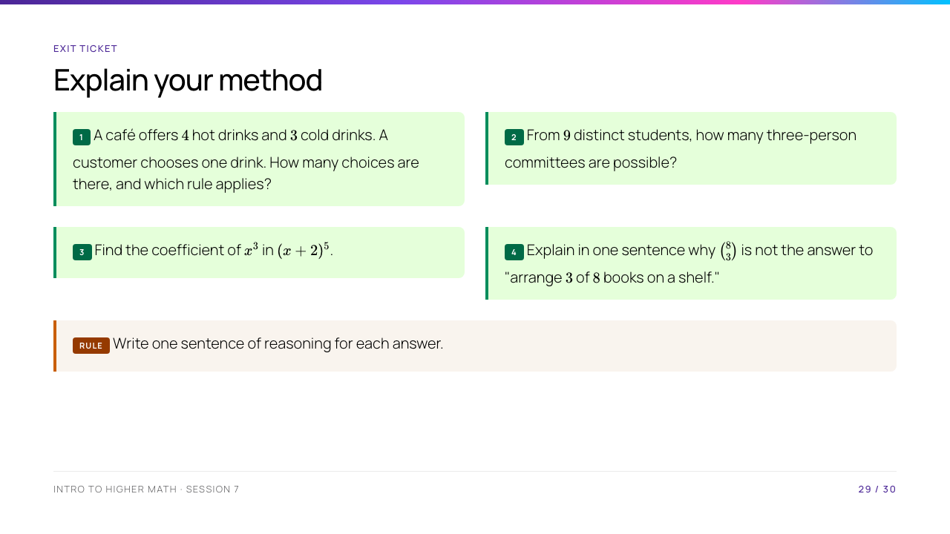
Notes:
Expected answers: 1. $4+3=7$, sum rule, because the drink types are disjoint choices. 2. $\binom93=84$. 3. $\binom52x^3(2^2)$ gives coefficient $40$. 4. A shelf order matters, so each chosen group has $3!$ different orders.

Slide 30
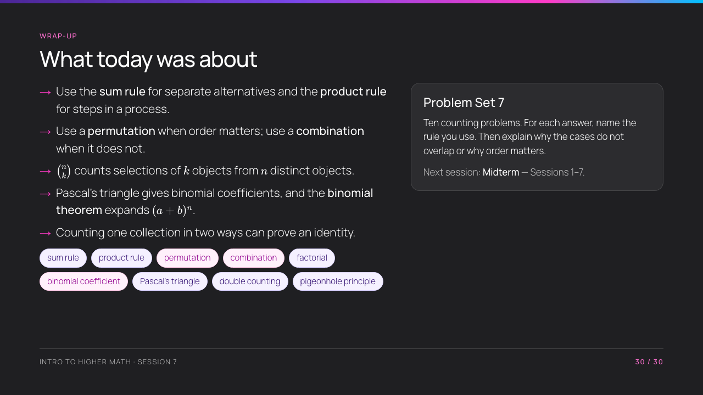
Notes:
End by asking students to say the key diagnostic question before choosing a formula: "Does order matter?" Remind them that a correct number with an unexplained model is not a complete solution.

