Slide 1

A LabVIEW Dependency Injection Framework
Kurt Friday: Chief Engineer and Co-Founder - Medulla Pty Ltd

Slide 2
What is ViPER?
ViPER is an OO Framework that allows you to build systems that Implement Dependency Injection. ViPER based systems assemble themselves at runtime from a collection of pre-built and pre-verified components.
Why create ViPER?
ViPER was developed to minimize the effort spent on software verification & validation activities for systems used in mission critical applications or in regulated environments such as medical device manufacturing.
Notes:
Talk about the motivation to build ViPER
Initial problem, systems 90% the same but all different builds
Change management issues, add a driver, redundant hardware How do you accommodate future change How to get away from building executables and going through extensive V&V
Didn’t know what Dependency injection was just wanted to solve a problem.
I wanted a plugin architecture where the dependencies sat outside the build not inside.
Started to build 1st generation called ViKING
Then started contracting to Cochlear to develop an implant test system, this architecture significantly reduced the cost of V&V activities

Slide 3
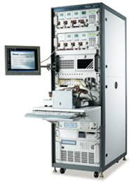
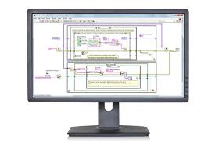

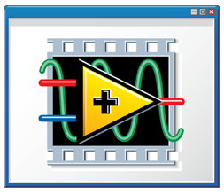
Simplified process of updating a Xilinx JTAG driver for a conventional system
Software
Development
Un-verified
build exe
System
Verification Protocol
Verified
build exe
Test System
Notes:
Talk about the motivation to build ViPER
Initial problem, systems 90% the same but all different builds
Change management issues, add a driver, redundant hardware How do you accommodate future change How to get away from building executables and going through extensive V&V
Didn’t know what Dependency injection was just wanted to solve a problem.
I wanted a plugin architecture where the dependencies sat outside the build not inside.
Started to build 1st generation called ViKING
Then started contracting to Cochlear to develop an implant test system, this architecture significantly reduced the cost of V&V activities

Slide 4
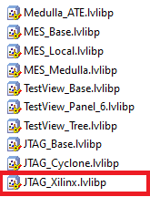
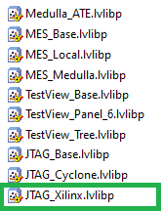

Simplified process of updating a Xilinx JTAG driver for a ViPER system
Software
Development
JTAG_Xilinx
Un-verified
JTAG_Xilinx
Verification Protocol
JTAG_Xilinx
Verified
Test System
Notes:
Talk about the motivation to build ViPER
Initial problem, systems 90% the same but all different builds
Change management issues, add a driver, redundant hardware How do you accommodate future change How to get away from building executables and going through extensive V&V
Didn’t know what Dependency injection was just wanted to solve a problem.
I wanted a plugin architecture where the dependencies sat outside the build not inside.
Started to build 1st generation called ViKING
Then started contracting to Cochlear to develop an implant test system, this architecture significantly reduced the cost of V&V activities

Slide 5
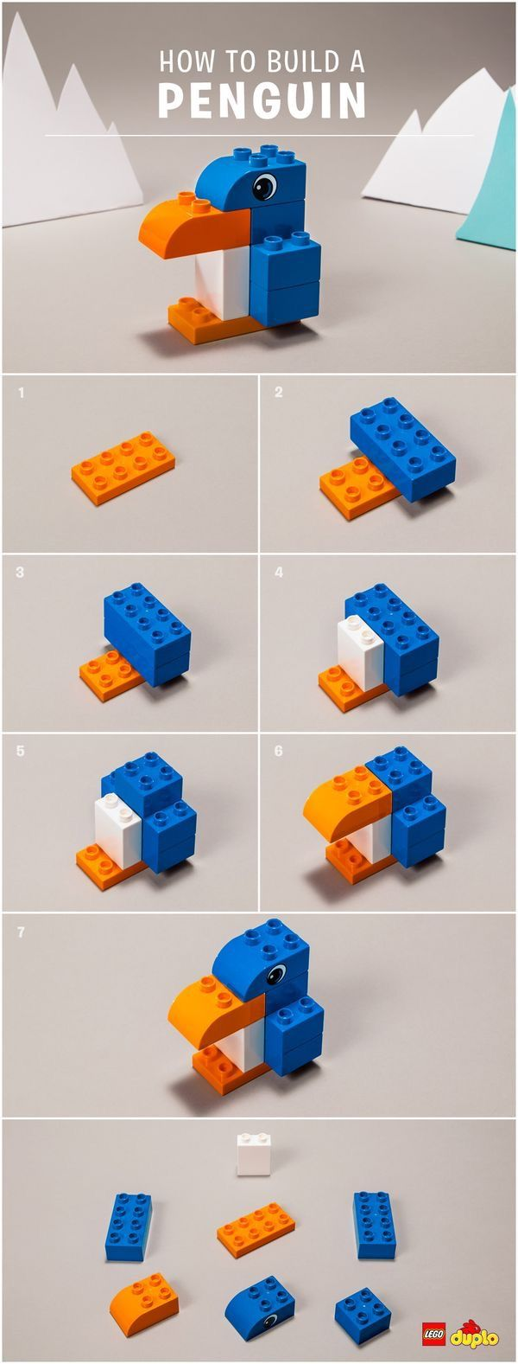



Object Definition Document
Constructor
Object
Components

Slide 6
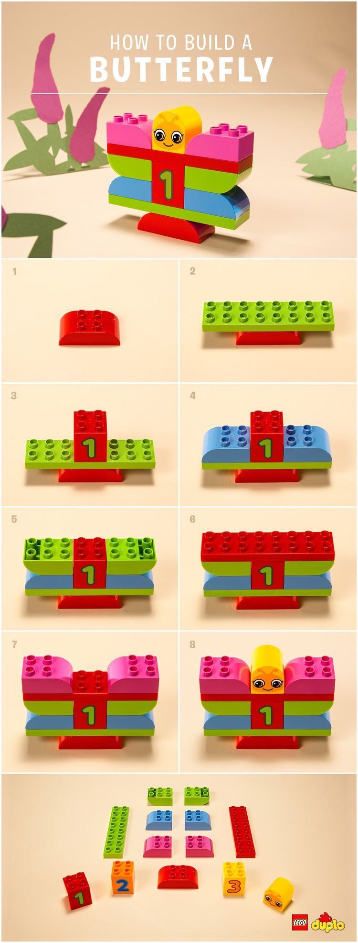

Object Definition Document
Constructor
Object
Components
Notes:
Blah

Slide 7

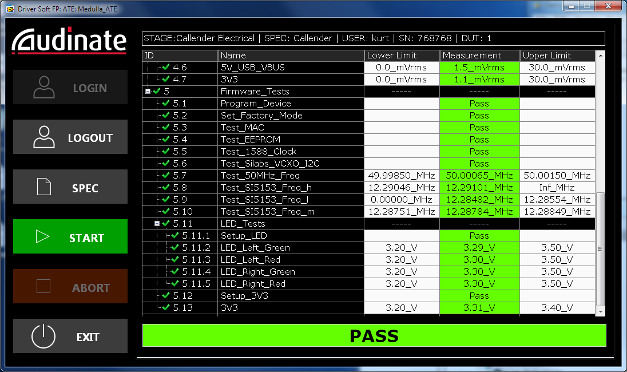
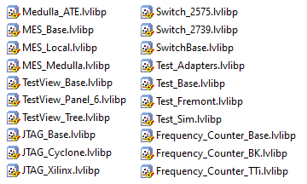
Object Definition Document
Constructor
Object
ATE_Engineering
Components

Slide 8
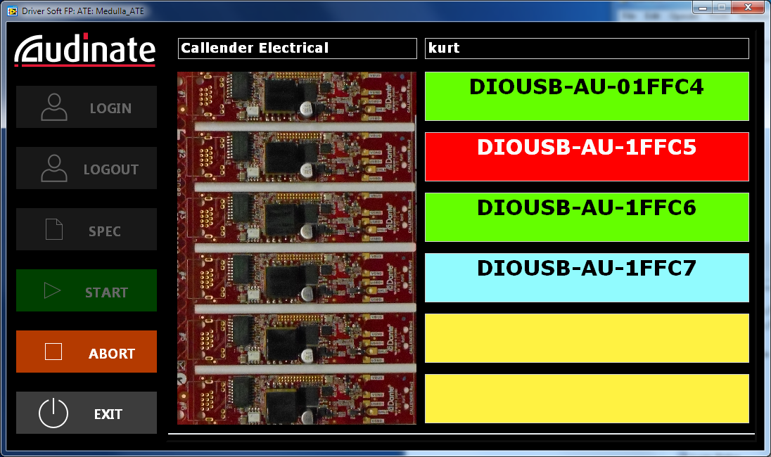
Object Definition Document
Constructor
Object
ATE_Production
Components

Slide 9

Demo Time !

Slide 10
Presentations
GLA 2021
https://labviewwiki.org/wiki/GLA_Summit_2021/Open_Source_ViPER
GLA 2022
https://labviewwiki.org/wiki/GLA_Summit_2020/ViPER_-_A_LabVIEW_Dependency_Injection_Framework

