Slide 1
MCDO:
Candidate Subscription App
Members:
Del Valle, Lance
Kho, Jon Macaulay
Ley, Kurt
Ong, Jarrettte

Slide 2
Background of The Application
Inline with the coming election, we have decided to create a web application to be hosted on Bluemix that helps in distributing news, issues and information regarding the candidates to the public voters.

Slide 3
MCDO: Candidate Subscription App
The app allows users to register and provide their phone number and other credentials. After this, they can choose which candidates they will subscribe to. The application then stores these credentials to a database.
Campaign managers also register to the app and choose the candidate they are managing. They have the ability to send notifications to the list of users who are subscribed to their candidate. The application uses the Twilio service to deliver these updates via SMS messages.

Slide 4
Users Involved
Candidate supporters
Users who will choose which candidate to support and they will receive updates regarding any events or happening that is related to that candidate.
Campaign Managers
They are the ones who will send the notification to all supporters of the candidate they are managing.

Slide 5
Relevance of the Application
Effective and Easy Dissemination of Information.
Candidate Supporters only need internet connection once = when registering with the Web application.
Can be used during Pre Election, Election, and Post Election.

Slide 6


Services Used

Slide 7
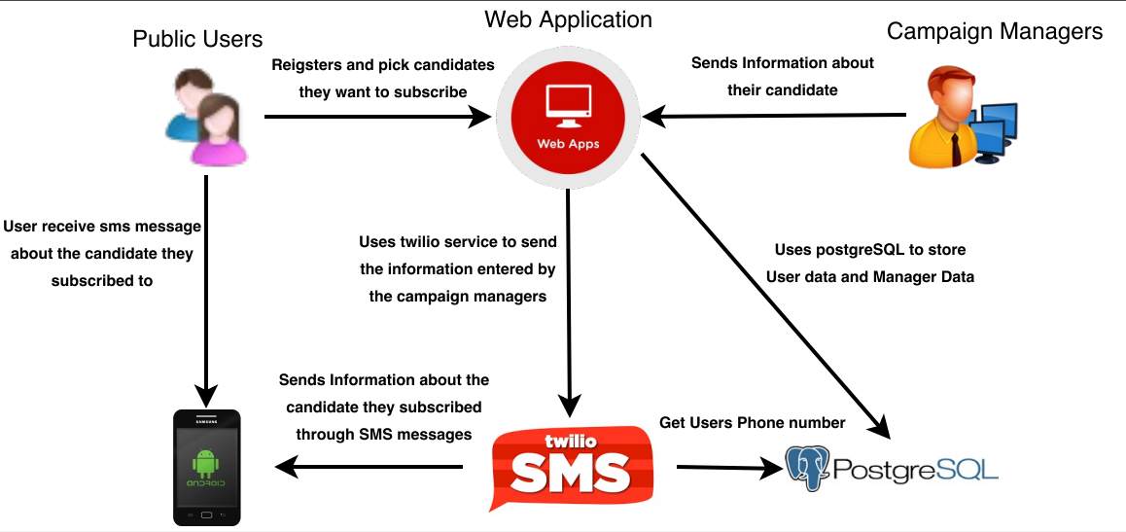
How the application works

