Slide 1
Insights for Twitter
By: Kurt Ley

Slide 2
Insights for Twitter
Description:
Use IBM® Insights for Twitter to incorporate Twitter content from the Twitter Decahose or PowerTrack streams into your IBM Bluemix® applications.

Slide 3
Rest API
The Insights for Twitter service consists of a RESTful(Representational State Transfer) API to search for and consume Twitter content

Slide 4
API Operations
Search - Finds Tweets in the Decahose or filtered PowerTrack stream.
Count - Returns the number of Tweets based on a given query.
Check - Determines whether a list of messages complies with Twitter policies and Twitter users.
Tracks - Provides Entry Plan users an assortment of endpoints to manage PowerTrack filters.

Slide 5
Types of Streams
Decahose streams
Free Plan & Entry Plan
Tweets are derived from Twitter in real time
PowerTrack streams
Entry Plan
Tweets are derived from Twitter in real time
Filter incoming Tweets, based on a user-defined rules-based filter

Slide 6
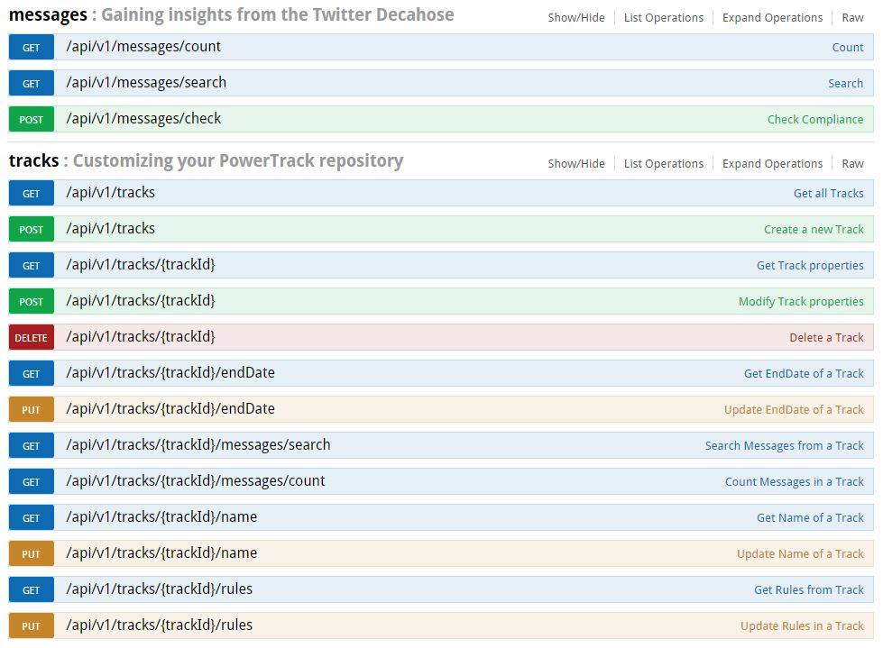
Stream & API Operations

Slide 7
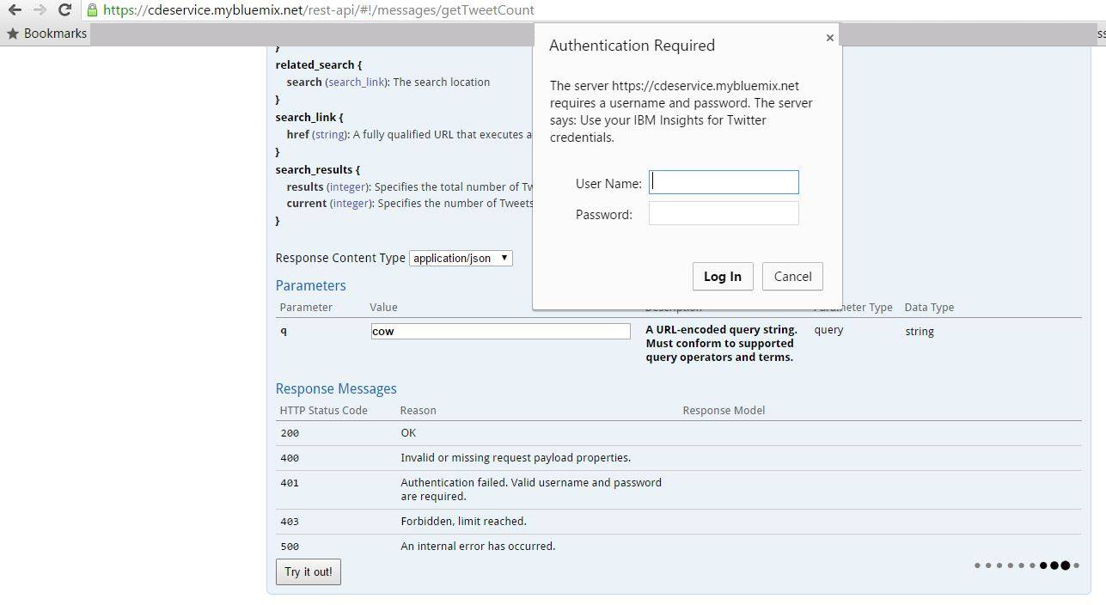
Demo - Authentication

Slide 8
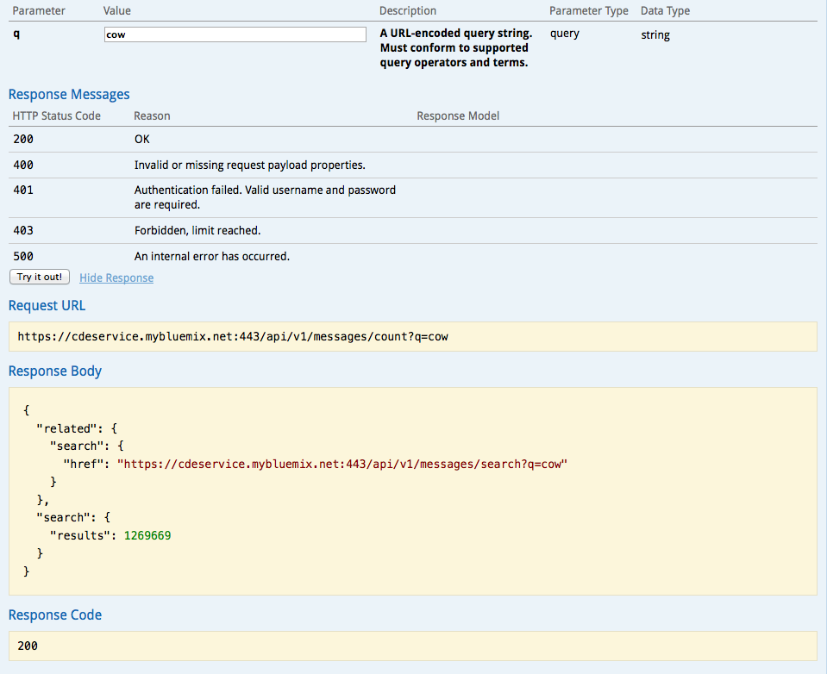
Demo – Count & Search

Slide 9
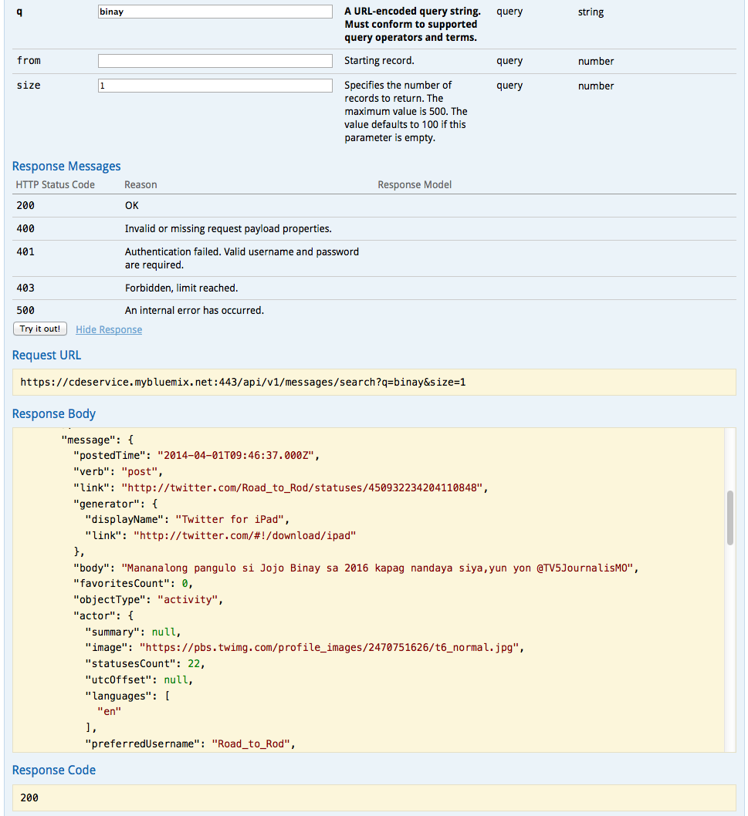
Demo - Search

Slide 10
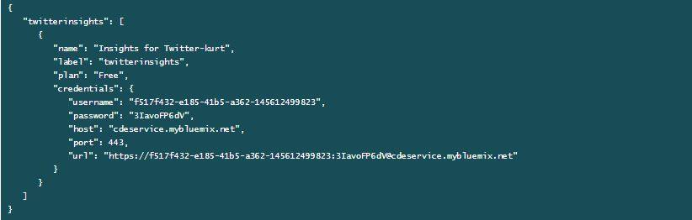
How my app works
Get credentials from VCAP Services in Bluemix

Slide 11
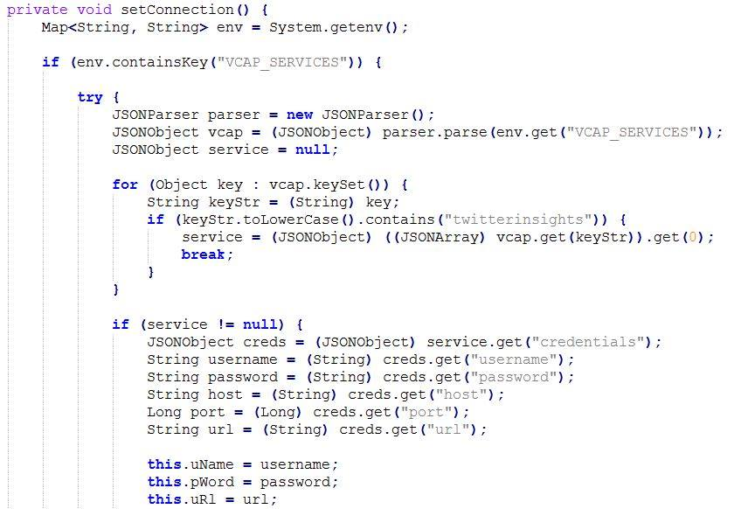
How my app works
Get credentials from VCAP Services in Bluemix

Slide 12
How my app works
Get credentials from VCAP Services in Bluemix

Slide 13
How my app works
Form the URL to use the Insights for Twitter Service
URLEncoder – converts characters into a format that can be transmitted over the internet

Slide 14
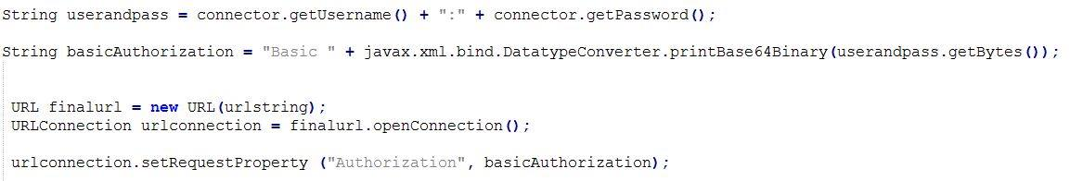
How my app works
To be able to make a request, we need to provide our username and password through Basic Access Authentication

Slide 15
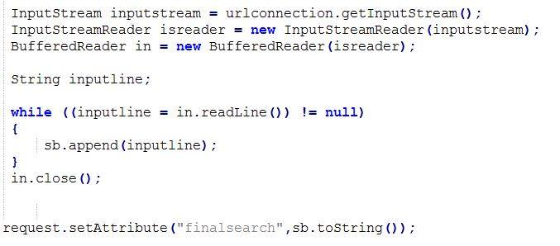
How my app works
Get output of the Insights for Twitter Service and display it in the JSP.

Slide 16
Searching Twitter Content
Rich set of Query Parameters
https://console.ng.bluemix.net/docs/services/Twitter/index.html#twitter

Slide 17
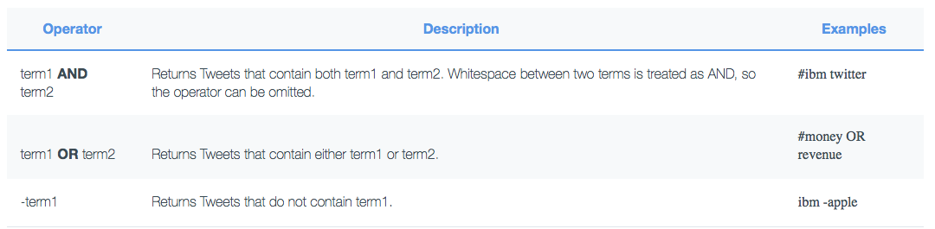
Searching Twitter Content

Slide 18
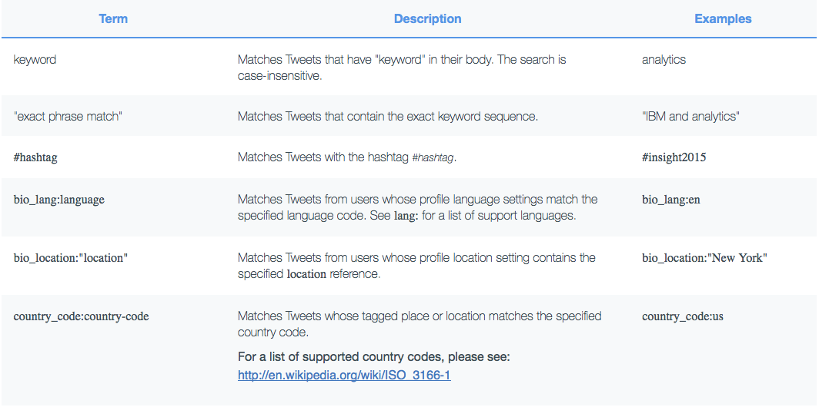
Searching Twitter Content

Slide 19
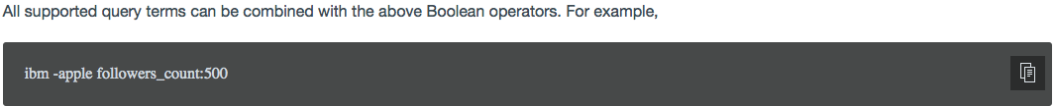
Searching Twitter Content

Slide 20
Intended Use
Marketing Agencies can grab useful data from twitter
Filter opinions based on demographics
e.g. What is the sentiment of 20 year old male voters from the Philippines regarding Mar Roxas

