Slide 1
INVESTMENT CASE STUDY SUBMISSION
Member name: Nishant Patel

Slide 2
Abstract
For the Investment analysis of different types of funded firms based on demography(Country based, etc) and on type of funds (seed, venture, etc) to find the best option for Sparks Fund to get the best suited match for the funding type to invest and find even the best company for the same.
For Sector Analysis using the mapping for getting the major 8 sectors to get the primary category mapped to the main sector and in turn analyse the base data for the demographic top 3 countries and the top 3 sector with highest number of investments.
There is usage of variety of pandas feature to:
Clean the data
Aggregate the data
Merge and Join the data
Filter the Data
Modify and Update the Data
And finally plot the dataset,

Slide 3
Problem solving methodology
Round2 data
Companies data
Cleaning the Data
Encoding = ISO-8859-1
Join round2 and companies
Final Master_frame
Funding analysis
Group by funding_round_type
Averaging
Fulfill Spark fund requirement
Mapping Sectors
Join primary category to mapping
Main sector
Refine Dataset
Drop NaN
Sector Analysis – 1
Top 9 countries with Venture
Top raised_funding
VENTURE
Top 3 English speaking counties – USA, GBR and CAN
Country: USA, FT: venture
Country: GBR FT: venture
Country: CAN, FT: venture
Sector Analysis – 2
total_investments
investment_count
Top 3 sectors by count, country wise
Top company by sector country wise
Raw Data

Slide 4
Analysis - Code base
"""Basic imports and setup for data analysis"""
import pandas as pd
import numpy as np
from matplotlib import pyplot as plt
pd.set_option('display.max_columns', 100)
pd.set_option('display.max_rows', 20)
"""Read and refine base raw data"""
companies = pd.read_csv(r'C:\Users\npatel\Desktop\Upgrad\companies.txt', sep='\t', lineterminator='\n', encoding='ISO-8859-1')
rounds2 = pd.read_csv(r'C:\Users\npatel\Desktop\Upgrad\rounds2.csv', encoding='ISO-8859-1')

Slide 5
Analysis - Code base
"""Join round2 and companies data"""
print(companies.head())
x = pd.unique(rounds2['company_permalink'].str.lower()).tolist()
y = pd.unique(companies.str.lower()).tolist()
companies['permalink'] = companies['permalink'].str.lower()
rounds2['company_permalink'] = rounds2['company_permalink'].str.lower()
print(list(set(x).difference(set(y))))
print(companies.columns)
print(rounds2.columns)
master_frame = pd.merge(rounds2, companies, how='left', left_on='company_permalink', right_on='permalink')
"""Funding Analysis and Spark Fund Requirements"""
print(master_frame)
funding_frame = master_frame[['funding_round_type', 'raised_amount_usd']]
avg_summary_funding_frame = funding_frame.groupby(funding_frame['funding_round_type'], as_index=False).mean()
print(avg_summary_funding_frame)
avg_summary_funding_frame.plot.bar(x='funding_round_type', y='raised_amount_usd')
print(avg_summary_funding_frame[(5000000<=avg_summary_funding_frame.raised_amount_usd) & (avg_summary_funding_frame.raised_amount_usd<=15000000)])

Slide 6
Analysis - Code base
"""Top 9 countries for FT: Venture"""
venture_frame = master_frame[(master_frame.funding_round_type == 'venture')]
top9 = venture_frame.groupby(venture_frame['country_code']).sum().nlargest(9,'raised_amount_usd')
print(top9)
plt.figure()
top9.plot(kind='bar')
"""Sector Mapping and Primary category listing"""
master_frame['category_list'] = master_frame['category_list'].str.split('|')
master_frame['primary_sector'] = master_frame.category_list.str[0]
mapping = pd.read_csv(r'C:\Users\npatel\Desktop\Upgrad\mapping.csv', encoding='ISO-8859-1')
sector_list = mapping.columns.tolist()[1:]
sector_list.remove('Blanks')
for sector in sector_list:
mapping[sector] = mapping[sector].apply(lambda z: sector if z==1 else '')
mapping['main_sector'] = mapping[sector_list[0]]
for sector in sector_list[1:]:
mapping['main_sector'] = mapping['main_sector'] + mapping[sector]
mapping = mapping.drop(columns=sector_list+['Blanks'])
master_sector_frame = pd.merge(master_frame, mapping, how='left', left_on='primary_sector', right_on='category_list')

Slide 7
Analysis - Code base - Country: USA, FT: venture
"""Sector Analysis 1 and 2, FT: Venture, Top 3 sectors country wise"""
master_sector_frame = master_sector_frame.dropna()
# Country: USA, FT: venture
D1 = master_sector_frame[(master_sector_frame['country_code'] == 'USA') & (master_sector_frame['funding_round_type'] == 'venture')]
D1_sector_investments = D1.groupby('main_sector').agg({'funding_round_type':'count',
'raised_amount_usd': 'sum'}).reset_index().rename(columns={'funding_round_type':'investment_count',
'raised_amount_usd': 'total_investments'})
D1 = pd.merge(D1, D1_sector_investments, how='left', left_on='main_sector', right_on='main_sector')
print(D1_sector_investments['investment_count'].sum())
print(D1_sector_investments['total_investments'].sum())
print(D1_sector_investments.nlargest(8,'investment_count'))
D1_sector_investments = D1_sector_investments.nlargest(3,'investment_count')
D1_sector_investments['country'] = D1_sector_investments.investment_count.apply(lambda x: 'USA')
#print(D1[D1.main_sector=='Cleantech / Semiconductors'].nlargest(1,'raised_amount_usd'))

Slide 8
Analysis - Code base - Country: GBR, FT: venture
# Country: GBR, FT: venture
D2 = master_sector_frame[(master_sector_frame['country_code'] == 'GBR') & (master_sector_frame['funding_round_type'] == 'venture')]
D2_sector_investments = D2.groupby('main_sector').agg({'funding_round_type':'count',
'raised_amount_usd': 'sum'}).reset_index().rename(columns={'funding_round_type':'investment_count',
'raised_amount_usd': 'total_investments'})
D2 = pd.merge(D2, D2_sector_investments, how='left', left_on='main_sector', right_on='main_sector')
print(D2_sector_investments['investment_count'].sum())
print(D2_sector_investments['total_investments'].sum())
print(D2_sector_investments.nlargest(8,'investment_count'))
D2_sector_investments = D2_sector_investments.nlargest(3,'investment_count')
D2_sector_investments['country'] = D2_sector_investments.investment_count.apply(lambda x: 'GBR')
#print(D2[D2.main_sector=='Cleantech / Semiconductors'].nlargest(1,'raised_amount_usd'))

Slide 9
Analysis - Code base - Country: CAN, FT: venture
# Country: CAN, FT: venture
D3 = master_sector_frame[(master_sector_frame['country_code'] == 'CAN') & (master_sector_frame['funding_round_type'] == 'venture')]
D3_sector_investments = D3.groupby('main_sector').agg({'funding_round_type':'count',
'raised_amount_usd': 'sum'}).reset_index().rename(columns={'funding_round_type':'investment_count',
'raised_amount_usd': 'total_investments'})
D3 = pd.merge(D3, D3_sector_investments, how='left', left_on='main_sector', right_on='main_sector')
print(D3_sector_investments['investment_count'].sum())
print(D3_sector_investments['total_investments'].sum())
print(D3_sector_investments.nlargest(8,'investment_count'))
D3_sector_investments = D3_sector_investments.nlargest(3,'investment_count')
D3_sector_investments['country'] = D3_sector_investments.investment_count.apply(lambda x: 'CAN')
#print(D3[D3.main_sector=='Cleantech / Semiconductors'].nlargest(1,'raised_amount_usd'))
pd.concat([D1_sector_investments,D2_sector_investments,D3_sector_investments]).plot().bar()

Slide 10
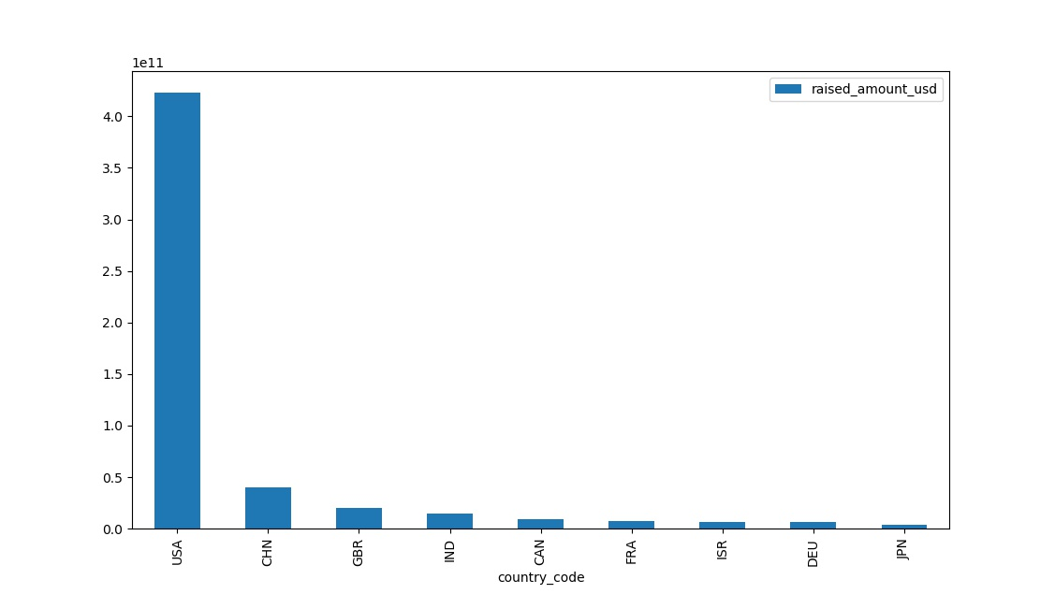
<Results>

Slide 11
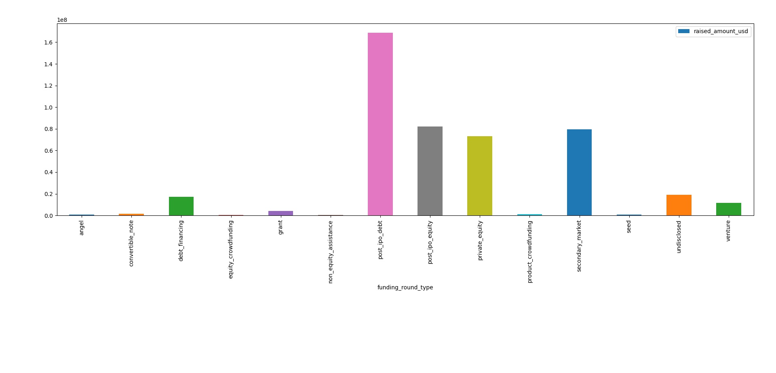
<Results>

Slide 12
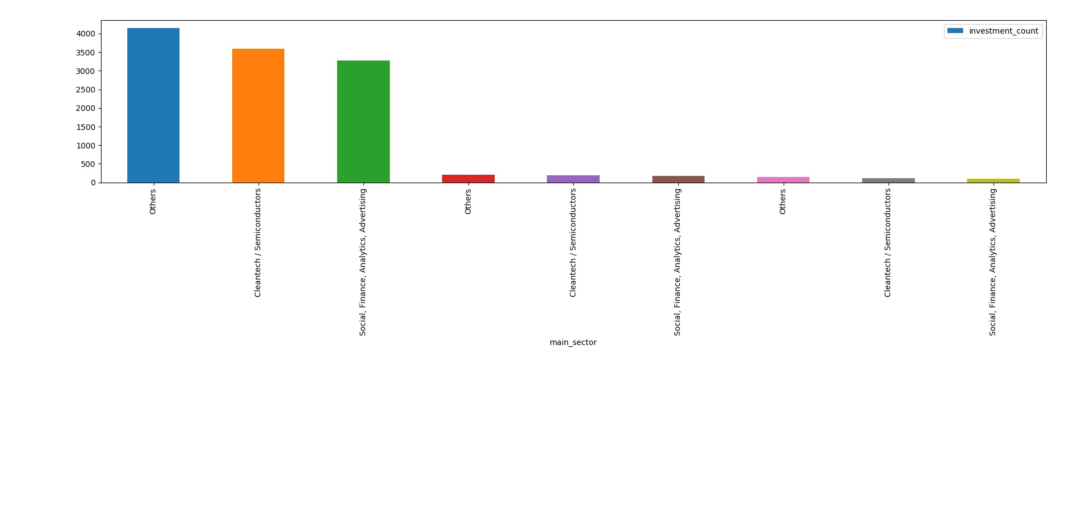
<Results>

Slide 13
<Conclusions>
The Summary of the Analysis is:
Spark Fund should invest in FT is Venture, sector should be Others and Category should be Education
Top 3 English speaking countries with FT venture are:
USA
GBR
CAN
Major companies in focus for investments are:
social-finance
greatpoint-energy
oneweb
adaptimmune
desire2learn
clementia-pharmaceuticals

