Slide 1
Predicting Heart Failure Mortality Micro-Project #3 https://github.com/kurtgrothe/ANA500
Kurt Grothe
October 16, 2022

Slide 2
Problem Statement
Problem Statement & Hypothesis Formulation
According to the CDC heart disease is the leading cause of death in the United States. Every 34 seconds a person dies from heart disease. From a financial point of view, heart disease costs the United States 229 billion each year.
The objective of this study is to predict heart failure mortality using various independent variables.

Slide 3

Hypothesis Formulation
Problem Statement & Hypothesis Formulation
$$H_{0}:There is no statitical difference between heart failure mortality and diabetes along with other medical factors.$$
$$H_{A}:There is a statitical difference between heart failure mortality and diabetes along with other medical factors.$$
The null hypothesis ($H_{0}$) states that age, anemia, creatinine phosphokinase, diabetes, ejection fraction, high blood pressure, platelet count, serum creatinine, serum sodium, gender and smoking (independent variables) have no association with heart failure mortality (dependent variable).
The alternative hypothesis ($H_{A}$ states that age, anemia, creatinine phosphokinase, diabetes, ejection fraction, high blood pressure, platelet count, serum creatinine, serum sodium, gender and smoking (independent variables) are associated with heart failure mortality (dependent variable).

Slide 4
Hierarchy Chart
Program Design
Heart Failure(Yes/No) = CVD dataset (age, anemia, creatinine phosphokinase, diabetes, ejection fraction, high blood pressure, platelet count, serum creatinine, serum sodium, gender and smoking)
Main Program
(Output: Heart failure(y/n);
Input; CVD dataset)

Slide 5
Flowchart
Program Design
Step 1:
Acquire
Step 2:
Prepare
Start
Load Data
Exploratory Data Analysis
Visualize
Data
Clean Data
Select Analytical Technique
Select Estimator
Improve Model Performance
Split Data for Testing and Training
Train the Estimator
Step 3:
Analyze data
Assess Model Performance
Visualize Heart Failure predicted vs actual
Metrics
Test the Estimator
Step 4:
Report
Step 5:
Act

Slide 6
Pseudocode
Program Design
# Fit the model
grid_search.fit(X_train_scaled, y_train);
# Make a prediction on the test split to find model accuracy
predicted = grid_search.predict(X_test_scaled)
acc = accuracy_score(predicted, y_test)
entries.append(acc)
print(grid_search.best_params_)
# If model have the highest accuracy, it's out best model
if acc > highest_acc:
highest_acc = acc
best_model = grid_search
# Plot results
sns.barplot(x='Estimater', y='Accuracy', data=df)
import pandas library
import numpy
import matplotlib
1. Acquire Data
# load data
df = pandas dataframe. csv_dataset
# verify data load check contents via head
df.head
2. Prepare Data
# missing value check
df.isnull
# Summary Stats
df.describe
df.info
df = df[‘cols_w_extreme_vlaues’ < value_remove_outliers]
sns.catplot #all categorical variables
sns.boxplot # all continuous variables against death event
3. Analyze
#Split Data for training and testing
X_train, X_test, y_train, y_test = train_test_split(X, y, test)
#Scale data
sc=MinMaxScaler()
X_train_scaled = sc.fit_transform(X_train)
X_test_scaled = sc.transform(X_test)
# Create 7 clf models and store results utilizing grid_search
for model in models:
print(model["estimater"])
# Create model
clf = model["estimater"]
# Instantiate the grid search model
grid_search = GridSearchCV(estimator = clf, param_grid = model["params"],
cv = 10)

Slide 7
Acquire
The Data Science Process (1/5)
CVD dataset was acquired through Kaggle.com. Kaggle, a sbusidary of Google LLC is an online community of data scientists and machine learning practitioners.
Data source:
https://www.kaggle.com/datasets/whenamancodes/heart-failure-clinical-records?resource=download

Slide 8
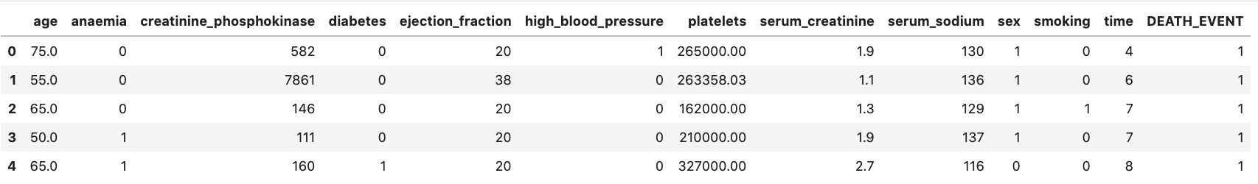
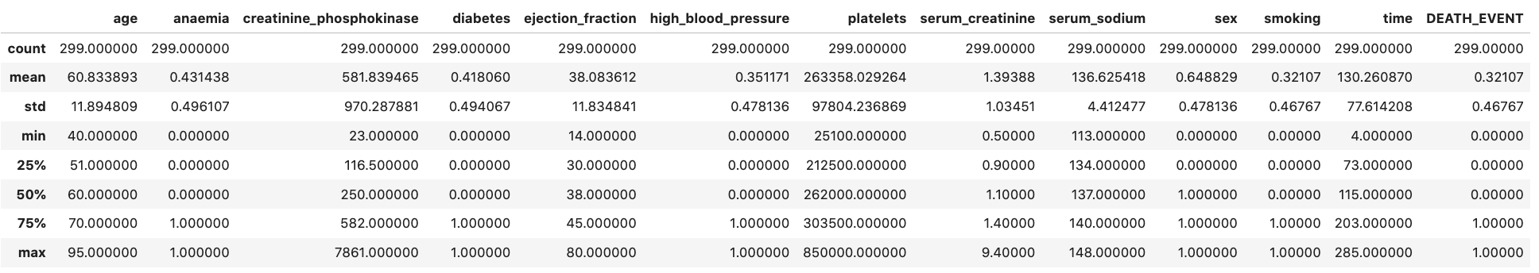
Prepare
The Data Science Process (2/5)
First Five Rows Data
Summary Statistics

Slide 9
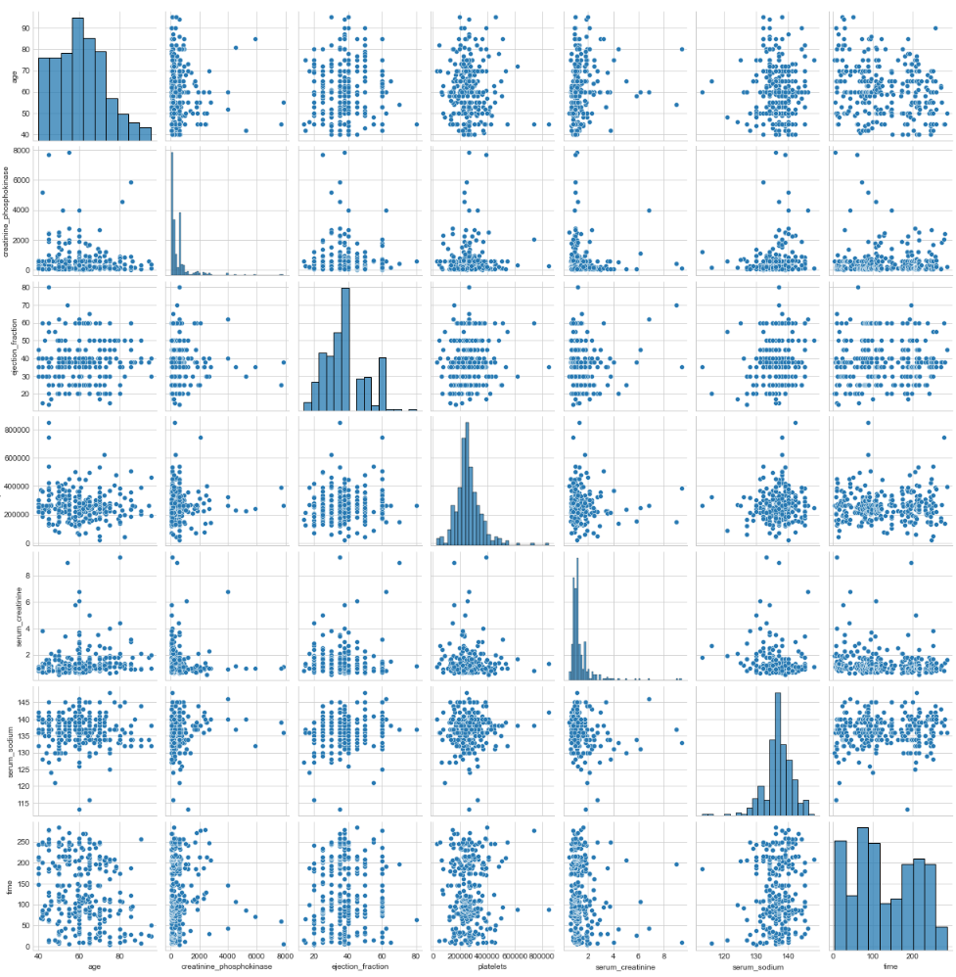
Prepare, cont.
The Data Science Process (2/5)
Correlation
and
Histograms

Slide 10
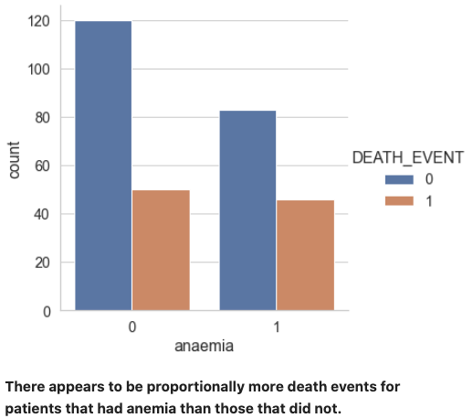
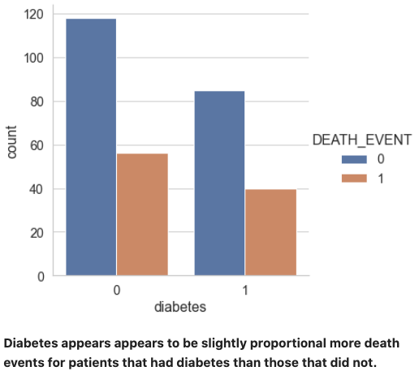
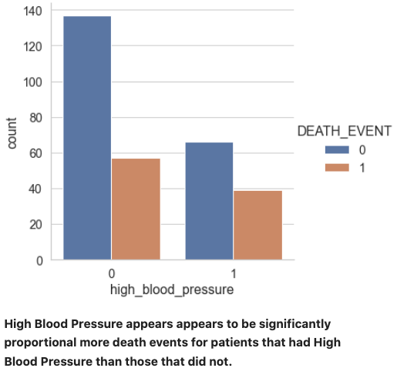
Prepare, cont.
The Data Science Process (2/5)

Slide 11
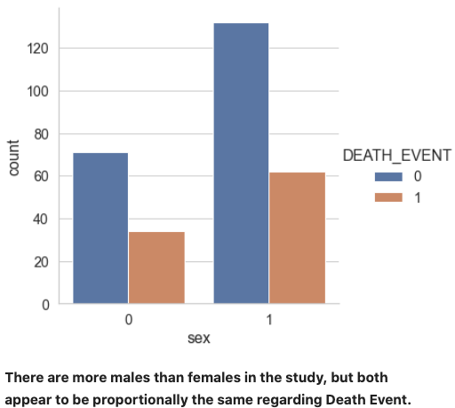
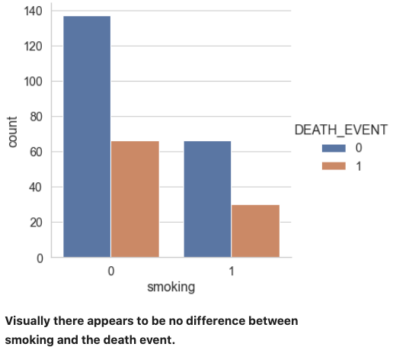
Prepare, cont.
The Data Science Process (2/5)

Slide 12
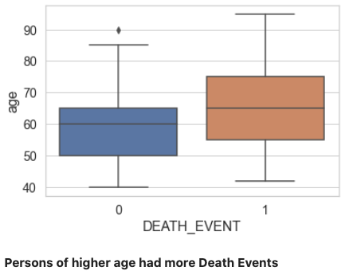
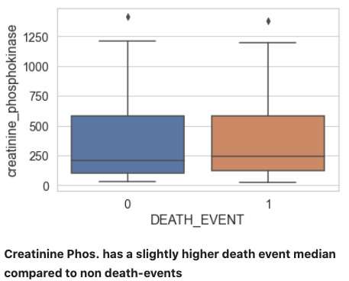
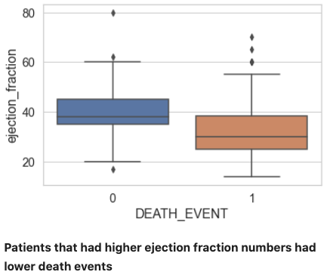
Prepare, cont.
The Data Science Process (2/5)

Slide 13
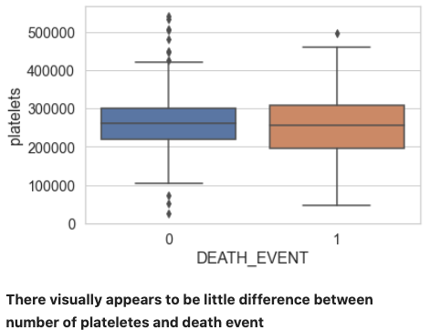
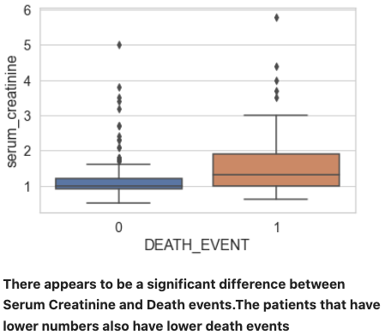
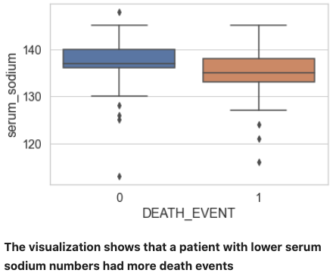
Prepare, cont.
The Data Science Process (2/5)

Slide 14
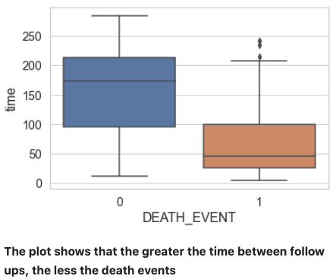
Prepare, cont.
The Data Science Process (2/5)

Slide 15
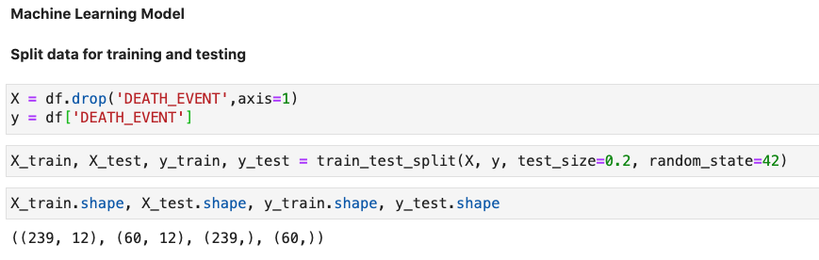
Analyze data
The Data Science Process (3/5)

Slide 16
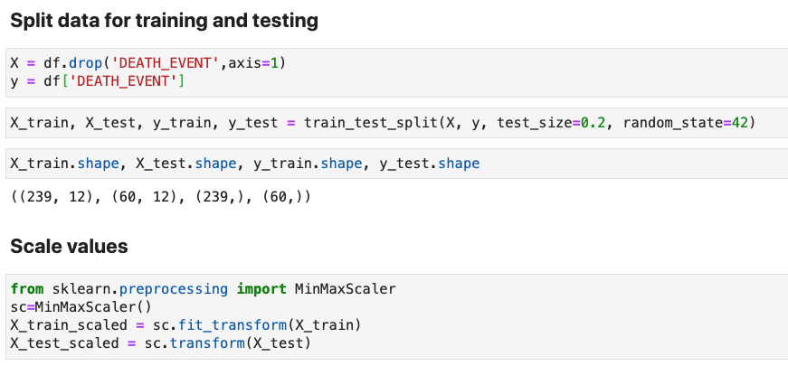
Analyze data
The Data Science Process (3/5)

Slide 17
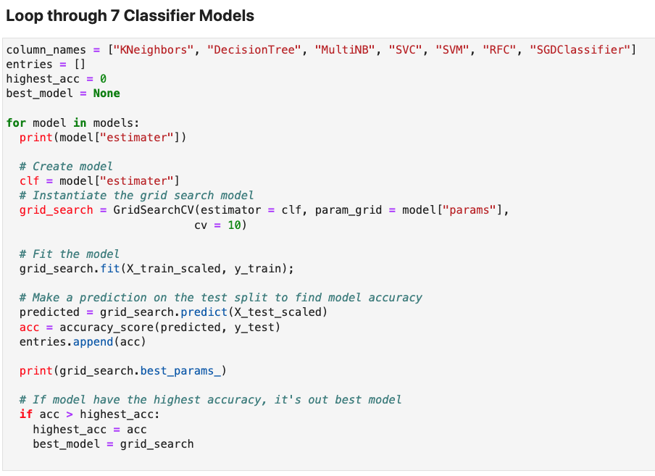
Analyze data
The Data Science Process (3/5)

Slide 18
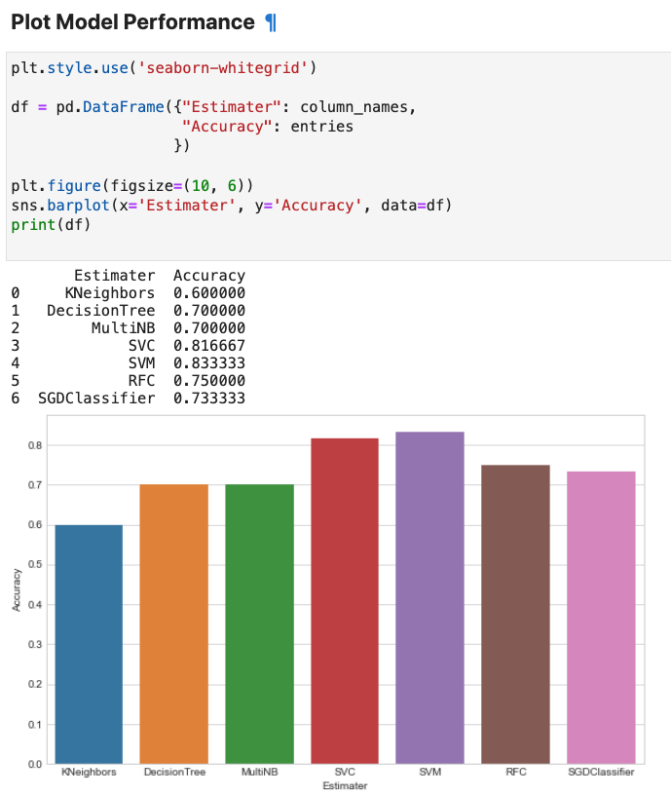
Analyze data
The Data Science Process (3/5)

Slide 19
Report
The Data Science Process (4/5)
Support Vector Machine (SVM) performed the best out of eight models. SVM reported a 83% accuracy where the the other models ranged from 68% (Neural Network) to 82% (SVC Estimator).

Slide 20
Act
The Data Science Process (5/5)
Based on the result of this project we recommend the implementation of the SVM model.

