Slide 1

KITTING
Functional walkthrough – level 400
Kurt Hatlevik

Slide 2
What is a Kit ?
Business advantages with KIT’s ?
Reduced inventory levels
Instead of keeping a large set of finished goods on stock, just pick the components
Respond quickly and economically to increased retailer demand for custom packs.
Operator effectiveness
Decreased unpacking, walking, searching
Reduced overall deliveries to the line
Less space required on the line for material storage
Quality and part shortage issues caught farther upstream
Pricing
Price of a kit is defined from the components or directly on the kit
Discounts can be defined on the components or directly on the kit

Slide 3
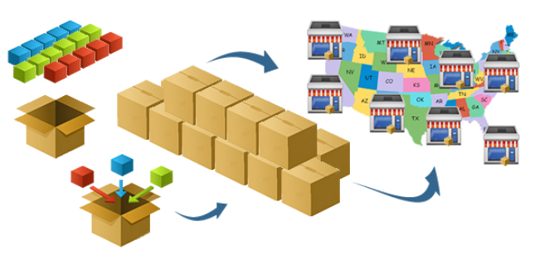
Typical kitting services
Keep components on the shelfs
Allows value added services (VAS)
Special packaging
Special labeling
Other services
Maintain pricelist on components
Maintain pricelist on kits
Secure margin on components

Slide 4
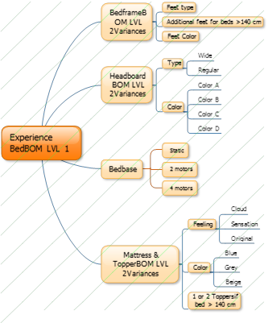
How to create a sales Kit

Slide 5
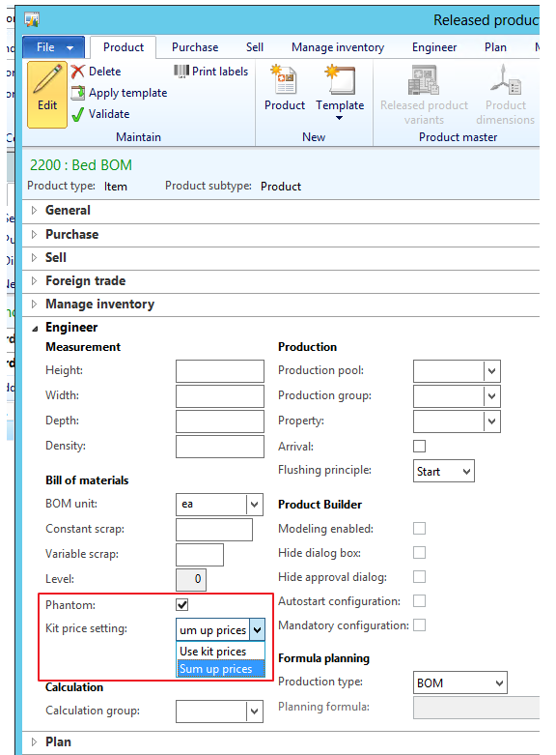
Designing a KIT – Step 1
Create an item, and mark it as a phantom, and select Kitting price setting.
Use kit prices means that prices are defined on the kit.
Sum up prices means that prices are defined on the kit lines.

Slide 6
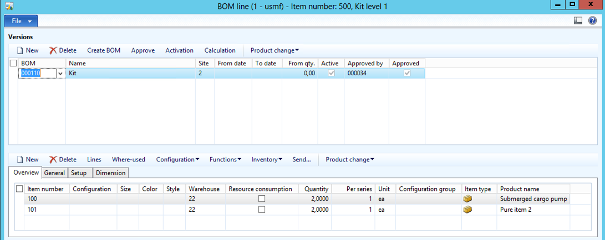
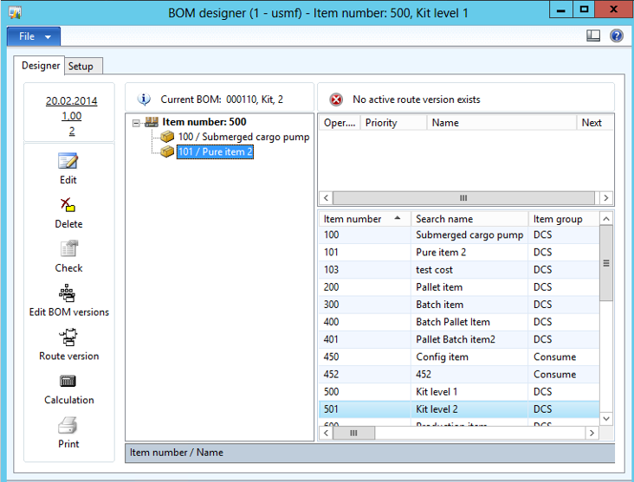
Designing a KIT – Step 2
Create a BOM using BOM line or BOM designer

Slide 7
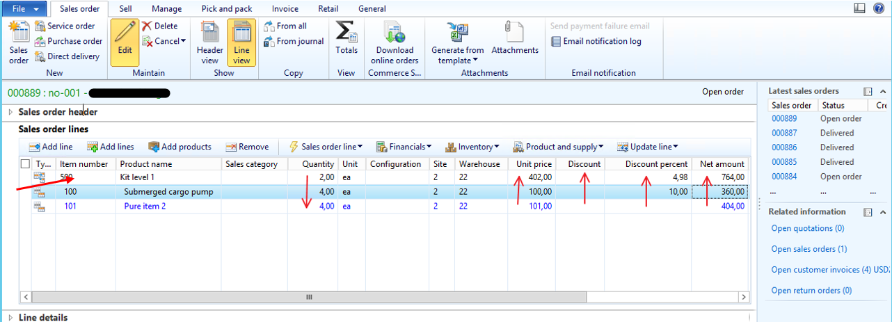
Create a sales order, and add the kit
Here a “Sum Up Prices”-kit has been selected

Slide 8
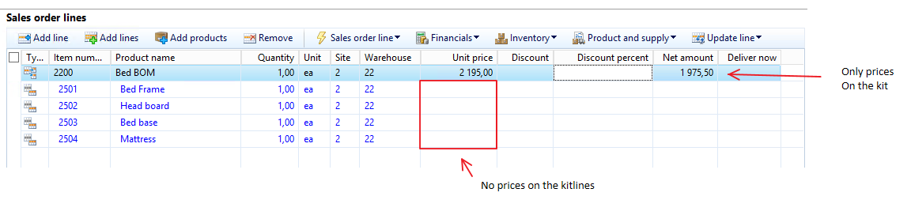
Create a sales order, and add the kit
Here a “Use kit prices”-kit has been selected

Slide 9
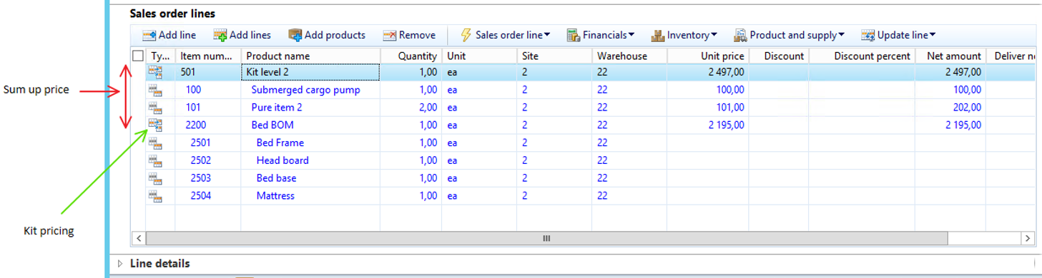
Create a sales order, and add the kit
Here a combination of “Sum up prices” and “use kit prices”-kit has been selected

Slide 10
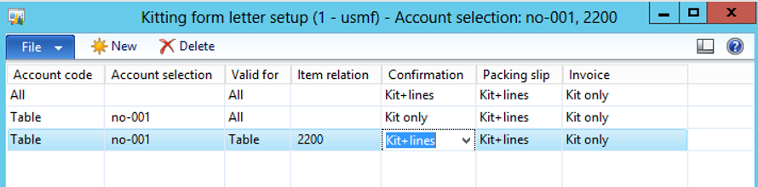
Setting up formletters
Specify if the kit-lines should be shown on confirmation/packingslip/invoice.

Slide 11
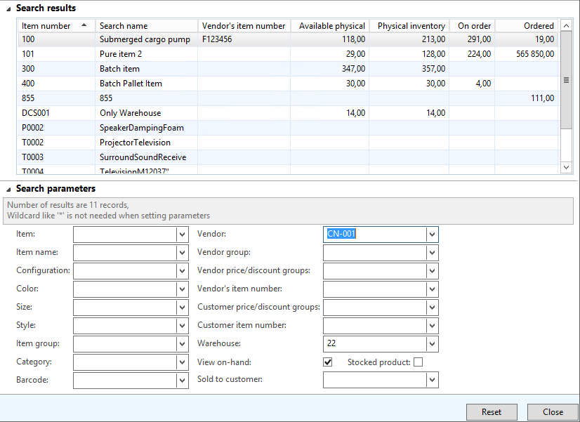
Additional features with kitting
Product lookup

Slide 12
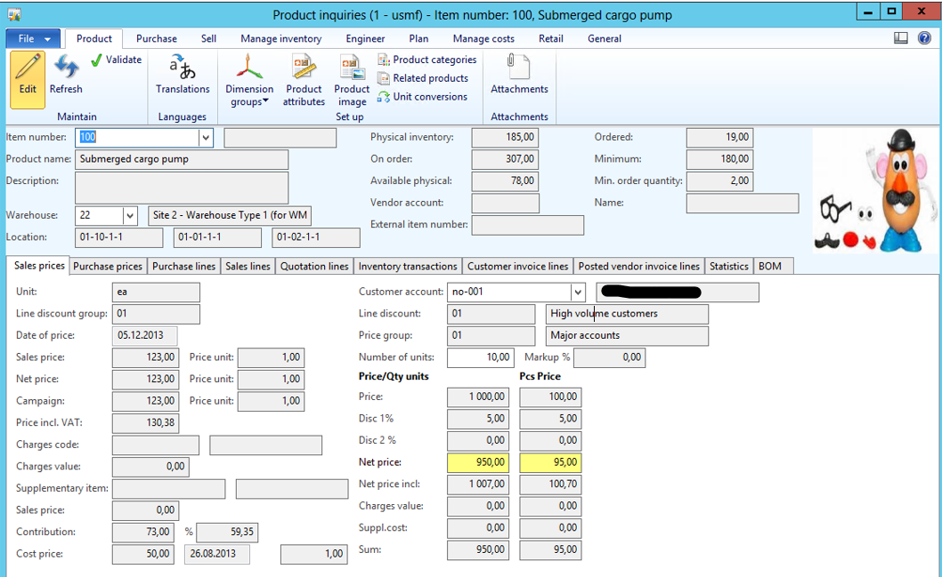
Additional Kitting features
Product inquiry

Slide 13
KITTING
Technical walkthrough – level 400
Kurt Hatlevik

Slide 14
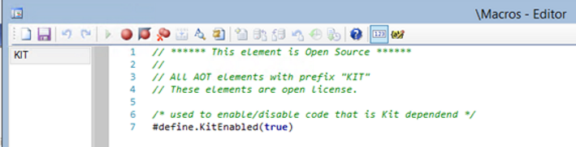
Global macro for Kitting
All kitting can be disabled by changing this macro to false

Slide 15
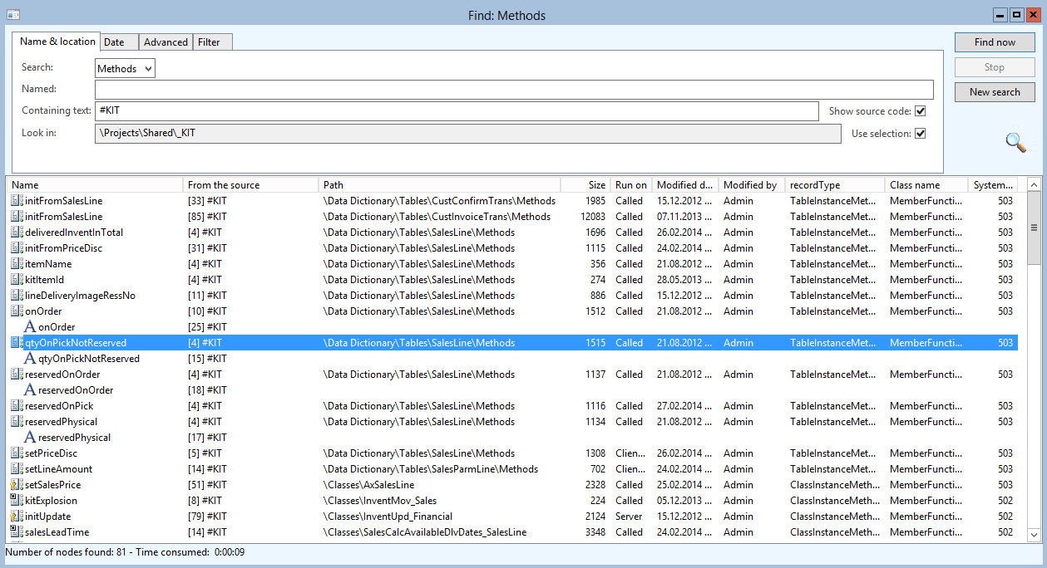
Search on all places where KIT is affecting Dynamics AX
Seach for «#KIT» to see all footprint

Slide 16
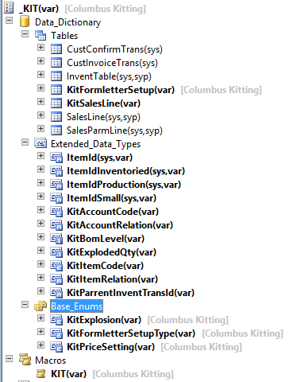
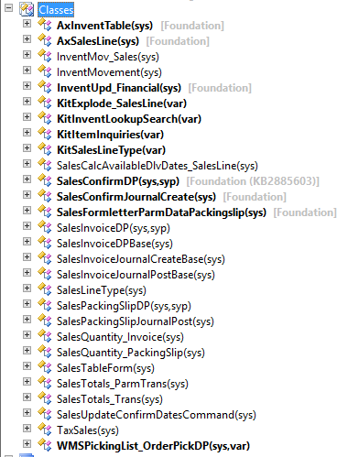
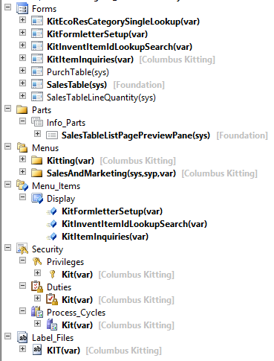
Affected objects in AX

Slide 17
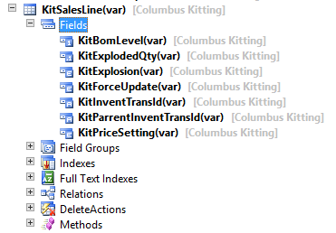
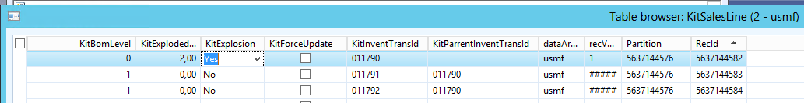
Kitting data structure
Kit (salesline)
Level 0
Kit-line (salesline)
Level 1
Kit-line (salesline)

Slide 18
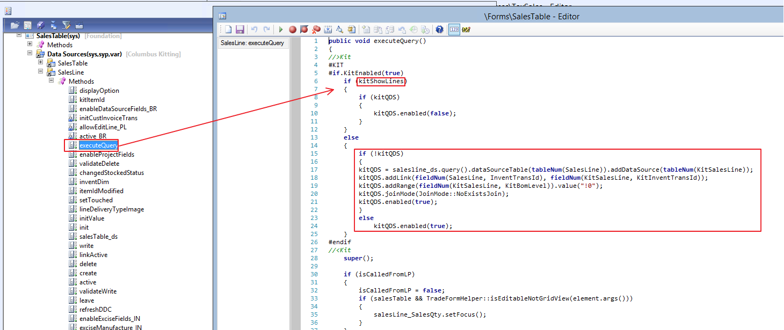
Changes to the Sales Table
How does kitting lines being shown on the salesTable ?

Slide 19
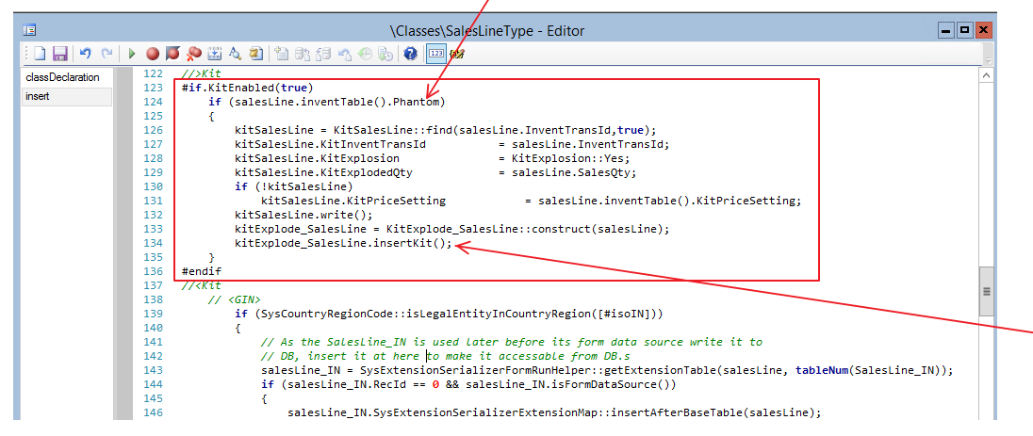
How does it work ?
When inserting a sales line, the kitting will be triggered

Slide 20
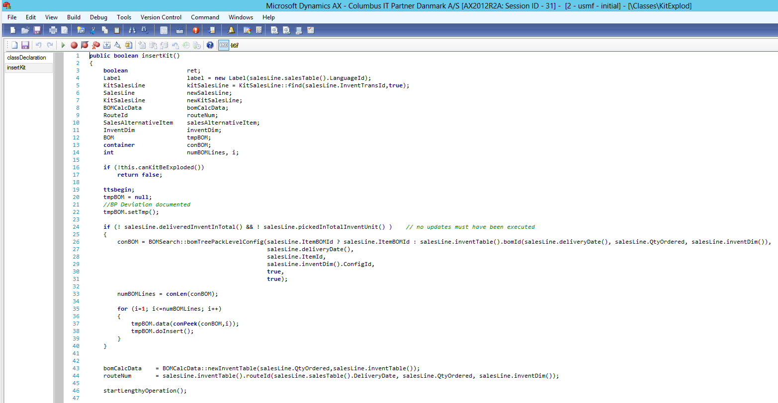
How the Kit is exploded
Getting BOM

Slide 21
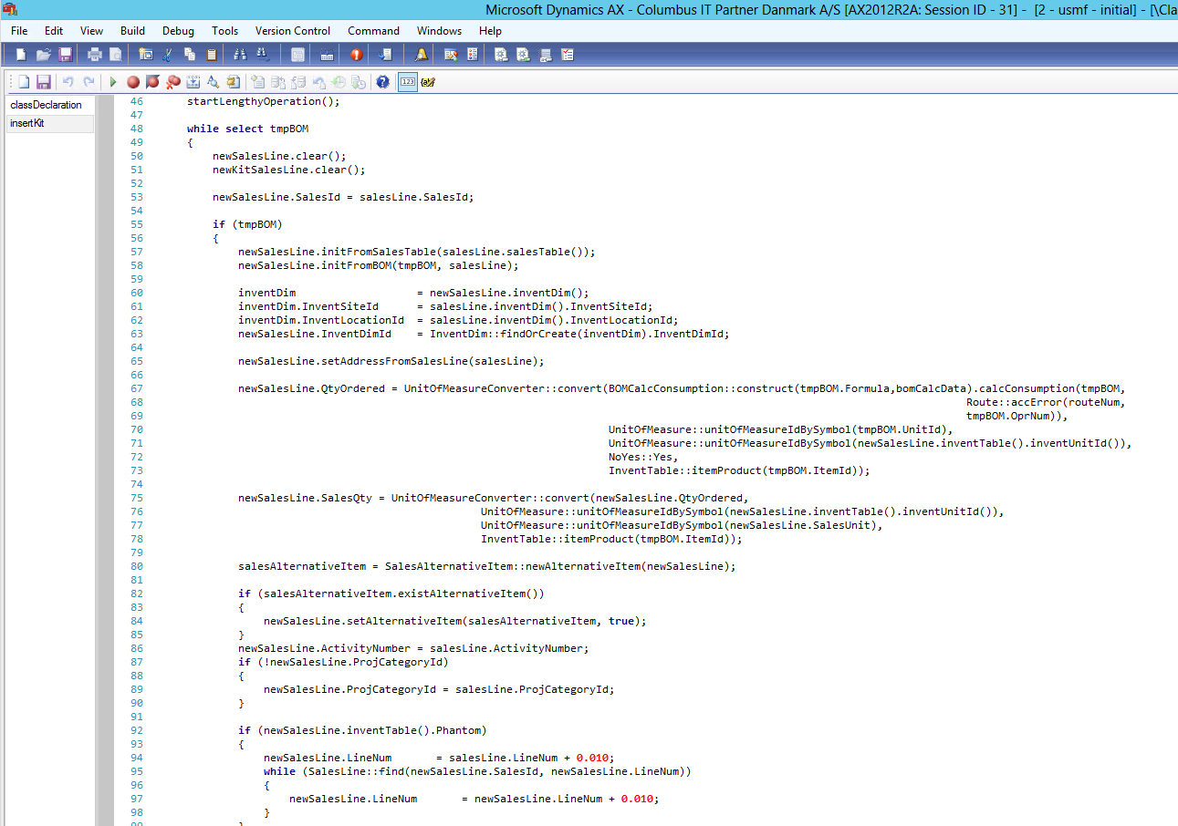
How the Kit is exploded
Creating the kit lines

Slide 22
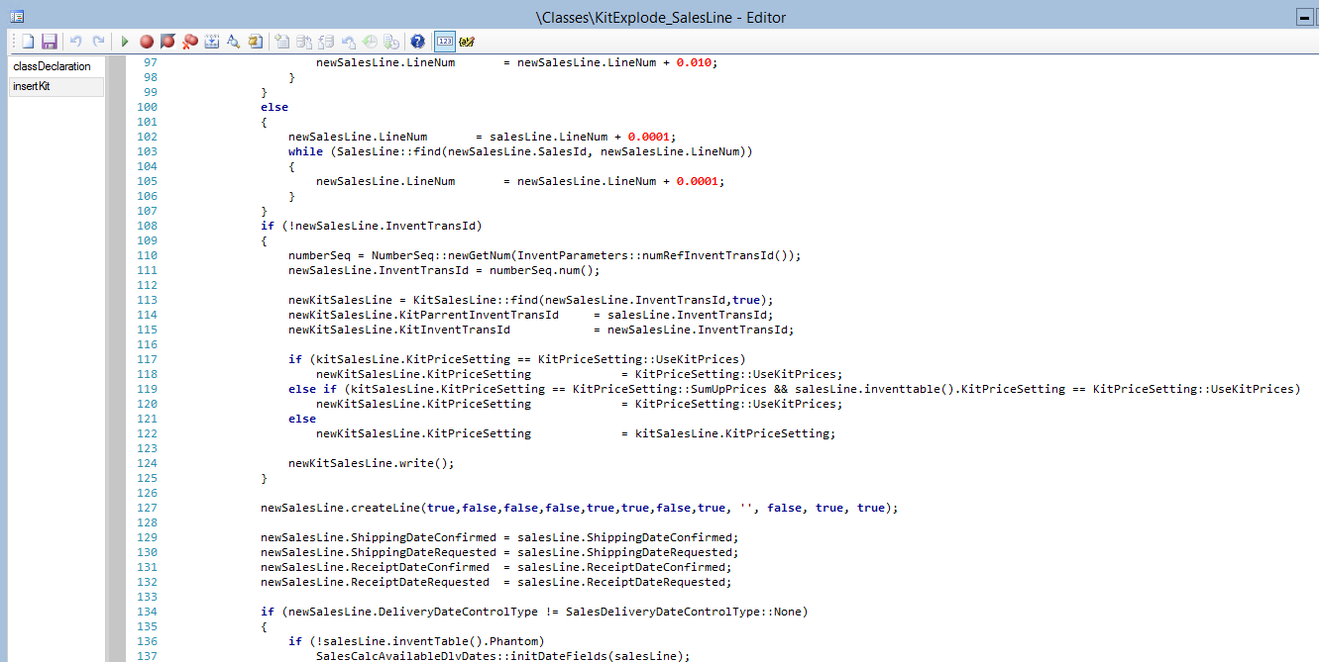
How the Kit is exploded
Documenting parrent-child
relationship
Starts a recursive
Insert chain allowing
Multilevel Kits

Slide 23
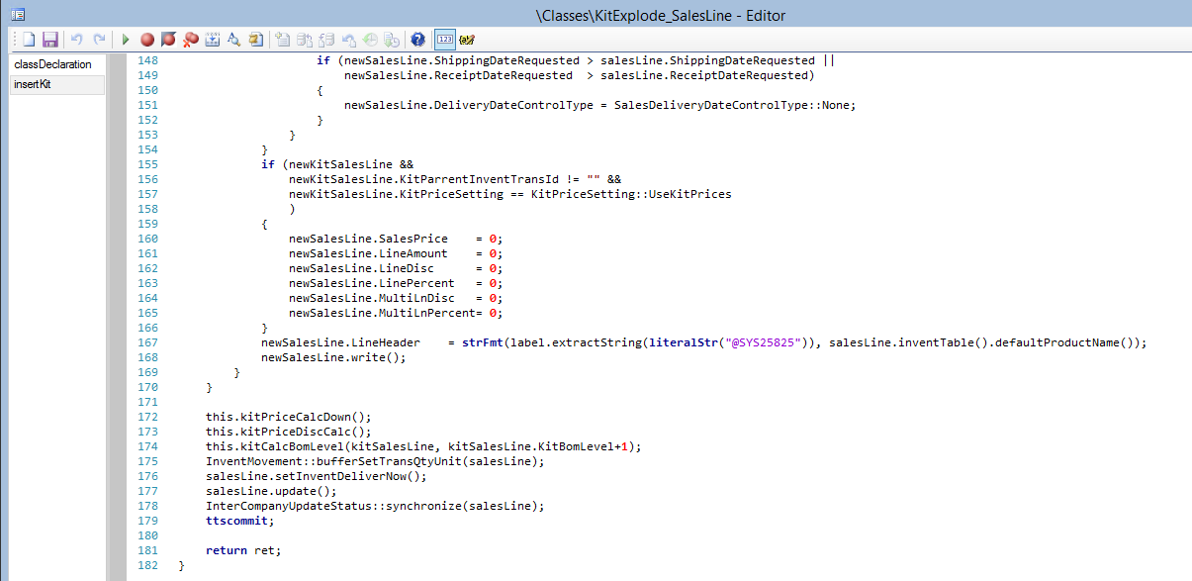
How the Kit is exploded
Cleaning prices
Recursive price and parameter calculations

Slide 24
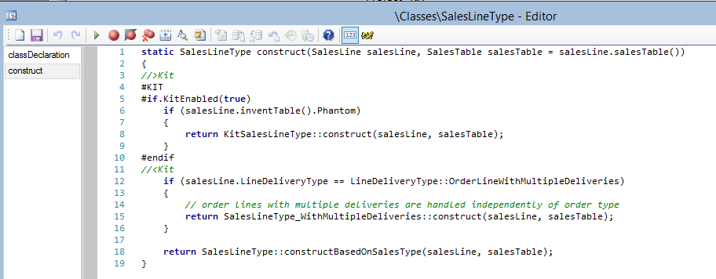
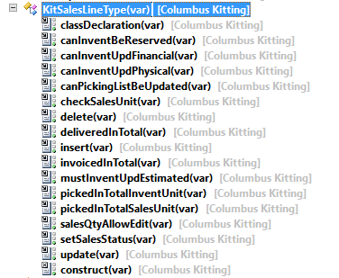
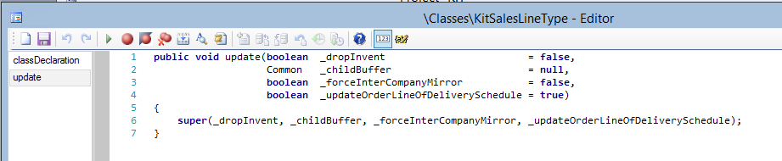
What happends on updates ?

Slide 25
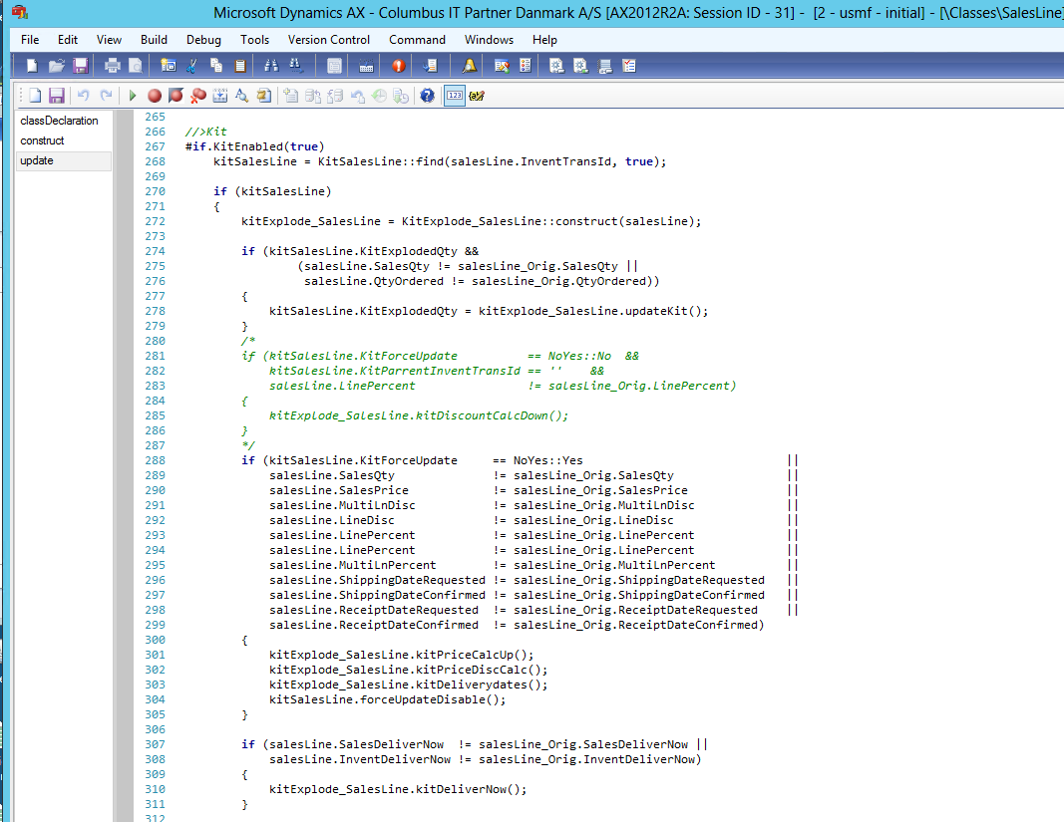
What happends on updates ?
Here the magic is happening

Slide 26
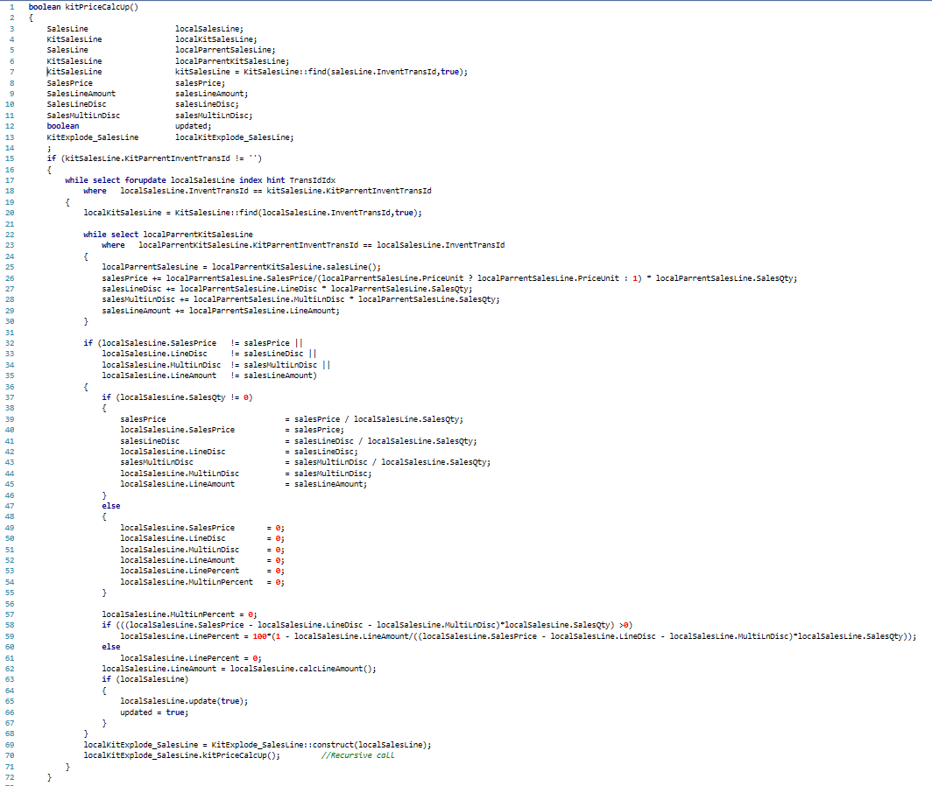
Looping through
all child kit lines
Calculating discount

Slide 27
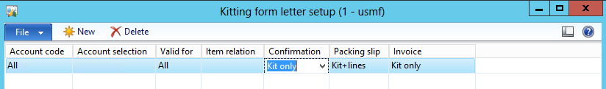
Printing formletters
Setup for formletters, when using the kitting solution

Slide 28
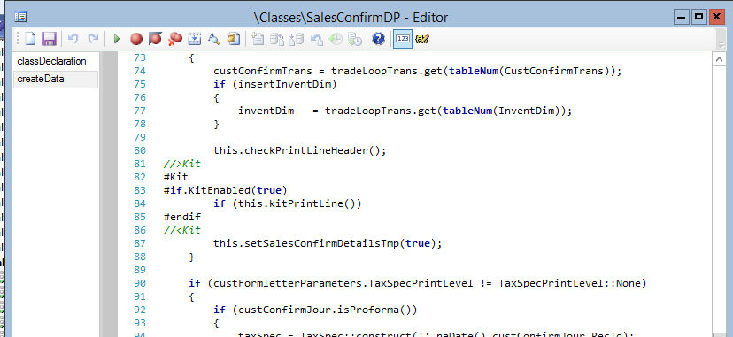
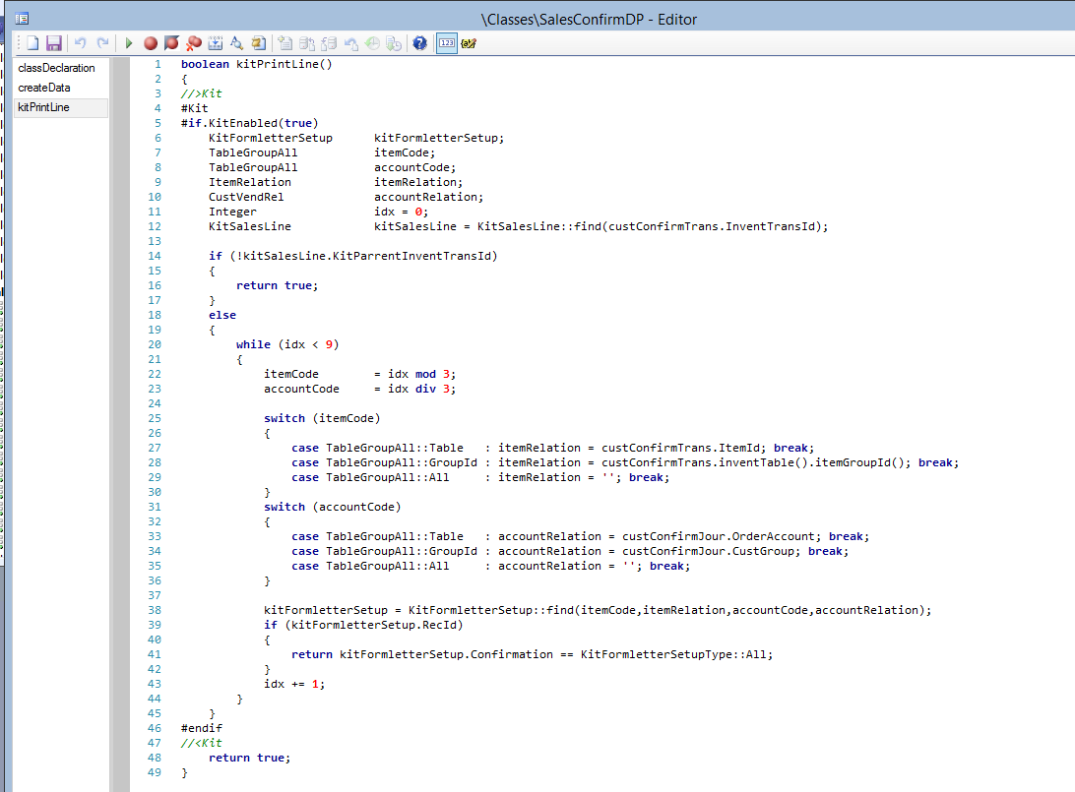
Printing formletters
When printing a formletter (Confirm, packingslip and invoice), this code will
controll what should be printed.

Slide 29
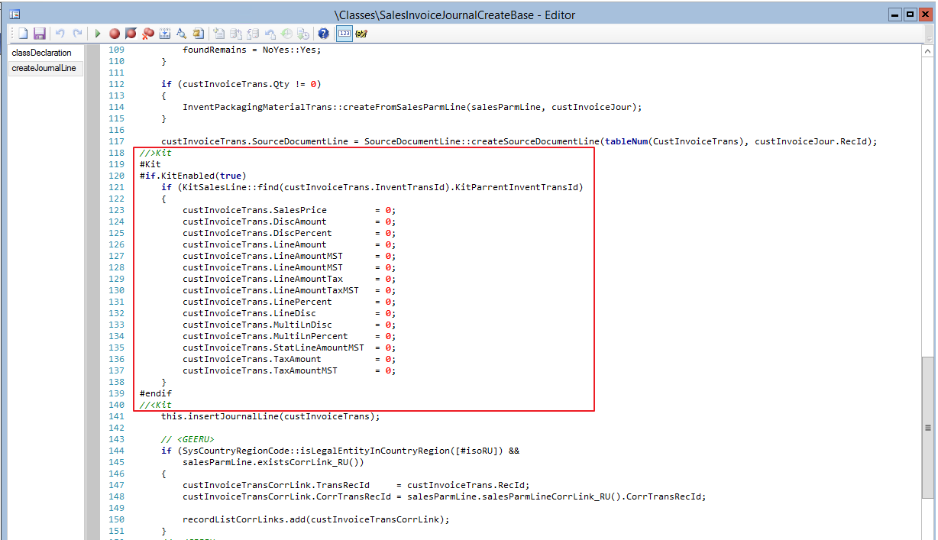
Invoicing
When creating sales invoice lines, all sales/kittinglines will have a zero value on the custInvoiceTrans.

Slide 30
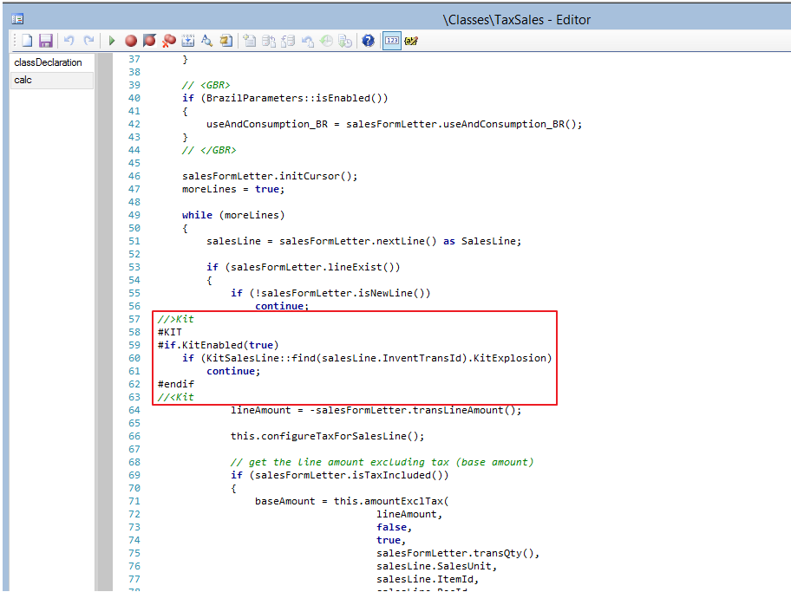
Tax
Taxes are always calculated on the basis on none exploded sales/kitting lines

