Slide 1

KITTING
Functional walkthrough
Kurt Hatlevik

Slide 2
What is a Kit ?
Business advantages with KIT’s ?
Reduced inventory levels
Instead of keeping a large set of finished goods on stock, just pick the components
Respond quickly and economically to increased retailer demand for custom packs.
Operator effectiveness
Decreased unpacking, walking, searching
Reduced overall deliveries to the line
Less space required on the line for material storage
Quality and part shortage issues caught farther upstream
Pricing
Price of a kit is defined from the components or directly on the kit
Discounts can be defined on the components or directly on the kit

Slide 3
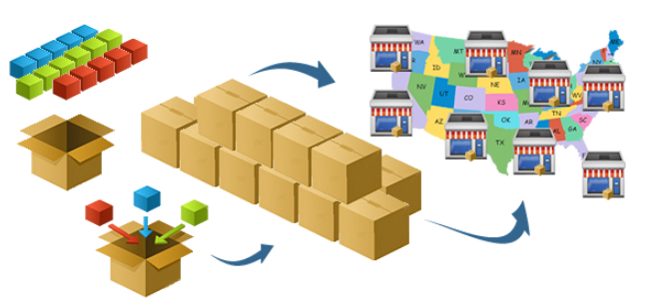
Typical kitting services
Keep components on the shelfs
Allows value added services (VAS)
Special packaging
Special labeling
Other services
Maintain pricelist on components
Maintain pricelist on kits
Secure margin on components

Slide 4
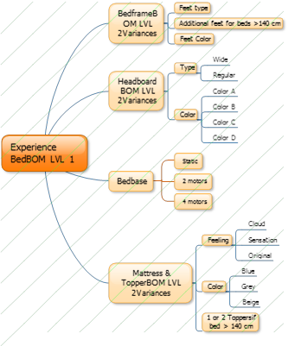
How to create a sales Kit

Slide 5
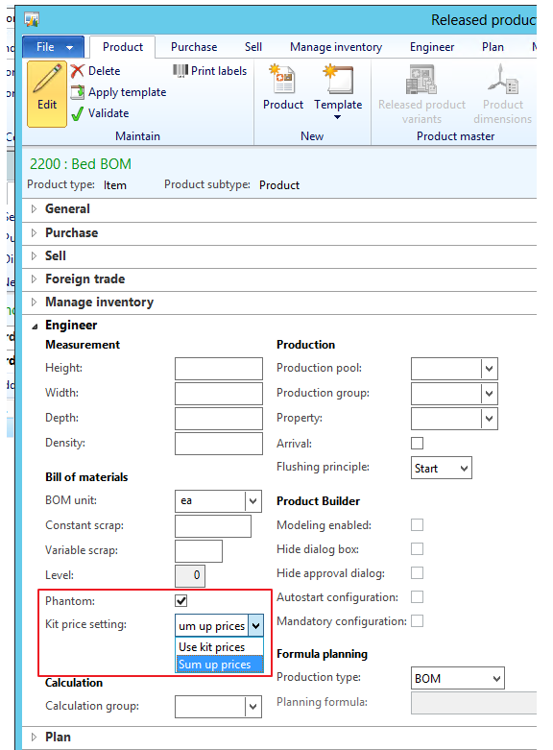
Designing a KIT – Step 1
Create an item, and mark it as a phantom, and select Kitting price setting.
Use kit prices means that prices are defined on the kit.
Sum up prices means that prices are defined on the kit lines.

Slide 6
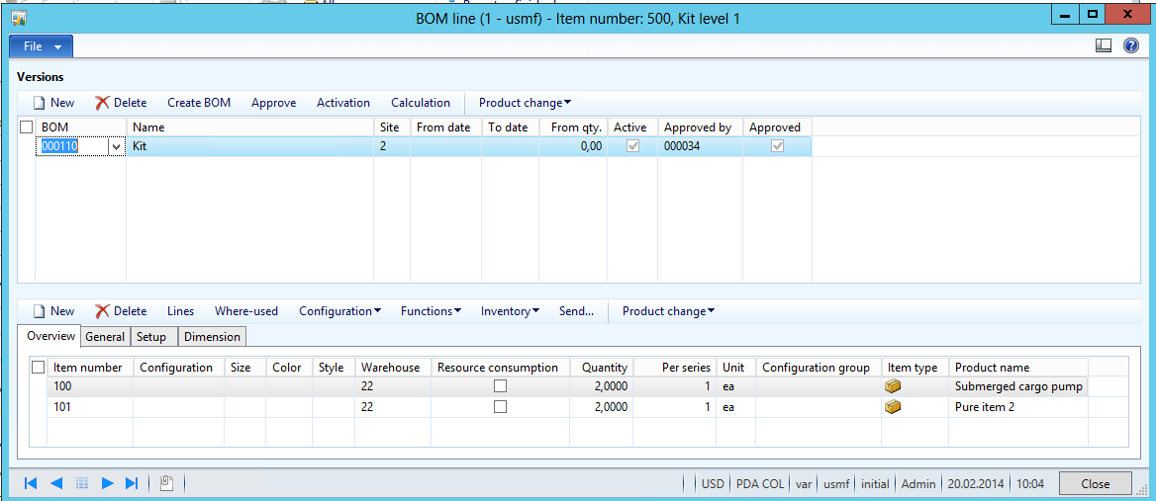
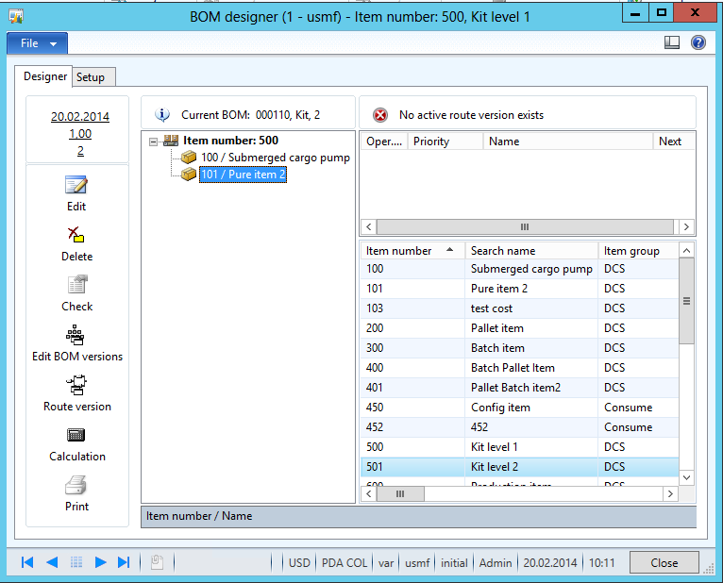
Designing a KIT – Step 2
Create a BOM using BOM line or BOM designer

Slide 7
Create a sales order, and add the kit
Here a “Sum Up Prices”-kit has been selected

Slide 8
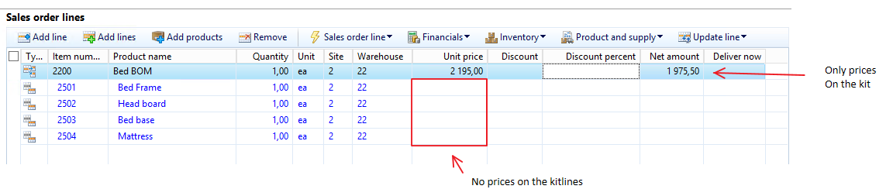
Create a sales order, and add the kit
Here a “Use kit prices”-kit has been selected

Slide 9
Create a sales order, and add the kit
Here a combination of “Sum up prices” and “use kit prices”-kit has been selected

Slide 10
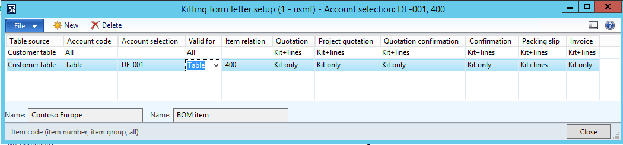
Setting up formletters
Specify if the kit-lines should be shown on confirmation/packinglsip/invoice.

Slide 11
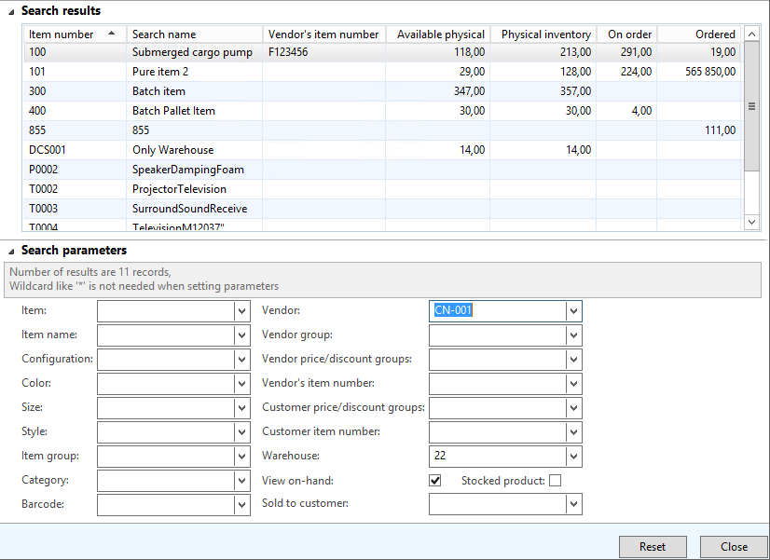
Additional features with kitting
Product lookup

Slide 12
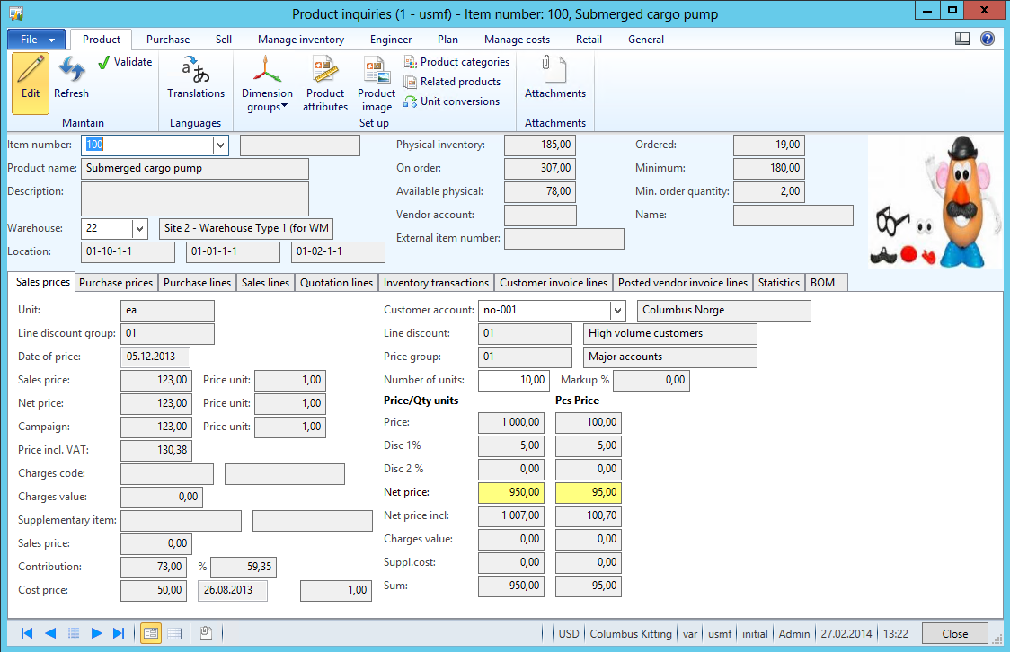
Additional Kitting features
Product inquiry

