Slide 1

Wine-o-mania
Kurt Held
Saurav Mitra
Diamond Williams
Karista Williams

Slide 2
Agenda
Data Source
Hypothesis
Conclusions
Questions

Slide 3
Data Source
We retrieved the original dataset from Kaggle.
The dataset contained 150k rows of information
Once the dataset was cleansed we had 77k
This was due to the dataset having a variety of missing values
After the dataset was cleansed we used OpenWeather and Google Maps APIs to retrieve additional information

Slide 4
Hypothesis
The relationship between price and region
The relationship between price and overall rating
The relationship between rating and location
The relationship between types of wines by locations
The overall best and worst wine

Slide 5
Price and Region

Slide 6
Price and Overall Rating

Slide 7
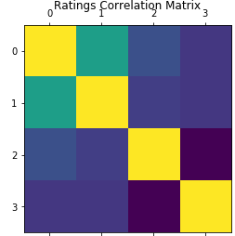
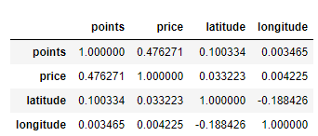
Rating and location
Ho: Wine ratings is impacted by the price and location of the wine
Ha: Wine ratings is not impacted by the price and location of the wine
This means that the price and location has low significance to the wines rating; therefore we should accept the alternative hypothesis and reject the null hypothesis

Slide 8
Wine Types by Location

Slide 9
Overall Best and Worst Wine

