Slide 1
Writing Systems

Slide 2
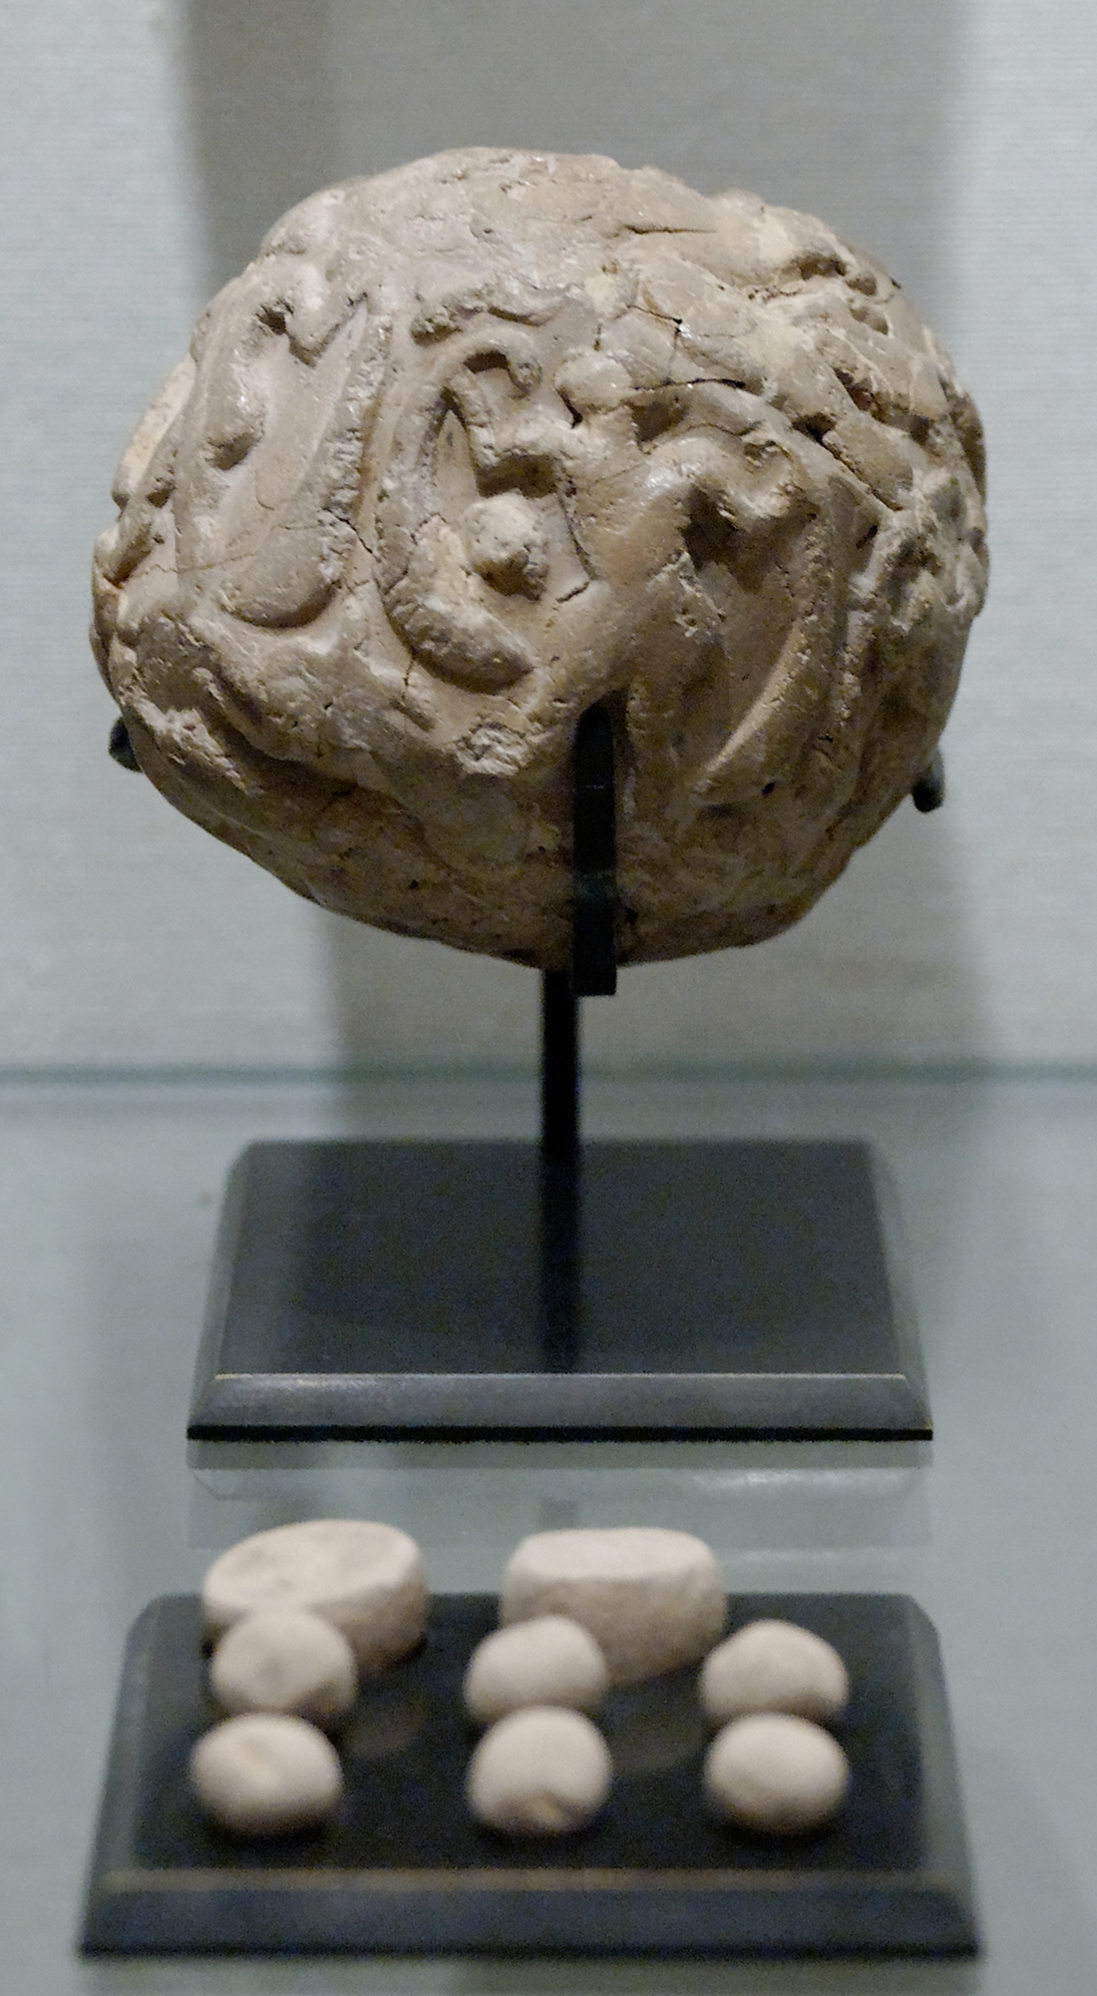
Accounting Tokens
Used to track accounts
Researchers believe that the clay envelopes were marked to show what was inside
These markings eventually started to stand on their own, without tokens
Nguyen, 2009

Slide 3
References
Nguyen, M. (2009) Globular envelope with a cluster of accounting tokens. Clay, Uruk period. From the Tell of the Acropolis in Susa [Photograph]. Wikimedia Commons. https://commons.wikimedia.org/wiki/File:Accountancy_clay_envelope_Louvre_Sb1932.jpg

