Slide 1
Telegraph

Slide 2
Optical Telegraphs

Slide 3
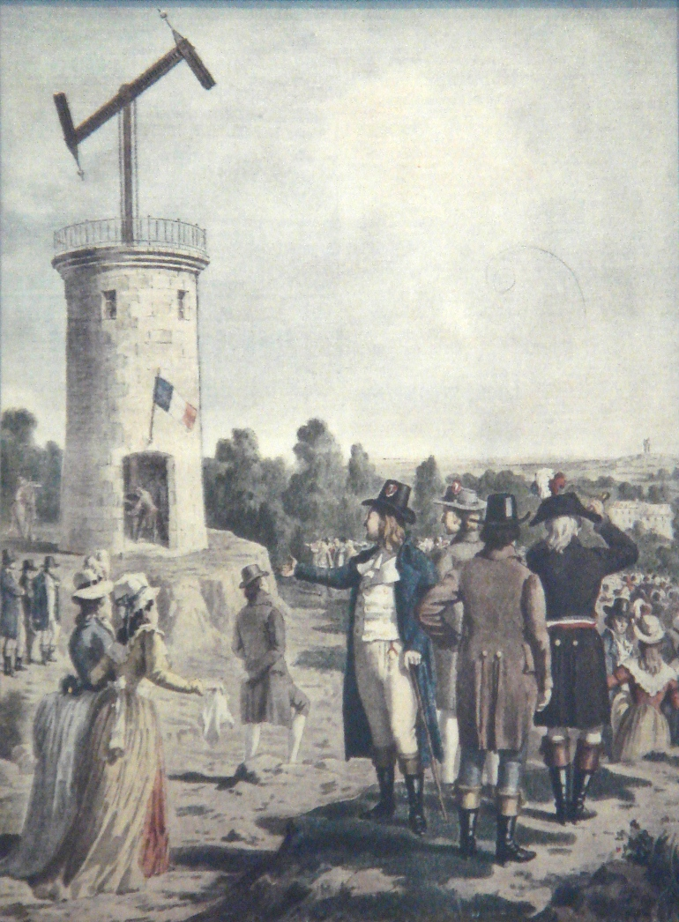
The French optical telegraph system used jointed poles mounted on towers.
Chappe’s Telegraph, 19th Century

Slide 4
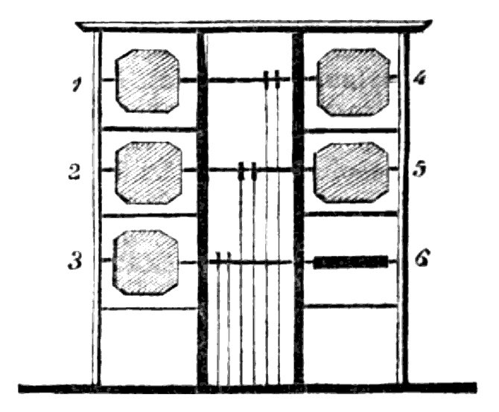
In many other areas, shutter-based systems were used (ex. UK and Sweden).
Murray Shutter Telegraph, 1827

Slide 5
Electric Telegraph

Slide 6
Polybius

Slide 7
Example Polybius Square
 | 1 | 2 | 3 | 4 | 5
1 | A | B | C/K | D | E
2 | F | G | H | I | J
3 | L | M | N | O | P
4 | Q | R | S | T | U
5 | V | W | X | Y | Z
This version, with the combined C/K, has been used extensively by prisoners and captured service members to allow them to communicate in secret.

Slide 8
Possible Improvements: One-to-One
 | 1 | 2 | 3 | 4 | 5
1 | A | B | C | D | E
2 | F | G | H | I | J
3 | K | L | M | N | O
4 | P | Q | R | S | T
5 | U | V | W | X | Y
6 | Z
One improvement to that system might be to add a row to allow for one symbol to one code, so that “C” and “K” don’t share a code point.

Slide 9
Possible Improvements: 1:1 & Symbols
 | 1 | 2 | 3 | 4 | 5
1 | A | B | C | D | E
2 | F | G | H | I | J
3 | K | L | M | N | O
4 | P | Q | R | S | T
5 | U | V | W | X | Y
6 | Z | [space] | , | . | ?
Another improvement could be to use the additional spaces on the added row for some symbols. You could also choose to add a number shifting mark.

Slide 10
Possible Improvements: Frequency Optimization
 | 1 | 2 | 3 | 4 | 5
1 | E | T | O | S | L
2 | A | I | H | U | W
3 | N | R | C | Y | G
4 | D | M | P | K | J
5 | F | V | Q | X | Z
6 | B
If one of these systems were actually used commonly in commercial practice, then it would help a lot if the time to send each symbol was shortest for the letters that are most frequently used. This approach is only really useful if people will use the code so much that the effort needed to memorize a layout that doesn’t leverage existing knowledge (alphabetical order) will be offset by the time savings.

Slide 11
Possible Improvements: Prowords and Abbreviations
 | 1 | 2 | 3 | 4 | 5
1 | A | B | C/K | D | E
2 | F | G | H | I | J
3 | L | M | N | O | P
4 | Q | R | S | T | U
5 | V | W | X | Y | Z
Even using the original version, using abbreviations and pre-arranged codes can cut transmission time significantly:
“CAN U GET ME SUM”
“WTHR BAD TDAY”

Slide 12
References
Chappe’s semaphore [Painting]. (19th century). Wikimedia Commons. https://commons.wikimedia.org/wiki/File:Chappe_semaphore.jpg
Murray shutter telegraph [Diagram]. (1827, November 24) Wikimedia Commons. https://commons.wikimedia.org/wiki/File:Murray_Shutter_Telegraph_1795.png

