Slide 1
L16: Wireless
Examples of different signal appearances on a waterfall graphic

Slide 2

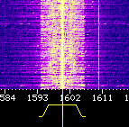

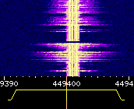
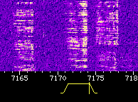
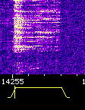
CW (Morse Code)
AM Voice
AM Voice
FM Voice
Lower Sideband (LSB) Voice
Upper Sideband (USB) Voice

