Slide 1
Deceptive Appeals

Slide 2
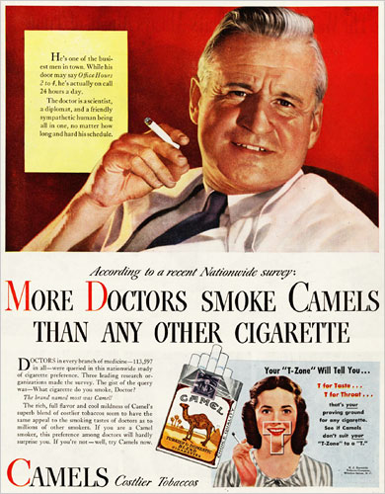
Does this argument include:
Falsification?
Concealment?
Equivocation?

Slide 3
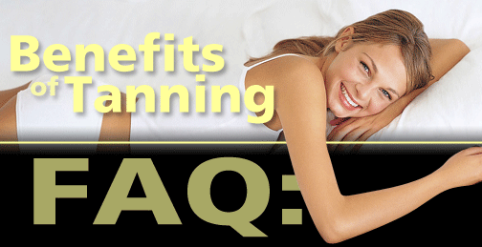
Does this argument include:
Falsification?
Concealment?
Equivocation?
Q: Don't UV rays damage the skin?
A: Skin damage is caused primarily by overexposure to UV rays and burning. A healthy tan, on the other hand, helps prevent sunburn.

Slide 4
Facial Affect Displays

Slide 5
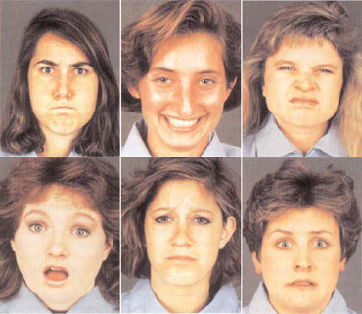
Universal Facial Affect Displays

Slide 6
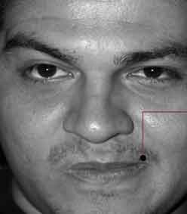
Plus one, added later

Slide 7
