Slide 1
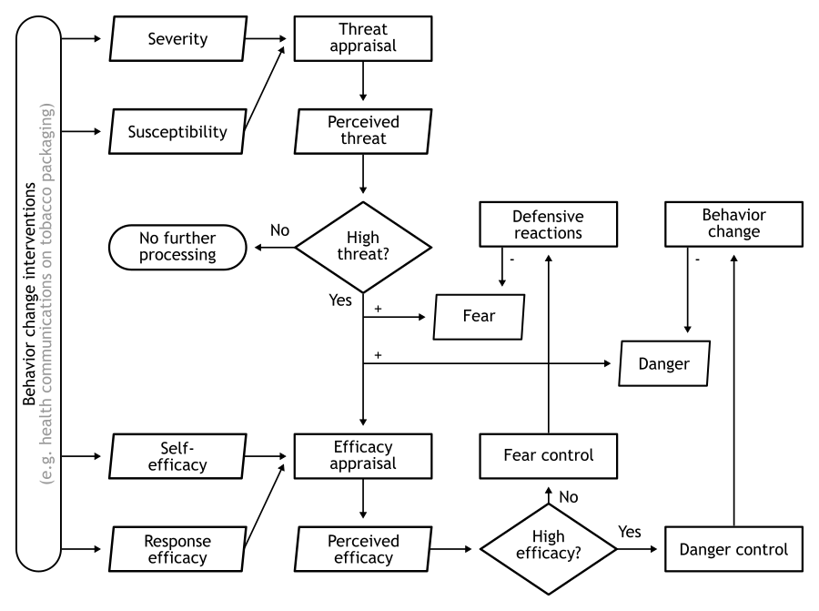
Extended Parallel Process Model
Theory: Witte, 1992
Illustration: Peters, 2018

Slide 2
Examples of Motivated Appeals

Slide 3
Fear Appeals
Donald Trump’s “Break In” ad (2020)
https://www.youtube.com/watch?v=moZOrq0qL3Q
Honorable mention: The “Daisy” Ad (1964)
https://www.youtube.com/watch?v=riDypP1KfOU

Slide 4
Pity Appeals
Katopodis, 2020

Slide 5
Guilt Appeals
Katopodis, 2020

Slide 6
Humor Appeals
Katopodis, 2020

Slide 7
Ingratiation
Katopodis, 2020

Slide 8
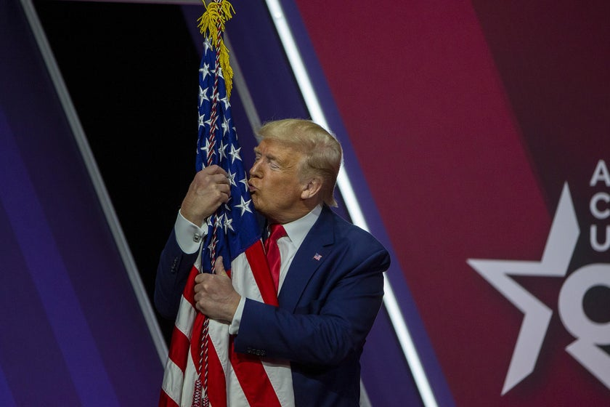
Patriotism Appeals
Katopodis, 2020

Slide 9
Sex Appeals
Katopodis, 2020

Slide 10
Warmth Appeals
Katopodis, 2020

Slide 11
Sex Appeal + Pity Appeal
Katopodis, 2020

Slide 12
References
Katopodis, T. (2020, February 29). President Donald Trump kisses the flag of the United States of America at the annual Conservative Political Action Conference (CPAC) at Gaylord National Resort & Convention Center February 29, 2020 in National Harbor, Maryland [Digital Image]. Getty Images.
Peters, G. (2018, March 23). Illustration of the Extended Parallel Process Model [Digital Illustration]. Wikipedia. https://en.wikipedia.org/wiki/Extended_parallel_process_model#/media/File:Extended_Parallel_Process_Model.png
Witte, K. (1992). Putting the fear back into fear appeals: The extended parallel process model. Communication Monographs, 59(4), 329–349.

