Slide 1
Why Do Communication Skills Matter?

Slide 2
Communication is literally unavoidable.
"You cannot not communicate."
—Watzlawick, Beavin, & Jackson
(1967, p. 51)

Slide 3
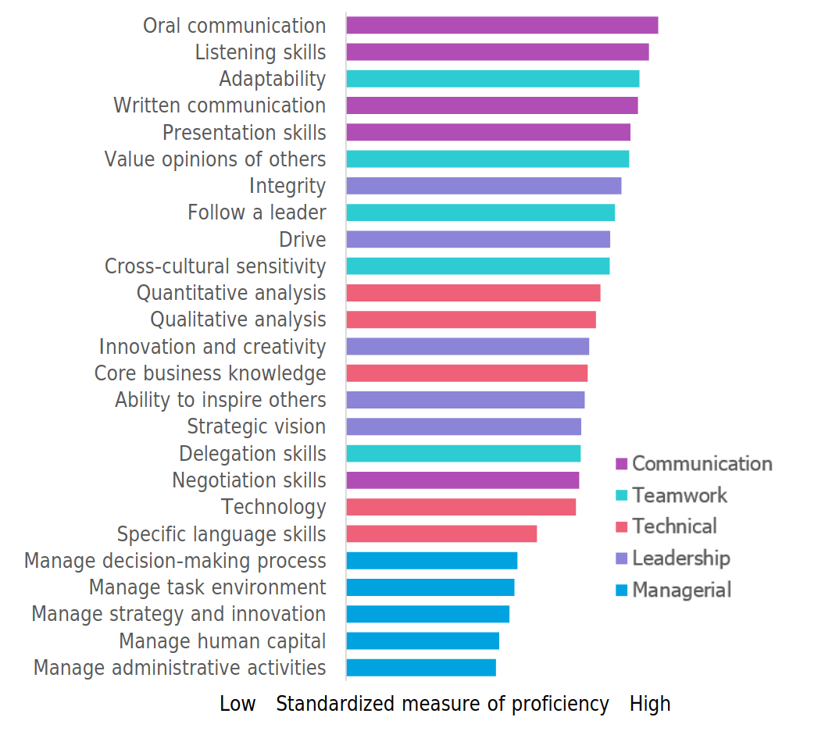
Communication skills are highly valued by corporate recruiters.
Communication Skills
Courtesy of GMAT, ©2017

Slide 4
References
Graduate Management Admission Council (GMAC). (2017) Corporate recruiters survey report 2017. https://www.gmac.com/-/media/files/gmac/research/employment-outlook/2017-gmac-corporate-recruiters-web-release.pdf
Watzlawick, P., Beavin, J. H., & Jackson, D. D. (1967). Pragmatics of human communication: A study of interactional patterns, pathologies, and paradoxes. In C. D. Mortensen (Ed.), Communication theory (2nd ed., pp. 48-71). Norton.

