Slide 1
An Example Visual Aid
How to Use the Assertion-Evidence Structure with Different Forms of Visual Evidence

Slide 2
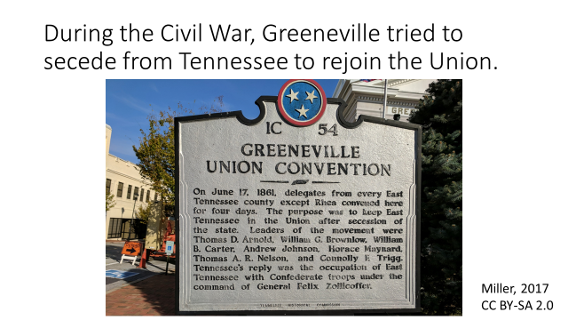
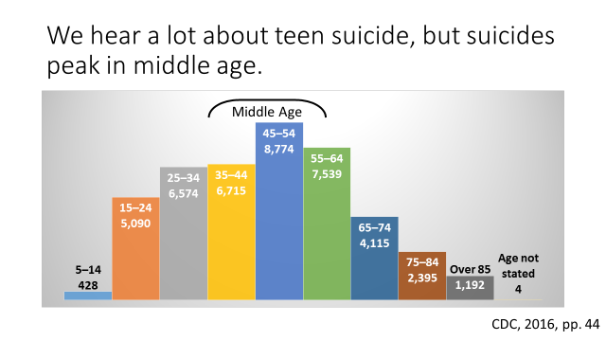
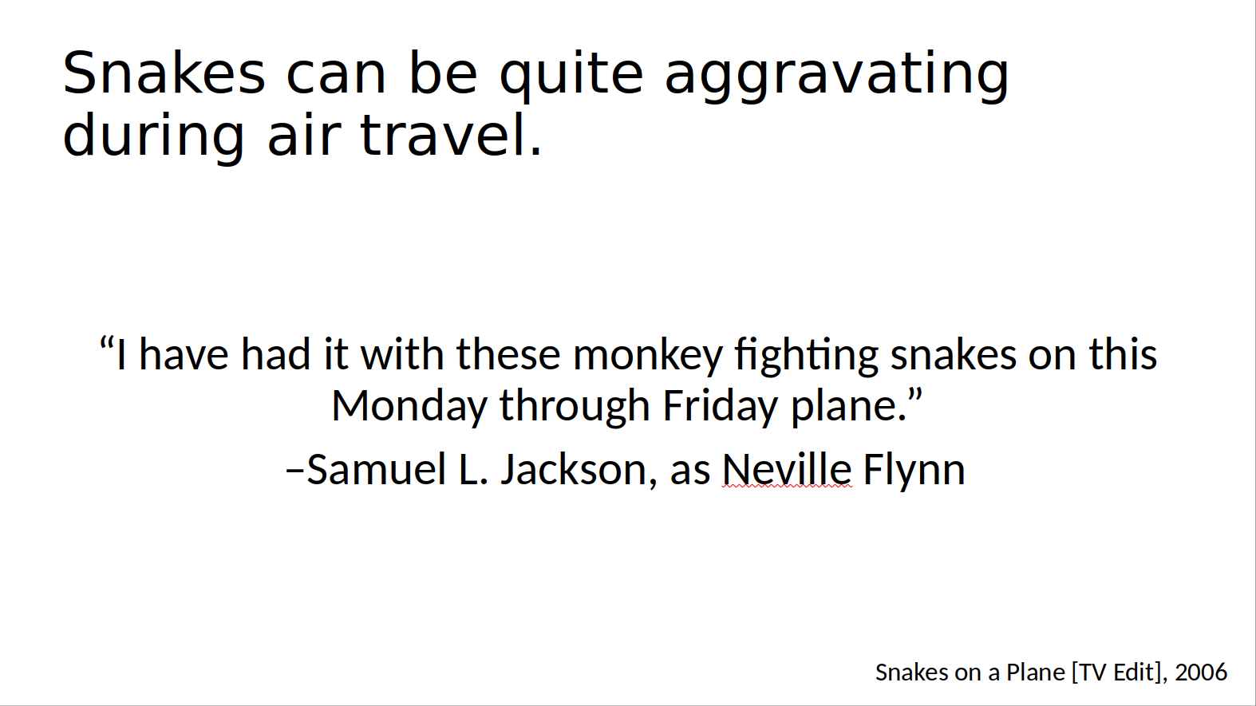
Things, numbers, and other people’s words are all forms of evidence which translate well visually.
Things used as visual evidence
Numbers used as visual evidence
Other people’s words used as visual evidence
Notes:
https://flowingdata.com/2017/02/09/how-to-spot-visualization-lies/
<number>

Slide 3
An Assertion-Evidence Structure slide must have three parts.
Full-sentence heading that makes a clam
Visual evidence that supports the heading
Citation for the visual evidence

Slide 4
Call-outs may also be included, and are often helpful
This is a call-out

Slide 5
There are full size examples on the next three slides.

Slide 6
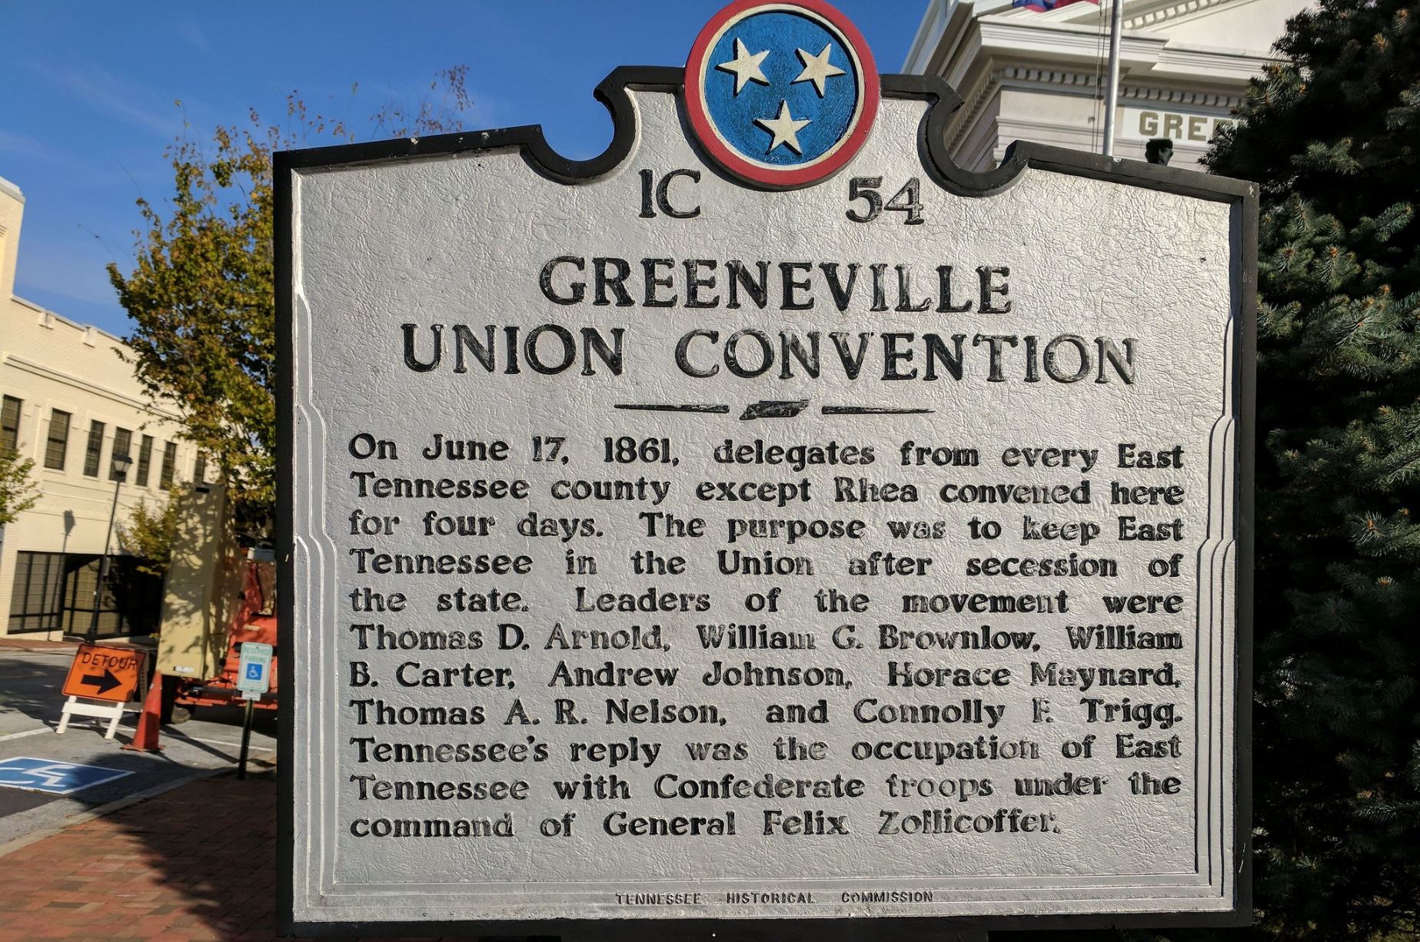
During the Civil War, Greeneville tried to secede from Tennessee to rejoin the Union.
Miller, 2017
CC BY-SA 2.0
Notes:
Miller, K. D. (2017, September 25). Union Convention Historical Marker in Greeneville, TN [Digital Photograph]. Retrieved from https://www.flickr.com/photos/140911330@N07/37432735836
<number>

Slide 7
We hear a lot about teen suicide, but suicides peak in middle age.
Middle Age
CDC, 2016, pp. 44
Notes:
United States Center for Disease Control. (2016, June 30). Deaths: Final Data for 2014. National Vital Statistics Reports, 65(4). Retrieved from https://www.cdc.gov/nchs/data/nvsr/nvsr65/nvsr65_04.pdf
<number>

Slide 8
Snakes can be quite aggravating during air travel.
“I have had it with these monkey fighting snakes on this Monday through Friday plane.”
–Samuel L. Jackson, as Neville Flynn
Snakes on a Plane [TV Edit], 2006
Notes:
Berenson, C. (Producer), & Ellis, D. R. (Director). (2006, August 18). Snakes on a plane [Motion picture, television edit]. United States: New Line Cinema.
<number>

Slide 9
References
Berenson, C. (Producer), & Ellis, D. R. (Director). (2006, August 18). Snakes on a plane [Motion picture, television edit]. United States: New Line Cinema.
Miller, K. D. (2017, September 25). Union Convention Historical Marker in Greeneville, TN [Digital Photograph]. https://www.flickr.com/photos/140911330@N07/37432735836
United States Center for Disease Control. (2016, June 30). Deaths: Final Data for 2014. National Vital Statistics Reports, 65(4). https://www.cdc.gov/nchs/data/nvsr/nvsr65/nvsr65_04.pdf

