Slide 1
WORD OF THE DAY………
AHOLEHOLE
Aholehole is pronounced “ah-holy-holy,” and is the name of a species of Hawaiian flagtail fish native to the central Pacific.
By:
Gabriel Dacuan
Crhistian Layco

Slide 2
<!DOCTYPE html> <html> <head> <link rel="stylesheet" href="bag.css"><!--to connect to the css--> <script src="jquery.js"></script><!--to connect to the jquery library--> <script src="animate.js"><!--to connect to jquery codes--> </script> <script src="jquery-ui.js"><!--to cennect to the jq ui library--> </script> </head> <body> <div style="position:center;"><!--to position it to center--> <button class="btn1" title="This will move you to the direction UP">up</button><!--this is a button that has a title in it when hovered--> <button class="btn2" title="This will move you to the direction down">down</button><!--this is a button that has a title in it when hovered--> <button class="btn3" title="This will move you to the direction LEFT">left</button><!--this is a button that has a title in it when hovered--> <button class="btn4" title="This will move you to the direction RIGHT">right</button><!--this is a button that has a title in it when hovered--> <button class="btn5" title="This will move you to the PHILIPPINES">Philippines</button><!--this is a button that has a title in it when hovered--> </div> </body> </html>

Slide 3
Css CODES body{ background-image:url(map.gif)/*this is the background image of the html*/ } button { width: 8em;/*this is the width of the button*/ } .ui-widget{/*this is the widget appearing when you hover to an elemnt*/ font-family:century gothic;/*desired font style*/ font-zize:15px;/*desired font size*/ border: 1px solid #000000;/*desired border*/ background:#ffffff;/*desired background*/ color:black;/*desired font color*/ padding:8px;/*desired padding*/ position:absolute;/*the positionwhich is absolute*/ } .ui-helper-hidden-accessible{/*the appering black text*/ height: 0px;/*to minimize to a not visible px*/ overflow:hidden;/*to hide it*/ }

Slide 4
JQUERY CODES $(document).ready(function(){//to activate this you need to open the website $(".btn1").click(function(){//so when when the button named by this id was clicked it will proceed to its function $("body").animate({ backgroundPositionX: "+=0px",//in this case the horizontal movements will do nothing backgroundPositionY: "+=500px"//in this case it will move depends on how many the pixels you assigned }); }); $(".btn2").click(function(){//so when when the button named by this id was clicked it will proceed to its function $("body").animate({ backgroundPositionX: "+=0px", //in this case the horizontal movements will do nothing backgroundPositionY: "-=500px"//in this case it will move depends on how many the pixels you assigned }); }); $(".btn3").click(function(){//so when when the button named by this id was clicked it will proceed to its function $("body").animate({ backgroundPositionX: "+=500px",//in this case it will move depends on how many the pixels you assigned backgroundPositionY: "+=0px"//in this case the vertical movements will do nothing }); }); $(".btn4").click(function(){//so when when the button named by this id was clicked it will proceed to its function $("body").animate({ backgroundPositionX: "-=500px",//in this case it will move depends on how many the pixels you assigned backgroundPositionY: "+=0px"//in this case the vertical movements will do nothing }); }); $(document).one('click', '.btn5', function(){//this is used t activate one click only $("body").animate({ backgroundPositionX: "1500px",//in this case it will move to the specific part depends on how many the pixels you assigned backgroundPositionY: "1500px"//in this case it will move to the specific part depends on how many the pixels you assigned }); }); });

Slide 5
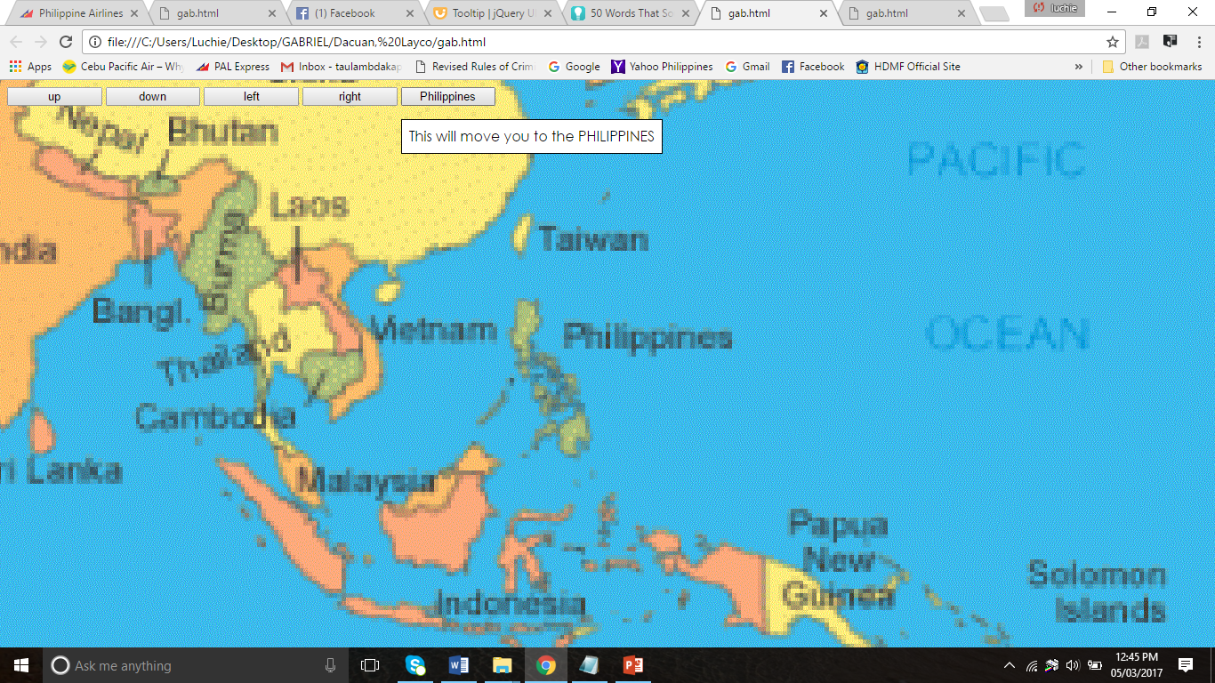
OUtPut

