Slide 1



Medical Clinic
Software System to Support a Doctor
Akademia Górniczo-Hutnicza im. Stanisława Staszica w Krakowie
AGH University of Science and Technology

Slide 2
Table of Contents
General Description
Goals
Areas
Use Case Diagram
Activity Diagram
Context Diagram
Data Flow Diagram
Storage Structure
System Architecture
STD
User Interfaces
Summary

Slide 3
1. General Description
Our idea
Problem Statements
Objectives

Slide 4
2. Goals
Provide a paper-less hospital up to %90
Specially designed to help old people

Slide 5
3. Areas
Administrative area
Medical area
Ordering area
Human resources

Slide 6
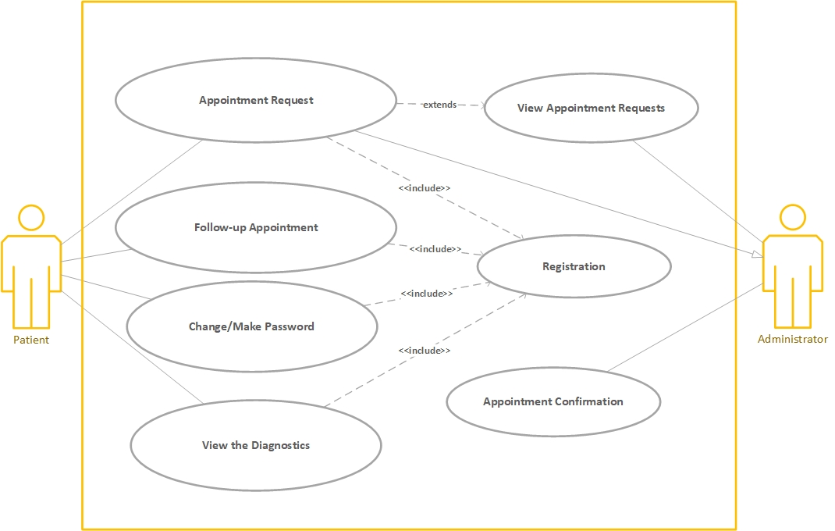
4. Use Case Diagram

Slide 7
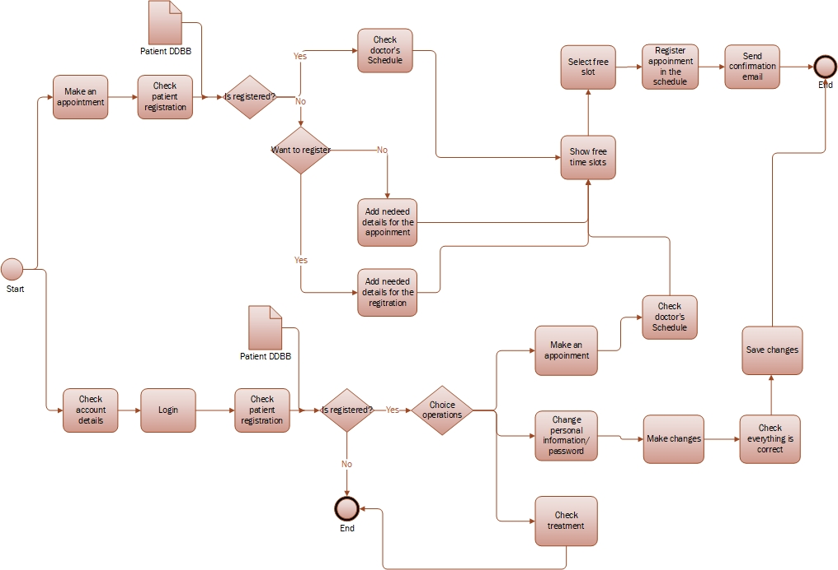
5. Activity Diagram

Slide 8
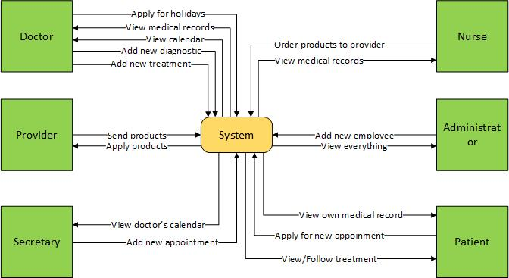
6. Context Diagram

Slide 9
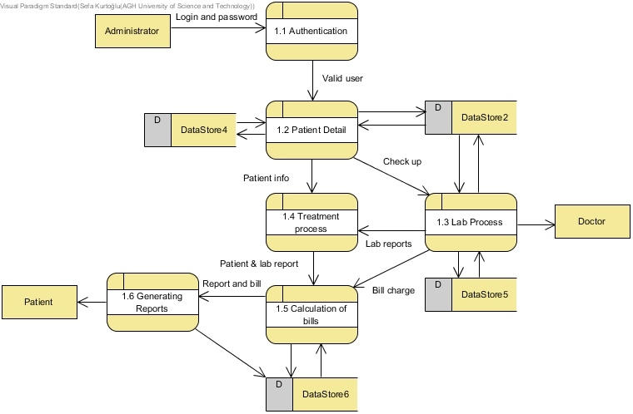
7. Data Flow Diagram

Slide 10
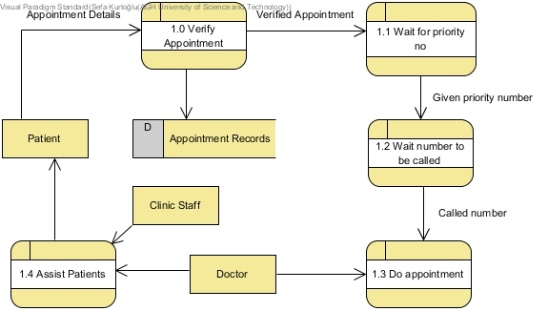

Slide 11
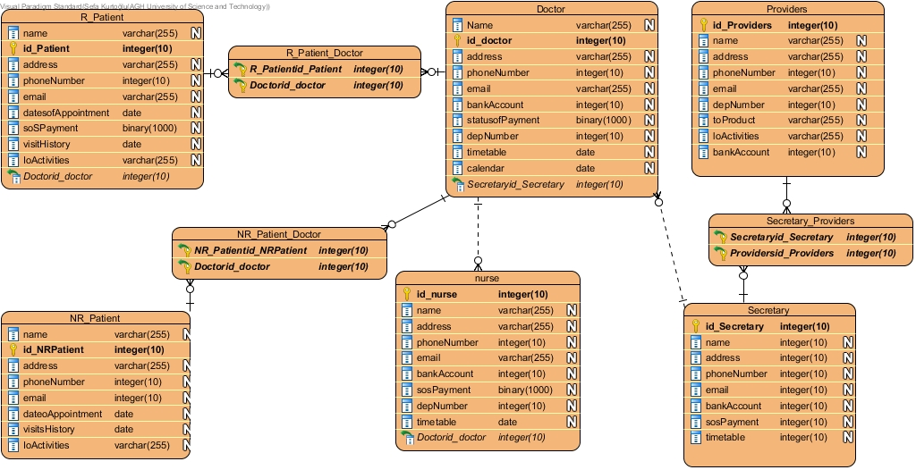
8. Storage Structure

Slide 12
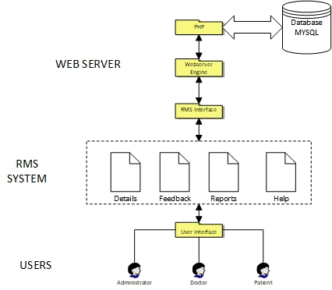
9. System Architecture

Slide 13
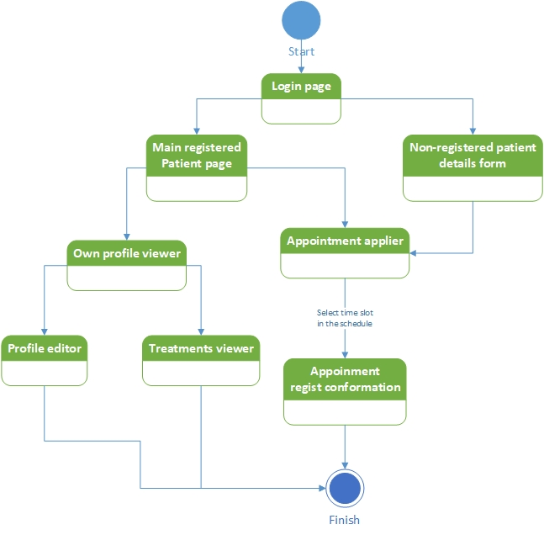
10. STD

Slide 14
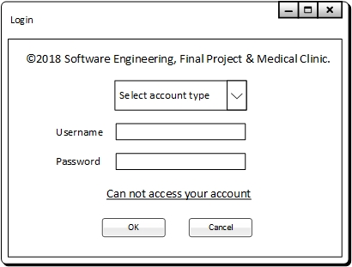
11. User Interfaces

Slide 15
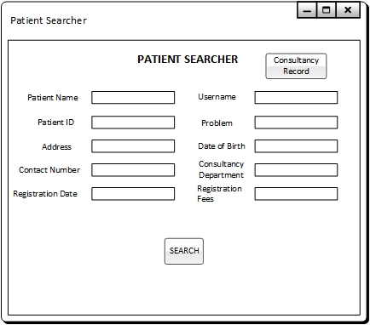

Slide 16
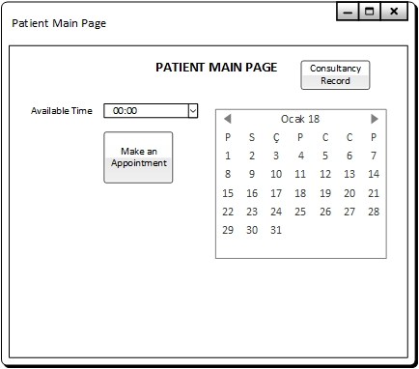

Slide 17
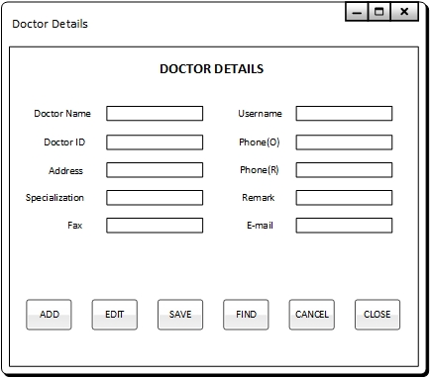

Slide 18
12. Summary
Future Enhancements
Conclusion

Slide 19
Contact
Iñaki Seco
inaki.seco@opendeusto.es
Sefa Kurtoğlu
1030520412@erciyes.edu.tr

Slide 20



