Slide 1
ART 482 · CORPORATE IDENTITY
JAMES KURTZ
Welcome to CorpID
Class 1 · Monday, August 24, 2026
CORPID · ART 482 · CLASS 1 · FALL 2026
CORPID.KURTZ.CC

Slide 2
01
Introductions
CORPID · ART 482 · CLASS 1 · FALL 2026
CORPID.KURTZ.CC

Slide 3
01 · INTRODUCTIONS
03 / 30
Getting to Know You
State your name
What you want out of this course
What you want to learn
What you want to accomplish
What you want to gain
CORPID · ART 482 · CLASS 1 · FALL 2026
CORPID.KURTZ.CC

Slide 4
01 · INTRODUCTIONS
04 / 30
Getting To Know Me
Education
Work history
Current situation
Family
Hobbies & extras
CORPID · ART 482 · CLASS 1 · FALL 2026
CORPID.KURTZ.CC

Slide 5





Slide 6
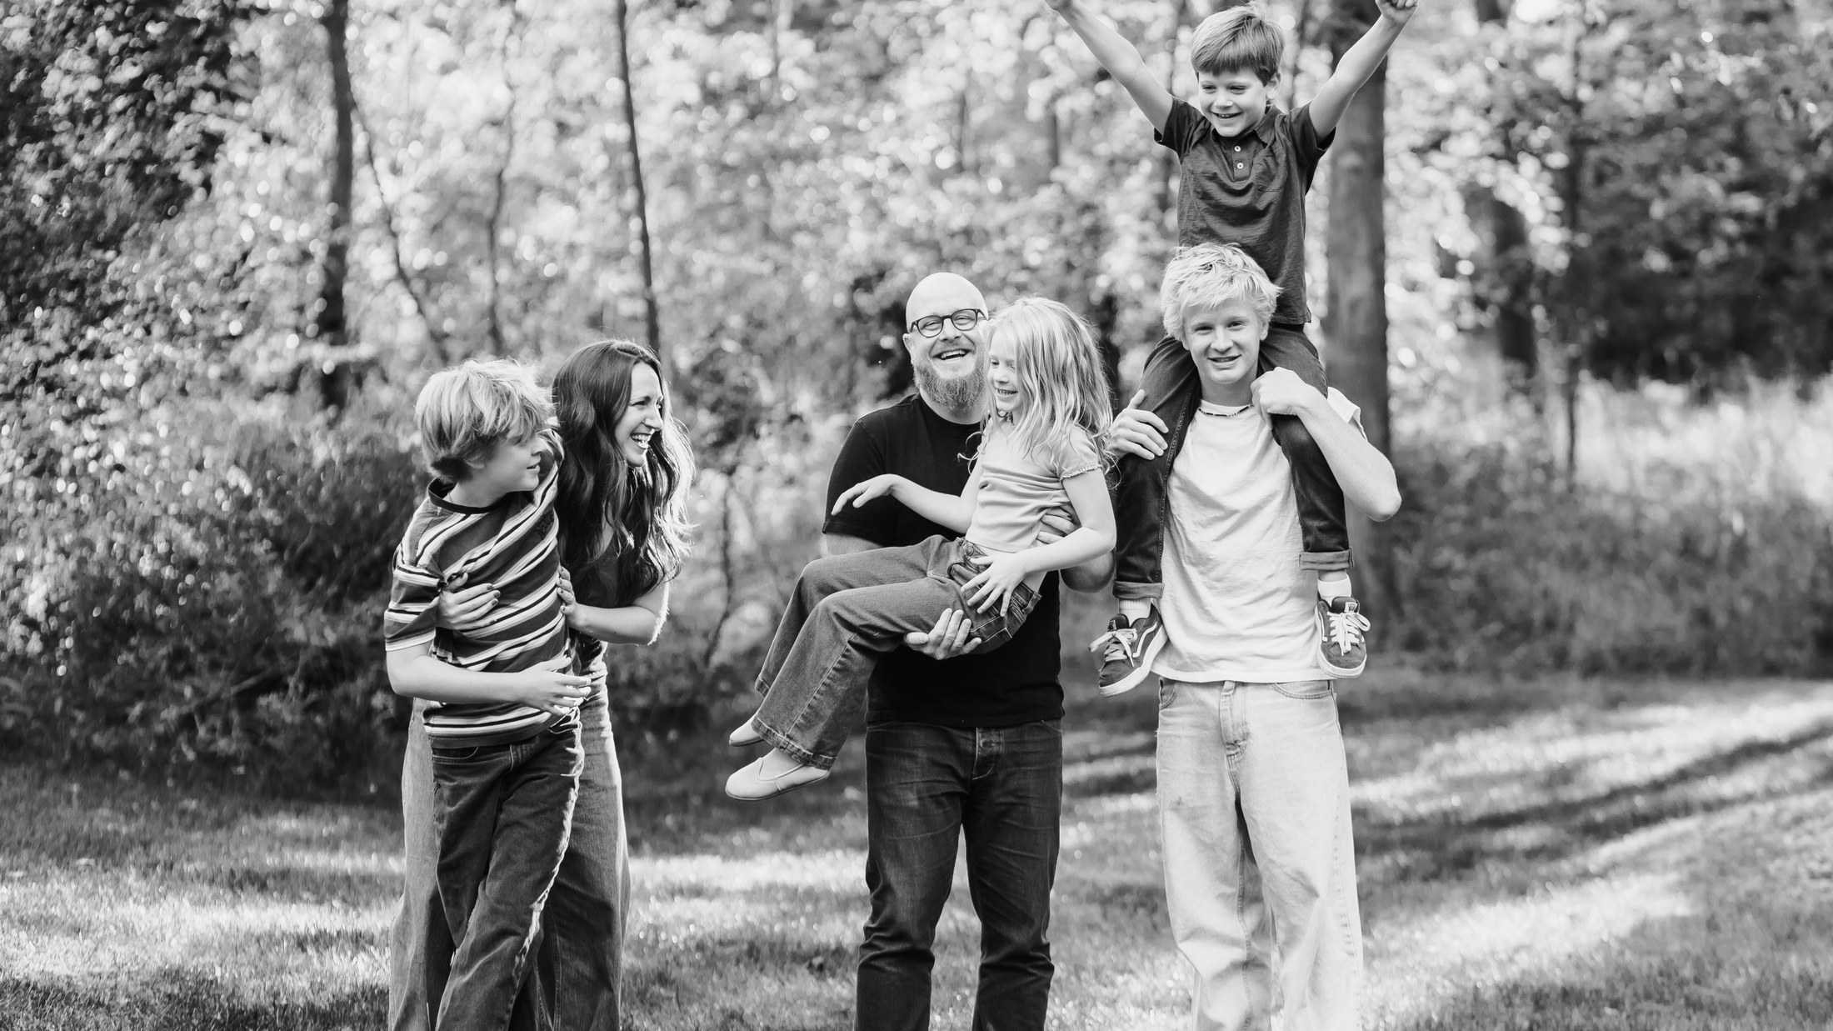

Slide 7
02
Course Overview
CORPID · ART 482 · CLASS 1 · FALL 2026
CORPID.KURTZ.CC

Slide 8
02 · COURSE OVERVIEW
08 / 27
Corporate Identity Systems
Not just a logo: a complete system
Built for one real, local business
Run a full professional rebrand process
Portfolio-ready by the end of the semester
CORPID · ART 482 · CLASS 1 · FALL 2026
CORPID.KURTZ.CC

Slide 9
02 · COURSE OVERVIEW
09 / 27
Four phases, one semester.
Discover
Aug 24 – Sep 23
Develop
Oct 19 – Nov 18
• Research your business & competitors
• Sketch concept directions, narrow to one
• Build applications across every touchpoint
• 1-on-1 portfolio reviews
Define
Sep 28 – Oct 14
Deliver
Nov 23 – Dec 9
• Lock the system: color, type, grid
• Write the rationale behind it
• Finalize the full brand guide
• Present to industry professionals
Schedule may change as we go
CORPID · ART 482 · CLASS 1 · FALL 2026
CORPID.KURTZ.CC

Slide 10
02 · COURSE OVERVIEW
10 / 27
Brightspace
Attendance
Grades
Announcements
That's it
CORPID · ART 482 · CLASS 1 · FALL 2026
CORPID.KURTZ.CC

Slide 11
02 · COURSE OVERVIEW
11 / 27
corpid.kurtz.cc
Schedule, materials, examples, policies
Functionally replaces Brightspace
Let's look at it together right now
CORPID · ART 482 · CLASS 1 · FALL 2026
CORPID.KURTZ.CC

Slide 12
02 · COURSE OVERVIEW
12 / 27
Can't Access the Website?
Tell me anytime
I'll get you the materials directly
CORPID · ART 482 · CLASS 1 · FALL 2026
CORPID.KURTZ.CC

Slide 13
03
Expectations
CORPID · ART 482 · CLASS 1 · FALL 2026
CORPID.KURTZ.CC

Slide 14
03 · EXPECTATIONS
14 / 27
How the grade breaks down.
Mark Comparisons
5%
High-Contrast Drawings
5%
System Definition
10%
Personal Identity
5%
Brand Guide + Applications
60%
Process Book
10%
Final Presentation
5%
Total
100%
CORPID · ART 482 · CLASS 1 · FALL 2026
CORPID.KURTZ.CC

Slide 15
03 · EXPECTATIONS
15 / 27
Attendance Policy
29 classes, about 79 hours together: make the most of it
Miss more than 2, your grade starts stepping down
A lot of people were surprised by that last year
CORPID · ART 482 · CLASS 1 · FALL 2026
CORPID.KURTZ.CC

Slide 16
03 · EXPECTATIONS
16 / 27
Late Work Policy
10% off per class period late
Nothing accepted after one week
That means a zero
CORPID · ART 482 · CLASS 1 · FALL 2026
CORPID.KURTZ.CC

Slide 17
03 · EXPECTATIONS
17 / 27
AI
University policy applies
Lots of thoughts on this
We'll cover it later and throughout
CORPID · ART 482 · CLASS 1 · FALL 2026
CORPID.KURTZ.CC

Slide 18
03 · EXPECTATIONS
18 / 27
Presentations & Critiques
Phones down, laptops closed
Order will be randomized, be ready to present
CORPID · ART 482 · CLASS 1 · FALL 2026
CORPID.KURTZ.CC

Slide 19
03 · EXPECTATIONS
19 / 27
Portfolio Showpiece
This becomes a keystone portfolio piece
Put in the real effort
This is the one that can help you get a job
CORPID · ART 482 · CLASS 1 · FALL 2026
CORPID.KURTZ.CC

Slide 20
03 · EXPECTATIONS
20 / 27
Process Over Proof
Not about "proof": it's about real engagement
Engage with the process, not just the checklist
Be curious, make mistakes, change direction
Actually learn, don't just clear the minimum
CORPID · ART 482 · CLASS 1 · FALL 2026
CORPID.KURTZ.CC

Slide 21
04
Today's Assignments
Mark Comparisons
Personal Identity
Process Book
CORPID · ART 482 · CLASS 1 · FALL 2026
CORPID.KURTZ.CC

Slide 22
04 · MARK COMPARISONS
22 / 27
Mark Comparisons
10 comparisons, 5 business types
Good marks: from anywhere
Bad marks: local only (Akron, Cleveland, Columbus, Pittsburgh)
This becomes your working pool for the rest of the semester
Be ready to explain why each mark is good or bad: it shows your taste
Due Monday, August 31, worth 5%
CORPID · ART 482 · CLASS 1 · FALL 2026
CORPID.KURTZ.CC

Slide 23
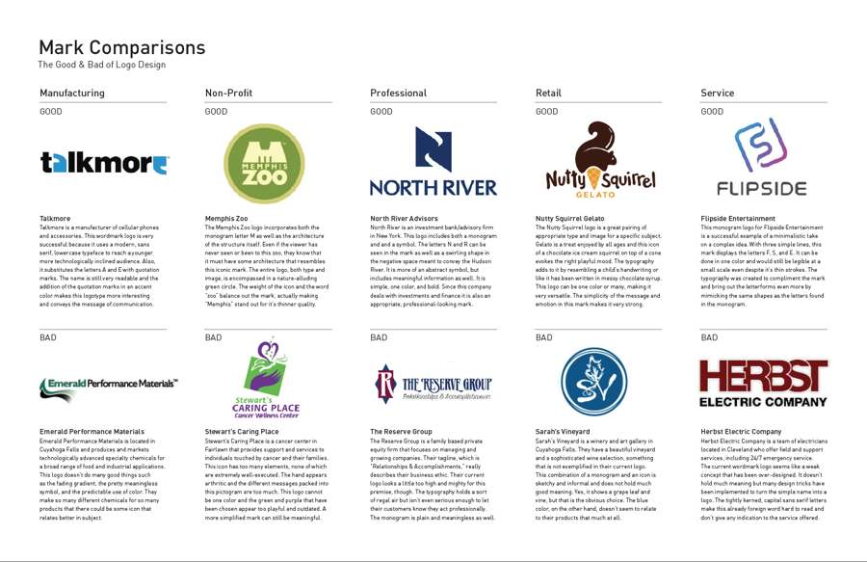
04 · MARK COMPARISONS
23 / 27
What this looks like
A past student's Mark Comparisons page · corpid.kurtz.cc has more
CORPID · ART 482 · CLASS 1 · FALL 2026
CORPID.KURTZ.CC

Slide 24
04 · PERSONAL IDENTITY
24 / 27
Personal Identity
Typographic mark + business card
Also applies to a resume or letterhead layout
No fixed checkpoints
Develop it in parallel, all semester
Due Wednesday, November 18 (end of Develop), worth 5%
CORPID · ART 482 · CLASS 1 · FALL 2026
CORPID.KURTZ.CC

Slide 25
04 · PROCESS BOOK
25 / 27
Process Book
Document everything
Sketches, dead ends, decisions
Not just a highlight reel
Starts today, not week 14
Log something after every class
All semester, worth 10%
CORPID · ART 482 · CLASS 1 · FALL 2026
CORPID.KURTZ.CC

Slide 26
05 · BEFORE NEXT CLASS
26 / 27
Before next class
Mark Comparisons due Monday
Group review: be ready to talk about it
Start your Process Book right away
No class Wednesday, Aug 26
CORPID · ART 482 · CLASS 1 · FALL 2026
CORPID.KURTZ.CC

Slide 27
ART 482 · CORPORATE IDENTITY
27 / 27
Questions?
See you Monday, August 31.
CORPID · ART 482 · CLASS 1 · FALL 2026
CORPID.KURTZ.CC

