Slide 1
Anaconda Tutorial
TA : 叶俊杰 2024年9月2日星期一

Slide 2
Outline
● Introduction: What is Anaconda?
● Install in your computer

Slide 3

What is Anaconda?
Anaconda is a distribution that provides easy access to and management of packages, and unified management of environments.
Anaconda includes over 180 scientific packages and their dependencies, including conda, Python, and more.

Slide 4
Install Anaconda in your computer
Anaconda介绍、安装及使用教程
(https://zhuanlan.zhihu.com/p/32925500)

Slide 5
PyTorch Tutorial

Slide 6
Outline
● Background: Prerequisites & What is Pytorch?
● Training & Testing Neural Networks in Pytorch
● Dataset & Dataloader ● Tensors
● torch.nn: Models, Loss Functions
● torch.optim: Optimization
● Save/load models

Slide 7


Prerequisites
● We assume you are already familiar with…
1.
Python3
■ if-else, loop, function, file IO, class, ... ■ refs: link1, link2, link3
2.
Deep Learning Basics
■ ref: link1, link2
Some knowledge of NumPy will also be useful!

Slide 8

What is PyTorch?
● An machine learning framework in Python.
● Two main features:
○ N-dimensional Tensor computation (like NumPy) on GPUs ○ Automatic differentiation for training deep neural networks

Slide 9

Training Neural Networks
Define Neural
Network
Optimization
Algorithm
Loss Function
Training

Slide 10
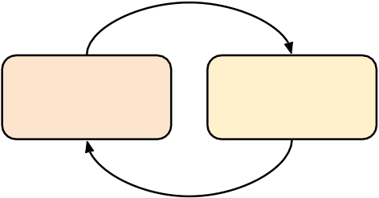
Training & Testing Neural Networks
Training Validation Testing

Slide 11
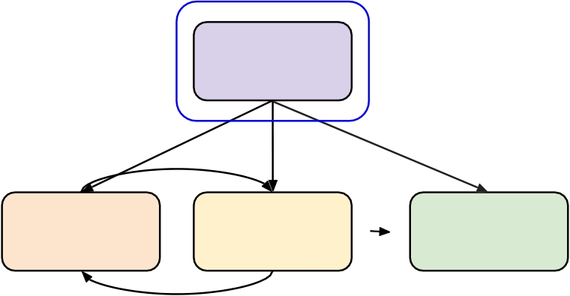
Training & Testing Neural Networks - in Pytorch
Step 1.
torch.utils.data.Dataset &
torch.utils.data.DataLoader
Load Data
Training Validation Testing

Slide 12
Dataset & Dataloader
● Dataset: stores data samples and expected values
● Dataloader: groups data in batches, enables multiprocessing
● dataset = MyDataset(file)
●
dataloader = DataLoader(dataset, batch_size, shuffle=True)
Training: True Testing: False

Slide 13
Dataset & Dataloader
from torch.utils.data import Dataset, DataLoader
class MyDataset(Dataset):
def init (self, file):
self.data = ...
def __getitem__(self, index):
return self.data[index]
def __len__(self):
return len(self.data)
Read data & preprocess
Returns one sample at a time Returns the size of the dataset

Slide 14
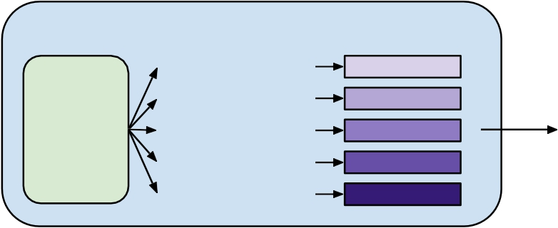
Dataset & Dataloader
dataset = MyDataset(file)
dataloader = DataLoader(dataset, batch_size=5, shuffle=False)
DataLoader
getitem getitem getitem getitem
(0) (1) (2) (3)
0 1 2 3
Dataset
batch_size
getitem (4) 4 mini-batch

Slide 15
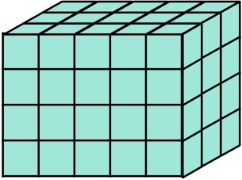
Tensors
● High-dimensional matrices (arrays)
1-D tensor e.g. audio
2-D tensor
e.g. black&white
images
3-D tensor e.g. RGB images

Slide 16
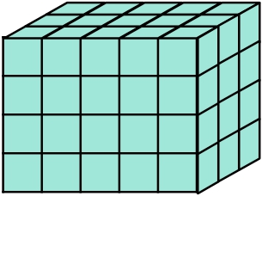
Tensors – Shape of Tensors
● Check with .shape
3 4
5
(5, )
dim 0
3
5
(3, 5)
dim 0 dim 1
5
(4, 5, 3)
dim 0 dim 1 dim 2
Note: dim in PyTorch == axis in NumPy

Slide 17
Tensors – Creating Tensors
● Directly from data (list or numpy.ndarray) x = torch.tensor([[1, -1], [-1, 1]])
tensor([[1., -1.],
[-1., 1.]])
x = torch.from_numpy(np.array([[1, -1], [-1, 1]]))
● Tensor of constant zeros & ones
x = torch.zeros([2, 2])
tensor([[0., 0.],
[0., 0.]])
x = torch.ones([1, 2, 5])
tensor([[[1., 1., 1., 1., 1.],
[1., 1., 1., 1., 1.]]])
shape

Slide 18
Tensors – Common Operations
Common arithmetic functions are supported, such as:
● Addition ● Summation
z = x + y y = x.sum()
● Subtraction ● Mean
z = x - y y = x.mean()
● Power
y = x.pow(2)

Slide 19
Tensors – Common Operations
● Transpose: transpose two specified dimensions
>>> x = torch.zeros([2, 3])
2
>>> x.shape torch.Size([2, 3])
>>> x = x.transpose(0, 1)
3
>>> x.shape
torch.Size([3, 2])
3
2

Slide 20
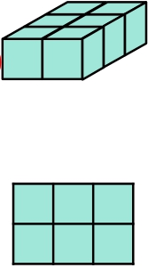
Tensors – Common Operations
● Squeeze: remove the specified dimension with length = 1
>>> x = torch.zeros([1, 2, 3])
>>> x.shape 1 3
torch.Size([1, 2, 3])
>>> x = x.squeeze(0)
(dim = 0)
>>> x.shape
2
2
torch.Size([2, 3]) 3

Slide 21
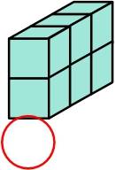
Tensors – Common Operations
● Unsqueeze: expand a new dimension
>>> x = torch.zeros([2, 3])
2
>>> x.shape torch.Size([2, 3])
3
>>> x = x.unsqueeze(1) (dim = 1)
>>> x.shape 2
torch.Size([2, 1, 3]) 1 3

Slide 22



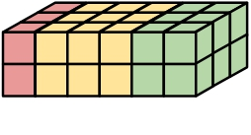
x
Tensors – Common Operations
● Cat: concatenate multiple tensors
2
3
1
y
>>> x = torch.zeros([2, 1, 3]) >>> y = torch.zeros([2, 3, 3])
2
3
3
>>> z = torch.zeros([2, 2, 3]) z 2
>>> w = torch.cat([x, y, z], dim=1)
>>> w.shape
3
2
torch.Size([2, 6, 3]) w 2
3
more operators: https://pytorch.org/docs/stable/tensors.html 6

Slide 23
Tensors – Data Type
● Using different data types for model and data will cause errors.
see official documentation for more information on data types.
Data type | dtype | tensor
32-bit floating point | torch.float | torch.FloatTensor
64-bit integer (signed) | torch.long | torch.LongTensor

Slide 24
Tensors – PyTorch v.s. NumPy
● Similar attributes
see official documentation for more information on data types.
ref: https://github.com/wkentaro/pytorch-for-numpy-users
PyTorch | NumPy
x.shape | x.shape
x.dtype | x.dtype

Slide 25
Tensors – PyTorch v.s. NumPy
● Many functions have the same names as well
ref: https://github.com/wkentaro/pytorch-for-numpy-users
PyTorch | NumPy
x.reshape / x.view | x.reshape
x.squeeze() | x.squeeze()
x.unsqueeze(1) | np.expand_dims(x, 1)

Slide 26
Tensors – Device
● Tensors & modules will be computed with CPU by default
Use .to() to move tensors to appropriate devices. ● CPU
x = x.to(‘cpu’)
● GPU
x = x.to(‘cuda’)

Slide 27

Tensors – Device (GPU)
● Check if your computer has NVIDIA GPU
torch.cuda.is_available()
● Multiple GPUs: specify ‘cuda:0’, ‘cuda:1’, ‘cuda:2’, ...
● Why use GPUs?
○ Parallel computing with more cores for arithmetic calculations ○ See What is a GPU and do you need one in deep learning?

Slide 28
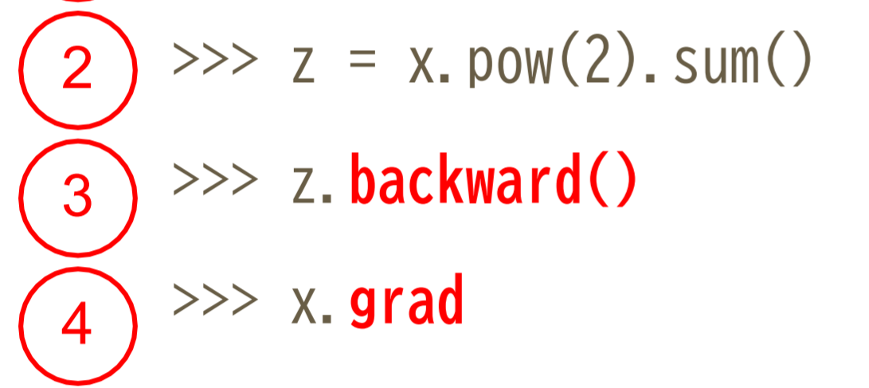
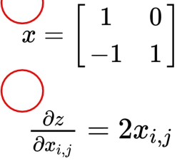
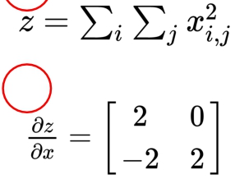
Tensors – Gradient Calculation
1 >>> x = torch.tensor([[1., 0.], [-1., 1.]],requires_grad=True)
1
2
tensor([[ 2., 0.],
[-2., 2.]]) 3 4

Slide 29
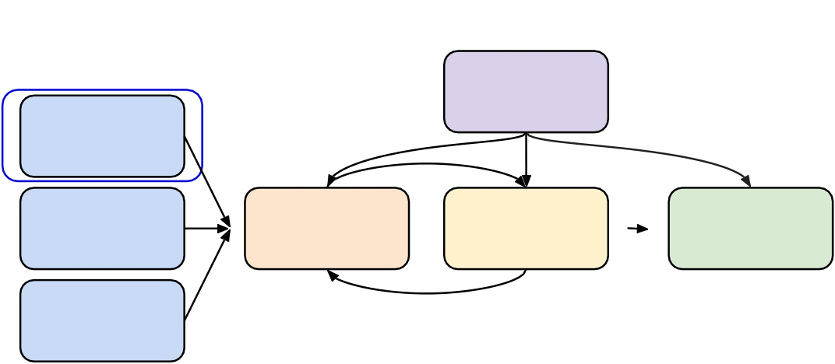
Training & Testing Neural Networks – in Pytorch
Step 2. torch.nn.Module
Load Data
Define Neural
Network
Loss Function
Optimization
Algorithm
Training
Validation
Testing

Slide 30
torch.nn – Network Layers
● Linear Layer (Fully-connected Layer)
nn.Linear(in_features, out_features)
Input Tensor * x 32
Output Tensor * x 64
nn.Linear(32, 64)
can be any shape (but last dimension must be 32) e.g. (10, 32), (10, 5, 32), (1, 1, 3, 32), ...

Slide 31
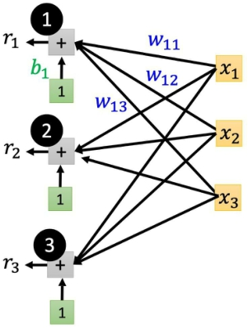
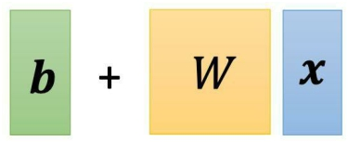
torch.nn – Network Layers
● Linear Layer (Fully-connected Layer)

Slide 32
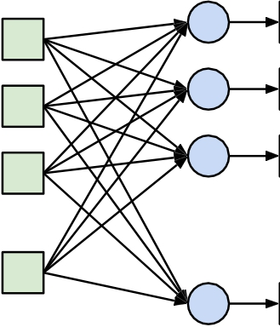
torch.nn – Neural Network Layers
● Linear Layer (Fully-connected Layer)
y1 y2 y3
y
64
x1 x2 x3
x
32
32
64
W
(64x32)
x
+
=
x
b
y
...
...

Slide 33
torch.nn – Network Parameters
● Linear Layer (Fully-connected Layer)
>>> layer = torch.nn.Linear(32, 64)
>>> layer.weight.shape
torch.Size([64, 32]) >>> layer.bias.shape
torch.Size([64])
W
(64x32)
x
x
+
b
=
y

Slide 34
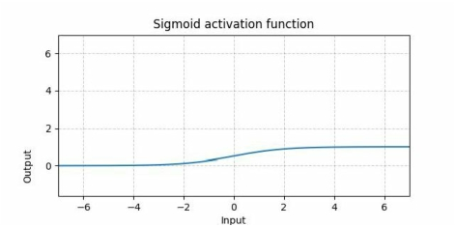
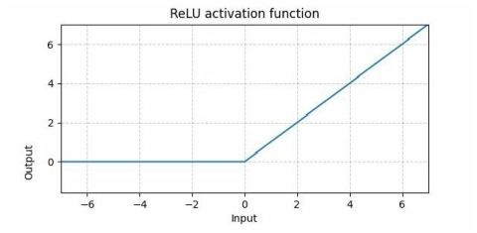
torch.nn – Non-Linear Activation Functions
● Sigmoid Activation
nn.Sigmoid()
● ReLU Activation
nn.ReLU()

Slide 35
torch.nn – Build your own neural network
import torch.nn as nn
class MyModel(nn.Module):
def init(self):
super(MyModel, self).init ()
self.net = nn.Sequential(
nn.Linear(10, 32), nn.Sigmoid(), nn.Linear(32, 1)
Initialize your model & define layers
)
def forward(self, x):
return self.net(x)
Compute output of your NN

Slide 36
torch.nn – Build your own neural network
import torch.nn as nn import torch.nn as nn
class MyModel(nn.Module):
Def __init__(self):
super(MyModel, self).__init__ () self.net = nn.Sequential(
class MyModel(nn.Module):
def init (self):
super(MyModel, self). init () self.layer1 = nn.Linear(10, 32)
=
self.layer2 = nn.Sigmoid() self.layer3 = nn.Linear(32,1)
nn.Linear(10, 32), nn.Sigmoid(), nn.Linear(32, 1)
)
def forward(self, x):
return self.net(x)
def forward(self, x): out = self.layer1(x) out = self.layer2(out) out = self.layer3(out) return out

Slide 37
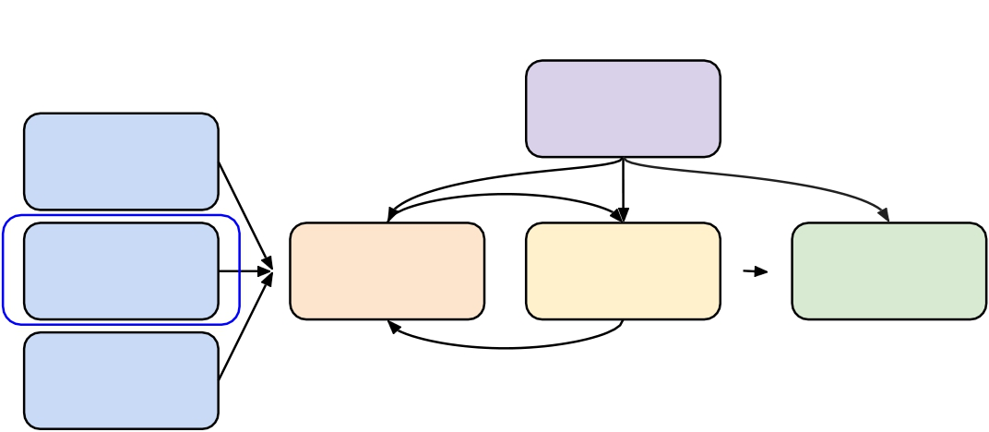
Training & Testing Neural Networks – in Pytorch
Step 3. torch.nn.MSELoss
torch.nn.CrossEntropyLoss etc.
Load Data
Define Neural
Network
Loss Function
Optimization
Algorithm
Training
Validation
Testing

Slide 38
torch.nn – Loss Functions
● Mean Squared Error (for regression tasks)
criterion = nn.MSELoss()
● Cross Entropy (for classification tasks)
criterion = nn.CrossEntropyLoss()
● loss = criterion(model_output, expected_value)

Slide 39
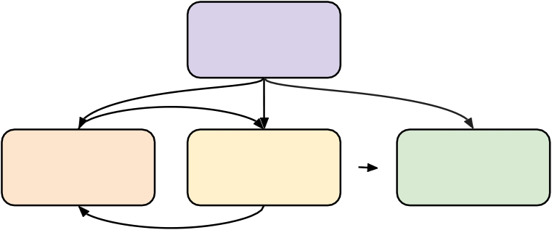
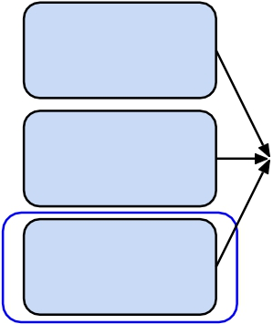
Training & Testing Neural Networks – in Pytorch
Step 4. torch.optim
Load Data
Define Neural
Network
Loss Function
Optimization
Algorithm
Training
Validation
Testing

Slide 40
torch.optim
● Gradient-based optimization algorithms that adjust network parameters
to reduce error. (See Adaptive Learning Rate lecture video)
● E.g. Stochastic Gradient Descent (SGD)
torch.optim.SGD(model.parameters(), lr, momentum = 0)

Slide 41
torch.optim
optimizer = torch.optim.SGD(model.parameters(), lr, momentum = 0)
● For every batch of data:
1. Call optimizer.zero_grad() to reset gradients of model parameters.
2. Call loss.backward() to backpropagate gradients of prediction loss.
3.
Call optimizer.step() to adjust model parameters.
See official documentation for more optimization algorithms.

Slide 42
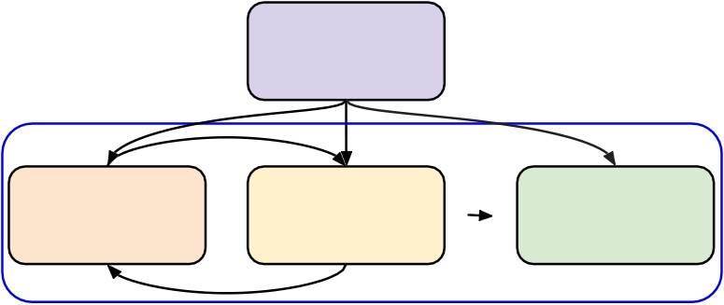
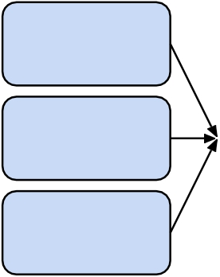
Training & Testing Neural Networks – in Pytorch
Load Data
Define Neural
Network
Loss Function
Optimization
Algorithm
Training
Validation
Step 5.
Entire Procedure
Testing

Slide 43
Neural Network Training Setup
dataset = MyDataset(file)
tr_set = DataLoader(dataset, 16, shuffle=True) model = MyModel().to(device)
criterion = nn.MSELoss()
optimizer = torch.optim.SGD(model.parameters(), 0.1)
read data via MyDataset
put dataset into Dataloader
construct model and move to device (cpu/cuda) set loss function
set optimizer

Slide 44
Neural Network Training Loop
iterate n_epochs
set model to train mode
iterate through the dataloader set gradient to zero
move data to device (cpu/cuda) forward pass (compute output) compute loss
compute gradient (backpropagation) update model with optimizer
for epoch in range(n_epochs):
model.train()
for x, y in tr_set:
optimizer.zero_grad()
x, y = x.to(device), y.to(device) pred = model(x)
loss = criterion(pred, y) loss.backward() optimizer.step()

Slide 45
Neural Network Validation Loop
model.eval()
total_loss = 0
for x, y in dv_set:
x, y = x.to(device), y.to(device)
with torch.no_grad():
pred = model(x)
loss = criterion(pred, y)
total_loss += loss.cpu().item() * len(x) avg_loss = total_loss / len(dv_set.dataset)
set model to evaluation mode
iterate through the dataloader move data to device (cpu/cuda) disable gradient calculation forward pass (compute output) compute loss
accumulate loss compute averaged loss

Slide 46
Neural Network Testing Loop
model.eval()
preds = []
for x in tt_set:
x = x.to(device)
with torch.no_grad():
pred = model(x) preds.append(pred.cpu())
set model to evaluation mode
iterate through the dataloader move data to device (cpu/cuda) disable gradient calculation forward pass (compute output) collect prediction

Slide 47
Notice - model.eval(), torch.no_grad()
● model.eval()
Changes behaviour of some model layers, such as dropout and batch normalization.
● with torch.no_grad()
Prevents calculations from being added into gradient computation graph. Usually used to prevent accidental training on validation/testing data.

Slide 48
Save/Load Trained Models
● Save
torch.save(model.state_dict(), path)
● Load
ckpt = torch.load(path) model.load_state_dict(ckpt)

Slide 49
More About PyTorch
● torchaudio
○ speech/audio processing ● torchtext
○ natural language processing
● torchvision
○ computer vision ● skorch
○ scikit-learn + pyTorch

Slide 50
More About PyTorch
● Useful github repositories using PyTorch
○ Huggingface Transformers (transformer models: BERT, GPT, ...)
○ Fairseq (sequence modeling for NLP & speech)
○ ESPnet (speech recognition, translation, synthesis, ...) ○ Most implementations of recent deep learning papers ○ ...

Slide 51
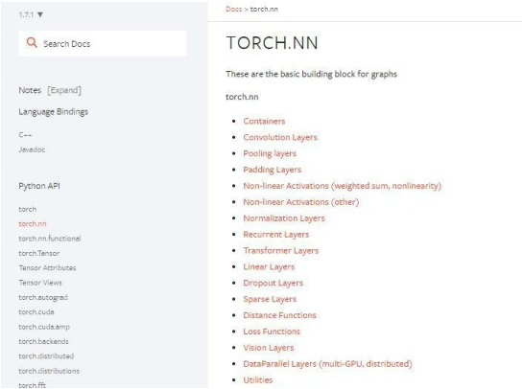
PyTorch Documentation
https://pytorch.org/docs/stable/
● torch.nn -> Neural Network
● torch.optim -> Optimization Algorithms ● torch.utils.data -> Dataset, Dataloader

Slide 52
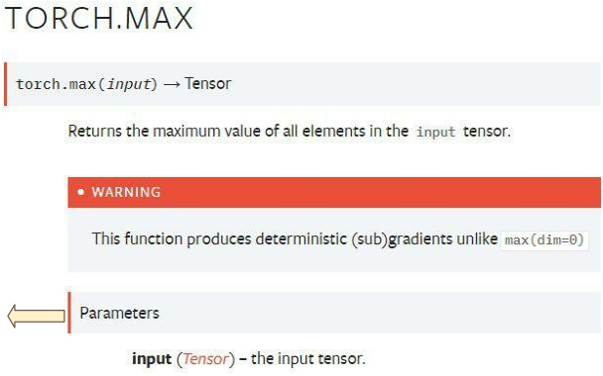
PyTorch Documentation Example
Function inputs and outputs
Data type and explanation of each input

Slide 53
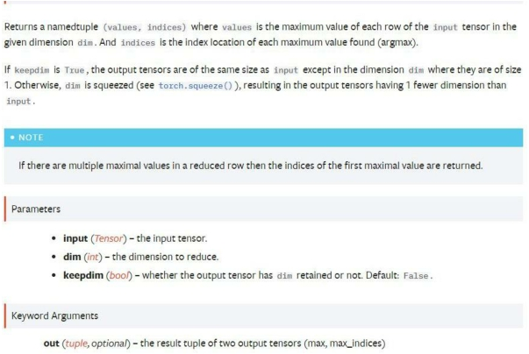
PyTorch Documentation Example
● Some functions behave
differently with different inputs ● Parameters : You don’t need to
specify the name of the argument (Positional Arguments)
● Keyword Arguments : You have to specify the name of the argument
They are separated by *

Slide 54
PyTorch Documentation Example
● Some functions behave
differently with different inputs
● Arguments with default value : Some arguments have a default value (keepdim=False), so passing a value of this argument is optional

Slide 55
PyTorch Documentation Example
Three Kinds of torch.max
1. torch.max(input) → Tensor
2.
torch.max(input, dim, keepdim=False, *,
out=None) → (Tensor, LongTensor)
3.
torch.max(input, other, *, out=None) → Tensor
input : Tensor, dim : int, keepdim : bool other : Tensor

Slide 56
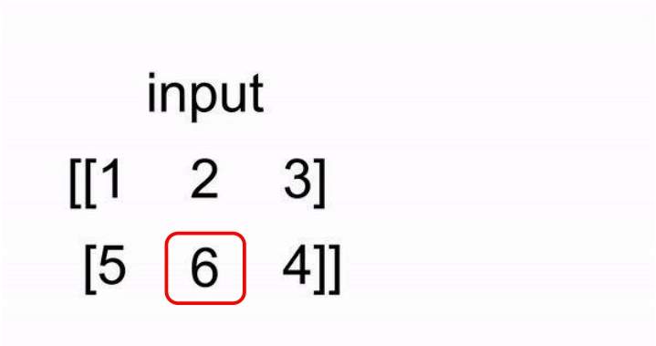
PyTorch Documentation Example
1.torch.max(input) → Tensor
Find the maximum value of a tensor, and return that value.

Slide 57
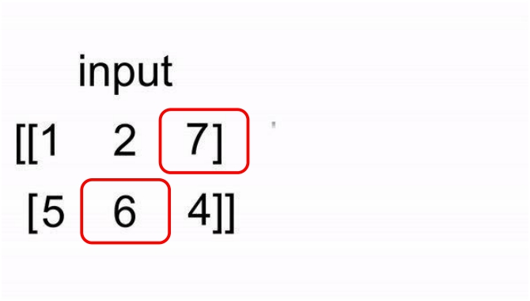
PyTorch Documentation Example
2. torch.max(input, dim, keepdim=False, *, out=None) → (Tensor, LongTensor)
Find the maximum value of a tensor along a dimension, and return that value, along with the index corresponding to that value.

Slide 58
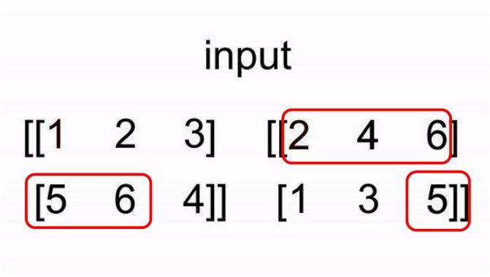
PyTorch Documentation Example
3.torch.max(input, other) → Tensor
Perform element-wise comparison between two tensors of the same size, and select the maximum of the two to construct a tensor with the same size.

Slide 59
Common Errors - torch.max (Colab)
Three Kinds of torch.max Colab code
1.
2.
3.
torch.max(input) → Tensor torch.max(input,
dim, keepdim=False, *, out=None) → (Tensor, LongTensor) torch.max(input, other,
*, out=None) → Tensor
x = torch.randn(4,5) y = torch.randn(4,5)
m, idx = torch.max(x,0,False,p)→x
*out is a keyword argument
m, idx = torch.max(x,True)→x
*did not specify dim
input : Tensor dim : int keepdim : bool other : Tensor

Slide 60
Common Errors - Tensor on Different Device to Model
model = torch.nn.Linear(5,1).to("cuda:0")
x = torch.randn(5).to("cpu")
y = model(x)
Tensor for * is on CPU, but expected them to be on GPU => send the tensor to GPU
x = torch.randn(5).to("cuda:0")
y = model(x) print(y.shape)

Slide 61
Common Errors - Mismatched Dimensions
x = torch.randn(4,5) y = torch.randn(5,4) z = x + y
The size of tensor a (5) must match the size of tensor b (4) at non-singleton dimension 1
=> the shape of a tensor is incorrect, use transpose, squeeze, unsqueeze to align
the dimensions
y = y.transpose(0,1) z = x + y print(z.shape)

Slide 62
Common Errors - Cuda Out of Memory
import torch
import torchvision.models as models
resnet18 = models.resnet18().to( "cuda:0" ) # Neural Networks for Image
data = torch.randn( 512,3,244,244) # Create fake data (512
out = resnet18(data.to( "cuda:0" )) # Use Data as Input and Feed to
print(out.shape)
CUDA out of memory. Tried to allocate 350.00 MiB (GPU 0; 14.76 GiB total capacity; 11.94 GiB already allocated; 123.75 MiB free; 13.71 GiB reserved in total by PyTorch)
=> The batch size of data is too large to fit in the GPU. Reduce the batch size.

Slide 63
Common Errors - Mismatched Tensor Type
import torch.nn as nn
L = nn.CrossEntropyLoss()
outs = torch.randn(5,5)
labels = torch.Tensor([1,2,3,4,0])
lossval = L(outs, labels) # Calculate CrossEntropyLoss between outs and labels
expected scalar type Long but found Float
=> labels must be long tensors, cast it to type “Long” to fix this issue
labels = labels.long() lossval = L(outs,labels) print(lossval)

Slide 64
Colab Tutorial

Slide 65
Outline
● Introduction
● Getting Started
● Changing Runtime
● Executing Code Block ● Check GPU type
● File Manipulation
● Mounting Google Drive ● Saving Notebook
● Useful Linux Commands
● Problems You May Encounter… (very important) ● References

Slide 66
Introduction
What is Colab?
Colab, or "Colaboratory", allows you to write and execute Python in your browser, with
● Zero configuration required
● Free access to GPUs ● Easy sharing

Slide 67
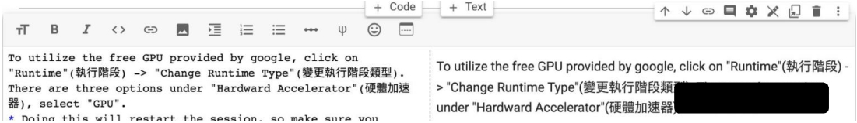
Getting Started
Creating a new cell
You can create a new code cell by clicking on +Code, clicking on +Text generates a text cell
There are options for moving your cell up/down or copy or delete it
Code Cell
Text
Cell

Slide 68
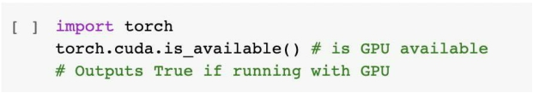

Getting Started
You can type python code in the code cell, or use a leading exclamation mark ! to change the code cell to treating the input as a shell script
→ python
→ shell script

Slide 69
Getting Started
Using an exclamation mark (!) starts a new shell, does the operations, and then kills that shell, while percentage (%) affects the process associated with the notebook, and it is called a magic command.
Use % instead of ! for cd (change directory) command other magic commands are listed here

Slide 70
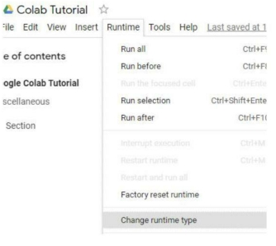
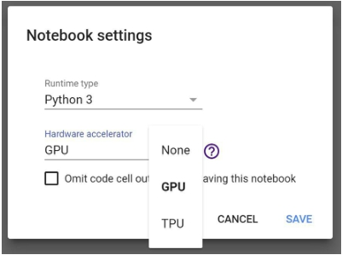
Changing Runtime
To utilize the free GPU provided by google,
click on "Runtime"(執行階段) → "Change Runtime Type"(變更執行階段類型).
select "GPU" for "Hardware Accelerator"(硬體加速器)
Doing this will restart the session, so make sure you change to the desired runtime before executing any code.

Slide 71
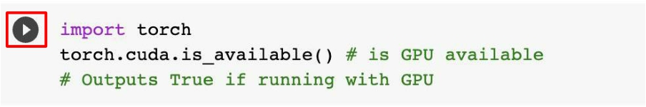
Executing Code Block
Click on the play button to execute a specific code cell

Slide 72
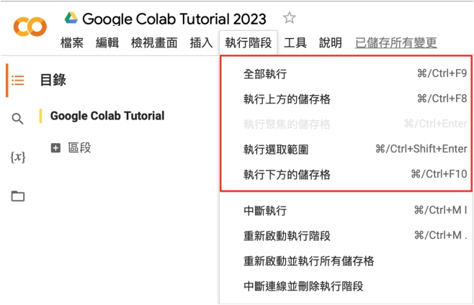
Executing Code Block
Other options to run your code

Slide 73
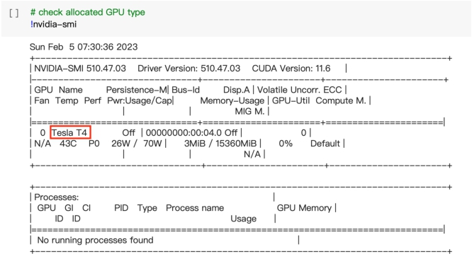
Check GPU Type
Use the command nvidia-smi to check the allocated GPU type
Available GPUs:
T4 > K80
(but most of the time you get K80 using the free Colab)

Slide 74
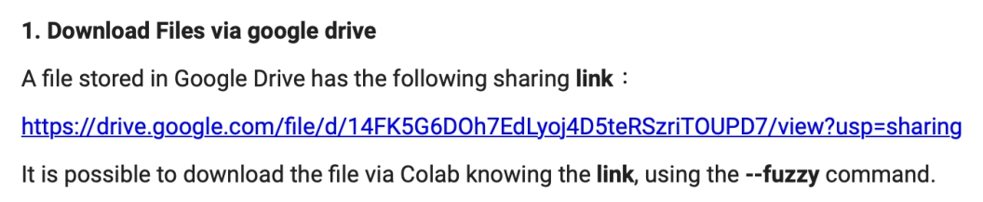
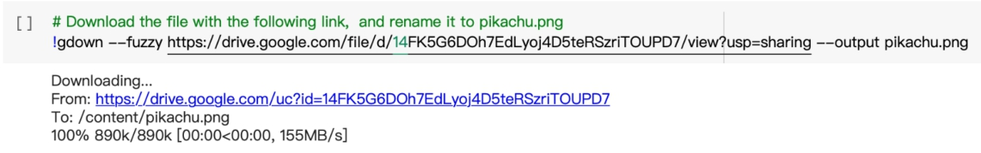
File Manipulation Download files via Google Drive

Slide 75
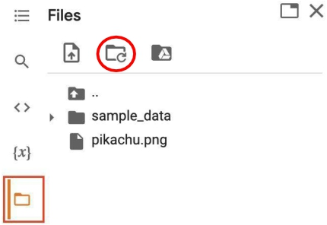
File Manipulation
File Structure
● You may click on the folder icon on the left
to view your current files
● After downloading files, if the files are not
immediately shown, click the refresh button ● Files are temporarily stored, and will be
removed once you end your session.
refresh

Slide 76
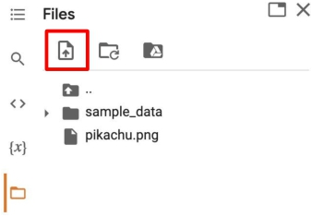
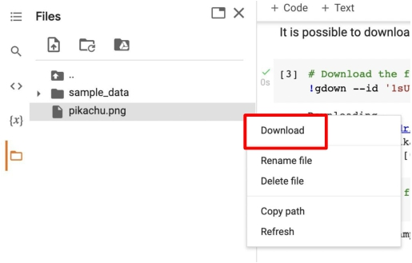
File Manipulation
Upload and Download Files
Click the upload icon to upload local files to your session
click to download files to your local

Slide 77
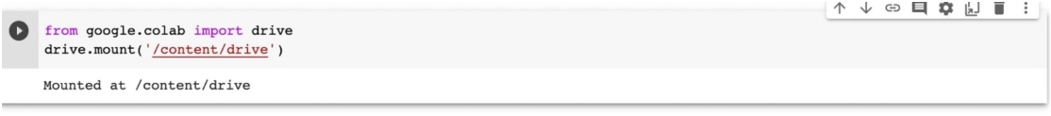
Mounting Google Drive
If you don’t want to download the data every time you start a new session, or you want some files to be saved permantly,
you can mount your own google drive to colab and directly download/save the data to your google drive.
Mount Drive:

Slide 78
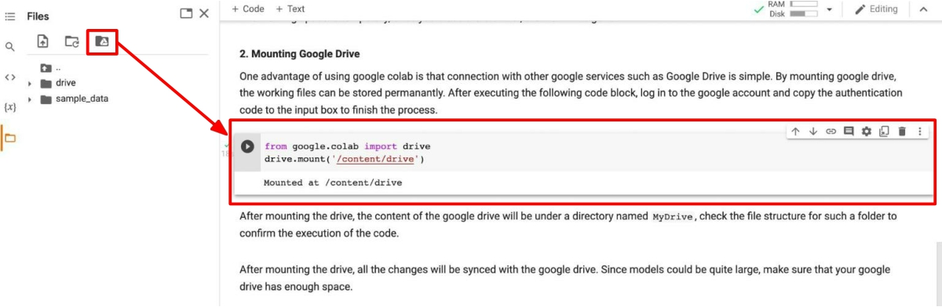
Mounting Google Drive
Click on the Google Drive icon, the Mount Drive code block will be generated

Slide 79
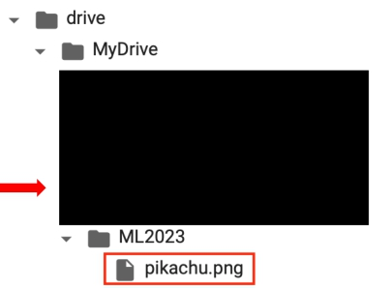
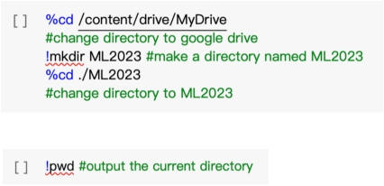
Mounting Google Drive
Execute the following three code blocks in order
This will download the image to your google drive, and you can access it later

Slide 80
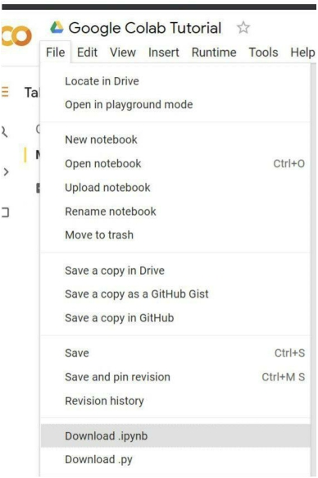
Saving Notebook
● Download the .ipynb file to your local device
(File > Download .ipynb)
● Save the colab notebook to your google drive
(File > Save a copy in Drive).
● Convert .ipynb to .py and download
(File > Download .py)

Slide 81
Useful Linux Commands (in Colab)
ls : List all files in the current directory
ls -l : List all files in the current directory with more detail pwd : Output the working directory
mkdir <dirname> : Create a directory <dirname> cd <dirname> : Move to directory <dirname> gdown : Download files from google drive
wget : Download files from the internet python <python_file>: Executes a python file

Slide 82
Problems You May Encounter…
● Colab will automatically disconnect if idle timeout(90 min., sometimes varying) or
when your screen goes black
→ solution: keep your screen on or try using javascript
● GPU usage is not unlimited ! (your account will be stopped for a period if you reached
the max gpu usage 12 hrs)
* The cooldown period before you can connect to another GPU will extend from hours to days to weeks depending on your usage
→ solution: open another account
Best solution:
1. buy colab pro :）
2. use your own resource (if able)

Slide 83
Reference
● https://colab.research.google.com
● https://research.google.com/colaboratory/faq.html

