Slide 1
CYBER SECURITY AWARENESS SYSTEM
1
Developed By
1. Ananya Shreepati Samanta — 25UAM090
2. Akanksha Amol Kurundwade — 25UAM092
3. Palak Babaso Patil — 25UAM093
4. Arpita Raju Taradale — 25UAM095
5. Akhila Kiran Dhutre — 25UAM098
CYBER
SAFETY

Slide 2
Introduction of Our Project
2
What is Cyber Security?
Cyber security is the practice of protecting computers, mobile devices, networks, applications and personal information from digital threats.
Aim of the Project
To understand real-life cybercrime risks, learn preventive measures from police, court and banking professionals, and spread cyber-safety awareness among the public.
Phishing, fake links and fraudulent messages
OTP, UPI and online banking scams
Password theft and account hacking
Social media scams and identity theft
Malware and malicious websites
Our Approach
Police Station Visit • Court Visit • Bank Visit • Public Awareness Activity

Slide 3
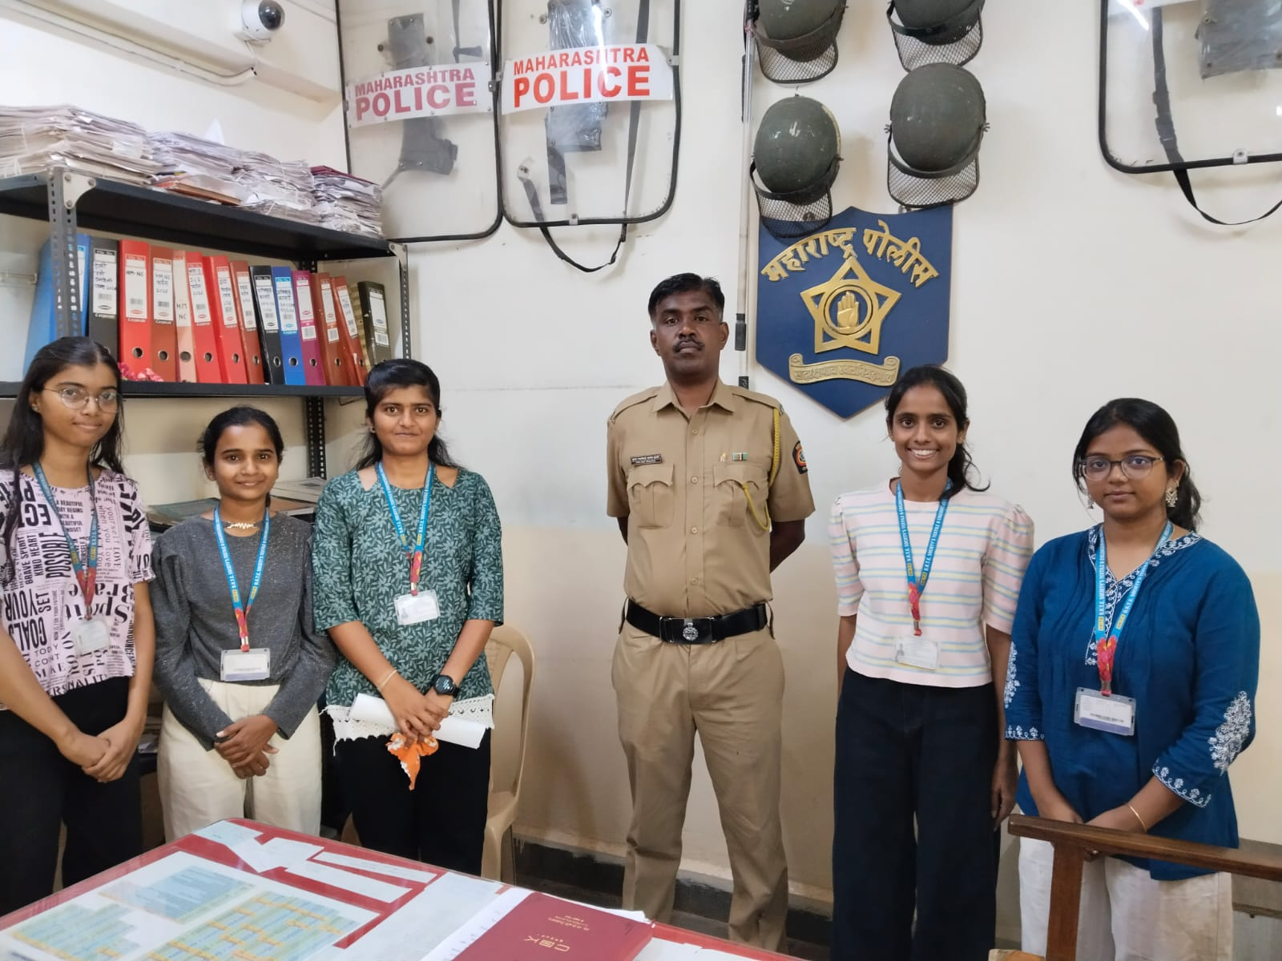
Police Station Visit – Shivaji Nagar Police Station
3
We visited Shivaji Nagar Police Station to understand how cybercrime complaints are handled.
We learned about reporting online fraud and the importance of preserving digital evidence.
We discussed common cybercrime situations and precautions citizens should follow.
The visit helped us understand the role of police in investigating cyber-related offences.
Interaction with Police Personnel

Slide 4
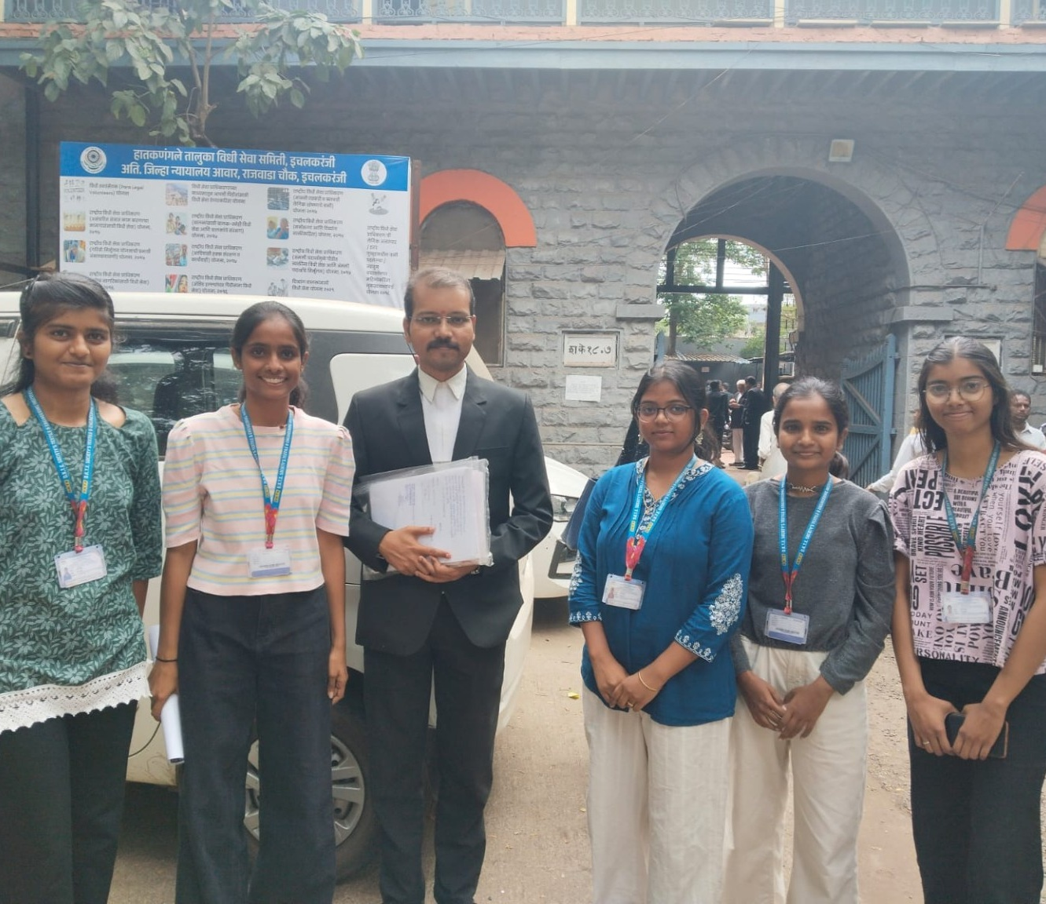
Court Visit – Civil and Criminal Court, Ichalkaranji
4
The court visit helped us understand the legal side of cybercrime.
We learned about the importance of digital evidence in legal proceedings.
Cybercrime cases may involve online fraud, identity misuse and other digital offences.
The visit showed us the importance of laws and legal action in protecting citizens.
Visit to Civil & Criminal Court, Ichalkaranji

Slide 5
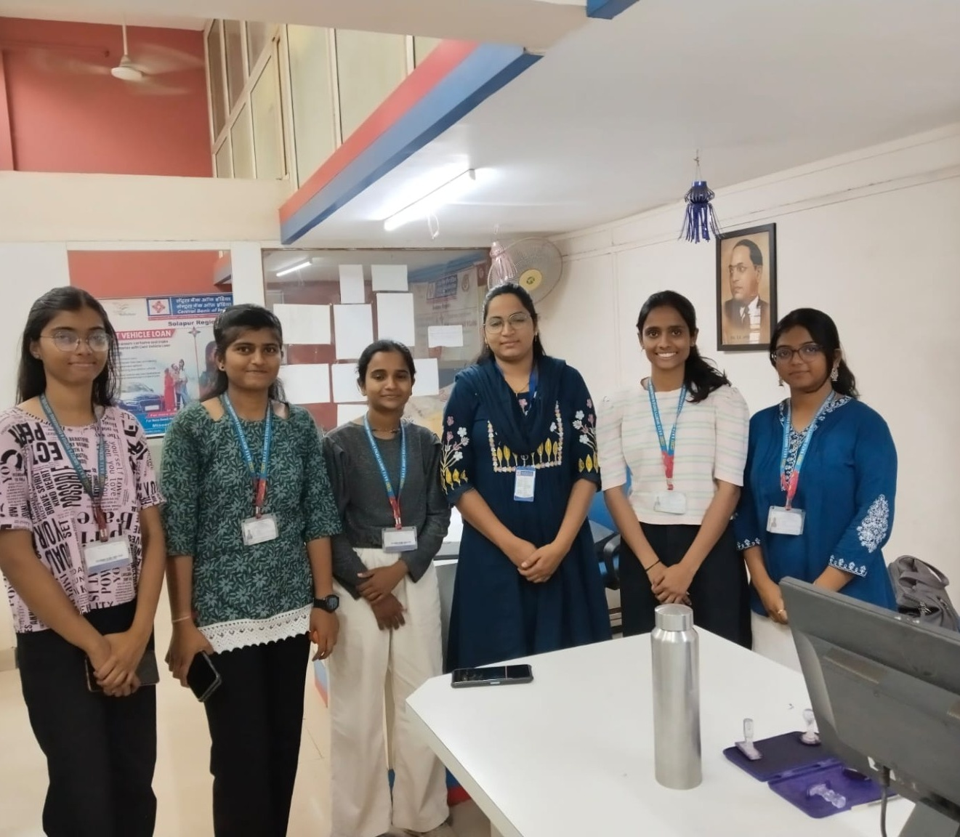
Bank Visit – Central Bank of India
5
We learned about the importance of security in digital banking.
Never share OTP, PIN, CVV, passwords or other confidential banking details.
Users should verify links, calls and messages before making online payments.
Suspicious or unauthorized transactions should be reported immediately to the bank.
Safe digital banking practices can prevent many types of financial cyber fraud.
Visit to Central Bank of India

Slide 6
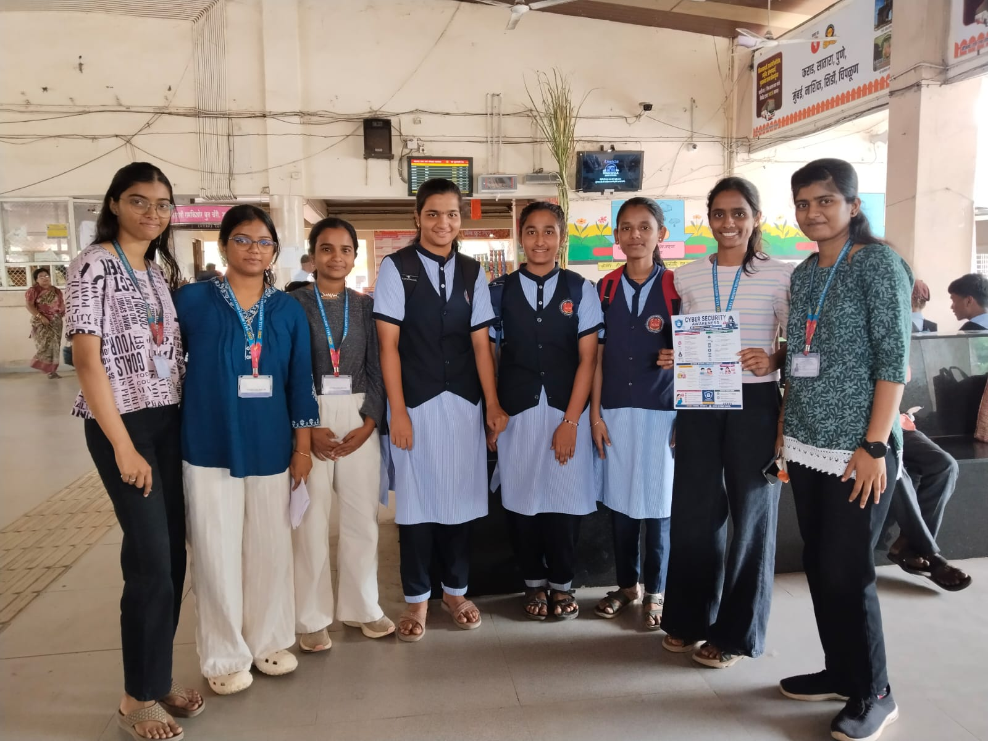
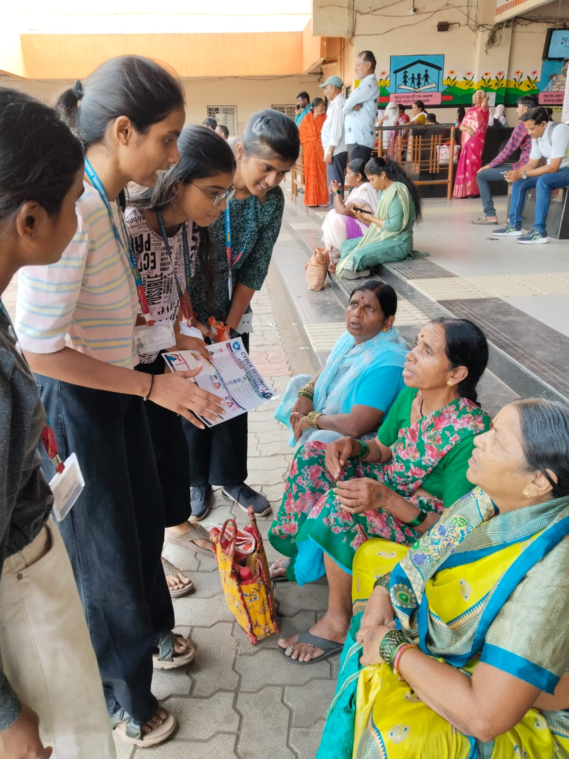
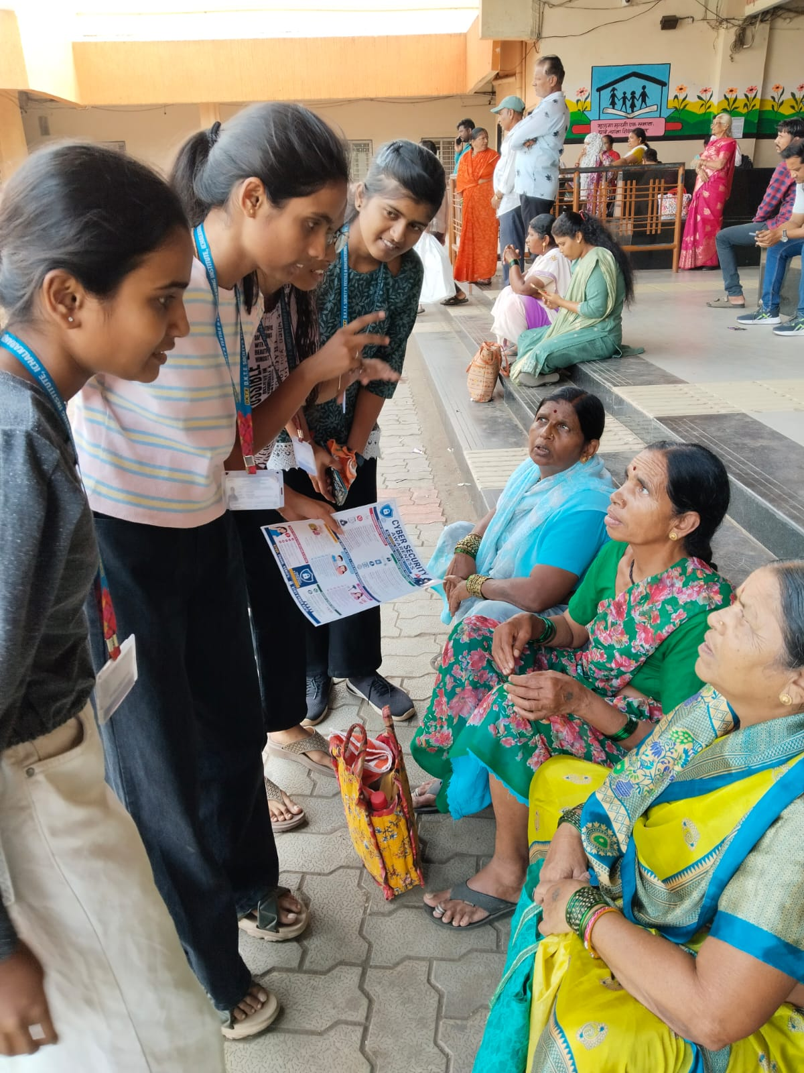
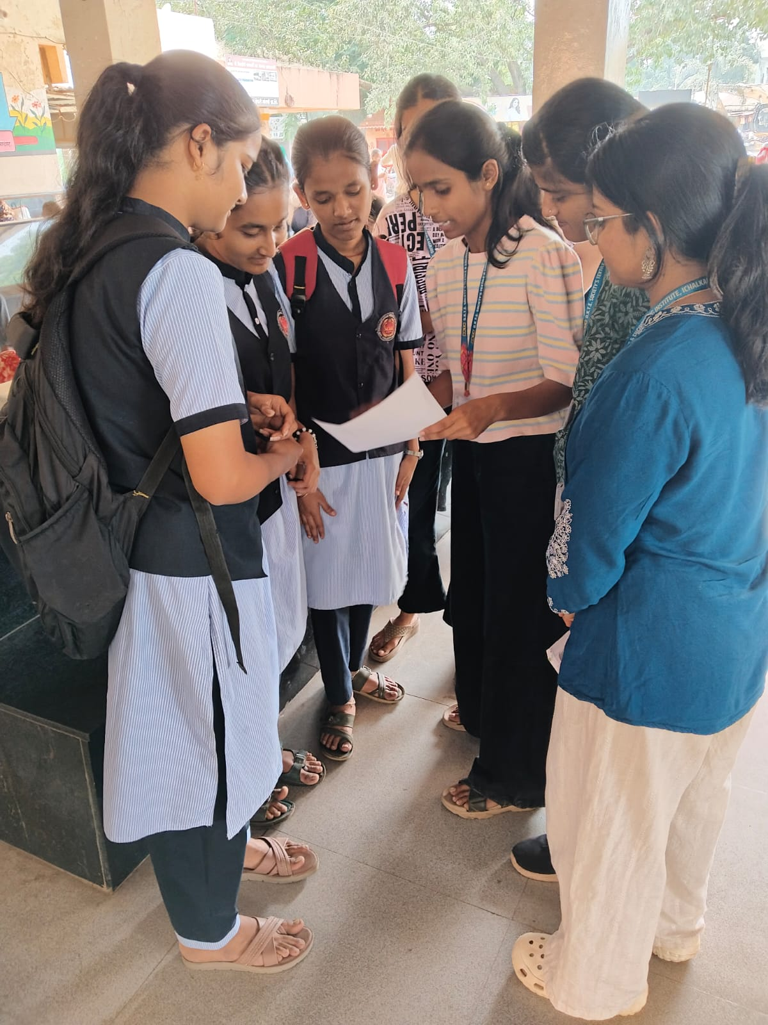
Public Awareness – Ichalkaranji Bus Stand
6
Spreading awareness about phishing • OTP/UPI fraud • fake calls • safe passwords

Slide 7
Benefits of the Project
7
Awareness
Helps people recognize common cyber threats and scams.
Safe Payments
Promotes secure use of UPI, cards, ATMs and online banking.
Data Protection
Encourages protection of passwords and personal information.
Reporting
Creates awareness about reporting suspicious or fraudulent activity.
Practical Learning
Connects classroom knowledge with real-life situations.
Community Impact
Spreads cyber-safety knowledge among students and the public.

Slide 8
Conclusion
8
What We Learned
The Cyber Security Awareness System project gave us practical knowledge about cybercrime prevention, digital safety and responsible use of technology.
Police and court visits helped us understand the reporting and legal aspects of cybercrime.
The bank visit showed us how simple precautions can reduce online financial fraud.
The public awareness activity helped us share cyber-safety practices with the community.
Cyber security is a shared responsibility — think before you click and never share confidential information.
“Think Before You Click – Stay Safe, Stay Secure.”

