Slide 1
IBM University Engagement Project Submission
“Exploring the Power of Agentic AI with IBM Granite and IBM Bob”

Slide 2
Problem Statement -
Problem Statement : Interview Trainer Agent
The Challenge
Students and job seekers often struggle with interview preparation, question selection, and performance evaluation. Traditional preparation methods provide generic questions and lack personalized practice, realistic interview simulations, and actionable feedback. Without intelligent guidance, candidates may find it difficult to identify their weak areas and improve their interview performance.
The Objective
Build an AI-powered Interview Agent that delivers personalized interview preparation, realistic practice, and performance feedback for candidates. The solution should:
Personalized Interview Preparation – Generate questions based on the candidate’s resume, skills, and target role.
AI Question Generation – Create relevant technical, HR, and behavioral interview questions.
Interview Simulation – Conduct structured mock interviews to provide a realistic practice experience.
Answer Evaluation & Feedback – Analyze responses and provide constructive feedback and improvement suggestions.
Performance Analysis – Identify strengths, weaknesses, and areas requiring improvement.
Multi-Agent System : –
Interview Question Agent – Generates relevant interview questions.
Interview Evaluation Agent – Evaluates candidate responses.
Feedback Agent – Provides personalized feedback and recommendations.
Performance Dashboard – Display interview results, scores, strengths, weaknesses, and overall progress.

Slide 3

Project Tile – InterviewIQ-Agent
Domain of Project – Education & Career Development
Student Name | Recent Passport Photo | Email ID | Mobile number [WhatsApp]
Pranav K |  | Kxxxxxxxx@gmail.com | 7xxxxxxxxx9
Recommended font style and size: Font Style: Arial Font Size (Heading): 28
Font Size (Content): 20
Notes:
7xxxxxxxxx9

Slide 4
Proposed Solution -
Proposed Solution: AI-Powered InterviewIQ-Agent
The proposed solution is a multi-agent AI-powered Interview Agent built using IBM BOB, IBM watsonx.ai, and IBM Granite Models to provide personalized interview preparation, realistic mock interviews, and intelligent performance feedback.
The solution uses AI to analyze the candidate’s resume, skills, target role, and interview responses to generate relevant questions and evaluate performance.
The system consists of key components:
Interview Question Agent – Generates personalized technical, HR, and behavioral questions.
Interview Simulation Agent – Conducts structured mock interview sessions.
Answer Evaluation Agent – Analyzes responses and evaluates relevance, clarity, and quality.
Feedback Agent – Provides personalized feedback and improvement suggestions.
Performance Dashboard – Displays scores, strengths, weaknesses, and overall interview progress.
The solution provides an end-to-end intelligent interview preparation platform that helps candidates practice effectively, identify skill gaps, and improve their interview readiness through AI-driven guidance and feedback.

Slide 5
Technology Used
IBM Bob platform -For designing and orchestrating multi-agent interview workflows visually
IBM Grainte model - for eg – ibm-granite-3-2-8b – For natural language understanding, reasoning,question generation and personalized interview feedback.
IBM Cloud – It provides the infrastructure to build, deploy, and scale the InterviewIQ Agent efficiently. IBM Cloud enables a reliable, secure, and scalable environment for deploying the InterviewIQ Agent.
RAG– RAG to fetch real data first, then generate intelligent answers, Retrives relevant information from the candidate’s resume and knowledge sources to generate accurate, personalized interview questions
IBM Watsonx.ai - For model deployment, AI development, embeddings, and AI governance
Vector Database – For efficient RAG-based retrieval of resume, skills, and interview-related information

Slide 6
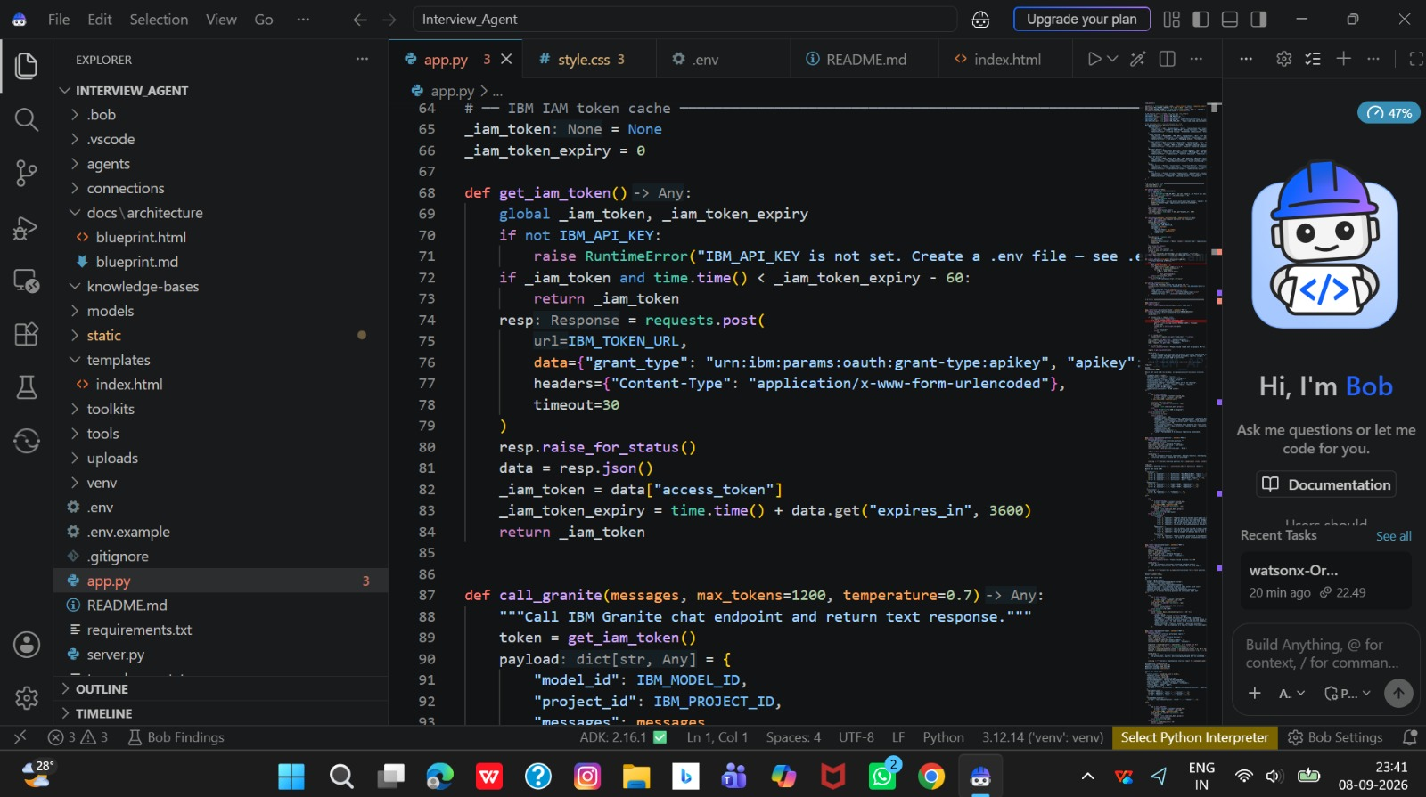
Required Files created using IBM bob -
App.py
Requirements.txt
Style.css
.env
Index.html

Slide 7
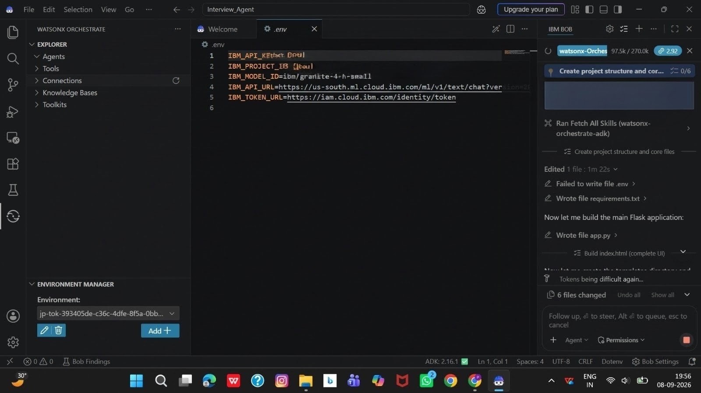
IBM Bob Screenshots:

Slide 8
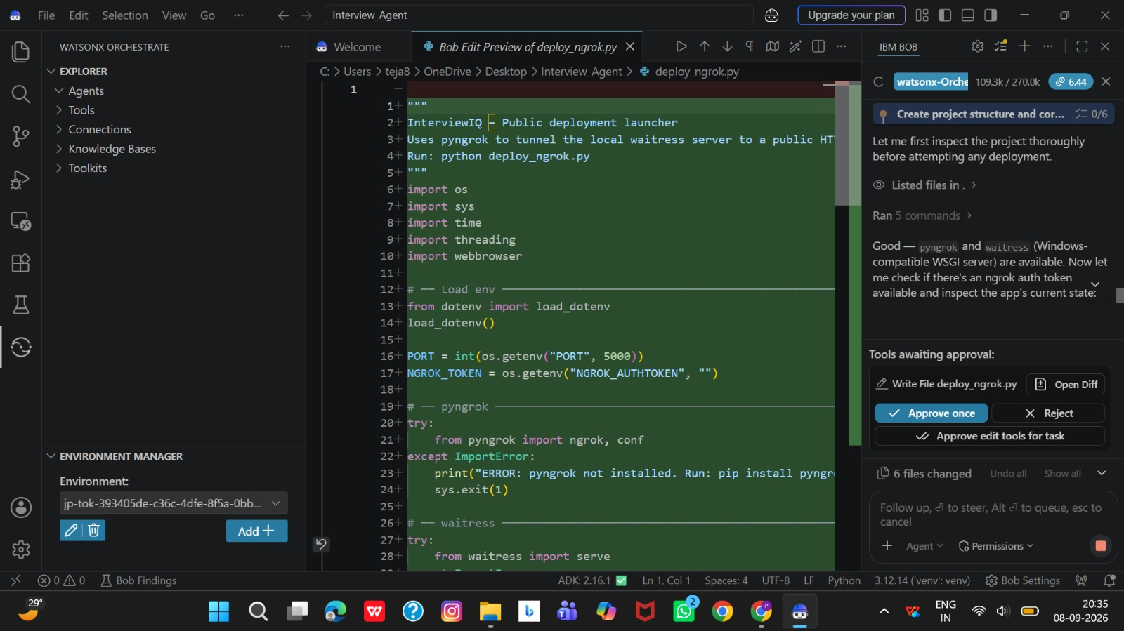

Slide 9
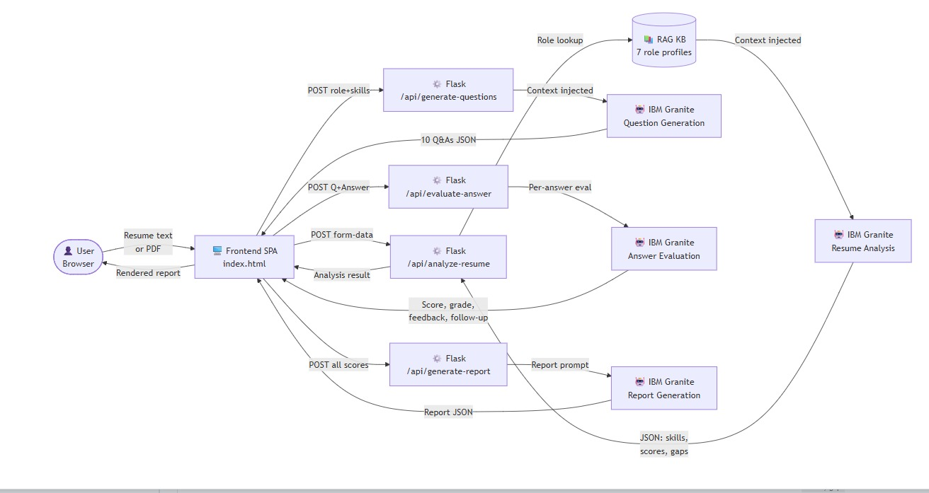
Architecture blueprint for IBM bob:

Slide 10

Role of Agentic AI in the solution
Role of Agentic AI in InterviewIQ Agent
Agentic AI enables the InterviewIQ Agent to function as an intelligent, autonomous interview-preparation system rather than a simple chatbot. Using IBM watsonx.ai, IBM Granite models, and IBM Bob, it coordinates multiple specialized agents to provide personalized interview preparation.
Each agent performs a specific role—such as analyzing the user’s resume, retrieving relevant interview questions, generating technical and HR questions, evaluating answers, and providing feedback—while working collaboratively. This multi-agent approach ensures efficient task execution and relevant results.
Agentic AI brings context awareness by understanding the user’s skills, resume, target role, and previous responses to generate tailored interview questions and recommendations. It supports real-time adaptation, continuously adjusting questions and feedback based on the user’s answers and performance.
Additionally, agents communicate with each other to improve decision-making, question relevance, answer evaluation, and personalized feedback.
Overall, Agentic AI makes InterviewIQ Agent proactive, personalized, adaptive, and goal-driven, acting as a smart digital interview coach that helps users improve their interview readiness.

Slide 11
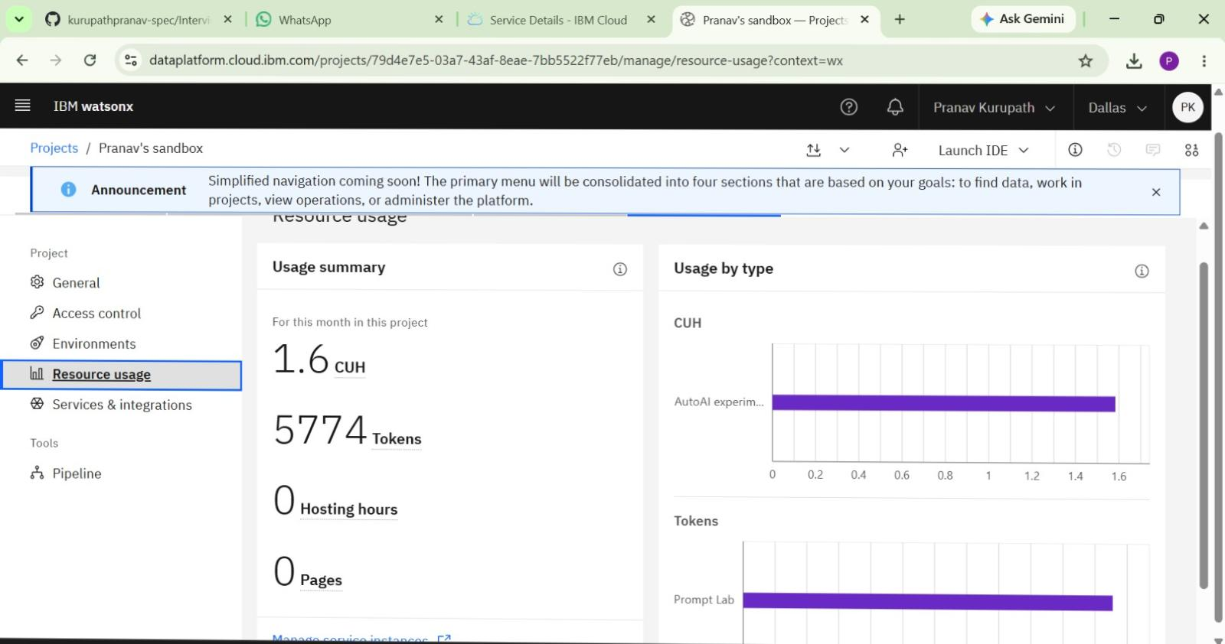
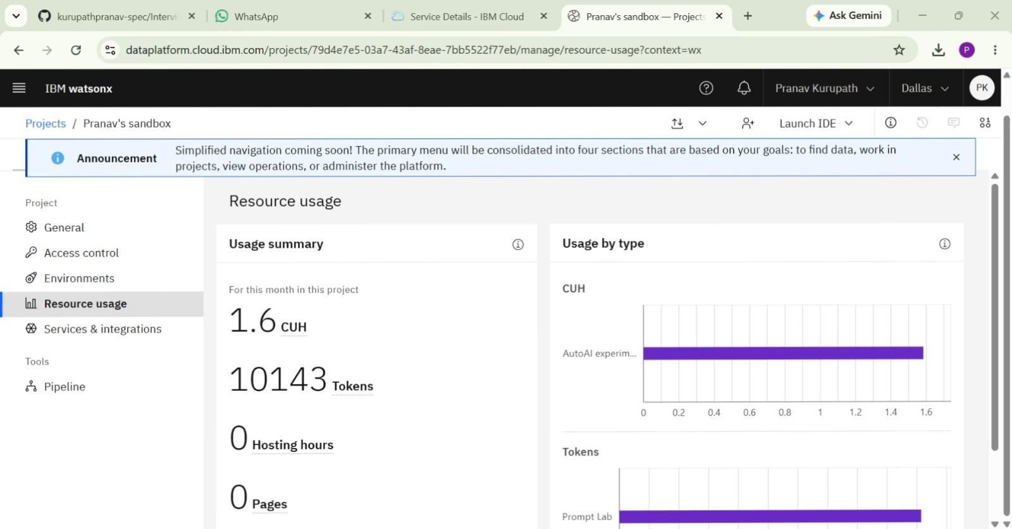
Token Usage
4369 token are used
Before Prompt
After the Prompt
·
·
·

Slide 12
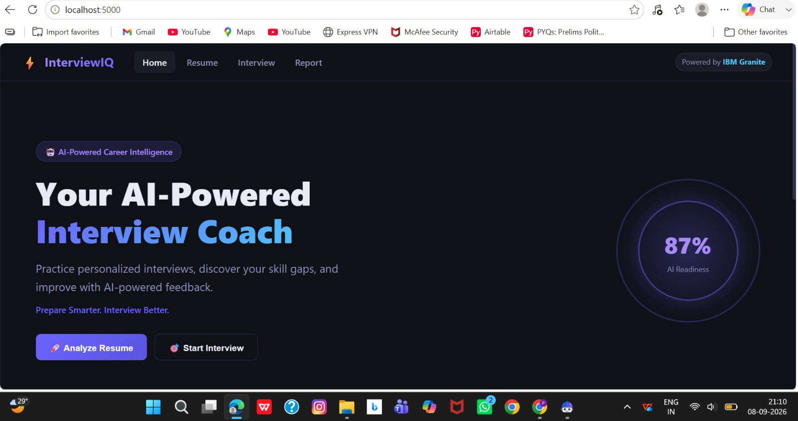
Project Output Screenshot
Please put IBM Bob output screenshots with 2-3 prompts.
You can take 2-3 more slides for each screenshot
·
·
·

Slide 13
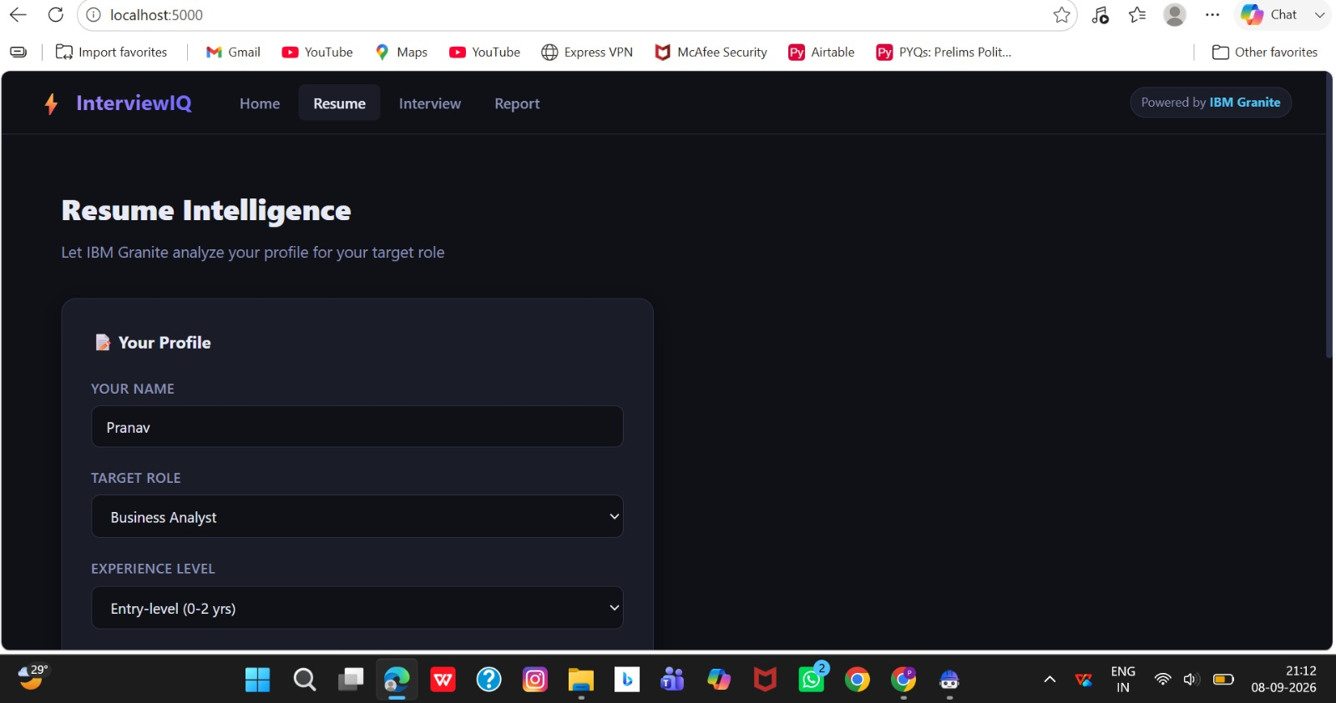
Project Output Screenshot
Please put IBM Bob output screenshots with 2-3 prompts.
You can take 2-3 more slides for each screenshot
·
·
·

Slide 14
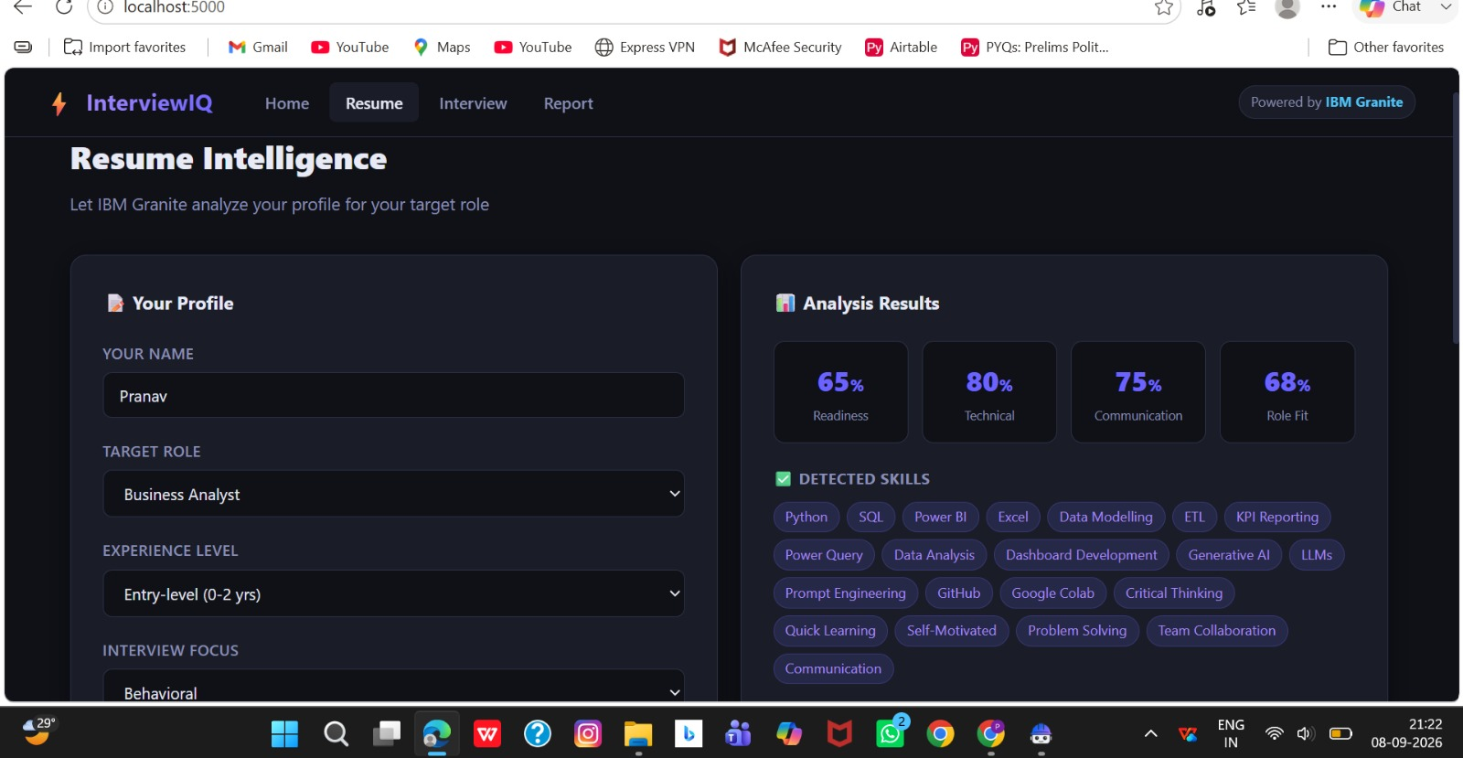
Project Output Screenshot
Please put IBM Bob output screenshots with 2-3 prompts.
You can take 2-3 more slides for each screenshot
·
·
·

Slide 15
Novelty and Uniqueness
The proposed InterviewIQ Agent stands out by combining Agentic AI, RAG, and personalization into a single intelligent interview-preparation system.
Multi-Agent Intelligence – Multiple specialized agents collaborate to provide personalized interview preparation.
RAG-Based Accuracy – Retrieves relevant interview information and combines it with AI generation for reliable questions and guidance.
Hyper-Personalization – Tailors interview questions based on the user's resume, skills, experience, and target job role.
Real-Time Feedback Loop – Continuously adapts questions and recommendations based on the user's answers and performance.
Multi-Modal Interaction – Supports text-based interaction and can be extended to voice-based interview practice.
Technical + HR Preparation – Covers technical, coding, behavioral, and HR interview questions in one platform.
Performance Analysis – Evaluates responses and provides actionable feedback to help users improve.
Scalable & Enterprise-Ready – Built using IBM watsonx.ai, IBM Granite models, and IBM Bob, supporting reliable AI workflows and deployment.
This makes InterviewIQ Agent a smart, adaptive, and proactive digital interview coach, not just a static question-generation tool.

Slide 16
Git Hub Link
· Please create public github repository (Enable Add README button while creating repository) with format –
Please test and Paste the working Github URL – github
Make sure you have Uploaded following three files into your github repository 1) All Agent relevant files of IBM Cloud , 2) yourproblemstatement.pdf file 3) your projectpresntation.pptx file 4)any other files
·
·
·

Slide 17
Future Scope
1. AI-Powered Mock Interviews – Add real-time mock interview sessions where the system asks questions, evaluates responses, and provides personalized feedback.
2. Voice-Based Interview Practice – Enable voice interaction for a more realistic interview experience, including speech-based answers and feedback.
3. Multilingual Support – Support multiple languages to make interview preparation accessible to a wider range of users.
4. Advanced Performance Analytics – Provide detailed dashboards showing strengths, weaknesses, improvement areas, and interview readiness scores.
5. Job-Specific Preparation – Integrate job descriptions to automatically generate role-specific questions and preparation plans based on required skills.
6. Continuous Learning – Improve recommendations over time by learning from previous interview sessions, user performance, and feedback.
·
·
·

Slide 18
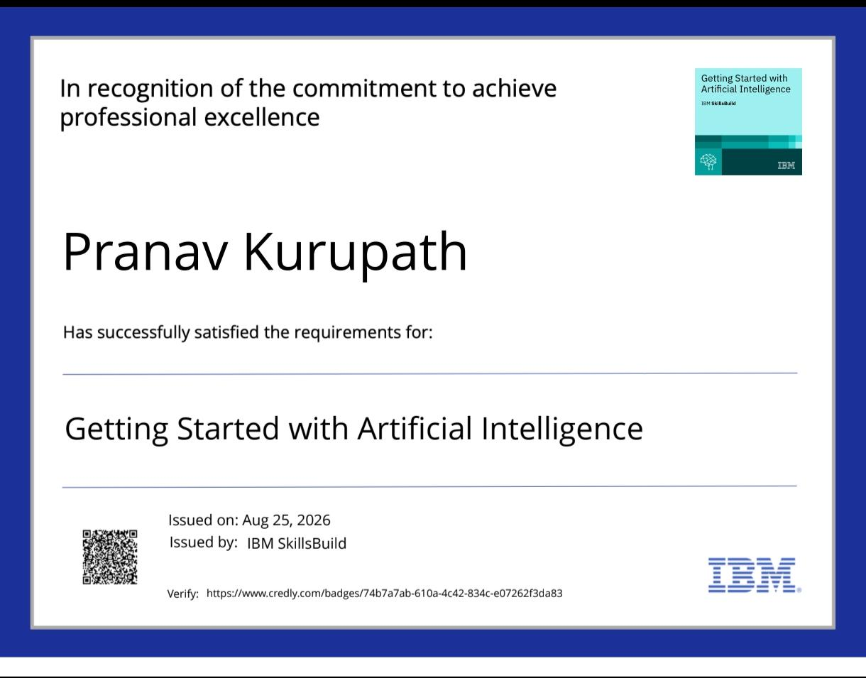
Certificates Earned:
Please add your credly certificate(Getting Started with Artificial Intelligence)

Slide 19
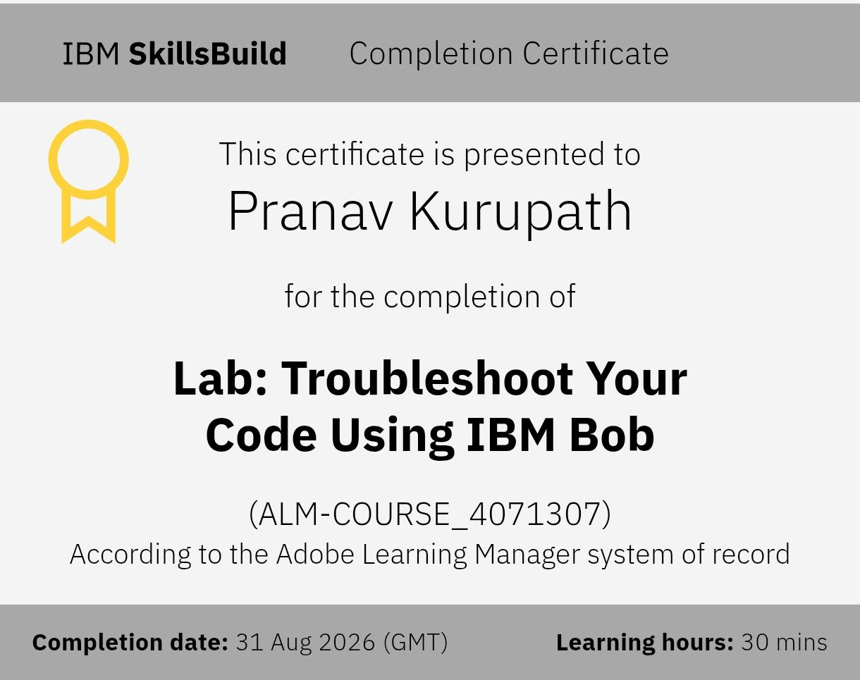
Certificates Earned:​
Add your IBM BOB Certificate

Slide 20


