Slide 1
IMPLEMENTATION OF VAN EMDE BOAS TREE WITH APPLICATION TO KRUSKAL AND COMPARE WRT UNION FIND AND AVL
P V HARIDATTA 2019201010
KURUVA JAYA KRISHNA 2019201076

Slide 2
OBJECTIVE:
Kruskal’s algorithm Implementation using vEB tree,AVL,Union Find and their performance comparison.
Given a connected and undirected graph, a spanning tree of that graph is a subgraph that is a tree and connects all the vertices together. A single graph can have many different spanning trees. (MST) or minimum weight spanning tree for a weighted, connected and undirected graph is a spanning tree with weight less than or equal to the weight of every other spanning tree. The weight of a spanning tree is the sum of weights given to each edge of the spanning tree.

Slide 3
DISJOINT DATA STRUCTURE
A disjoint-set data structure is a data structure that tracks a set of elements partitioned into a number of disjoint (non-overlapping) subsets. It provides near-constant-time operations to add new sets, to merge existing sets, and to determine whether elements are in the same set. Disjoint-sets play a key role in Kruskal’s algorithm for finding the minimum spanning tree of a graph.
OPERATIONS :
1. MAKE_UNION()
2. FIND ()
3. UNION()

Slide 4
AVL TREE :
AVL tree is a self-balancing Binary Search Tree (BST) where the difference between heights of left and right subtrees cannot be more than one for all nodes.
In an AVL Tree, the heights of the two child subtrees of any node differ by at most one; if at any time they differ by more than one, rebalancing is done to restore this property. Insertions and deletions may require the tree to be rebalanced by one or more tree rotations.
insert(x) : O(log n).
is Empty() : O(1)
find(x) : O(log n)
delete(x) : O(log n).
max() : O(log n).
min() : O(log n).

Slide 5
Van Emde Boas Tree
Performs following operations in O(lglgu) time
where u is universal set {0,1,2,.........u-1}
Insertion
Deletion
Successor
Predecessor

Slide 6

Van Emde Boas Tree
Performs following operations in O(lglgu) time
where u is universal set {0,1,2,.........u-1}
Insertion
Deletion
Successor
Predecessor

Slide 7
Finding minimum and maximum element in O(1) i.e constant time.
We assume, by simplicity, that u is an exact power of two (u = 2^k for some natural number k).
We also assume that there are not duplicated elements.

Slide 8
Preliminary approaches
In order to gain insight for our problem we shall
examine the following preliminary approaches for
storing a dynamic set :
▪ Direct adressing.
▪ Superimposing a binary tree structure.
▪ Superimposing a tree of constant height.

Slide 9
Direct adressing
The direct-addressing stores the dynamic set as a bit vector.
To store a dynamic set of values from the universe {0, 1, ..., u-1} we
maintain an array A[0 .. u-1] of u bits.
Entry A[x] holds 1 if the value x is in the dynamic set and 0
otherwise.

Slide 10
INSERT, DELETE and MEMBER operations can be performed in O(1) time with this bit vector.
MINIMUM, MAXIMUM, SUCCESSOR and PREDECESSOR can take
O(u) in the worst case since we might have to scan through O(u) elements.

Slide 11
Superimposing a binary tree structure
One can short-cut long scans in the bit vector by superimposing a binary tree on the top of it.
Entries of the bit vector form the leaves of the binary tree.
Each internal node contain 1 if and only if in its subtree contains 1.
Bit stored in an internal node is the logical-or of its children.

Slide 12
MINIMUM:
  Algorithm: start at the root and head down toward the leaves, always taking the leftmost node containing 1.
  Time complexity: O(log u)
MAXIMUM:
  Algorithm: start at the root and head down toward the
leaves, always taking the rightmost node containing1.
  Time complexity: O(log u)

Slide 13
P R E D E C E S S O R (A, x) :
  Start at the leaf indexed by x and head up toward the root until we enter a node from the right and this node has a 1 in its left child z.
  Head down through node z, always taking the rightmost node
containing a 1.
  Time complexity: O(log u).
S U C C E S S O R(A, x) :
  Start at the leaf indexed by x and head up toward the root until we enter a node from the left and this node has a 1 in its right child z.
  Head down through node z, always taking the leftmost node
containing a 1.
  Time complexity: O(log u).

Slide 14
INSERTION (A, x) :
  Start at the leaf indexed by x and head up toward the root storing 1 in all nodes belonging to the simple path from x to the root.
  Time complexity: O(log u).
DELETION (A, x) :
  Start at the leaf indexed by x and head up toward the root, recomputing the bit in each internal node on the simple path from x to the root as the logical-or of its two children.
  Time complexity: O(log u).

Slide 15
This approach is only marginally better than just using a balanced search tree.
MEMBER operation can be performed in O(1) time, what is better than O(log n) for BST.
If the number of elements n is much smaller than size of the universe u than BST would be faster for all the other operations.

Slide 16
Superimposing a tree of constantheight
Let us assume that u = 2^{2k} for some natural k.
Consider that we superimpose a tree of degree u^{1/2}
The height of the resulting tree would be always 2.
Again, each internal node stores the logical-or of the bits within its subtree.
The u^{1/2} internal nodes at depth 1 summarize each group (logical-or) of u^{1/2} values.
These internal nodes can be seen as an an array
Summary [0 .. u^{1/2} – 1]

Slide 17
Given an index x, one can find the cluster that x belongs by expression floor(x/sqrt(u))
Operations INSERT and MEMBER can be performed in O(1) time.
We can use summary array to perform all other operations
MAX/MIN/PRED/SUC/DEL in O(u^{1/2}) time.

Slide 18
The main idea is superimposing a tree of variable degree
_{u}1/k.
Starting with an universe of size u we make structures of u^1/2 which which themselves contain structures holding u^1/4 items..
This subdivision process stops when there are only 2 items.
k
For simplicity we assume that u = 2² for some integer k.

Slide 19
Let u=2^k be the size of the universe for some integer k ≥ 0 .
If u = 2 then it is the basis size, and the proto-vEB(u) contains the array A[0..1] of two bits.
Otherwise the proto-vEB(u) structure is defined recursively as follows:
  It contains a pointer named summary to a proto-vEB(u^{1/2})
structure.
  Its contains an array cluster[0 .. u^{1/2} - 1] of u^{1/2} pointers, each to a
proto-vEB(u^{1/2}) structure.

Slide 20
A given value x resides in cluster number
floor(x /sqrt( u))
Since that x is a binary integer of lg u bits, cluster number is given by the most significant (lg u)/2 bits of x.
The position in which x appears in its cluster is given by the expression x mod sqrt(u)

Slide 21
As a consequence, the position of x inside its cluster is given by the least significant (lg u)/2 bits of x
The following functions will be necessary to explore the proto-vEB structure:
high(x) = x / sqrt(u)
low(x) = x mod sqrt(u)
index(x, y) = x*sqrt(u)+y

Slide 22
Running time:
T(u)=T(sqrt(u))+O(1)
T(u)=O(lglgu)

Slide 23
The REAL van Emde Boas Tree
Proto-vEB structure was close to what is needed to achieve O(lg lg n) running times.
It requires too many (2 or more) recursions in most of the operations (time complexity bounds allow only one recursion).

Slide 24
The REAL van Emde Boas tree stores some extra information in order to make at most one recursive call on each of the operations.

Slide 25
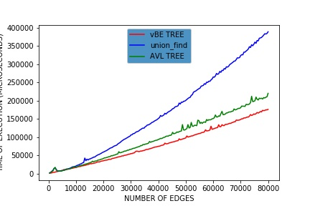
COMPARISON OF PERFORMANCE OF DATA STRUCTURES :
PERFORMANCE COMPARISON OF AVL,vBE,Disjoint_union :
y-axis : Time taken in Microseconds
x-axis : Number of edges

Slide 26
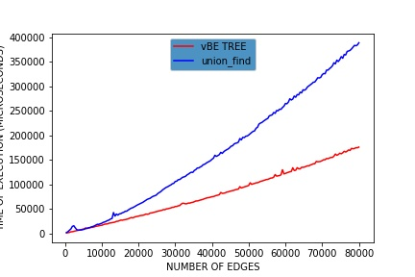
PERFORMANCE COMPARISON OF vEB tree,union find

Slide 27
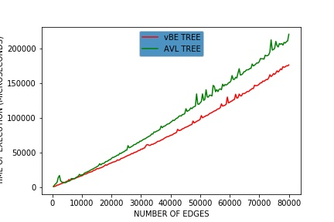
PERFORMANCE COMPARISON OF vEB tree,AVL tree

