Slide 1


Team Members:
Automated Material Identification in Drainage Systems Using Sensor Technology
KURUVA JAYANTH
VULLIKANTI VIBHUDESWAR REDDY
CHINTAPALLI VENKATA KRISHNA REDDY
KARNA CHARAN
2023BCSE 07AED228
2023BCSE07AED281
2023BCSE07AED282
2023BCSE07AED283
Name of the Mentor: MS. NIVEDITA MANOHAR 5CS1990 Design Project -2

Slide 2

Agenda
Introduction
Review of literature (Refer minimum of 10 Recent Journal / Conference papers)
Observations from the literature review (Brief description as points)
Limitations from the literature review (Brief description as points)
Problem Definition & Proposed Methodology
Problem Statement
Proposed Research / Methodology
Hardware Requirements
Software Requirements
References ( Min. of 10 papers)

Slide 3
Introduction
In recent years, automation and sensor technology have emerged as effective tools for enhancing waste detection and management. By employing a combination of sensors such as infrared, ultrasonic, and metal detectors, it becomes possible to automatically identify and classify the type of material present in the drainage flow. This enables early detection of obstructions and facilitates targeted removal of harmful waste before it accumulates into major blockages.
The proposed project, Automated Material Identification in Drainage Systems Using Sensor Technology, aims to design and implement a system capable of distinguishing between plastics and metals in real time. The system integrates multiple sensors with a microcontroller and communication module, allowing the collected data to be processed and transmitted to monitoring units. This innovation contributes to the development of smart drainage systems, aligning with modern smart city frameworks and environmental sustainability goals.

Slide 4
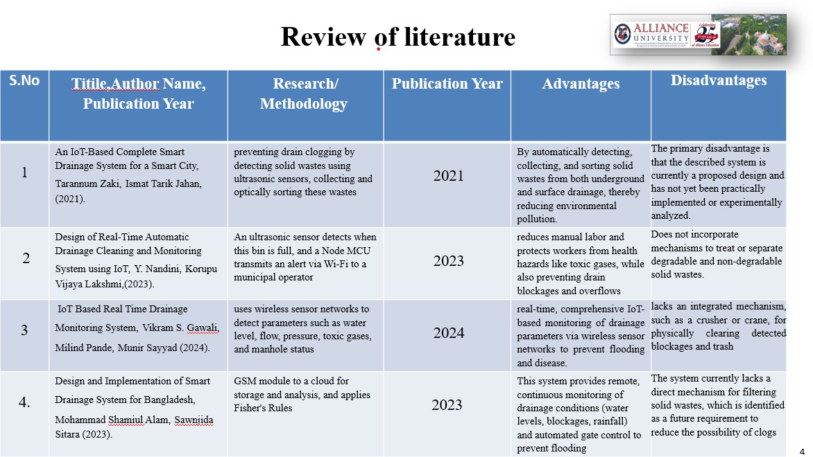

Slide 5
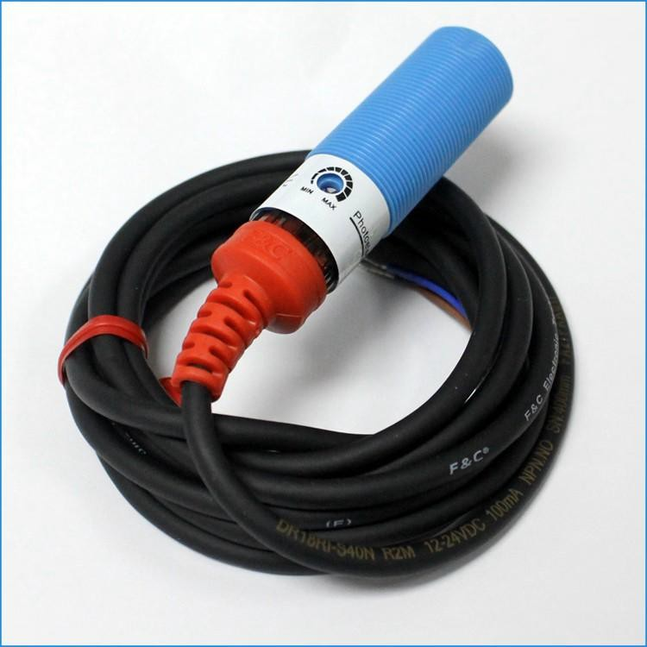
Sensors:
M18 NPN No 3 Wires Photoelectric Sensor

Slide 6
Observations from the Literature Review
IoT architecture trade-offs – power, range, cost, cloud vs. edge processing.
Prototypes & field trials – real-time blockage/waste detection and reduced manual inspections
Design insights – importance of sensor fusion, low-cost communication (ESP32), and modularity.
Research gaps – material classification (e.g., metals and wrappers) and long-term
maintenance/calibration challenges

Slide 7
Limitations from the Literature Review
Sensor Accuracy Issues – Sensors may not always detect the exact chemical composition or type of plastic due to water impurities, mixed waste, or overlapping signals.
Environmental Interference – Presence of mud, oil, sewage, or biological matter can interfere
with readings and reduce detection efficiency.
Maintenance Requirements – Sensors in drainage systems require regular calibration, cleaning, and replacement due to clogging, corrosion, or biofouling.
High Initial Cost – Deploying advanced chemical or capacitive sensors in large drainage networks can be expensive.

Slide 8

Problem Statement / Scope of the Project
The proposed project, “Automated Material Identification in Drainage Systems Using Sensor Technology,” aims to provide a smart, efficient, and cost-effective solution to this challenge.
The project develops a smart sensor-based system to automatically detect and identify materials in drainage systems. It ensures real-time monitoring, improves safety, reduces manual work, and supports future upgrades for better waste management

Slide 9
Proposed Idea / Solution
Sensor Integration
Inductive/Metal Sensors: To identify metallic objects in the drainage flow.
Ultrasonic Sensors: To measure water flow levels and detect potential blockages.
Data Processing Unit
A microcontroller (e.g., ESP32) will collect input signals from sensors.
The system will process data in real time to determine the type of waste present.
Threshold values and algorithms will be programmed to classify the material as metal or wrappers.
IoT-Based Monitoring
Sensor outputs will be connected to an IoT module (Wi-Fi).
Data will be transmitted to a central monitoring mobile application. h.notifications will be generated when significant waste is detected.
System Automation
The system enables automated classification without human intervention.
Real-time alerts allow authorities to respond quickly before blockages occur.
Data logs can be stored for long-term analysis of waste accumulation trends.

Slide 10
Objectives of the Idea / Solution as Design Project
The primary aim of this project, “Automated Material Identification in Drainage Systems Using Sensor Technology,” is to develop a smart, efficient, and reliable system that can detect and classify non biodegradable waste in drainage systems. The specific objectives are:
To design and implement a sensor-based system capable of identifying and differentiating metals and
wrapper in real time.
To integrate sensors like (metal detectors) with a microcontroller for accurate material detection.
To establish an IoT-enabled monitoring mechanism for transmitting sensor data to a mobile application.
To generate real-time alerts that help authorities take preventive actions before severe blockages or
flooding occurs.
To minimize manual inspection and health risks faced by sanitation workers by introducing automation in drainage maintenance.
To provide a low-cost and scalable solution that can be deployed in both small-scale and large-scale
drainage systems.

Slide 11
Proposed Research / Methodology
The methodology for the project “Automated Material Identification in Drainage Systems Using Sensor Technology”
follows a structured approach to design, development, and testing:
1: Problem Analysis & Requirement Gathering
Study existing challenges in drainage waste management.
Identify the types of materials (metal) most commonly responsible for blockages.
Define system requirements such as sensor types, power needs, communication methods, and data handling.
2: System Design
Develop a block diagram showing flow: Sensors → ESP-32 → IoT Module → Monitoring System.
Select appropriate components:
Inductive/metal sensors for detecting metals.
ESP32 as the microcontroller.
Wi-Fi modules for IoT connectivity.
3: Hardware Development
Assemble sensors and microcontroller into a prototype.
Calibrate sensors for accurate detection under drainage conditions (wet, dark, turbid environment).
Ensure waterproofing and protective casing for electronics.
4: Software Development
Write microcontroller code to collect and process sensor data.
Program logic to classify waste material (metal).

Slide 12
5: IoT Dashboard / Alert System
Develop a central monitoring dashboard (mobile/PC application).
Display real-time data such as material type detected, and sensor status.
Send alerts/notifications to authorities when abnormal waste accumulation or blockage risk is
detected.
6: Testing & Validation
Test the system in a controlled environment (simulated drainage setup).
Verify detection accuracy for different materials (metals).
Check real-time data transmission, response time, and system reliability.
7: Analysis & Optimization
Analyze test results to evaluate accuracy, efficiency, and limitations.
Optimize sensor placement, calibration, and coding for improved performance.
Document system strengths and weaknesses for future improvements.
8: Final Deployment & Reporting
Demonstrate prototype functionality in real or simulated drainage conditions.
Prepare detailed project documentation including objectives, design, results, and future scope.
Provide recommendations for large-scale deployment in municipal drainage systems.

Slide 13
Hardware Requirements
Microcontroller: ESP32 (for data processing).
Inductive/Metal detector sensor – for metal identification.
IoT Connectivity Modules: Wi-Fi (ESP32) for data transmission.
Power Supply: Rechargeable battery / DC adapter with waterproof casing.
Prototype Model: Simulated drainage pipeline with controlled waste insertion.
Supporting Components: Jumper wires,waterproof casing, LED indicators.

Slide 14
Software Requirements
Programming Environment:
C++ (for logic and testing).
IoT Platforms:
Dashboard/GUI Tools: MIT App Inventor / Node-RED / Web App for visualization.
Simulation Tools: Proteus, Tinker cad, or MATLAB (optional, for system simulation).

Slide 15
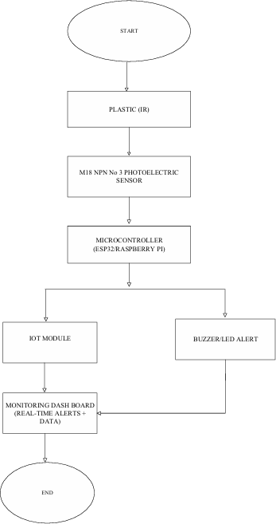
Process / Flow / Design Diagram

Slide 16
Proposed Modules
Sensor Module
Inductive/Metal Sensor: Identifies metallic waste materials.
Ensures accurate data collection from the drainage environment.
2. Processing Module
Using a (ESP32) to receive signals from sensors.
Executes logic to differentiate between metals .
Performs calibration and filtering of sensor data for higher accuracy.
3. Communication Module (IoT)
Integrates Wi-Fi (ESP32) for real-time data transmission.
Sends detected information to a central monitoring system (dashboard/app).
4. Monitoring & Alert Module
A dashboard or mobile application displays:
Type of material detected.
Generates alerts/notifications when abnormal waste is detected.
Local prototype alert system (LED) to indicate blockage.

Slide 17
Novelty of the Proposed Idea / Project
Unlike existing drainage monitoring systems that only detect water levels or blockages, this project introduces a multi-sensor IoT-based approach that can identify metallic, and wrappers waste.
The system emphasizes low-cost, energy-efficient design with ESP32 communication for real-time alerts.
Incorporates sensor fusion with decision-support capability, enabling both early blockage
detection and waste-type classification, which is rarely addressed in prior work.

Slide 18
University organization as an example
Target Waste:
Single-use flexible waste such as snack wrappers, confectionery packaging, and mixed materials (e.g.,
thin aluminum layers)..
Sensor Integration and Setup:
Core Components: Deploy a specialized sensor capable of identifying metal and wrappers materials, interfaced with a platform (VS code).
Sensor Polling: The controller runs a continuous monitoring routine, periodically reading sensor values to
maintain active detection at the sensing zone.
Detection and Signal Generation:
Trigger Event: When a flexible metal and wrappers item (e.g., snack wrapper, thin film) moves across the sensing region, it activates the detection mechanism.
Signal Output: Upon detection, the sensor sends an electrical pulse or digital signal indicating the presence of plastic material.

Slide 19
Data Processing and Transmission:
Microcontroller Response: The microcontroller receives and validates the detection signal, filters any false positives, and classifies the event.
Data Stream: It transmits structured data including detection type, timestamp, and sensor ID to a local or cloud-based monitoring interface.
Real-Time Alert and Reporting:
Output Display: The event data is displayed on an interface such as an LCD screen, or IoT application.

Slide 20
Conclusion
The project “Automated Material Identification in Drainage Systems Using Sensor Technology” presents a smart, efficient, and sustainable approach to addressing one of the major challenges in urban waste management. By integrating infrared, ultrasonic, and inductive sensors with a microcontroller and IoT platform, the system successfully detects and differentiates between plastics and metals in drainage networks. Real-time monitoring and alert generation reduce dependency on manual inspection, improve response times, and minimize health risks to sanitation workers.
This project not only enhances the efficiency of drainage maintenance but also contributes to environmental protection and smart city development by preventing blockages and promoting sustainable waste management practices. The proposed system is low-cost, scalable, and adaptable, making it suitable for deployment in diverse drainage infrastructures.

Slide 21
Reference:
https://ieeexplore.ieee.org/stamp/stamp.jsp?tp=&arnumber=9623149
https://ieeexplore.ieee.org/document/10084257
https://ieeexplore.ieee.org/document/10497198
https://ieeexplore.ieee.org/document/10070054
IoT-Based Smart Drainage System | SpringerLink
https://ijercse.com/article/1%20April%202025%20IJERCSE.pdf
https://ijrpr.com/uploads/V4ISSUE10/IJRPR18367.pdf
https://hittransaction.in/journals/10_NSIC2025/CRC-03.pdf
https://www.ijsdr.org/papers/IJSDR1905040.pdf
https://www.irejournals.com/formatedpaper/1700668.pdf
https://link.springer.com/article/10.1007/s10230-025-01063-y
https://link.springer.com/article/10.1007/s10311-025-01874-z
https://www.jetir.org/papers/JETIR2405620.pdf

Slide 22
https://link.springer.com/article/10.1007/s10661-025-14081-8
https://link.springer.com/article/10.1007/s10661-025-13675-6
https://www.ijraset.com/research-paper/automatic-drainage-monitoring-and-control-system
https://ijrpr.com/uploads/V5ISSUE5/IJRPR27265.pdf
https://www.tandfonline.com/doi/full/10.1080/15623599.2022.2085853
https://www.sciencedirect.com/science/article/abs/pii/S0926580516304319
https://www.sciencedirect.com/science/article/pii/S2095756417300788
Book Reference:
Plastic Products Leach Chemicals That Induce In Vitro … by Zimmermann et al. (2021)
Safety of recycled plastics and textiles: Review on the … by AK Undas (2023)

