Slide 1
PROJECT OVERVIEW
Colorectal Adenoma
vs Normal Mucosa
Gene-Expression Classification with Machine Learning
Aryan Khan(23BCB0115)
Akash(23BCB0064)
Kunal Sah(23BCB0111)
Hardik Jalan(23BCB0019)
A research prototype that studies gene-expression patterns to distinguish pre-cancerous adenomas from normal colon tissue.
01

Slide 2
01 • THE NEED
Why study colorectal adenomas?
Adenomas are precancerous growths; understanding their molecular signals can support earlier research insights.
Normal mucosa
Adenoma
The challenge
Healthy colon lining has gene-activity patterns that reflect normal tissue function.
A precancerous polyp can show altered gene activity before invasive cancer develops.
Expression data contain thousands of measurements, making meaningful patterns hard to inspect manually.
Can a machine-learning model learn expression patterns that help distinguish adenoma samples from normal mucosa?
02

Slide 3
02 • PROJECT AIM
What is the project designed to do?
Turn complex gene-expression measurements into an interpretable two-class prediction.
1. Compare
2. Classify
3. Explain
Use expression profiles from normal mucosa and adenoma samples.
Estimate which of the two groups a sample most resembles.
Explore genes associated with the separation and connect them to biological pathways.
Adenoma vs normal mucosa — not cancer staging, screening, or a clinical diagnosis.
03

Slide 4
03 • BIOLOGICAL CONTEXT
What is gene expression?
Genes are instructions; gene expression reflects how actively those instructions are being used.
DNA
RNA
Measured profile
Genetic instructions
Expression signal
Thousands of gene-level values
The project looks for patterns across these measurements that differ between adenoma and normal samples.
04

Slide 5
04 • SYSTEM OVERVIEW
How the project works — at a glance
A high-level view of the journey from public gene-expression data to a prediction and biological context.
Public datasets
Align genes
Normalize
Learn patterns
Predict group
Interpret
Expression profiles
Keep comparable genes
Make scales more comparable
Train a classifier
Adenoma / Normal
Genes & pathways
Core function: classification support + biological interpretation
05

Slide 6
05 • DATA
What information does it use?
The project uses existing public research datasets rather than collecting new patient samples.
Training dataset • GSE8671
Independent dataset • GSE50114
64 samples from 32 patients, including paired normal mucosa and adenoma samples. Measured using an Affymetrix microarray platform.
46 samples (37 adenoma and 9 normal) measured on a different Agilent microarray platform. Used as an external test cohort.
Why two datasets?
To assess whether patterns learned in one study can transfer to data collected on a different platform.
06

Slide 7
06 • PREPARING COMPARABLE DATA
Why does data alignment matter?
Different platforms can measure the same biology on different numerical scales.
Different probes
Different scales
Shared gene set
Each platform may use different probes or identifiers for genes.
Raw intensity values and log-ratios are not directly comparable.
The workflow maps identifiers and retains genes represented in both datasets.
The purpose is to reduce technical mismatch so the model can focus more on biological patterns.
07

Slide 8
07 • MAKING MEASUREMENTS COMPARABLE
What does normalization do?
It changes the scale of measurements so genes and datasets can be compared more fairly.
BEFORE
AFTER
Values may be on very different scales
Values are rescaled within each dataset
This makes cohort-level patterns easier to compare; it does not remove every source of bias.
08

Slide 9
08 • CLASSIFICATION
How does the model make a prediction?
The classifier learns combinations of gene-expression signals associated with the two sample groups.
Expression profile
Learned pattern
Score
Predicted group
Many gene values
for one sample
Weighted signals
from selected genes
Estimated
probability
Adenoma or
Normal
The output is a model-based estimate — it is not a definitive statement about an individual’s health.
09

Slide 10
09 • PROJECT FUNCTIONS
What can the project provide?
The project is organized around summary, data context, model evaluation and exploration.
Summary
Data & method
Model evaluation
A concise overview of the classification task and key message.
A clear explanation of the datasets and conceptual workflow.
Performance measures and visual summaries of predictions.
Prediction explorer
Gene exploration
Limitations
Browse sample-level predicted groups and compare with known labels.
View selected genes that contribute to the model’s separation.
Keep the interpretation grounded in sample size and validation constraints.
10

Slide 11
10 • BIOLOGICAL INTERPRETATION
Why look at genes and pathways?
A prediction is more useful for research when the signals can be connected to biological knowledge.
Selected genes
Pathway context
Research hypotheses
The model identifies a subset of genes whose expression patterns help distinguish the groups.
Functional enrichment can group genes into biological processes and pathways for follow-up.
These patterns can suggest candidates for further study, but do not prove causation.
Examples highlighted in the project include Wnt-pathway-associated genes such as AXIN2 and RNF43.
11

Slide 12
11 • TRUSTWORTHINESS
Why test on an independent dataset?
A model can perform well on familiar data but struggle when the data come from another study.
Internal evaluation
External evaluation
Tests the model using held-out folds from the training study. Patient pairs are kept together to reduce leakage.
Tests whether the learned pattern transfers to a separate cohort measured using another platform.
The key lesson is a strong internal performance alone is not enough; external validation is essential.
12

Slide 13
12 • RESPONSIBLE INTERPRETATION
What are the boundaries of this project?
The project is a research prototype, and its output must be interpreted with care.
Small cohorts
64 training samples and 46 external samples.
Imbalanced external set
Only 9 normal samples; specificity is estimated from a small group.
Platform dependence
Current normalization uses statistics from each dataset.
Narrow task
Separates adenoma from normal mucosa; it does not stage cancer.
Not a clinical tool
No prospective clinical validation or single-patient deployment.
13

Slide 14
13 • METHODS
What did we implement?
The project combines a probe-level classification pipeline, a harmonized gene-level validation pipeline, and a separate R bioinformatics workflow.
Three classifiers
Feature selection
Training safeguards
• Logistic Regression
• Linear Support Vector Machine (SVM)
• Random Forest (300 trees)
• ANOVA F-test (f_classif)
• Earlier probe-level pipeline: top 100 features
• Harmonized gene-level pipeline: top 50 genes
• Selection fitted inside each CV training fold
• Median imputation
• Scaling for linear models
• Patient-grouped, stratified 5-fold CV
• Paired samples from one patient kept in the same fold
Why ANOVA F-scores?
Each probe is ranked by how strongly its group means differ relative to within-group variation. SelectKBest keeps the highest-ranked k features. The top probe in the exploratory full-data ranking was 206134_at (F = 724.55; p = 6.58 × 10⁻³⁶). These exploratory scores are not the fold-specific scores used during cross-validation.
Important: k=100 and k=50 belong to different pipeline versions; do not describe them as one identical model configuration.
14

Slide 15
14 • R BIOINFORMATICS
What did the R analysis find?
Script: scripts/deg_go_kegg.R • Dataset: GSE8671 • Contrast: Adenoma versus Normal mucosa
54,675
5,508
3,413
1,009 / 2,404
probes analyzed
significant probes
unique significant genes
upregulated / downregulated
Differential expression
Gene annotation
GO + KEGG enrichment
limma paired design (patient + group). Filter: adjusted p < 0.05 and |log2 fold change| ≥ 1. Volcano plot and top-50 DEG heatmap are generated.
Gene symbols are mapped to Entrez IDs using org.Hs.eg.db / clusterProfiler. 3,002 of 3,413 significant gene symbols mapped in the reported run.
The script runs GO Biological Process and KEGG enrichment and writes CSVs / dot plots. Specific enriched terms are not included in the supplied ZIP, so they must be read from the local output files before naming pathways.
Interpretation: these are candidate expression differences associated with adenoma, not proof that the genes cause cancer. Gene-ID mapping warnings mean enrichment should be interpreted with care.
15

Slide 16
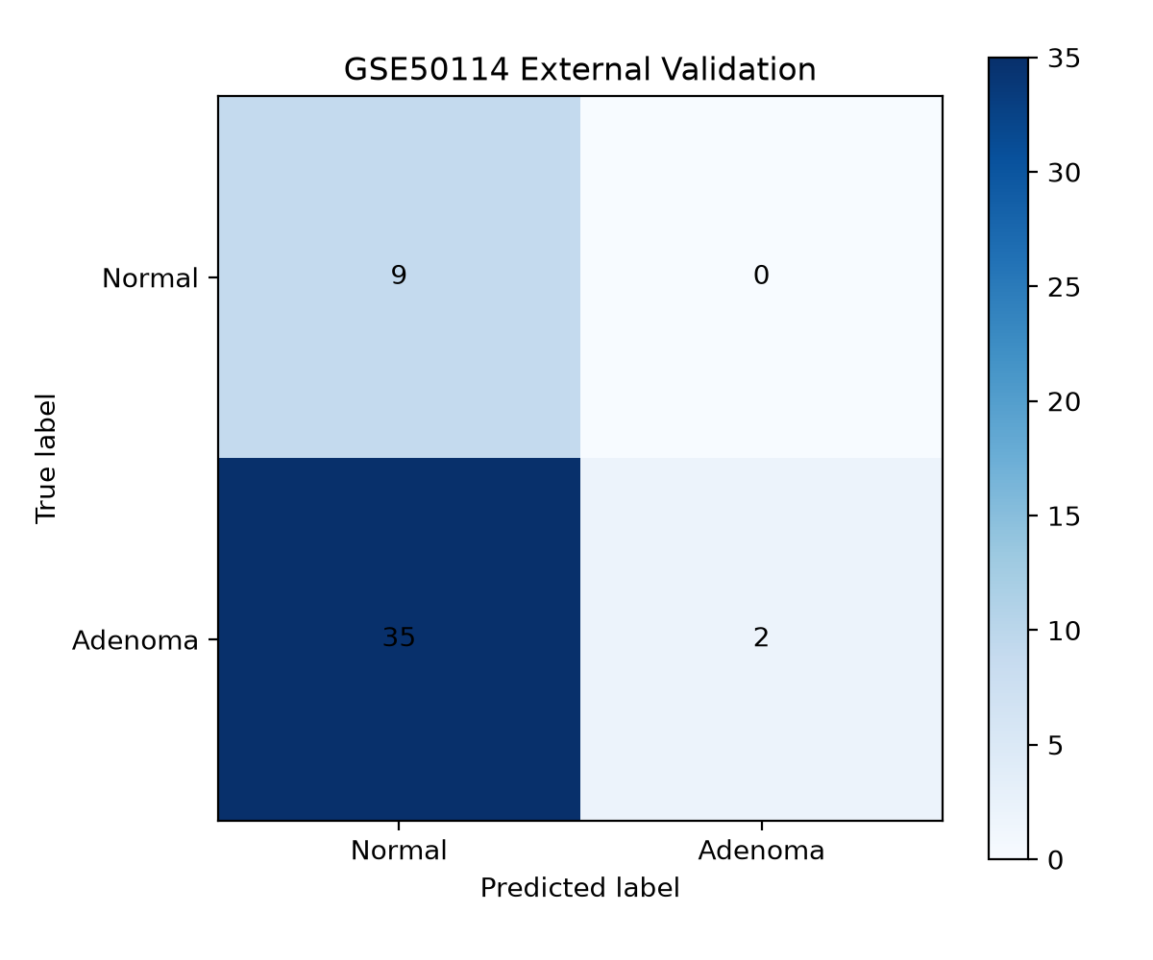
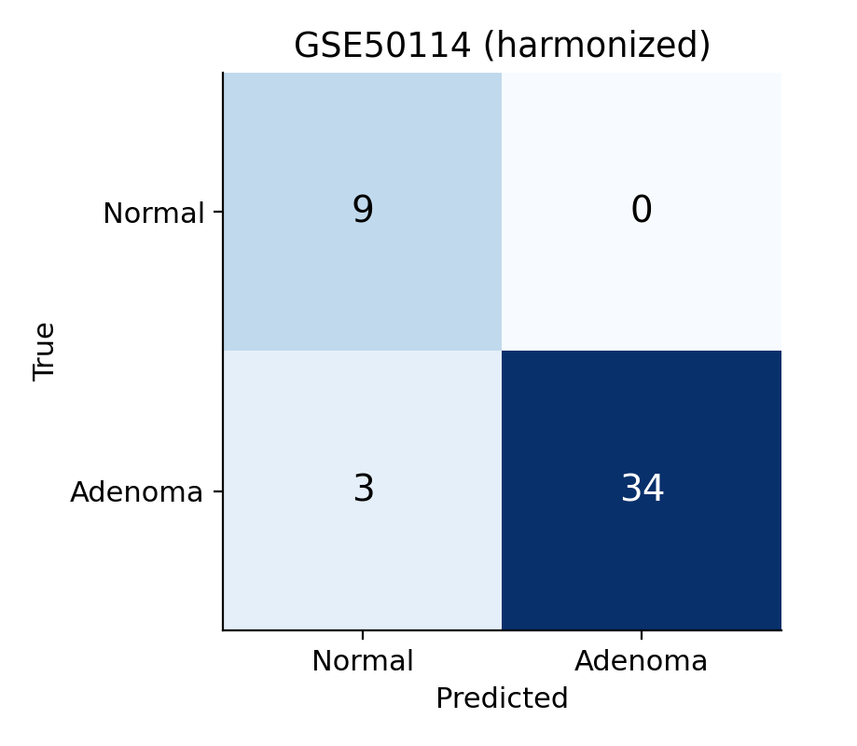
15 • MODEL EVALUATION
External validation: harmonization changed the result
GSE50114 contains 46 samples (37 Adenoma, 9 Normal) from a different microarray platform.
Evaluation
Accuracy
Balanced acc.
Sensitivity
Specificity
Internal grouped 5-fold CV
100.0%
100.0%
100.0%
100.0%
External • original pipeline
23.9%
52.7%
5.4%
100.0%
External • harmonized pipeline
93.5%
95.9%
91.9%
100.0%
Original pipeline
Harmonized pipeline
What changed?
The original model predicted 35/37 adenomas as Normal. Harmonization (log2 transform for GSE8671 + per-dataset gene-wise z-score) improved transfer: 34/37 adenomas and 9/9 normals were correct. Harmonized precision = 100%, F1 = 95.8%, ROC AUC = 1.00. The original run also had AUC = 1.00 despite poor threshold-based classification.
Caution: per-dataset z-scoring uses the external cohort's distribution; this is not yet a validated single-new-patient workflow.
16

Slide 17
16 • KEY FINDINGS
What can we conclude?
The strongest evidence is a research signal and a validation lesson—not a clinically ready diagnostic test.
Candidate gene signals
Biological interpretation
Validation lesson
The harmonized logistic model's leading weighted genes include GTF2IRD1, GALNT6, SLC12A2, AXIN2 and RNF43. These are model features for follow-up, not proven causal drivers.
R identified 3,413 unique significant genes. GO/KEGG were run; cite named pathways only after confirming the local enrichment CSVs and adjusted p-values.
Internal grouped CV was perfect, but the unharmonized external accuracy was 23.9%. Harmonized external accuracy was 93.5%; this is promising but needs independent replication.
ANOVA feature ranking (exploratory top probes)
206134_at F=724.55 p=6.58×10⁻³⁶ • 209301_at F=656.42 p=1.09×10⁻³⁴ • 203908_at F=599.46 p=1.42×10⁻³³
The F-score measures group separation relative to within-group variation; it is not a model accuracy score. These displayed scores were calculated across all samples for exploration, not within each held-out CV fold.
Limitations to state in the viva
• Small cohorts; only 9 external normal samples
• Different platforms can introduce batch effects
• Gene mapping is incomplete; enrichment terms need direct review
• No prospective clinical validation; not a diagnostic tool
17

Slide 18
Where could the project go next?
More independent cohorts
Check robustness across larger and more diverse datasets.
Reference-based harmonization
Develop a workflow suitable for a single new sample.
Broader biological analysis
Explore pathways and compare adenoma with carcinoma.
Prospective validation
Only after extensive testing, assess whether it could support clinical research.
Thank you
18

