Slide 1
DATA ANALYTICS PORTFOLIO PROJECT
Customer Segmentation Using
RFM Analysis in E-Commerce
Turning 541,909 transactions into a Recency-Frequency-Monetary segmentation model,
ranked deciles, and targeted retention strategy.
Kusam Bhagat | Data Analyst

Slide 2
Problem Statement & Objective
THE PROBLEM
OBJECTIVE
E-commerce businesses generate huge volumes of transactional data but struggle to turn it into actionable customer segmentation. Without a structured approach, it's difficult to identify high-value customers, spot at-risk buyers, and target marketing spend where it will actually pay off — directly affecting retention, churn, and customer lifetime value.
1
Apply RFM (Recency, Frequency, Monetary) analysis to segment customers
2
Rank customers into revenue deciles to isolate top and low-performing groups
3
Translate findings into targeted retention, re-engagement, and upselling strategies
2

Slide 3
Dataset Overview
541,909
8
12
transaction rows
raw columns
months of activity
A UK-based online retailer's transaction log, covering 01 Dec 2010 – 09 Dec 2011 (final month partial).
KEY VARIABLES
InvoiceNo Unique transaction / order ID
StockCode Unique product identifier
Description Product description
Quantity Units purchased
InvoiceDate Timestamp of purchase
UnitPrice Price per unit (GBP)
CustomerID Unique customer identifier
Country Customer's country
3

Slide 4
Data Cleaning & Preparation
1
Missing CustomerID removed
24.93% of rows (135,080) had no CustomerID and couldn't be attributed to a customer for RFM — excluded.
2
Non-customer adjustment rows removed
1,336 rows were internal stock adjustments — no description, £0 price, no customer — confirmed distinct from real returns.
3
Genuine cancellations retained
~9,288 “C”-prefixed cancellation invoices were kept so Monetary reflects true net customer spend, not gross sales.
4
Data types corrected
Quantity and InvoiceDate were stored as text with two mixed date formats — standardized and converted to proper number / date types.
Result: raw_data (541,909 rows) → cleaned_data (406,829 rows), fully typed and ready for analysis.
4

Slide 5
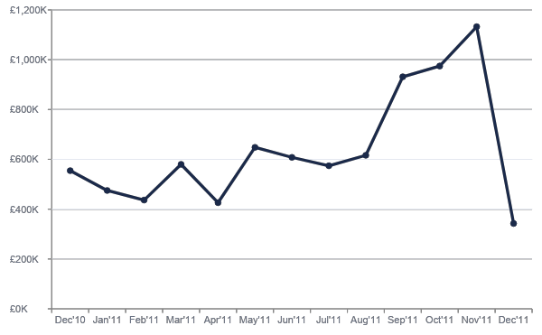
Exploratory Data Analysis — Revenue Trend
SEASONAL PEAK
Sep–Nov 2011 show the strongest revenue — consistent with pre-holiday shopping buildup.
DATA CAVEAT
Dec 2011's low total is not a real decline — the dataset only covers the first 9 days of that month.
5

Slide 6
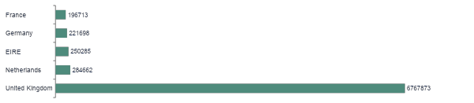
Business Snapshot
4,372
67%
£374.05
22,190
unique customers
active in last 90 days
average order value
total transactions
TOP REVENUE COUNTRIES
6

Slide 7
RFM Methodology
Every customer is scored on three dimensions of buying behaviour, each ranked 1 (weakest) to 5 (strongest) using NTILE(5) in SQL.
R
F
M
Recency
Frequency
Monetary
Days since the customer's last purchase, measured against the dataset's most recent transaction date.
Number of distinct invoices (orders) placed by the customer across the full timeframe.
Total net spend per customer (Quantity × UnitPrice), including cancellations, across all orders.
Fewer days → higher score
More orders → higher score
Higher spend → higher score
Combined RFM Code: R, F and M scores are concatenated (e.g. “555” = top-tier on all three) to classify each customer into a named segment.
7

Slide 8
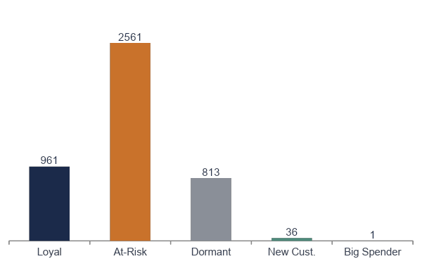
RFM Customer Segments
Loyal (961)
High R, F & M — your best, most consistent customers
At-Risk (2,561)
Largest group; moderate/mixed scores, needs closer monitoring
Dormant (813)
Low across R, F & M — stopped buying, at risk of churn
New Customer (36)
Recent, single purchase — too early to judge long-term value
Big Spender (1)
Recent, one high-value order, not yet a repeat buyer
4,372 customers total — segmented from raw RFM scores (R≥4 & F≥4 & M≥4 = Loyal, etc.), not just the exact code.
8

Slide 9
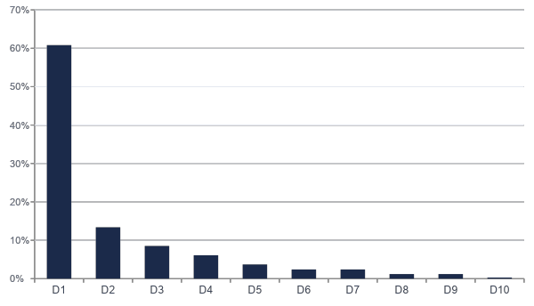
Decile Analysis
Independent of RFM segments, every customer is also ranked purely by total spend and split into 10 equal-sized groups.
Decile 1
Top 10% of customers by revenue — highest priority for retention and loyalty investment.
Decile 10
Bottom 10% — infrequent or dormant customers, lowest priority for spend.
Revenue share by decile, from rfm_final_v2 (Power BI). Figures are approximate, rounded from dashboard chart labels.
9

Slide 10
Recommendations by Segment
Loyal
Early access to seasonal deals — e.g. festive promotions released one month before public launch.
RETENTION
Dormant
Threshold spend offers (“spend £X, get a hamper”) plus discounts on previously purchased product categories.
RE-ENGAGEMENT
At-Risk
Broad, moderate “come back” discount now; flag for finer RFM sub-segmentation in future analysis.
MONITOR
New Customer
Time-limited incentive on their second order to convert a first-time buyer into a repeat customer.
NURTURE
Big Spender
Feedback outreach plus a second-purchase incentive while their first experience is still fresh.
UPSELLING
10

Slide 11
Marketing Budget Allocation Framework
Loyal
Proven, already-engaged spenders — the most predictable return per £. Priority: protect and reward (loyalty perks, early access, referral asks).
40% OF BUDGET
At-Risk
Largest segment (59% of customers) — even a modest per-customer spend adds up, and it protects revenue by preventing drift into Dormant.
30% OF BUDGET
Dormant
Lowest ROI per £ spent — cheap, low-cost win-back only (email reminders), not heavy discounts.
15% OF BUDGET
New Customer
Small group, but nurturing them into Loyal customers is cheaper than acquiring brand-new ones from scratch.
10% OF BUDGET
Big Spender
Just 1 customer — minimal spend, personal outreach (a feedback call) rather than a mass campaign.
5% OF BUDGET
11

Slide 12
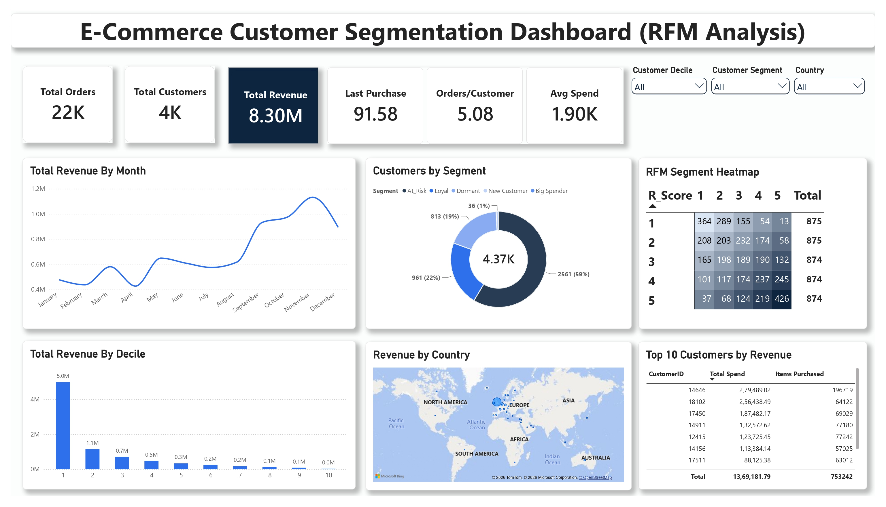
Power BI Dashboard
WHAT THE DASHBOARD SHOWS
RFM segmentation breakdown (customer count by segment)
Decile-wise revenue contribution
Monthly revenue trend
Key measures: Total Revenue, Total Customers, Total Orders
£8.30M
Total net revenue (DAX measure, cleaned_data)
12

Slide 13
Technical Blueprint & Tools
SQL Server (T-SQL)
Power BI (DAX)
Python (pandas)
Data cleaning, RFM & decile calculation, exploratory analysis
Dashboard visuals — segmentation, deciles, revenue trend
Cross-validation of SQL / Power BI results
METHOD SUMMARY
1
Raw data loaded to SQL Server → cleaned (missing/adjustment rows removed, types fixed)
2
Recency, Frequency, Monetary computed per customer; scored 1–5 with NTILE, tie-broken by CustomerID
3
Scores combined into RFM Codes and rule-based segments; customers ranked into 10 revenue deciles
4
Single source-of-truth table (rfm_final_v2) feeds Power BI dashboard and DAX measures
13

Slide 14
Thank You
Questions & discussion welcome.
Kusam Bhagat
Data Analyst
linkedin.com/in/kusam-bhagat | github.com/kusambhagat

