Slide 1
A delivery protection and notification system
Kusch Xukui Qin
12/9/2021
CSCI 6011 Intro to Computer Systems Final Project

Slide 2
Content
Overview of the project
Current solutions
Related projects
Live demonstration
Conclusion

Slide 3

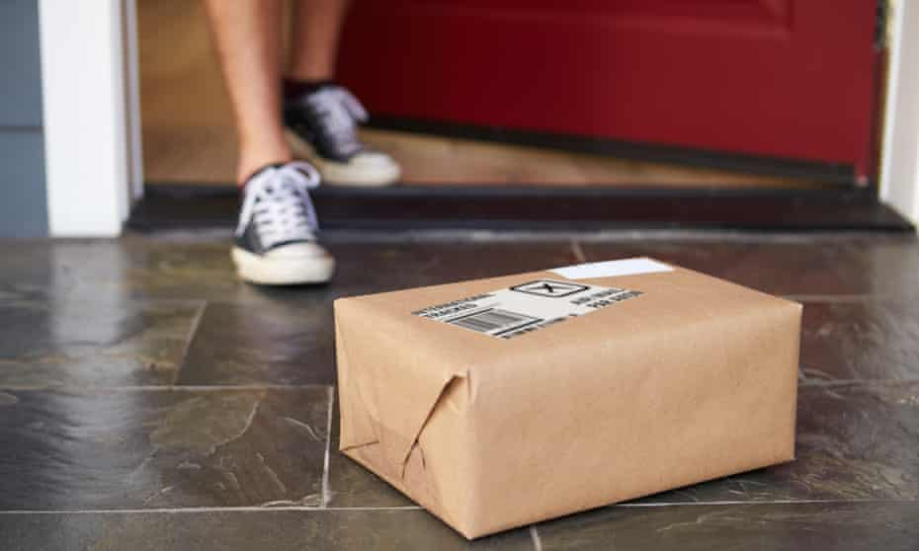
Overview
Image source: Google

Slide 4

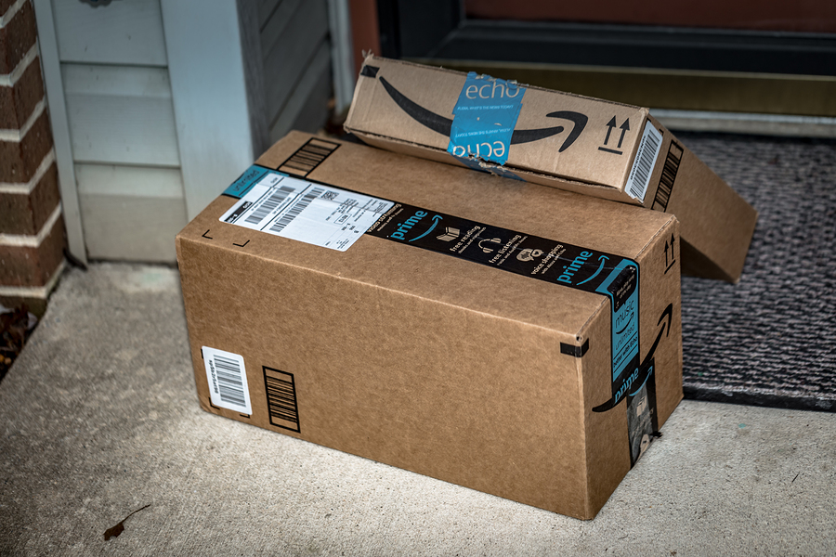
Overview
Image source: Google

Slide 5
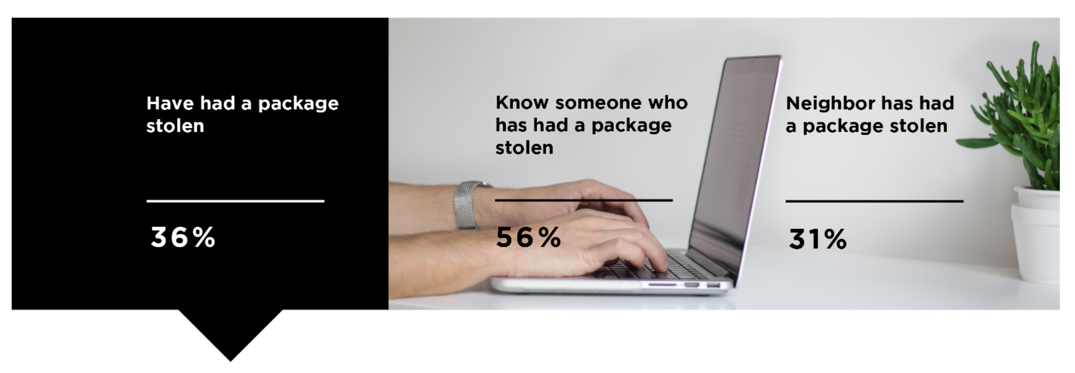
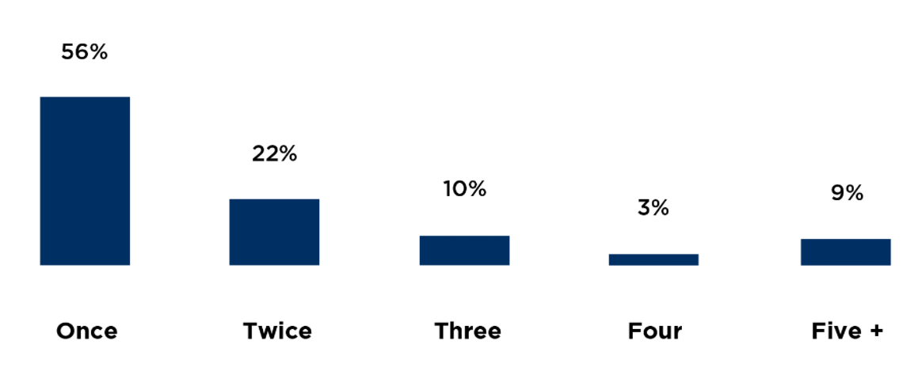
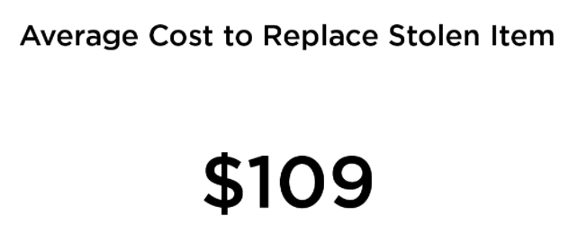
Overview
https://www.crresearch.com/blog/2019-package-theft-statistics-report

Slide 6
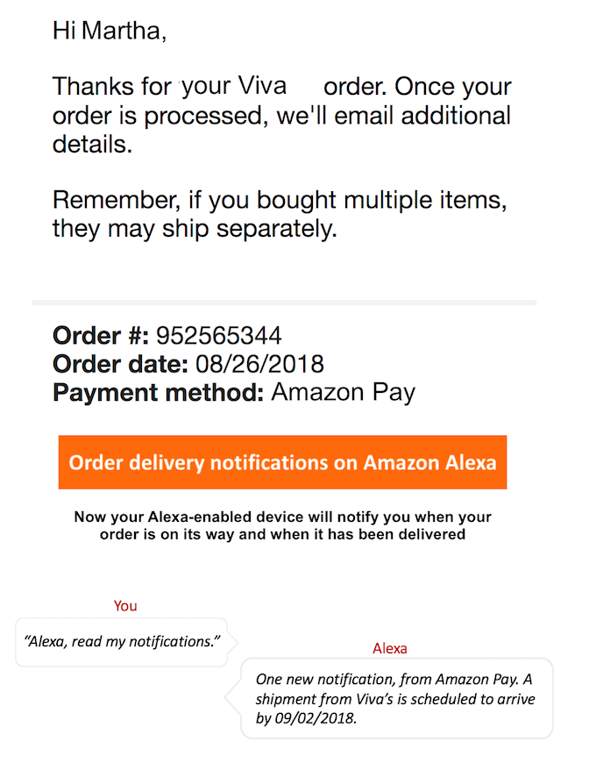
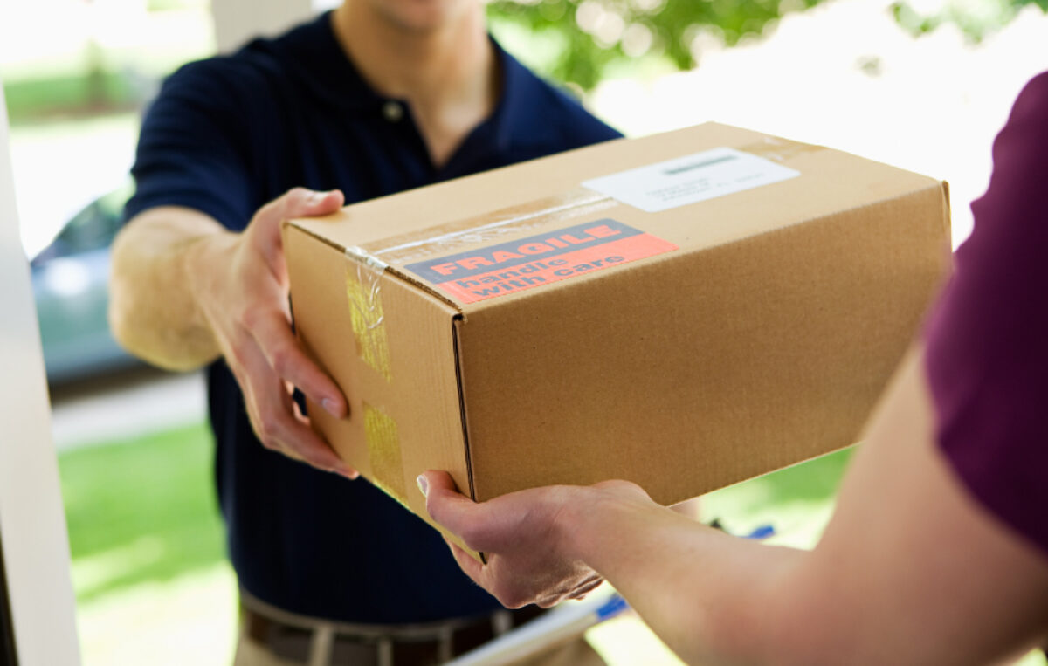
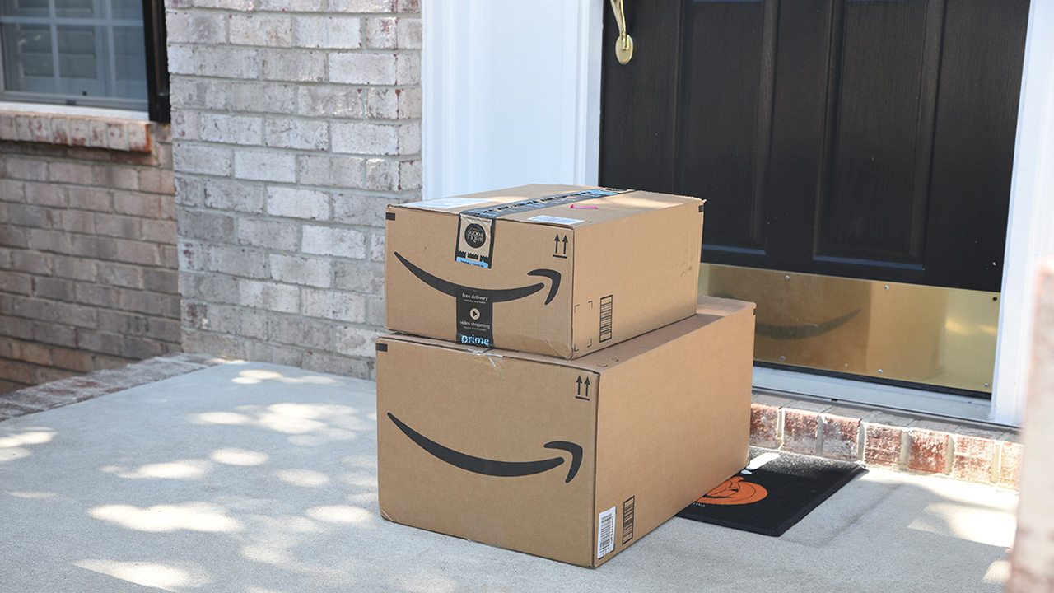
Current solutions
A. Delivery notifications by the express companies
Not every express company provides the service
Image source: Google

Slide 7
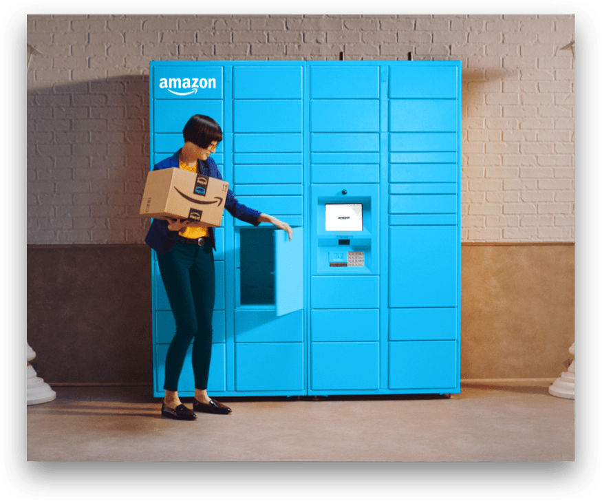
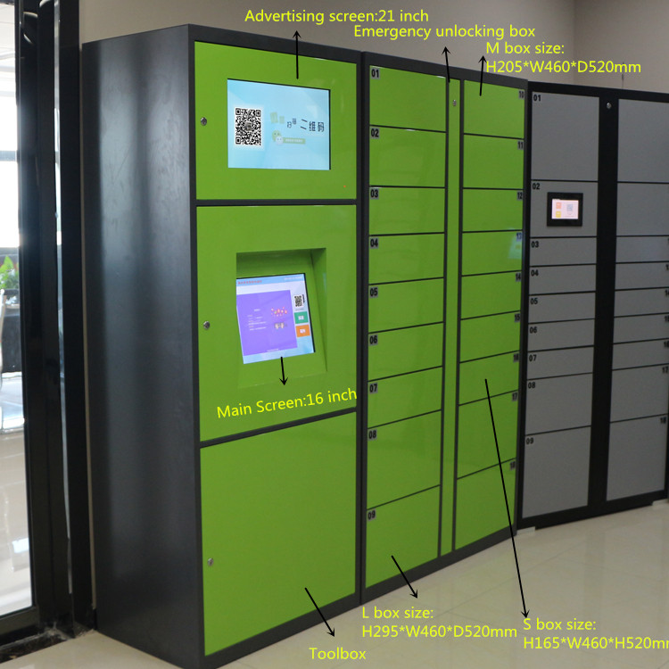
Current solutions
B. Centralized locker boxes provided by express company
Image source: Google

Slide 8
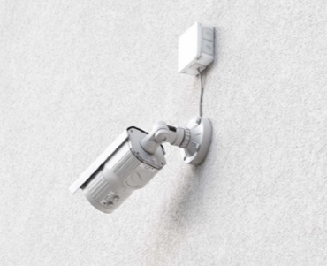
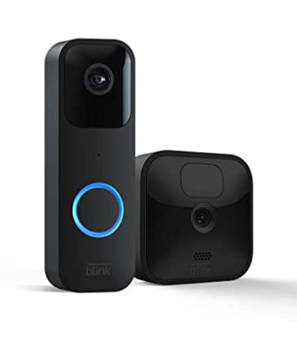
Current solutions
C. Security cameras
Image source: Google, Amazon

Slide 9
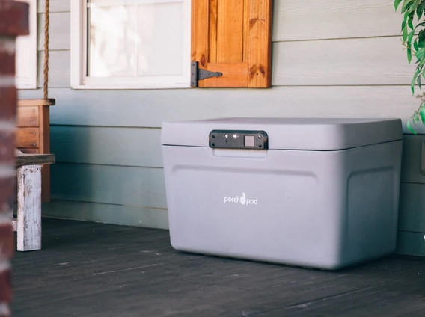
Current solutions
D. Deliver locker box
$200~600
No notifications
Requires delivery person to use app
https://www.theporchpod.com/

Slide 10

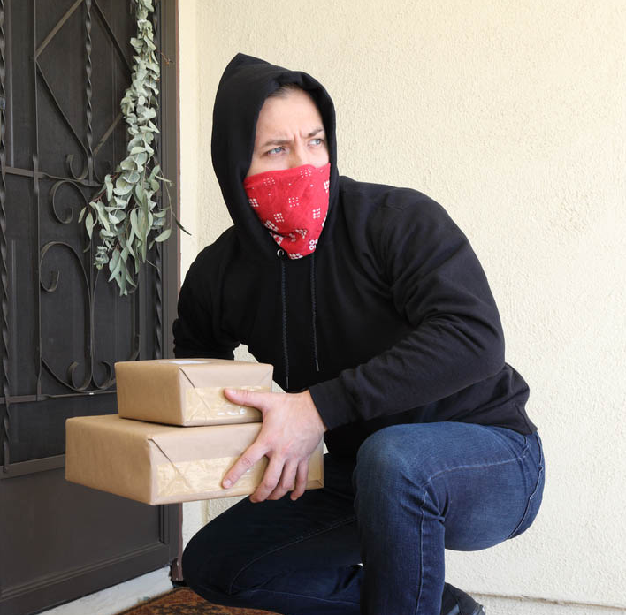
Proposed project
Package delivered
Email notification in seconds
A low-cost delivery notification and protection system
Package taken
Email notification in seconds
Notes:
Email notification in seconds

Slide 11
Live demo

Slide 12
Comparison between related projects
Properties\Projects | Notification service | Centralized locker boxes | Security camera | Locker box | My new system
Cost | $0 | $0 | $40~300 | $200~600 | <$30
Quality consistency | Depends | Depends | √ | √ | √
Notification with picture | Depends | No picture | X | X | √
Stolen notification | X | √ | X | √ | √
Picture of thief | X | Depends | Depends | X | √
Power and data used | Low | Low | High | Low | Low

Slide 13
Future works
1. Cases for multiple deliveries
2. Recognizing the owner
3. Alarm while taking away the parcel

Slide 14

Conclusion
Image source: Google

