Slide 1

SMS
Staff Management System
A digital leave, permission & travel approval platform built for St. John’s University of Tanzania’s multi-level institutional workflow
ST. JOHN’S UNIVERSITY OF TANZANIA
COURSE / UNIT
GROUP MEMBERS
PRESENTED TO
DATE
[Course Code – Unit Name]
[Name 1]
[Name 2]
[Name 3]
[Instructor Name]
[Presentation Date]

Slide 2
OVERVIEW
SMS
Presentation Agenda
Six evaluation areas, covered in order
1
Problem Identification & Relevance
10 pts
2
Requirements Analysis & Feasibility
10 pts
Why this system, why now
Functional, non-functional & economic
3
System Design
15 pts
4
Implementation & Functionality
20 pts
Architecture, UML & ER diagrams
What actually works, live
5
User Interface & UX
10 pts
6
Database Design & Management
10 pts
Design system & usability
Schema, integrity, security
Staff Management System · SJUT
2

Slide 3
EVALUATION AREA 1 · 10 MARKS
SMS
Problem Identification & Relevance
Clear problem statement, justification, objectives, relevance of the proposed solution
The Problem
Objectives
Multiple approval levels — Unit Head, HOD, Dean, DVC, HR — historically tracked on paper or over email.
No visibility for staff into where their request currently sits in the chain.
No institutional audit record of who approved what, and when.
No structured delegation for an acting/holding staff member when the requester is away.
Digitize the full multi-level approval chain for Leave, Permission, and Travel requests.
Every registered staff member — any role, any department — gets a working self-service portal, not just a curated few.
A complete audit trail of every action in the system, in chronological order.
Acting-staff delegation — including HOD override-on-behalf when needed.
Relevance: the design directly mirrors SJUT’s real organizational hierarchy and was validated end-to-end with real staff accounts across real departments — not a synthetic demo dataset. The same approval-chain pattern generalizes to any institution with layered sign-off requirements.
Staff Management System · SJUT
3

Slide 4
EVALUATION AREA 2 · 10 MARKS
SMS
Requirements Analysis
Functional & non-functional requirements, user needs, feasibility
Functional Requirements
Non-Functional Requirements
The system shall allow staff to submit Leave, Permission, and Travel requests.
The system shall route each request through its correct multi-stage approval chain.
The system shall let approvers approve or reject requests with comments.
The system shall support acting-staff delegation, including HOD override-on-behalf.
The system shall generate, print, and track the validity of staff ID cards.
The system shall provide live search across staff, requests, and role records.
The system shall log every login, logout, password change, and approval action.
The system shall notify users in-app of pending approvals and status changes.
Multi-tenant isolation — every query is university-scoped, so data never crosses institutions.
Server-side validation — e.g. acting staff must be in the same department, enforced beyond the UI.
Role-gated access — single login, panel access decided server-side per role.
Usability — consistent search pattern, responsive layout, compact professional density.
Auditability — every state-changing action is logged automatically via middleware.
Feasibility — built entirely on open-source tooling (Laravel, MySQL) already within SJUT’s technical reach.
Staff Management System · SJUT
4

Slide 5
EVALUATION AREA 2 · FEASIBILITY
SMS
Economic Importance & Feasibility
How the system pays for itself in cost savings, productivity, and organizational efficiency
1
2
3
Lower Administrative Costs
Faster Staff Management
Fewer Errors, More Accountability
No more printing, filing, or physically storing leave/permission/travel paperwork.
Records and request status are available instantly instead of searched for by hand.
Server-side validation and a full audit trail remove disputes over who approved what.
4
5
6
Cheaper, Faster ID Cards
Better Decisions via Reporting
Scales Without Scaling Cost
Cards are generated and printed straight from staff records, with expiry tracking and instant reissue — no external vendor round-trip.
Built-in report generation gives management real data instead of guesswork.
One system serves more staff and departments without a matching rise in admin headcount — long-term ROI.
Staff Management System · SJUT
5

Slide 6
EVALUATION AREA 3 · 15 MARKS
SMS
System Design
Architecture, approval-flow design, and the logical system structure
Browser
→
Laravel Application
→
MySQL / MariaDB
Blade views + Bootstrap 5
Controllers · Middleware · Eloquent
staff, departments, requests, logs
Leave Approval Pipeline
Unit Head
›
HOD
›
Dean
›
DVC
›
HR
›
HR Logistics
Two-layer role design: a Spatie role (e.g. “hod”) controls what a user can see; a dedicated foreign key on the Department/School record (hod_staff_id, dean_staff_id) decides who can actually approve for that unit — keeping permission labels separate from operational routing authority.
Staff Management System · SJUT
6

Slide 7
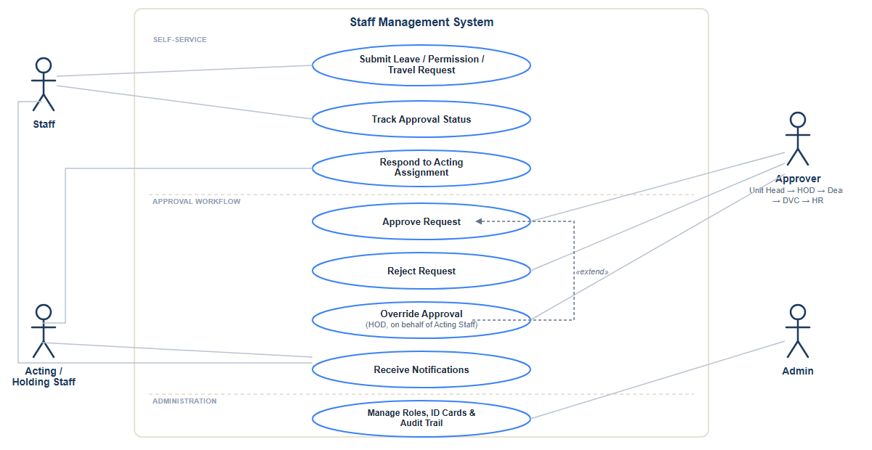
EVALUATION AREA 3 · 15 MARKS
SMS
Use Case Diagram (UML)
Actors and the core interactions they have with the system
Staff Management System · SJUT
7

Slide 8
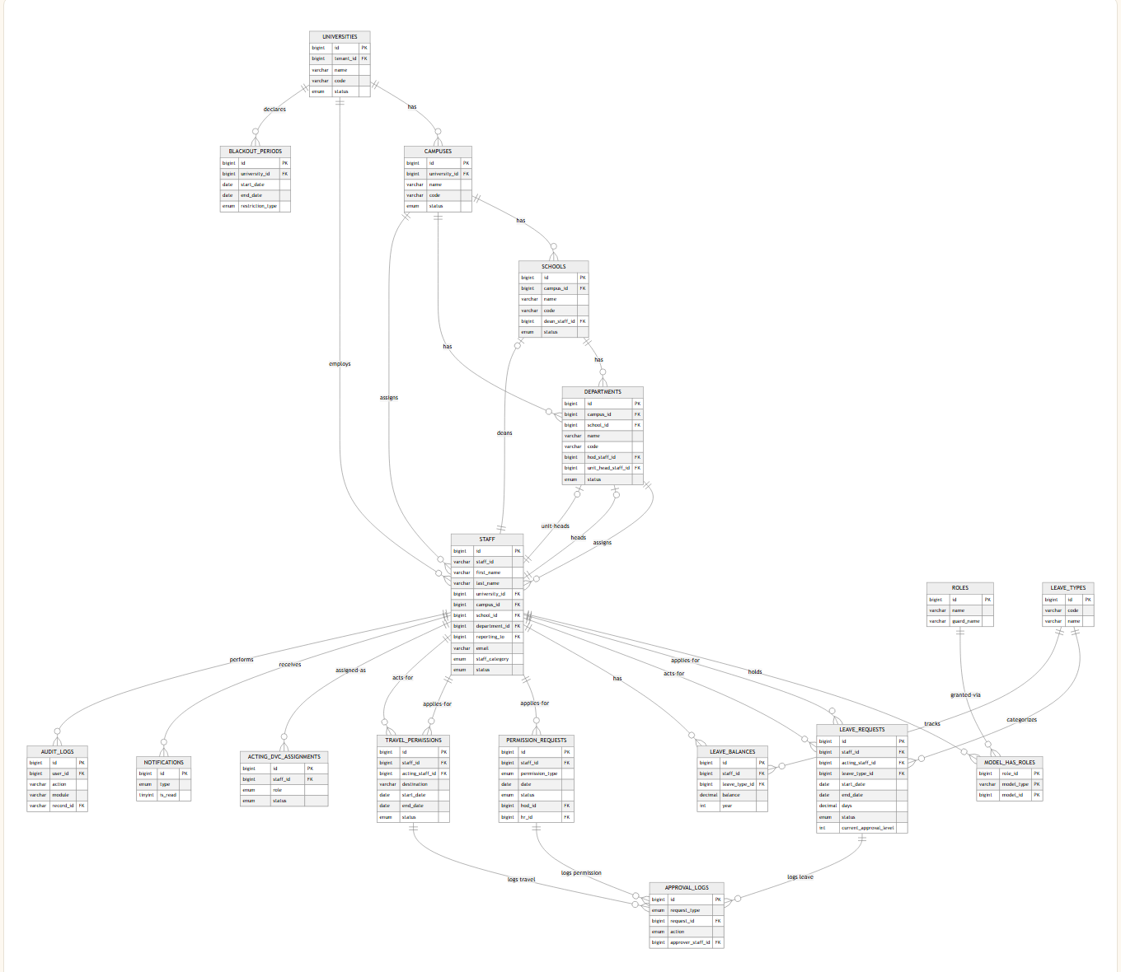
EVALUATION AREA 3 · 15 MARKS
SMS
Entity-Relationship Diagram
Institute hierarchy, staff/roles, and the three request workflows with their shared approval-log and notification trail
Staff Management System · SJUT
8

Slide 9
EVALUATION AREA 4 · 20 MARKS
SMS
Implementation & Functionality
Correctness, completeness, feature integration — what actually works, live
PHP 8.4
Laravel
MySQL
Blade
Bootstrap
Spatie
Tabler Icons
✓
Full request lifecycle
✓
Acting-staff delegation
Leave, Permission & Travel — submit through final sign-off, live status at every stage
Accept / decline flow, plus HOD override-on-behalf with correct timeline reflection
✓
Live search everywhere it matters
✓
Comprehensive audit trail
Leave, Permission, and Role Management pages — debounced, no page reload needed on most
Login, logout, password changes, page views, and every create/approve/reject action
✓
In-app notification system
✓
ID card generation & tracking
Real-time bell dropdown + dedicated notifications page with read/unread filtering
Issue and print staff ID cards, track expiry, and instantly reissue a lost card
✓
Admin management tools
✓
Report generation
Roles, departments, universities, data cleanup — all with working search
Built-in reports so management works from real data, not guesswork
Verified, not assumed: the entire approval chain was tested end-to-end using real SJUT staff accounts spanning Unit Head, HOD, Dean, DVCA, and HR.
Staff Management System · SJUT
9

Slide 10
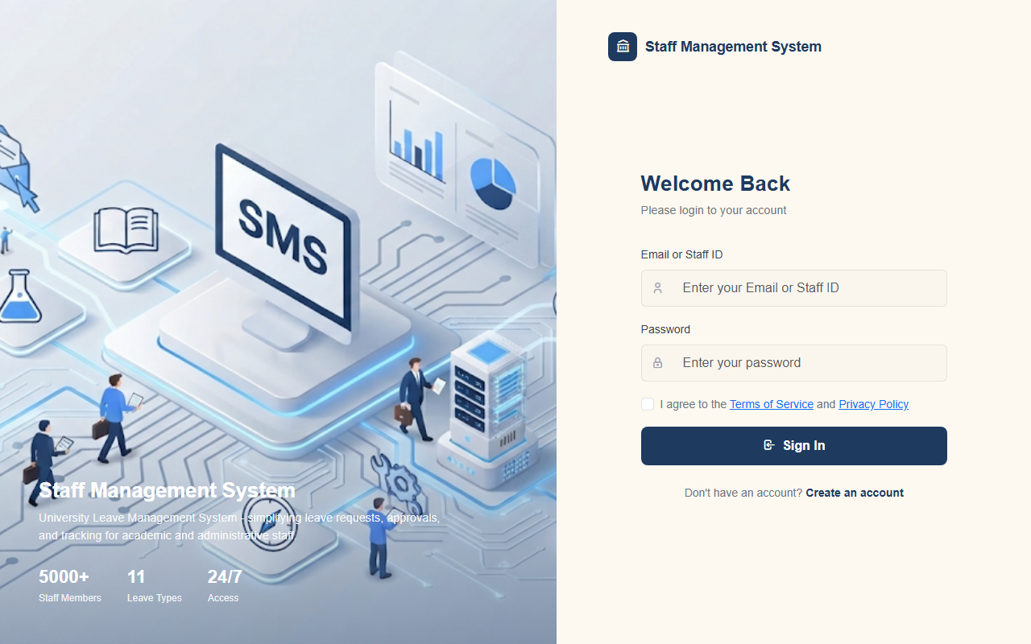
EVALUATION AREA 5 · 10 MARKS
SMS
User Interface & User Experience
Usability, navigation, consistency, accessibility, visual presentation
Design System
Single login, role-gated — one entry point, server decides what each role can reach.
Consistent search pattern — the same live-search component reused across Leave, Permission, and Role Management.
Uniform tab navigation — Notifications filters now match the Profile page’s tab style.
Clear unread/read states — tinted background, accent border, bold title for anything needing attention.
Responsive layout — mobile sidebar toggle and breakpoints down to phone width.
Staff Management System · SJUT
10

Slide 11
EVALUATION AREA 6 · 10 MARKS
SMS
Database Design & Management
Structure, relationships, normalization, data integrity and security
universities
schools
departments
staff
leave_requests
approval_logs
tenant root
dean_staff_id
hod / unit_head
the User model
+ permission / travel
per-stage history
Normalization & Separation of Concerns
Integrity & Security
approval_logs (per-request approval history) is kept separate from audit_logs (system-wide activity) and hold_position_history (acting-staff specific) — each log serves one purpose.
Leave, Permission, and Travel each own their approval-state columns rather than sharing one generic table.
staff carries university/campus/department foreign keys, enforcing the institutional hierarchy at the data layer.
Cross-tenant isolation enforced in every query touching multi-university data.
Referential rules validated at the application layer (e.g. Rule::exists scoped by department).
Full CRUD + auth audit trail via a catch-all logging middleware, immune to any single controller forgetting to log.
ID cards carry their own validity window (issued_at / valid_until), independently trackable and revocable.
Staff Management System · SJUT
11

Slide 12
SUMMARY
SMS
Where Each Requirement Was Met
A one-glance map from the evaluation rubric to what you just saw
# | Evaluation Area | Covered By | Marks
1 | Problem Identification & Relevance | Slide 3 — SJUT approval-chain pain points & objectives | 10
2 | Requirements Analysis | Slides 4–5 — functional/non-functional + economic feasibility | 10
3 | System Design | Slides 6–8 — architecture, UML use-case diagram, full ERD | 15
4 | Implementation & Functionality | Slide 9 + live demo — verified with real accounts | 20
5 | User Interface & UX | Slide 10 — design system & consistency | 10
6 | Database Design & Management | Slide 11 — schema, normalization, integrity | 10
 | Group Total |  | 75
Staff Management System · SJUT
12

Slide 13
Thank You
Questions & Live Demonstration

