Slide 1
Lab 1

Slide 2
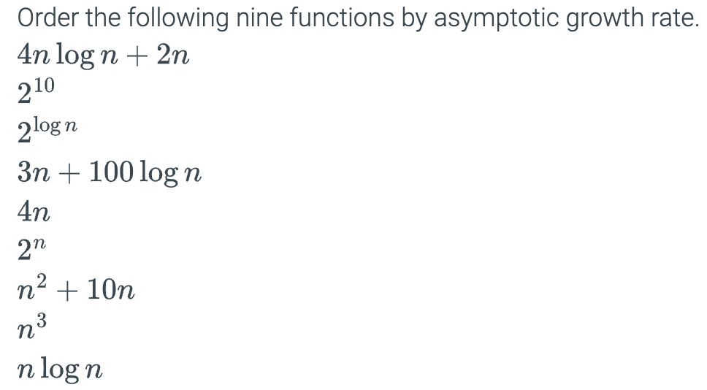
1.

Slide 3
2. Refer to the provided Python script (lab1_exercises.py). Determine the time complexity of each method in that script. For each function, provide a brief explanation of how you calculated its time complexity.

Slide 4
3. Write a python function that has O(1) space complexity in the best case, and O(n²) space complexity in the worst case.

Slide 5
Submission Instructions
Submit the following in iCollege:
Python script/solution (FULL_NAME_Lab1.py)
Due date/time for submission: Within 24 hours from your lab’s end time.
Notes:
- Lab attendance and participation is mandatory. Your iCollege submission will only be considered
for grading if you attend the corresponding lab session in-person.
- It is the student’s responsibility to ask the lab instructor to update his/her attendance
record during each lab session.
- If you arrive more than 20 minutes late, a 10% penalty will be applied.
- Be prepared to answer a few questions on your solution/partial solution during the lab session.

