Slide 1









MOVIE TICKET BOOKING SYSTEM
Kush Modi

Slide 2

INDEX
Introduction
1
File Structure
2
User Interaction Flow
3
Java Models
4
Data Management
5

Slide 3
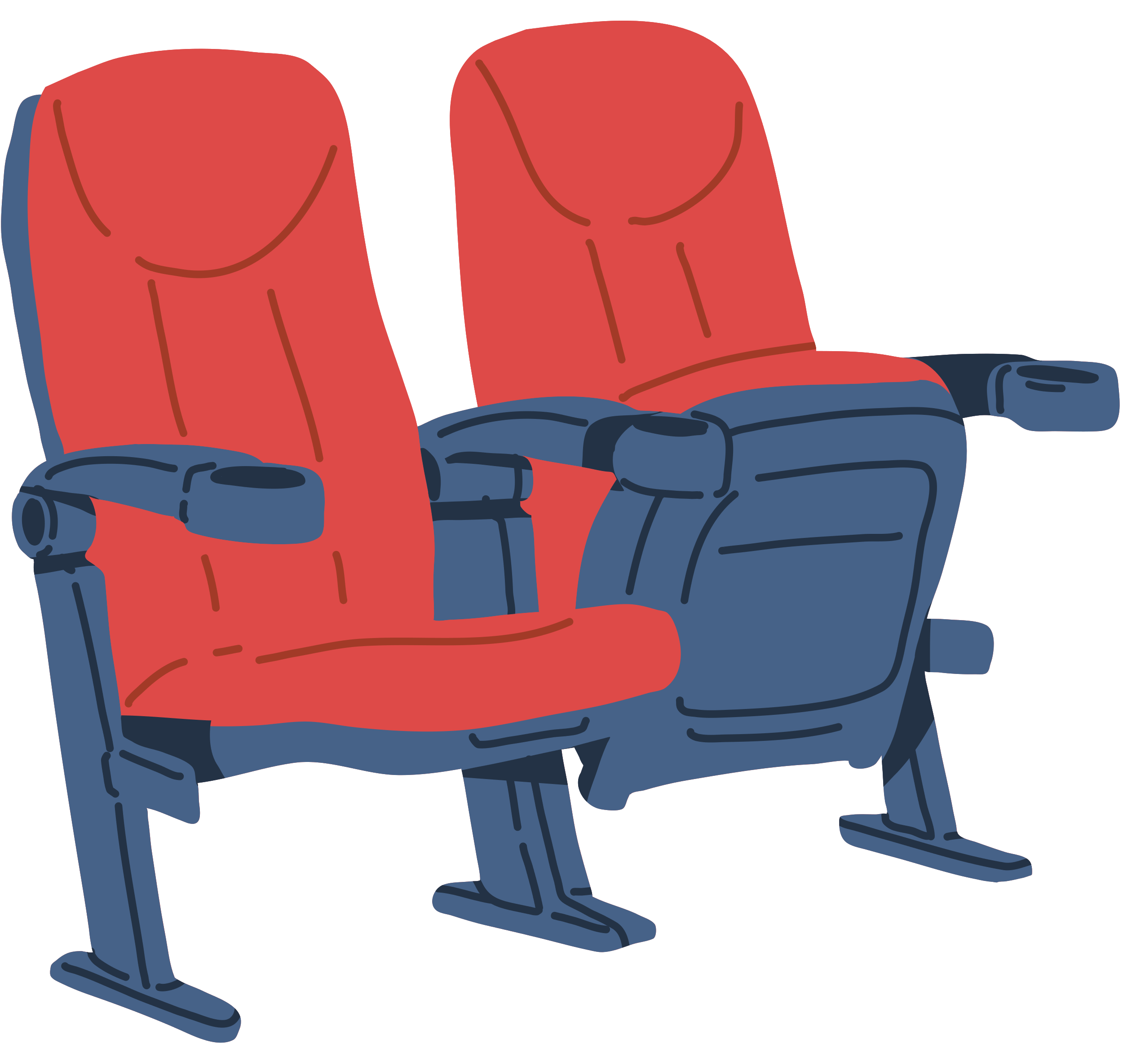
INTRODUCTION
Purpose: To demonstrate a practical application of OOP concepts and file I/O in Java.
Functionality: A CLI-based system allowing users to register, login, select movies, showtimes, and book tickets.
Storage: Utilizes CSV files for data persistence.

Slide 4
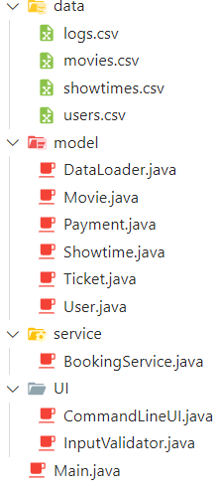
FILE STRUCTURE
MTBS Directory: Root folder containing all project components.
Data Subfolder: Stores CSV files for movies, showtimes, logs, and user data.
Model Subfolder: Contains Java classes representing different data models.
Service Subfolder: Includes services for booking and payment processing.
UI Subfolder: Manages user input and command-line interface.
Main.java: The entry point of the application.

Slide 5
USER INTERACTION FLOW
Registration/Login: Initial step for user authentication.
Movie Selection: Users can browse and select a movie.
Showtime Selection: Users choose a preferred showtime.
Ticket Booking: Users specify the number of tickets and complete the booking.
Confirmation: Users receive confirmation and ticket details are saved.

Slide 6

JAVA MODELS
Movie.java: Represents a movie with attributes like title, genre, and duration.
Ticket.java: Encapsulates ticket details including movie, showtime, and seat number.
Showtime.java: Defines the showtimes for movies with attributes such as time and date.
User.java: Stores user information necessary for login and registration processes.
Payment.java: Handles payment details and transaction status.

Slide 7

DATA MANAGEMENT
CSV Files: Serve as the database for storing user and ticket information.
Data Loader: Handles the loading and updating of CSV files.
Flexibility: Easy addition of new movies and showtimes by updating respective CSVs.

Slide 8
THE END
THANK YOU

