Slide 1
Neural Machine Translation
Translating English sentence into Spanish

Slide 2
What is the Use?
To convey the meaning, tone, and intention of a message.
Politically, narrows down the barrier between different cultures and regions.
Provides automated platform for translation.
Cheaper price and more flexibility over multiple languages than manual translators.
.

Slide 3
Literature surveys
Neural machine translation: A review of methods, resources, and tools (Tan et al, 2020)
Sequence to Sequence Learning with Neural Networks (Sutskever, Vinyals and V. Le, 2014)
On the Properties of Neural Machine Translation: Encoder–Decoder Approaches (Cho, Merrienboer, Bahdanau, and Bengio, 2014)
LSTM-based Encoder-Decoder for Multi-sensor Anomaly Detection (Malhotra et al, 2016)
Neural Machine Translation with Supervised Attention (Liu, Utiyama, Finch and Sumita, 2016)
.

Slide 4
Dataset
The data was open source, available at this link.
The data was present in .txt format.
It contained of English sentences and their corresponding Spanish translations.
It was then parsed, lower-cased, cleaned and stripped-off.
.

Slide 5
State of the art
A seq2seq model was used to handle sequential nature of sentences.
The algorithm uses many-to-many recurrent neural networks.
It was encoder-decoder based model.
LSTMs were used to handle vanishing gradient problem.
.

Slide 6
Model Architecture
The architecture had an input layer followed by a word embedding layer.
Further it had 3 LSTM encoder layers whose combined input was fed to a decoder embedding layer.
This was further followed by a decoder LSTM layer, which was then turned into a softmax dense layer.
.

Slide 7
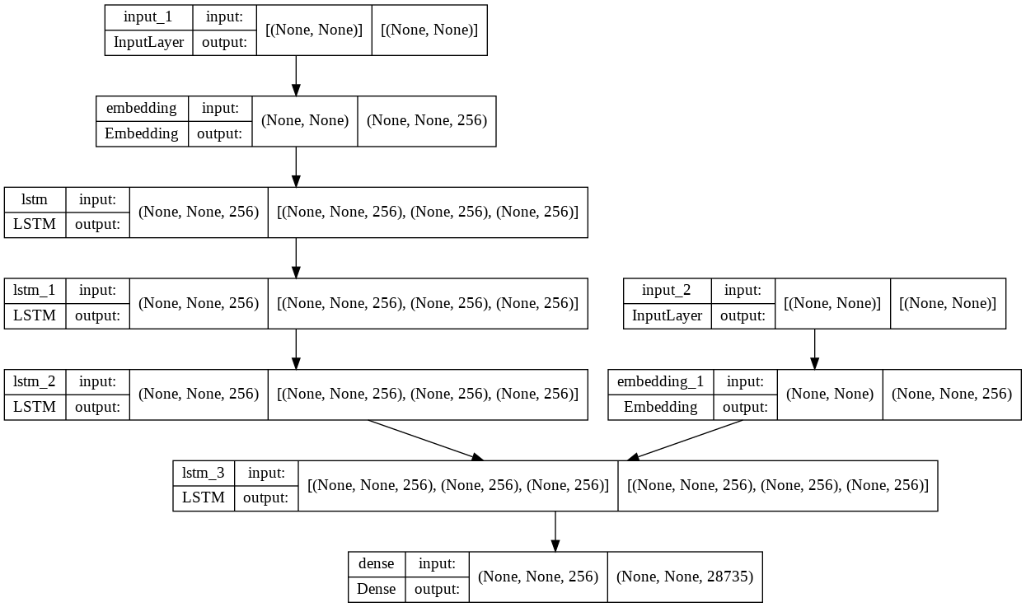
Model.jpeg

Slide 8
Training the model
The model was trained for 12 epochs with a batch size of 128.
The Adam optimizer was used and vailated on the test data.
The model performed with an accuracy of around 85%.
.

Slide 9
Interactive interface
The model was transitioned into an interactive web application using Flask framework.
It provides an interactive interface for our language translation
It was written in python and did use basic HTML and CSS.
It is yet to be deployed on a cloud platform for permanent hosting.

Slide 10
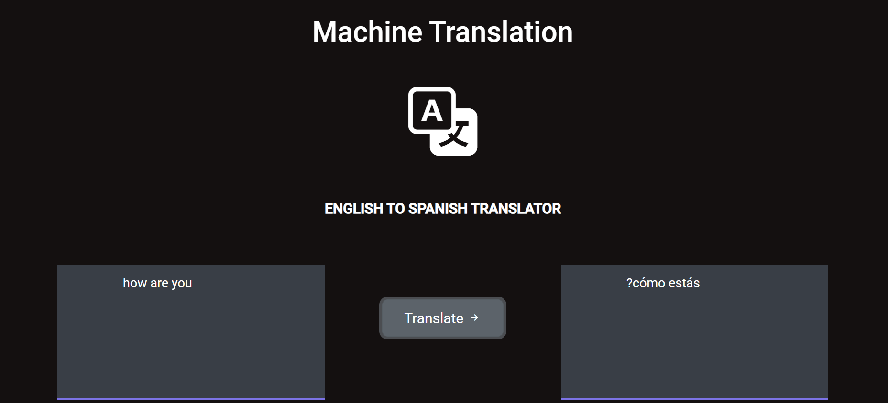
Sneek peak click me

Slide 11
Extras
Another interactive web interface was created using Hugging Face and Gradio library.
Hugging Face is an open-source pre-trained library for projects based on neural networks.
The model was hosted permanently oh Hugging face spaces.
The link to the website can be found here.
.

Slide 12
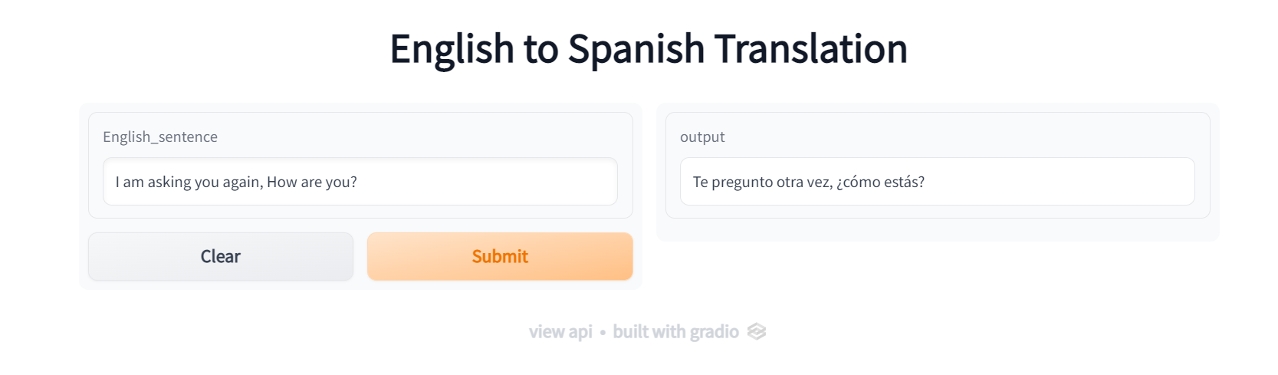
The Gradio web App

Slide 13
Gracias
Thank You

