Slide 1
PROJECT TITLE NE555 LED Blinking Timer Circuit

Slide 2
Introduction
A blinking LED timer circuit is an electronic circuit that continuously turns an LED ON and OFF at regular intervals.
The circuit uses the NE555 timer IC, which is a popular timer and pulse generation IC.
The NE555 operates in astable mode to generate continuous square wave pulses.
These pulses control the blinking of the LED automatically.
Produces repetitive ON/OFF signals
controls LED blinking speed using resistors and capacitors
demonstrates timer and oscillator concepts
used in alarms, indicators, flashers, and pulse circuits

Slide 3
PROJECT Design Flow
Schematic design
ERC
Verification footprint assignment
PCB layout design
Component placement
PCB routing
Board outline creation
DRC verification
3D PCB visualization
Gerber file generation

Slide 4
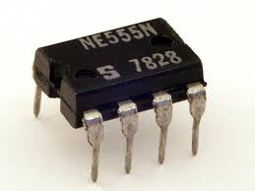
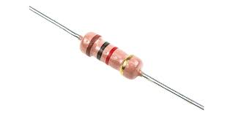
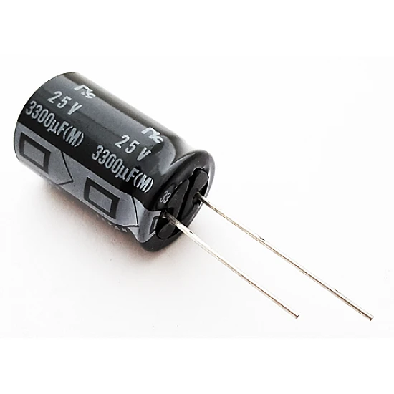
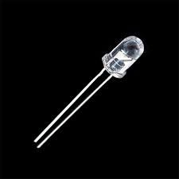
COMPONENTS USED
NE555 timer
Resistors
Capacitors
LED
2-pin connector
PCB board
Copper tracks
Power supply source

Slide 5
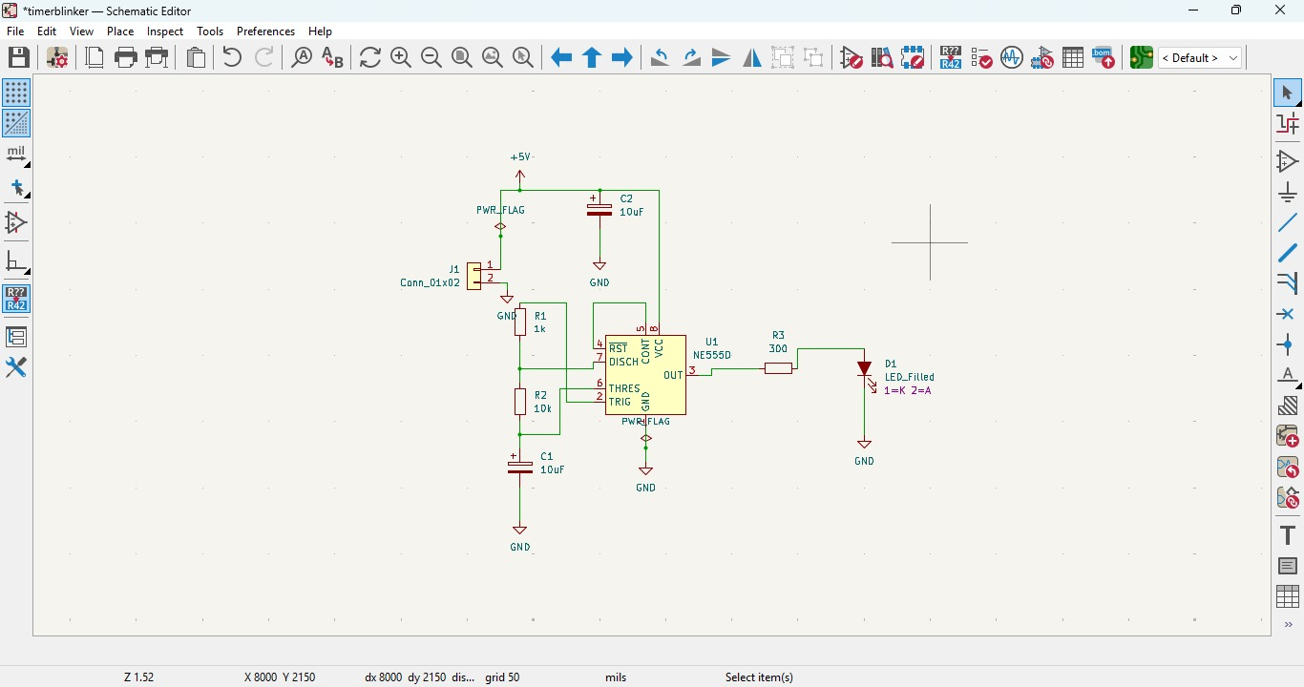
_{Schematic design}
The NE555 timer circuit was designed using the schematic editor in KiCad. Components such as resistors, capacitors, LED, connector, and NE555 IC were connected according to the circuit requirements.

Slide 6
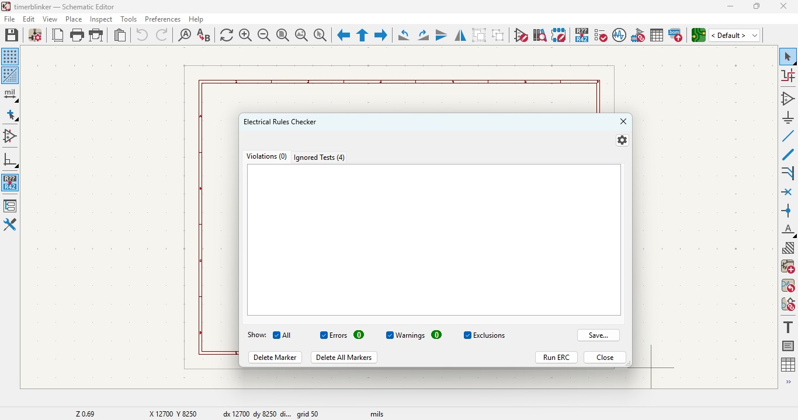
ERC Verification
Electrical Rule Check (ERC) was performed to identify electrical and connection errors in the schematic. The circuit successfully passed ERC verification with zero errors.

Slide 7
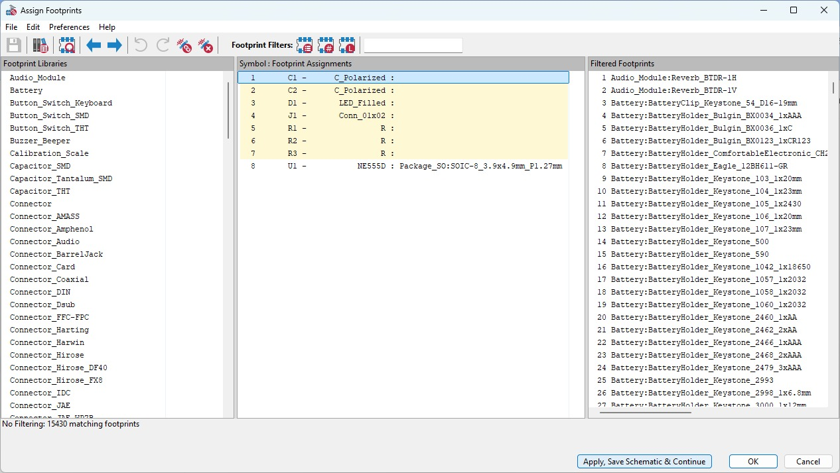
Footprint Assignment
Appropriate PCB footprints were assigned to all components to define their physical size and placement on the PCB board.

Slide 8
PCB layout design
The schematic was converted into PCB layout format using the KiCad PCB editor.
Component placement
All components were arranged properly to ensure compact design, easier routing, and better circuit organization.
PCB routing
Copper tracks were routed between component pads to establish electrical connections on the PCB.
Board outline creation
The PCB boundary was created using the edge. Cuts layer to define the final shape and size of the board.

Slide 9
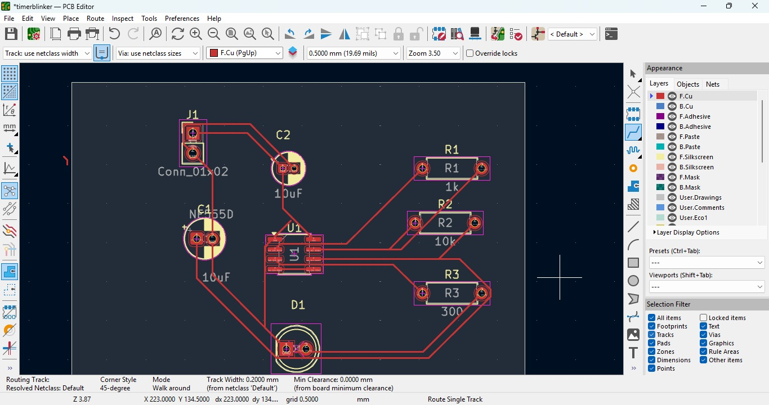

Slide 10
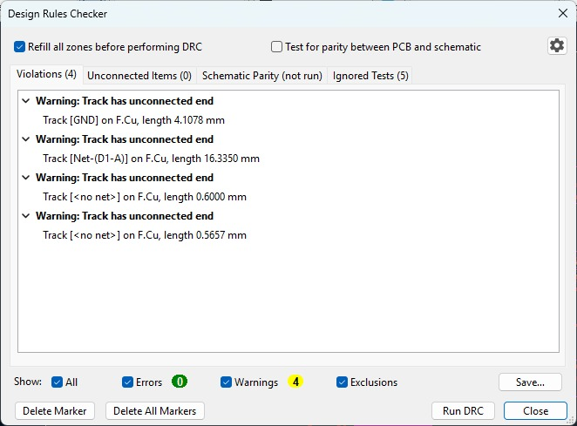
DRC verification
Design rule check (DRC) was performed to verify PCB routing, spacing, and connectivity. The PCB passed verification successfully.

Slide 11
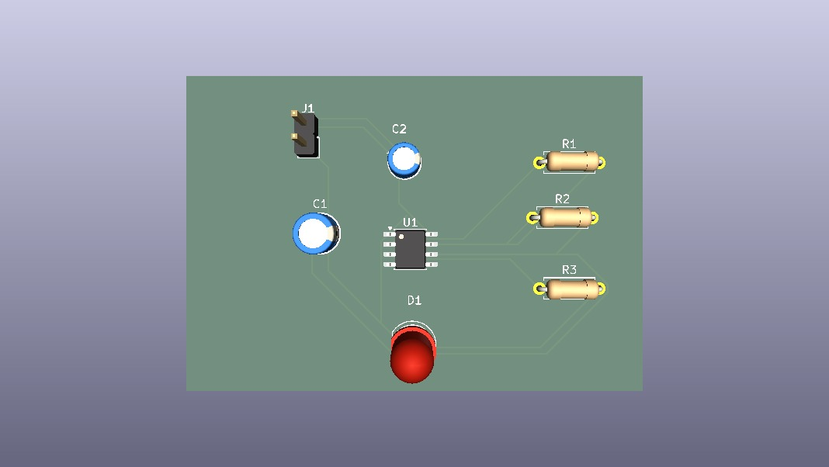
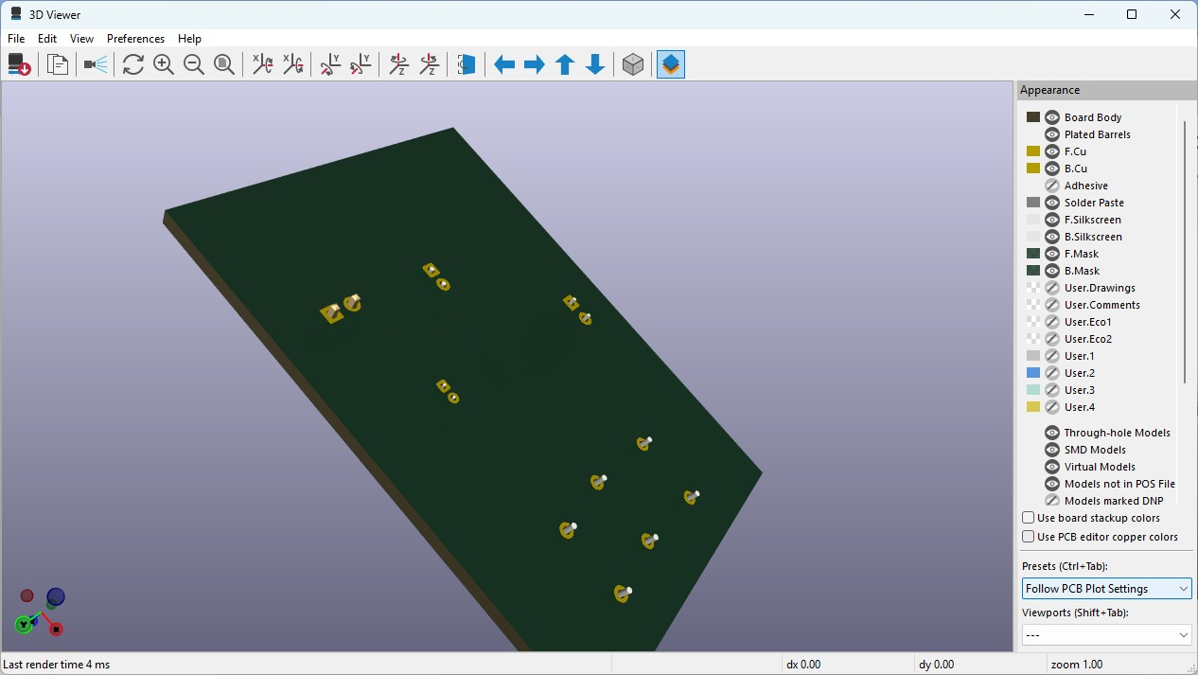
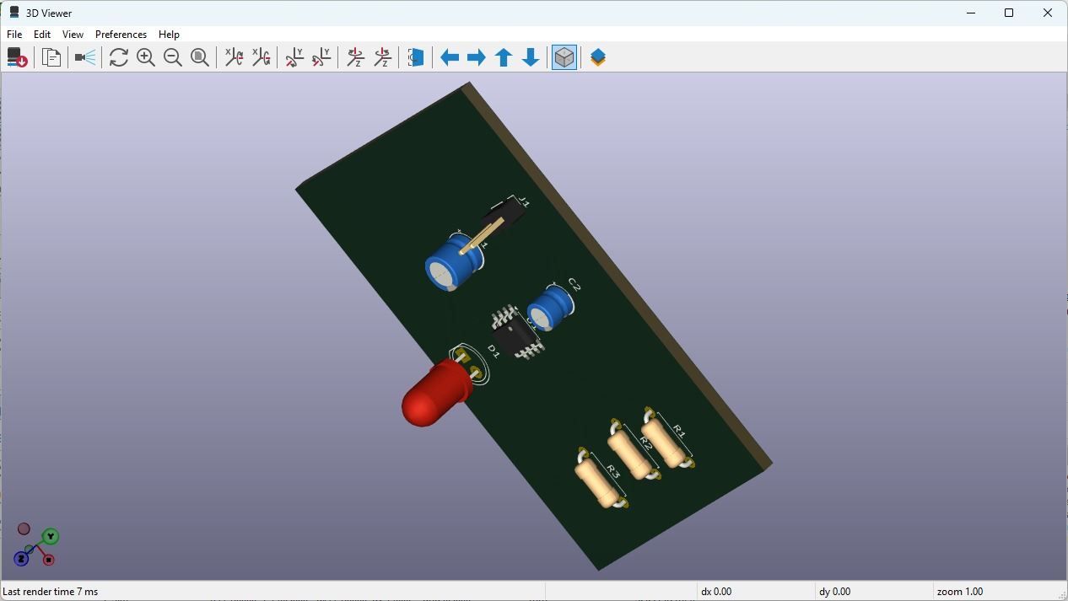
3D PCB visualization
The completed PCB was viewed in 3D mode to inspect component placement and overall board appearance.

Slide 12
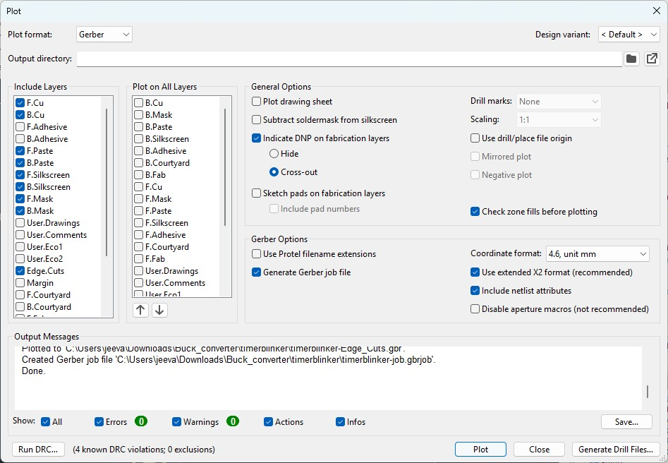
Gerber file generation
Gerber and drill files were generated for PCB manufacturing and fabrication purposes.

Slide 13
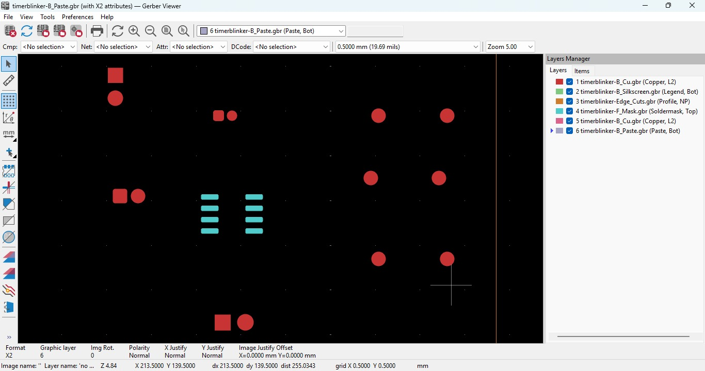

Slide 14
PCB Manufacturing and Gerber File Processing
Gerber files contain the complete manufacturing data of the PCB design.
These files include copper layers, drill holes, solder mask, silkscreen, and pcb outline information.
PCB manufacturing machines read gerber files using precise x-y coordinate systems.
CNC drilling machines use drill data to create accurate component holes on the PCB.
SMT pick-and-place machines use component coordinates and rotation angles for automatic assembly.
The manufacturing process is based on geometrical and mathematical positioning for high precision.
After gerber file generation, the pcb becomes ready for industrial fabrication and assembly.

Slide 15
CONCLUSION
The blinking LED timer circuit using the NE555 timer IC was successfully designed and implemented using KiCad. The project included schematic creation, ERC verification, footprint assignment, PCB routing, DRC verification, 3D visualization, and gerber file generation. Through this project, the complete PCB design and manufacturing workflow was understood, and the final PCB design was prepared successfully for industrial fabrication.

