Slide 1
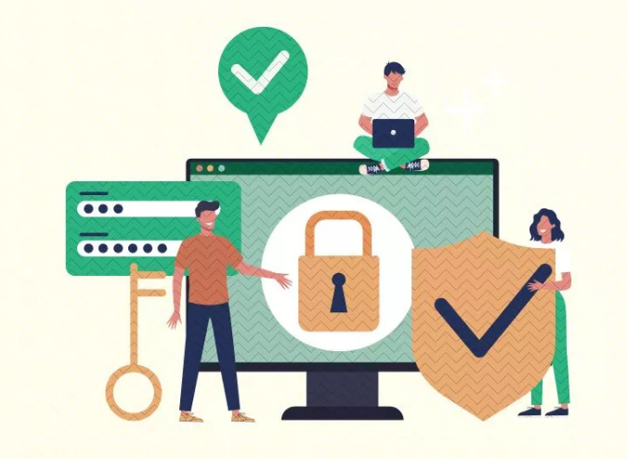


Bank of Baroda Hackathon - 2022
Keystroke.io: Authentication based on Keystroke dynamics
Team name: 1001001

Slide 2
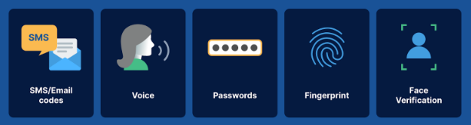
Introduction
The traditional authentication factors are weak as they can be "phished", stolen, discovered, and cracked in a number of ways. Yet businesses continue to use it to protect their most important corporate data.
Slides 05

Slide 3
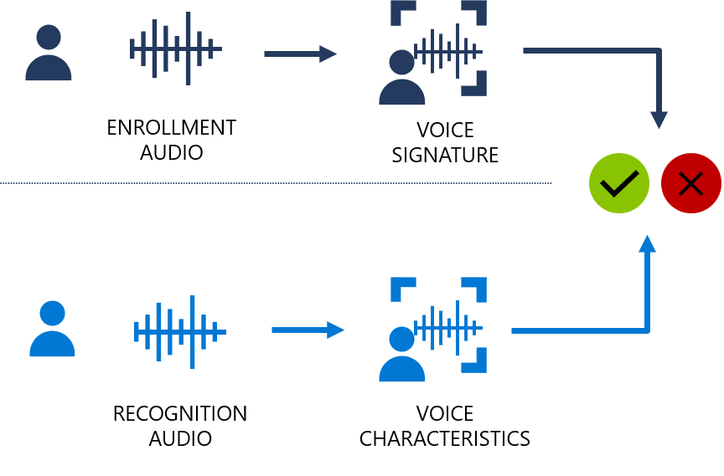
Voice Authentication
Voice biometrics is the science of using a person’s voice as a uniquely identifying biological characteristic in order to authenticate them.
Slides 05

Slide 4
Disadvantages
Requires liveness detection to verify that a sample is from a live speaker and not a recording.
It is not immune to spoofing attacks which includes recorded voice, computer-altered voice and synthetic voice.
Background noise can impact the quality of the sample and, in turn, matching performance.
Slides 05

Slide 5
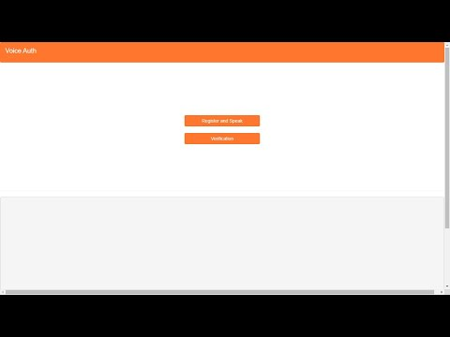
Demonstration

Slide 6

Problem statement
As we press into the twenty-first century, Digital banking has become the single most effective channel for financial institutions to drive growth, increase revenue and attract new customers. However, advanced safeguards against fraud and impersonation, as well as more foolproof measures against unauthorized access to computer resources and data are now being sought.
We present Keystroke.io, a safeguard mechanism which authenticates access by recognizing certain unique and habitual patterns in a user's typing rhythm.

Slide 7
Keystroke dynamics is not WHAT you type, but HOW you type !!!

Slide 8
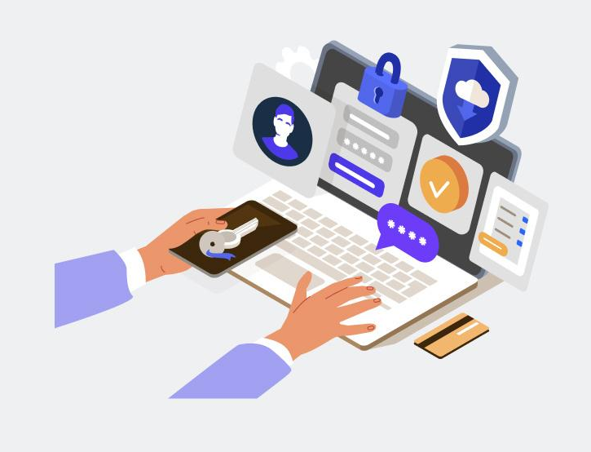
Keystroke dynamics
Keystroke Dynamics uses the manner and rhythm in which an individual types characters on a keyboard or keypad. The keystroke rhythms of a user are measured to develop a unique biometric template of the user's typing pattern for future authentication.
Slides 05

Slide 9
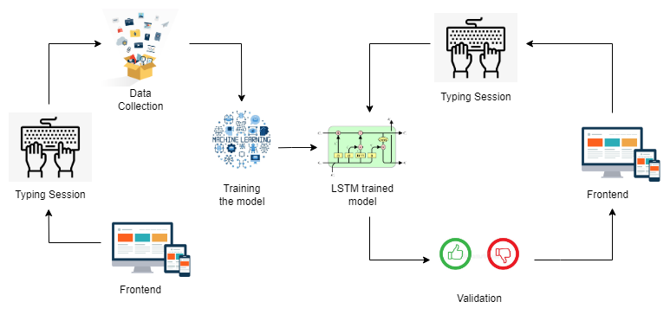
Data flow diagram

Slide 10
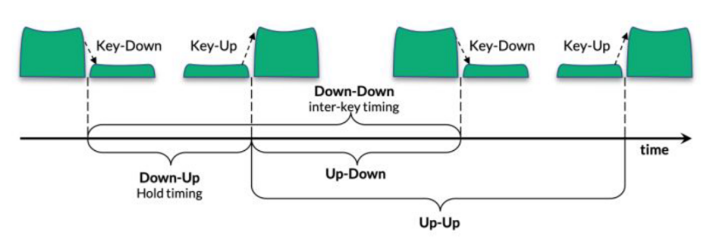
Features

Slide 11
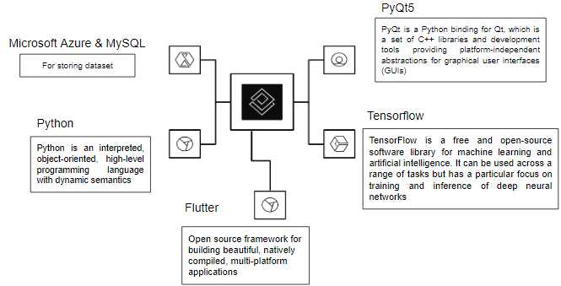
Tech Stack

Slide 12
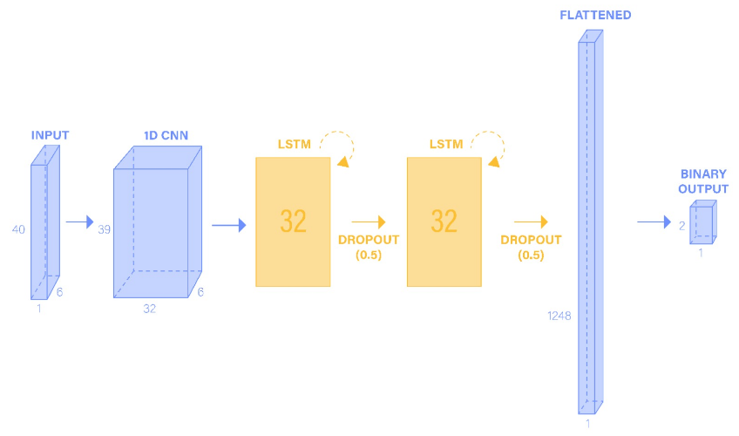
Architecture

Slide 13
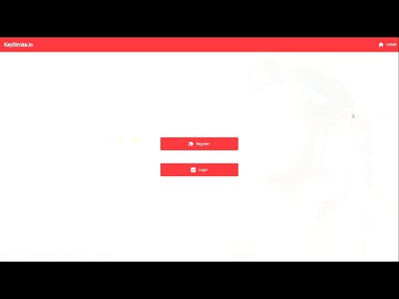
Demonstration

Slide 14
Scope of work
Keystroke.io can be used by banks, surveillance facilities and anyone for their personal use.
Banks: The idea can be used in their web/mobile applications to track the behavioral patterns of their customers to continuously authenticate their identity apart from the usual authentication.
Surveillance and Security Facilities: To monitor the systems and make sure an unauthorized individual is not occupying the control room.
Personal use: Users who wish to keep their data secured and ensure their privacy can use keystroke.io to trigger a response in case a third person accesses their phone or computer system.
Slides 05

Slide 15
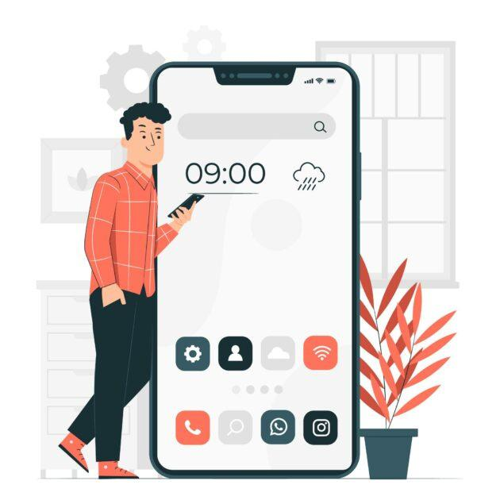
Future scope
It can potentially be extended over mobile devices and other touch screens.
It can be expanded to capture other behavioural patterns like mouse activity, device movement and touch screen behavior.
It can be used in combination with speech as part of a multi-factor authentication system.

Slide 16

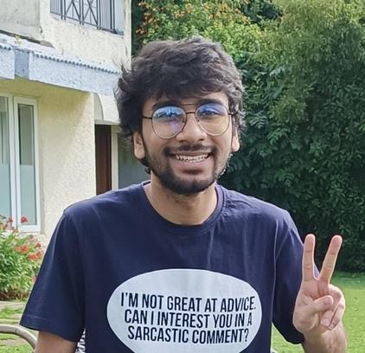
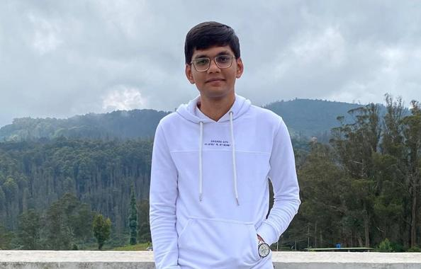

OUR TEAM
Meet our amazing team
K Divyasri
Kushagra Gupta
Lakshya Khandelwal
Praneeth Shetty
THANK YOU

