Slide 1

Enhancing Student Learning through PDF-to-Text-Image-to-Video Conversion, presented by Kushagra Soni, aims to make learning fun and accessible.

Slide 2

The issue highlighted pertains to students facing challenges in fully engaging with books, attributed to factors such as lack of interest, comprehension issues, or time limitations. Supported by statistics detailing student reading patterns, the project aims to transform PDF text into captivating video content.

Slide 3
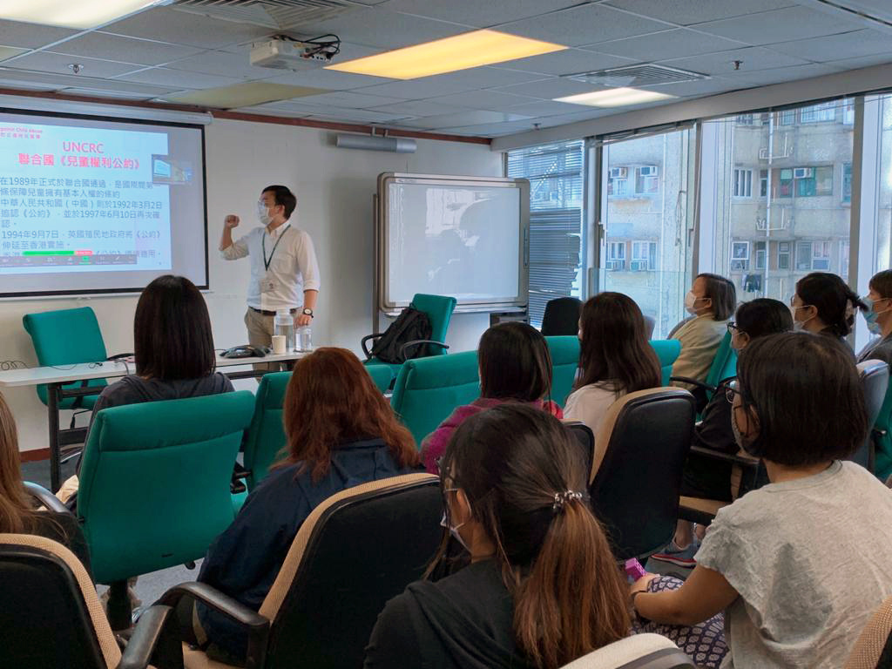
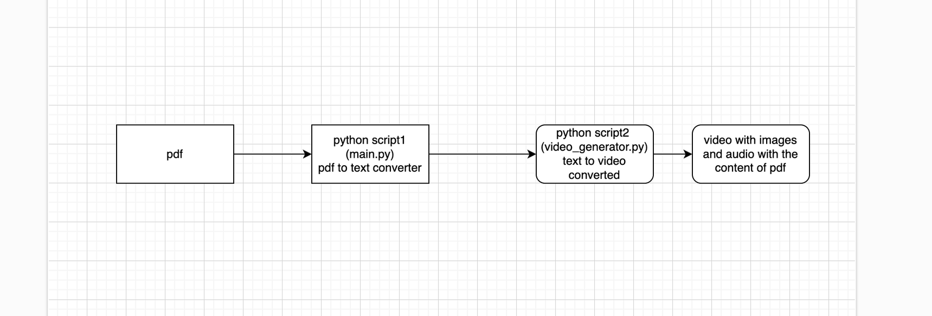
Project Overview
Step 1: Convert PDF to Text Image
Step 2: Convert Text Image to Video
Demo Video := in zip file of code repo as .webm

Slide 4



