Slide 1
Role of Regularization in the Prediction of Valence from Speech
Multimodal Signal Processing (MSP) lab
The University of Texas at Dallas
Erik Jonsson School of Engineering and Computer Science
Qualification Exam Presentation – Fall 2018
Kusha Sridhar
(presented at Interspeech 2018)

Slide 2










Motivation
Very Active
Attribute Descriptors
Supported by core affect theory
Human interaction consists of mixed emotional content – hard to classify into few distinct classes
Emotional attributes can describe differences within emotional categories – Appealing !!!
Arousal
Angry
Happy
Very Negative
Very Positive
Neutral
Valence
Sad
Very Passive

Slide 3



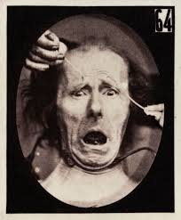

Motivation – From Psychology
Emotional attributes are more suitable to describe complex human behaviors in everyday interactions.
Characteristic behaviors in the expression of valence
People express pleasure or displeasure in varied manners
Appraisal of situation dictates behaviors
Two people in the same situation often externalize valence differently
In self-reported mood, the spread for valence scores is higher than arousal [Feldman 1995]
$σ^{2}$(Valence) = 2 . $σ^{2}$(Arousal)

Slide 4
Study of Valence Emotion
Valence attribute (negative vs. positive) is key in many applications
Mental health, costumer service, security and defense
Speech-based classifiers often lead to lower performance for valence, compared to other emotional attributes (e.g., arousal and dominance)
Studies | Arousal | Valence
Trigeorgis 2016 (convolutional RNN) | 0.686 (CCC) | 0.261 (CCC)
Parthasarathy 2016 (rank-based classifier) | 89.7% (Accuracy) | 65.7% (Accuracy)
Lotfian 2016 (preference learning) | 75.1% (Accuracy) | 66.8% (Accuracy)
It is important to explore options to improve the performance in detecting valence from speech

Slide 5
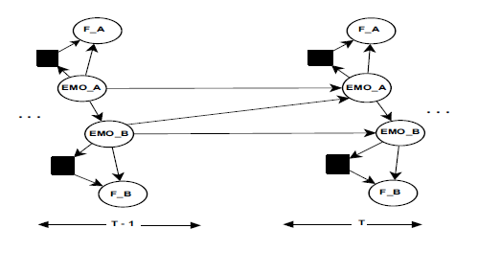
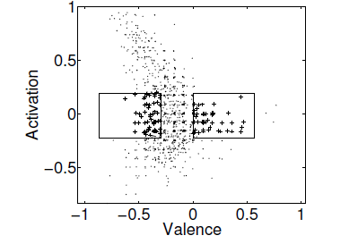
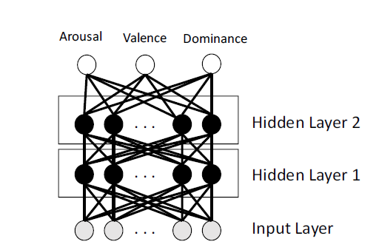
Motivation – From speech
Previous observations for detecting valence from speech
Few acoustic features are more discriminative for valence alone [Busso&Rahman, 2012]
Temporal context can help improve valence prediction [Lee et al., 2009]
Improvements when jointly predicting valence with arousal and dominance under a multitask learning framework [Parthasarathy and Busso, 2017,2018]
This paper explores the role of regularization in DNNs as one of the aspects that can lead to better prediction of valence from speech

Slide 6
Improving Valence Predictions
Role of regularization
Hypothesis: Higher regularization leads to better prediction for valence
Allows DNN to find consistent trends across speakers
Focus is on the role of dropout in the prediction of valence
Methodology
Analyzing the model performance as a function of dropout probability
Analyzing performance for different DNN configurations (# layers, # nodes, emotional attributes)

Slide 7
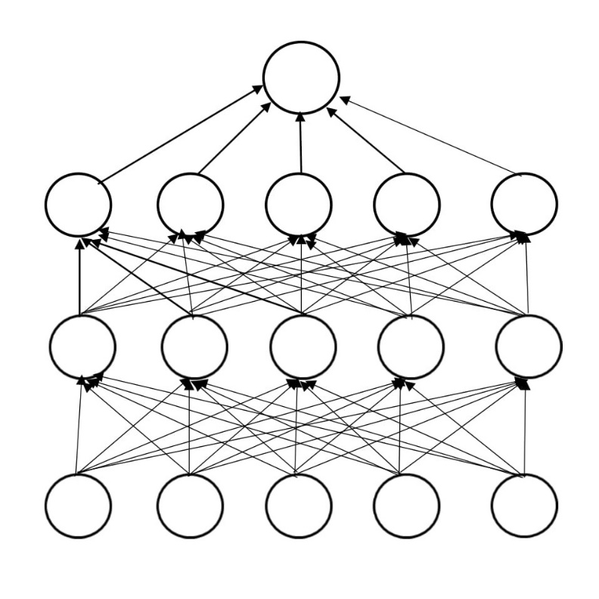
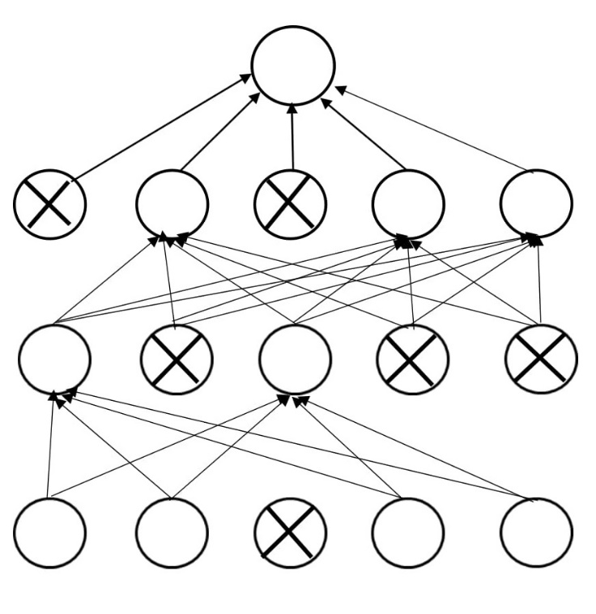
Regularization in DNNs
Regularization is very important in DNNs to avoid overfitting
Learn general patterns rather than specific trends in training set
Different approaches for regularization:
Dropout, early stopping, data augmentation, weighted penalties on the training data, multitask learning
Dropout
Randomly ignores nodes in the network
Essentially, it trains a smaller network on each iteration
Prevents learning of interdependent feature weights
Prevent co-dependencies across neighbor nodes
Randomly shut down parts of the network
Standard network
Network with dropout
p = Dropout rate

Slide 8
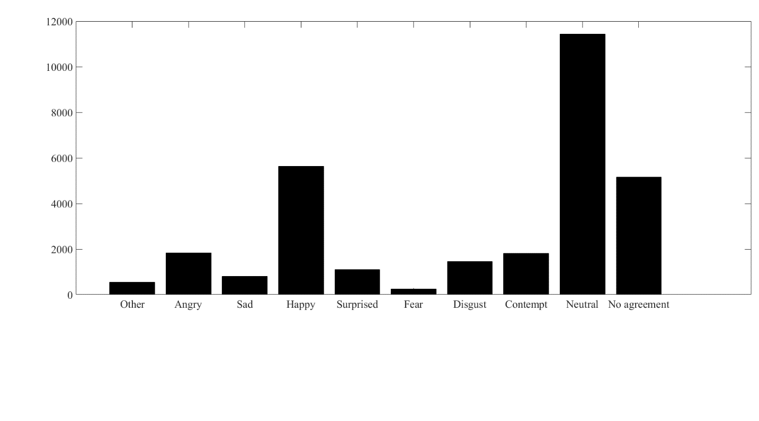
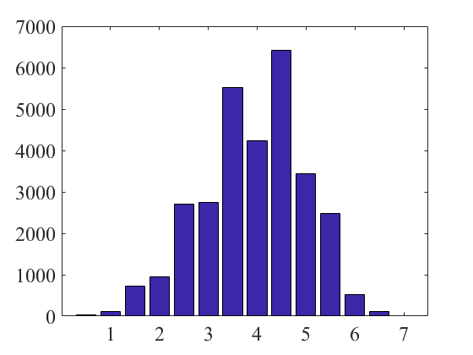
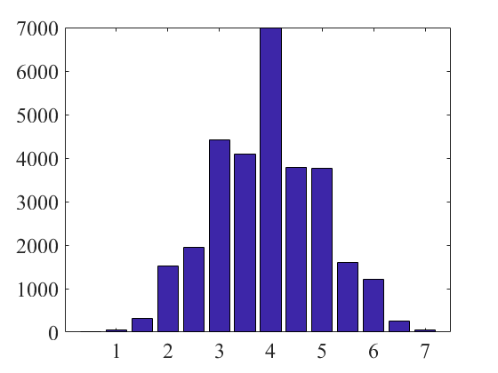
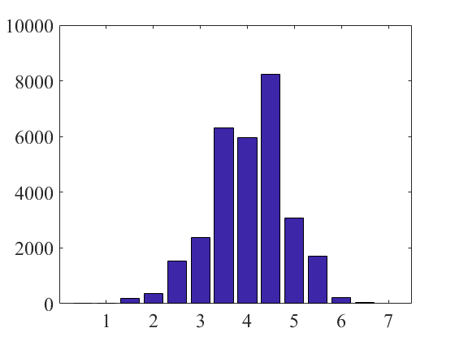
MSP-Podcast database
Ongoing effort
With emotion labels: 30,681 sentences
(50h, 09m)
Segmented turns
244,477 sentences from 1500 podcasts
Arousal
Valence
Dominance

Slide 9

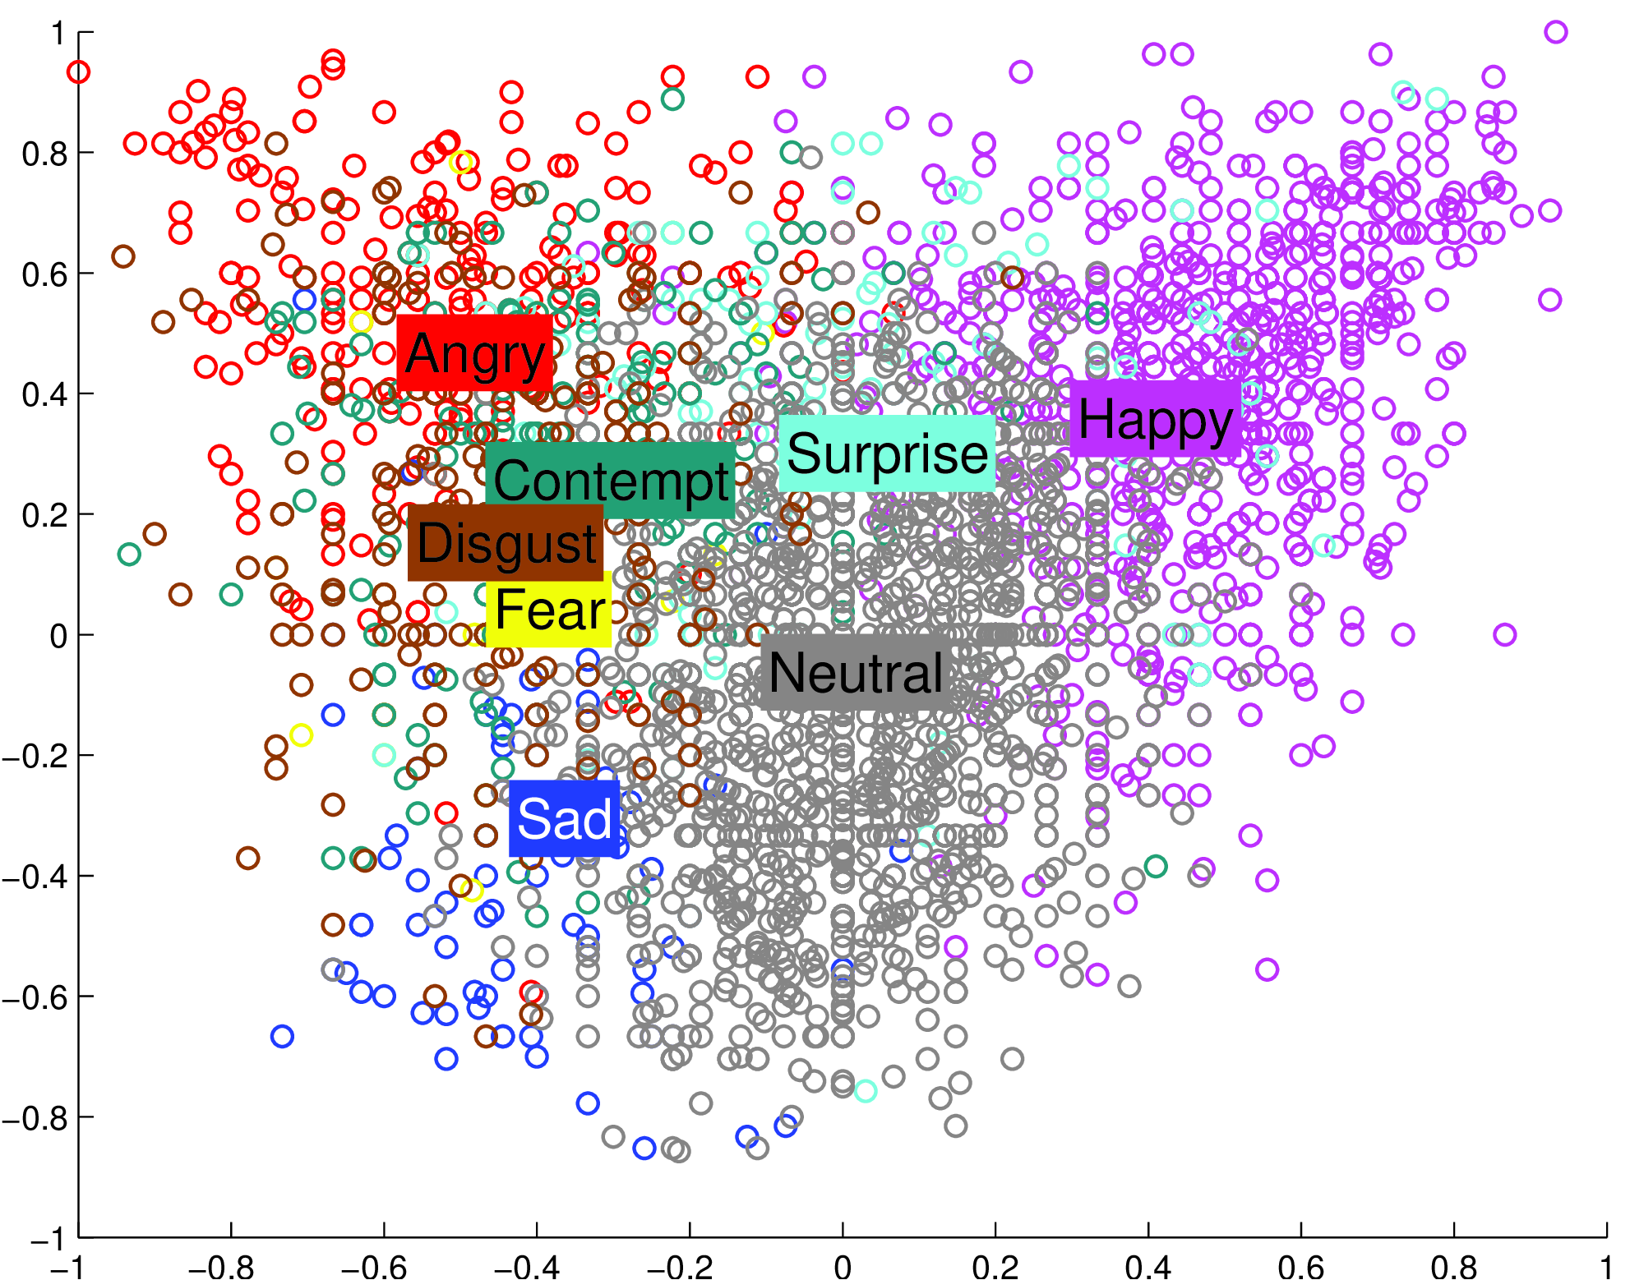


MSP-Podcast database
Version 1.0 of the MSP-Podcast corpus
20,045 (30h43m)
Corpus partition with minimal speaker overlap sets:
Training data: 11,750 samples
Test data: 6,069 samples
Validation data: 2,226 samples
Hot anger
Cold anger
Arousal
Neutral
Happiness
Valence

Slide 10
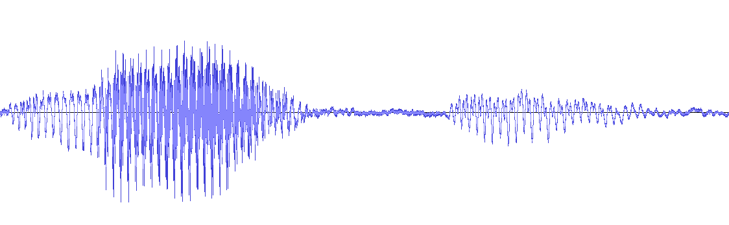
Experimental Framework
The features correspond to the IS2013 ComparE feature set (6,373 features)
Architecture of the network
2, 4 or 6 layers
256, 512 and 1024 nodes per layer
Output of DNN is a prediction score for arousal, valence or dominance
Batch normalization to normalize the output of each layer
Trained for 1,000 epochs with early stopping
Concordance Correlation Coefficient (CCC) achieved on the validation set
Network parameters | Values
Activation | ReLU
Optimizer | SGD with momentum of 0.9
Learning rate | 0.001
Evaluation metric & cost function | Concordance Correlation Coefficient (CCC)
Linear unit
Fully connected layers
Fully connected layers

Slide 11
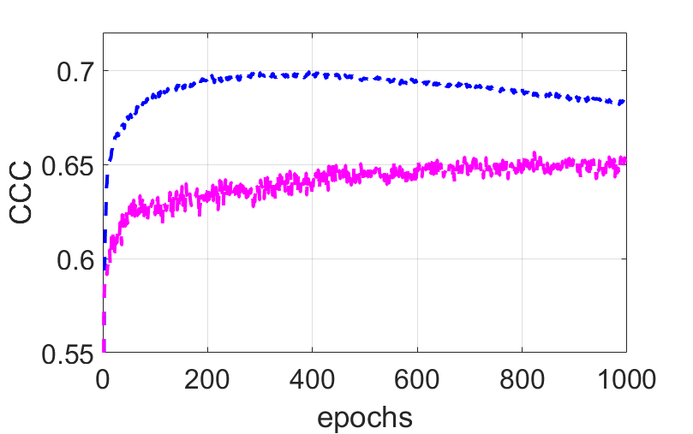
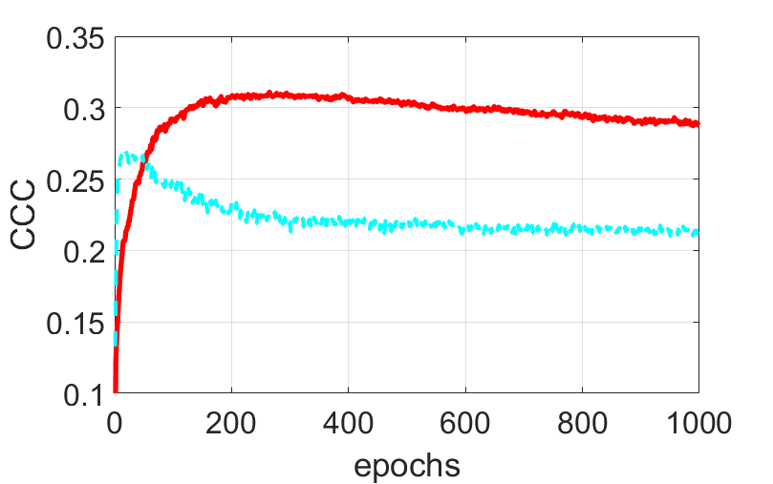
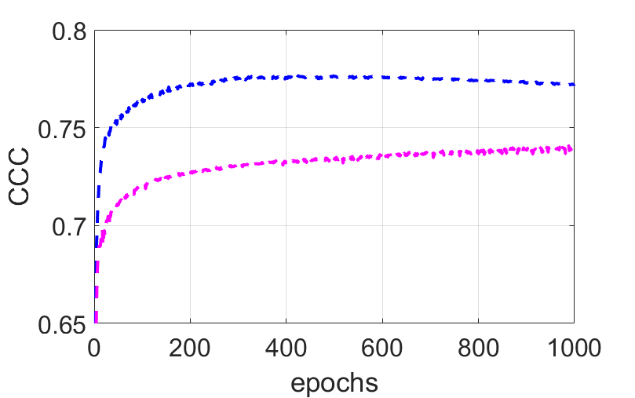
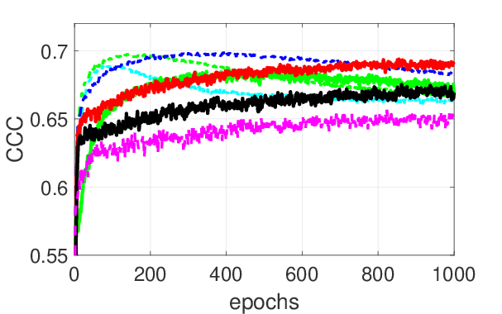
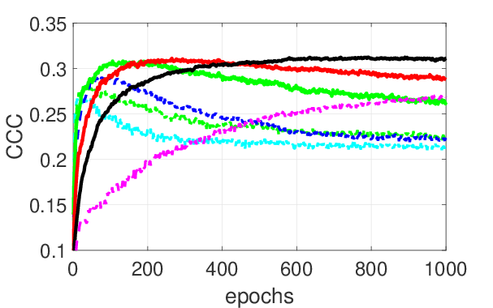
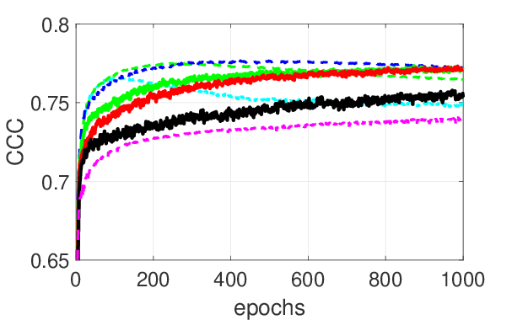
Analysis: Performance in Terms of Dropout
Valence – Test set
Arousal – Test set
Dominance – Test set
Two layers with 256 nodes
Results:
The optimum dropout rate:
Valence is in the range {0.7,0.8}
Arousal and dominance is in the range {0.4,0.5}

Slide 12
Analysis: Performance in Term of Nodes
DNN with two layers (256, 512, 1,024 nodes)
Average CCC values for p = 0.5 and p=0.7 over 10 trials
* indicate significant differences between both dropout rates (one-tailed t-test)
Results
Better performance for valence with p=0.7
Better performance for arousal and dominance with p=0.5
 |  | Test set
Attributes | Nodes | P = 0.5 | P = 0.7
Valence | 256 512 1024 | 0.2903 0.2870 0.2841 | 0.3102* 0.3080* 0.3009*
Arousal | 256 512 1024 | 0.7733* 0.7717* 0.7691* | 0.7577 0.7525 0.7472
Dominance | 256 512 1024 | 0.6936* 0.6902* 0.6888* | 0.6733 0.6617 0.6523

Slide 13
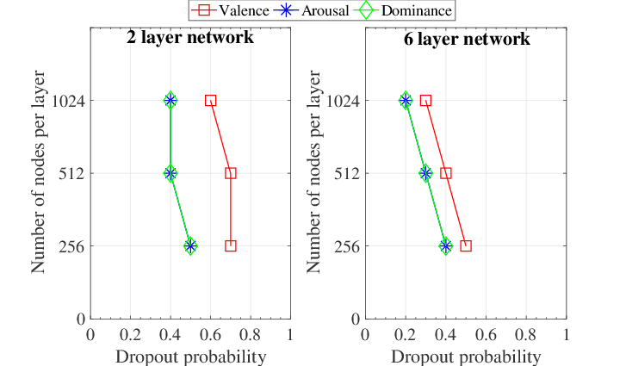
Analysis: Optimal Dropout Rate (# Nodes)
DNNs with two or six layers
256, 512 or 1,024 nodes
Dropout on all layers
Results:
Optimal dropout rate for arousal and dominance are the same across conditions
Optimal dropout rate decreases as the network is implemented with more nodes
Gap between optimal dropout rate for valence and arousal/dominance is consistent

Slide 14
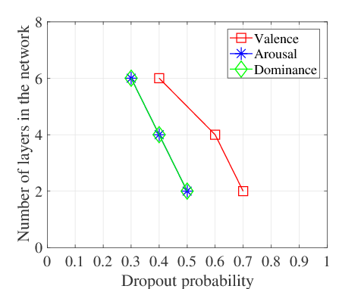
Analysis: Optimal Dropout Rate (# Layers)
DNNs with two, four or six layers
256 nodes
Results:
Optimal dropout rate decreases as the network is implemented with more layers
Gap between optimal dropout rate for valence and arousal/dominance is consistent

Slide 15
Why Does Valence Need Higher Dropout?
Hypothesis:
Speaker dependent nature of emotional cues
When heavily regularized, the network learns features that are consistent across all speakers
It places less emphasis on speaker dependent traits
Experiment to validate this hypothesis
Compare DNNs trained on speaker dependent and independent train-test partitions
Speaker dependent predictors should lead to higher performance gain for valence
They learn patterns from target speaker
Train Partition
Test Partition
Speaker 1
Speech from different speakers
Sp1
Sp1
Sp2
Sp2
Speaker 2
Speaker n
Sp n
Sp n
Train Partition
Test Partition
Speech from different speakers
Sp1
Speaker
independent
Sp2
Sp n
Train Partition
Test Partition
Speaker
dependent
Speech from different speakers
Sp1
Sp1
Sp2
Sp2
Sp n
Sp n

Slide 16
Speaker dependent vs independent conditions
 |  | Speaker Independent | Speaker Dependent | Gain (%)
Attributes | Nodes | Test | Test | Test
Valence | 256 512 1024 | 0.2906 0.2835 0.2880 | 0.3761 0.3686 0.3600 | 29.42 30.01 28.57
Arousal | 256 512 1024 | 0.7712 0.7720 0.7688 | 0.7885 0.7813 0.7800 | 2.24 1.20 1.45
Dominance | 256 512 1024 | 0.6901 0.6837 0.6782 | 0.7051 0.7052 0.7005 | 2.17 3.14 3.28
DNNs with two layers
Results:
Important performance gain for valence in speaker dependent condition (~30%)
Performance gain is not as high for arousal and dominance
Significant gap in performance validates our hypothesis that valence is expressed with more speaker dependent cues

Slide 17
Final Remarks
Predicting valence from speech requires a higher dropout rate than arousal or dominance
Optimal dropout rate is consistently higher for valence across different network configuration
Discriminative acoustic features for detecting valence vary across speakers
Dropout regularizes the network to learn consistent patterns across speakers
Take home message:
Valence imposes challenges that should be carefully considered
Optimal parameters are not necessarily the same as the ones for arousal or dominance

Slide 18
Future Directions
Evidence from Speaker dependent experiments – leveraging information learned from train speakers to personalize to target speakers.
Using techniques like model adaptation or weighting to achieve personalization.

Slide 19
Questions ?
This work was funded by NSF CAREER award IIS-1453781
MSP Lab UT Dallas

Slide 20

MSP-Podcast database
Audio sharing website
Duration filter
Podcast Audio
16kHz, 16b PCM, Mono
Diarization
2.75s<…<11s
SNR filter
Music detection
Perceptual Evaluation
Manual screening
Emotion retrieval
Remove telephone quality
Speech only audio
High quality audio
Collection of audio recordings^{[1]} (Podcasts)
Naturalness and the diversity of emotions
Creative Commons copyright licenses
Duration between 2.75s – 11s
Perceptive evaluation of emotional content
[1] Reza Lotfian and Carlos Busso, "Building naturalistic emotionally balanced speech corpus by retrieving emotional speech from existing podcast recordings," IEEE Transactions on Affective Computing

Slide 21
Data Collection
Podcast Audio
16kHz, 16b PCM, Mono
Audio sharing websites: Collect podcasts from websites like soundcloud.com, archive.org, vimeo.com & youtube.com with creative commons license.
To increase the diversity of the corpus, we choose podcasts from different fields like entertainment, sports, politics, news, interviews,…etc.,
Podcasts are converted to mono channel having 16KHz sampling rate and 16-bit PCM

Slide 22
Segmentation
Duration filter
Diarization
2.75s<…<11s
Podcast lengths vary and some have multiple speakers, to have short segments (between 2.75s and 11s) with single speaker per segment, we diarize the podcasts.
Diarization tool: videoindexer.ai
This diarization tool gives information about speaker IDs, transcripts for the audios and percentage of different categorical emotional content.
The diarization helps to segment the podcasts into short chunks of length between 2.75s and 11s with single speaker per segment.

Slide 23
Filtering….
After diarization
SNR filter
Music detection
Remove telephone quality
Speech only audio
High quality audio
After diarization, we pass the segments through a filtering pipeline.
At first, we filter out the segments with background noise, silent samples and bad quality audios by looking at the SNR of the audio signals.
The bad quality samples are often with low energy (less than 8KHz, 4KHz telephone), which are removed by putting a threshold on the SNR value at 20dB.
The diarization tool cannot distinguish between clean and noisy or speech with music, so we use a SVM classifier to detect music by analyzing the spectrum of the audio signal represented by pyknogram patterns.

Slide 24
Retrieval
Perceptual Evaluation
Manual screening
Emotion retrieval
The filtered segments are now passed through an emotion retrieval process.
We use multiple algorithms for emotion retrieval:
A 2-layer neural network emotion classifier (classify with respect to categorical attributes)
RankNet (predict in the arousal, valence, dominance dimension)
Based on lexical content : The Stanford Parser (Input the ASR transcripts of each segment → output the emotional content)
Emotion Classifier with reject options (Selective Guaranteed Risk Algorithm, putting thresholds on the predicted class distributions) → select or reject samples based on their level of difficulty or uncertainty.
The next step is manual screening – The cleaning and retrieval pipeline is not perfect and sometimes a few spurious samples may be accepted, so even after the automated process of cleaning and retrieval, we double check the retrieved segments for noise, background music, bad language and overlapped speech by listening to each of them and selecting the ones which are emotional in nature.

Slide 25
Perceptual Evaluation
The final step is the annotation process.
We annotate the clean segments on a crowd-sourcing platform called Amazon Mechanical Turk (AMT).
Each audio is annotated with a questionnaire format:
Self Assessment Manikins (SAMs) are used to annotate the activation, valence and dominance content of the segments on a seven point likert scale. The annotators are asked to evaluate how active or calm, pleasant or unpleasant, dominant or submissive the speaker is on the audio clip. This is transformed into numbers in the range 1 to 7. These become the dimensional attribute labels for the segment.
The annotators are also asked to choose the primary and secondary emotional content of the audio clip by choosing from a bunch of options. These become the primary and secondary labels for the segment.
The final annotated audio segments are incorporated into the MSP-Podcast database.

