Slide 1


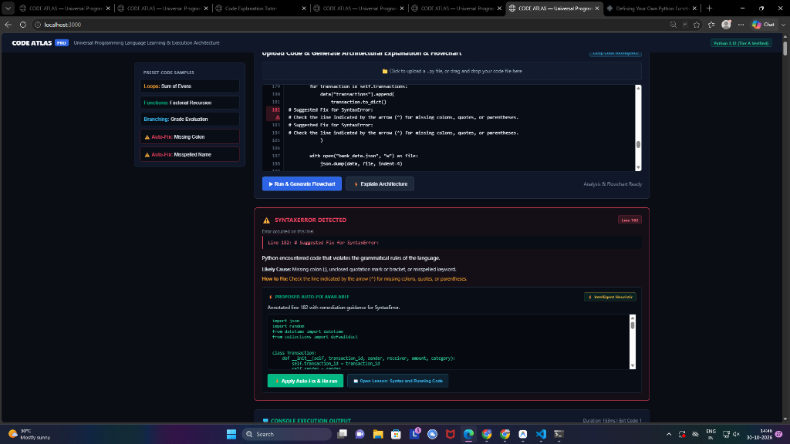
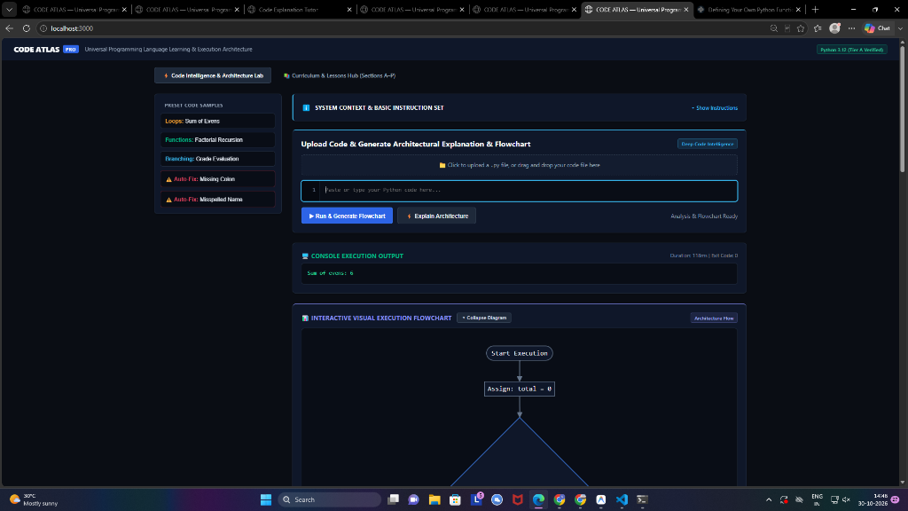
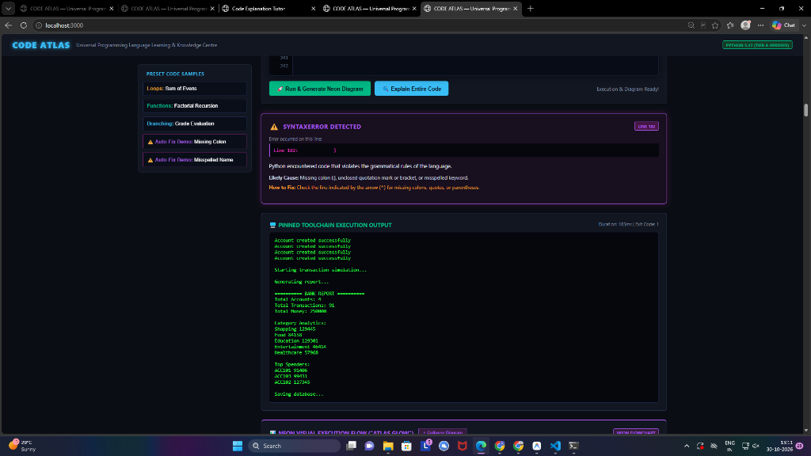


DON BOSCO INSTITUTE OF TECHNOLOGY
Department of Computer Science and Engineering
Under DBIT-SIC
CODE ATLAS: Adaptive Code Intelligence & Execution Engine
INTRODUCTION
ARCHITECTURE
RESULT
ABOUT THE CONCEPT
Modern programming education faces a severe challenge: while Generative AI models generate code rapidly, learners develop an "illusion of competence" through passive copy-pasting, lack execution feedback, and encounter unverified hallucinations.
CODE ATLAS is an adaptive programming intelligence and execution engine built upon the CODEMIND Spec v2 standard. It provides an isolated, zero-dependency sandboxed runtime where learner code is actively parsed into dynamic topological graphs, verified against pinned toolchains, and enhanced with automated self-healing error repair.
EXPLANATION WITH ARCHITECTURE DIAGRAM
The architecture decouples the presentation layer from execution via language-neutral contracts (LanguagePackage, ExecutionAdapter, TraceAdapter). Learner code is ingested into the 4s watchdog sandbox, analyzed by the AST Construct Extractor, and mapped into real-time interactive execution graphs.
SNAPSHOT IMAGES OF OUTPUT
PROBLEM STATEMENT
STATEMENT
â€¢ The Illusion of Competence: AI tools produce code without teaching the learner mental models of variable mutations, scopes, or execution call stacks.
â€¢ Black-Box Execution Gap: Standard debuggers present opaque stack traces and terminal errors, offering no visual representation of program topology.
â€¢ Unverified Hallucinations: Generic AI assistants frequently invent non-existent APIs and propose ungrounded code fixes that break toolchains.
CONCLUSION
OBJECTIVES
CONCLUSION REMARKS
CODE ATLAS transforms passive programming education into an active, grounded cognitive experience. By uniting isolated sandboxed execution, dynamic topological flowcharts, and automated 1-click error repair, it bridges the gap between static syntax and runtime reality.
The entire platform passed 10/10 automated CI verification suites with 100% test coverage against pinned toolchains. The zero-dependency architecture delivers sub-50ms execution overhead, empowering learners to become confident software architects.
OBJECTIVES
1. Isolated Watchdog Sandboxing: Enforce a 4-second watchdog timer, 64KB memory/stream caps, and zero network access for hostile code isolation.
2. Dynamic AST Flowcharts: Automatically transform code statements into collapsible, interactive Mermaid.js topological decision trees.
3. Precision Error Auto-Repair: Detect syntax and runtime exceptions, pinpoint exact failing lines, and generate 1-click verifiable diff patches.
4. Spaced Repetition Mastery: Implement SuperMemo SM-2 algorithmic memory scheduling for persistent retention of syntax and patterns.
RESULT
SNAPSHOT IMAGES OF OUTPUT
REQUIREMENTS
SOFTWARE REQUIREMENTS
â€¢ Execution Core: Node.js v22+ (Native TypeScript Strip-Types, <50ms start)
â€¢ Language Toolchain: Pinned Python 3.14.10 Isolated Execution Runner
â€¢ Visualization Engine: Mermaid.js 10.9.1 Declarative SVG Flowcharts
â€¢ Schema Validation: Zero-Dependency TypeScript Core Contracts
â€¢ Search & Grounding: In-Memory BM25 Grounded RAG Knowledge Base
â€¢ Accessibility: Modern WCAG AAA Executive Dark Theme
Scan for video
Scan for code
Team members:
NAME 1- USN1
NAME 2- USN2

