Slide 1



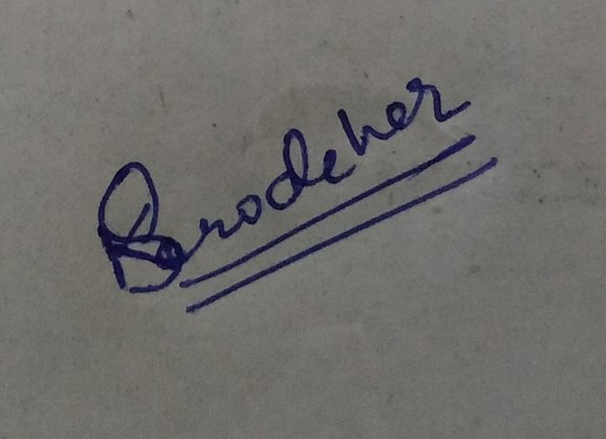
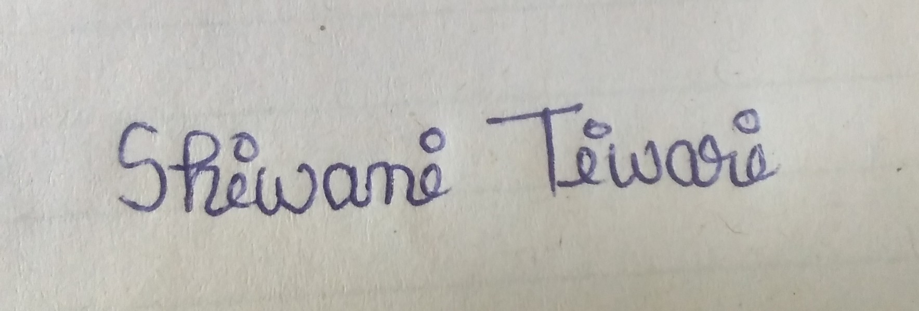
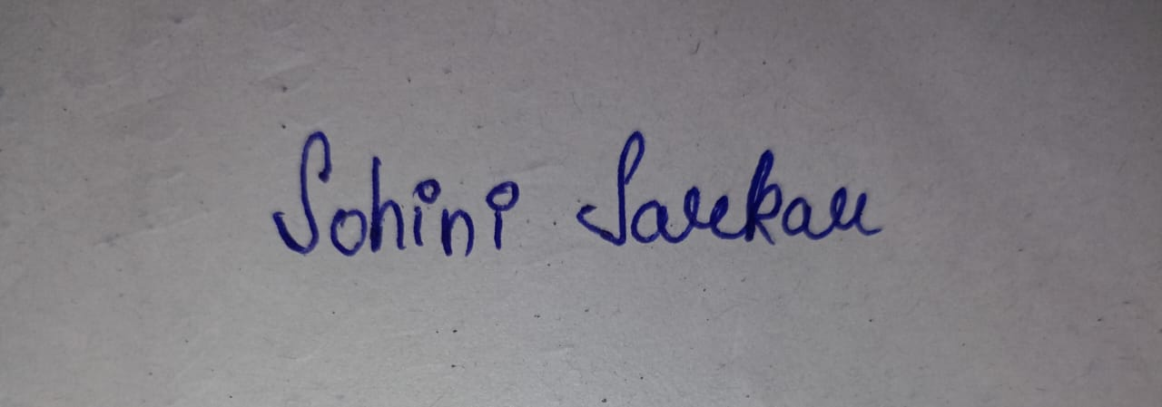
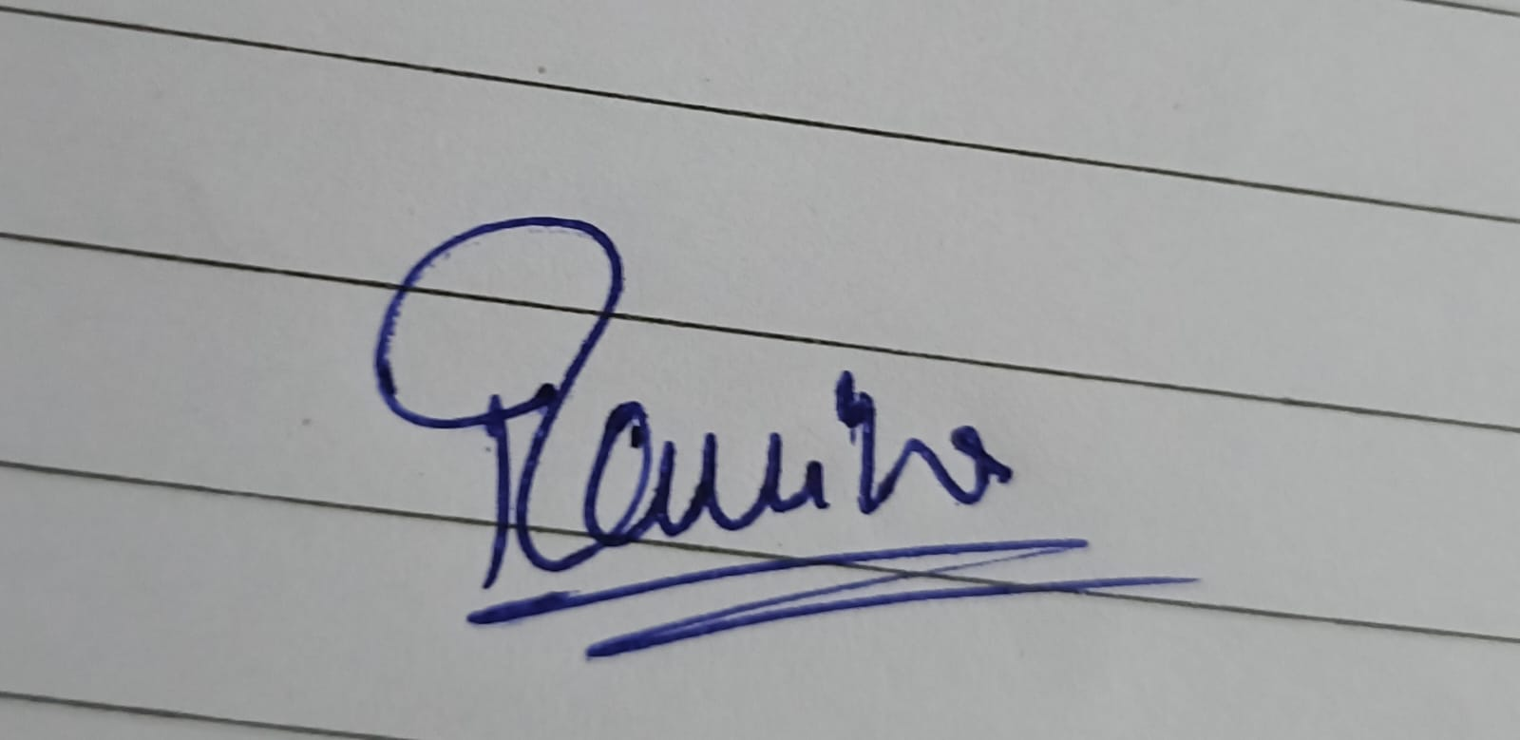
AI-Powered Driver Drowsiness Detection System
Milestone 1 Presentation
Team: Kushagra, Shiwani, Sohini, Shubham, Ravina

Slide 2

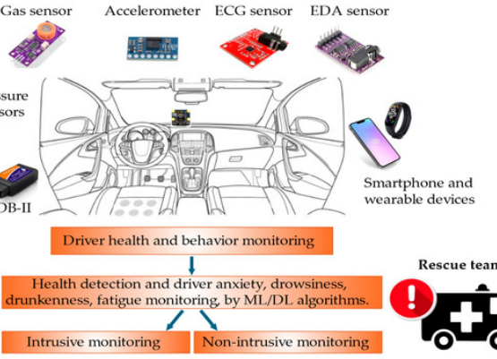
PROBLEM & MOTIVATION
Safety Crisis on Roads
■
Night & Long-haul Safety: Driver fatigue is a leading cause of fatal accidents in commercial transport.
■
Urbanization Trends: Increasing cab and private vehicle usage demands automated alertness monitoring.
■
Proactive Warnings: The system aims to provide an additional safety layer before fatigue becomes dangerous.

Slide 3





SCOPE & STAKEHOLDERS
Hardware Scope
Stakeholders
Exclusions
Prioritizing Dashboard/Embedded Cameras over smartphones to avoid battery drain and multitasking interference.
Logistics agencies, cab owners, bus operators, and individual drivers aiming for highway safety parameters.
Out of Scope: Real-car mechanical braking integration, mobile application development, and cloud dashboards.

Slide 4
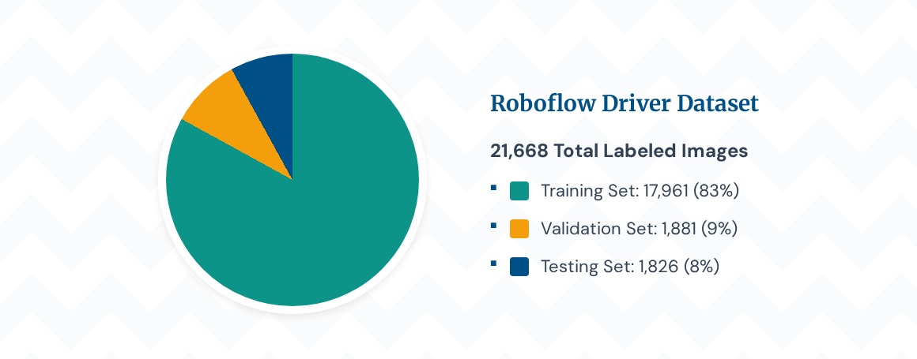
DATASET UNDERSTANDING

Slide 5



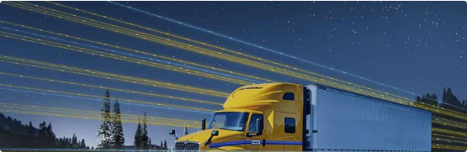
CLASSES & HORIZON
Next Steps: Temporal Data
Integrating video frameworks for sequence validation in Milestone 2:
■
NTHU Dataset: For sequence tracking and varied lighting profiles.
Class Distribution
■
Open Eyes: 9,510 objects
■
YawDD Dataset: For specialized continuous yawning validation.
■
Yawn States: 7,196 objects
■
Closed Eyes: 6,804 objects

Slide 6
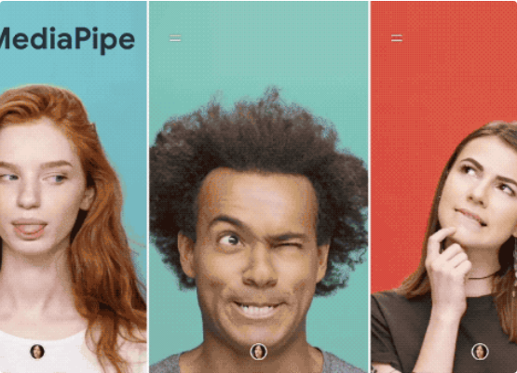
RULE-BASED: MEDIAPIPE
Facial Landmark Logic
■
EAR (Eye Aspect Ratio): Calculating distances between vertical eyelid points to isolate blinks and closures.
■
MAR (Mouth Aspect Ratio): Monitoring vertical lip separation to identify distinct yawning trends.
■
OpenCV: Real-time frame processing and handling runtime threshold overlays.

Slide 7






PERCLOS & POSE LOGIC
PERCLOS
Head Pose
Limitations
Tracking the percentage of eye closure over time to filter out standard, rapid blinks from genuine fatigue.
Detecting nodding or slumping events by measuring head tilt (pitch/yaw) indicating fatigue.
Fixed ratios lose accuracy during lighting shifts, camera angle offsets, or when drivers wear eyewear.

Slide 8
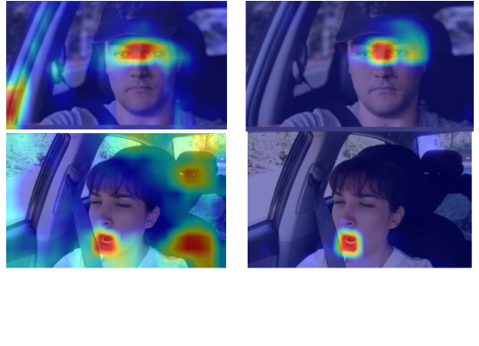
DEEP LEARNING: YOLO
Robust State Identification
■
Direct Classification: Detecting Closed Eye or Yawn boxes directly from raw pixels.
■
Resiliency: Convolutional weights adapt better to cabin noise, obstructions, and low lighting.
■
Models: Utilizing YOLOv8n or YOLO11n for high FPS on dashboard hardware.

Slide 9






PROPOSED HYBRID PIPELINE
Proposed Paradigm: Landmark precision cross-checked against YOLO detections, smoothed by temporal sliding windows for reliable, real-time alerts.

Slide 10
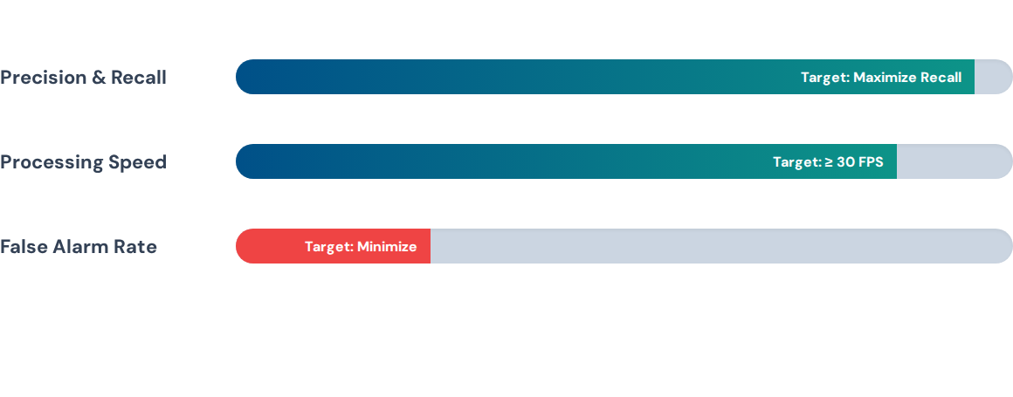
EVALUATION METRICS
Testing via mAP layers and tracking stability over time using balanced F1-scores.

Slide 11




TESTING & ALERTS
Environments
Alert Logic
Expected Output
Validating across lighting challenges, tunnel simulations, eyewear variations, and deep angle changes.
Stage 1: Alert State (Green) Stage 2: Mild Fatigue (Orange Visual) Stage 3: Drowsy Warning (Red Audio)
Continuous fatigue score log records paired with immediate onscreen tracking overlays.

Slide 12
REFERENCES
■
Roboflow Driver Drowsiness Public Dataset Engine Hub (2024)
■
MediaPipe Face Mesh Processing Framework - Google Engineering
■
Ultralytics YOLO Framework Architecture Repository
■
Soukupova & Cech: Real-Time Eye Blink Detection (EAR Reference)
Thank You!
Questions? | Milestone 1 Final Presentation

