Slide 1

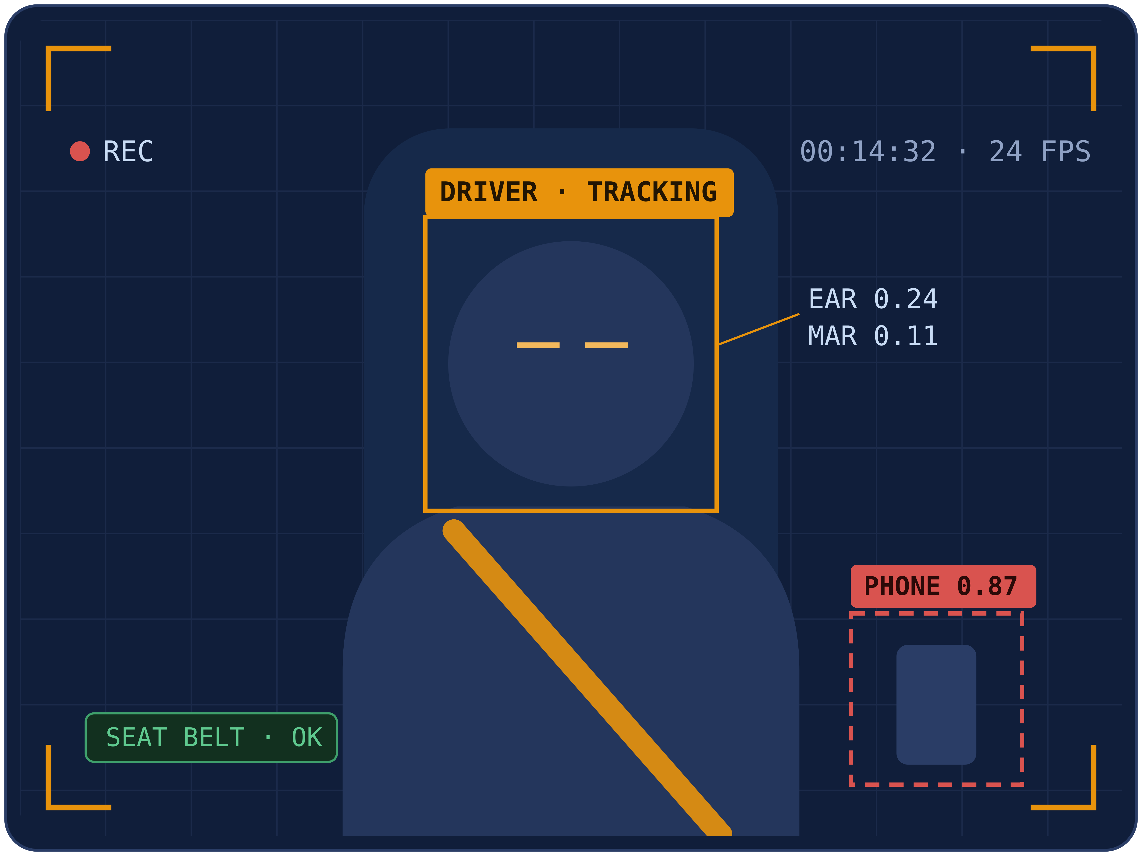
BSDA4001
DS/AI LAB COURSE· MILESTONE 1
AI-Powered Driver Wellness and Safety Monitoring System
Beyond drowsiness detection — a video-based, multi-model driver safety system with temporal deep learning, object-level compliance and trip intelligence.
LIVE MONITORING CONCEPT — dash-camera view with real-time detections
Kushagra
Shiwani
Sohini
Shubham
Ravina
Revised project direction after Milestone 1
01 / 15
Notes:
Introduce the team and the revised project title. Explain that Milestone 1 feedback pushed the project from a basic drowsiness detector toward a full driver wellness and safety monitoring system. Set the agenda: problem, data, models, architecture, and evaluation.

Slide 2
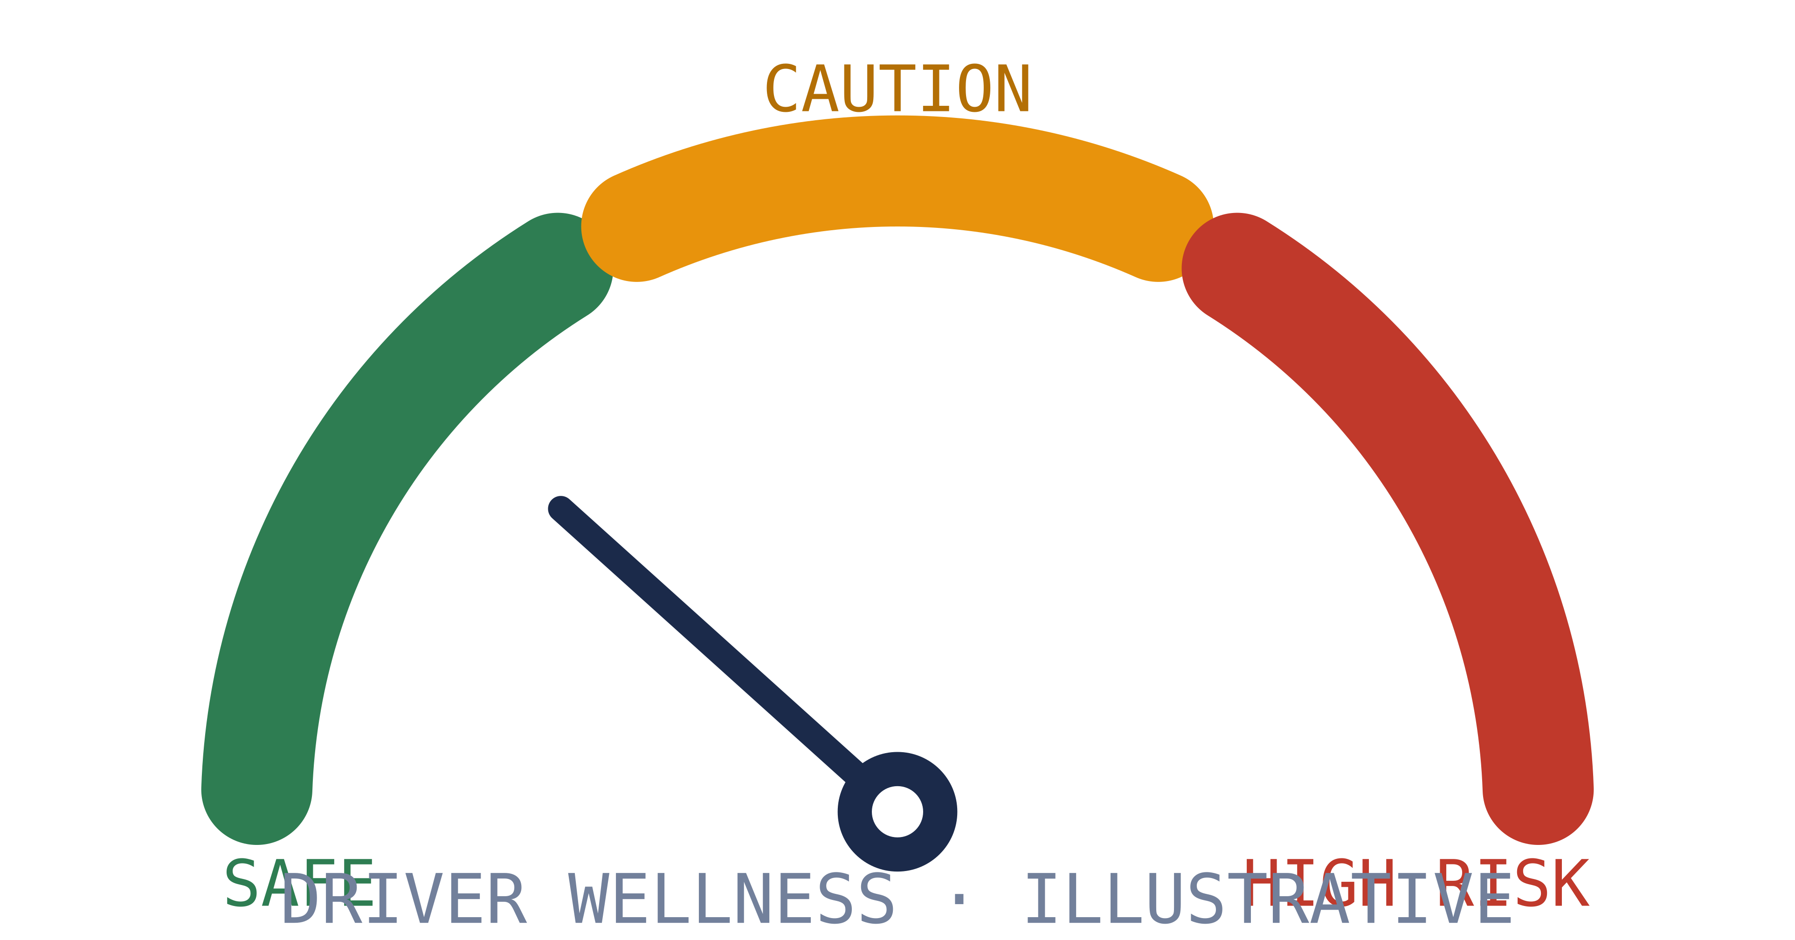
02 · INTRODUCTION
One System for the Whole Driver State
Monitors overall driver state from continuous video
Moves beyond a basic drowsiness detector
Detects fatigue, distraction, seat belt, phone, smoking, drinking
Tracks head pose and gaze-away behavior
Fuses module outputs into one driver wellness score
Generates trip-level and weekly/monthly driver reports
The end product: every module feeds a single, continuously updated driver wellness state.
16–64
10
3
SAFE · CAUTION · HIGH RISK
FRAME SEQUENCE WINDOWS
SYSTEM OUTPUTS
RISK LEVELS
AI-POWERED DRIVER WELLNESS & SAFETY MONITORING · MILESTONE 1
02 / 15
Notes:
Fatigue is a time-based condition: slow blinks, prolonged closures, yawning and nodding only show up across frames. A driver can look normal in one frame, so the system analyzes continuous video. Outputs feed a wellness score and trip reports for drivers, fleets, cab agencies and logistics operators.

Slide 3


03 · PROBLEM STATEMENT
Single Frames Cannot Explain Fatigue
Goal: real-time, video-based monitoring of fatigue, distraction, unsafe behavior and safety compliance.
WHY THE OLD APPROACH FAILS
THE REVISED SYSTEM
Single frames: a blink and drowsiness look identical
Learns fatigue as it develops across video sequences
Static frame counts and hardcoded thresholds
CNN-LSTM, CNN-GRU, TCN or lightweight 3D CNN
MediaPipe/OpenCV: auxiliary features, not decision logic
Talking, singing or laughing trigger false alerts
YOLO reserved for object-level safety tasks
Frame-level YOLO has no sense of time
Fusion layer → Safe / Caution / High Risk
AI-POWERED DRIVER WELLNESS & SAFETY MONITORING · MILESTONE 1
03 / 15
Notes:
The old frame-level YOLO plus fixed thresholds could not separate a blink from drowsiness, causing false alerts on talking or laughing. The revised system learns temporal patterns from video sequences, keeps MediaPipe as an auxiliary feature extractor, and reserves YOLO for object-level tasks. A fusion layer classifies the driver as Safe, Caution or High Risk.

Slide 4



04 · MOTIVATION
Why This Project, Why Now
01
02
03
Road safety need
Course learning goals
Practical relevance
Fatigue drives crashes on night and long-distance routes
Drowsiness is not the only unsafe state
Phone use, missing seat belt, smoking, gaze-away
Full ML lifecycle, not plug-and-play detection
Dataset collection, EDA, video preprocessing
Sequences, training, evaluation, local deployment
Fleets monitor wellness and risky behavior
Cab agencies and logistics: safer operations
Drivers get early warnings; reports reveal trends
AI-POWERED DRIVER WELLNESS & SAFETY MONITORING · MILESTONE 1
04 / 15
Notes:
Three motivations: road safety impact, course learning goals, and practical relevance. The revised scope forces the complete ML lifecycle instead of a plug-and-play detector. Fleets, cab agencies, logistics companies and individual drivers can all use the outputs.

Slide 5
05 · SCOPE & BOUNDARIES
What We Build — and Deliberately Don't
IN SCOPE
OUT OF SCOPE
Video-based fatigue detection with temporal models
Real-car braking, steering or vehicle control
Landmark temporal features via MediaPipe/OpenCV
Certified commercial safety product
Distraction and driver activity classification
Production hardware or cloud fleet platform
YOLO: seat belt, phone, smoking, drinking
Full mobile application development
Wellness score, event logs, trip reports
Medical diagnosis of the driver
Local dashboard demo + full dataset lifecycle
ECG, EEG or other physiological sensors
Academic prototype — video and computer-vision based, not a certified safety system
AI-POWERED DRIVER WELLNESS & SAFETY MONITORING · MILESTONE 1
05 / 15
Notes:
Scope is an academic software prototype using recorded datasets, uploaded videos and a local webcam, framed for a dash-cam style deployment. We explicitly exclude vehicle control, certified products, hardware or cloud deployment, and any physiological sensing or medical diagnosis.

Slide 6







06 · STAKEHOLDERS
Who Benefits From Safer Drivers
Drivers
Passengers
Cab agencies
Logistics & trucking
Warnings for fatigue, distraction, seat belt, unsafe behavior
Safer rides through earlier driver warnings
Safety patterns during rides and night operations
Fatigue tracking on long-distance transport
DIRECT USERS
drivers & vehicle operators
INDIRECT
passengers, fleets, road-safety stakeholders
Bus operators
Fleet owners
Safety reviewers
Passenger safety on long and night routes
Wellness scores reveal risky driving trends
Logs expose repeated driver safety issues
AI-POWERED DRIVER WELLNESS & SAFETY MONITORING · MILESTONE 1
06 / 15
Notes:
Direct users are drivers and vehicle operators; passengers and road-safety stakeholders benefit indirectly. Fleet owners and agencies get wellness scores and trip reports to spot risky trends. Reviewers can use event logs to trace repeated safety issues.

Slide 7
07 · PROJECT OBJECTIVES
Ten Objectives, Three Phases
1
2
3
PHASE 01 — DATA FOUNDATION
PHASE 02 — MODEL DEVELOPMENT
PHASE 03 — SYSTEM & EVALUATION
1
Collect fatigue, distraction and safety datasets
4
Temporal fatigue: CNN-LSTM, CNN-GRU, TCN, 3D CNN
8
Fuse outputs into a driver wellness score
2
EDA: classes, balance, duration, lighting, quality
5
MediaPipe features: EAR, MAR, head pose, gaze
9
LLM trip reports from structured logs
3
Preprocess: frames, crops, fixed-length sequences
6
YOLO: seat belt, phone, smoking, drinking
10
Metrics: accuracy, F1, mAP, FPS, false alarms
7
Distraction CNN: MobileNetV3, EfficientNet-B0, ResNet18
AI-POWERED DRIVER WELLNESS & SAFETY MONITORING · MILESTONE 1
07 / 15
Notes:
Ten objectives grouped into three phases: data foundation, model development, and system plus evaluation. Emphasize that they cover the complete lifecycle — from dataset collection and EDA through fusion, reporting and metrics.

Slide 8
08 · DATA
Datasets: Collection and Understanding
DATASET | TYPE | PURPOSE
NTHU Driver Drowsiness | Driver video | Fatigue and drowsiness patterns from video sequences
YawDD | Yawning video | Continuous yawning and mouth-movement patterns
State Farm Distracted Driver | Activity images | Texting, drinking, reaching and safe-driving classes
Drive&Act | Multi-modal video | Fine-grained driver action recognition
DMD Driver Monitoring | Video, multi-modal | Distraction, gaze and drowsiness scenarios
Kaggle / Roboflow sets | Object detection | Seat belt, phone, smoking, drinking detection
EDA class balance · duration · FPS · lighting · annotation quality · usable splits
PREP face/upper-body crops → normalized 16/32/64-frame sequences → splits
Final selection depends on access, license, size and Google Colab feasibility.
AI-POWERED DRIVER WELLNESS & SAFETY MONITORING · MILESTONE 1
08 / 15
Notes:
Different modules need different data: video for fatigue, activity data for distraction, object-detection sets for compliance, while trip reports reuse our own structured logs. EDA checks balance, duration, lighting and annotation quality before committing. Final choices depend on access, licensing and what Colab can realistically train.

Slide 9
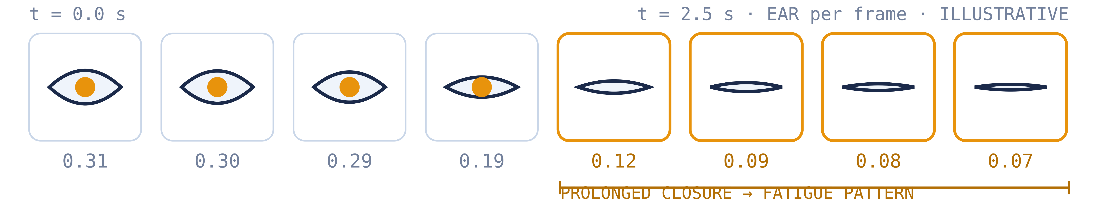
09 · CORE MODEL
Video-Based Fatigue Detection
WHY TEMPORAL MODELS
CANDIDATE MODELS
Blink vs drowsiness: identical in one frame
Open mouth: yawn, talk, laugh or sing?
Patterns: slow blinks, closures, yawns, nodding
CNN-LSTM — frame features + learned time behavior
CNN-GRU — similar, lighter and faster
TCN — efficient temporal patterns
3D CNN (light) — spatial + temporal jointly
CNN + Attention — focuses on key frames
FIRST BUILD → CNN-LSTM / CNN-GRU (Colab-feasible)
AI-POWERED DRIVER WELLNESS & SAFETY MONITORING · MILESTONE 1
09 / 15
Notes:
This is the core deep-learning component: sequences of 16 to 64 frames instead of isolated images. The strip shows how prolonged eye closure only becomes visible across frames. Candidates range from CNN-LSTM and CNN-GRU to TCN, lightweight 3D CNNs and attention; we start with CNN-LSTM or CNN-GRU as most feasible on Colab.

Slide 10
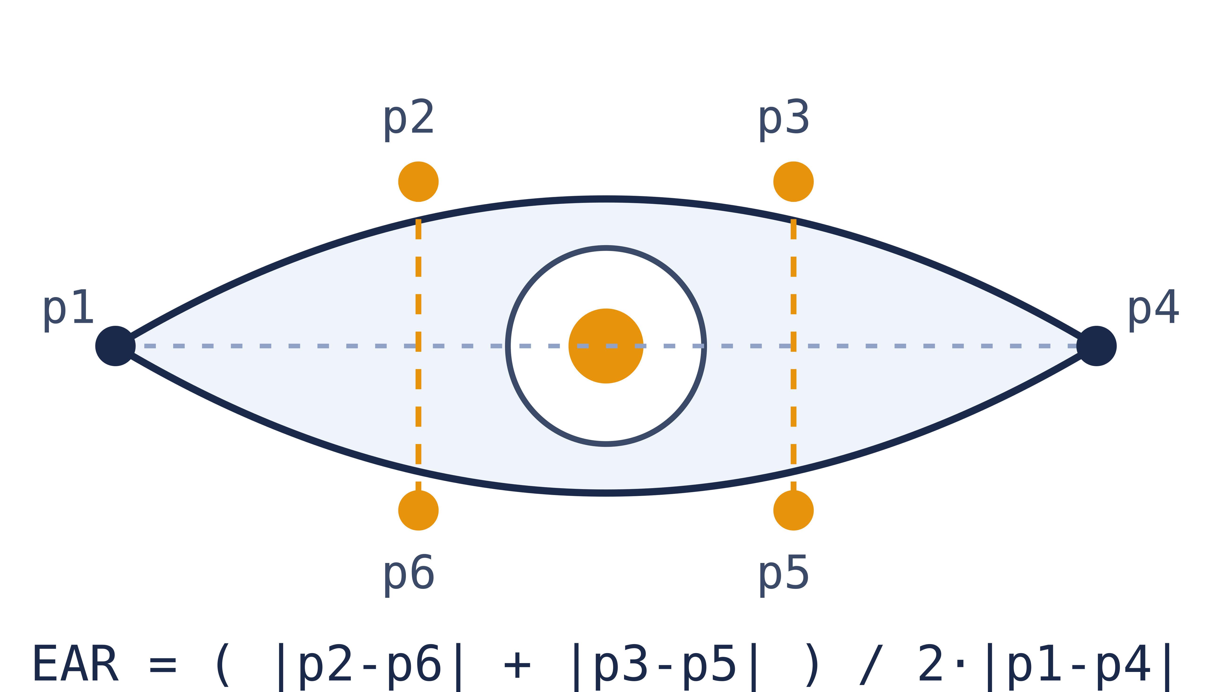
10 · INTERPRETABLE SIGNALS
Landmark-Based Temporal Features
EAR OVER TIME — ILLUSTRATIVE
Eye Aspect Ratio — six landmarks per eye (MediaPipe / OpenCV)
EAR
MAR
PITCH
YAW
Sequences → LSTM / GRU / TCN. Learned patterns replace fixed thresholds; EAR/MAR/pose trends make every prediction explainable.
ROLL
BLINK
GAZE
extracted per frame → time-series input
AI-POWERED DRIVER WELLNESS & SAFETY MONITORING · MILESTONE 1
10 / 15
Notes:
MediaPipe and OpenCV extract interpretable per-frame signals: EAR, MAR, head pose, blink pattern and gaze. The chart contrasts a brief blink dip with a sustained drowsiness episode — the shape over time is what matters. These time-series feed LSTM, GRU or TCN models and double as explainability behind each prediction.

Slide 11
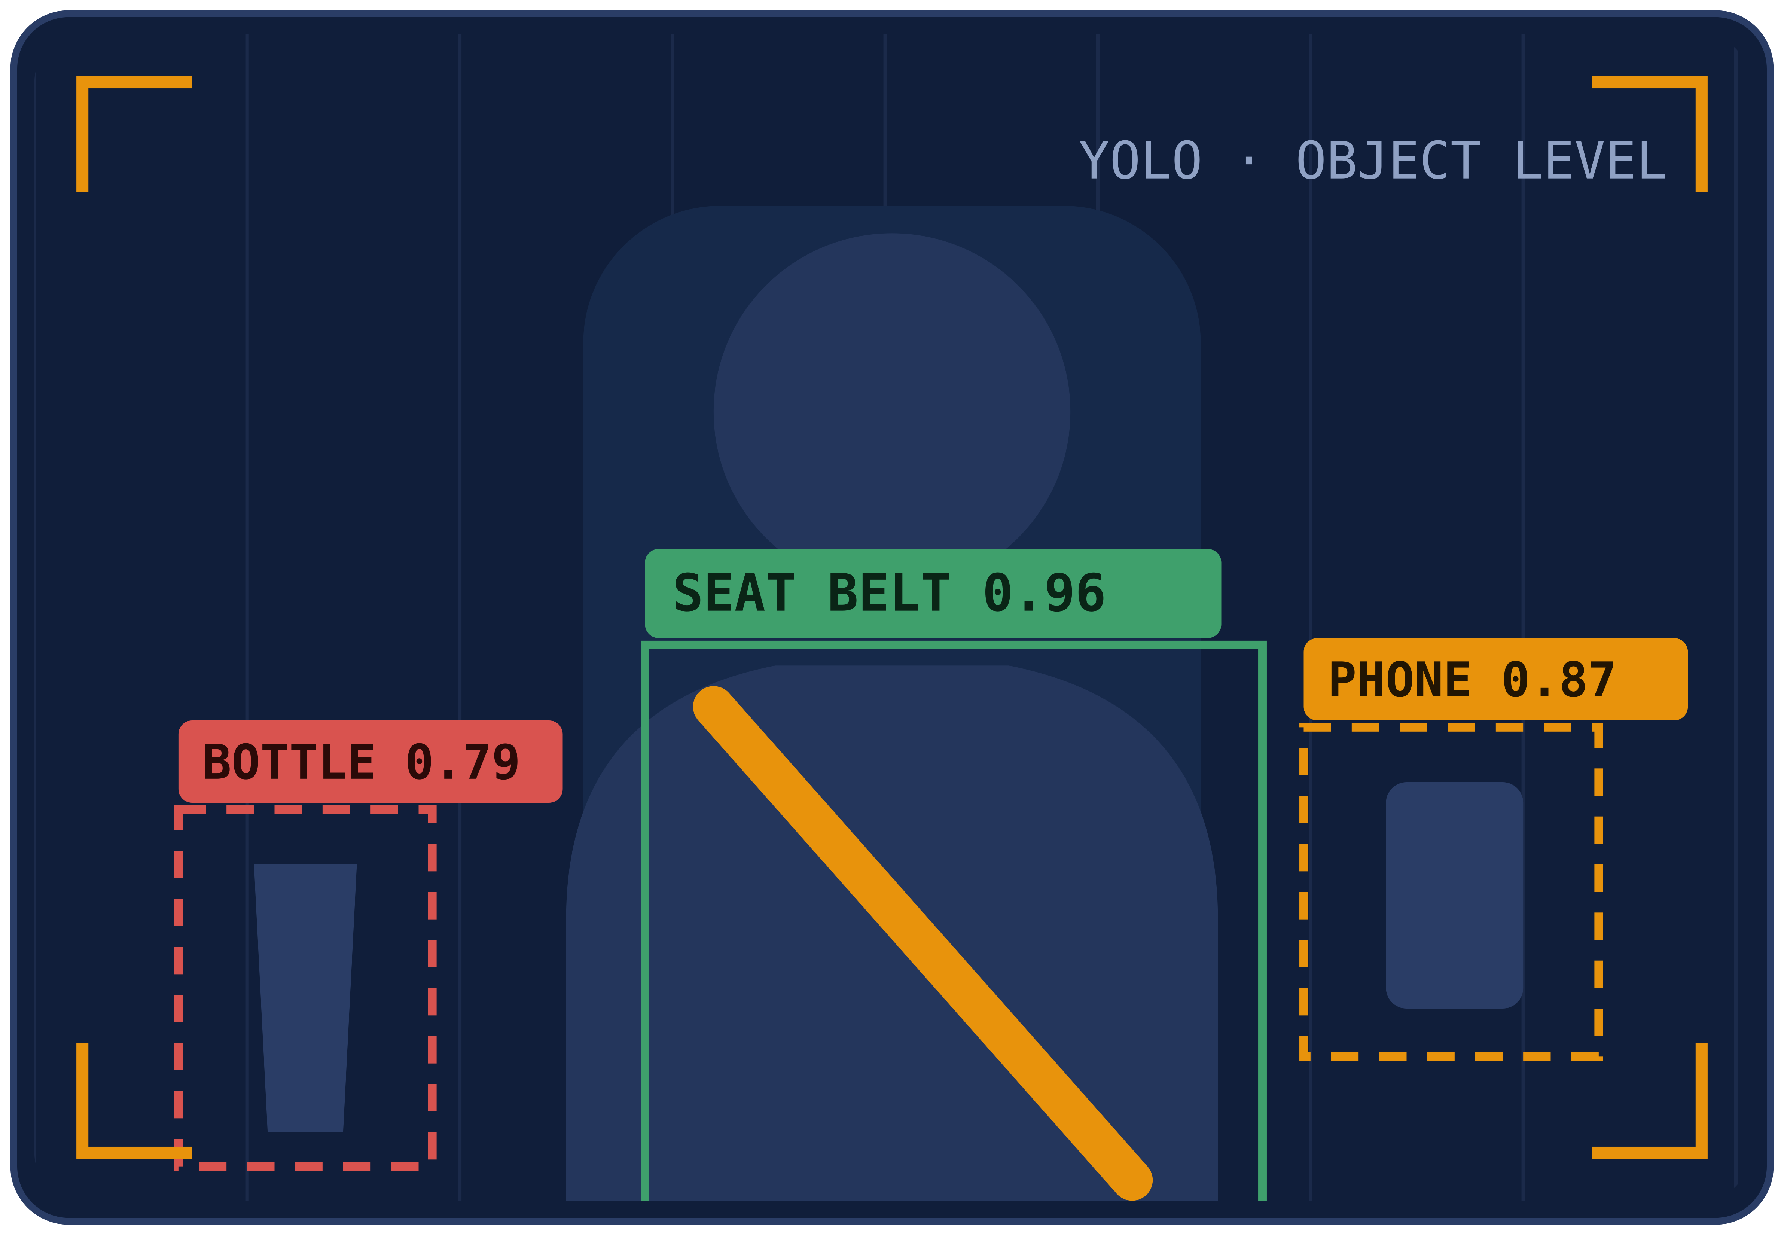
11 · SUPPORTING MODULES
Distraction and Object-Level Safety
DISTRACTION CLASSIFIER — CNN
Classes: texting, phone call, drinking, reaching, radio, grooming
Plus a safe-driving baseline class
Models: MobileNetV3, EfficientNet-B0, ResNet18
CNN-LSTM upgrade if video/action data available
Image baseline first, temporal upgrade later
Seat belt · phone · smoking · drinking — YOLOv8n / YOLO11n
Objects are frame-visible — YOLO fits there; fatigue stays video-sequence based
AI-POWERED DRIVER WELLNESS & SAFETY MONITORING · MILESTONE 1
11 / 15
Notes:
Distraction uses a lightweight CNN classifier over classes like texting, phone calls, drinking and reaching, starting from an image baseline. YOLO handles frame-visible objects: seat belt, phone, cigarette, bottle. YOLO never decides fatigue on its own.

Slide 12
12 · SYSTEM DESIGN
Proposed Architecture — Multi-Branch Pipeline
MULTI-BRANCH ANALYSIS
Temporal Fatigue Model
Video Input
webcam · recorded
Preprocessing
frames · crops · sequences
Fusion
combine signals
Wellness Score
Safe · Caution · High Risk
Alerts + Trip Report
logs · LLM summary
Landmark Features
Distraction CNN
YOLO Object Detection
WHAT CHANGED FROM THE OLD DESIGN
Frame-level YOLO → video-sequence temporal modeling
Hardcoded thresholds → learned fatigue patterns
Drowsiness-only → full wellness monitoring + reporting
AI-POWERED DRIVER WELLNESS & SAFETY MONITORING · MILESTONE 1
12 / 15
Notes:
Walk the pipeline left to right: input, preprocessing, four parallel analysis branches, fusion, wellness score, then alerts and reporting. Highlight the shift from frame-level rules to learned temporal modeling, and the new reporting layer that did not exist in the old design.

Slide 13
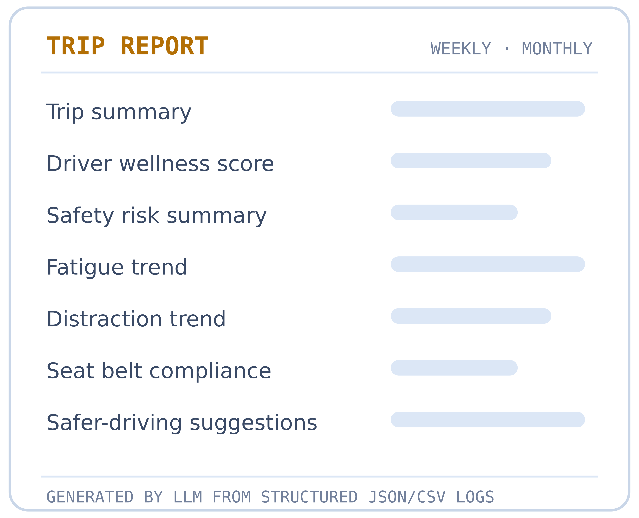
13 · OUTPUT LAYER
Wellness Score and Trip Reports
DRIVER WELLNESS SCORE
TRIP REPORTS — LLM LAYER
Inputs: fatigue state, landmark trends, distraction class
Plus seat belt, unsafe objects, gaze direction
LLM reads structured JSON/CSV logs — never raw video
Llama 3.3 70B via API; smaller model for local demo
Add-on layer — never replaces the ML models
Safe — driver behavior appears normal
duration · events
violations · state
times → summary,
trends, compliance,
suggestions
Caution — mild fatigue or distraction detected
High Risk — strong fatigue or multiple risk signals
Shown on the dashboard · stored in trip logs
AI-POWERED DRIVER WELLNESS & SAFETY MONITORING · MILESTONE 1
13 / 15
Notes:
All module outputs fuse into one wellness score with three levels: Safe, Caution and High Risk. Trip reports are an add-on LLM layer reading structured JSON or CSV logs — never raw video. Reports summarize trips, trends and compliance, and suggest safer driving.

Slide 14
14 · RIGOR
Evaluation Plan and Testing
METRICS BY MODULE
TESTING SCENARIOS
Fatigue
Accuracy, precision, recall, F1, confusion matrix, sequence-level accuracy
Lighting
Driver
bright · low light · night-like · backlight
glasses · sunglasses · varied camera angles
Priority
High recall — missed fatigue is dangerous; precision limits alert fatigue
Object detection
mAP, precision, recall, class-wise accuracy, inference FPS
Behavior
Compliance
blinks · closure · yawning · talking · laughing · look-away
phone use · drinking · seat belt on / off
Real-time
FPS, latency, inference time, local webcam demo performance
False alarms
Talking ≠ yawning · blink ≠ fatigue · mirror check ≠ distraction
Tested on recorded videos and live local webcam
AI-POWERED DRIVER WELLNESS & SAFETY MONITORING · MILESTONE 1
14 / 15
Notes:
Each module gets its own metrics; recall is prioritized because missed fatigue is dangerous, while precision keeps alerts trustworthy. Real-time viability is judged by FPS and latency on the webcam demo. Testing spans lighting conditions, eyewear, natural behaviors and compliance scenarios.

Slide 15
15 · CLOSING
Team and References
Kushagra
Shiwani
Sohini
Shubham
Ravina
Revised scope, architecture, documentation, integration planning
Dataset collection, dataset EDA, video data preparation
Landmark features, metrics validation, documentation review
Deep learning model design, temporal pipeline, YOLO modules
Evaluation plan, testing scenarios, reporting review
DATASETS NTHU · YawDD · State Farm · Drive&Act · DMD
TOOLS MediaPipe · OpenCV · Ultralytics YOLO
RESEARCH CNN-LSTM / GRU, TCN, 3D CNN · EAR, MAR, PERCLOS, head pose
REPORTING Llama / open-source LLM documentation
From drowsiness detection to complete driver wellness monitoring.
15 / 15
Notes:
Close with responsibilities across the five members and the key datasets, tools and research areas referenced. End on the one-line takeaway: from drowsiness detection to complete driver wellness monitoring. Invite questions on scope or feasibility.

