Slide 1
AI Strategies for Cloud Cost Optimization and Server Health Management
Team -23
Shubham Mishra
Kush Agarwal

Slide 2
AI Strategies for Cloud Cost Optimization and Server Health Management

Slide 3
INTRODUCTION
Welcome to the presentation on Maximizing Effciency through for Cloud Cost Optimization and Server Health Management. We will explore the latest advancements in AI technologies and their application in maximizing effciency in cloud environments.

Slide 4
AI Strategies
AI Strategies for Cloud Cost Optimization | AI Strategies for Server Health Management
Predictive Analytics | Predictive Maintenance
Automated Resource Management | Performance Optimization
Rightsizing Resources | Capacity Planning

Slide 5
Predictive Analytics:
Demand Forecasting: AI can predict future cloud resource usage based on historical data, allowing businesses to scale resources dynamically to match demand, avoiding over-provisioning and under-utilization.
Cost Forecasting: By analyzing usage patterns, AI can forecast future cloud spending, helping organizations budget more accurately and identify cost-saving opportunities.

Slide 6
Automated Resource Management:
Auto-scaling: AI-driven auto-scaling automatically adjusts the number of running instances based on real-time demand, ensuring optimal resource usage.
Instance Optimization: AI algorithms can recommend the best instance types and sizes for specific workloads, balancing performance and cost.

Slide 7
Rightsizing Resources:
Resource Allocation: AI tools can analyze the performance and usage metrics of cloud resources to suggest resizing (up or down) to match workload requirements.
Instance Scheduling: AI can automate the start and stop of instances based on predefined schedules or usage patterns, reducing costs during off-peak hours.

Slide 8
Predictive Maintenance:
Failure Prediction: AI can predict potential hardware or software failures by analyzing server logs, performance metrics, and historical failure data, enabling proactive maintenance.
Anomaly Detection: Machine learning algorithms can detect unusual patterns or anomalies in server behavior, indicating potential issues before they escalate.

Slide 9
Performance Optimization:
Dynamic Resource Allocation: AI can dynamically allocate resources such as CPU, memory, and storage based on real-time performance metrics to maintain optimal server health.
Load Balancing: AI-driven load balancing can distribute workloads evenly across servers, preventing overloading and ensuring consistent performance.

Slide 10
Capacity Planning:
Resource Forecasting: AI can forecast future resource needs based on usage trends, helping in planning capacity upgrades or downgrades to maintain server health.
Traffic Prediction: By predicting traffic spikes, AI can help prepare servers to handle increased load without performance degradation.

Slide 11


AI FOR CLOUD COST OPTIMIZATION
Utilizing can analyze usage patterns and identify opportunities for
. Through predictive analysis and
automated resource allocation, AI can significantly reduce cloud expenses.

Slide 12



SERVER HEALTH MANAGEMENT WITH AI
AI-powered can
continuously assess server health, predict potential failures, and recommend proactive
maintenance. This approach ensures
and minimizes downtime.

Slide 13
REAL-TIME RESOURCE ALLOCATION
AI enables
to resource
allocation based on demand patterns,
optimizing performance and minimizing unnecessary expenses. This dynamic approach ensures
.

Slide 14



PREDICTIVE ANALYTICS FOR COST FORECASTING
AI-driven can forecast future resource usage and associated costs, enabling proactive budget planning and cost containment. This approach provides
in cloud operations.

Slide 15


AUTOMATED REMEDIATION FOR SERVER HEALTH
AI-driven can swiftly
address server issues, reducing manual intervention and enhancing
. Automated responses to health
alerts ensure
.

Slide 16

OPTIMIZING WORKLOAD DISTRIBUTION
AI algorithms can analyze
and optimize distribution across servers, ensuring and minimizing
performance bottlenecks. This approach enhances .

Slide 17



SECURITY AND COMPLIANCE CONSIDERATIONS
AI can enhance by
identifying anomalies and potential threats in real time, ensuring with industry
regulations. This proactive approach strengthens and regulatory adherence.

Slide 18
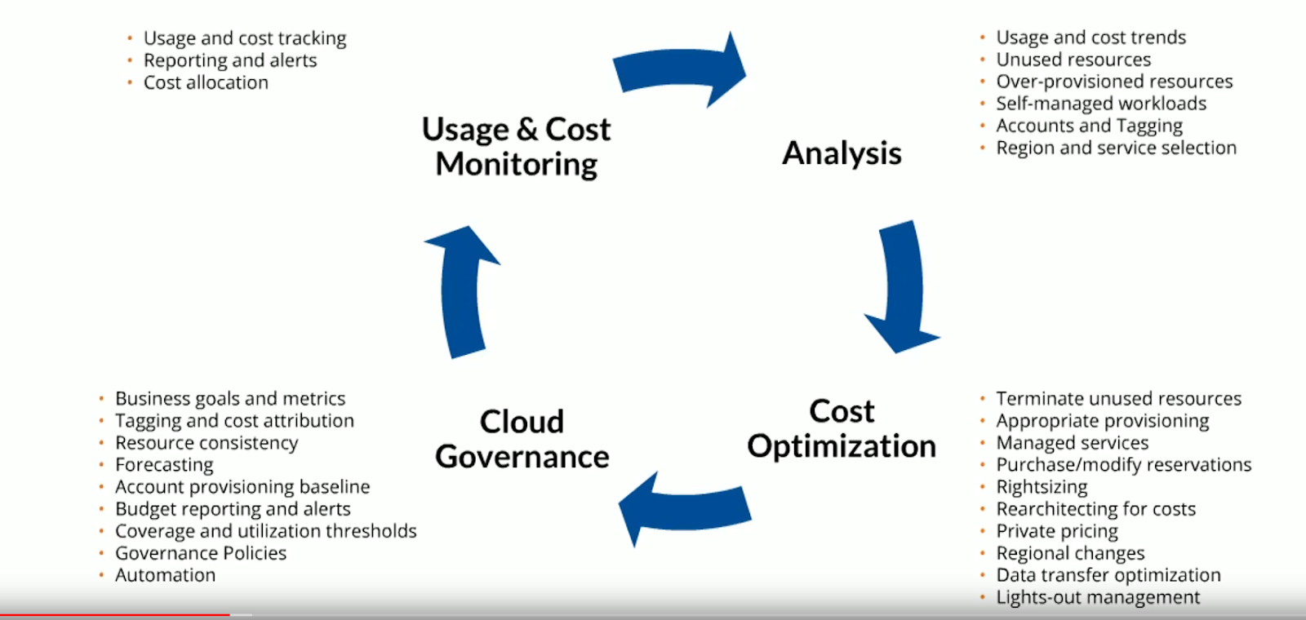

Slide 19
CONCLUSION
In conclusion, leveraging AI strategies for cloud cost optimization and
server health management is essential for maximizing effciency. Embracing AI-driven solutions enables organizations to achieve
substantial cost savings and maintain reliable performance in cloud environments.

Slide 20

Thanks!

