Slide 1
Path Integral Formulation of Quantum Mechanics
Kushagra Chandak
International Institute of Information Technology, Hyderabad, India (IIIT-H)
June 14, 2017

Slide 2
Outline
Introduction
Propagator
Evolution Operator
The matrix element
Moving forward (deriving the path integral)
Math trickery
Final touch
Kushagra Chandak Path Integral Formulation of QM June 14, 2017

Slide 3
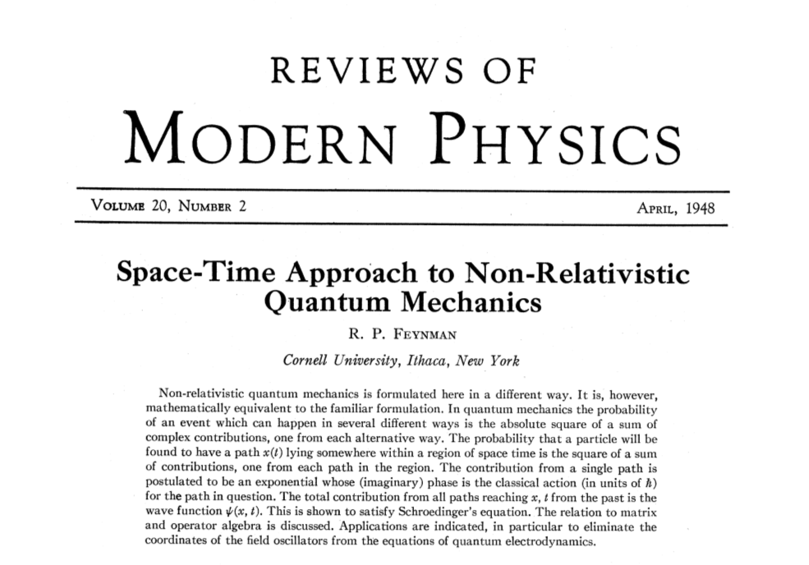
Let us go back to the year
1948...
Kushagra Chandak Path Integral Formulation of QM June 14, 2017

Slide 4
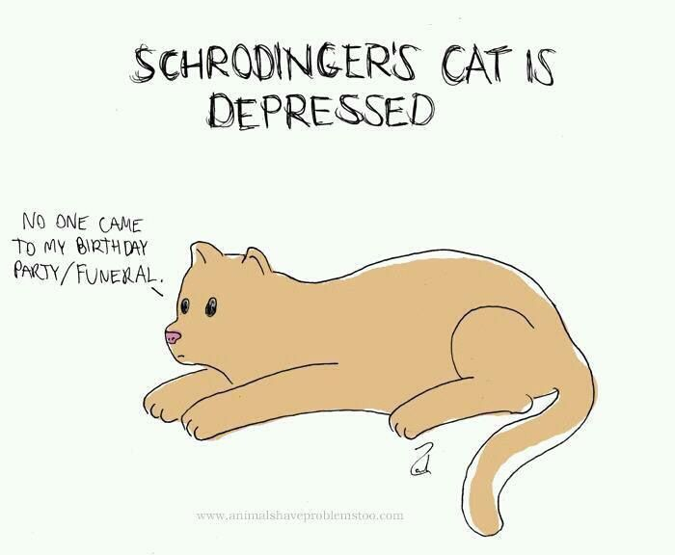
Introduction: QM theories
Schroedinger's differential equation
Kushagra Chandak Path Integral Formulation of QM June 14, 2017

Slide 5
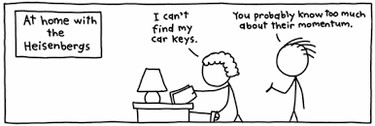
Introduction: QM theories
Heisenberg's matrix algebra
Kushagra Chandak Path Integral Formulation of QM June 14, 2017

Slide 6
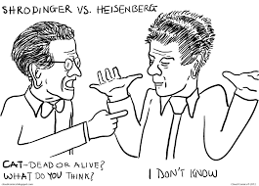

Introduction: QM theories
Feynman's path integral
Kushagra Chandak Path Integral Formulation of QM June 14, 2017

Slide 7
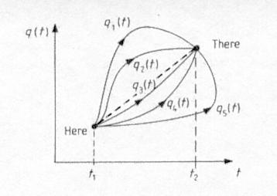
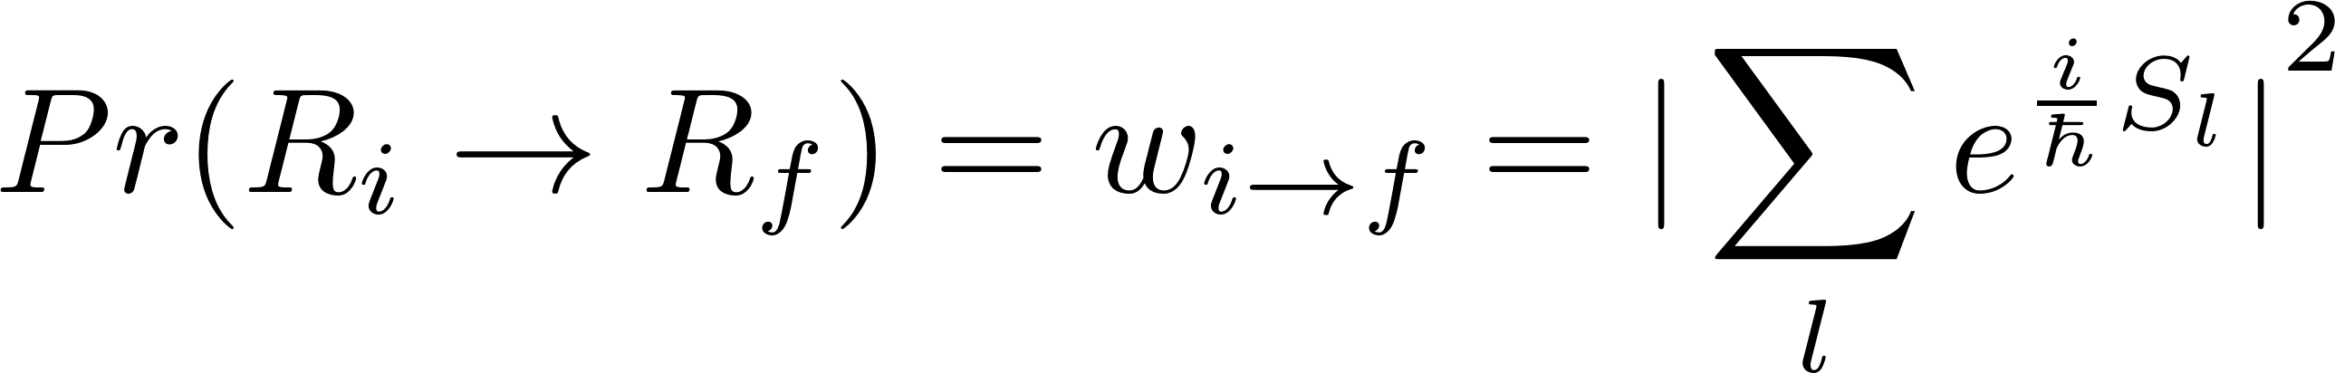
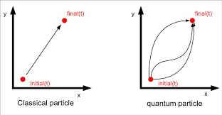
Brief overview: New formulation
Aim: Transition amplitude of a quantum particle
from an initial point R_{i} to a final point R_{f}
Notion of a trajectory: Particle goes through each of
the possible paths at the same time.
Weights associated with each path:
Probability:
Kushagra Chandak Path Integral Formulation of QM June 14, 2017

Slide 8
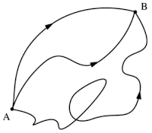
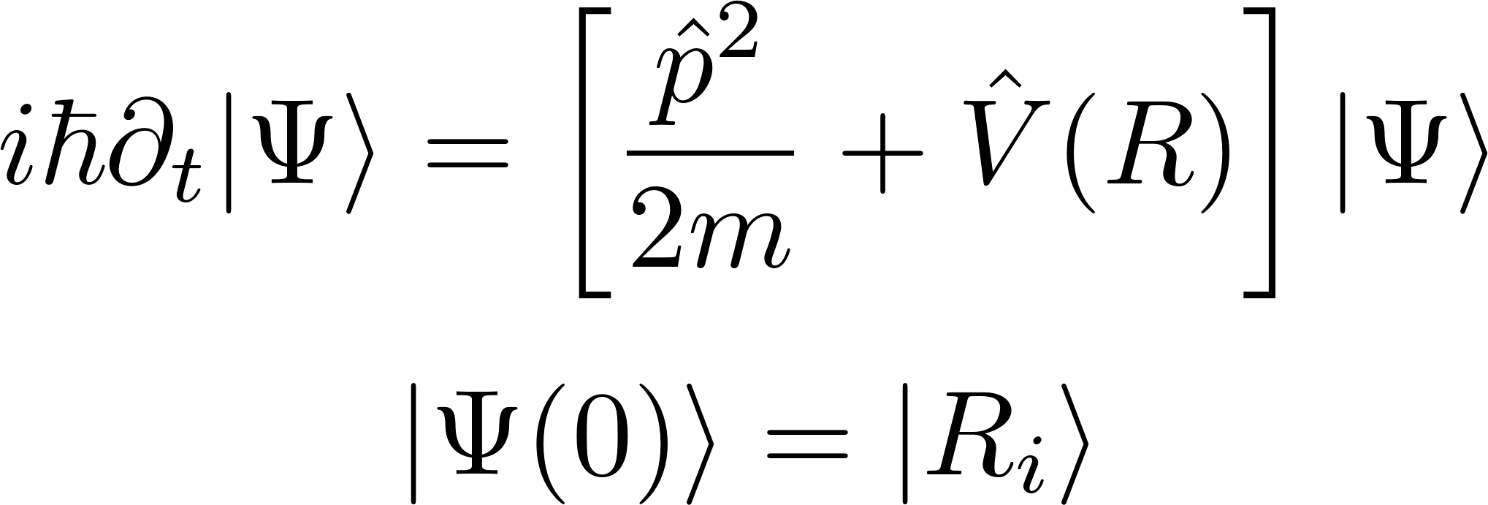
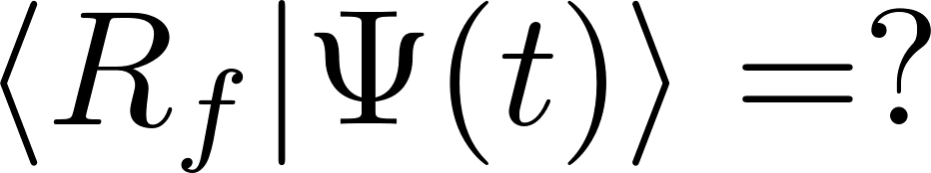
Propagator
Consider a particle localized at a point R_{i} at t=0 and let it evolve according to the Schroedinger equation.
Task: What part of it will propagate to a final point R_{f}?
Kushagra Chandak Path Integral Formulation of QM June 14, 2017

Slide 9
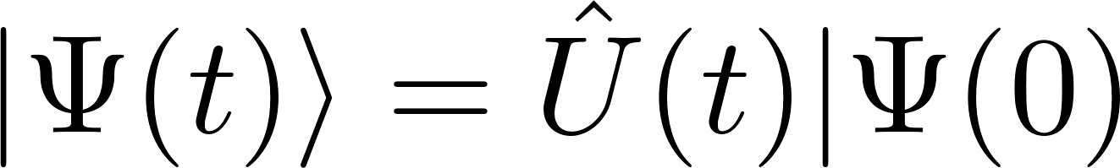
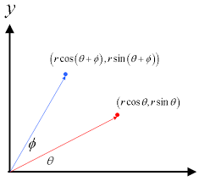
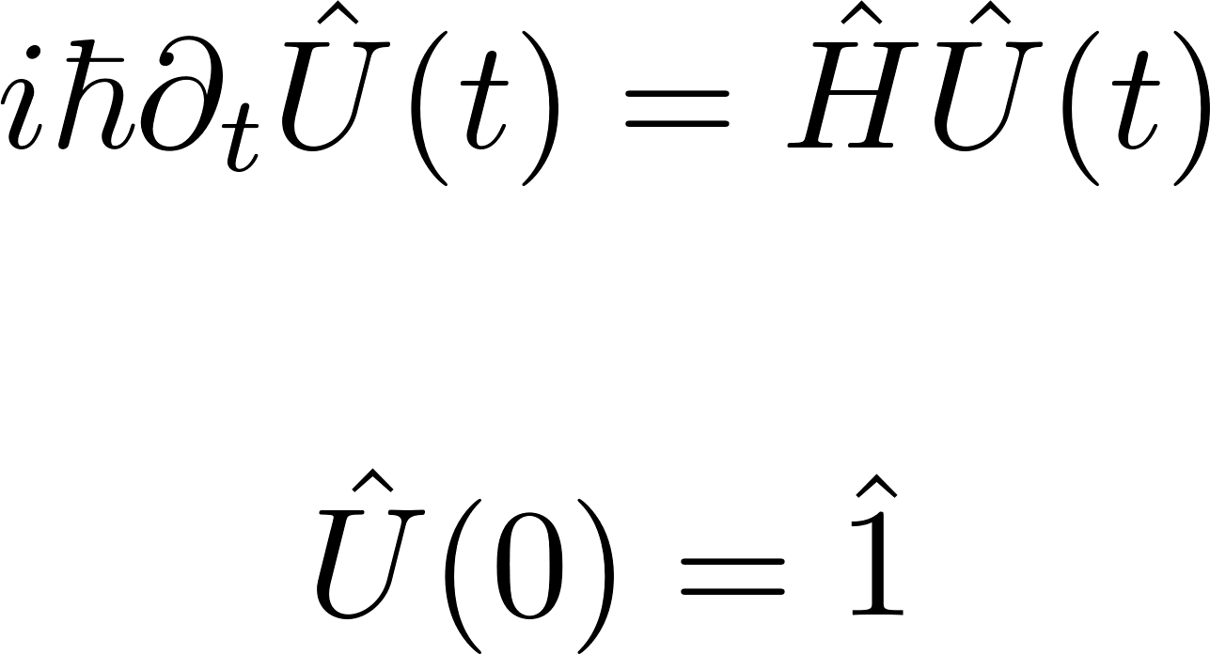
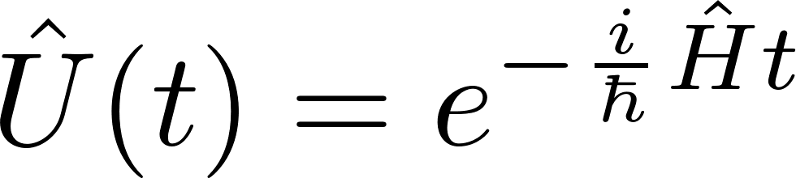
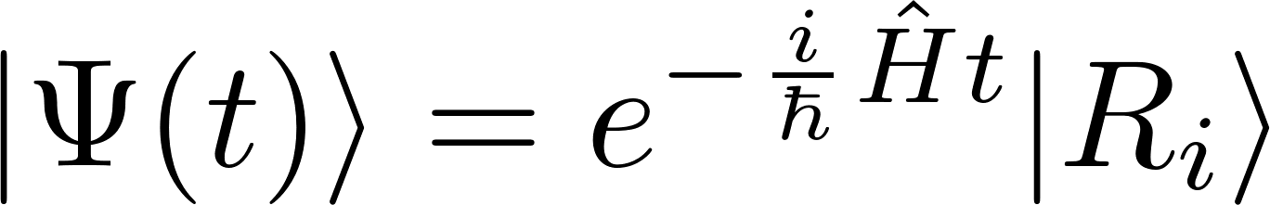
Evolution Operator
Substituting in Schroedinger equation
If we substitute evolution operator as an exponential
Kushagra Chandak Path Integral Formulation of QM June 14, 2017

Slide 10
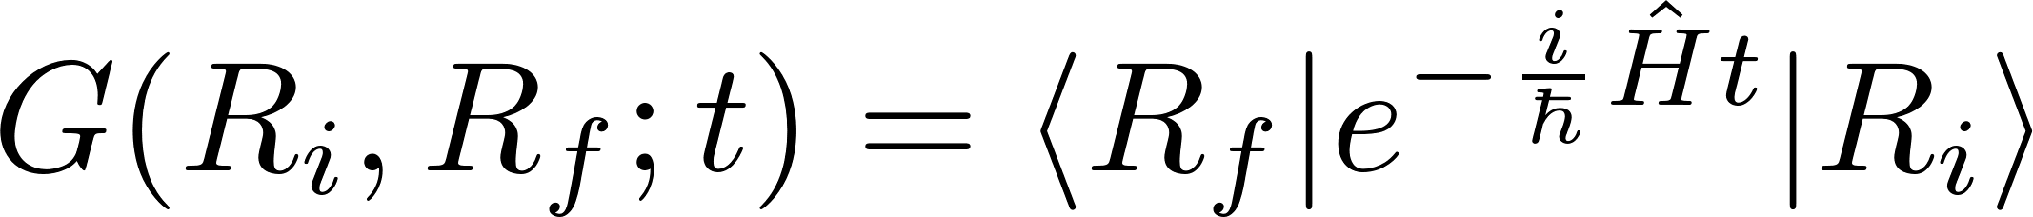
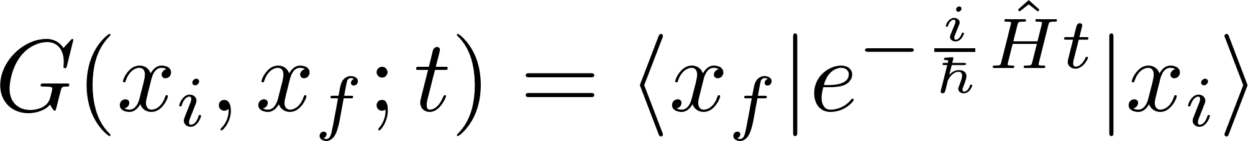
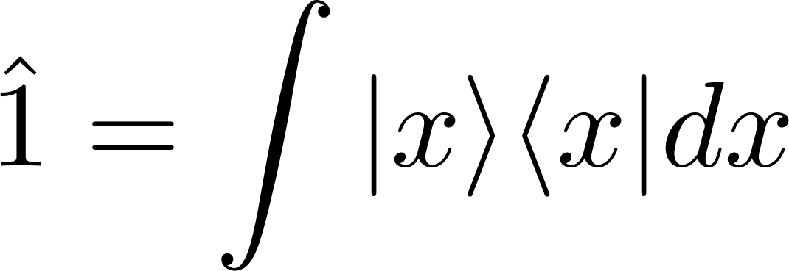
The Matrix Element
The 1-D case
Useful Formulas
Kushagra Chandak Path Integral Formulation of QM June 14, 2017

Slide 11
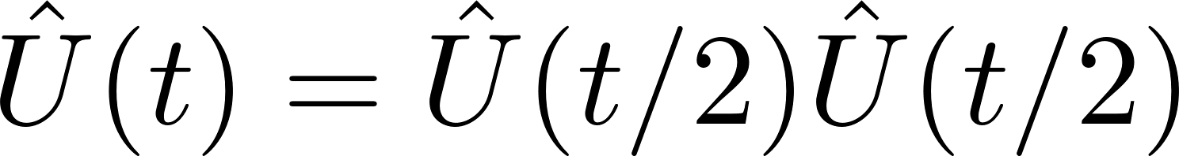
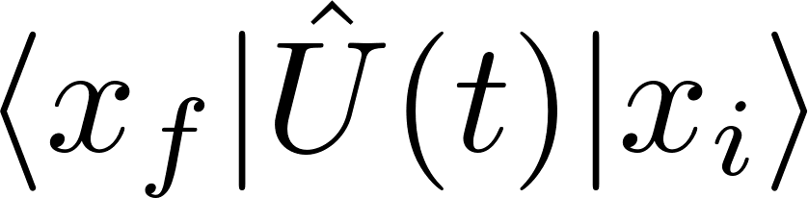
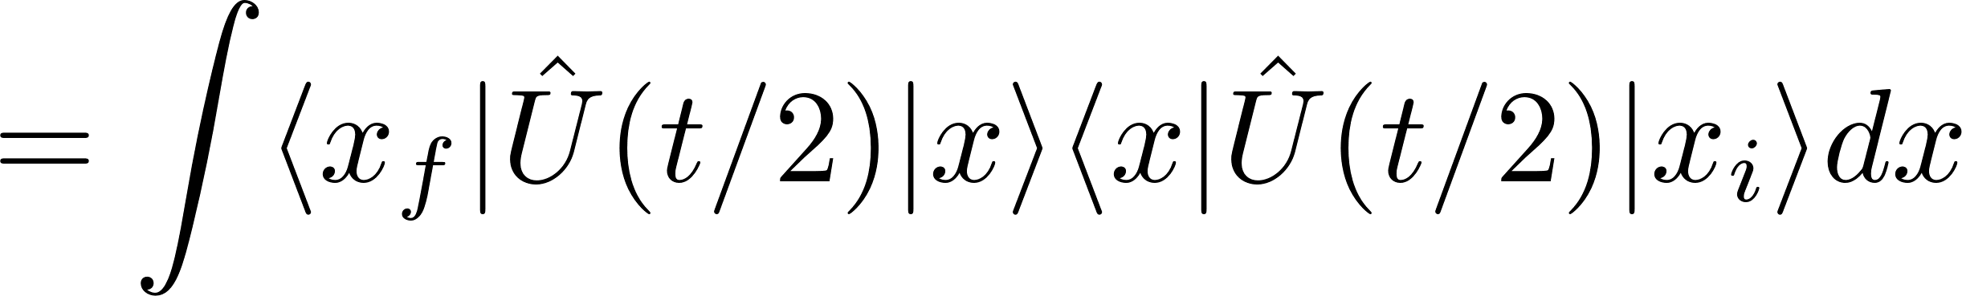
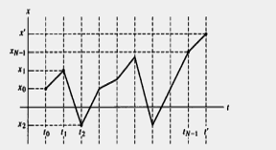
Heading towards the goal...
Divide in grid
Kushagra Chandak Path Integral Formulation of QM June 14, 2017

Slide 12
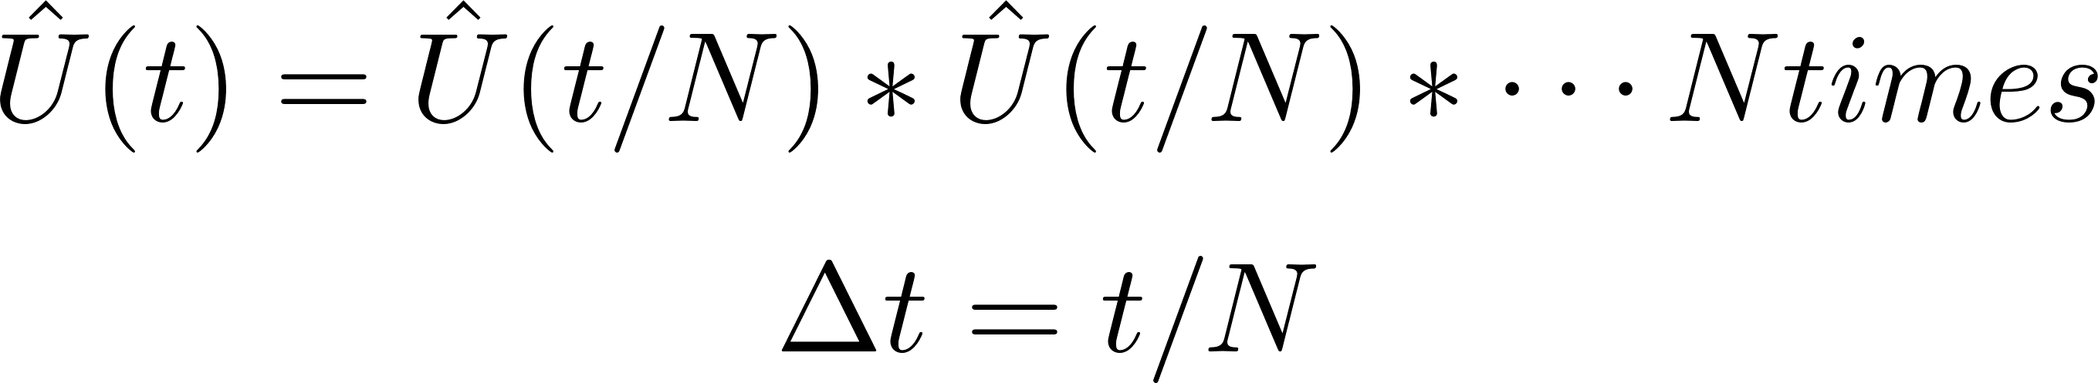
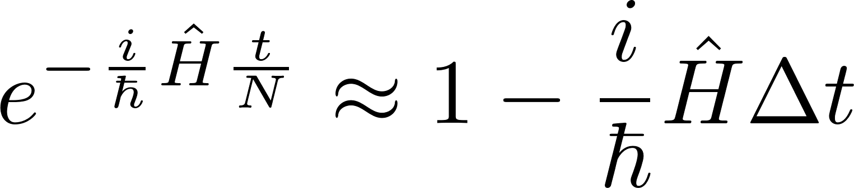
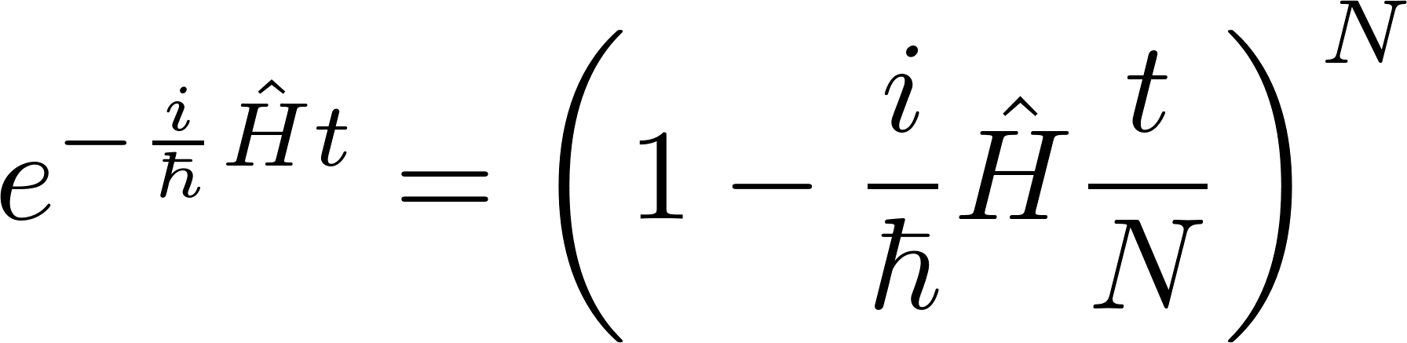
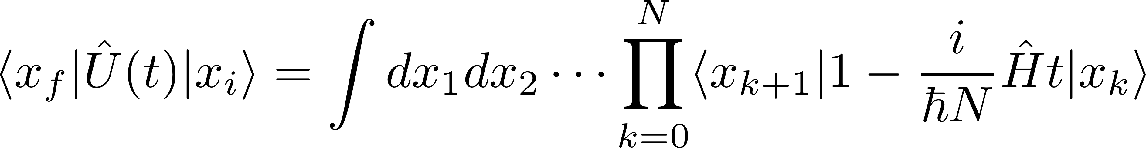
Moving closer...
Kushagra Chandak Path Integral Formulation of QM June 14, 2017

Slide 13

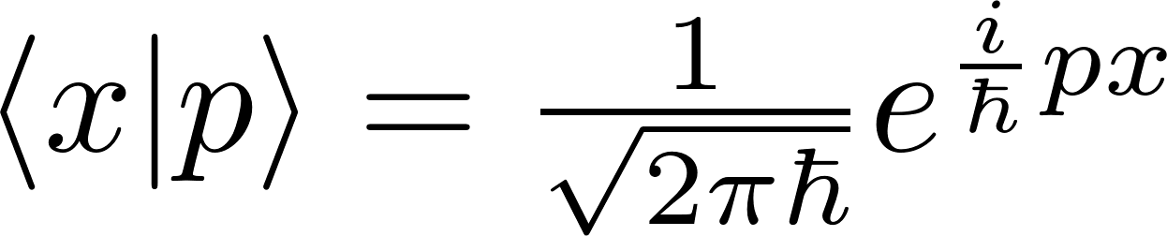
Recall QM
Kushagra Chandak Path Integral Formulation of QM June 14, 2017

Slide 14
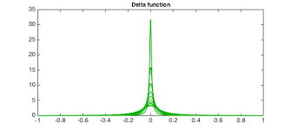
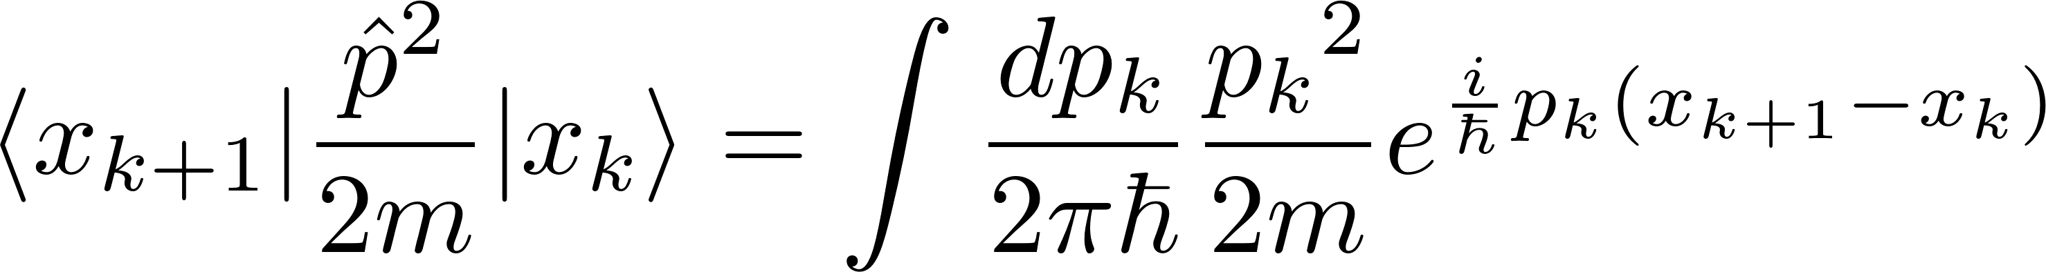
The matrix elements
Kushagra Chandak Path Integral Formulation of QM June 14, 2017

Slide 15
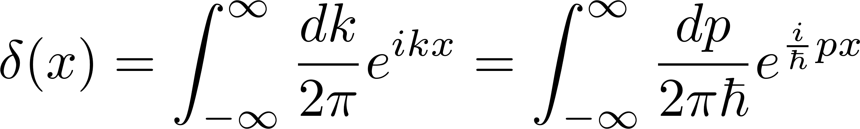
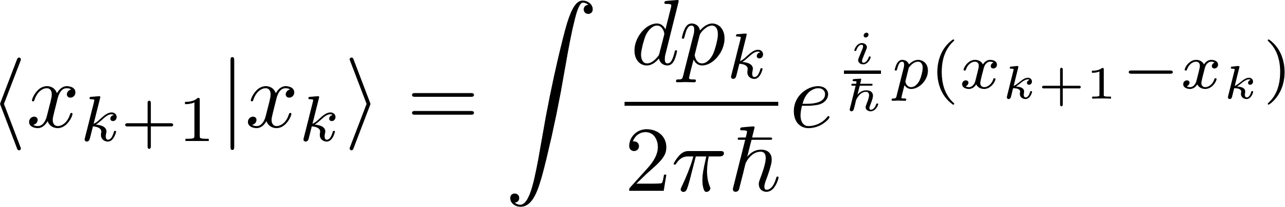
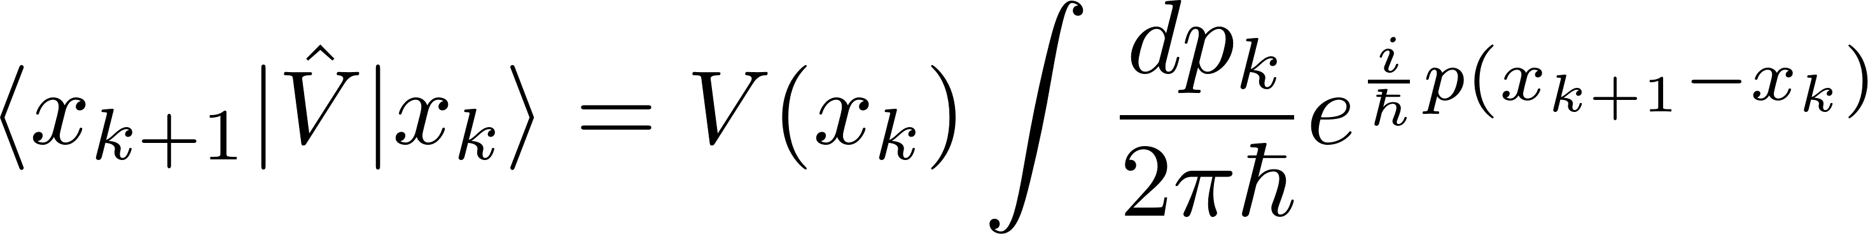
A bit of math trickery
Kushagra Chandak Path Integral Formulation of QM June 14, 2017

Slide 16
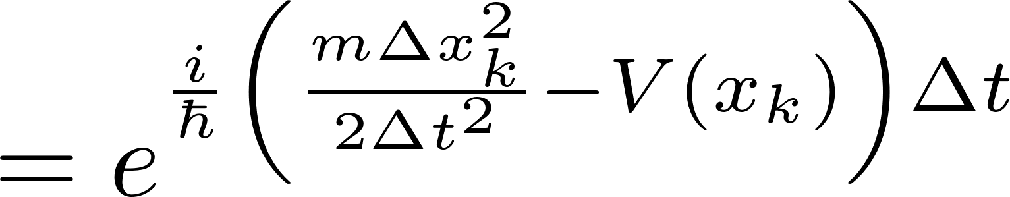
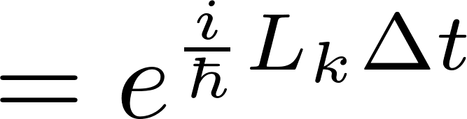
The final touch: Putting together
Kushagra Chandak Path Integral Formulation of QM June 14, 2017

Slide 17
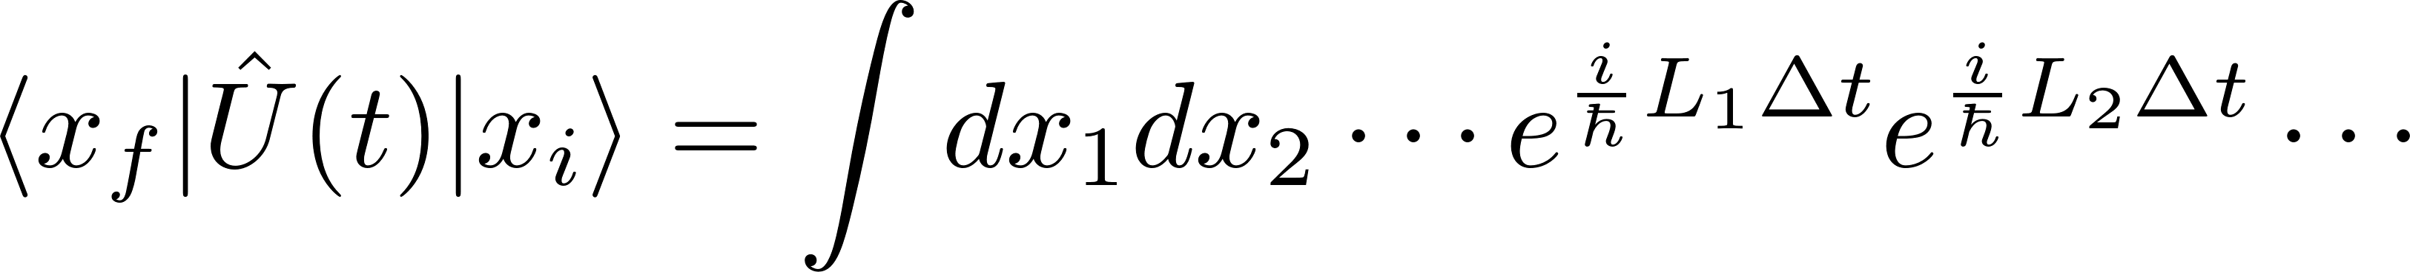
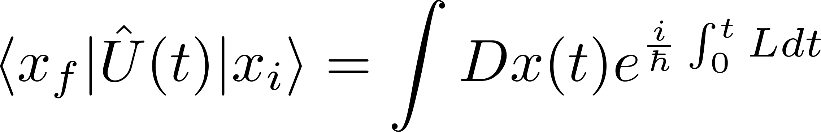
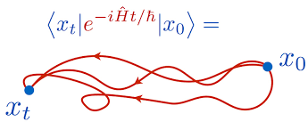
The final touch: The result
Kushagra Chandak Path Integral Formulation of QM June 14, 2017

Slide 18
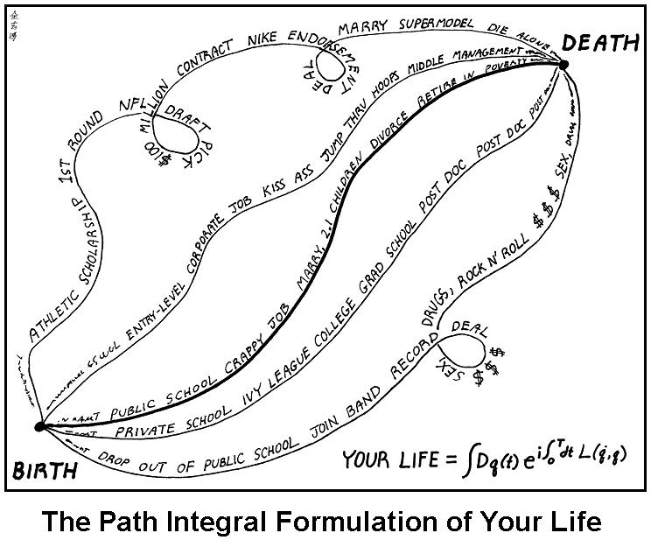
Take home
Kushagra Chandak Path Integral Formulation of QM June 14, 2017

