Slide 1
Advanced Programming
Exception Handling + Misc Stuff

Slide 2
Dealing with Errors
Expected behaviour from User end
Return to a safe state and enable the user to execute other commands; or
Allow the user to save all work and terminate the program gracefully.
Problems to consider
User input errors: Entered a string where integer is expected
Device error: Printer ran out of paper
Physical limitations: Run out of memory
Code error: Trying to pop empty stack

Slide 3
Exception Handling
When an error occurs at runtime, a program can “throw an exception.”
Throwing an exception is more flexible than terminating the program because you can provide a handler that “catches” the exception and deals with it.
try
{
statements that might throw exceptions
}
catch (Exception e)
{
handler action
}

Slide 4
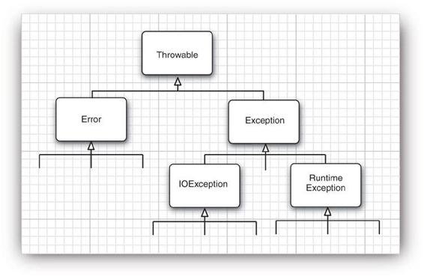
Classification of Exceptions
All exceptions descend from Throwable
Runtime Exception: When you made a programming error
A bad cast
An out-of-bounds array access
A null pointer access
IOException:
Attempts to read from a file that might not exist or that it might be empty
Image Source: Core Java, Volume-1

Slide 5
Error Vs Exception
Exceptions are related to application where as Errors are related to environment in which application is running
Recovering from Error is not possible. The only solution to errors is to terminate the execution. Where as you can recover from Exception by using either try-catch blocks or throwing exception back to caller.
You will not be able to handle the Errors using try-catch blocks. Even if you handle them using try-catch blocks, your application will not recover if they happen. On the other hand, Exceptions can be handled using try-catch blocks and can make program flow normal if they happen.

Slide 6
Error Vs Exception
Exceptions in java are divided into two categories – checked and unchecked. Where as all Errors belongs to only one category i.e unchecked.
Compiler will not have any knowledge about unchecked exceptions which include Errors and sub classes of RunTimeException because they happen at run time. Where as compiler will have knowledge about checked Exceptions. Compiler will force you to keep try-catch blocks if it sees any statements which may throw checked exceptions.

Slide 7
Checked Vs Unchecked Exception
Checked Exception: IOException. You should declare/throw checked exception.
Image loadImage(String s) throws EOFException
Unchecked Exception: Error or Runtime Exception. You do not throw it. You catch it.
//don’t do it..
void drawImage(int) throws ArrayIndexOutOfBoundsException

Slide 8
Declaring Checked Exception
A Java method can throw an exception if it encounters a situation it cannot handle.
The method tells the compiler what can go wrong
If your method fails to faithfully declare all checked exceptions, the compiler will issue an error message.
public FileInputStream(String name) throws FileNotFoundException
//Constructor of FileInputStream class
If the exception occurs the constructor call will not initialize a new FileInputStream object but instead will throw an object of the FileNotFoundException class.
Runtime system searches for appropriate exception handler

Slide 9
Throw Exception
Find an appropriate exception class.
Make an object of that class.
Throw it.
String readData(Scanner in) throws EOFException //declares exception can occur
{
while (. . .)
{
if (!in.hasNext()) // EOF encountered
{
if (n < len)
throw new EOFException(); //actually throws the exception once it occurs
}
}
return s;
}

Slide 10
Catch Exception
If an exception occurs that is not caught anywhere, the program will terminate and print a message to the console, giving the type of the exception and a stack trace
try
{
code
}
catch (ExceptionType e)
{
handler for this type
}
If any code inside the try block throws an exception of the class specified in the catch clause, then
1. The program skips the remainder of the code in the try block.
2. The program executes the handler code inside the catch clause.

Slide 11
Catch Exception
public void read(String filename)
{ try
{
InputStream in = new FileInputStream(filename);
int b;
while ((b = in.read()) != -1)
{
process input
}
}
catch (IOException exception)
{
exception.printStackTrace();
}
}

Slide 12
Catch Multiple Exceptions
try
{
code that might throw exceptions
}
catch (FileNotFoundException e)
{
emergency action for missing files
}
catch (UnknownHostException e)
{
emergency action for unknown hosts
}
catch (IOException e)
{
emergency action for all other I/O problems
}

Slide 13
finally Clause
Statement in the finally clause is executed whether or not an exception is encountered in the try block
Good idea to use the finally clause whenever you need to close a resource
InputStream in = new FileInputStream(...);
try
{
code that might throw exceptions
}
catch (IOException e)
{
show error message
}
finally
{
in.close();
}

Slide 14
finally and return
finally will be called after return…

Slide 15
Exceptions and Inheritance
When a method in a class declares that it throws an exception that is an instance of a particular class, then it may throw an exception of that class or of any of its subclasses: declare IOException throw FileNotFoundException.
If you override a method from a superclass, the checked exceptions that the subclass method declares cannot be more general than those of the superclass method (ok to throw more specific exceptions)
If the superclass method throws no checked exception at all, neither can the subclass.

Slide 16
Creating your own Exception class
class FileFormatException extends IOException
{
public FileFormatException() {}
public FileFormatException(String gripe)
{
super(gripe);
}
}

Slide 17
Rethrow and Exception Chaining
try
{
access the database
}
catch (SQLException e)
{
Throwable se = new ServletException("database error");
se.initCause(e);
throw se;
}

Slide 18
Stack Trace
A stack trace is a listing of all pending method calls at a particular point in the execution of a program.
Access the text description of a stack trace by calling the printStackTrace method of the Throwable class
getStackTrace method yields an array of StackTraceElement objects, which you can analyze in your program
The StackTraceElement class has methods to obtain the file name and line number, as well as the class and method name, of the executing line of code

Slide 19
Object Wrappers
All primitive types have class counterparts
Eg. Class Integer corresponds to the primitive type int
These are called wrapper classes. Example: Integer, Long, Float, Double, Short, Byte, Character, Void
Wrapper classes are
immutable
final
Create arraylist of integers
ArrayList<int> list = new ArrayList<int>(); //ERROR
ArrayList<Integer> list = new ArrayList<Integer>(); //OK

Slide 20
Autoboxing
The call
list.add(3);
is automatically translated to
list.add(Integer.valueOf(3));
This conversion is called autoboxing.
Conversely, while unboxing the compiler translates
int n = list.get(i);
into
int n = list.get(i).intValue();

Slide 21
Methods with Variable Number of Parameters
After Java SE 5, possible to provide methods that can be called with a variable number of parameters.
Also called “varargs” methods.
Example, printf can have varied number of parameters
System.out.printf("%d", n);
System.out.printf("%d %s", n, "widgets");

Slide 22
Methods with Variable Number of Parameters
Defining own method with variable number of parameters
public static double max(double... values)
{
double largest = Double.MIN_VALUE;
for (double v : values)
if (v > largest) largest = v;
return largest;
}
Simply call the function like this:
double m = max(3.1, 40.4, -5);
The compiler passes a new double[] { 3.1, 40.4, -5 } to the max function.

Slide 23
Enumeration Classes
To restrict set of values a variable can hold. Example:
public enum Size{SMALL, MEDIUM, LARGE, EXTRA_LARGE};
Type defined by this declaration is actually a class.
This class has exactly four instances—it is not possible to construct new objects
Size s = Enum.valueOf(Size.class, "SMALL");sets s to Size.SMALL.
Other methods: toString(), ordinal(), compareTo(E other)

Slide 24
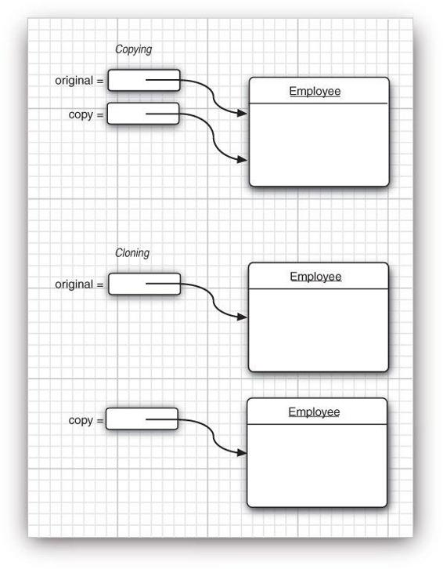
Object Cloning
Employee original = new Employee("John Public", 50000);
Employee copy = original;
copy.raiseSalary(10); // oops--also changed original
V/S
Employee copy = original.clone();
copy.raiseSalary(10); // OK--original unchanged

Slide 25
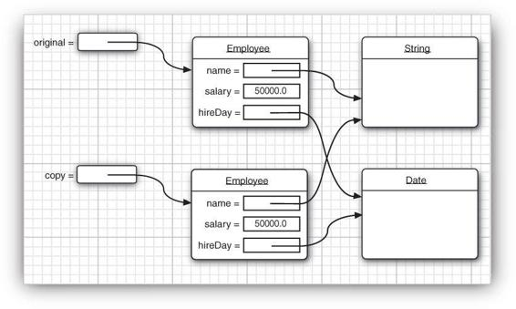
Object Cloning
The default cloning operation is “shallow”—it doesn’t clone objects that are referenced inside other objects
If the subobject shared between the original and the shallow clone is immutable, then the sharing is safe.
When subobjects are mutable, redefine the clone method to make a deep copy that clones the subobjects as well

Slide 26
Inner Classes
Class that is defined inside another class. What’s the need?
Inner class methods can access the data from the scope in which they are defined—including the data that would otherwise be private.
Can be hidden from other classes in the same package.
Anonymous inner classes are handy to define callbacks.

Slide 27
Inner Classes
An inner class method gets to access both its own data fields and those of the outer object creating it.
public class TalkingClock
{
private int interval;
private boolean beep;
public TalkingClock(int interval, boolean beep) { . . . }
public class TimePrinter implements ActionListener
{//inner class
public void actionPerformed(ActionEvent event)
{ Date now = new Date();
System.out.println("At the tone, the time is " + now);
if (beep) Toolkit.getDefaultToolkit().beep();
}
}
}

Slide 28
Inner Classes
Note that you refer to an inner class as
OuterClass.InnerClass
when it occurs outside the scope of the outer class.
Example:
TalkingClock tick = new TalkingClock(1000, true);
TalkingClock.TimePrinter listener = tick.new TimePrinter();

Slide 29
public class DataStructure {
private final static int SIZE = 15;
private int[] arrayOfInts = new int[SIZE];
public DataStructure() {
// fill array with ascending integer values
for (int i = 0; i < SIZE; i++)
arrayOfInts[i] = i;
}
public void printEven() {
// Prints values of even indices of array
DataStructureIterator iterator = this.new EvenIterator();
while (iterator.hasNext())
System.out.print(iterator.next() + " ");
System.out.println();
}
interface DataStructureIterator extends java.util.Iterator<Integer> { }
// Inner class implements the DataStructureIterator interface,
// which extends the Iterator<Integer> interface
private class EvenIterator implements DataStructureIterator {
// Start stepping through the array from the beginning
private int nextIndex = 0;
public boolean hasNext() {
// Check if the current element is the last in the array
return (nextIndex <= SIZE - 1);
}
public Integer next() {
// Record a value of an even index of the array
Integer retValue = Integer.valueOf(arrayOfInts[nextIndex]);
// Get the next even element
nextIndex += 2;
return retValue;
}
}

Slide 30
public static void main(String s[]) {
// Fill the array with integer values and print out only
// values of even indices
DataStructure ds = new DataStructure();
ds.printEven();
}
}

Slide 31
Local Inner Class
Define the class locally in a single method
Never declared with an access specifier (that is, public or private)
Scope is always restricted to the block in which they are declared
Completely hidden from the outside world—not even other code in the outer class can access them.

Slide 32
Local Inner Class
No method except start has any knowledge of the TimePrinter class
public void start()
{
class TimePrinter implements ActionListener
{ public void actionPerformed(ActionEvent event)
{
Date now = new Date();
System.out.println("At the tone, the time is " + now);
if (beep) Toolkit.getDefaultToolkit().beep();
}
}
ActionListener listener = new TimePrinter();
Timer t = new Timer(interval, listener);
t.start();
}

Slide 33
Anonymous Inner Class
If you want to make only a single object of this class, you don’t even need to give the class a name. Such a class is called an anonymous inner class.
public void start(int interval, final boolean beep)
{ ActionListener listener = new ActionListener()
{
public void actionPerformed(ActionEvent event)
{
Date now = new Date();
System.out.println("Beep time is " + now);
if (beep) Toolkit.getDefaultToolkit().beep();
}
};
Timer t = new Timer(interval, listener);
t.start();
}

Slide 34
Nested Classes – Static Vs Non-Static (Inner)
class EnclosingClass {
static class Nested {
void someMethod() { System.out.println("hello"); }
}
}
EnclosingClass.Nested n = new EnclosingClass.Nested();
An inner class is a specific type of nested class that occurs when a nested class is non-static.
An instance of an inner class has access to all of the members of the outer class, even those that are marked “private”.
static inner classes is the wrong terminology – they should be called static nested classes instead

Slide 35
Static Block
static {
// whatever code is needed for initialization goes here
}
Also called Static initialization blocks
A class can have any number of static initialization blocks, and they can appear anywhere in the class body.
The runtime system guarantees that static initialization blocks are called in the order that they appear in the source code.
The static block code will be executed when JVM loads the class. JVM combines all these blocks into one single static block and then executes.

Slide 36
Static Block
Output:
This is first static block
This is second static block and Static Variable
This is static method
This is third static block
This is constructor
This is static method2
public class StaticExample{
static { System.out.println("This is first static block"); }
public StaticExample() { System.out.println("This is constructor"); }
public static String staticString = "Static Variable";
static { System.out.println("This is second static block and “ + staticString); }
public static void main(String[] args){
StaticExample statEx = new StaticExample();
StaticExample.staticMethod2();
}
static { staticMethod(); System.out.println("This is third static block"); }
public static void staticMethod() { System.out.println("This is static method"); }
public static void staticMethod2() { System.out.println("This is static method2"); }
}

