Slide 1
Advanced Programming
File Handling

Slide 2
Streams
Input Stream: An object from which we can read a sequence of bytes
Output Stream: An object to which we can write a sequence of bytes
Sources and destinations of byte sequences can be files, network connections and even blocks of memory
The abstract classes InputStream and OutputStream form the basis for a hierarchy of input/output (I/O) classes.

Slide 3
Streams
In java, 3 streams are created for us automatically. All these streams are attached with console.
1) System.out: standard output stream
2) System.in: standard input stream
3) System.err: standard error stream

Slide 4
Read and Write Bytes
The InputStream class has an abstract method:
abstract int read()
Note that InputStream is abstract class
This method reads one byte and returns the byte that was read, or -1 if it encounters the end of the input source.
The InputStream class also has non-abstract methods to read an array of bytes or to skip a number of bytes
Similarly, the OutputStream class defines the abstract method
abstract void write(int b)
which writes one byte to an output location.

Slide 5
Read and Write Bytes
Both the read and write methods block until the byte is actually read or written.
If the stream cannot immediately be accessed (say due to busy network connection), the current thread blocks.
This gives other threads the chance to do useful work while the method is waiting for the stream to become available again.
The available method lets you check the number of bytes that are currently available for reading.
When you have finished reading or writing to a stream, close it by calling the close method to free up resources.

Slide 6
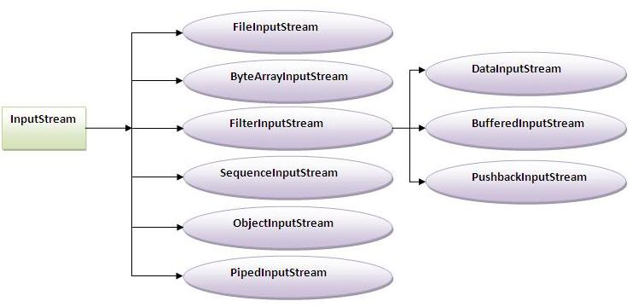
Image Source: javatpoint.com

Slide 7
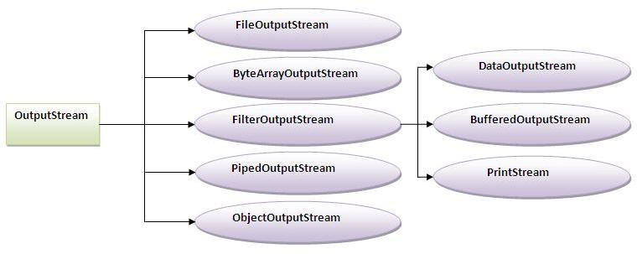
Image Source: javatpoint.com

Slide 8
public static void main(String args[]) throws IOException
{
FileInputStream in = null;
FileOutputStream out = null;
try {
in = new FileInputStream("input.txt");
out = new FileOutputStream("output.txt");
int c;
while ((c = in.read()) != -1) {
out.write(c);
}
}finally {
if (in != null)
in.close();
if (out != null)
out.close();
}
}

Slide 9
Character Stream Classes
There are two abstract classes with several concrete classes that handle unicode character
Reader
Writer
The basic methods of the Reader and Writer classes are similar to those for InputStream and OutputStream.
abstract int read()
abstract void write(int c)
The read method returns either a Unicode code unit (as an integer between 0 and 65535) or -1 when reached the end of the file. The write method is called with a Unicode code unit

Slide 10
public static void main(String args[]) throws IOException
{
FileReader in = null;
FileWriter out = null;
try {
in = new FileReader("input.txt");
out = new FileWriter("output.txt");
int c;
while ((c = in.read()) != -1)
out.write(c);
}finally {
if (in != null)
in.close();
if (out != null)
out.close();
}
}

Slide 11
Byte Stream v/s Character Stream
Java Byte streams are used to perform input and output of 8-bit bytes
Java Character streams are used to perform input and output for 16-bit unicode
Though internally FileReader uses FileInputStream and FileWriter uses FileOutputStream but here major difference is that FileReader reads two bytes at a time and FileWriter writes two bytes at a time

Slide 12
Decorator Pattern
The Decorator Pattern attaches additional responsibilities to an object dynamically.
Decorators provide a flexible alternative to subclassing for extending functionality.

Slide 13
<<Interface>> Component
commonMethod
ConcreteComponent
commonMethod
<<Interface>> Decorator
Component wrappedObject
commonMethod
ConcreteDecoratorA
commonMethod
ConcreteDecoratorB
commonMethod

Slide 14
Combining Streams
Combine streams into chains to achieve more advanced input and output operations
Example
Reading every byte one at a time from a file is slow.
Faster to read a larger block of data from the disk and then iterate through that block byte for byte afterwards.
To achieve buffering, wrap InputStream in BufferedInputStream
InputStream input = new BufferedInputStream(new FileInputStream("c:\\data\\input-file.txt"));

Slide 15
FilterInputStream Subclasses
BufferedInputStream
CheckedInputStream
CipherInputStream
DataInputStream
DeflaterInputStream
DigestInputStream
InflaterInputStream
LineNumberInputStream
ProgressMonitorInputStream
PushbackInputStream

Slide 16
Combining Stream
Some Examples
1. Data->Buffered->File
2. Pushback->Buffered->File
3. Data->Pushback->Buffered->File
4. Data->Zip->File

Slide 17
Text Input and Output
When saving data, you have the choice between binary and text formats.
For example, if the integer 1234 is saved
In binary, it is written as the sequence of bytes 00 00 04 D2 (in hexadecimal notation).
In text format, it is saved as the string "1234".
Although binary I/O is fast and efficient, it is not easily readable by humans

Slide 18
Write Text Output
PrintWriter class has methods to print strings and numbers in text format
PrintWriter out = new PrintWriter("emp.txt");
is equivalent to
PrintWriter out = new PrintWriter(new FileWriter("emp.txt"));
For example, consider this code:
String name = "Harry Hacker";
double salary = 75000;
out.print(name);
out.print(' ');
out.println(salary);
This writes the characters
Harry Hacker 75000.0
to the writer out. The characters are then converted to bytes and end up in the file emp.txt.

Slide 19
Read Text Input
BufferedReader class with the readLine method reads a line of text
public static void main(String args[])throws Exception{
InputStreamReader r=new InputStreamReader(System.in);
BufferedReader br=new BufferedReader(r);
System.out.println("What’s your name");
String name=br.readLine();
System.out.println("Hello "+name);
}

Slide 20
Read and Write Binary Data
DataOutput interface defines methods for writing a number, a character, a boolean value, or a string in binary format
For example, writeInt always writes an integer as a 4-byte binary quantity regardless of the number of digits.
The resulting output is not human-readable, but the space needed will be the same for each value of a given type and reading it back in will be faster than parsing text.

Slide 21
Read and Write Binary Data
To read the data back in, there are methods defined in the DataInput interface
The DataInputStream class implements the DataInput interface.
DataInputStream in = new DataInputStream(new FileInputStream("employee.dat"));
Similarly, to write binary data, use the DataOutputStream class that implements the DataOutput interface
DataOutputStream out = new DataOutputStream(new FileOutputStream("employee.dat"));

Slide 22
Random Access Files
RandomAccessFile class: To allow read or write data anywhere in a file
Open a random-access file
Specify the option by using the string "r" (for read access) or
"rw" (for read/write access) as the second argument in the constructor
RandomAccessFile in=new RandomAccessFile("emp.dat", "r");
RandomAccessFile inOut=new RandomAccessFile("emp.dat", "rw");
Has a file pointer that indicates the position of the next byte to be read or written.
Seek method: sets the file pointer to an arbitrary byte position within the file. The argument to seek is a long integer between zero and the length of the file in bytes.

Slide 23
Random Access Files
The getFilePointer method returns the current position of the file pointer.
The RandomAccessFile class implements both the DataInput and DataOutput interfaces.
To read and write from a random-access file, use methods such as readInt/writeInt and readChar/writeChar

Slide 24
Random Access Files
File file = new File("DemoRandomAccessFile.txt");
RandomAccessFile raf = new RandomAccessFile(file, "rw");
byte ch = raf.readByte();
System.out.println("Read first character of file: " + (char)ch);
System.out.println("Read full line: " + raf.readLine());
// Seek to the end of file
raf.seek(file.length());
// Append to the end of the file
raf.write(0x0A);
raf.writeBytes("This will complete the Demo");
raf.close();
Source: http://www.java-tips.org/

Slide 25
Object Stream and Serialization
Objects created are rarely all of the same type.
For example, consider an array called staff that is nominally an array of Employee records but contains objects that are actually instances of a subclass such as Manager.
Object serialization makes it possible to write any object to a stream and read it again later.
Serialization: Saving an object's state to a sequence of bytes;
Deserialization: Rebuilding those bytes into a live object

Slide 26
Object Stream and Serialization
ObjectOutputStream out = new ObjectOutputStream(new FileOutputStream("employee.dat"));
Employee harry = new Employee("Harry Hacker", 50000,1989, 10, 1);
Manager boss = new Manager("Carl Cracker", 80000, 1987, 12, 15);
out.writeObject(harry);
out.writeObject(boss);
ObjectInputStream in = new ObjectInputStream(new FileInputStream("employee.dat"));
Employee e1 = (Employee) in.readObject();
Employee e2 = (Employee) in.readObject();

Slide 27
Object Stream and Serialization
However, the class must implement the Serializable interface:
class Employee implements Serializable { . . . }
Marker Interface: The Serializable interface has no methods, so you don’t need to change your classes in any way
Consider
harry = new Employee("Harry Hacker", . . .);
Manager carl = new Manager("Carl Cracker", . . .);
carl.setSecretary(harry);
Manager tony = new Manager("Tony Tester", . . .);
tony.setSecretary(harry);

Slide 28
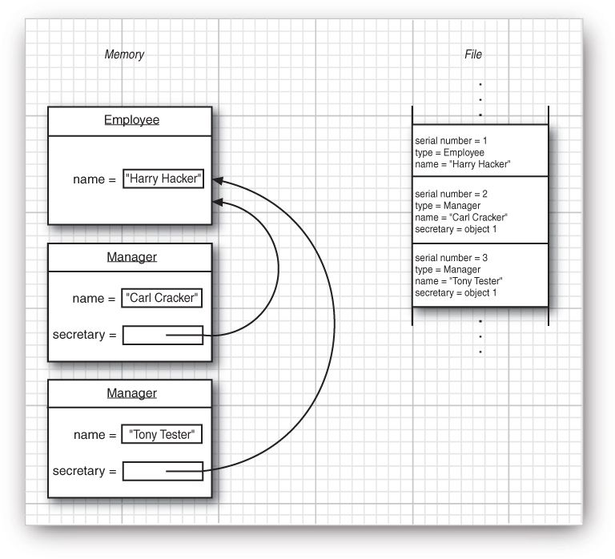
Source: Core Java, Volume 2

Slide 29
Object Stream and Serialization
We cannot save and restore the memory addresses for the secretary objects.
When an object is reloaded, it will likely occupy a completely different memory address than it originally did.
Instead, each object is saved with a serial number. This is object serialization.
Object serialization saves object data in a particular file format

Slide 30
Key points in Serialization
If a class implements serializable then all its sub classes will also be serializable.
If a class has a reference of another class, all the references must be Serializable otherwise serialization process will not be performed. In such case, NotSerializableException is thrown at runtime.
If there is any static data member in a class, it will not be serialized because static is the part of class not object.
If you don't want to serialize any data member of a class, you can mark it as transient.

Slide 31
Serializable Vs Externalizable
Serialization provides default functionality to store and later recreate the object.
It uses complex algorithm to define the whole graph of objects to be stored.
In default serialization the object is constructed entirely from its stored bits, with no constructor calls
If you want restricted serialization or don't want some portion of your object to be serialized then use Externalizable.
The Externalizable interface extends the Serializable interface and adds two methods, writeExternal() and readExternal(). These are automatically called while serialization or deserialization.
While working with Externalizable remember that the default constructer should be public else the code will throw exception.

Slide 32
Other File Operations
Various operations other than read and write.
Example, Files class to remove or rename the file, or find out when a file was last modified.
Such classes are concerned with the storage of files on a disk, whereas the stream classes are concerned with the contents of files.

Slide 33
Working with File System
An object of the FileSystem class represents a file system in a Java program.
A FileSystem object is used to perform two tasks:
an interface between a Java program and a file system.
a factory for creating many types of file system-related objects and services.

Slide 34
public static void main(String[] args) {
FileSystem fs = FileSystems.getDefault();
System.out.println("Read-only file system: " + fs.isReadOnly());
System.out.println("File name separator: " + fs.getSeparator());
for (FileStore store : fs.getFileStores()) {
printDetails(store);
}
for (Path root : fs.getRootDirectories()) {
System.out.println(root);
}
}
public static void printDetails(FileStore store) {
try {
String desc = store.toString();
String type = store.type();
long totalSpace = store.getTotalSpace();
long unallocatedSpace = store.getUnallocatedSpace();
long availableSpace = store.getUsableSpace();
System.out.println(desc + ", Total: " + totalSpace + ", Unallocated:" + unallocatedSpace + ", Available: " + availableSpace);
} catch (IOException e) {
e.printStackTrace();
}
}
Source: www.java2s.com

Slide 35
Output:
Read-only file system: false
File name separator: \
Windows7_OS (C:), Total: 211223048192, Unallocated:48459059200, Available: 48459059200
Data (D:), Total: 272628707328, Unallocated:66110119936, Available: 66110119936
Lenovo_Recovery (E:), Total: 14680059904, Unallocated:3377917952, Available: 3377917952
(Z:), Total: 211223048192, Unallocated:48459059200, Available: 48459059200
C:\
D:\
E:\
Z:\

Slide 36
Paths
A Path is a sequence of directory names, optionally followed by a file name
Path absolute = Paths.get("/home", "cay"); //path on Unix: /home/cay
Path relative = Paths.get("myprog", "conf", "user.properties");
The static Paths.get method receives one or more strings, which it joins with the path separator of the default file system ( \ for Windows)

Slide 37
Paths
To combine or resolve paths: The call p.resolve(q) returns a path according to these rules:
• If q is absolute, then the result is q.
• Otherwise, the result is “p then q”, according to the rules of the file system.

Slide 38
Files
byte[] bytes = Files.readAllBytes(path);
Files.write(path, content.getBytes(charset));
Copy, Move, Delete, Rename Files
Files.copy(fromPath, toPath);
Files.move(fromPath, toPath);
Files.delete(path);
Create Files and Directories
Files.createDirectories(path);
Files.createFile(path);

Slide 39
File Locking
If multiple simultaneously executing programs need to modify the same file, they need to communicate in some way, or the file can easily become damaged
A file lock controls access to a file or a range of bytes within a file.
To lock a file, call either the lock or tryLock methods of the FileChannel class.
FileChannel = FileChannel.open(path);
FileLock lock = channel.lock();
or
FileLock lock = channel.tryLock();

Slide 40
File Locking
lock method: blocks until the lock becomes available
trylock method: returns immediately, either with the lock or with null if the lock is not available.
The file remains locked until the channel is closed or the release method is invoked on the lock.
You can also lock a portion of the file with the call
FileLock lock(long start, long size, boolean shared)
FileLock tryLock(long start, long size, boolean shared)
The shared flag is false to lock the file for both reading and writing. It is true for a shared lock, which allows multiple processes to read from the file, while preventing any process from acquiring an exclusive lock

